Slide 1



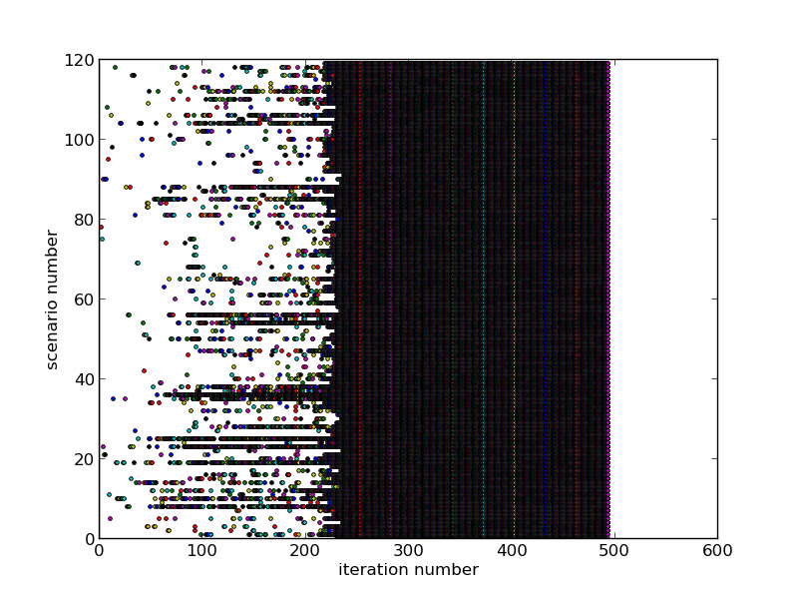
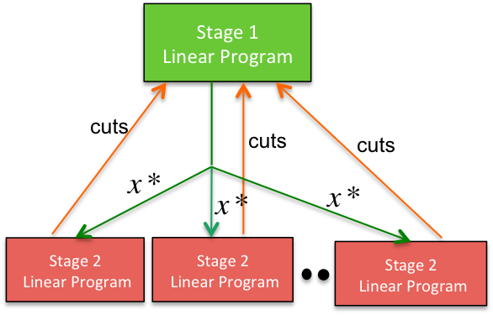


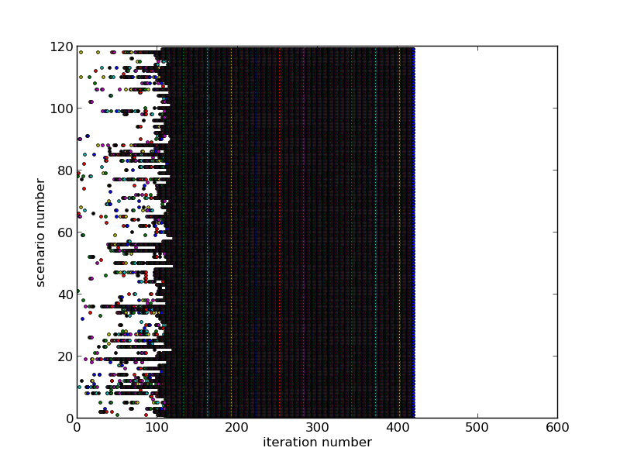



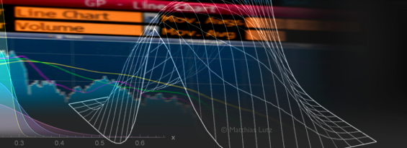
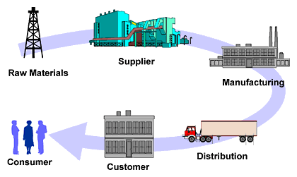
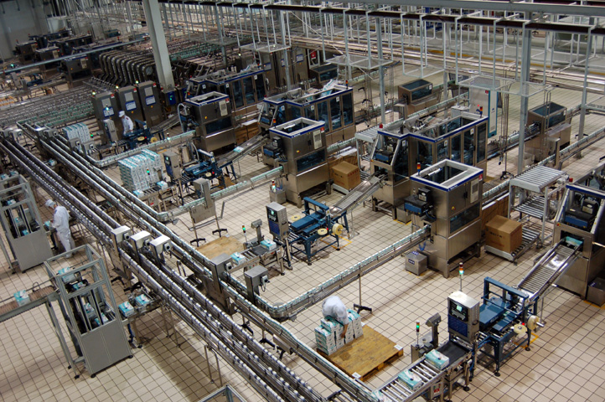
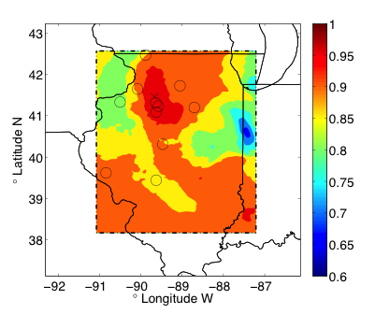
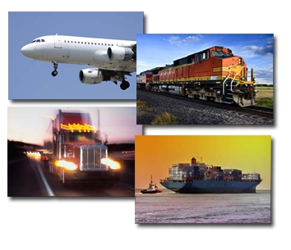

1. MOTIVATION
Split-and-Merge Method for Accelerating Convergence of Stochastic Linear Programs
Akhil Langer and Udatta Palekar*
Department of Computer Science, *Department of Business
University of Illinois at Urbana-Champaign
MOTIVATION
NESTED BRANCH-AND-BOUND PARALLELISM
RESULTS
CHALLENGE
Mission requirements subject to enormous uncertainty, even in peacetime
Relax integer program to linear program → Each vertex is a stochastic linear program
Scenario Activity
Cut Activity
US Air Mobility Command Mission:
Optimally schedule 1300 aircraft for
Stage 1 Linear Program
Parallel exploration of tree vertices Simultaneous evaluation of scenarios
Multicut benders method
Cargo shipment Personnel movement | Distinguished visitor support Air refueling
Demand delays Demand changes Aircraft breakdown | Weather events Natural disaster Conflicts
cuts
cuts
cuts
Stage 2 Linear Program
Stage 2 Linear Program
Stage 2 Linear Program
Total Iterations = 495
Time to Solution = 1190s
STOCHASTIC OPTIMIZATION OVERVIEW
Nested Parallelism
SAM method
PERFORMANCE COMPARISON WITH COMMERCIAL SOLVERS
34% improvement in time
Stage 1 (strategic decision) Cost of resource allocation + Expected cost of stage 2 decisions
(Integer) Linear Program
Planning Stage: Makes decision about known parameters
Scaling
SIPS Performance
1. 96x speedup from 3 to 480 cores
Total Iterations = 415
Time to Solution = 784s
costs,
Execution stage: Assumes probabilistic distribution of uncertain parameters is known and evaluates them for the stage 1 decision
VS
Gurobi IP Solver Performance
Typical parallel efficiency of just 0.1 at 32 cores
Stage 2 (operational decisions) Execution cost
(Integer) Linear Program
Hierarchical Split-and-Merge Method
Challenge Root vertex solve is a bottleneck, when #scenarios are large
58% improvement in time
APPLICATIONS
STATE-OF-THE-ART CANNOT SOLVE LARGE PROBLEMS TO OPTIMALITY
Total Iterations = 360 Time to Solution = 507s
What is new that we are doing?
Combine stochastic programming with high performance computing Facilitates reconciliation of myriad possible outcomes in a timely manner Makes it feasible to solve integer programs
RELATED WORK
Magnanti and Wong
Add only dominating cuts
Requires solving additional optimization problems
Linderoth et al
Requires solving additional optimization problems to determine usability of cuts
Trust Region, Ruszczynski and Linderoth et al
Add objective term to minimize movement of candidate solution
Requires doing several minor iterations between major iterations
Progressive Hedging Algorithm
Requires search for optimal Lagrangean multiplier
SAM BENEFITS
Higher cut activity from initial iterations of Benders method
Reduced Stage 1 bottleneck size
Increased Parallelism in Stage 1
Reduced total iterations and time to solution
FUTURE WORK
Further exploration of SAHM method
Automated determination of split-phase duration
Determining optimal subproblem size
TAKEAWAYS
Accelerated convergence by problem decomposition
Enabled large-scale stochastic optimizations leading to
robust planning of US AMC operations
Reduced time to solution
Asynchronous parallel programming model for
maximum productivity and performance
Agriculture
Telecommunication
CASE STUDY: US MILITARY AICRAFT ALLOCATION PROBLEM
ONGOING WORK
Decomposition Schemes
Scenario based decomposition
Lagrangean based temporal decomposition
Automated distribution of processes to stage 1 and stage 2
Finance
Supply-chain Management
PROPOSED APPROACH – SPLIT-AND-MERGE METHOD
Production planning
Energy-grids
Split the original problem into many small subproblems each with subset of scenarios
Forestry
Transportation
US AMC yearly expenses: ~USD 4 Billion
Average cost benefit: 10%
Robustness: 66% reduction in variance
Perform stochastic linear optimization of subproblems (in parallel) until converged or until a specified number of iterations
LIMITATIONS OF NAÏVE PARALLELIZATION
Scalability limited by #scenarios
Stage 1 bottleneck
Parallel efficiency decreases with increase in Stage 1 size
REFERENCES
Akhil Langer, Ramprasad Venkataraman, Udatta Palekar, and Laxmikant V. Kale. "Parallel branch-and-bound for two-stage stochastic integer optimization." In High Performance Computing (HiPC), 2013 20th International Conference on, pp. 266-275. IEEE, 2013. Best Paper Award.
Langer, Akhil, Ramprasad Venkataraman, Udatta Palekar, Laxmikant Kale, and Steven Baker. "Performance Optimization of a Parallel, Two Stage Stochastic Linear Program." In 2012 IEEE 18th International Conference on Parallel and Distributed Systems, pp. 676-683. IEEE, 2012.
Laxmikant Kale, Anshu Arya, Nikhil Jain, Akhil Langer, Jonathan Liander, Harshitha Menon, Xiang Ni, Yanhua Sun, Ehsan Totoni, Ramprasad Venkataraman, and Lukasz Wesolowski. Migratable Objects + Active Messages + Adaptive Runtime = Productivity + Performance A Submission to 2012 HPC Class II Challenge. Technical Report 12-47, Parallel Programming Laboratory, November 2012. HPCC 2012 Finalist.
Langer, Akhil, Ramprasad Venkataraman, Gagan Gupta, Laxmikant Kale, Udatta Palekar, Steven Baker, and Mark Surina. "Poster: enabling massive parallelism for stochastic optimization." In Proceedings of the 2011 companion on High Performance Computing Networking, Storage and Analysis Companion, pp. 89-90. ACM, 2011.
Merge cuts from subproblems
Solve the original problem with collected cuts
Parallel Design
Scalability: 120 scenarios

