Slide 1

Parallel Algorithms for Two-stage Stochastic Optimizations with Application to AMC Planning
Akhil Langer
PhD Final Defense
Department of Computer Science
University of Illinois at Urbana-Champaign
22nd June, 2015
Notes:
Good Morning Everyone. The title of my thesis is Scalable Algorithms for Two-stage stochastic optimization. The algorithms developed are generic but they have been shown to help solve some of the real-time dynamic problems faced by US AMC.

Slide 2
PhD Committee Members
Dr. Steven Baker, MITRE Corp.
Prof. David Padua, Computer Science, UIUC
Prof. Udatta Palekar (Advisor), Business Administration, UIUC
Prof. Rob Rutenbar, Computer Science, UIUC
Prof. Laxmikant V. Kalé (Advisor), Computer Science, UIUC
Notes:
I would like to thank all of you for agreeing to be on my committee and taking out time from your busy schedules. It took a number of iterations to finalize this time.
Dr Steven Baker who is over the phone has been working with me, helping us understand the on-ground situation
At AMC and various challenges and difficulties that we need to address to solve these problems.

Slide 3
Stochastic Optimization
In several real world situations, many factors cannot be deterministically predicted
e.g. weather in agriculture, demand in manufacturing, stock prices for an investor, etc.
However, resource allocation has to take place before actual realization of unknown parameters
Multistage stochastic programs – unknown parameters realized in multiple steps
Our focus on two-stage stochastic optimizations

Slide 4
Stochastic Optimization
Benders Decomposition
Stage 1 (strategic decision)
Cost of resource allocation + Expected Cost of Stage 2 Decisions
(Integer) Linear Program
costs,
x*
Stage 2 (operational decisions)
Expected execution cost
(Integer) Linear Program
Notes:
We deal with this problem using the stochastic programming approach in which a probabilistic disrtribution of demands is assumed which are also called as scenarios.
Aircraft allocation decisions to different wings and missions are made a month in advance. These decisions are evaluated against the scenarios and the cost is estimated.
When integer decisions are involved, it is an integer program.

Slide 5


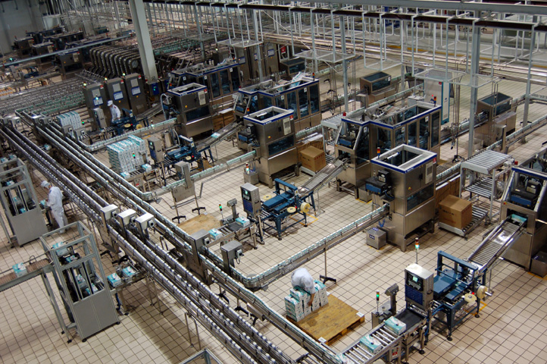
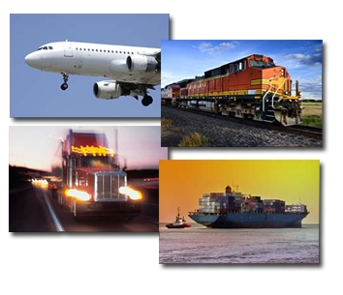
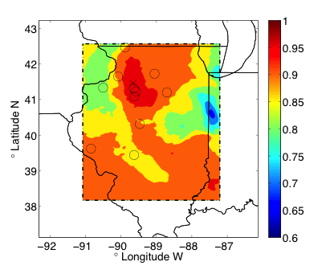
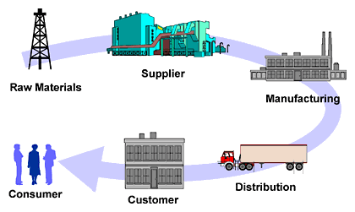
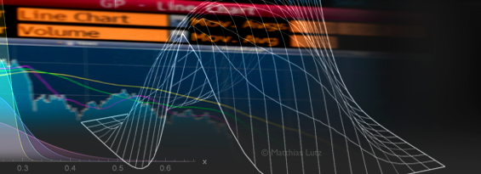
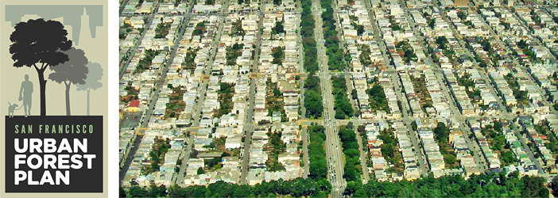
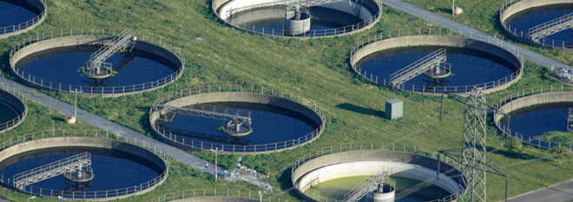
Applications
Production planning
Agriculture
Telecommunication
Energy
grids
Transportation
Forestry
Water Resource Management
Forestry
Finance
Notes:
Some other interesting applications that use two-stage stochastic optimization are energy grid optimizations, production planning, financial planning, and supply chain management.

Slide 6
AMC Planning
AMC Mission
Provide airlift, air refueling, special air mission & aeromedical evacuation
US Air Mobility Command (AMC)
Headquarter @
Scott AFB, Saint Louis, IL
Notes:
Just the Air Mobility Command of US Transcom has to schedule 1300 aircrafts for different missions such as cargo shipment, personnel movemennt, contingencies such as wars, natural diassters, etc.
AMC has to allocate aircraft to different missions a month in advance when the mission requirements are not known because they are subject to enormous uncertainty even in peacetime.
Additionally, weather disruptions and aircraft breakdown affect the decisions.

Slide 7
AMC Planning
Even in peacetime, mission requirements are subject to enormous uncertainty
Uncertainties – demands, aircraft breakdown, weather, natural disaster, conflict, etc.
AMC must reconcile diverse uncertainty when allocating, scheduling and replanning
Dataset Sizes

Slide 8
Thesis Statement
Large-scale stochastic optimization problems intractable on single/multi-core machines
Efficient distributed solvers not available
  Solve large-scale stochastic optimization problems in a timely manner using High Performance Computing
Solution for dynamic and real-time problems faced by US Air Mobility Command
Notes:
So, lage-scale stochasitc programs are intractable on single/multi-core machines because of the large number of variables and large number of scenarios.
And there are no efficient distributed solvers available that can solve these problemsin a timely manner for practical purposes. What is new or different we are doing.
We are combining stochasitc programming with large-scale high performance computing.
In second part of the thesis, We also propose stochastic programming solutions for some of the dynamic and real-time problems faced by US AMC.

Slide 9
Thesis Contents
Parallel Algorithms for Two-stage Stochastic Programs
  Performance optimizations and parallel design for Benders method – Chapter 2
  Parallel Stochastic Integer Program Solver (PSIPS) – Chapter 3
  Two decomposition schemes
    Split-and-Merge (SAM) - Chapter 4
    Lagrangian Decomposition and Merge (LDAM) – Chapter 5
Real-world applications
  Aircraft Allocation Problem – Chapter 6
  Dynamic Mission Replanning – Chapter 7
Notes:
To further introduce stochastic optimization and to show our solutions

Slide 10
Parallel Algorithms for
Two-stage Stochastic Optimization

Slide 11

Related Work
Extensive Formulation
  Becomes unwieldy with increase in number of scenarios
  Unable to optimize even toy instances
Superlinear increase in time with number of scenarios

Slide 12
Related Work
Extensive Formulation
  Becomes unwieldy with increase in number of scenarios
  Unable to optimize even toy instances
Parallelizing IP is difficult
  e.g. Gurobi has poor parallel efficiency¹
PySP solver @ SNL
  Parallel implementation of R-W progressive hedging
  Heuristic requires parameter tuning
  Inefficient because of IP solves
Lubin et al, 2011
  Poor load balancing
  Scaling up to 32 cores
¹Koch, Thorsten, Ted Ralphs, and Yuji Shinano. "Could we use a million cores to solve an integer program?." Mathematical Methods of Operations Research 76.1 (2012): 67-93.

Slide 13
Thesis Overview
Stage 1
Time
Processors
Stage 2

Slide 14
Benders Method
Parallel Design
Design Considerations
Coarse Grained decomposition
Unpredictable Grain sizes
Maintaining responsiveness
stage 1 decision
stage 1 decision
Notes:
The two-stage formulation can be readily mapped into a parallel design, with the first stage generating candidate solutions and stage 2 evaluating these
Decision in parallel for all the scenarios. To handle the unpredictbaility in scenario evaluation, we create a work management entity that allocates scenaios to
Solver as they request for more work. IN order to maintina responsiveness, the manager is kept on
A dedicated processor.
TO use the state-of-the-art our design delegates the individual LP solves to existing libraries such as Gurobi.
These LP solves are very coarse grained as they can not be decomposed further.
Further, the grain sizes are very unpredictable as the time to find an optimal solution in a linear program varies from problem to problem.
This calls for a pull-based work scheme.

Slide 15
Parallel Design
Scalability
10t120s Dataset
Time
Processors
Timeline
Scaling
11x Speedup
Scalability limited by the number of scenarios
Stage 1 bottleneck
  Parallel efficiency ⬇ with ⬆ in stage 1 size

Slide 16
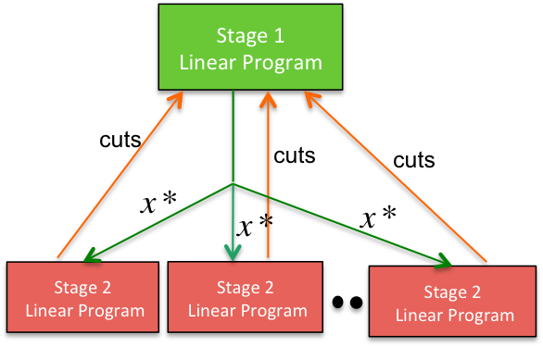
Thesis Overview
Stochastic Integer Program Optimization
Stage 1
Integer Program
Stage 1
Linear Program
cuts
cuts
cuts
cuts
cuts
cuts
Stage 2
Linear Program
Stage 2
Linear Program
Stage 2
Linear Program
Stage 2
Linear Program
Stage 2
Linear Program
Stage 2
Linear Program
Nested Parallelism
Simultaneous evaluation of scenarios Parallel exploration of Branch-and-Bound vertices
Akhil Langer, Ramprasad Venkataraman, Udatta Palekar, and Laxmikant Kale. Parallel Branch-and-bound for Two-stage Stochastic Integer Optimization. In Proceedings of the 20th IEEE International Conference on High Performance Computing, HiPC 2013. Best Paper Award
Notes:
Branch-and-Bound is an expected norm for solving integer programs. Therefore, we relax the integer program in stage 1 to a linear program and
Solve the stochastic linear program using the iterative method. When the solution is obtained, branching is done on fractional solutions. When an integer
Solution is obtained it acts as an incumbent solution and can be used to prune the vertices that can provably not give better solutions than the current incumbent.
Note that we have two-way parallelism, simultaneous evaluation of scenarios and parallel exploration of branch-and-bound vertices.

Slide 17
Thesis Overview
Stage 1
When Stage 1 is IP
BnB Parallelism
Stage 1 Bottleneck
Chapter 2
Chapter 3
Benders
Convergence Rate
Chapter 4,5
Stage 2
Stage 2 Scenarios
Chapter 2
Applications
Aircraft Allocation Problem
Dynamic Mission Replanning
Chapter 6
Chapter 7

Slide 18
Thesis Overview
Stage 1
When Stage 1 is IP
BnB Parallelism
Stage 1 Bottleneck
Chapter 2
Chapter 3
Benders
Convergence Rate
Chapter 4,5
Stage 2
Stage 2 Scenarios
Chapter 2
Applications
Aircraft Allocation Problem
Dynamic Mission Replanning
Chapter 6
Chapter 7

Slide 19
Benders Method
Stage 1 Optimization
costs,
x*
Increasing Stage 1 memory footprint & solve time

Slide 20
Benders Method
Stage 1 Optimization
Time to solution:
19ks − > 8ks, 57% improvement

Slide 21
Benders Method
Evaluating Cut-retirement strategies
LFU – Least Frequently Used
LRU – Least Recently Used
LRFU – Least Recently/Frequently Used
LRFU performs the best

Slide 22
Thesis Overview
Stage 1
When Stage 1 is IP
BnB Parallelism
Stage 1 Bottleneck
Chapter 2
Chapter 3
Benders
Convergence Rate
Chapter 4,5
Stage 2
Stage 2 Scenarios
Chapter 2
Applications
Aircraft Allocation Problem
Dynamic Mission Replanning
Chapter 6
Chapter 7

Slide 23
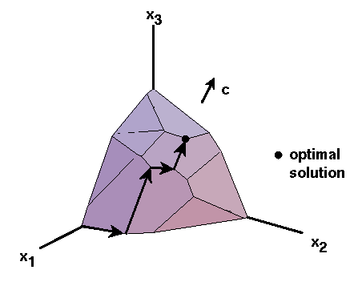
Benders Method
Stage 2 Optimization
Advanced Start
Linear Program optimization
Senarios have similarities
Start from a pre-specified basis
Saves computation of initial basis
Number of simplex iterations depend on distance from optimal solution

Slide 24
Benders Method
Stage 2 Scenario Clustering
Cluster similar scenarios
Each processor is assigned a cluster Similar scenarios solved on the same processor
33% reduction in average scenario solve times

Slide 25
Thesis Overview
Stage 1
When Stage 1 is IP
BnB Parallelism
Stage 1 Bottleneck
Chapter 2
Chapter 3
Benders
Convergence Rate
Chapter 4,5
Stage 2
Stage 2 Scenarios
Chapter 2
Applications
Aircraft Allocation Problem
Dynamic Mission Replanning
Chapter 6
Chapter 7

Slide 26
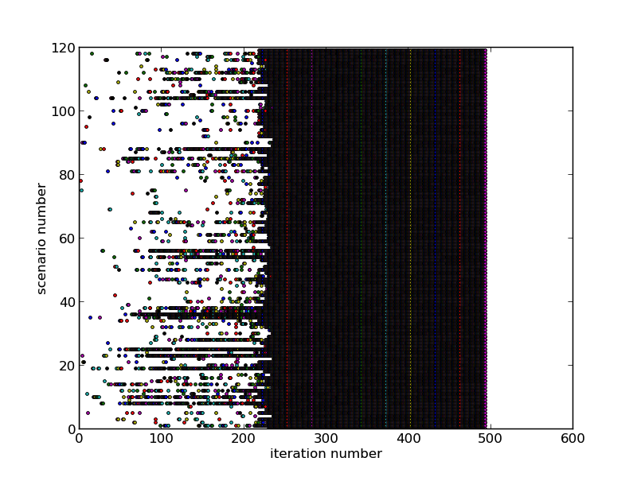
Split-and-Merge (SAM) Method
Few cuts sufficient to provide a new solution in the initial iterations
Not all cuts active in initial iterations of Benders method

Slide 27
Split and Merge (SAM) Method
Stage 1
Stage 2 Scenarios
Stage 2 Scenarios
Stage 2 Scenarios
Stage 2 Scenarios
Split
Stage 1
Stage 1
Stage 1
Stage 1
Stage 2 Scenarios
Stage 2 Scenarios
Stage 2 Scenarios
Stage 2 Scenarios
Merge
Cuts
Stage 1
Stage 2 Scenarios
Stage 2 Scenarios
Stage 2 Scenarios
Stage 2 Scenarios
Notes:
In SAM, n stochastic programs (P1, P2, ..., Pn) are created and each of these is assigned one cluster of scenarios (lines 3-4). Probabilities of the scenarios in each of these subproblems are scaled up so that they add up to 1 (lines 5-6). We then apply the Bender’s multicut method to these n stochastic programs independently of each other (lines 8-16). Bender’s decomposition is applied to these subproblems for a fixed number of rounds (r) or till the subproblem has converged to optimality, whichever is the earliest (line 12). Once this criteria has been met for all the subproblems, the cut constraints from these problems are collected (lines 21-22). The cuts from subproblems are also valid for the original problem with all the scenarios. These cuts are used as the initial set of cut constraints for applying the multicut Bender’s method to the original stochastic linear program.

Slide 28
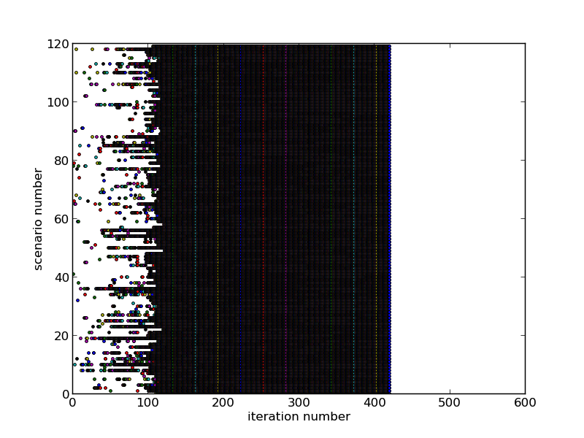
Split and Merge (SAM) Method
Scenario Activity
Cut Activity
Benders
Method
1190s
SAM
784s

Slide 29
Split and Hierarchical Merge
(SAHM)
Stage 1
Stage 2 Scenarios
Stage 2 Scenarios
Stage 2 Scenarios
Stage 2 Scenarios
Split
Stage 1
Stage 1
Stage 1
Stage 1
Stage 2 Scenarios
Stage 2 Scenarios
Stage 2 Scenarios
Stage 2 Scenarios
Cuts
Stage 1
Stage 1
Hierarchical
Merge
Stage 2 Scenarios
Stage 2 Scenarios
Stage 2 Scenarios
Stage 2 Scenarios
Cuts
Stage 1
Stage 2 Scenarios
Stage 2 Scenarios
Stage 2 Scenarios
Stage 2 Scenarios
507s

Slide 30
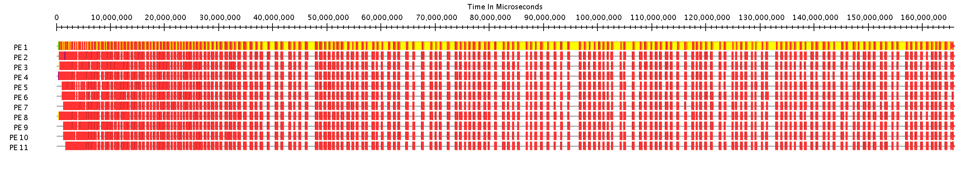
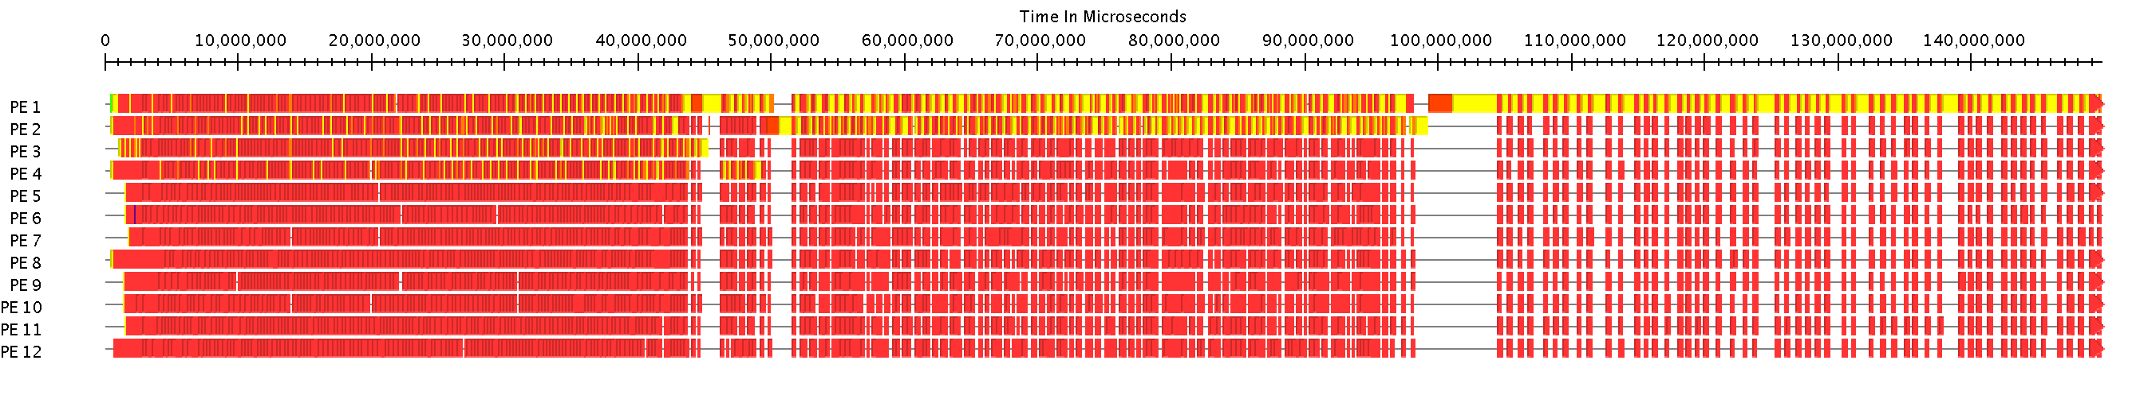
SAHM
Timeline View
Benders
SAHM
Reduced Stage 1 bottleneck size
Higher Processor utilization
Stage 1 parallelism

Slide 31
SAHM: Results
8t120s, 8 subproblems
#Processors | #Split-phase rounds |  |  |  | SAHM Average Time | SAHM Speedup | Benders Time | Benders Speedup | SAHM vs Benders
 | 200 | 300 | 400 | 500
12 | 868 | 787 | 748 | 844 | 812 | 1.0 | 889 | 1.0 | 9%
24 | 481 | 446 | 443 | 477 | 462 | 1.75 | 580 | 1.5 | 20%
48 | 313 | 266 | 243 | 254 | 269 | 3.2 | 425 | 2.1 | 37%
96 | 320 | 207 | 202 | 205 | 234 | 3.5 | 354 | 2.5 | 34%
8t1000s, 8 subproblems
#Processors | #Split-phase rounds |  |  |  | SAHM Average Time | SAHM Speedup | Benders Time | Benders Speedup | SAHM vs Benders
 | 200 | 300 | 400 | 500
12 | 4475 | 4098 | 4279 | 4216 | 4267 | 1.0 | 6062 | 1.0 | 32%
24 | 2005 | 2025 | 2054 | 2179 | 2066 | 2.1 | 3293 | 1.8 | 39%
48 | 1644 | 1151 | 1181 | 1296 | 1318 | 3.2 | 2510 | 2.4 | 54%
96 | 1328 | 997 | 790 | 713 | 957 | 4.5 | 1863 | 3.3 | 58%
192 | 665 | 600 | 536 | 526 | 581 | 7.3 | 1445 | 4.2 | 64%

Slide 32
Lagrangian Decomposition
Motivation
Significant Stage 1 bottleneck and slow convergence rate for large problems
Notes:
Larger problems still remain intractable because of the large number of cuts required and large stage 1 solve times.

Slide 33
Lagrangian Decomposition
A Simple Example
Problem to be
decomposed
Lagrangian Decomposition Enhanced Problem
Dualize
Copy Constraints
Decomposed Problem

Slide 34
Temporal Decomposition using Lagrangian Decomposition
subp -> subproblem
Demand constraints

Slide 35
Lagrangian Decomposition
Approach
Search for optimal λ required in every round
This search can be computationally prohibitive

Slide 36
Proposition
Theorem. Dual values corresponding to copy constraints in the lagrangian decomposition enhanced problem are same as the optimal lagrangian multipliers of the decomposed problem.
Proof that follows from duality theorem given in Section 5.4

Slide 37
Lagrangian Decomposition
Approach
Instead of doing the expensive λ search,
solve Lagrangian Decomposition Enhanced Problem

Slide 38
Lagrangian Decomposition and Merge (LDAM) method
Solve Lagrangian Decomposed Problem
Subproblem cuts eliminate part of search space of original problem
Merge Cuts from Subproblems
Solve original problem with cuts from the subproblems

Slide 39
LDAM
Parallel Design

Slide 40
LDAM Results
8t120s
With 4 Subproblems
10t120s
With 5 Subproblems
12t120s
With 4 Subproblems
15t120s
With 5 Subproblems

Slide 41
LDAM Results
Solution Time on 48 processors
Dataset | SAHM Time | Benders Time | SAHM vs Benders
8t120s | 435 | 454 | 4.2%
10t120s | 553 | 704 | 21%
12t120s | 1834 | 10962 | 83%
15t120s | 9365 | >36000 | -
Able to solve otherwise intractable problems in reasonable time
83% reduction in solution time for some problems

Slide 42
Related Work
Magnanti and Wong, 1981
  Add only dominating cuts
  Requires solving additional optimization problems
Linderoth et al, 2003
  Requires solving additional optimization problems to determine usability of cuts
Trust Region, Ruszczynski, 1886 and Linderoth et al, 2003
  Add objective term to minimize movement of candidate solution
  Requires several minor iterations between major iterations
Progressive Hedging Algorithm, 1991
  Requires search for optimal Lagrangian multiplier which can be prohibitive

Slide 43
Thesis Overview
Stage 1
When Stage 1 is IP
BnB Parallelism
Stage 1 Bottleneck
Chapter 2
Chapter 3
Benders
Convergence Rate
Chapter 4,5
Stage 2
Stage 2 Scenarios
Chapter 2
Applications
Aircraft Allocation Problem
Dynamic Mission Replanning
Chapter 6
Chapter 7

Slide 44
Stochastic Integer Program Optimization
Stage 1
Integer Program
Stage 1
Linear Program
cuts
cuts
cuts
cuts
cuts
cuts
Stage 2
Linear Program
Stage 2
Linear Program
Stage 2
Linear Program
Stage 2
Linear Program
Stage 2
Linear Program
Stage 2
Linear Program
Nested Parallelism
Simultaneous evaluation of scenarios Parallel exploration of Branch-and-Bound vertices
Notes:
Branch-and-Bound is an expected norm for solving integer programs. Therefore, we relax the integer program in stage 1 to a linear program and
Solve the stochastic linear program using the iterative method. When the solution is obtained, branching is done on fractional solutions. When an integer
Solution is obtained it acts as an incumbent solution and can be used to prune the vertices that can provably not give better solutions than the current incumbent.
Note that we have two-way parallelism, simultaneous evaluation of scenarios and parallel exploration of branch-and-bound vertices.

Slide 45



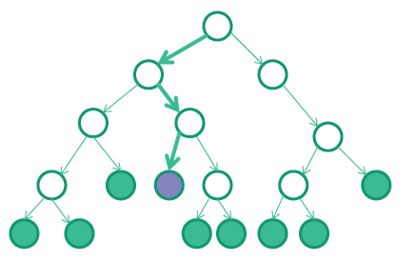
Nested Parallelism
Design Challenges
Fundamental computation unit- Linear Program Optimization
  Coarse grained decomposition Unpredictable grain sizes
Solver Libraries maintain internal state
  Limits concurrency because of
  memory overheads
Variable Amount of Available Parallelism
Better Utilization ≠ Better Performance
CLP
GLPK
Notes:
Unlike typical scientific iterative applications, we encounter several interesting characteristics that make it challenging to realize a scalable design.
A Linear Program optimization is the basic computational unit and it is very coarse grained as it can take upto 10s of serconds.
It is highly unpredictable as well because the optimization time depends on how far the optimal is from the starting pont.
Because the solver libraries consume a lot of memory to maintain internal state that accelerates the optimization time across solves, there is a limitation on the
Number of vertices that can be simultaneously explored
The tree is not well behaved because parts of the tree can be fathomed.
Better utilization does not mean better performance because time spent in exploring lesser important subtrees can worsen the performance.

Slide 46
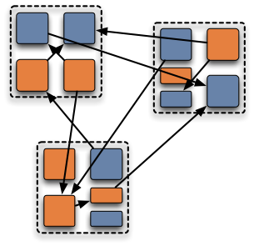
Parallel Programming Model
Charm++ parallel programming model fits well into B&B parallelism
  Object-based expression
  One-sided messaging
  Prioritized execution
Notes:
To implement this, we chose the Charm++ parallel programming language, becayse it has one-sided messafing, does prioritized execution and allows object-baseed expression

Slide 47
PSIPS: Design
Stage 1 Manager
Stage 1 Solvers Load Information
Stage 2 Manager
Issue Vertex Migration
Stage 2 Work Queue
Vertex Request
Assign Scenarios
Stage 1 Decisions
Work Request
Stage 1 Solvers
Expensive Object Migration Dedicate processors Unpredictable grain sizes Pull-based load balancing
Feedback (cuts)
Stage 2 Solvers

Slide 48
PSIPS
Timeline view
Time
Naïve Benders
Processors
Time
Processors
Nested
Parallelism

Slide 49
PSIPS: Design A
Dedicated solver instances per vertex
Stage 2
Solver Instance
Stage 2
Solver Instance
Stage 2
Solver Instance
v1
v2
v1
Stage 1
Solver Instance
Stage 1
Solver Instance
Stage 1
Solver Instance
Stage 2
Solver Instance
Stage 2
Solver Instance
Stage 2
Solver Instance
Stage 2
Solver Instance
v3
Stage 1
Solver Instance
Stage 2
Solver Instance
Stage 2
Solver Instance
v4
Stage 1
Solver Instance
Stage 2
Solver Instance
v1
v2
v3
v4
Notes:
Applying the typical way of doing b&B, we dedicated a set of stg1 andf stage 2 solver instances for every tree vertex and these solver instances are distributed
To the processes as discussed earlier

Slide 50
Design A Performance
Cause of variation in performance across trials
  Incumbents found in different order
Memory requirements inhibit large-scale optimization
Notes:
This shows the scaling plot on up to 120 cores with time to solution on y-axis and number of processes on the x-axis.
Multiple markers for the same scale here correspond to the performance for different trials with the same configuration.
This amount of variation in performance is typical in branch-and-bound applications. Because of operating system noise
And network interference, incumbents in different parts of the tree can be found in different orders across trials. This can
lead to difference in the pruning rate actross trialals. We are getting decent speedups but a
A major disadvantage of this approach is that it inhibits the number of bnb vertices that are being explored concurrently
Because of the large memory overhead associated with each vertex.

Slide 51
Nested Parallelism: Design B
Interleaved vertex optimization on shared solver instance
Stage 2
Solver Instance
v1
Stage 1
Solver Instance
Stage 2
Solver Instance
Stage 2
Solver Instance
v2
Stage 1
Solver Instance
Stage 2
Solver Instance
Stage 2
Solver Instance
v3
Stage 1
Solver Instance
Stage 2
Solver Instance
v1
v2
v3
v4
Stage 2
Solver Instance
v4
Stage 1
Solver Instance
Stage 2
Solver Instance
Notes:
In the problem that we are dealing with, since a change in allocation decision only changes the objective function of the dual of the stage 2 linear
Program, we can actually share the feedback cuts across the vertices in the branch and bound tree. We exploited this feature and assigned only 1 solver
Instance per process. After solving a vertex, instead of waiting for the stage 2 response, the stage 1 solver switches to another vertex by applying the associated
Branching decisions. In this way, we were able to interleave the execution of vertices on the same set of solvers.

Slide 52
Performance Comparison
Design A
PSIPS preliminary design
Design B
PSIPS optimized design
Cause of Variation across trials
Incumbents found in different order | Advanced Start Sequence of vertex optimization
Memory requirements inhibit large-scale optimization | No memory limitations
Notes:
This approach eliminates the memory overhead and significantly reduces the overall time to solution.
However, it introduces a lot of variability in performance across identical trials. As you can see that there can be as much
As 3 fold difference in the time to solution. This happens because linear program uses what is called as advanced start or warm start
In which they start the new optimizartion from the optimal point of the previous problem. This significantly, improves the

Slide 53
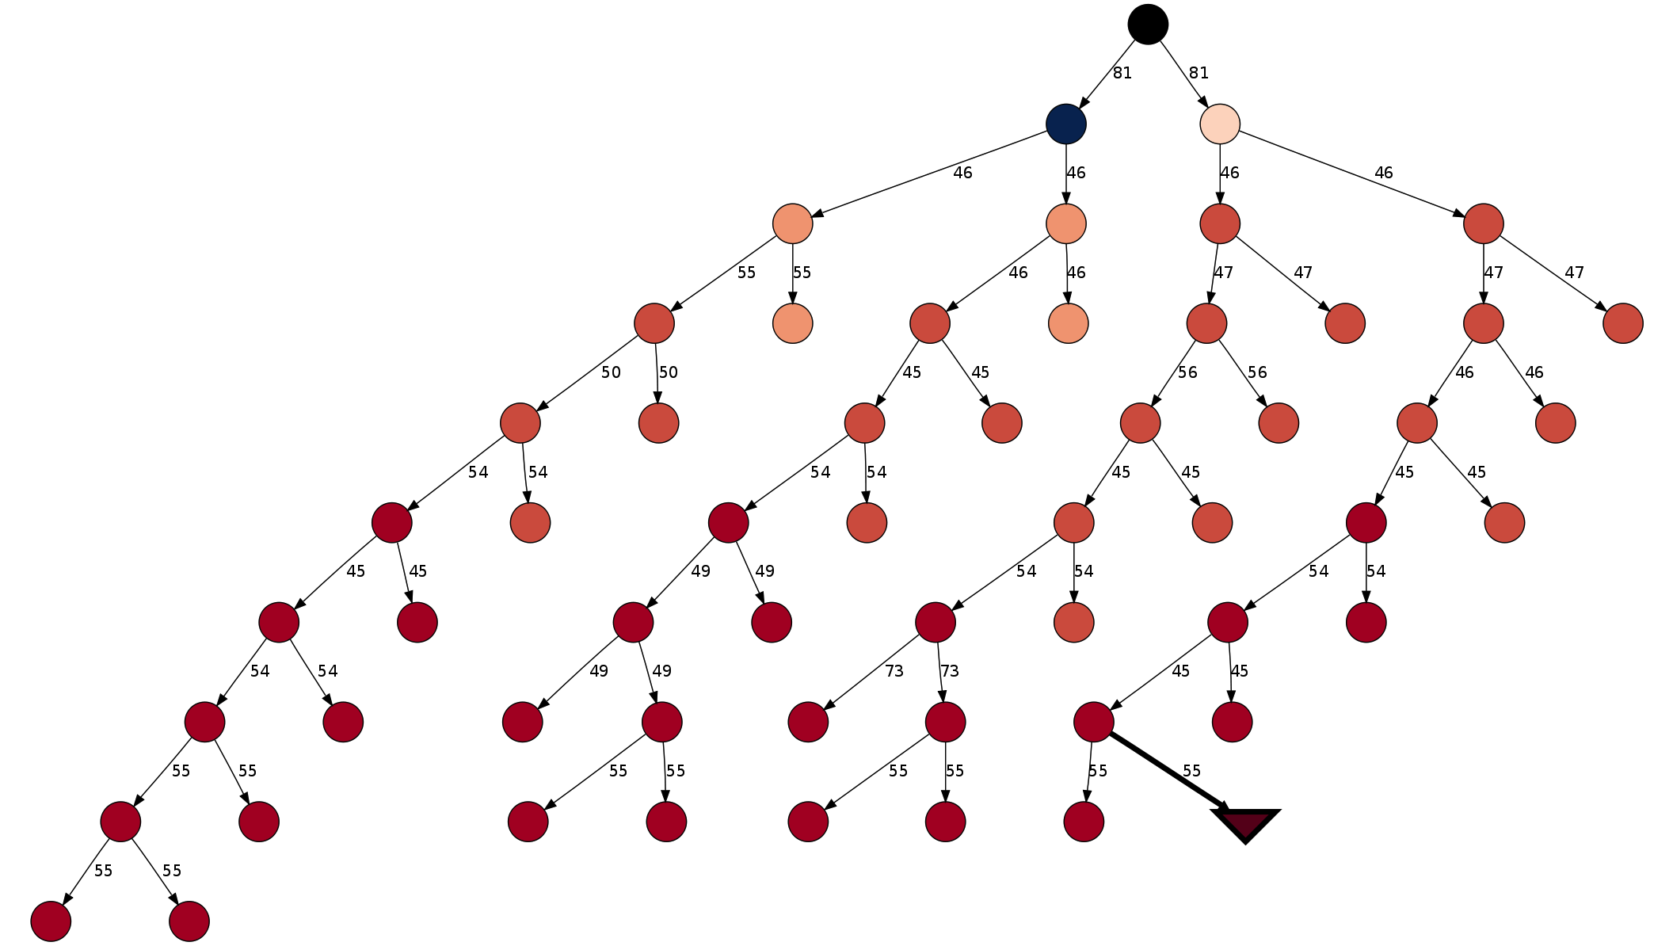
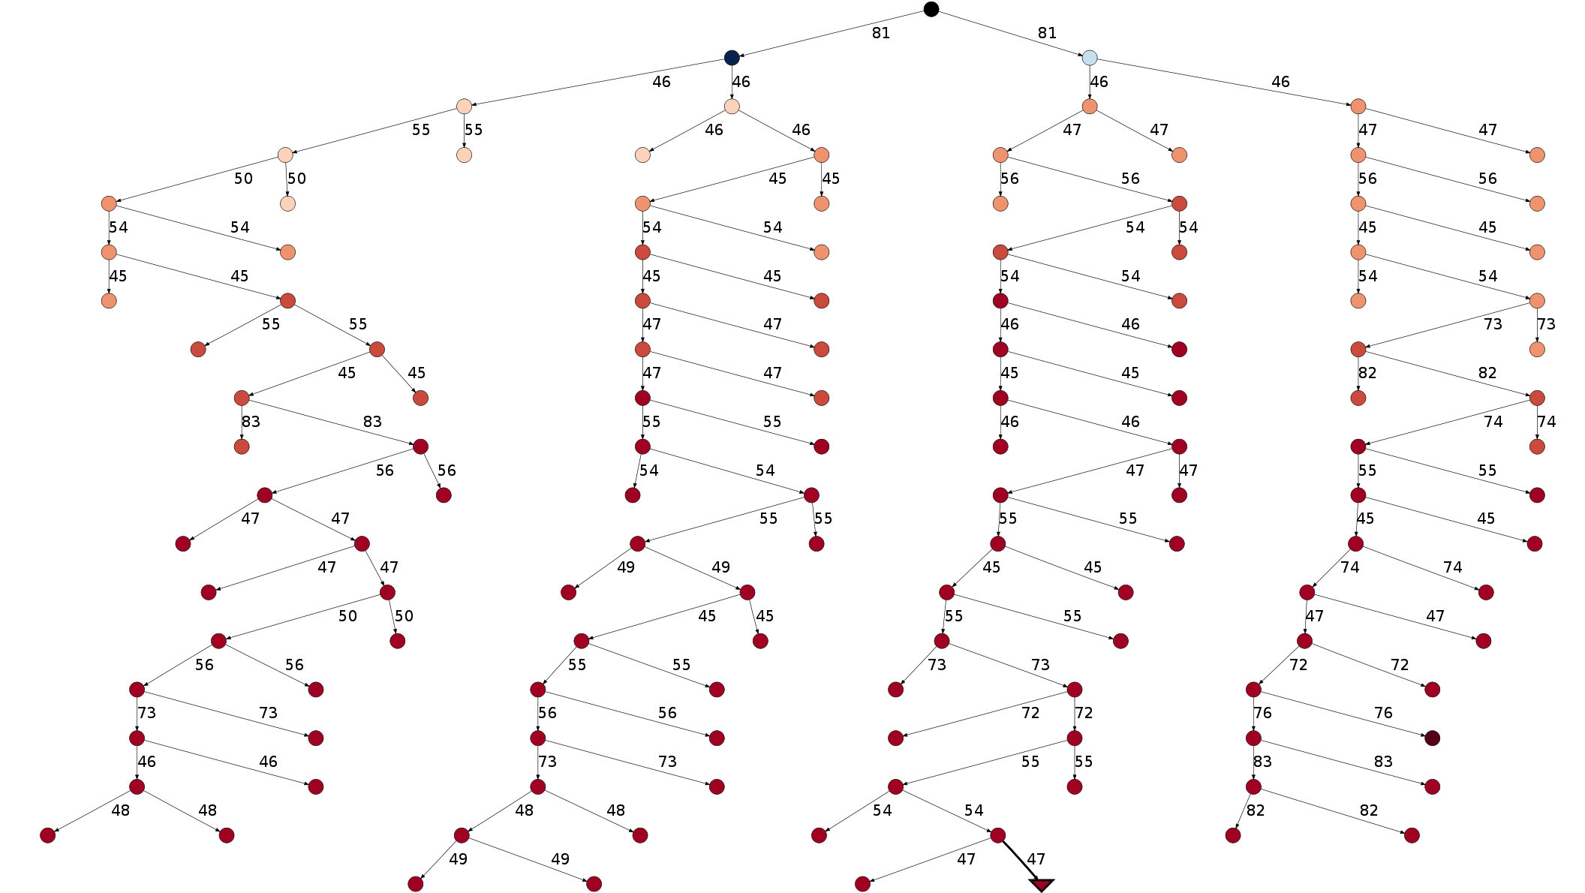
Performance Diagnosis
Large variation in
performance across trials
How bad is performance variation?
Makes it difficult to guarantee better performance with increase in the number of processors But better performance as compared to Design A
Notes:
This is a branch-and-bound tree shown with branching variable. This is another tree explored in an identical trial resulting in This is a branch-and-bound tree shown with branching variable. This is another tree explored in an identical trial resulting in ery different size and branching decisions.
ery different size and branching decisions.

Slide 54
Performance Diagnosis
Why is Design B Faster than Design A?
Improvement in Stage 1 solve times
Design A
Design B

Slide 55
Performance Diagnosis
Why is Design B Faster than Design A?
Reduction in number of rounds per tree vertex
Design A
Design B

Slide 56
PSIPS Performance Results
Testbed
HPC Cluster – 3216 cores
Intel X5650 2.66 GHZ
24 GB RAM
LP Solver
Gurobi optimizer
with Academic licenses
Performance measurement in presence of variation
Fraction of trials achieving certain parallel efficiency (with baseline as 3 cores)
Notes:
Therefore to measure the performance of our scheme in the presence of variability, we did 20 trials at each configuration and
Computed the fractin of trials that gave a certain target minimum parallel efficiency.
For example, in the plot here 40% of the trials had parallel efficiency greater than 80%
And the parallel efficiency was greater than 40% in 100% of the trials.

Slide 57
PSIPS: Strong Scaling Results
SIPS Performance
96x speedup from 3 cores to 480 cores Parallel efficiency greater than 0.4 at 120 cores in ~100% of the cases
VS
Gurobi Integer Program Solver Performance
Typical parallel efficiency of 0.1 at 32 cores¹
Akhil Langer, Ramprasad Venkataraman, Udatta Palekar, and Laxmikant Kale. Parallel Branch-and-bound for Two-stage Stochastic Integer Optimization. In Proceedings of the 20th IEEE International Conference on High Performance Computing, HiPC 2013. Best Paper Award
¹Koch, Thorsten, Ted Ralphs, and Yuji Shinano. "Could we use a million cores to solve an integer program?." Mathematical Methods of Operations Research 76.1 (2012): 67-93.
Notes:
Finally, we plot the average performance across 5 trials for several different data sets.
We obtained 32x speedup while scaling from 3 cores to 480 cores.
Our parallel efficiency is greater than 0.4 at 120 cores in 100% of the cases
As compares to SIPS, the Gurobi IP Solver has been observed to have a parallel efficiency of only 0.1 at 32 cores.

Slide 58
Solution for some dynamic and
real-time problems faced by
US Air Mobility Command

Slide 59
Thesis Overview
Stage 1
When Stage 1 is IP
BnB Parallelism
Stage 1 Bottleneck
Chapter 2
Chapter 3
Benders
Convergence Rate
Chapter 4,5
Stage 2
Stage 2 Scenarios
Chapter 2
Applications
Aircraft Allocation Problem
Dynamic Mission Replanning
Chapter 6
Chapter 7

Slide 60
Military Aircraft Allocation Problem
Stage 1
Long term leasing of civilian aircraft, allocation of aircraft to missions, wings
Stage 2
Select aircraft routes, and
assign demand to aircraft

Slide 61
Military Aircraft Allocation Problem
Cost benefit Analysis in Imminent Disaster Situation
Deterministic vs Stochastic optimization
Average Cost Benefit: 10%
Maximum benefits: 57%
Robustness: 66% reduction in variance
Cost of hedging: 5%
Notes:
Some other interesting applications that use two-stage stochastic optimization are energy grid optimizations, production planning, financial planning, and supply chain management.

Slide 62
Thesis Overview
Stage 1
When Stage 1 is IP
BnB Parallelism
Stage 1 Bottleneck
Chapter 2
Chapter 3
Benders
Convergence Rate
Chapter 4,5
Stage 2
Stage 2 Scenarios
Chapter 2
Applications
Aircraft Allocation Problem
Dynamic Mission Replanning
Chapter 6
Chapter 7

Slide 63
Dynamic Mission Replanning
Responding to disruptive events at execution time
AMC publishes planned set of itineraries, assignment of aircraft, crew, and demand assignment to these itineraries
Planned itineraries are subject to disruptions, such as weather events and aircraft breakdown
Notes:
Once the aircraft has been allocated to locations and missions and the demands have been realized, AMC publishes a schedule
That consists of a list of itineraries, and an assignment of aircraft and crew to these itineraries. It also includes how much of a demand is served by which itinerary.
However, at the time of the execution the schedule is changed to take into account any changes/additions in the demand and more importantly disruptions
Such as weather events, aircraft breakdown, etc. As a result only 90% of the airlift missions

Slide 64
Dynamic Mission Replanning
Responding to disruptive events at execution time
Duty officer must consider:
MOG,
Cargo available times for loading,
target delivery time, cargo priorities,
fuel availability, etc.
TACC duty officer
Notes:
The barrel master must impose any changes to the schedule,
The barrel master must aim to minimize the impact of these changes on crew schedules, delivery delays, and the number and magnitude of further future changes.

Slide 65
Dynamic Mission Replanning
Responding to disruptive events at execution time
Current process is very cumbersome, error-prone and leads to cumulative delays in mission
90% of the airlift missions by AMC
do not execute as planned
TACC duty officer
Uses visualization aids
Notes:
The current approach used by the AMC relies on experienced barrel masters who use various visualization tools to identify and eliminate infeasibilities in the schedule. In particular, such an approach is myopic and ignores the impact of the changes on future missions.

Slide 66
Dynamic Mission Replanning
Modeling Features
Static Information
Current execution schedule
Aircraft assignment
Demand mapping, etc.
Dynamic Information
Disruptive event
Future scenarios
  Weather events, aircraft breakdowns, demand changes, resource availability changes
Output
Modified execution schedule
Notes:
We divide the available information into two types. Static information which includes available resources, and the current execution schedule
Dynamic information contains disruptive events that affect the current execution schedule, and any possible probability weighted future disruption events.
The primary goal of the DMR is to make decisions that gives a feasible modified schedule.

Slide 67
Dynamic Mission Replanning
Modeling Approach
Choose one from recourse itineraries set
Original Itinerary Recourse Itineraries
Notes:
It is easy to check which itinearies are affected and recourses are genreated. Here is a simple example of an itinerary. Explain the itinerary plot.
This itinerary is affected by a weather event shown by the read line and the event became known at t=270 (green line). Now there are several possible recourses
Available here. Either the itinerary can be dealyed on the prior base until the weather becomes clear.
Or it can be redirected to a nearby location from where it moves on to the next location in the itineraiey. Or it goes to a nearby location and then waits until the weather becomes clear and goes to the original stop.
One of these recourses has to be chosen in a way that minimizes the objective function, where the objective function consists of penalty due to delayed itineraries, penalty due to late arrival of demands, etc.
Note that this is just one itinerary, there are many itineraries involved and they all must remain feasible. Therefore, we consider second, their dorder afffected itineraries also, generate their recourses, and select from their recourses.

Slide 68
Dynamic Mission Replanning
Modeling Approach
Naïve/ Myopic Optimization (MyOp)
  Just resolve current infeasibility
Deterministic Optimization (DetOp)
  Assume a nominal future scenario
Stochastic Optimization (StOp)
  Optimize against probability weighted future scenarios
Notes:
We discuss several ways of solving the DMR problem.
A naive approach to the DMR problem is to simply solve a deterministic optimization
problem at each time t when we become aware of a disruptive event, i.e., assuming that no further disruptions will occur in the future. The solution that is thus found is followed until the next disruptive event.
The second approach is to just take into account a nominal set of expected future disruptive events, clearly the solution will be bad if the same set of events do not take place.
Finally, we propose a stochastic optimization approach, in which the scheduler does not naively solve a deterministic problem but instead solves a stochastic optimization problem.

Slide 69
Dynamic Mission Replanning
Stochastic Optimization Approach
Event by event multistage stochastic program
  Computationally intractable
Stage 1
Stage 2
Stage 3
Notes:
So, whenever an event takes place it solves a stochastic program.
We do not expect that the scheduler will have the computational resources to solve this problem.

Slide 70
Dynamic Mission Replanning
Stochastic Optimization Approach
Event by event multistage stochastic program
  Computationally intractable
Solve Aggregated LP in Stage 2
  Some prescient knowledge is involved
Notes:
So, whenever an event takes place it solves a stochastic program
Therefore we formulate the problem as two-stage stochastic program. Consider a monolith problem in which all the LP’s that are solved at each event awareness time are put together into a single LP. The itinerary variables from the previous event LP become the right hand sides of the next event LP

Slide 71
Stochastic Formulation: Stage 1

Slide 72
Stochastic Formulation: Stage 1 (Contd.)

Slide 73
Stochastic Formulation: Stage 2

Slide 74
Stochastic Formulation: Stage 2 (Contd.)
Variables from previous Event LP

Slide 75
Dynamic Mission Replanning
Simulation Setup
Notes:
There are several details about the modeling approach, which I am skipping in the interest of time. I will directly move to the simulation setup and results.
We simulated a real-life scneario, in which we evaluate how these approaches perform over an entire execution schedule.
We assume a total of 3 events in each scenario and a total of 16 scnearios. At the aware ness of each disruptive event
All 16 scenarios are simulated.

Slide 76
Dynamic Mission Replanning
Results – KPI Comparison
Three types of situations, each with two simulations
Notes:
The objective function has the sum of demand penalties and itinerary delays. Some cost factor is assumed to put them in the same units.
But we would like to see how does these approached performed on the individual factors also such as the total number of hours by which the itins are delayed,
Demand penalty.

Slide 77
Contributions
Solving large scale stochastic optimization problems
  Not looked before because stochastic-optimization is hard problem
  Identify decomposable structures and their interdependencies for parallelization
Stochastic Integer Programing Solver (PSIPS)
  Combine Stochastic Programming with High Performance Computing
  Nested Parallel Design, Novel ideas such as state sharing amongst tree vertices
  High parallel efficiencies compared to state-of-the-art solvers

Slide 78
Contributions
Scenario (SAM) and temporal decomposition (LDAM) schemes for accelerating convergence of stochastic programs
  Significant reduction in solution time
  Solve otherwise intractable problems
  Higher parallel scalability
A computational engine for dynamic and real-time problems faced by AMC
  Significant savings in cost
Work will provide springboard for more robust problem solving with HPC in many logistics and planning problems

Slide 79
Publications
Akhil Langer et al. Parallel Branch-and- Bound for Two-stage Stochastic Integer Optimizations. HiPC 2013.
Best Paper Award.
Akhil Langer and Udatta Palekar. Split-and-Merge Method for Accelerating Convergence of Stochastic Linear Programs. ICORES 2015.
Akhil Langer et al. Analyzing Energy-Time Tradeoff of Power Overprovisioned HPC Data Centers. HPPAC 2015.
Akhil Langer et al. Energy-efficient Computing for HPC workloads on Heterogeneous Manycore architectures. PMAM 2015.

Slide 80
Publications
Osman Sarood, Akhil Langer et al. Maximizing Throughput of Over- provisioned Data Centers Under a Strict Power Budget. SC 2014.
Bilge Acun, Abhishek Gupta, Nikhil Jain, Akhil Langer et al. Parallel Programming with Migratable Objects: Charm++ in Practice. SC 2014.
Akhil Langer. An Optimal Distributed Load Balancing Algorithm for Homogeneous Work Units. ICS 2014.
Akhil Langer et al. Scalable Algorithms for Distributed-Memory Adaptive Mesh Refinement. SBAC-PAD 2012.
Best Poster Awards at HiPC.

Slide 81
Publications
Osman Sarood, Akhil Langer et al. Optimizing Power Allocation to CPU and Memory Subsystems in Overprovisioned HPC Systems. Cluster 2013.
Akhil Langer et al. Scalable Algorithms for Constructing Balanced Spanning Trees on System-ranked Process Groups. EuroMPI, 2012.
Akhil Langer et al. Performance Optimization of a Parallel, Two Stage Stochastic Linear Program: The Military Aircraft Allocation Problems. ICPADS 2012.

Slide 82
Publications
Position Papers
Power-aware and Temperature Restrain Modeling for Maximizing Performance and Reliability. MODSIM 14.
A Multi-resolution Emulation + Simulation Methodology. MODSIM 13.
Actionable Performance Modeling for Future Supercomputers. MODSIM 13.
Under Review
Ehsan Totoni, Akhil Langer, et al. VAS: Variation Aware Scheduling
for HPC Systems. SC 15.
Akhil Langer et al. Energy-optimal Configuration Selection for Manycore Chips with Variation. IJHPCA.
Akhil Langer et al. Stochastic Optimization for Military Aircraft Allocation with Consideration for Disaster Management. EJCO.

Slide 83
Publications
Under Preparation
Akhil Langer and Laxmikant V. Kalé. Ideal Load Balancer for Homogeneous Tasks. IEEE TPDS Journal.
Akhil Langer et al. Distributed Algorithms for Adaptive Mesh Refinement Simulations. ACM TOPC Journal.
Akhil Langer et al. Responding to Disruptive Events at Execution Time: A Stochastic Integer Programming Approach. European Journal for Operations Research (EJOR).
Akhil Langer et al. Accelerating Convergence of Stochastic Linear Programs using Lagrangian Decomposition.

Slide 84
Backup Slides

Slide 85
Scaling for Scheduling problem
6.9X Speedup while scaling from 12 to 192 cores
43% parallel efficiency

Slide 86
LDAM
Stage 2 Details for LDP

