Slide 1
Efficient High Performance Computing in the Cloud
Abhishek Gupta
PhD Final Exam
Advisor: Laxmikant V. Kale
05/22/2014
Prelim Exam on 05/09/2013

Slide 2
Committee
Prof. Maria J. Garzaran (UIUC, CS)
Prof. Indranil Gupta (UIUC, CS)
Prof. Laxmikant V. Kale (UIUC, CS)
Dr. Dejan Milojicic (HP Labs)

Slide 3
Motivation: Why Clouds for HPC ?
Rent vs. own, pay-as-you-go
No startup/maintenance cost, cluster create time
Elastic resources
No risk e.g. in under-provisioning
Prevents underutilization
Benefits of virtualization
Flexibility and customization
Security and isolation
Migration and resource control
Cloud for HPC: A cost-effective and timely solution? Multiple providers – Infrastructure as a Service

Slide 4
Experimental Testbed and Applications
Platform/ Resource | Ranger (TACC) | Taub (UIUC) | Open Cirrus (HP) | HPC-optimized Cloud (EC2-CC) | Private Cloud (HP) | Public Cloud (HP)
Network | Infiniband (10Gbps) | Voltaire QDR Infiniband | 10 Gbps Ethernet internal; 1 Gbps Ethernet x-rack | Xen HVM hypervisor, same placement group (10Gbps Physical Ethernet), | Emulated network card under KVM hypervisor (1Gbps Physical Ethernet) | Emulated network under KVM hypervisor (1Gbps Physical Ethernet)
NAS Parallel Benchmarks class B (NPB3.3-MPI)
NAMD - Highly scalable molecular dynamics
ChaNGa - Cosmology, N-body
Sweep3D - A particle in ASCI code
Jacobi2D - 5-point stencil computation kernel
Nqueens - Backtracking state space search
Notes:
Todo: Change table, keep only relevant aspects which I will discuss
Details in report

Slide 5
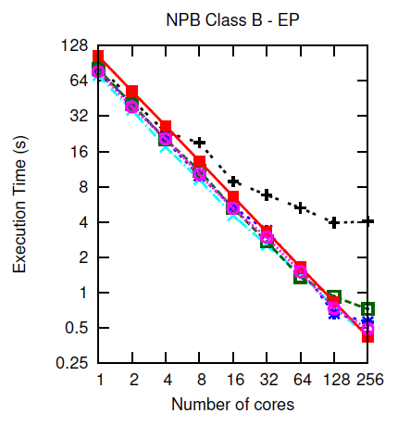
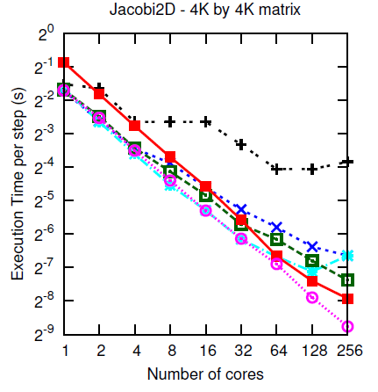
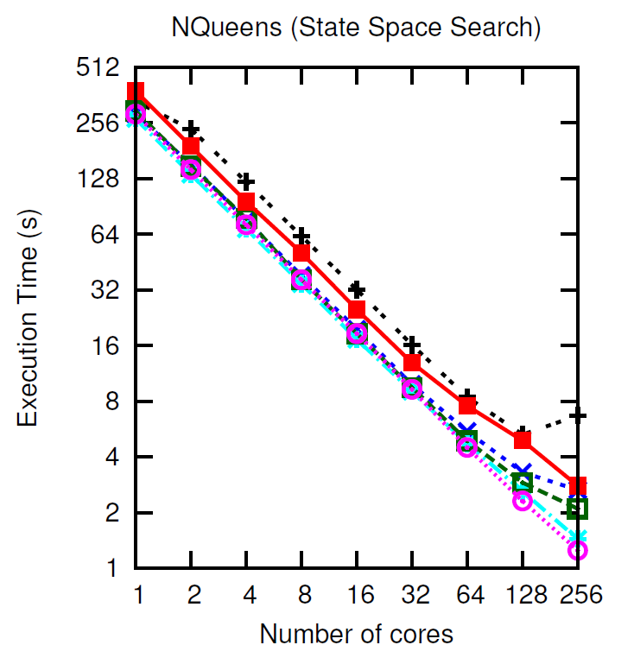
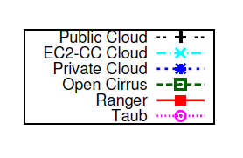
Performance (1/3)
Some applications cloud-friendly
Notes:
Execution Time vs. Number of cores (strong scaling for all except Sweep3D) for different applications. All
applications scale very well on Taub and Ranger and moderately well on Open Cirrus. On Private Cloud, IS does not
scale at all, LU and NAMD stop scaling after 32 cores whereas EP, Jacobi2D and NQueens scale well. Public cloud
exhibits poor scalability.
For NPB, we present results for only Embarrassingly
parallel (EP), LU solver (LU), and Integer sort (IS)
benchmarks due to space constraints. The first observation is
the difference in sequential performance: Ranger takes almost
twice as long as the other platforms, primarily because of the
older and slower processors.
The slope of the curve shows how
the applications scale on different platforms. Despite the poor
sequential speed, Ranger’s performance crosses Open Cirrus,
private cloud and public cloud for some applications at around
32 cores, yielding a much more linearly scalable parallel
performance. We investigated the reasons for better scalability
of these applications on Ranger using application profiling,
performance tools and microbenchmarking the platforms and
found that network performance is a dominant factor (section
IV-A). While all applications scale well on Ranger and
Taub, some applications, especially the NPB IS (Integer Sort)
benchmark, fail to scale on the clouds and Open Cirrus. IS
is a communication intensive benchmark and involves data
reshuffling and permutation operations for sorting. Sweep3D
also exhibits poor weak scaling after 4–8 cores on cloud. Other
communication intensive applications such as LU, NAMD
and ChaNGa also stop scaling on private cloud around 32
cores, but do reasonably well on Open Cirrus, because of the
impact of virtualization on network performance (which we
confirm below). The remaining applications, EP, Jacobi2D,
and NQueens, scale well on all the platforms up to 256 cores
except the public cloud where most applications suffer a hit
above 4 cores. On public cloud, we used VM instances with
4 virtual cores, hence there is no inter-VM communication
up to 4 cores, resulting in good parallel scaling and a sudden
performance penalty as the communication starts happening
across VMs.
Split into 3 sub-plots.
-- apps doing well on all
-- IS
-- all except public and private (and diff bw public, private)
---- what are the reasons??
Comm – why ?? (we went ahead?? – what factors – thin VM, … amazon ec2 clouds…) – extensive researched…
Public and private? … not much has been done for these?? – attribute this to multi-tenancy, scheduling..
Cost

Slide 6
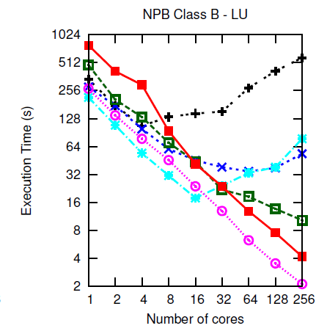
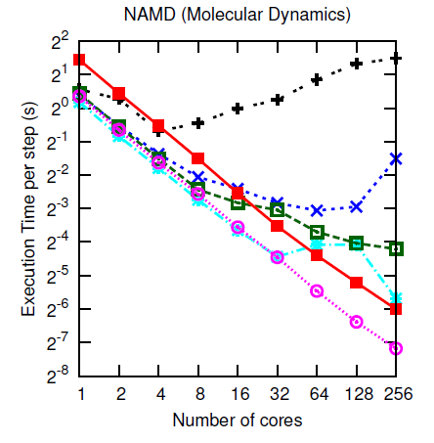
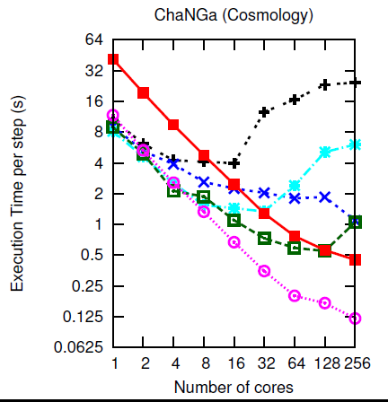
Performance (2/3)
Some applications scale till 16-64 cores
Notes:
Execution Time vs. Number of cores (strong scaling for all except Sweep3D) for different applications. All
applications scale very well on Taub and Ranger and moderately well on Open Cirrus. On Private Cloud, IS does not
scale at all, LU and NAMD stop scaling after 32 cores whereas EP, Jacobi2D and NQueens scale well. Public cloud
exhibits poor scalability.
For NPB, we present results for only Embarrassingly
parallel (EP), LU solver (LU), and Integer sort (IS)
benchmarks due to space constraints. The first observation is
the difference in sequential performance: Ranger takes almost
twice as long as the other platforms, primarily because of the
older and slower processors.
The slope of the curve shows how
the applications scale on different platforms. Despite the poor
sequential speed, Ranger’s performance crosses Open Cirrus,
private cloud and public cloud for some applications at around
32 cores, yielding a much more linearly scalable parallel
performance. We investigated the reasons for better scalability
of these applications on Ranger using application profiling,
performance tools and microbenchmarking the platforms and
found that network performance is a dominant factor (section
IV-A). While all applications scale well on Ranger and
Taub, some applications, especially the NPB IS (Integer Sort)
benchmark, fail to scale on the clouds and Open Cirrus. IS
is a communication intensive benchmark and involves data
reshuffling and permutation operations for sorting. Sweep3D
also exhibits poor weak scaling after 4–8 cores on cloud. Other
communication intensive applications such as LU, NAMD
and ChaNGa also stop scaling on private cloud around 32
cores, but do reasonably well on Open Cirrus, because of the
impact of virtualization on network performance (which we
confirm below). The remaining applications, EP, Jacobi2D,
and NQueens, scale well on all the platforms up to 256 cores
except the public cloud where most applications suffer a hit
above 4 cores. On public cloud, we used VM instances with
4 virtual cores, hence there is no inter-VM communication
up to 4 cores, resulting in good parallel scaling and a sudden
performance penalty as the communication starts happening
across VMs.
Split into 3 sub-plots.
-- apps doing well on all
-- IS
-- all except public and private (and diff bw public, private)
---- what are the reasons??
Comm – why ?? (we went ahead?? – what factors – thin VM, … amazon ec2 clouds…) – extensive researched…
Public and private? … not much has been done for these?? – attribute this to multi-tenancy, scheduling..
Cost

Slide 7
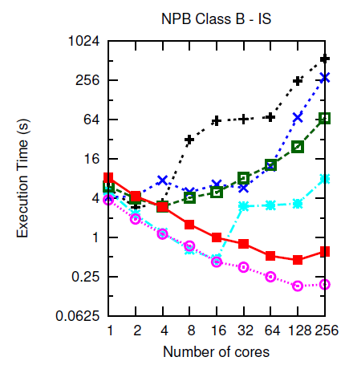
Performance (3/3)
Some applications cannot survive in cloud
A. Gupta et al. “The Who, What, Why and How of High Performance Computing in the Cloud” in IEEE CloudCom 2013 Best Paper
Notes:
Execution Time vs. Number of cores (strong scaling for all except Sweep3D) for different applications. All
applications scale very well on Taub and Ranger and moderately well on Open Cirrus. On Private Cloud, IS does not
scale at all, LU and NAMD stop scaling after 32 cores whereas EP, Jacobi2D and NQueens scale well. Public cloud
exhibits poor scalability.
For NPB, we present results for only Embarrassingly
parallel (EP), LU solver (LU), and Integer sort (IS)
benchmarks due to space constraints. The first observation is
the difference in sequential performance: Ranger takes almost
twice as long as the other platforms, primarily because of the
older and slower processors.
The slope of the curve shows how
the applications scale on different platforms. Despite the poor
sequential speed, Ranger’s performance crosses Open Cirrus,
private cloud and public cloud for some applications at around
32 cores, yielding a much more linearly scalable parallel
performance. We investigated the reasons for better scalability
of these applications on Ranger using application profiling,
performance tools and microbenchmarking the platforms and
found that network performance is a dominant factor (section
IV-A). While all applications scale well on Ranger and
Taub, some applications, especially the NPB IS (Integer Sort)
benchmark, fail to scale on the clouds and Open Cirrus. IS
is a communication intensive benchmark and involves data
reshuffling and permutation operations for sorting. Sweep3D
also exhibits poor weak scaling after 4–8 cores on cloud. Other
communication intensive applications such as LU, NAMD
and ChaNGa also stop scaling on private cloud around 32
cores, but do reasonably well on Open Cirrus, because of the
impact of virtualization on network performance (which we
confirm below). The remaining applications, EP, Jacobi2D,
and NQueens, scale well on all the platforms up to 256 cores
except the public cloud where most applications suffer a hit
above 4 cores. On public cloud, we used VM instances with
4 virtual cores, hence there is no inter-VM communication
up to 4 cores, resulting in good parallel scaling and a sudden
performance penalty as the communication starts happening
across VMs.
Split into 3 sub-plots.
-- apps doing well on all
-- IS
-- all except public and private (and diff bw public, private)
---- what are the reasons??
Comm – why ?? (we went ahead?? – what factors – thin VM, … amazon ec2 clouds…) – extensive researched…
Public and private? … not much has been done for these?? – attribute this to multi-tenancy, scheduling..
Cost

Slide 8
Objectives
HPC in cloud
What (applications), why (benefits), who (users)
How:
Bridge HPC-cloud Gap
Improve HPC performance
Improve cloud utilization=> Reduce cost
Notes:
Cloud provider + User perspective
HPC-aware Cloud + Cloud-aware HPC
Performance achieved on cloud vs. supercomputer?
The bigger and more important question: why and who should choose (or not choose) cloud for HPC, for what applications, and how should cloud be used for HPC?
2 ways how : improve performance or reduce cost by improving utilization

Slide 9
Objectives and Contributions
Research Goals
HPC in cloud
What (applications), why (benefits), who (users)
How:
Bridge HPC-cloud Gap
Techniques
Perf.,
Cost Analysis
Multi-platform Online Application Aware Mapping
Application-aware VM consolidation
Heterogeneity, Multi-tenancy aware HPC
Malleable jobs: Dynamic shrink/expand
Tools Extended
OpenStack Nova Scheduler
CloudSim Simulator
Charm++ Load Balancing
Charm++
Core RTS
HPC Aware Clouds
Cloud Aware HPC
Notes:
Cloud provider + User perspective
HPC-aware Cloud + Cloud-aware HPC
Performance achieved on cloud vs. supercomputer?
The bigger and more important question: why and who should choose (or not choose) cloud for HPC, for what applications, and how should cloud be used for HPC?

Slide 10
Objectives and Contributions
Research Goals
HPC in cloud
What (applications), why (benefits), who (users)
How:
Bridge HPC-cloud Gap
Techniques
Perf.,
Cost Analysis
Multi-platform Online Application Aware Mapping
Application-aware VM consolidation
Heterogeneity, Multi-tenancy aware HPC
Malleable jobs: Dynamic shrink/expand
Papers (all are 1st author)
IEEE TCC 2nd round review
IEEE CloudCom 2013 best paper
ACM HPDC 2012 short paper
IEEE Open Cirrus Summit 2011 best student paper
IEEE IC2E 2013
ACM FedCloud Workshop 2012
IEEE/ACM CCGrid 2013
UIUC Tech Report/ Submission-Ready for IEEE HiPC 2014
IPDPS 2013 Best PhD Forum paper
SC 2013 Doctoral showcase
Notes:
Cloud provider + User perspective
HPC-aware Cloud + Cloud-aware HPC
Performance achieved on cloud vs. supercomputer?
The bigger and more important question: why and who should choose (or not choose) cloud for HPC, for what applications, and how should cloud be used for HPC?

Slide 11
What applications in cloud, Why and who should choose clouds?
Next …
HPC in cloud
Performance analysis
Cost analysis
Challenges/Bottlenecks
Opportunities
Selecting platform for
applications

Slide 12
Application Characteristics
Bottlenecks in bold, MPI collectives in parentheses
Communication intensive applications performed poorly in cloud
Notes:
Public vs private cloud – almost similar network perf.. Then why so much difference.. Scheduler was OpenStack

Slide 13
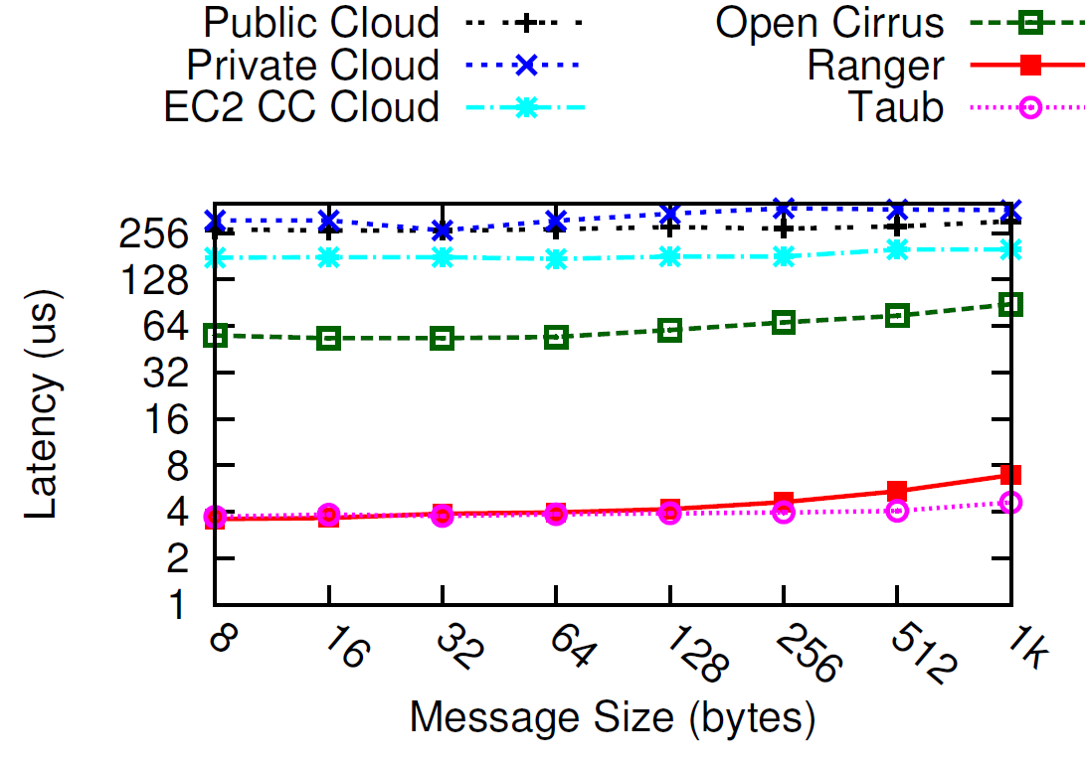
Bottlenecks in Cloud: Communication Latency
Low is better
Cloud message latencies (256μs) off by 2 orders of magnitude compared to supercomputers (4μs)
Notes:
Public vs private cloud – almost similar network perf.. Then why so much difference.. Scheduler was OpenStack

Slide 14
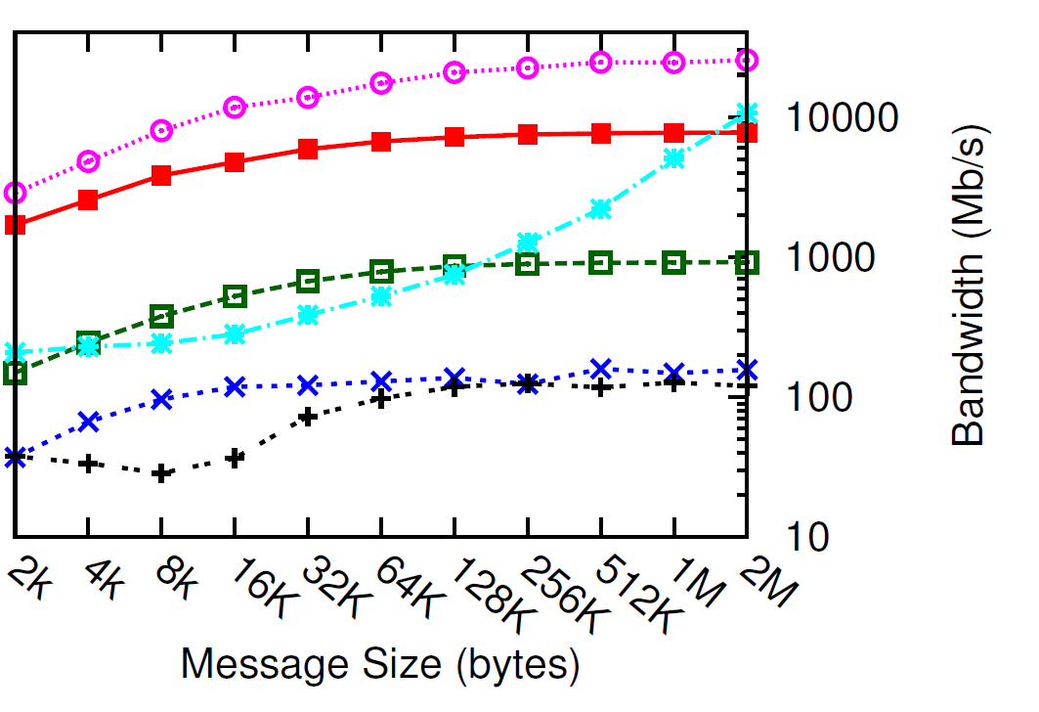
Bottlenecks in Cloud: Communication Bandwidth
High is better
Cloud communication performance off by 2 orders of magnitude – why?
Notes:
Public vs private cloud – almost similar network perf.. Then why so much difference.. Scheduler was OpenStack

Slide 15
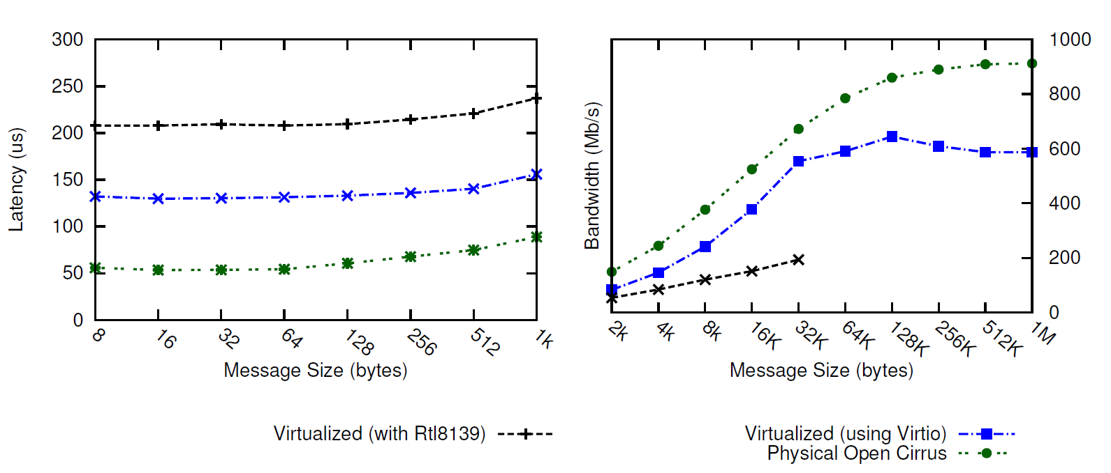
Commodity Network or Virtualization Overhead (both?)
Low is better
High is better
Significant virtualization overhead (Physical vs. virtual)
Led to collaborative work on “Optimizing virtualization for HPC – Thin VMs, Containers, CPU affinity” with HP labs, Singapore.
Notes:
This thesis does not address improving network perf but the less explored challenges for HPC-Clouds.
Fix this slide.

Slide 16
Public vs. Private Cloud
Low is better
Similar network performance for public and private cloud. Then, why does public cloud perform worse?
Multi-tenancy
Notes:
Public vs private cloud – almost similar network perf.. Then why so much difference.. Scheduler was OpenStack
To sustain low cost.. Which motivates us to study cloud eco for HPC a bit more detail…

Slide 17
multi-tenancy and Heterogeneity Challenge
Multi-tenancy: Cloud providers run a profitable business by improving utilization of underutilized resources
Cluster-level by serving large number of users,
Server-level by consolidating VMs of complementary nature (such as memory- and compute-intensive) on same server.
Heterogeneity: Cloud economics is based on:
Creation of a cluster from existing pool of resources and
Incremental addition of new resources.
Heterogeneity and multi-tenancy intrinsic in clouds, driven by cloud economics but
For HPC, one slow processor => all underutilized processors
Notes:
Heterogeneity, multi-tenancy are intrinsic from cost point of view but they result in perf degradation… so then how does economics work for hpc –clouds.. We evaluated the cost of running apps on cloud vs sc..

Slide 18
HPC-Cloud Divide Summary
HPC
Cloud
Application performance
Dedicated execution
HPC-optimized interconnects, OS
Not cloud-aware
Service, cost, resource utilization
Multi-tenancy
Commodity network, virtualization
Not HPC-aware
Mismatch: HPC requirements and cloud characteristics Only embarrassingly parallel, small scale HPC applications in clouds

Slide 19
HPC-Cloud Economics
Then why cloud for HPC?
Small-medium enterprises, startups with HPC needs
Lower cost of running in cloud vs. supercomputer?
For some applications?
Notes:
Why Cloud ?
Variable usage in time (resulting in lower utilization)
Trading CAPEX for OPEX
Shift towards a delivery model of Software as a Service
Cloud users perspective
Use cloud when their applications fit the profile above
Cloud providers perspective
Aggregated resource utilization of all their tenants can sustain a profitable pricing model when compared to the substantial infrastructure investments required to offer computing and storage resources through a cloud interface.

Slide 20
HPC-Cloud Economics*
Cost = Charging rate($ per core-hour) × P × Time
$ per CPU-hour on SC
$ per CPU-hour on cloud
High means cheaper to run in cloud
Cloud can be cost-effective till some scale but what about performance?
* Ack to Dejan Milojicic and Paolo Faraboschi who originally drew this figure
Notes:
We will come back to this point in proposed work section.

Slide 21
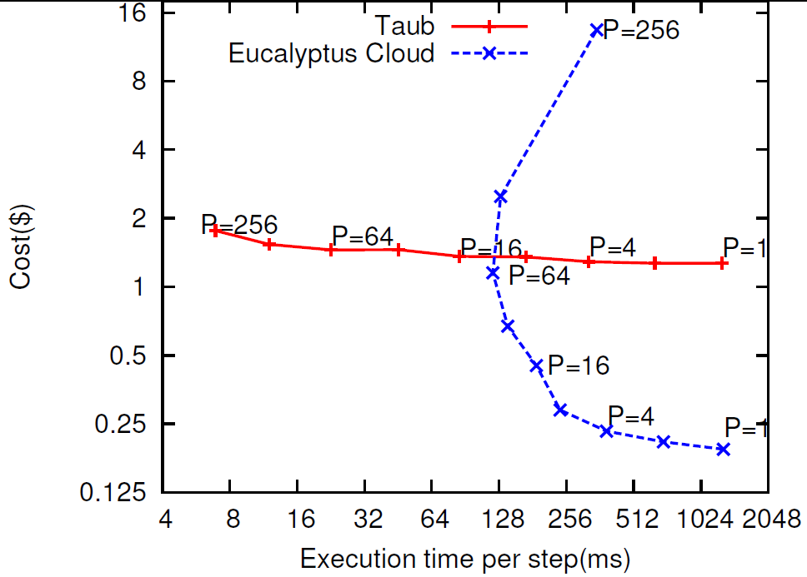
User Perspective: Possible benefits
Cost = Charging rate($ per core-hour) × P × Time
Time constraint
Choose this
Low is better
Cost constraint
Choose this
Low is better
Interesting cross-over points when considering cost. Best platform depends on scale, budget.
A. Gupta et al., “Exploring the Performance and Mapping of HPC Applications to Platforms in the cloud,” short paper in HPDC ’12. New York, NY, USA: ACM, 2012
Notes:
Application to app
scale

Slide 22
Cloud Provider Perspective: Mapping Jobs to Platforms
Less load on SC
Reduced wait time
Better cloud utilization
Notes:
Downloaded SLURM code and doing preliminary investigation. In SLURM, job launch can be done by SLURM (using srun), or by application (e.g. we can use charmrun). Job allocation, that is assignment of nodes to a job request, is separate from job launch. SLURM has a manager daemon and a slurmd daemon on each compute node. slurmd daemons are used by srun. We can decide if we want to use srun or not. I recommend we can stick with charmrun for now. For shrink/expand, we can add commands like sexpand, sshrink or srealloc analogous to existing SLURM commands (e.g. salloc). srealloc would: 1. Do the SLURM pre-processing that happens with salloc (e.g database update) 2. Communicate with the application using CCS 3. Wait (block?) for some time or expect a response from aplication 4. Dp SLURM post-processing e.g that happens when a job exits, here part of nodes are reusable in case of shrink. Besides this, we will need to add new scheduling algorithms, I think that can be added as a plugin. A link to SLURM quickstart: https://computing.llnl.gov/linux/slurm/quickstart.html

Slide 23
Mapping Heuristics
2 dimensions:
Match: Application-agnostic vs. Application-aware
Availability: Static vs. Dynamic
Static: made a-priori to job scheduling
Dynamic: aware of current platform loads and availability
Classification | App-agnostic | App-aware
Static | SCOnly, ClusterOnly, CloudOnly | ?
Dynamic | RoundRobin BestFirst MostFreeFirst | ?
Can we do some better mapping?
Notes:
The intuition is
that the core-hours taken for a job to complete on a platform
are directly proportional to the slowdown it suffers
on that platform compared to the supercomputer. Hence,
the Adaptive heuristic optimizes along two dimensions:
it balances load across multiple platforms and it matches
application characteristics to platforms. In contrast, the
first three dynamic heuristics are application-agnostic.
Table 5 classifies our heuristics into static vs. dynamic,
and application-aware vs. application-agnostic
Downloaded SLURM code and doing preliminary investigation. In SLURM, job launch can be done by SLURM (using srun), or by application (e.g. we can use charmrun). Job allocation, that is assignment of nodes to a job request, is separate from job launch. SLURM has a manager daemon and a slurmd daemon on each compute node. slurmd daemons are used by srun. We can decide if we want to use srun or not. I recommend we can stick with charmrun for now. For shrink/expand, we can add commands like sexpand, sshrink or srealloc analogous to existing SLURM commands (e.g. salloc). srealloc would: 1. Do the SLURM pre-processing that happens with salloc (e.g database update) 2. Communicate with the application using CCS 3. Wait (block?) for some time or expect a response from aplication 4. Dp SLURM post-processing e.g that happens when a job exits, here part of nodes are reusable in case of shrink. Besides this, we will need to add new scheduling algorithms, I think that can be added as a plugin. A link to SLURM quickstart: https://computing.llnl.gov/linux/slurm/quickstart.html

Slide 24
Static Application-Aware Heuristics
Red: slowdown
Light blue: No slowdown
Notes:
Downloaded SLURM code and doing preliminary investigation. In SLURM, job launch can be done by SLURM (using srun), or by application (e.g. we can use charmrun). Job allocation, that is assignment of nodes to a job request, is separate from job launch. SLURM has a manager daemon and a slurmd daemon on each compute node. slurmd daemons are used by srun. We can decide if we want to use srun or not. I recommend we can stick with charmrun for now. For shrink/expand, we can add commands like sexpand, sshrink or srealloc analogous to existing SLURM commands (e.g. salloc). srealloc would: 1. Do the SLURM pre-processing that happens with salloc (e.g database update) 2. Communicate with the application using CCS 3. Wait (block?) for some time or expect a response from aplication 4. Dp SLURM post-processing e.g that happens when a job exits, here part of nodes are reusable in case of shrink. Besides this, we will need to add new scheduling algorithms, I think that can be added as a plugin. A link to SLURM quickstart: https://computing.llnl.gov/linux/slurm/quickstart.html

Slide 25
Static Application-Aware Heuristics
Red: slowdown
Light blue: No slowdown
AppPartition
Cloud
Cluster
Supercomputer
Notes:
Downloaded SLURM code and doing preliminary investigation. In SLURM, job launch can be done by SLURM (using srun), or by application (e.g. we can use charmrun). Job allocation, that is assignment of nodes to a job request, is separate from job launch. SLURM has a manager daemon and a slurmd daemon on each compute node. slurmd daemons are used by srun. We can decide if we want to use srun or not. I recommend we can stick with charmrun for now. For shrink/expand, we can add commands like sexpand, sshrink or srealloc analogous to existing SLURM commands (e.g. salloc). srealloc would: 1. Do the SLURM pre-processing that happens with salloc (e.g database update) 2. Communicate with the application using CCS 3. Wait (block?) for some time or expect a response from aplication 4. Dp SLURM post-processing e.g that happens when a job exits, here part of nodes are reusable in case of shrink. Besides this, we will need to add new scheduling algorithms, I think that can be added as a plugin. A link to SLURM quickstart: https://computing.llnl.gov/linux/slurm/quickstart.html

Slide 26
Static Application-Aware Heuristics
Red: slowdown
Light blue: No slowdown
ScalePartition
Supercomputer
Cluster
Cloud
Notes:
Downloaded SLURM code and doing preliminary investigation. In SLURM, job launch can be done by SLURM (using srun), or by application (e.g. we can use charmrun). Job allocation, that is assignment of nodes to a job request, is separate from job launch. SLURM has a manager daemon and a slurmd daemon on each compute node. slurmd daemons are used by srun. We can decide if we want to use srun or not. I recommend we can stick with charmrun for now. For shrink/expand, we can add commands like sexpand, sshrink or srealloc analogous to existing SLURM commands (e.g. salloc). srealloc would: 1. Do the SLURM pre-processing that happens with salloc (e.g database update) 2. Communicate with the application using CCS 3. Wait (block?) for some time or expect a response from aplication 4. Dp SLURM post-processing e.g that happens when a job exits, here part of nodes are reusable in case of shrink. Besides this, we will need to add new scheduling algorithms, I think that can be added as a plugin. A link to SLURM quickstart: https://computing.llnl.gov/linux/slurm/quickstart.html

Slide 27
Mapping Heuristics Summary
2 dimensions:
Match: Application-agnostic vs. Application-aware
Availability: Static vs. Dynamic
Static: made a-priori to job scheduling
Dynamic: aware of current platform loads and availability
Classification | App-agnostic | App-aware
Static | SCOnly, ClusterOnly, CloudOnly | AppParititon ScalePartition
Dynamic | RoundRobin BestFirst MostFreeFirst | Adaptive
Adaptive: Select platform with largest Effective Job-specific Supply (EJS).
A platform’s EJS for a job = free cores on that platform * job’s normalized performance obtained on that platform.
Notes:
The intuition is
that the core-hours taken for a job to complete on a platform
are directly proportional to the slowdown it suffers
on that platform compared to the supercomputer. Hence,
the Adaptive heuristic optimizes along two dimensions:
it balances load across multiple platforms and it matches
application characteristics to platforms. In contrast, the
first three dynamic heuristics are application-agnostic.
Table 5 classifies our heuristics into static vs. dynamic,
and application-aware vs. application-agnostic
Downloaded SLURM code and doing preliminary investigation. In SLURM, job launch can be done by SLURM (using srun), or by application (e.g. we can use charmrun). Job allocation, that is assignment of nodes to a job request, is separate from job launch. SLURM has a manager daemon and a slurmd daemon on each compute node. slurmd daemons are used by srun. We can decide if we want to use srun or not. I recommend we can stick with charmrun for now. For shrink/expand, we can add commands like sexpand, sshrink or srealloc analogous to existing SLURM commands (e.g. salloc). srealloc would: 1. Do the SLURM pre-processing that happens with salloc (e.g database update) 2. Communicate with the application using CCS 3. Wait (block?) for some time or expect a response from aplication 4. Dp SLURM post-processing e.g that happens when a job exits, here part of nodes are reusable in case of shrink. Besides this, we will need to add new scheduling algorithms, I think that can be added as a plugin. A link to SLURM quickstart: https://computing.llnl.gov/linux/slurm/quickstart.html

Slide 28
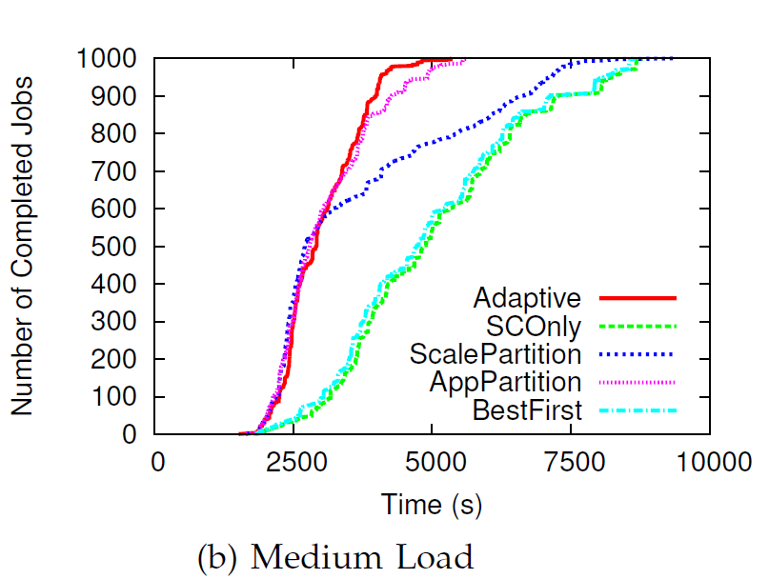
Mapping Benefits
CloudSim: 3 datacenters – supercomputer, cluster, cloud
Job logs from Parallel Workload Archive, first 1000 jobs
Each job record: (job’s arrival time, number of cores (P), runtime on supercomputer, application name assigned randomly)
Normal load
High load: runtimes scaled up by 2X.
Significant improvement in throughput and makespan, attributed to improved response time and runtime
A. Gupta et al., “Evaluating and Improving the Performance and Mapping of HPC in Cloud,” accepted in 1st round, under 2nd round at IEEE TCC Special issue.
Notes:
Downloaded SLURM code and doing preliminary investigation. In SLURM, job launch can be done by SLURM (using srun), or by application (e.g. we can use charmrun). Job allocation, that is assignment of nodes to a job request, is separate from job launch. SLURM has a manager daemon and a slurmd daemon on each compute node. slurmd daemons are used by srun. We can decide if we want to use srun or not. I recommend we can stick with charmrun for now. For shrink/expand, we can add commands like sexpand, sshrink or srealloc analogous to existing SLURM commands (e.g. salloc). srealloc would: 1. Do the SLURM pre-processing that happens with salloc (e.g database update) 2. Communicate with the application using CCS 3. Wait (block?) for some time or expect a response from aplication 4. Dp SLURM post-processing e.g that happens when a job exits, here part of nodes are reusable in case of shrink. Besides this, we will need to add new scheduling algorithms, I think that can be added as a plugin. A link to SLURM quickstart: https://computing.llnl.gov/linux/slurm/quickstart.html

Slide 29
Research Agenda
Why and who should choose (or not choose) cloud for HPC, for what applications? ☑
How can we bridge the gap between HPC and cloud?
Multiple platforms vs. single platform? ☑
HPC-aware clouds?
Improve performance through intelligent VM placement tailored to HPC characteristics?
Increase resource utilization: Application-aware VM consolidation (at acceptable performance penalty)?
Cloud-aware HPC?
Adaptive parallel runtime to improve performance in cloud?
Increase utilization and leverage crucial characteristics of cloud ?
Notes:
Increase resource util ➔ cost savings
They appear to be conflicting but as we will see, we can actually do good on both
Cloud offerings use application-agnostic VM placement
Poor performance of HPC apps in Cloud
Cost savings potential through application aware consolidation

Slide 30
Next …
HPC in
HPC-aware cloud
Challenges/Bottlenecks
Opportunities
Heterogeneity
Multi-tenancy
VM consolidation
Application-aware
Cloud schedulers
SCHEDULING/PLACEMENT
Notes:
Cloud offerings use application-agnostic VM placement
Poor performance of HPC apps in Cloud
Cost savings potential through application aware consolidation

Slide 31
What about Multi-tenancy: VM Consolidation for HPC in Cloud(1)
0.5 GB
VM Requests
HPC performance vs. Resource utilization
(prefers dedicated execution) (shared usage in cloud)?
Up to 23% savings
How much interference?
Notes:
Challenge:
Cross-Application Interference,
Sensitivity to network topology
Sensitivity to heterogeneity
-- cloud economics wants resource packing..
Scope: Improved Resource Utilization
Amazon EC2 – pack cluster compute and High Memory Instance = 23% cost savings

Slide 32
VM Consolidation for HPC in Cloud (2)
Experiment: Shared mode (2 apps on each node – 2 cores each on 4 core node) performance normalized wrt. dedicated mode
Challenge: Interference
4 VM per app
Scope
High is better
EP = Embarrassingly Parallel
LU = LU factorization
IS = Integer Sort
ChaNGa = Cosmology
Careful co-locations can actually improve performance. Why?
Correlation : LLC misses/sec and shared mode performance.
Notes:
Co-relation between LLC misses/sec and shared mode perf.
Apps with high LLC misses/s benefit when sharing node with apps with low LLC misses/s – e.g. LU
Apps with low LLC misses/s marginally affected when sharing node with apps with high LLC misses/s e.g. EP
But what about IS?
IS is network-intensive, so local vs. remote dominates

Slide 33
HPC-Aware Cloud Schedulers
Characterize applications along two dimensions:
Cache intensiveness
Assign each application a cache score (LLC misses/sec)
Representative of the pressure they put on the last level cache and memory controller subsystem
Parallel Synchronization and network sensitivity
33
Notes:
ExtremeHPC: Extremely tightly coupled or topology sensitive
applications for which the best will be to provide
dedicated nodes, example – IS.
SyncHPC: Sensitive to interference, but less compared to
ExtremeHPC and can sustain small degree of interference
to get consolidation benefits, examples – LU, ChaNGa.
AsyncHPC: Asynchronous (and less communication sensitive)
and can sustain more interference than SyncHPC,
examples – EP, MapReduce applications.
NonHPC: Do not perform any communication, can sustain
more interference, and can be placed on heterogeneous
hardware, example – Web applications.

Slide 34
HPC-Aware Cloud Schedulers
Co-locate applications with complementary profiles
Dedicated execution, topology- and hardware-awareness for extremely tightly-coupled HPC applications (up to 20% improvement, implemented in OpenStack)
For rest, Multi-dimensional Online Bin Packing (MDOBP): Memory, CPU
Dimension aware heuristic
34
Notes:
ExtremeHPC: Extremely tightly coupled or topology sensitive
applications for which the best will be to provide
dedicated nodes, example – IS.
SyncHPC: Sensitive to interference, but less compared to
ExtremeHPC and can sustain small degree of interference
to get consolidation benefits, examples – LU, ChaNGa.
AsyncHPC: Asynchronous (and less communication sensitive)
and can sustain more interference than SyncHPC,
examples – EP, MapReduce applications.
NonHPC: Do not perform any communication, can sustain
more interference, and can be placed on heterogeneous
hardware, example – Web applications.

Slide 35
MDOBP (Multi-Dimensional Online Bin Packing) :
Physical host
Remaining
Requested
α
Memory
Pack a VM request into hosts (bin)
Dimension-aware heuristic
Select the host for which the vector of requested resources aligns the most with the vector of remaining capacities*
the host with the minimum α where cos(α) is calculated using dot product of the two vectors, and is given by:
Residual capacities = (CPURes, MemRes) of a host , Requested VM: (CPUReq, MemReq).
CPUs
*S. Lee, R. Panigrahy, V. Prabhakaran, V. Ramasubramanian, K. Talwar, L. Uyeda, and U. Wieder., “Validating Heuristics for Virtual Machines Consolidation,” Microsoft Research, Tech. Rep., 2011.
Notes:
Procedure MDOBP : bin packing heuristic for selecting a host from available choices . We use a dimension-aware heuristic – select the host for which the vector of requested resources aligns the most with the vector of remaining capacities.
Key intuition: For best utilization of the capacity in both dimensions, it is desirable that the final sum of all the VM vectors on a host is close to the top right corner of the host rectangle. Hence, we select the host such that placing the requested VM on it would move the vector representing its occupied resources towards the top right corner.
The key intuition: For best utilization of the capacity in both dimensions, it is desirable that the final sum of all the VM vectors on a host is close to the top right corner of the host rectangle. Hence, we select the host such that placing the requested VM on it would move the vector representing its occupied resources towards the top right corner.
Residual capacities = (CPURes, MemRes) of a host, i.e. subtract from the capacity (total CPU, total memory) the total demand of all the items (VM cores, VM memory) currently assigned to it. Also consider requested VM: (CPUReq(= 1), MemReq). This heuristic selects the host with the minimum where cos() is calculated using dot product of the two vectors, and is given by:

Slide 36
HPC-Aware Cloud Schedulers
Co-locate applications with complementary profiles
Dedicated execution, topology- and hardware-awareness for extremely tightly-coupled HPC applications (up to 20% improvement, implemented in OpenStack)
For rest, Multi-dimensional Online Bin Packing (MDOBP): Memory, CPU
Dimension aware heuristic
Cross application interference aware (up to 45% performance improvement for single application, limit interference to 8%, implementation in OpenStack Nova)
Improve throughput by 32.3% (simulation using CloudSim)
A. Gupta, L. Kale, D. Milojicic, P. Faraboschi, and S. Balle, “HPC-Aware VM Placement in Infrastructure Clouds ,” at IEEE Intl. Conf. on Cloud Engineering IC2E ’13
36
Notes:
ExtremeHPC: Extremely tightly coupled or topology sensitive
applications for which the best will be to provide
dedicated nodes, example – IS.
SyncHPC: Sensitive to interference, but less compared to
ExtremeHPC and can sustain small degree of interference
to get consolidation benefits, examples – LU, ChaNGa.
AsyncHPC: Asynchronous (and less communication sensitive)
and can sustain more interference than SyncHPC,
examples – EP, MapReduce applications.
NonHPC: Do not perform any communication, can sustain
more interference, and can be placed on heterogeneous
hardware, example – Web applications.

Slide 37
Research Agenda
Why and who should choose (or not choose) cloud for HPC, for what applications? ☑
How can we bridge the gap between HPC and cloud?
Multiple platforms vs. single platform? ☑
HPC-aware clouds? ☑
Improve performance through intelligent VM placement tailored to HPC characteristics?
Increase resource utilization: Application-aware VM consolidation (at acceptable performance penalty)?
Cloud-aware HPC?
Adaptive parallel runtime to improve performance in cloud?
Increase utilization and leverage crucial characteristics of cloud ?
Notes:
Increase resource util ➔ cost savings
They appear to be conflicting but as we will see, we can actually do good on both
Cloud offerings use application-agnostic VM placement
Poor performance of HPC apps in Cloud
Cost savings potential through application aware consolidation

Slide 38
Cloud-Aware
HPC in Cloud
Next …
Challenges/Bottlenecks
Opportunities
Heterogeneity
Multi-tenancy
Elasticity
Cloud-aware
HPC Load Balancer
Malleable Jobs (Runtime Shrink/Expand)

Slide 39
Heterogeneity and multi-tenancy
Multi-tenancy => Dynamic heterogeneity
Interference random and unpredictable
Challenge: Running in VMs makes it difficult to determine if (and how much of) the load imbalance is
Application-intrinsic or
Caused by extraneous factors such as interference
Idle times
CPU/VM
VMs sharing CPU: application functions appear to be taking longer time
Time
Existing HPC load balancers ignore effect of extraneous factors
Notes:
Existing LB do not consider extraneous factors
Heterogeneity-awareness: significant performance improvement for HPC in cloud.
Besides the static heterogeneity, multi-tenancy in cloud introduces dynamic heterogeneity, which is random and unpredictable.
Poor performance of tightly-coupled iterative HPC applications.
To
demonstrate its severity, we conducted a simple experiment
where we ran a tightly-coupled 5-point stencil benchmark,
referred to as Stencil2D (2K 2K matrix), on 8-VMs, each
with a single virtual core (VCPU), pinned to a different
physical core of 4-core nodes. More details of our experimental
setup and benchmarks are given in Section V. To
study the impact of heterogeneity, we ran this benchmark in
2 cases - first, we used two physical nodes of same fast (3.00
GHz) processor type (Figure 1a) and second, we used two
physical nodes with different processor types – fast (3.00 GHz)
and slow (2.13 GHz) (Figure 1b).
In the context of cloud, the execution environment depends
on VM to physical machine mapping, which makes it (a)
dynamic and (b) inconsistent across multiple runs. Hence,
would be inefficient. Most existing dynama static allocation of compute tasks to parallel processes
ic load balancing
techniques operate based exclusively on the imbalance internal
to the application, whereas in cloud, the imbalance might be
due to the effect of extraneous factors. These factor originate
from two characteristics, which are intrinsic to cloud:
1) Heterogeneity: Cloud economics is based on the creation
of a cluster from existing pool of resources and
incremental addition of new resources. While doing this,
homogeneity is lost.
2) Multi-tenancy: Cloud providers run a profitable business
by improving utilization of underutilized resources. This
is achieved at cluster-level by serving large number
of users, and at server-level by consolidating VMs of
complementary nature (such as memory- and computeintensive)
on same server. Hence, multi-tenancy can be
at resource-level (memory, CPU), node-level, rack-level,
zone-level, or data center level.

Slide 40
Charm++ and Load Balancing
Migratable objects (chares)
Object-based over-decomposition
Load balancer migrates objects from overloaded
to under loaded VM
HPC VM1
HPC VM2
Background/ Interfering VM running on same host
Physical Host 1
Objects
(Work/Data Units)
Physical Host 2
Notes:
Charm++ is a perfect match for our technique.
Its object based over-decomposition coupled with migrateability of objects allows us to trasnfer tasks to load balance the application
Time logging of task, provided by charm++, is also an essential part of our scheme. We use these times to come up with decisions about which tasks to migrate in order to restore load balance.

Slide 41
Cloud-Aware Load Balancer
Static Heterogeneity:
Estimate the CPU capabilities for each VCPU, and use those estimates to drive the load balancing.
Simple estimation strategy + periodic load re-distribution
Dynamic Heterogeneity
Instrument the time spent on each task
Impact of interference: instrument the load external to the application under consideration (background load)
Normalize execution time to number of ticks (processor-independent)
Predict future load based on the loads of recently completed iterations (principle of persistence).
Create sets of overloaded and under loaded cores
Migrate objects based on projected loads from overloaded to underloaded VMs (Periodic refinement)

Slide 42
Load balancing approach
To get a processor-independent
measure of task loads, normalize the execution times to number of ticks
All processors should have load close to average load
Average load depends on task execution time and overhead
Overhead is the time processor is not executing tasks and not in idle mode.
Charm++ LB database
T_{lb}: wall clock time between two load balancing steps,
T_{i}: CPU time consumed by task i on VCPU p
from /proc/stat file
A. Gupta, O. Sarood, L. Kale, and D. Milojicic, “Improving HPC Application Performance in Cloud through Dynamic Load Balancing,” accepted at IEEE/ACM CCGRID ’13
Notes:
The main challenge is that the CPU time may include the time taken by interfering VM, so they may be inaccurate.
P is the total number of VCPUs, Np is the number
of tasks assigned to VCPU p, ti is the CPU time consumed
by task i running on VCPU p, fp is the frequency for VCPU
p estimated using the loop in Figure 2, and Op is the total
background load for VCPU p.
normalize the execution times to number of ticks by
multiplying the execution times for each task and the overhead
to the estimated VCPU frequency. The conversion from CPU
time to ticks is performed to get a processor-independent
measure of task loads, which is necessary for balancing load
across heterogeneous configuration, where the same task can
take different time when executing on a different CPU.

Slide 43
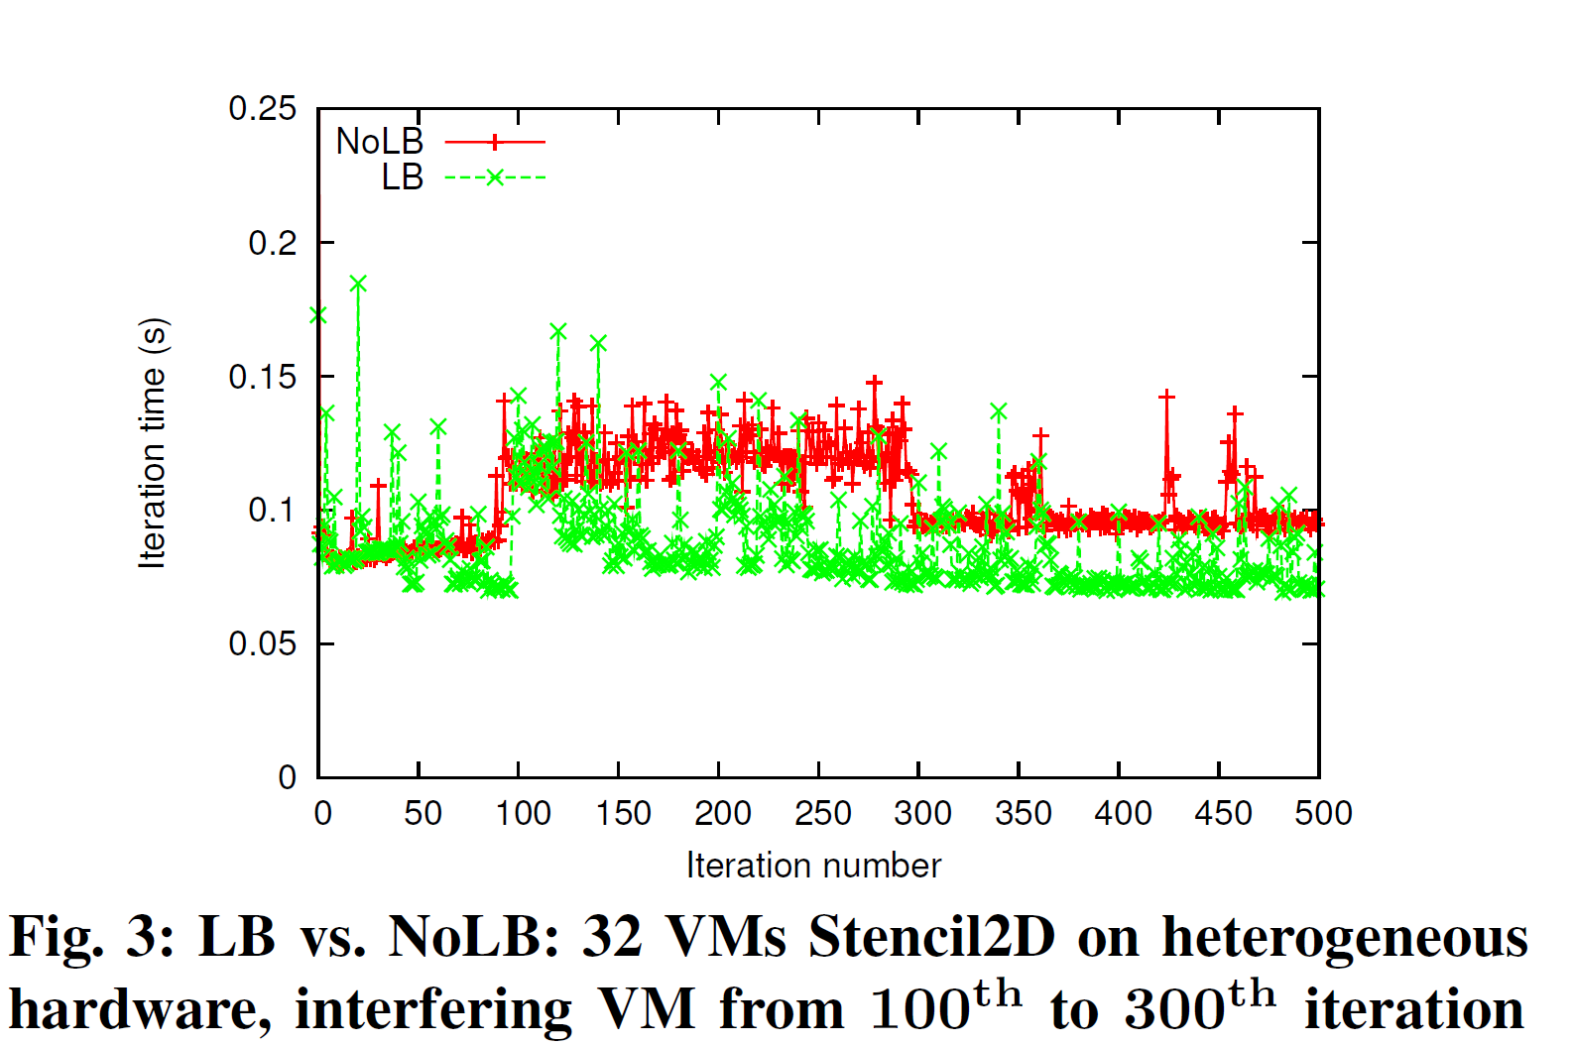
Results: Stencil3d
OpenStack on Open Cirrus test bed (3 types of processors), KVM, virtio-net, VMs: m1.small, vcpupin for pinning VCPU to physical cores
Sequential NPB-FT as interference, Interfering VM pinned to one of the cores that the VMs of our parallel runs use
Multi-tenancy
awareness
Low is better
Heterogeneity
awareness
Periodically measuring idle time and migrating load away from time-shared VMs works well in practice.
Notes:
To understand the effect of our load balancer under heterogeneity
and interference, we ran 500 iterations of Stencil2D
on 32 VMs (8 physical nodes – one Slow, rest Fast), and
plotted the iteration time (execution time of an iteration) vs.
iteration number in Figure 3. In this experiment, we started the
job in interfering VM after 100 iterations of parallel job had
completed. Load balancing was performed after every 20 steps,
which manifests itself as spikes in the iteration time every
20th step. We report execution times averaged across three
runs and use wall clock time, which includes the time taken
for object migration. The LB curve starts to show benefits
as we reach 100 iterations, due to heterogeneity-aware load
balancing. After 100 iterations, interfering job starts. When the
load balancer kicks in, it restores load balance by redistributing
tasks among VMs according to Algorithm 1. Now, there is a
large gap between the two curves demonstrating the benefits
of our refinement based approach, which takes around 3 load
balancing steps to gradually reduce the iteration time after
interference appears. The interfering job finishes at iteration
300 and hence the NoLB curve comes down. There is little
reduction in LB curve, since the previous load balancing steps
had reduced the impact of interference to a very small amount.
The difference between the two curves after that is due to
heterogeneity-awareness in load distribution.

Slide 44
Results: Improvements by LB
High is better
Heterogeneity and Interference – one Slow node, hence four Slow VMs, rest Fast, one interfering VM (on a Fast core) which starts at iteration 50.
Up to 40% Benefits
Notes:
an interfering VM, we achieve up to 45% improvement in
500 iterations for Stencil2D and Wave2D and 200 iterations for
Mol3D, with load balancing every 20th step
execution time (Figure 6a).
The amount of benefits is different
for different applications, especially in Figure 6b. We studied
this behavior using Projections tool and found that our load
balancer is distributing tasks well for all applications, but the
difference in achieved benefits is due to the different sensitivity
of these applications to CPU type and frequency. It can be
inferred from Figure 6b that Mol3D is the most sensitive to
CPU frequency, having most scope for improvement. Next,
Figure 6c shows that our techniques are also effective in the
presence of both the effects – the inherent hardware heterogeneity
and the heterogeneity introduced by multi-tenancy.
Another observation from Figure 6 is the variation in the
achieved benefits with increasing number of VMs. This is
attributed to the tradeoff between two factors: (1) Since there
is only one VM sharing physical CPU with interfering VM,
running on larger number of VMs implies distributing the work
of the overloaded VM to an increasing number of underutilized
VMs, which results in larger reduction in execution time (e.g.
Figure 6a Mol3D, 8 VM vs. 16 VM). (2) As we scale, the
average compute load per VM decreases. Hence, other factors,
such as communication time, dominate the total execution
time. This implies that even with better load balance and
higher % reduction in compute time, overall benefit is small,
since communication time is unaffected. Hence, as we scale
further, benefits decrease, but they still remain substantial.
Moreover, as we scale, benefits can actually be more important
because we save across larger number of processors. As
an example, from Figure 6b Stencil2D, we save 18.8% over 32
VMs, with absolute savings = 32 0:188 48:09 = 289:28
CPU-seconds, where application took 48.09 seconds on 32
VMs. Juxtaposing this with 20.5% reduction in time over 16
VMs which results in absolute savings = 160:20586:77 =
284:32 CPU-seconds, where application took 86.77 seconds on
16 VMs, we see that the overall savings are more for 32 VM
case compared to 16 VMs. Also, since we achieve higher %
benefits with larger problem sizes (Section VI-A3, Figure 5c),
the benefits will be even higher for weak scaling compared to
strong scaling as the impact of factor 2 above is minimized.

Slide 45
Larger Scale Evaluation
Grid'5000 testbed
Linux containers virtualization
Distem Software
Artificial heterogeneity and multi-tenancy
Possible to vary network latency and bandwidth

Slide 46
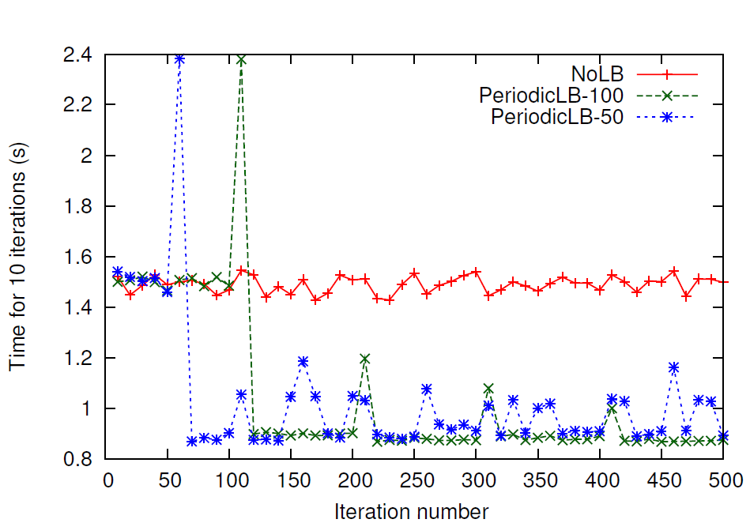
Larger Scale: LB Period Challenge
Wave2D on 64 cores
Low is better
Spikes = LB
When to perform periodic load balancing?
Too frequent => high overhead , Less frequent => low adaptivity
Interference unpredictable, varies from run to run
Load balancing overhead increases with scale
Periodic load balancing overkill when no interference
Do we really need load redistribution every few iterations?
Notes:
an interfering VM, we achieve up to 45% improvement in
500 iterations for Stencil2D and Wave2D and 200 iterations for
Mol3D, with load balancing every 20th step
execution time (Figure 6a).
The amount of benefits is different
for different applications, especially in Figure 6b. We studied
this behavior using Projections tool and found that our load
balancer is distributing tasks well for all applications, but the
difference in achieved benefits is due to the different sensitivity
of these applications to CPU type and frequency. It can be
inferred from Figure 6b that Mol3D is the most sensitive to
CPU frequency, having most scope for improvement. Next,
Figure 6c shows that our techniques are also effective in the
presence of both the effects – the inherent hardware heterogeneity
and the heterogeneity introduced by multi-tenancy.
Another observation from Figure 6 is the variation in the
achieved benefits with increasing number of VMs. This is
attributed to the tradeoff between two factors: (1) Since there
is only one VM sharing physical CPU with interfering VM,
running on larger number of VMs implies distributing the work
of the overloaded VM to an increasing number of underutilized
VMs, which results in larger reduction in execution time (e.g.
Figure 6a Mol3D, 8 VM vs. 16 VM). (2) As we scale, the
average compute load per VM decreases. Hence, other factors,
such as communication time, dominate the total execution
time. This implies that even with better load balance and
higher % reduction in compute time, overall benefit is small,
since communication time is unaffected. Hence, as we scale
further, benefits decrease, but they still remain substantial.
Moreover, as we scale, benefits can actually be more important
because we save across larger number of processors. As
an example, from Figure 6b Stencil2D, we save 18.8% over 32
VMs, with absolute savings = 32 0:188 48:09 = 289:28
CPU-seconds, where application took 48.09 seconds on 32
VMs. Juxtaposing this with 20.5% reduction in time over 16
VMs which results in absolute savings = 160:20586:77 =
284:32 CPU-seconds, where application took 86.77 seconds on
16 VMs, we see that the overall savings are more for 32 VM
case compared to 16 VMs. Also, since we achieve higher %
benefits with larger problem sizes (Section VI-A3, Figure 5c),
the benefits will be even higher for weak scaling compared to
strong scaling as the impact of factor 2 above is minimized.

Slide 47
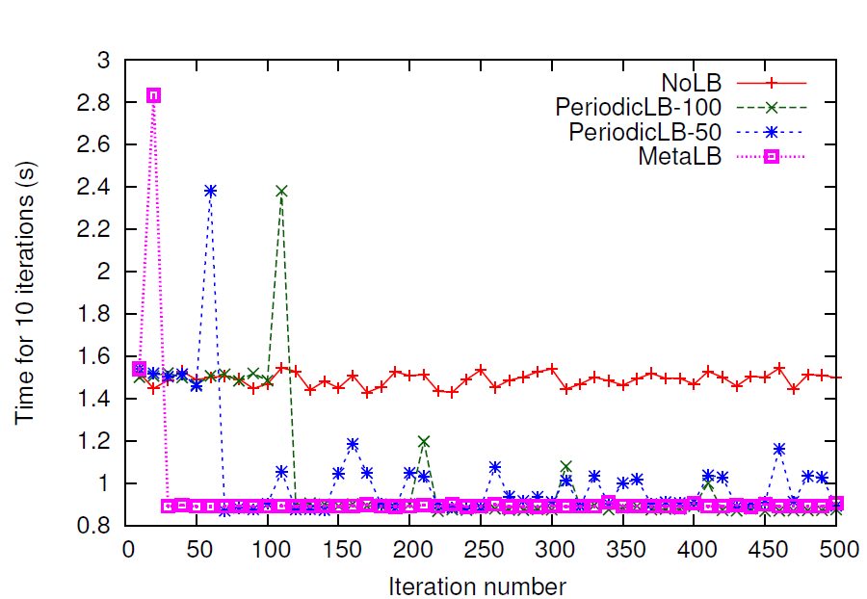
Larger Scale: LB Period Solution
Low is better
Solution: Inspired by Meta-balancer¹
Runtime-triggered instead of application-triggered
Decision to invoke LB driven by idle time measurements
MetaLB: Adaptive with low load balancing overhead
1. H. Menon, B. Acun, S. G. De Gonzalo, O. Sarood, and L. Kale,´ “Thermal aware automated load balancing for hpc applications,” in Cluster Computing (CLUSTER), 2013 IEEE International Conference on. IEEE, 2013
Notes:
an interfering VM, we achieve up to 45% improvement in
500 iterations for Stencil2D and Wave2D and 200 iterations for
Mol3D, with load balancing every 20th step
execution time (Figure 6a).
The amount of benefits is different
for different applications, especially in Figure 6b. We studied
this behavior using Projections tool and found that our load
balancer is distributing tasks well for all applications, but the
difference in achieved benefits is due to the different sensitivity
of these applications to CPU type and frequency. It can be
inferred from Figure 6b that Mol3D is the most sensitive to
CPU frequency, having most scope for improvement. Next,
Figure 6c shows that our techniques are also effective in the
presence of both the effects – the inherent hardware heterogeneity
and the heterogeneity introduced by multi-tenancy.
Another observation from Figure 6 is the variation in the
achieved benefits with increasing number of VMs. This is
attributed to the tradeoff between two factors: (1) Since there
is only one VM sharing physical CPU with interfering VM,
running on larger number of VMs implies distributing the work
of the overloaded VM to an increasing number of underutilized
VMs, which results in larger reduction in execution time (e.g.
Figure 6a Mol3D, 8 VM vs. 16 VM). (2) As we scale, the
average compute load per VM decreases. Hence, other factors,
such as communication time, dominate the total execution
time. This implies that even with better load balance and
higher % reduction in compute time, overall benefit is small,
since communication time is unaffected. Hence, as we scale
further, benefits decrease, but they still remain substantial.
Moreover, as we scale, benefits can actually be more important
because we save across larger number of processors. As
an example, from Figure 6b Stencil2D, we save 18.8% over 32
VMs, with absolute savings = 32 0:188 48:09 = 289:28
CPU-seconds, where application took 48.09 seconds on 32
VMs. Juxtaposing this with 20.5% reduction in time over 16
VMs which results in absolute savings = 160:20586:77 =
284:32 CPU-seconds, where application took 86.77 seconds on
16 VMs, we see that the overall savings are more for 32 VM
case compared to 16 VMs. Also, since we achieve higher %
benefits with larger problem sizes (Section VI-A3, Figure 5c),
the benefits will be even higher for weak scaling compared to
strong scaling as the impact of factor 2 above is minimized.

Slide 48
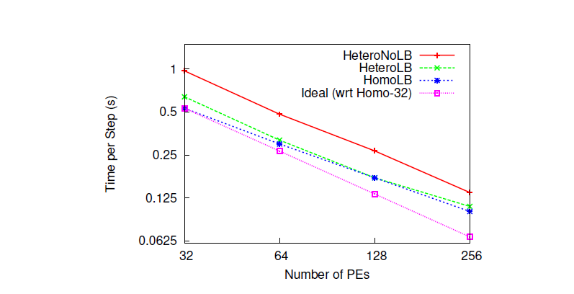
Scalability Results on Distem Cloud
LeanMD
Low is better
Good scaling with Runtime-triggered MetaLB approach

Slide 49
Research Agenda
Why and who should choose (or not choose) cloud for HPC, for what applications? ☑
How can we bridge the gap between HPC and cloud?
Multiple platforms vs. single platform? ☑
HPC-aware clouds? ☑
Improve performance through intelligent VM placement tailored to HPC characteristics?
Increase resource utilization: Application-aware VM consolidation (at acceptable performance penalty)?
Cloud-aware HPC?
Adaptive parallel runtime to improve performance in cloud? ☑
Increase utilization and leverage crucial characteristics of cloud ?
Notes:
Increase resource util ➔ cost savings
They appear to be conflicting but as we will see, we can actually do good on both
Cloud offerings use application-agnostic VM placement
Poor performance of HPC apps in Cloud
Cost savings potential through application aware consolidation

Slide 50
Malleable Parallel Jobs
Malleable jobs: dynamic shrink/expand number of processors
Twofold merit in the context of cloud computing.
Cloud user perspective:
Dynamic pricing offered by cloud providers, such as Amazon EC2
Better value for the money spent based on priorities and deadlines
Cloud provider perspective
Malleable jobs + smart scheduler => better system utilization, response time, and throughput
Honor job priorities
Insufficient work on parallel runtime support for malleable jobs
Either leave residual processes when shrinking or
Too much application specific programmer effort on resize
Notes:
dynamic expand/shrink capability of a job is invaluable in case of dynamic pricing offered by cloud providers, such as Amazon EC2 spot pricing which is based on variable market demands and supply. Such adaptivity gives the user additional ﬂexibility and helps him in obtaining better value for the money spent based on his priorities and deadlines.
Secondly, from the cloud provider’s perspective, adaptive jobs along with a smart scheduler are pivotal to attain better system utilization, response time, and throughput while following Quality of Service (QoS) agreements such as ﬁxed execution time for the agreed budget

Slide 51
Components of a Malleable Jobs System
New Jobs
Cluster
Nodes
Launch
Monitor
Shrink
Expand
Job Queue
Node Scheduler
Decisions
Scheduling Policy Engine
Execution Engine
Cluster State Changes
Shrink Ack.
Expand Ack.
Adaptive
Job Scheduler
Adaptive
Resource Manager
Adaptive/Malleable Parallel Runtime System
We will focus on Malleable Parallel Runtime

Slide 52
Definitions and Goals
Shrink: A parallel application running on nodes of set A is resized to run on nodes of set B where B ⊂ A
Expand: A parallel application running on nodes of set A is resized to run on nodes of set B, where B ⊃ A
Rescale: Shrink or expand
Goals:
Efficient
Fast
Scalable
Generic
Practical
Low-effort
Notes:
dynamic expand/shrink capability of a job is invaluable in case of dynamic pricing offered by cloud providers, such as Amazon EC2 spot pricing which is based on variable market demands and supply. Such adaptivity gives the user additional ﬂexibility and helps him in obtaining better value for the money spent based on his priorities and deadlines.
Secondly, from the cloud provider’s perspective, adaptive jobs along with a smart scheduler are pivotal to attain better system utilization, response time, and throughput while following Quality of Service (QoS) agreements such as ﬁxed execution time for the agreed budget

Slide 53
Approach (Shrink)
Launcher (Charmrun)
Application Processes
Tasks/Objects
CCS Shrink Request
Sync. Point, Check for Shrink/Expand Request
Object Evacuation
Load Balancing
Time
Checkpoint to Linux shared memory
Rebirth (exec) or die (exit)
Reconnect protocol
Restore Object from Checkpoint
Execution Resumes
via stored callback
ShrinkAck to external client
Notes:
Even though the benefits of malleability on utilization and wait time are well demonstrated using simulation, there has been little research on how to do it for HPC runtimes. The challenge is that you cannot just remove a few processes out an application – there are issues related to data redistribution, load balancing, spanning trees, communicators and so on.. Modification of runtime structures…
Our approach is rather than writing code which handles all this during a shrink/expand scheme.. Object evacutaion + in-memory checkpoint-restart + process exec to get a clean restart mechanism

Slide 54
Approach (Expand)
Launcher (Charmrun)
Application Processes
CCS Expand Request
Sync. Point, Check for Shrink/Expand Request
Time
Checkpoint to linux shared memory
Rebirth (exec) or launch (ssh, fork)
Connect protocol
Restore Object from Checkpoint
ExpandAck to external client
Load Balancing
Execution Resumes
via stored callback

Slide 55
Malleable RTS Approach Summary
Task migration
Checkpoint-restart
Load balancing
Linux shared memory
Notes:
dynamic expand/shrink capability of a job is invaluable in case of dynamic pricing offered by cloud providers, such as Amazon EC2 spot pricing which is based on variable market demands and supply. Such adaptivity gives the user additional ﬂexibility and helps him in obtaining better value for the money spent based on his priorities and deadlines.
Secondly, from the cloud provider’s perspective, adaptive jobs along with a smart scheduler are pivotal to attain better system utilization, response time, and throughput while following Quality of Service (QoS) agreements such as ﬁxed execution time for the agreed budget

Slide 56
Experimental Evaluation on Stampede
4 HPC mini-applications:
Stencil2D
LeanMD
Wave2D
LuLesh
Evaluate against design goals
Demonstrate the benefits of malleability with simple scheduling algorithm
Notes:
Downloaded SLURM code and doing preliminary investigation. In SLURM, job launch can be done by SLURM (using srun), or by application (e.g. we can use charmrun). Job allocation, that is assignment of nodes to a job request, is separate from job launch. SLURM has a manager daemon and a slurmd daemon on each compute node. slurmd daemons are used by srun. We can decide if we want to use srun or not. I recommend we can stick with charmrun for now. For shrink/expand, we can add commands like sexpand, sshrink or srealloc analogous to existing SLURM commands (e.g. salloc). srealloc would: 1. Do the SLURM pre-processing that happens with salloc (e.g database update) 2. Communicate with the application using CCS 3. Wait (block?) for some time or expect a response from aplication 4. Dp SLURM post-processing e.g that happens when a job exits, here part of nodes are reusable in case of shrink. Besides this, we will need to add new scheduling algorithms, I think that can be added as a plugin. A link to SLURM quickstart: https://computing.llnl.gov/linux/slurm/quickstart.html

Slide 57
Results: Adaptivity
Low is better
LeanMD: Adapting load distribution on rescale, showing that our approach is efficient
Notes:
Downloaded SLURM code and doing preliminary investigation. In SLURM, job launch can be done by SLURM (using srun), or by application (e.g. we can use charmrun). Job allocation, that is assignment of nodes to a job request, is separate from job launch. SLURM has a manager daemon and a slurmd daemon on each compute node. slurmd daemons are used by srun. We can decide if we want to use srun or not. I recommend we can stick with charmrun for now. For shrink/expand, we can add commands like sexpand, sshrink or srealloc analogous to existing SLURM commands (e.g. salloc). srealloc would: 1. Do the SLURM pre-processing that happens with salloc (e.g database update) 2. Communicate with the application using CCS 3. Wait (block?) for some time or expect a response from aplication 4. Dp SLURM post-processing e.g that happens when a job exits, here part of nodes are reusable in case of shrink. Besides this, we will need to add new scheduling algorithms, I think that can be added as a plugin. A link to SLURM quickstart: https://computing.llnl.gov/linux/slurm/quickstart.html

Slide 58
Results: Scalability
Low is better
Scales well with increasing number of processors
Notes:
Downloaded SLURM code and doing preliminary investigation. In SLURM, job launch can be done by SLURM (using srun), or by application (e.g. we can use charmrun). Job allocation, that is assignment of nodes to a job request, is separate from job launch. SLURM has a manager daemon and a slurmd daemon on each compute node. slurmd daemons are used by srun. We can decide if we want to use srun or not. I recommend we can stick with charmrun for now. For shrink/expand, we can add commands like sexpand, sshrink or srealloc analogous to existing SLURM commands (e.g. salloc). srealloc would: 1. Do the SLURM pre-processing that happens with salloc (e.g database update) 2. Communicate with the application using CCS 3. Wait (block?) for some time or expect a response from aplication 4. Dp SLURM post-processing e.g that happens when a job exits, here part of nodes are reusable in case of shrink. Besides this, we will need to add new scheduling algorithms, I think that can be added as a plugin. A link to SLURM quickstart: https://computing.llnl.gov/linux/slurm/quickstart.html

Slide 59
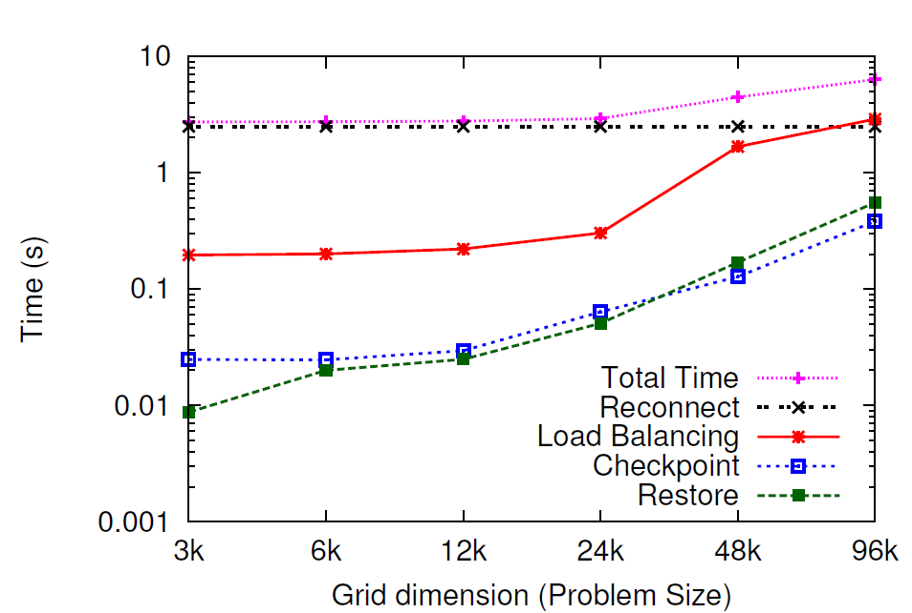
Results: Scalability
Low is better
Scales well with increasing problem size
Notes:
Downloaded SLURM code and doing preliminary investigation. In SLURM, job launch can be done by SLURM (using srun), or by application (e.g. we can use charmrun). Job allocation, that is assignment of nodes to a job request, is separate from job launch. SLURM has a manager daemon and a slurmd daemon on each compute node. slurmd daemons are used by srun. We can decide if we want to use srun or not. I recommend we can stick with charmrun for now. For shrink/expand, we can add commands like sexpand, sshrink or srealloc analogous to existing SLURM commands (e.g. salloc). srealloc would: 1. Do the SLURM pre-processing that happens with salloc (e.g database update) 2. Communicate with the application using CCS 3. Wait (block?) for some time or expect a response from aplication 4. Dp SLURM post-processing e.g that happens when a job exits, here part of nodes are reusable in case of shrink. Besides this, we will need to add new scheduling algorithms, I think that can be added as a plugin. A link to SLURM quickstart: https://computing.llnl.gov/linux/slurm/quickstart.html

Slide 60
Results Summary
Adapts load distribution well in response to a shrink/expand request (Efficient)
2k->1k in 13s, 1k->2k in 40s (Fast)
Scales well with increasing number of cores and also wrt problem size (Scalable)
Little application programmer effort (Low-effort)
4 mini-applications: Stencil2D, LeanMD, Wave2D, LuLesh
Can be used in most supercomputers (Practical)
What are the benefits for HPC in cloud?
Notes:
Downloaded SLURM code and doing preliminary investigation. In SLURM, job launch can be done by SLURM (using srun), or by application (e.g. we can use charmrun). Job allocation, that is assignment of nodes to a job request, is separate from job launch. SLURM has a manager daemon and a slurmd daemon on each compute node. slurmd daemons are used by srun. We can decide if we want to use srun or not. I recommend we can stick with charmrun for now. For shrink/expand, we can add commands like sexpand, sshrink or srealloc analogous to existing SLURM commands (e.g. salloc). srealloc would: 1. Do the SLURM pre-processing that happens with salloc (e.g database update) 2. Communicate with the application using CCS 3. Wait (block?) for some time or expect a response from aplication 4. Dp SLURM post-processing e.g that happens when a job exits, here part of nodes are reusable in case of shrink. Besides this, we will need to add new scheduling algorithms, I think that can be added as a plugin. A link to SLURM quickstart: https://computing.llnl.gov/linux/slurm/quickstart.html

Slide 61
Applicability to HPC in Cloud
Provider perspective: Improve cloud utilization using malleable jobs + adaptive job scheduling
Stampede interactive mode as our small cluster for scheduler demonstration
User Perspective: Price-sensitive rescale in spot markets
Notes:
Downloaded SLURM code and doing preliminary investigation. In SLURM, job launch can be done by SLURM (using srun), or by application (e.g. we can use charmrun). Job allocation, that is assignment of nodes to a job request, is separate from job launch. SLURM has a manager daemon and a slurmd daemon on each compute node. slurmd daemons are used by srun. We can decide if we want to use srun or not. I recommend we can stick with charmrun for now. For shrink/expand, we can add commands like sexpand, sshrink or srealloc analogous to existing SLURM commands (e.g. salloc). srealloc would: 1. Do the SLURM pre-processing that happens with salloc (e.g database update) 2. Communicate with the application using CCS 3. Wait (block?) for some time or expect a response from aplication 4. Dp SLURM post-processing e.g that happens when a job exits, here part of nodes are reusable in case of shrink. Besides this, we will need to add new scheduling algorithms, I think that can be added as a plugin. A link to SLURM quickstart: https://computing.llnl.gov/linux/slurm/quickstart.html

Slide 62
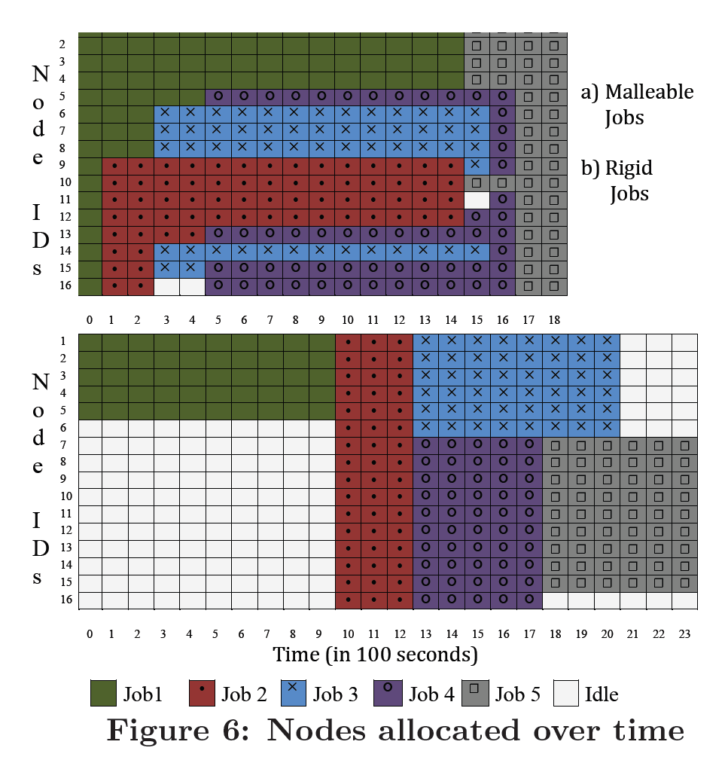
Provider Perspective: Scheduling Case Study
Improved cluster utilization
Reduced response time
Reduced makespan
5 jobs
Stencil2D, 1000 iterations each
4-16 nodes, 16 cores per node
Dynamic Equipartitioning for malleable jobs
FCFS for rigid jobs
Notes:
Downloaded SLURM code and doing preliminary investigation. In SLURM, job launch can be done by SLURM (using srun), or by application (e.g. we can use charmrun). Job allocation, that is assignment of nodes to a job request, is separate from job launch. SLURM has a manager daemon and a slurmd daemon on each compute node. slurmd daemons are used by srun. We can decide if we want to use srun or not. I recommend we can stick with charmrun for now. For shrink/expand, we can add commands like sexpand, sshrink or srealloc analogous to existing SLURM commands (e.g. salloc). srealloc would: 1. Do the SLURM pre-processing that happens with salloc (e.g database update) 2. Communicate with the application using CCS 3. Wait (block?) for some time or expect a response from aplication 4. Dp SLURM post-processing e.g that happens when a job exits, here part of nodes are reusable in case of shrink. Besides this, we will need to add new scheduling algorithms, I think that can be added as a plugin. A link to SLURM quickstart: https://computing.llnl.gov/linux/slurm/quickstart.html

Slide 63
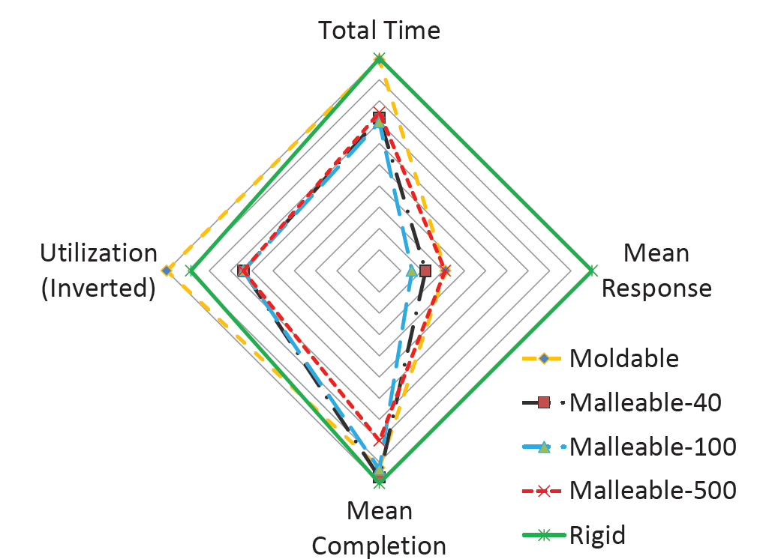
Provider Perspective: Scheduling Case Study
Significant improvement in mean response time and utilization
Notes:
Downloaded SLURM code and doing preliminary investigation. In SLURM, job launch can be done by SLURM (using srun), or by application (e.g. we can use charmrun). Job allocation, that is assignment of nodes to a job request, is separate from job launch. SLURM has a manager daemon and a slurmd daemon on each compute node. slurmd daemons are used by srun. We can decide if we want to use srun or not. I recommend we can stick with charmrun for now. For shrink/expand, we can add commands like sexpand, sshrink or srealloc analogous to existing SLURM commands (e.g. salloc). srealloc would: 1. Do the SLURM pre-processing that happens with salloc (e.g database update) 2. Communicate with the application using CCS 3. Wait (block?) for some time or expect a response from aplication 4. Dp SLURM post-processing e.g that happens when a job exits, here part of nodes are reusable in case of shrink. Besides this, we will need to add new scheduling algorithms, I think that can be added as a plugin. A link to SLURM quickstart: https://computing.llnl.gov/linux/slurm/quickstart.html

Slide 64
User Perspective: Price-sensitive Rescale in Spot Markets
Amazon EC2 spot price variation: cc2.8xlarge instance Jan 7, 2013
Main idea is to keep 2 pools
Static: certain minimum number of reserved instances
Dynamic: price-sensitive rescale over the spot instance pool
Price-sensitive rescale:
Expand when the spot price falls below a threshold
Shrink when it exceeds the threshold. B
Notes:
Downloaded SLURM code and doing preliminary investigation. In SLURM, job launch can be done by SLURM (using srun), or by application (e.g. we can use charmrun). Job allocation, that is assignment of nodes to a job request, is separate from job launch. SLURM has a manager daemon and a slurmd daemon on each compute node. slurmd daemons are used by srun. We can decide if we want to use srun or not. I recommend we can stick with charmrun for now. For shrink/expand, we can add commands like sexpand, sshrink or srealloc analogous to existing SLURM commands (e.g. salloc). srealloc would: 1. Do the SLURM pre-processing that happens with salloc (e.g database update) 2. Communicate with the application using CCS 3. Wait (block?) for some time or expect a response from aplication 4. Dp SLURM post-processing e.g that happens when a job exits, here part of nodes are reusable in case of shrink. Besides this, we will need to add new scheduling algorithms, I think that can be added as a plugin. A link to SLURM quickstart: https://computing.llnl.gov/linux/slurm/quickstart.html

Slide 65
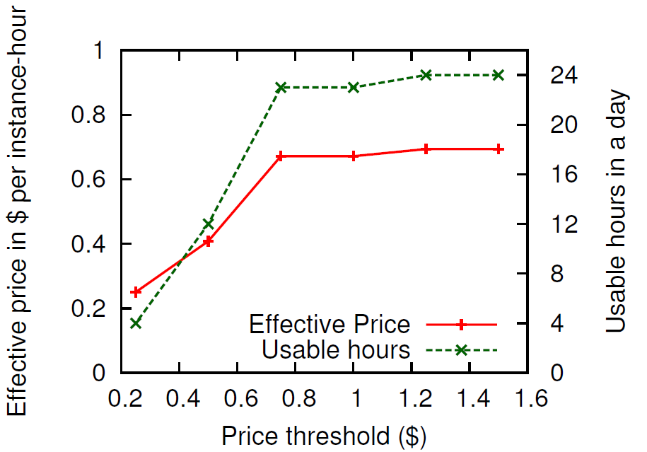
User Perspective: Price-sensitive Rescale in Spot Markets
Dynamic shrinking and expansion of HPC jobs can enable lower effective price in cloud spot markets
Notes:
Downloaded SLURM code and doing preliminary investigation. In SLURM, job launch can be done by SLURM (using srun), or by application (e.g. we can use charmrun). Job allocation, that is assignment of nodes to a job request, is separate from job launch. SLURM has a manager daemon and a slurmd daemon on each compute node. slurmd daemons are used by srun. We can decide if we want to use srun or not. I recommend we can stick with charmrun for now. For shrink/expand, we can add commands like sexpand, sshrink or srealloc analogous to existing SLURM commands (e.g. salloc). srealloc would: 1. Do the SLURM pre-processing that happens with salloc (e.g database update) 2. Communicate with the application using CCS 3. Wait (block?) for some time or expect a response from aplication 4. Dp SLURM post-processing e.g that happens when a job exits, here part of nodes are reusable in case of shrink. Besides this, we will need to add new scheduling algorithms, I think that can be added as a plugin. A link to SLURM quickstart: https://computing.llnl.gov/linux/slurm/quickstart.html

Slide 66
Lessons Learned
Evaluation and Mapping
Lightweight virtualization necessary to remove overheads
Application characterization for complex applications non-trivial, but economic benefits are substantial (e.g. multi-platforms)
HPC-aware clouds
Although counterintuitive, HPC users and cloud providers can achieve win-win by consolidating VMs using smart co-locations.
For win-win, cloud schedulers need knowledge of application characteristics e.g. cache, communication, HPC vs. non-HPC.
Cloud-aware HPC
Heterogeneity and multi-tenancy challenge for HPC
Dynamic environment in clouds necessitate adaptive HPC RTS
Tuning parallel application for cloud is non-trivial.
66

Slide 67
Conclusions and Contributions
HPC in current clouds is suitable for some applications not all and can be efficient using intelligent mapping of applications to platforms, HPC-aware cloud scheduling, and cloud-aware HPC execution.
HPC in the cloud for some applications not all
Application characteristics and scale, Performance-cost tradeoffs
Intelligent mapping of applications to platforms
Bridge the gap between HPC and cloud
Performance and utilization
HPC-aware cloud scheduling
Application-aware scheduling
Characterization and interference-aware consolidation
Cloud-aware HPC execution
Heterogeneity and Multi-tenancy aware load balancing
Malleable jobs
67
Notes:
Goal of increasing the utilization of underutilized resources through
The high-level question I wanted to answer in this talk is, can we build a large-scale update-intensive Internet service using and make it cheap, fast, manageable, available at the same time. And I think I answered the question affirmatively. The key insight I used to answer this question is the exploitation of A. S. For example, ….. By using application-specific requirements, we can achieve goals that are often contradicting, such as in cheapness and availability.
A system for cloud providers..
A system for HPC-cloud users..
Many ideas applicaton to exascale RTS..

Slide 68
Future Directions
Multi-platforms, mapping, and models
Application characterization
HPC-as-a-Service and multi-level cloud scheduling system
Supercomputer using a cloud model
HPC-aware clouds
Interaction between application and resource manager
Job interference categorization
Security for HPC in cloud
Cloud-aware HPC
Communication optimizations in HPC runtime
Adaptive communication-aware load balancing
68
Notes:
Goal of increasing the utilization of underutilized resources through
The high-level question I wanted to answer in this talk is, can we build a large-scale update-intensive Internet service using and make it cheap, fast, manageable, available at the same time. And I think I answered the question affirmatively. The key insight I used to answer this question is the exploitation of A. S. For example, ….. By using application-specific requirements, we can achieve goals that are often contradicting, such as in cheapness and availability.
A system for cloud providers..
A system for HPC-cloud users..
Many ideas applicaton to exascale RTS..

Slide 69
Impact
Effective HPC in cloud (Performance, cost)
Some techniques applicable beyond clouds
Charm++ production system
OpenStack scheduler
CloudSim
Industry participation (HP Lab’s award, internships, HP TechCon honorable mention)
2 patents

Slide 70
Thesis Related Publications
Journal Paper
A. Gupta et al., “Evaluating and Improving the Performance and Mapping of HPC in Cloud,” accepted in 1st round, under 2nd round at IEEE TCC Special issue invited paper.
Conference Papers
A. Gupta et al., “The Who, What, Why and How of High Performance Computing Applications in the Cloud,” Best paper at IEEE CloudCom 2013
A. Gupta, O. Sarood, L. Kale, and D. Milojicic, “Improving HPC Application Performance in Cloud through Dynamic Load Balancing,” accepted at IEEE/ACM CCGRID ’13
A. Gupta, L. Kale, D. Milojicic, P. Faraboschi, and S. Balle, “HPC-Aware VM Placement in Infrastructure Clouds ,” at IEEE Intl. Conf. on Cloud Engineering IC2E ’13
A. Gupta et al., “Exploring the Performance and Mapping of HPC Applications to Platforms in the cloud,” short paper in HPDC ’12. New York, NY, USA: ACM, 2012
A. Gupta et al., “Realizing the Potential of Malleable Parallel Jobs,” PPL Tech Report/ SubmissionReady for HiPC 2014
Workshop Papers
A. Gupta and D. Milojicic, “Evaluation of HPC Applications on Cloud,” in Open Cirrus Summit Best Student Paper, Atlanta, GA, Oct. 2011
A. Gupta, D. Milojicic, and L. Kale, “Optimizing VM Placement for HPC in Cloud,” in Workshop on Cloud Services, Federation and the 8th Open Cirrus Summit, San Jose, CA, 2012
A. Gupta and L. V. Kale, “Towards Efficient Mapping, Scheduling, and Execution of HPC Applications on Platforms in Cloud,” short paper and poster at 27th International Parallel and Distributed Processing Symposium(IPDPS) Ph.D Forum’13 Best PhD Forum award
O. Sarood, A. Gupta, and L. V. Kale, “Cloud Friendly Load Balancing for HPC Applications: Preliminary Work,” in 41st Intl. Conf. on Parallel Processing Workshops (ICPPW), 2012

Slide 71
Questions?

