Slide 1
Market Risk VaR: Model-Building Approach

Slide 2
The Model-Building Approach
The main alternative to historical simulation is to make assumptions about the probability distributions of the returns on the market variables
This is known as the model building approach (or sometimes the variance-covariance approach)

Slide 3
Example
You invest $300,000 in gold and a $500,000 in silver.
The daily volatilities of these two assets are 1.8% and 1.2% respectively
The coefficient of correlation between their returns is 0.6.
What is the 10-day 97.5% VaR for the portfolio?
By how much does diversification reduce the VaR?

Slide 4
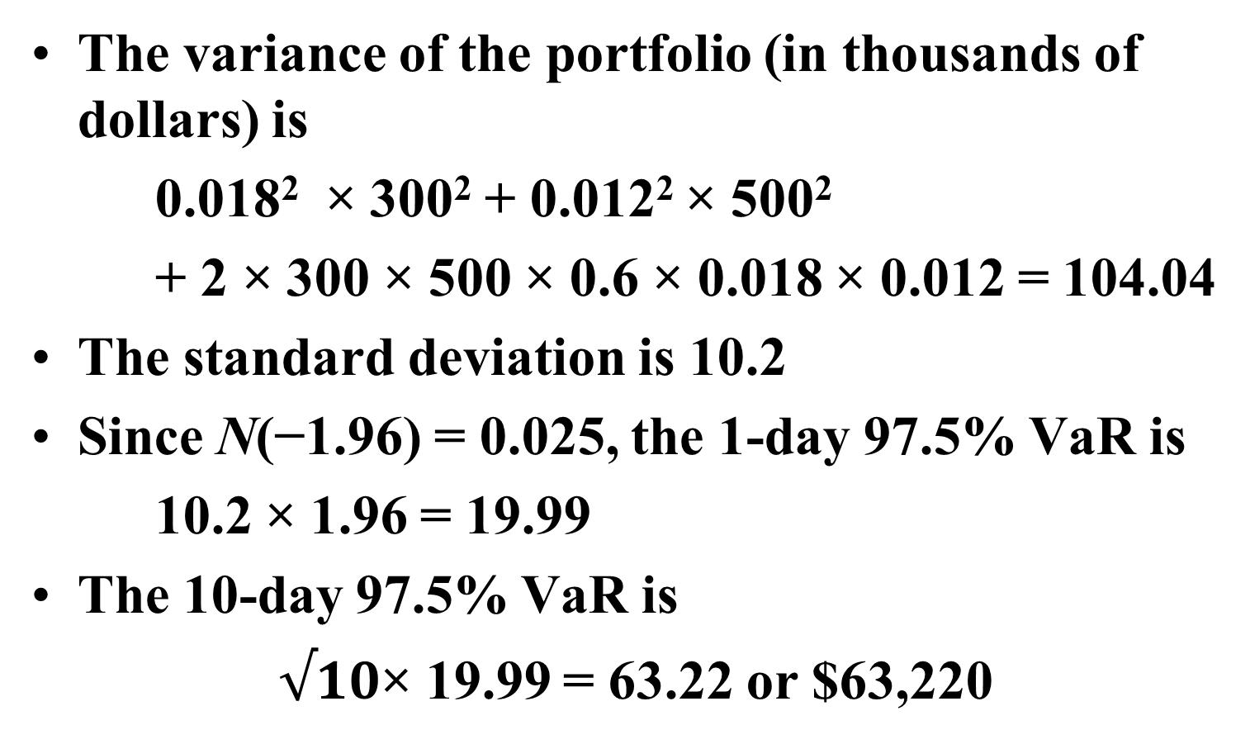
Example continued
The variance of the portfolio (in thousands of dollars) is
0.018² × 300² + 0.012² × 500²
+ 2 × 300 × 500 × 0.6 × 0.018 × 0.012 = 104.04
The standard deviation is 10.2
Since N(−1.96) = 0.025, the 1-day 97.5% VaR is
10.2 × 1.96 = 19.99
The 10-day 97.5% VaR is
$√10$× 19.99 = 63.22 or $63,220

Slide 5
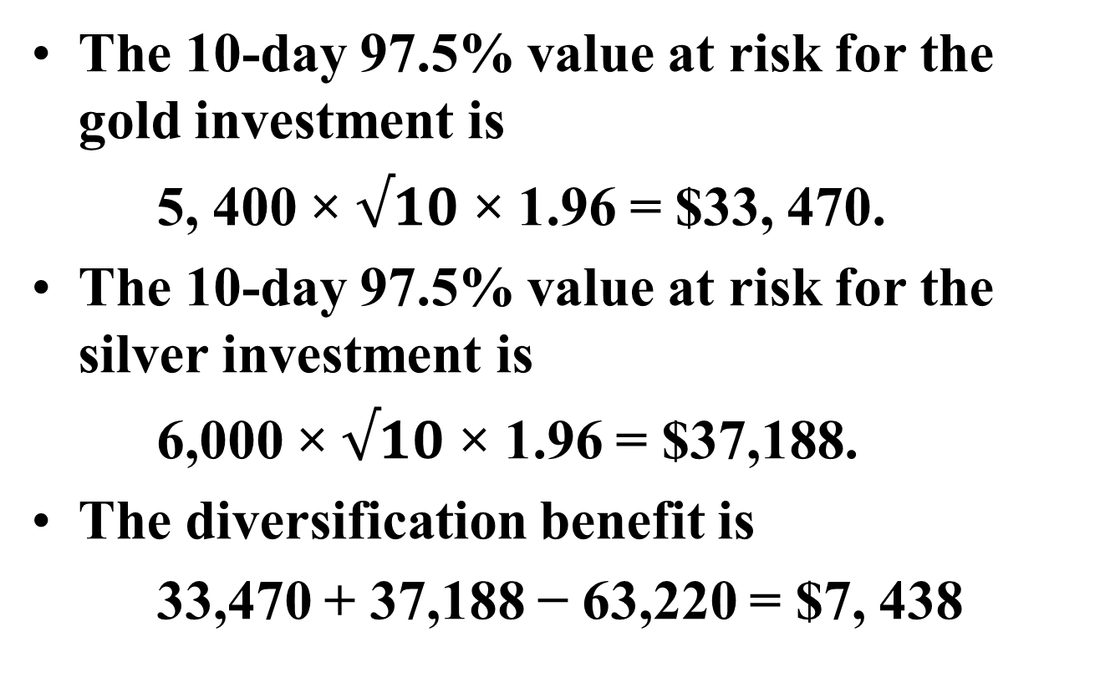
Example Continued
The 10-day 97.5% value at risk for the gold investment is
5, 400 × $√10$ × 1.96 = $33, 470.
The 10-day 97.5% value at risk for the silver investment is
6,000 × $√10$ × 1.96 = $37,188.
The diversification benefit is
33,470 + 37,188 − 63,220 = $7, 438

Slide 6
The Linear Model
We assume
The daily change in the value of a portfolio is linearly related to the daily returns from market variables
The returns from the market variables are normally distributed

Slide 7
Markowitz Result for Variance of Return on Portfolio

Slide 8
Corresponding Result for Variance of Portfolio Value
σ_{i} is the daily volatility of the ith asset (i.e., SD of daily returns)
σ_{P} is the SD of the change in the portfolio value per day
α_{i} =w_{i} P is amount invested in ith asset

Slide 9
Covariance Matrix (var_{i} = cov_{ii})

Slide 10
Alternative Expressions for σ_{P}²

Slide 11
VaR with Normally Distributed Market Factors
The general form for calculating parametric VaR is:
= Average expected return
σ = Standard deviation
T = Holding period
Z-Score=probability

Slide 12
But the Distribution of the Daily Return on an Option is not Normal
The linear model fails to capture skewness in the probability distribution of the portfolio value.

Slide 13
Option Position Risk Management
Option books bear huge amount of risk with substantial leverage in the position.
It is therefore crucial for option book runners to have an accurate and efficient risk management system and methodology.
If not properly implemented, financial institutions may face similar issues to distressed financial institutions like LTCM, Barings, AIG and many more.

Slide 14
“Greeks”
Option price = f(S, E, T, r, σ)
S= price of the underlying asset
E = exercise price
T= time to expiration
r= annualized risk free rate
σ= volatility of the return on the stock

Slide 15
“Greeks”
Delta: sensitivity of the option price or portfolio value
to a small change in the price of the underlying asset, S
Gamma: sensitivity of the delta to a small change in the price
of the underlying asset, S

Slide 16
“Greeks” continued
Rho: sensitivity of the option price change to a small change of r
Vega: sensitivity of the option price change to a small change of σ
Theta (time decay): sensitivity of the option price change to
the passage of time.

Slide 17
Black Scholes and “Greeks”
Black-Scholes Option Pricing Formula:
Calls: C= S₀ N(d₁) – Ee^{-rT} N(d₂)
Puts: P= Ee^{-rT} N(-d₂) – S₀ N(-d₁)
d₁=

Slide 18
Black Scholes Delta
Delta: The sensitivity of option price change to a small stock price change
Call: 0 ≤ N(d₁) ≤ 1
Put : -1 ≤ N(d₁) – 1 ≤ 0
Delta hedging:
– option + delta_stock× S;
This portfolio is called a Delta neutral portfolio.
Perfect delta hedging: If S changes, we need to rebalance the hedging position continuously.

Slide 19
Delta Hedging
Call price
Slope=Delta=0.6
100
S₀
S₀=$100 C=$10
Short 100 calls
Buy 100 × Delta = 60 shares
- ∆C = +∆S × Delta
if ∆S = +$1 (from $100 to $101)
The change of call price: $1 × 0.6 × 100 = $60
The change of stock position: $1 × 60 shares = $60

Slide 20
Dynamic hedging v.s. Static-hedging
As stock price keeps changing, the delta will change. Thus, we need to rebalance the portfolio in order to maintain the delta neutral condition.
S→ $110, Delta → 0.65.
We need to add extra 5 shares of stock into the portfolio. It’s called dynamic-hedging. If we just leave it alone, it’s called static-hedging
Problem of Delta-neutral hedging: If Delta is extremely sensitive to stock price changes, we need to rebalance the portfolio continuously.

Slide 21
Black Scholes Gamma
Gamma: Sensitivity of the delta change to a small change of S
Gamma
E
S₀

Slide 22
Gamma (cont.)
The delta of ATM options has the highest sensitivity to a stock price change.
For ATM options, as time passes away, the gamma increases dramatically, because ATM value is very sensitive to jumps in stock prices.
If γ_{Port} > 0, the value of the portfolio will increase as S moves (either up or down).
If γ_{Port} < 0, the value of the portfolio will decrease as S moves (either up or down).

Slide 23
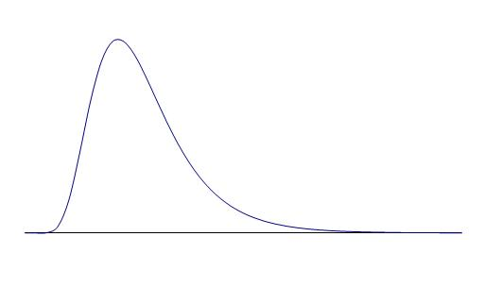
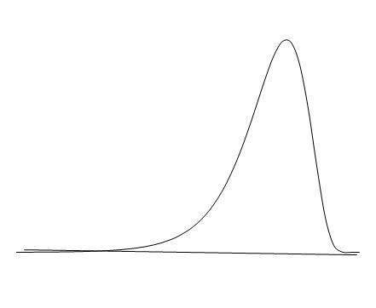
Skewness of the distribution of the return on the option
Positive Gamma
Negative Gamma

Slide 24
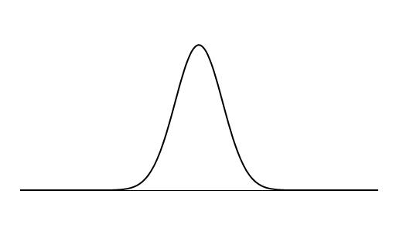
Translation of Asset Price Change to Price Change for Long Call
Long Call
Asset Price

Slide 25
Translation of Asset Price Change to Price Change for Short Call
Asset Price
Short Call

Slide 26
Delta-gamma-hedging
To make the delta-neutral portfolio into a Delta-gamma neutral portfolio, we need to:
Add certain amount of other options into the portfolio:
N_{G} × γ_{G} + γ = 0
(N_{G}= -γ/ γ_{G} is number of new options; γ_{G} is gamma of the new options)
2. Adjust number of stocks to make the new portfolio delta-neutral.

Slide 27
Delta-gamma-hedging: an Example
A Delta-neutral portfolio: shorts 100 Calls with a Delta of 0.6 and gamma of 1.5 longs 60 shares of stock
δ_{pf} = -0.6×100 + 1×60=0
γ_{pf} = -1.5 × 100 + 0 ×60 = -150
If we would like to use other call options with a delta of 0.5 and gamma of 2 to construct a delta-gamma-neutral portfolio:
N_{G}= -γ/ γ_{G}= - (-150)/2=75 Long 75 new options
γ_{pf} = -150 + 75×2= 0
Delta of the new portfolio: 75×0.5=37.5
Sell 37.5 shares of the stock.
The Delta-gamma-neutral portfolio:
Short 100 calls with Delta of 0.6 and gamma of 1.5
Long 75 calls with Delta of 0.5 and gamma of 2
Long 22.5 (60-37.5) shares of stock.

Slide 28
When Linear Model Can be Used
Portfolio of stocks
Portfolio of bonds
Forward contract on foreign currency
Interest-rate swap

Slide 29
The Linear Model and Options
Consider a portfolio of options dependent on a single stock price, S. Define the delta of the portfolio as
and the percentage change in price as:

Slide 30
Linear Model and Options continued
To an approximation
Similarly when there are many underlying market variables
where δ_{i} is the delta of the portfolio with respect to the change in price of the ith asset

Slide 31
Example-
Consider an investment in options on Microsoft and AT&T. Suppose the stock prices are 120 and 30 respectively and the deltas of the portfolio with respect to the two stock prices are 1,000 and 20,000 respectively
As an approximation
where Δx₁ and Δx₂ are the percentage changes in the two stock prices

Slide 32
Delta Gamma for a Long Call
The downside risk for the option is less than given by delta
approximation

Slide 33
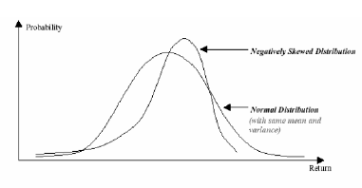
Skewness
Skewness refers to the asymmetry of a distribution:

Slide 34
Skewness continued
A distribution that is negatively skewed has a long tail on the left (negative) side of the distribution, indicating that the few outcomes that are below the mean are of greater magnitude than the larger number of outcomes about the mean.

Slide 35
Quadratic Model
The non-linearity of most derivative contracts is well approximated quadratically and such approximations aggregate over a portfolio.

Slide 36
Quadratic Model
For a portfolio dependent on a single stock price it is approximately true that
so that
Moments are

Slide 37
Quadratic Model continued
With many market variables and each instrument dependent on only one of the market variable
Δ_{pf} is a vector of individual asset’s deltas
Γ_{pf} is a variance covariance matrix

Slide 38
Quadratic Model continued
If Δx_{i}s come from a multivariate normal distribution:
Then the expression for variance of the portfolio simplifies to:
The VaR is given by:

Slide 39
Cornish Fisher Expansion
Cornish Fisher expansion can be used to calculate fractiles of the distribution of ΔP from the moments of the distribution

Slide 40
Cornish Fisher Expansion continued
Using the first three moments of ΔP, the Cornish-Fisher expansion estimates the α-quantile of the distribution of ΔP as:
Z_{α} is α-quantile of the standard normal distribution

Slide 41
Example
Consider a portfolio of options on a single asset. The delta of the portfolio is 12 and the gamma of the portfolio is –2.6. The value of the asset is $10, and the daily volatility of the asset is 2%. Derive a quadratic relationship between the change in the portfolio value and the percentage change in the underlying asset price in one day.
ΔP = 10 × 12Δx + 0.5 × 10² × (−2.6)(Δx)²

Slide 42
Example (cont.)
(a) Calculate the first three moments of the change in the portfolio value:
E[ΔP] =−130σ²=-0.052
E[ΔP²] =120² σ ²+3×130² σ ⁴ =5.768
E[ΔP³] =−9×120²×130σ⁴−15×130³σ⁶ =-2.698
where σ=0.02 is the standard deviation of Δx.

Slide 43
Example (cont.)
(b) Using the first two moments and assuming that the change in the portfolio is normally distributed, calculate the one-day 95% VaR for the portfolio:
the mean and standard deviation of ΔP are −0.052 and 2.402, respectively.
The 5 percentile point of the distribution is −0.052−2.402×1.65 = −4.02
The 1-day 95% VaR is therefore $4.02.

Slide 44
Example (cont.)
(c) Use the third moment and the Cornish–Fisher expansion to revise your answer to (b):
The skewness of the distribution is
Set q=0.05
The 5 percentile point is:
−0.052 − 2.402 × 1.687 = −4.10
The 1-day 95% VaR is therefore 4.10

Slide 45
Delta Gamma Monte Carlo -- Partial Simulation
Also known as the partial simulation method:
Create random simulation for risk factors
Then uses Taylor expansion (delta gamma) to create simulated movements in option value

Slide 46
Monte Carlo Simulation
To calculate VaR using MC simulation we
Value portfolio today
Sample once from the multivariate distributions of the Δx_{i}
Use the Δx_{i} to determine market variables at end of one day
Revalue the portfolio at the end of day

Slide 47
Monte Carlo Simulation continued
Calculate ΔP
Repeat many times to build up a probability distribution for ΔP
VaR is the appropriate fractile of the distribution times square root of N
For example, with 1,000 trial the 1 percentile is the 10th worst case.

Slide 48
Alternative to Normal Distribution Assumption in Monte Carlo
In a Monte Carlo simulation we can assume non-normal distributions for the x_{i} (e.g., a multivariate t-distribution)
Can also use a Gaussian or other copula model in conjunction with empirical distributions

Slide 49
Speeding up Calculations with the Partial Simulation Approach
Use the approximate delta/gamma relationship between ΔP and the Δx_{i} to calculate the change in value of the portfolio
This can also be used to speed up the historical simulation approach

Slide 50
Model Building vs Historical Simulation
Model building approach can be used for investment portfolios where there are no derivatives, but it does not usually work when for portfolios where
There are derivatives
Positions are close to delta neutral

Slide 51
Note on the "Root Squared Time" Rule
Normally daily VAR can be adjusted to other period by scaling by a square root of time factor
However, this adjustment assumes:
Position is constant during the full period of time
daily returns are independent and identically distributed
Hence, the time adjustment is not valid for options positions (that can be replicated by dynamically changing positions in underlying)
For portfolios with large options components, the full valuation must be implemented over the desired horizon ...

Slide 52
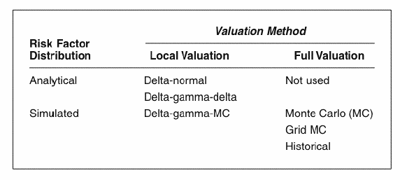
Comparison of Methods
For lager portfolios where optionality is not dominant, the delta normal method provides a fast and efficient method for measuring VaR
For portfolios exposed to few sources of risk and with substantial option components, the Greeks (delta-gamma) provides increase precision at low computational cost
For portfolios with substantial option components or longer horizons, a full valuation method may be required

Slide 53
Example: Leeson's Straddle
The Barings’ story provides a good illustration of these various methods. In addition to the long futures positions, Leeson also sold options:
35,000 calls and puts each on Nikkei futures
This position is known as a short straddle
Short straddle is about delta-neutral because the positive delta from the call is offset by a negative delta from the put, assuming that most of the options are at the money (ATM)

Slide 54
Example: Leeson's Straddle continued
With a multiplier of 500 yen for the options contract and 100-yen/$ exchange rate, the dollar exposure of the call options to the Nikkei was:
δ×$0.175 million
Initially, the market value of the position was zero
The position was designed to turn in a profit if the Nikkei remained stable.
Unfortunately it also had an unlimited potential for large losses.

Slide 55
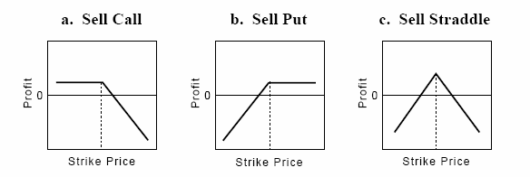
Sell Straddle Payoff
Sell Straddle = sell call + sell put
Strike = at the money
Successful, only if the spot remains stable
Delta = 0

Slide 56
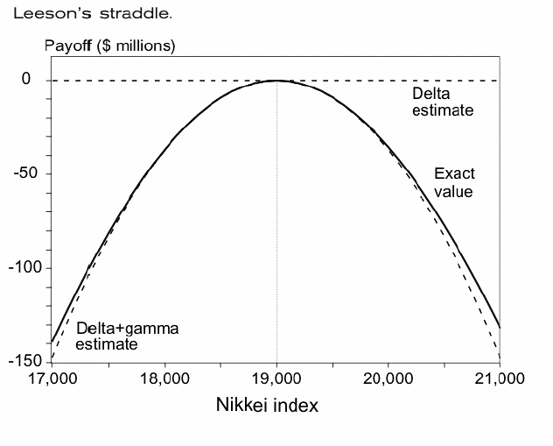
Example: Leeson's Straddle continued

Slide 57
Example: Leeson's Straddle continued
The figure on the previous slide displays the payoffs from the straddle, using a Black-Scholes model:
Annual volatility –20%
Time to maturity – 3 months
Current value of the underlying (Nikkei index)– 19,000
ATM options
At the current index value, the delta VaR for this position is close to zero
Reporting a zero delta-normal VaR is highly misleading

Slide 58
Example: Leeson's Straddle continued
Any move up of down has the potential to create a large loss:
A drop in the index to 17,000 would lead to an immediate loss of about $150 million
The graph shows that the delta-gamma approximation provides increased accuracy.

Slide 59
Example: Leeson's Straddle continued
Run a full Monte Carlo simulation with 10,000 replications to construct the distribution of the portfolio payoffs.
This distribution is obtained from a re-evaluation of the portfolio after a month over a range of values for the Nikkei.
Each replication uses full valuation with a remaining maturity of 2 months.

Slide 60
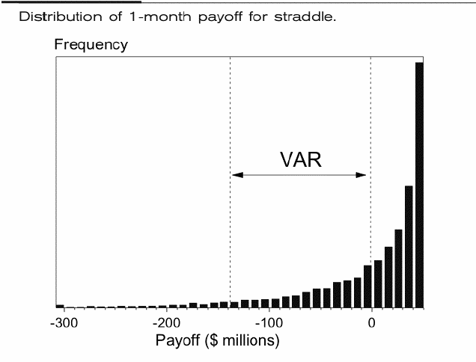
Example: Leeson's Straddle
The distribution is highly skewed to the left
Its mean is -$1million
Its 95th percentile is -$138 million
Hence, the 1-month 95 percent VaR is $138 million
VaR analysis would have prevented bankruptcy if positions were known

Slide 61
Example: Leeson's Straddle continued
Now consider the delta-gamma approximation
The total gamma of the position is the exposure times the sum of gamma for a call and put:
$0.175 million×0.000422=$0.0000739 million
Over a 1-month horizon, the standard deviation of the Nikkei is:

Slide 62
Example: Leeson's Straddle continued
Ignoring the time drift, the VaR is
This is substantially better than the delta-normal VaR of zero, which could have fooled us into believing the position was riskless.

Slide 63
Example: Leeson's Straddle continued
Using the Cornish-Fisher expansion and a skewness coefficient of -2.83, we obtain a correction factor
The refined VaR measure is then given by:
This is much closer to the true value of $138 million.

Slide 64
Example: Leeson's Straddle continued
Finally, consider the delta-gamma-Monte Carlo approach.
Use simulations for the value P of the underlying asset – Nikkei index
Use delta-gamma model to calculate σ(ΔP).
VaR is $128 million – not too far from the true value of $138 million

Slide 65
Example: Leeson's Straddle continued
The variety of methods shows that the straddle had substantial downside risk.
Indeed the options position contributed to Barings’ fall.
In the beginning of January 1995, the historical volatility on the Japanese market was very low, around 10%.
The Nikkei was around 19,000.
The options position would have been profitable if the market had been stable.
Kobe earthquake struck on January 17th, 1995.

Slide 66
Example: Leeson's Straddle continued
Nikkei dropped to 18,000.
Options became more expensive as the market volatility increased.
The straddle position lost money.
As losses ballooned, Leeson increased his exposure in a desperate attempt to recoup the losses.
On February 27th, 1995, the Nikkei dropped further to 17,000.
Unable to meet the mounting margin calls, Barings went bust.

Slide 67
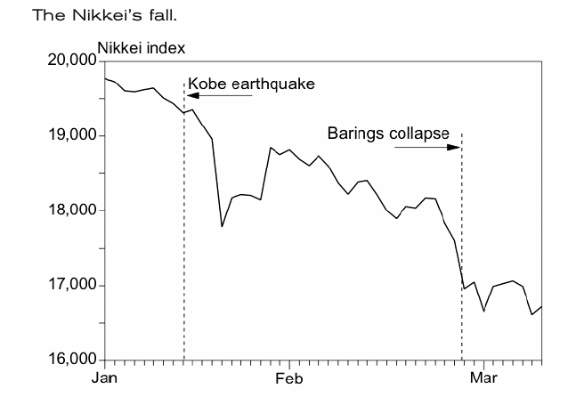
Example: Leeson's Straddle continued

