Slide 1
Getting Ready for
Exascale Science
Rick Stevens
Argonne National Laboratory
University of Chicago

Slide 2
Outline
What we are doing at ANL
  BG/P and DOE’s Incite Program for allocating resources
Potential paths to Exascale Systems
  How feasible are Exascale Systems?
  What will they look like?
Issues with heirloom and legacy codes
  How large is the body of code that is important?
  What are strategies for addressing migration?
Driving the development of next generation systems with E3 applications
  We will need to sustain large-scale investments to make Exascale systems possible, how do we build the case?

Slide 3
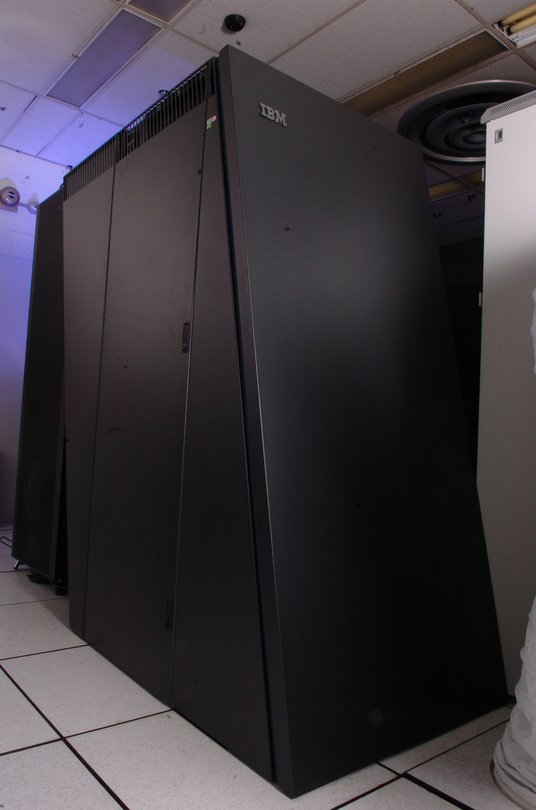
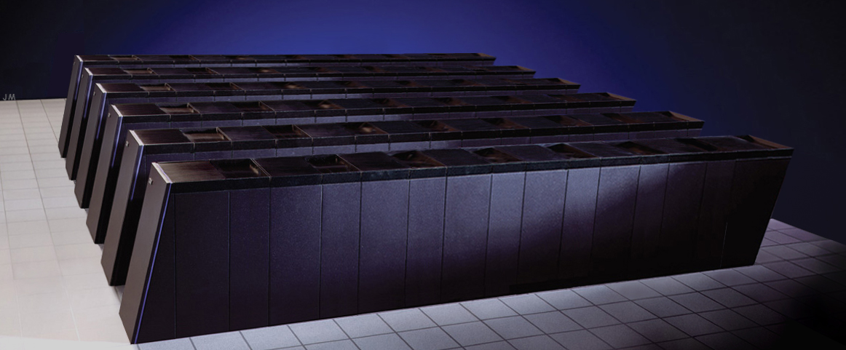
Argonne Leadership Computing Facility
Established 2006. Dedicated to breakthrough science and engineering.
Computers
  BGL: 1024 nodes, 2048 cores,
  5.7 TF speed, 512GB memory
  Supports development + INCITE
2008 INCITE
  111 TF Blue Gene/P system
  Fast PB file system
  Many PB tape archive
2009 INCITE production
  445 TF Blue Gene/P upgrade
  8PB next generation file system
  557TF merged system
BG/Q R&D proceeding
  Frequent design discussions
  Simulations of applications
In 2004 DOE selected the ORNL, ANL and PNNL team based on a competitive peer review
  ORNL to deploy a series of Cray X-series systems
  ANL to deploy a series of IBM Blue Gene systems
  PNNL to contribute software technology
Blue Gene/L at Argonne
Blue Gene/P Engineering Rendition

Slide 4
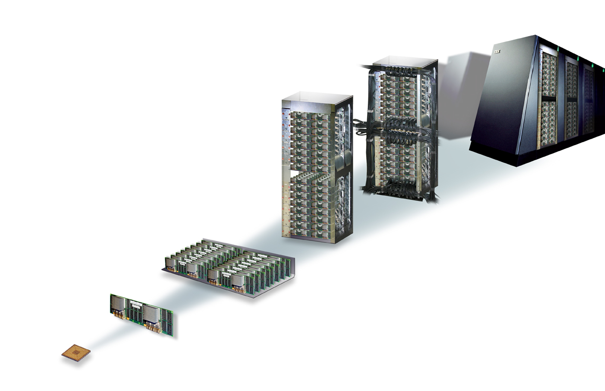
Blue Gene/P is an Evolution of BG/L
System
72 Racks
Rack
Cabled 8x8x16
Processors + memory + network interfaces are all on the same chip.
Faster Quad core processors with larger memory
5 flavors of network, with faster signaling, lower latency
32 Node Cards
Node Card
1 PF/s
144 TB
(32 chips 4x4x2)
32 compute, 0-4 IO cards
14 TF/s
2 TB
Compute Card
High packaging density
High reliability
Low system power requirements
XL compilers, ESSL, GPFS, LoadLeveler, HPC Toolkit
MPI, MPI2, OpenMP, Global Arrays
1 chip, 1x1x1
435 GF/s
64 GB
Chip
4 processors
13.9 GF/s
2 GB DDR
13.6 GF/s
8 MB EDRAM
IBM Confidential
Blue Gene community knowledge base is preserved

Slide 5
Some Good Features of Blue Gene
Multiple links may be used concurrently
  Bandwidth nearly 5x simple “pingpong” measurements
Special network for collective operations such as Allreduce
  Vital (as we will see) for scaling to large numbers of processors
Low “dimensionless” message latency
Low relative latency to memory
  Good for unstructured calculations
BG/P improves
  Communication/Computation overlap (DMA on torus)
  MPI-I/O performance
Smaller is Better
 | s/f | r/f | s/r | Reduce | Reduce for 1PF
BG/P | 2110 | 9 | 233 | 12us | 12us
BG/P (one link) | 2110 | 42 | 50 | 12us | 12us
XT3 | 7920 | 10 | 760 | 2slog p | 176us
Generic Cluster | 13500 | 34 | 397 | 2slog p | 316us
Power5 SP | 3200 | 6 | 529 | 2slog p | 41us
Notes:
Graph shows measured performance for halo exchange when implemented carefully (4x pingpong performance)
Reduce for 1 PF system based on 40000 MPI processes (40000 processors)
In table, small is always better

Slide 6
Communication Needs of the “Seven Dwarves”
These seven algorithms taken from “Defining Software Requirements for Scientific Computing”, Phillip Colella, 2004
Tree/Combine
Torus
  Molecular dynamics (mat)
  Electronic structure
  Reactor analysis/CFD
  Fuel design (mat)
  Reprocessing (chm)
  Repository optimizations
  Molecular dynamics (bio)
  Genome analysis
  QMC
  QCD
  Astrophysics
Algorithm
Scatter/Gather
Reduce/Scan
Send/Recv
Structured Grids
3, 5, 6, 11
Optional
X_{LB}
X
Unstructured Grids
3, 4, 5, 6, 11
X_{LB}
X
FFT
1, 2, 3, 4, 7, 9
Optional
X
Dense Linear Algebra
2, 3, 5
Not Limiting
Not Limiting
X
Sparse Linear Algebra
2, 3, 5, 6, 8, 11
X
X
Blue Gene
Advantage
Particles N-Body
1, 7, 11
Optional
X
X
Monte Carlo
4, 9
*
X
Legend: Optional – Algorithm can exploit to achieve better scalability and performance. Not Limiting – algorithm performance insensitive to performance of this kind of communication. X – algorithm performance is sensitive to this kind of communication. X_{LB} – For grid algorithms, operations may be used for load balancing and convergence testing
Notes:
These seven algorithms taken from “Defining Software Requirements for Scientific Computing”, Phillip Colella, 2004

Slide 7
Argonne Petascale System Architecture
Service Node
Cluster
Front End
Nodes
Infra. Support
Nodes
10
8
4
176 File Servers / Data Movers
176
44 Couplets SAN Storage
8
1 PF BG/P
10 Gb/s Switch Complex
352
16 PB disk
264 GB/sec
72 racks
72K nodes
288TB RAM
576 I/O nodes
66
66 Analytics Servers
576
1024 ports
Tape Libraries
3
6+1 Tape Servers
48
8 libraries *
48 drives
150 PB
7
10Gb/s Enet
1Gb/s Enet
Firewall
4xDDR IB
4Gb/s FC
ESnet, UltraScienceNet,
Internet2
* Tape capacity grows over lifetime of system
In the BG/P generation like BG/L the I/O Architecture is not tightly
coupled to the compute fabric!

Slide 8

DOE INCITE Program
Innovative and Novel Computational Impact on Theory and Experiment
U.S. Department of Energy
Since
2004
Office of Science
Solicits large computationally intensive research projects
  To enable high-impact scientific advances
Open to all scientific researchers and organizations
  Scientific Discipline Peer Review
  Computational Readiness Review
Provides large computer time & data storage allocations
  To a small number of projects for 1-3 years
  Academic, Federal Lab and Industry, with DOE or other support
Primary vehicle for selecting Leadership Science Projects for the Leadership Computing Facilities

Slide 9
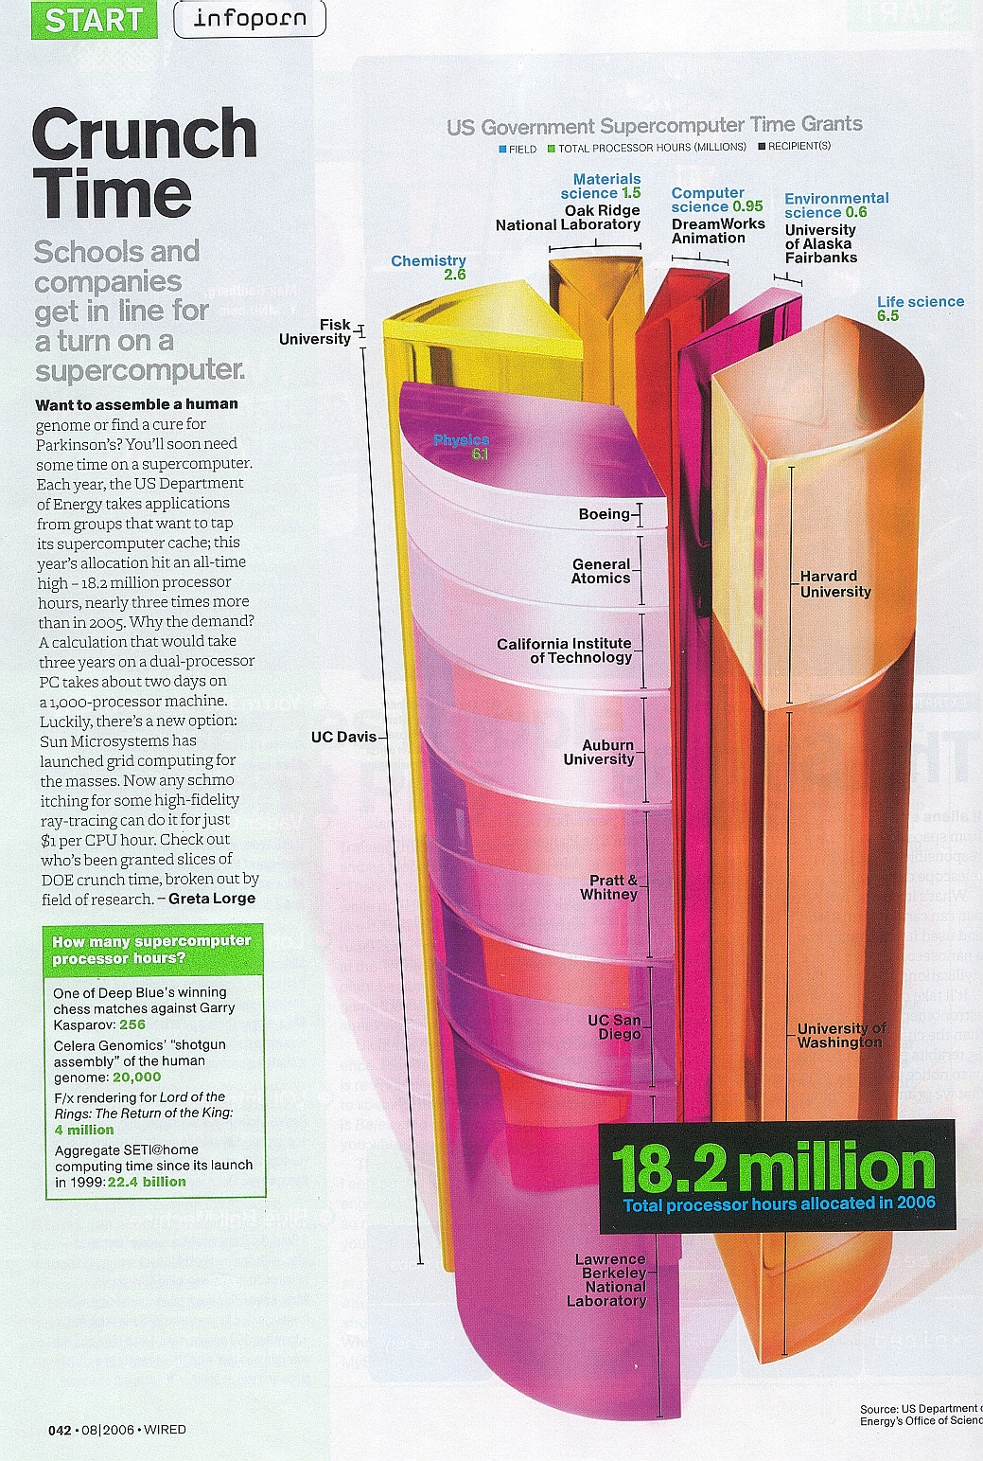
INCITE Awards in 2006
WIRED August, 2006

Slide 10
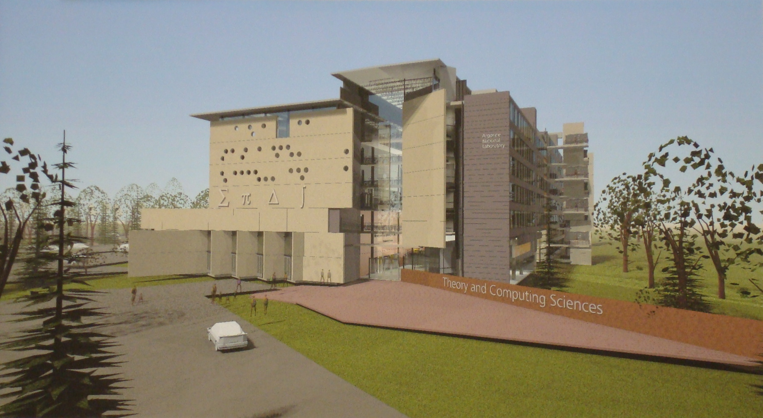
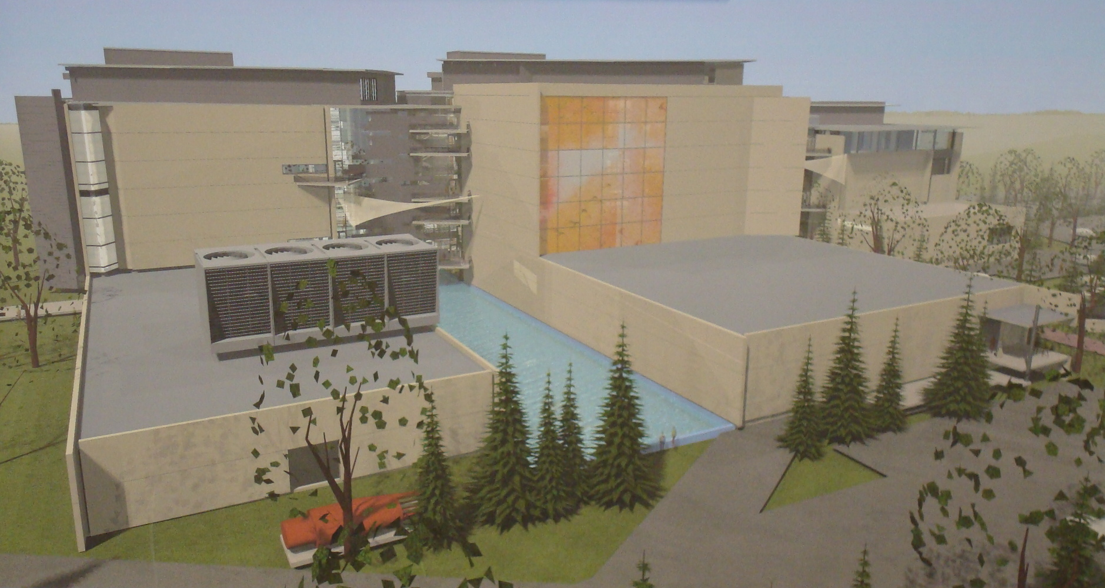
Theory and Computational Sciences Building
A superb work and collaboration environment for computer and computational sciences
  3rd party design/build project
  2009 beneficial occupancy
  200,000 sq.ft., 600+ staff
  Open conference center
  Research Labs
  Argonne’s library
Supercomputer Support Facility
  Designed to support leadership systems (shape, power, weight, cooling, access, upgrades, etc.)
  20,000 sq.ft. initial space
  Expandable to 40,000+ sq.ft.
TCS Conceptual Design

Slide 11
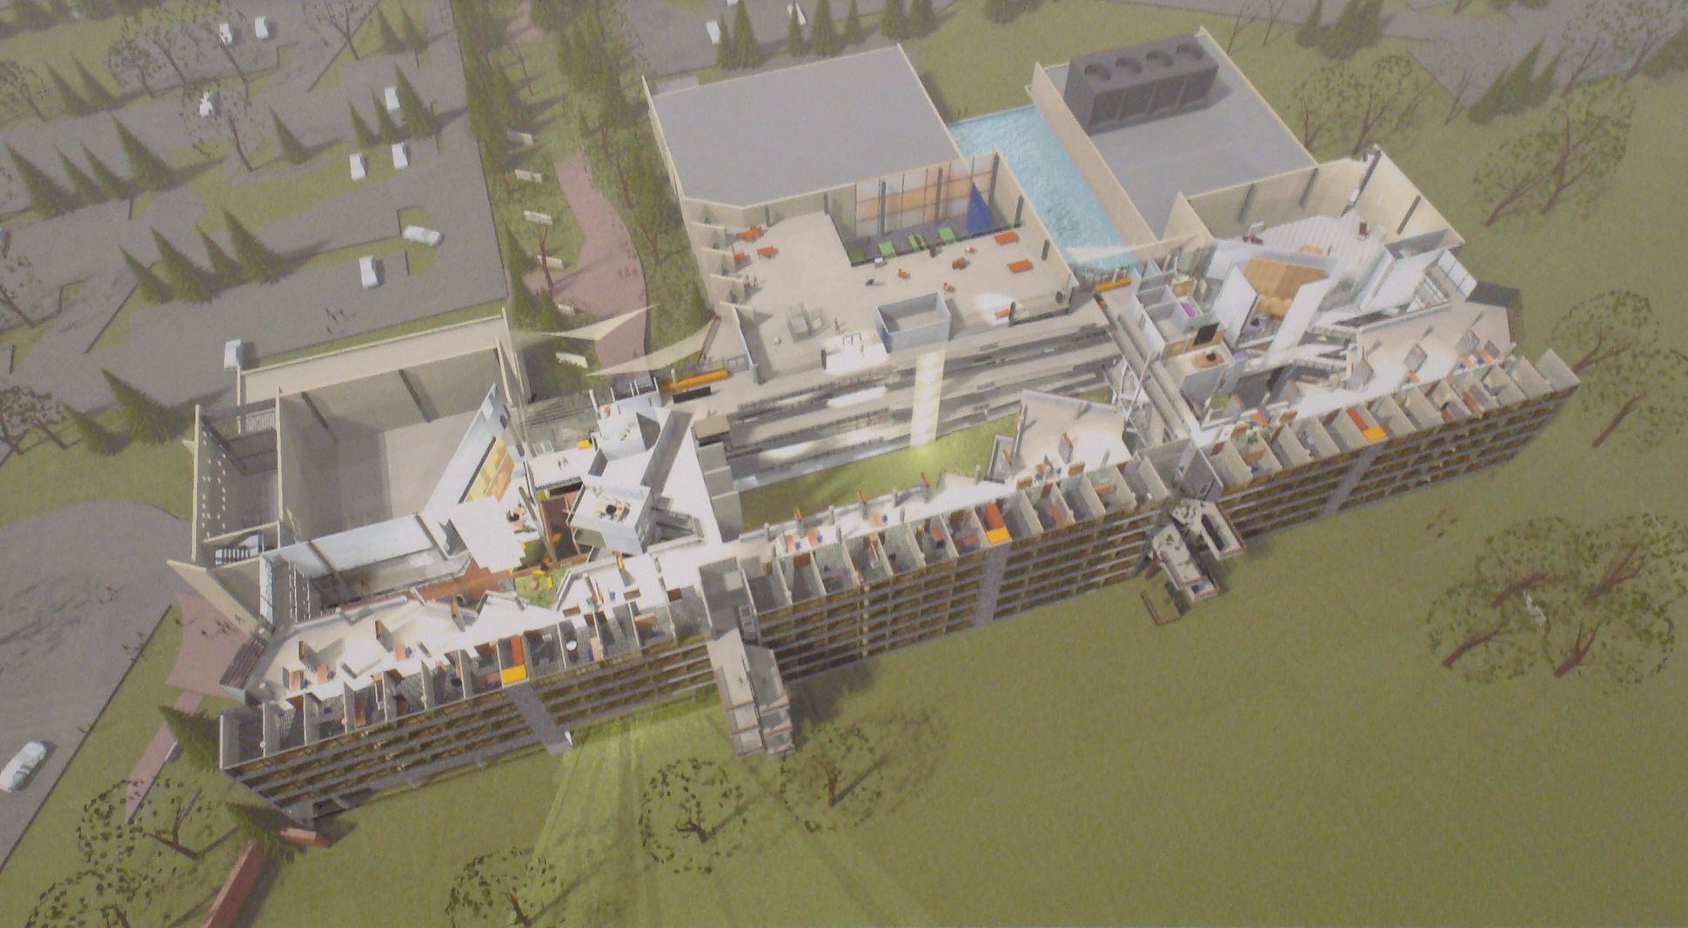
Argonne Theory and Computing Sciences Building
A 200,000 sq ft creative space to do science, Coming Summer 2009

Slide 12
Supercomputing & Cloud Computing
Two macro architectures dominate large-scale (intentional) computing infrastructures (vs embedded & ad hoc)
Supercomputing type Structures
  Large-scale integrated coherent systems
  Managed for high utilization and efficiency
Emerging cloud type Structures
  Large-scale loosely coupled, lightly integrated
  Managed for availability, throughput, reliability

Slide 13
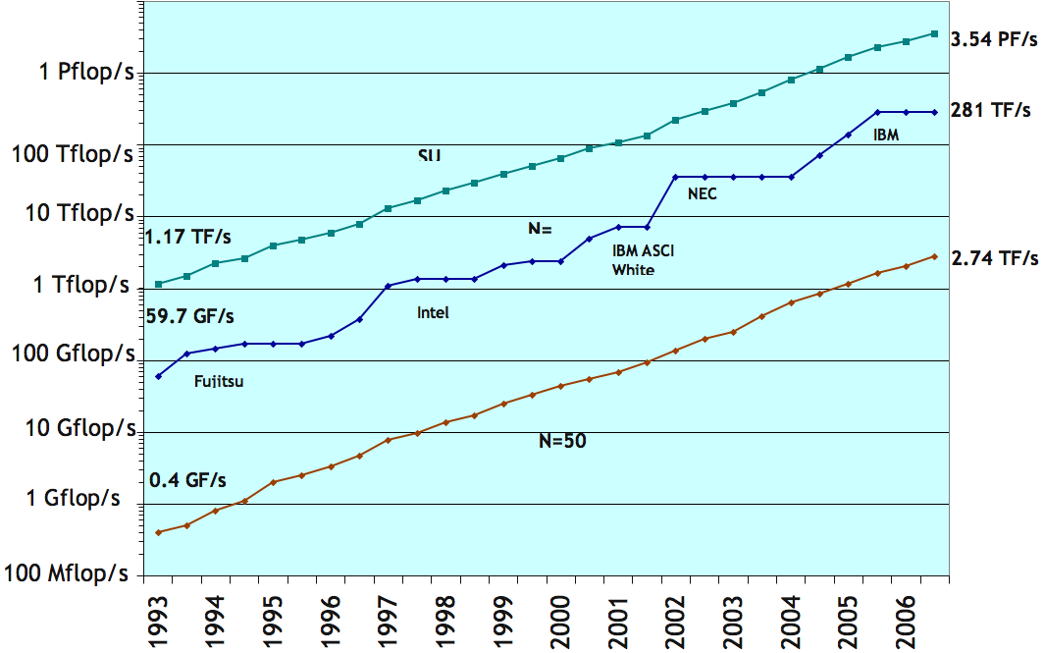
Top 500 Trends
Notes:
13

Slide 14
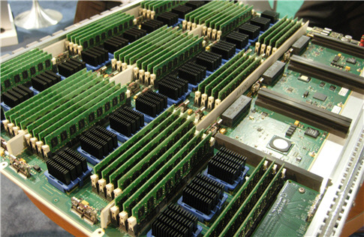
SiCortex Node Board

Slide 15
SiCortex Node Board
Low Power ➔ 600 mw core
72 cores in Deskside for $15K
All open source
Linux Everywhere

Slide 16

The NVIDIA Challenge and Opportunity

Slide 17
The NVIDIA Challenge and Opportunity
Potentially Easy Access to Teraflops
Simple Programming Model
Requires Large Thread Counts
Proprietary Software Environment

Slide 18
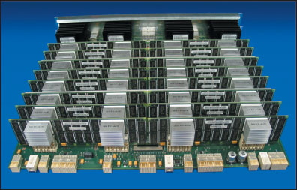
Blue Gene L Node Cards
Notes:
node_card.jpg, 178%

Slide 19
Blue Gene Node Cards
Fine Grain and Low Power
Existing Programming Model
Extremely Scalable
Mostly Open Software Environment
Notes:
node_card.jpg, 178%

Slide 20
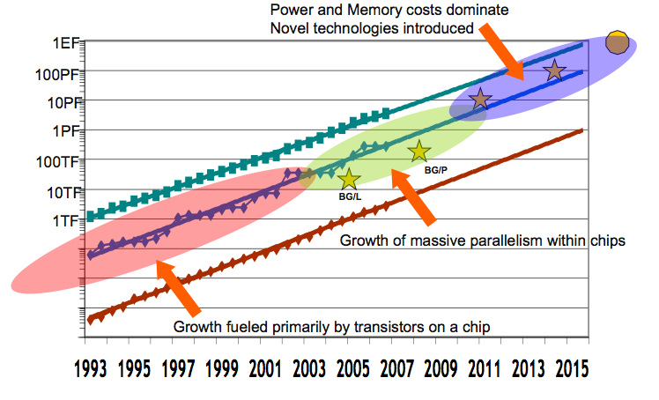
Looking to Exascale

Slide 21
A Three Step Path to Exascale

Slide 22
E3 Advanced Architectures - Findings
Exascale systems are likely feasible by 2017±2
10-100 Million processing elements (mini-cores) with chips as dense as 1,000 cores per socket, clock rates will grow slowly
3D chip packaging likely
Large-scale optics based interconnects
10-100 PB of aggregate memory
> 10,000’s of I/O channels to 10-100 Exabytes of secondary storage, disk bandwidth to storage ratios not optimal for HPC use
Hardware and software based fault management
Simulation and multiple point designs will be required to advance our understanding of the design space
Achievable performance per watt will likely be the primary metric of progress

Slide 23
E3 Advanced Architectures - Challenges
Performance per watt -- goal 100 GF/watt of sustained performance ⇒ 10 MW Exascale system
  Leakage current dominates power consumption
  Active power switching will help manage standby power
Large-scale integration -- need to package 10M-100M cores, memory and interconnect < 10,000 sq ft
  3D packaging likely, goal of small part classes/counts
Heterogenous or Homogenous cores?
  Mini cores or leverage from mass market systems
Reliability -- needs to increase by 10³ in faults per PF to achieve MTBF of 1 week
  Integrated HW/SW management of faults
Integrated programming models (PGAS?)
  Provide a usable programming model for hosting existing and future codes

Slide 24
Top Pinch Points
Power Consumption
  Proc/mem, I/O, optical, memory, delivery
Chip-to-Chip Interface Scaling (pin/wire count)
Package-to-Package Interfaces (optics)
Fault Tolerance (FIT rates and Fault Management)
  Reliability of irregular logic, design practice
Cost Pressure in Optics and Memory

Slide 25
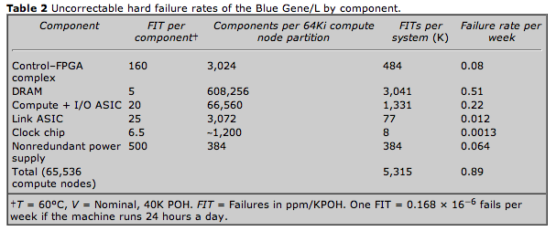
Failure Rates and Reliability of Large Systems
Theory
Experiment

Slide 26
Programming Models:
Twenty Years and Counting
In large-scale scientific computing today essentially all codes are message passing based (CSP and SPMD)
Multicore is challenging the sequential part of CSP but there has not emerged a dominate model to augment message passing
Need to identify new programming models that will be stable over long term

Slide 27
Quasi Mainstream
Programming Models
C, Fortran, C++ and MPI, CHARM++
OpenMP, pthreads
CUDA, RapidMind
Clearspeeds Cn
PGAS (UPC, CAF, Titanium)
HPCS Languages (Chapel, Fortress, X10)
HPC Research Languages and Runtime
HLL (Parallel Matlab, Grid Mathematica, etc.)

Slide 28
Little’s Law of High Performance Computing
Assume:
Single processor-memory system.
Computation deals with data in local main memory.
Pipeline between main memory and processor is fully utilized.
Then by Little’s Law, the number of words in transit between CPU and memory (i.e. length of vector pipe, size of cache lines, etc.)
= memory latency x bandwidth.
This observation generalizes to multiprocessor systems:
concurrency = latency x bandwidth,
where “concurrency” is aggregate system concurrency, and “bandwidth” is aggregate system memory bandwidth.
This form of Little’s Law was first noted by Burton Smith of Tera.
This slide stolen from David Bailey

Slide 29
Million Way Concurrency Today
Little’s law driven need for concurrency
  To cover latency in memory path
  Function of aggregate memory bandwidth and clock speed
  Independent of technology and architecture to first order
Mainstream CPUs (e.g. x86, PPC, SPARC)
  8-16 cores, 4-8 hardware threads per core,
  Total system with 10³ – 10⁵ nodes => 32K – 12M threads
  BG/P example at 1 PF 72 x 4K = 300,000 (but each thread has to do 4 ops/clock) => 1.2M ops per clock
GPU based cluster (e.g. 1000 Tesla 1 U nodes)
  3 x 128 cores x (32-96) threads per core x 1000 nodes = 12M – 36M threads

Slide 30
Lessons Learned from
Terascale to Petascale
The early adopters almost always self identify
Approximately 1/3 of the petascale codes didn’t exist 10 years ago
Most of them did exist but required considerable investment, new implementation and tuning
The simplest path forward (pure MPI) was the path of least resistance for most code groups
The challenges moving forward are likely to be slightly different

Slide 31
Existing Body of Parallel Software
How many existing HPC science and engineering codes scale beyond 1000 processors?
  My estimate is that it is less than 1000 world wide
  Top users at NERSC, OLCF and ALCF < 200 groups
  It appears likely that the bulk of cycles on Top500 are used in capacity mode with the exception of a sites with policies that enforce capability runs
How quickly are new codes being generated?
  Ab initio development
  Migration and porting from previous generations
There are different choices faced by large-established projects and personal explorations of new technologies

Slide 32
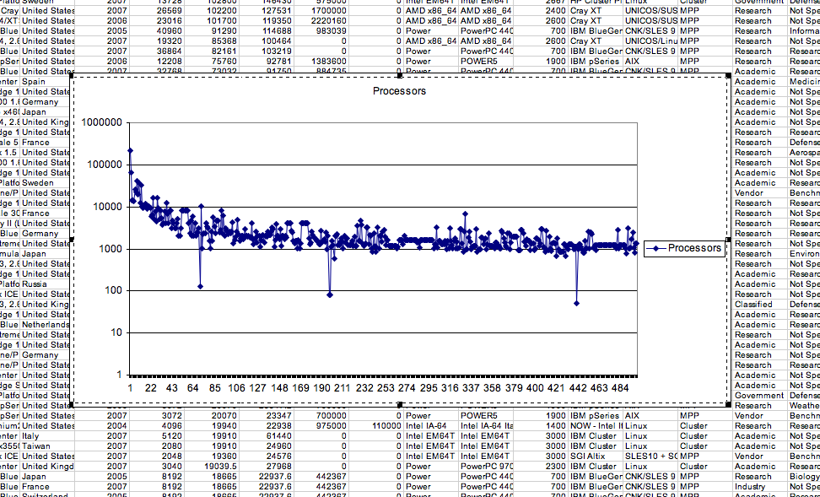
Number of Processors In the Top500

Slide 33
NERSC 2007 Rank Abundance

Slide 34
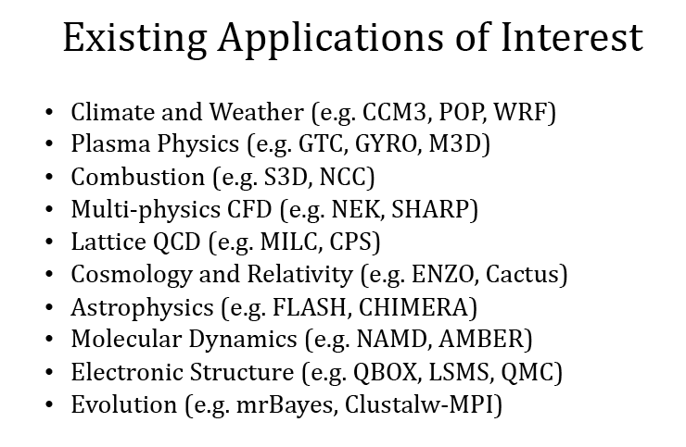
Driver Applications:
Basic Science and Emerging

Slide 35
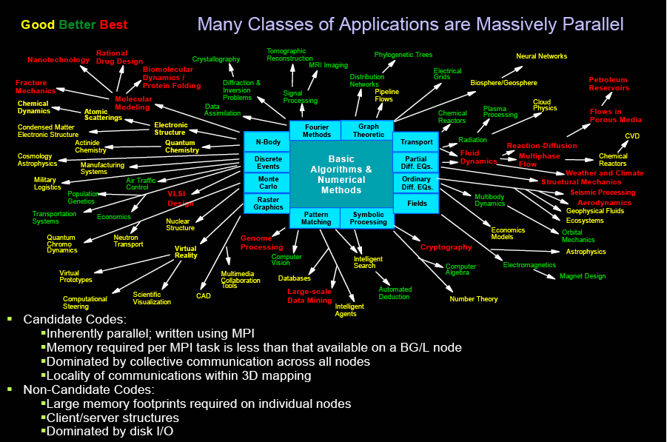

Slide 36
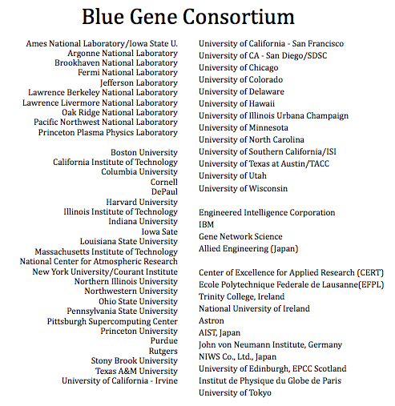
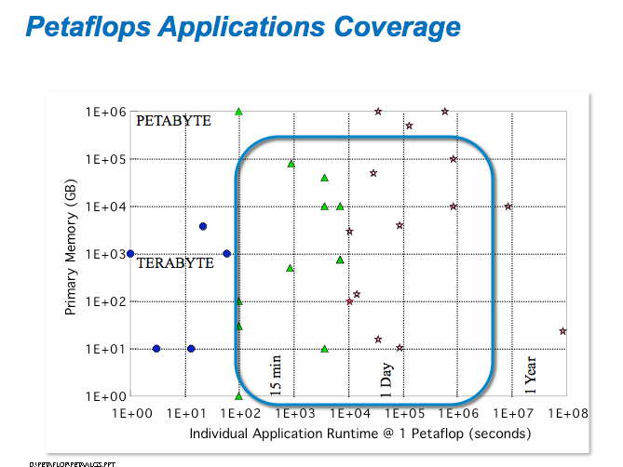
How Quickly Can A New Architecture Be Adopted?
Applied Mathematics and Computer Science are Essential to Advancing Science
Programming models are needed for million way concurrency and beyond
New classes of algorithms are needed that have better scaling properties
Systems software is needed to make systems stable and usable
New concepts are needed that enable whole new communities to access leadership class computing
Example Applications Ported to BG/L and BG/P
How fast can a community adopt a new machine architecture ?

Slide 37
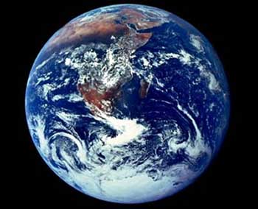
Humanity’s Top Ten Problems for next 50 years
ENERGY
WATER
FOOD
ENVIRONMENT
POVERTY
TERRORISM & WAR
DISEASE
EDUCATION
DEMOCRACY
POPULATION
2007 7 Billion People
2050 8-10 Billion People
Richard Smalley’s Top Ten List

Slide 38
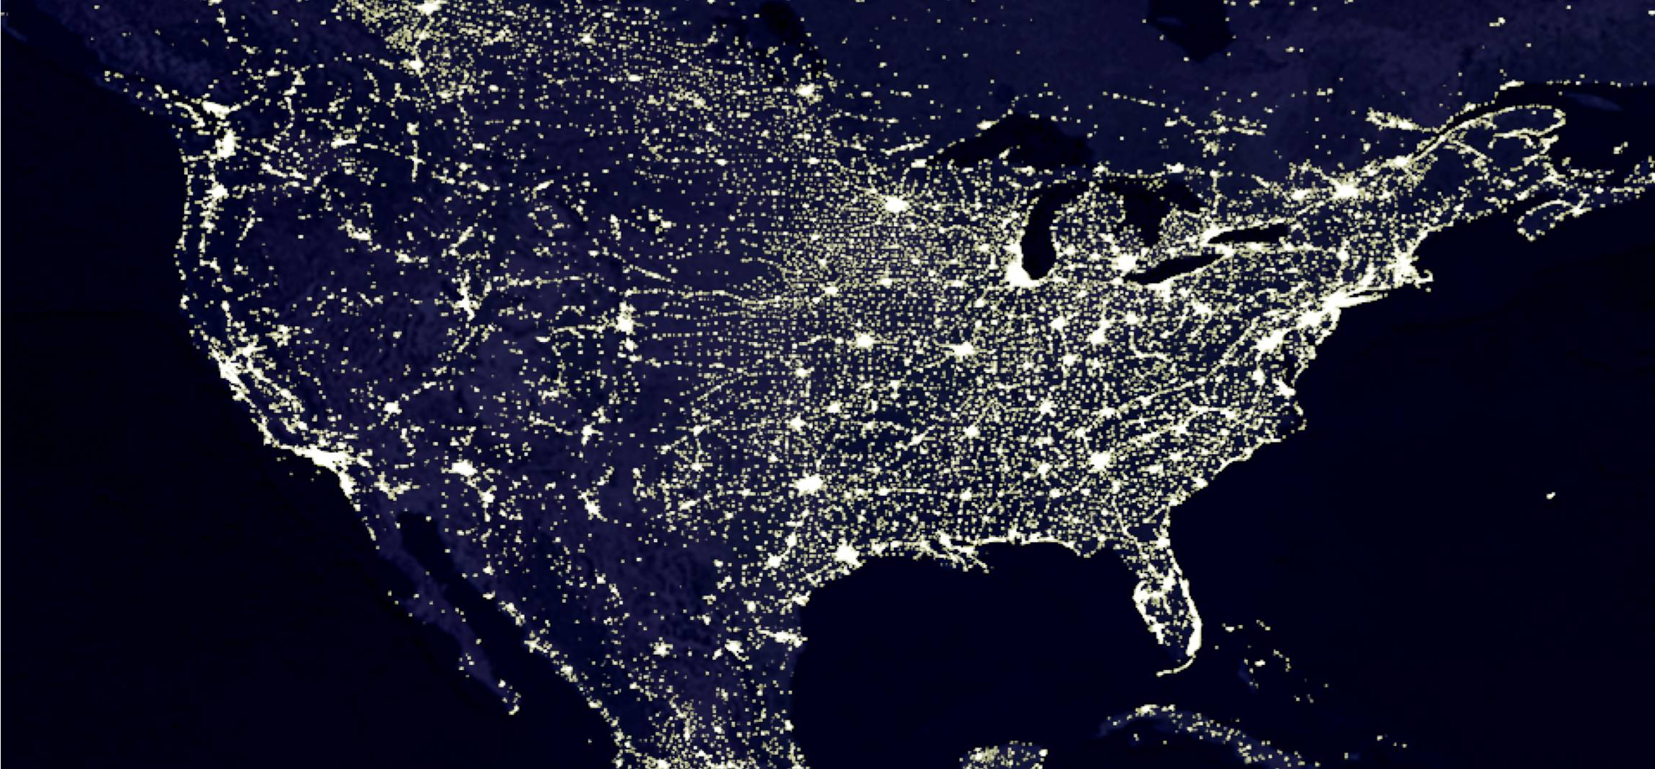
The Grid - the Triumph of 20th Century Engineering
clean versatile power everywhere, at the flick of a switch

Slide 39
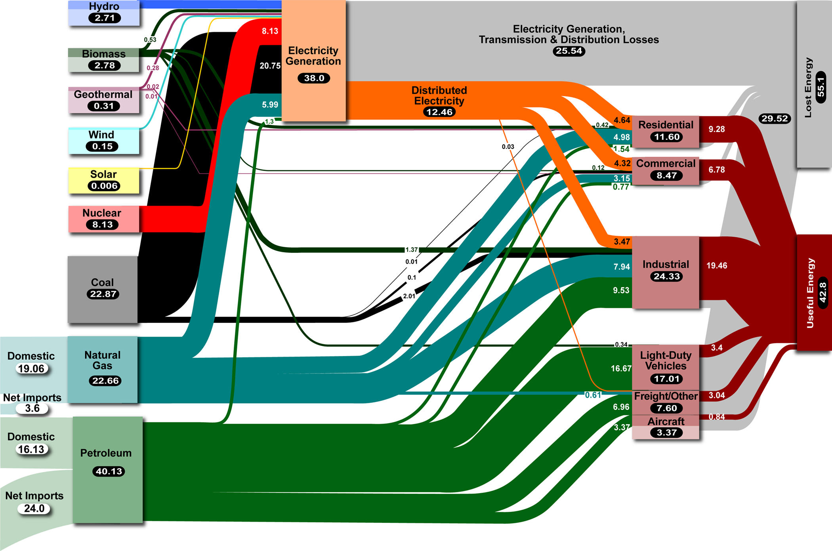
Energy Flows in 2005
in quads = 10¹⁵ Btu
Lawrence Livermore National Laboratory
http://eed.llnl.gov/flow/
complex system: many interacting degrees of freedom

Slide 40
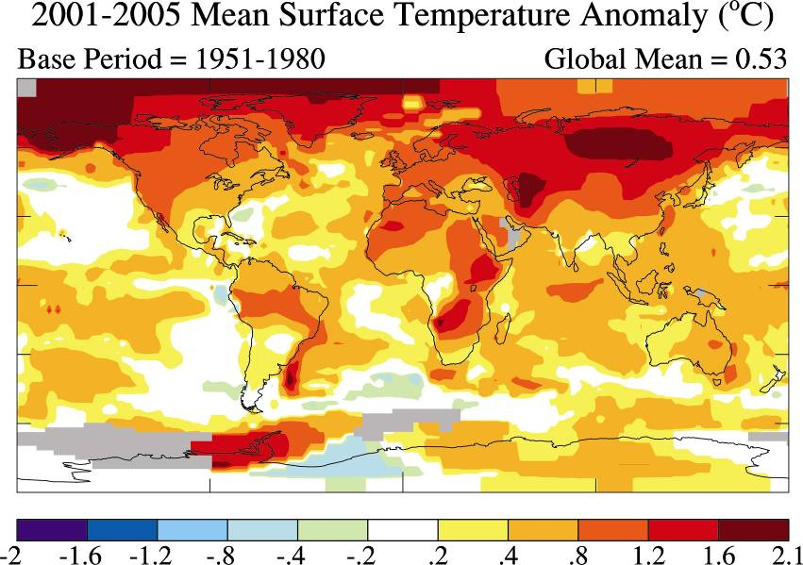
2001-2005 mean ∆T_{avg} above 1951-80 base, °C
Temperature increases are nonuniform: higher mid-continent, highest of all in far North. (These are observations, not modeling results.)
J. Hansen et al., PNAS 103: 14288-293 (26 Sept 2006)

Slide 41
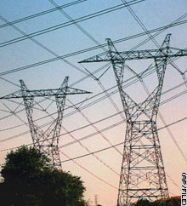
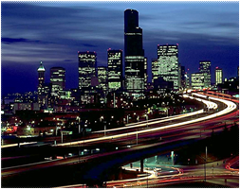
The 21st Century: A Different Set of Challenges
capacity
growing electricity uses growing cities and suburbs
high people / power density
urban power bottleneck
reliability
power quality
efficiency
lost energy
average
power loss/customer
    (min/yr)
US 214
France 53
Japan 6
Sustained
Interruptions
33%
$52.3 B
62% energy lost in
production / delivery
8-10% lost in grid
40 GW lost (US)
~ 40 power plants
2030: 60 GW lost (US)
340 Mtons CO₂
$26.3 B
2030
50% demand growth (US)
100% demand growth (world)
Momentary
Interruptions
67%
$79 B economic loss (US)
LaCommare & Eto, Energy 31, 1845 (2006)

Slide 42
The Energy Alternatives
Fossil
Nuclear
Renewable
Fusion
solar, wind, hydroelectric
ocean tides and currents
biomass, geothermal
energy gap
~ 14 TW by 2050
~ 33 TW by 2100
10 TW = 10,000 1 GW power plants
1 new power plant/day for 27 years
China: 1 GW / week
no single solution
diversity of energy sources required

Slide 43
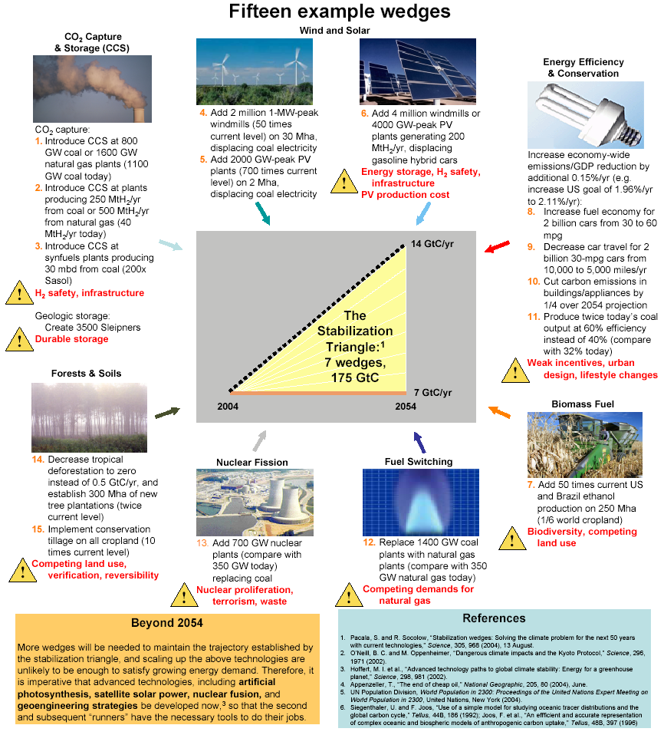
There are more than 7 wedges to choose from: Here are 15 candidates.

Slide 44
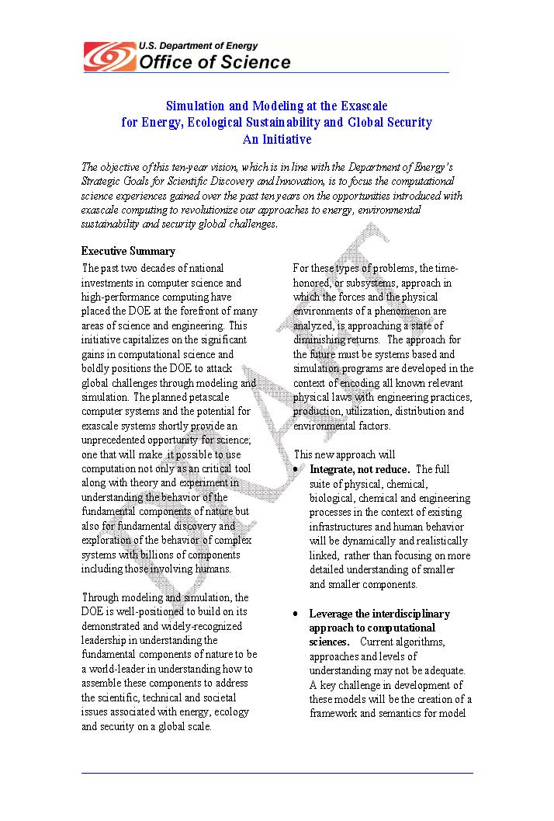
Modeling and Simulation at the Exascale for Energy and the Environment
The objective of this ten-year vision, which is in line with the Department of Energy’s Strategic Goals for Scientific Discovery and Innovation, is to focus the computational science experiences gained over the past ten years on the opportunities introduced with exascale computing to revolutionize our approaches to energy, environmental sustainability and security global challenges.
Based on this initial white paper, ANL, LBNL, and ORNL organized
the community input process in the form of three town hall meetings.

Slide 45

Planning for the Exascale Future!
During the spring of 2007
Argonne, Berkeley and Oak Ridge held three Townhall meetings to chart
future directions
Exascale Computing Systems
  Hardware Technology
  Software and Algorithms
  Scientific Applications
Energy
  Combustion
  Fission and Fusion
  Solar and Biomass
  Nanoscience and Materials
Environment
  Climate Modeling
  Socio-economics
  Carbon Cycle

Slide 46


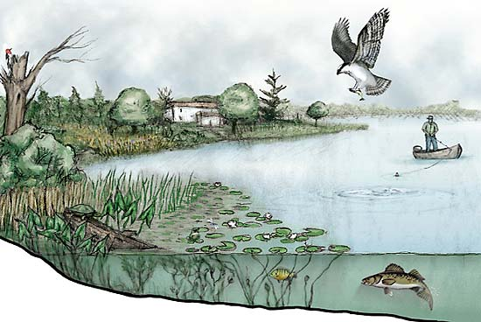

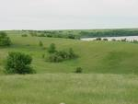
The Economic Systems Sit Within the Physical Environment
Air
Ecosystems
Water
Land

Slide 47
The Opportunity
Attack global challenges through modeling and simulation
Planned petascale and the potential exascale systems provide an unprecedented opportunity
Beyond computation as an critical tool along with theory and experiment
Understanding the behavior of the fundamental components of nature
Fundamental discovery and exploration of complex systems with billions of components including those involving humans

Slide 48
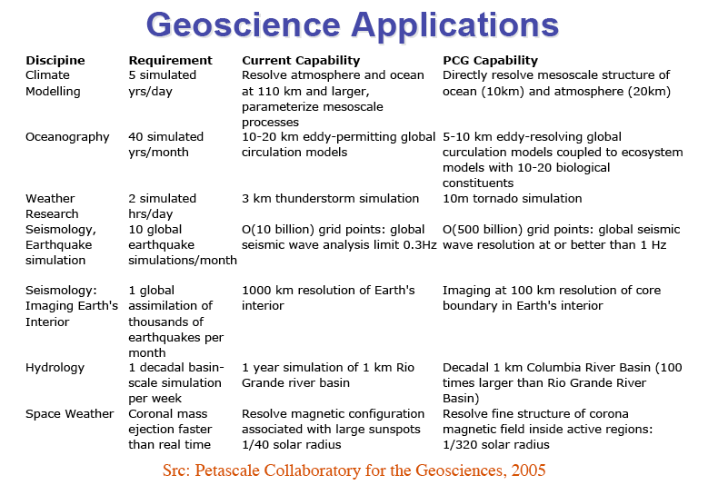
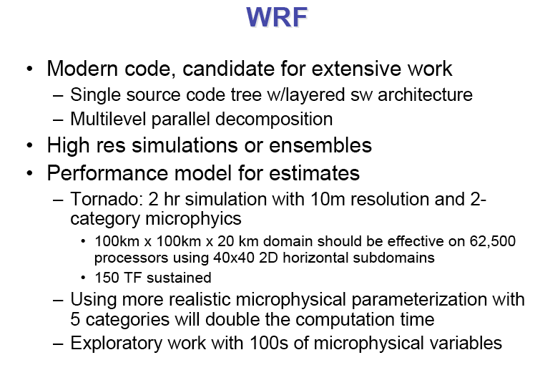
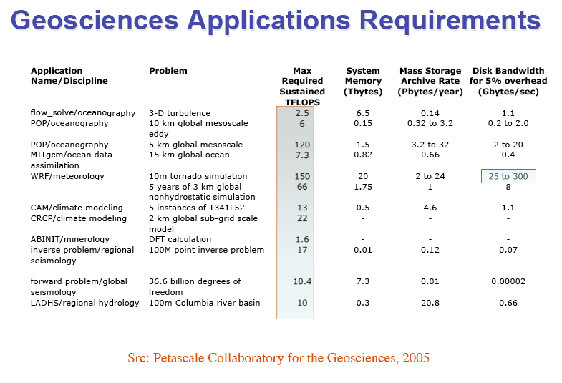
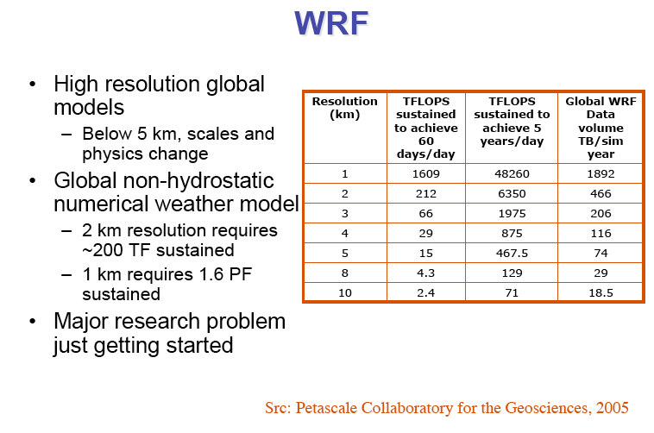
Petascale Geoscience

Slide 49
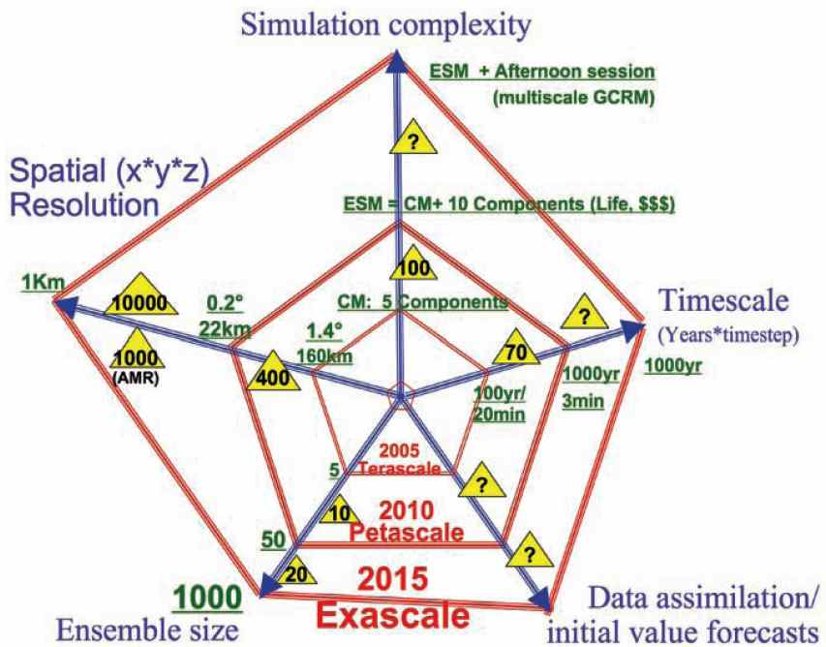
Reliable Climate Forecasts from Next
Generation Earth System Models
Key Challenges
  High certainty forecasts for the next few decades
  Long term forecasts relevant to regional/community scales
Urgent Questions for Petascale to Exascale Simulations
  Carbon sequestration
  option models
  Systems understanding
  of carbon-climate coupling
  Triggering mechanisms for extreme weather shifts
  Stability/sustainability of tropical rainforests and polar ice caps
  Sustainability of sea and land/ agricultural ecosystems

Slide 50
Trajectory of Climate Model Developments

Slide 51
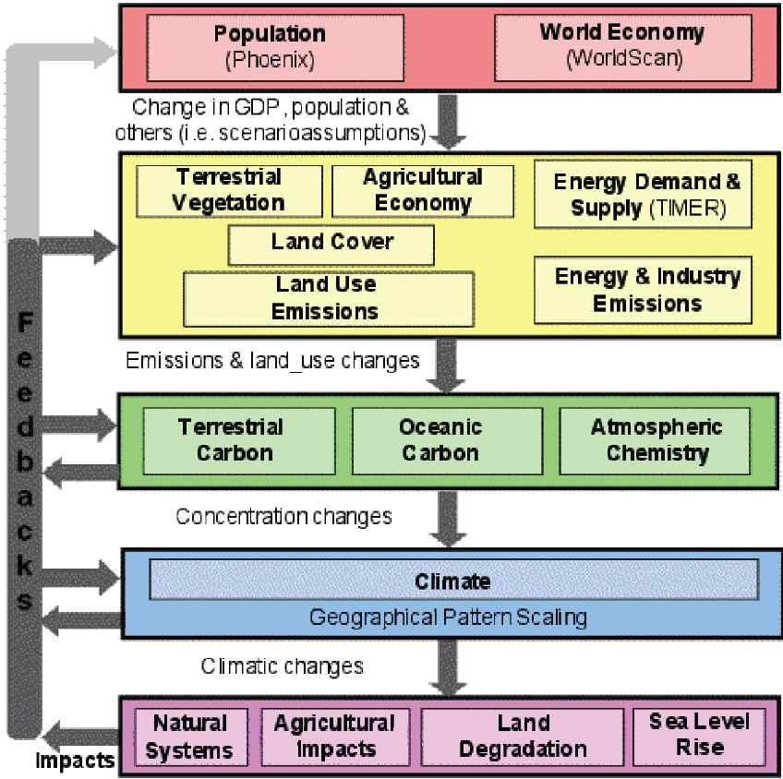
From Earth System Modeling to Computational Socio-Economics
Earth system modeling has progressed to a point where there is considerable confidence in predictions of continental- and global-scale climate changes over the next 100 years [IPCC 2007]
Integrated modeling of the social, economic, and environmental system with an extensive treatment of couplings among these different elements and consequent nonlinearities and uncertainties would have great impact.
Computational limitations have prevented existing models from including substantial regional and sectoral disaggregation, dynamic treatment of world economic development and industrialization, and detailed accounting for technological innovation, industrial competition, population changes and migration.

Slide 52
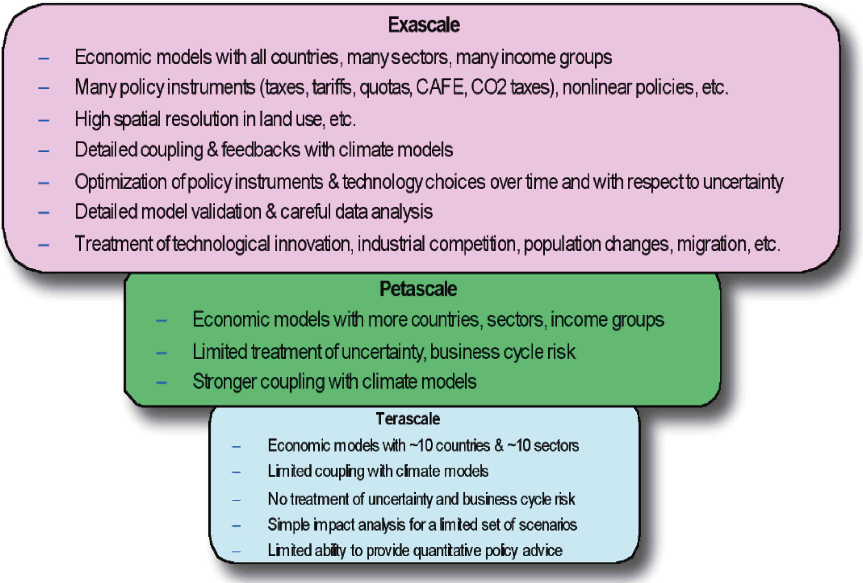
Impact of Socio-Economic Modeling
Emergence of petascale and
prospect of exascale computers
enable a fully integrated
treatment of diverse factors.
Models have potential to
transform understanding of
socio-economic-environmental interactions.
How will climate change impact
energy demand and prices?
How will nonlinearities, thresholds,
and feedbacks impact both climate
and energy supply?
How will different adaptation and mitigation strategies effect energy supply and demand, the economy, the environment, etc.?
How can computational approaches help identify good strategies for R&D, policy, and technology adoption under conditions of future uncertainty?

Slide 53
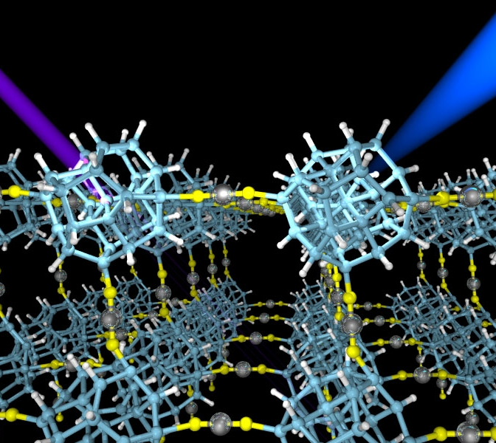
Nanoscale Materials by Design
Major challenges in nano/materials science
Numerical approximations and models for accurate physics and properties
Integrated diverse models to simulate the whole system or process
Large-scale systems (>100K atoms) and long duration dynamics (nanoseconds or microseconds)
Requires both computers larger than petascale and algorithms with better scaling with problem size
Today’s O(N³) DFT methods will be limited to ~50K atom single point electronic structures on petaflops
Addressing these issues opens many valuable design avenues
Optimal materials for dense hydrogen storage
Inexpensive, efficient and environmentally benign solar cells
Nanostructured data storage
Bio-nano electronics
These problems each have very large parameter spaces, so design optimizations take many runs

Slide 54
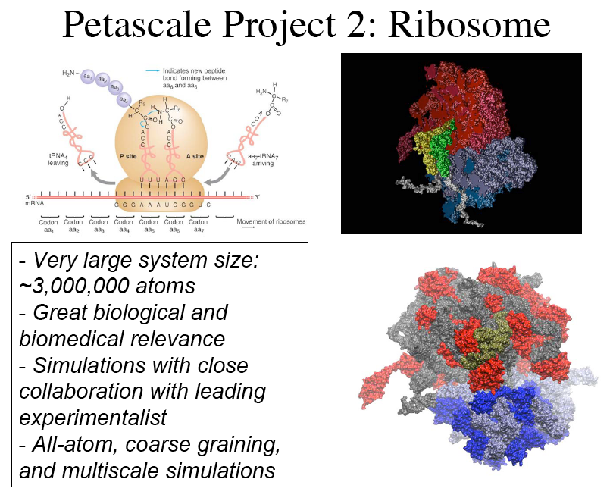
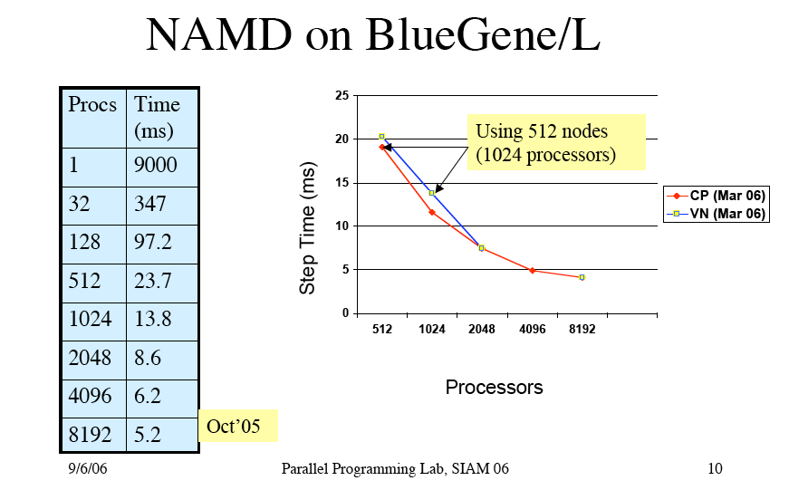
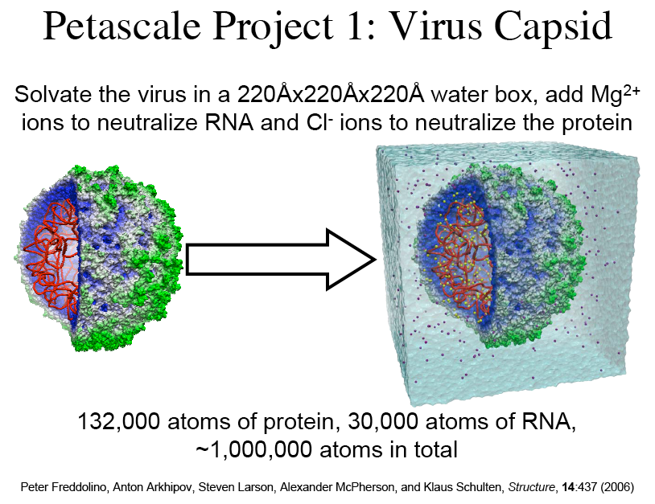
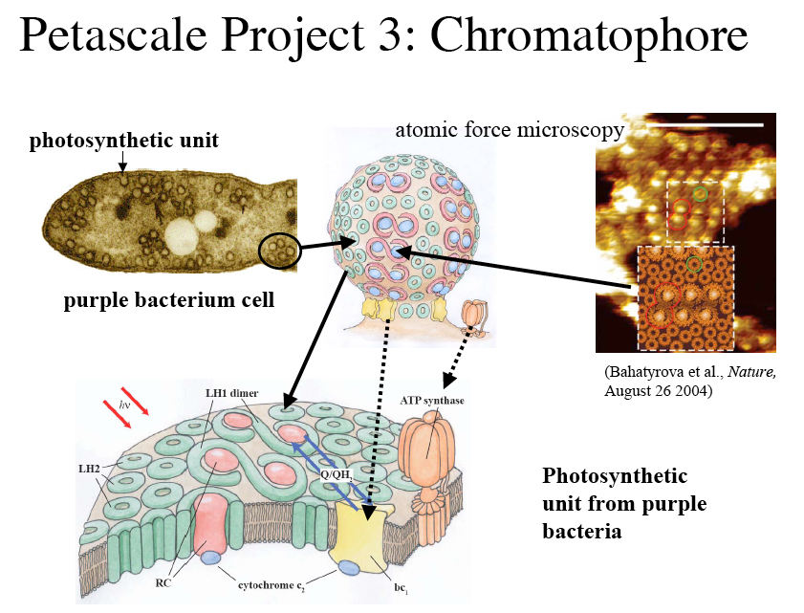
Petascale Molecular Modeling

Slide 55
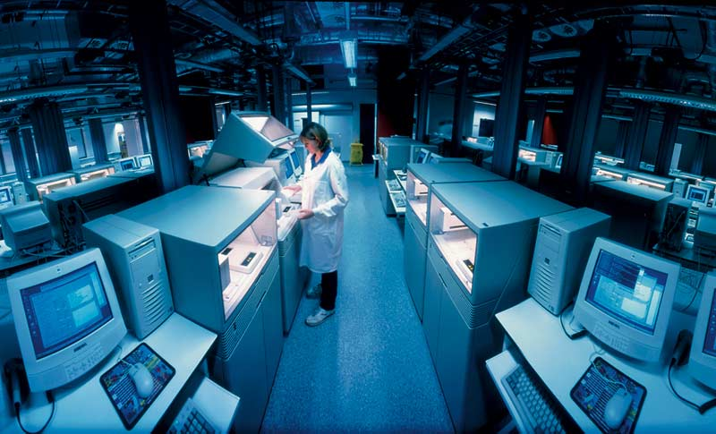
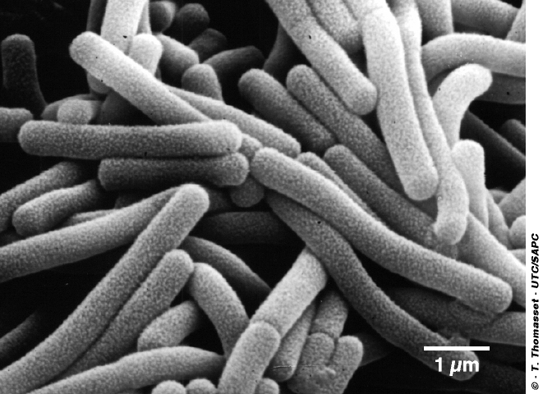
Petascale Impact on Biological Theory
Potential high impact on theory development
  The ability to run large-scale simulations that can capture non-trivial variation in an evolutionary process could have a dramatic impact on our ability to move from qualitative to quantitative theory in biology
Software readiness for petascale systems
  While physical process oriented software is on a trajectory to achieve scalable performance on petascale systems, agent based evolution and ecosystem modeling environments are lagging far behind
  Data analysis and bioinformatics environments are in the middle, hindered in part by the lack of data intensive infrastructure
Capability and capacity computing estimates
  First principles MD and QM simulations have enormous computing requirements, but perhaps limited impact on large-scale theory
  Agent based simulations have not been effective scoped
Related experimental support is needed
  Validation experiments driven by the simulation and modeling will be required

Slide 56
An Integrated View of Modeling, Simulation, Experiment, and Bioinformatics
Problem
Specification
Modeling and
Simulation
Analysis &
Visualization
Bioinformatics
Analysis
Tools
Integrated
Biological
Databases
Experimental
Design
High-throughput
Experiments
Analysis &
Visualization

Slide 57
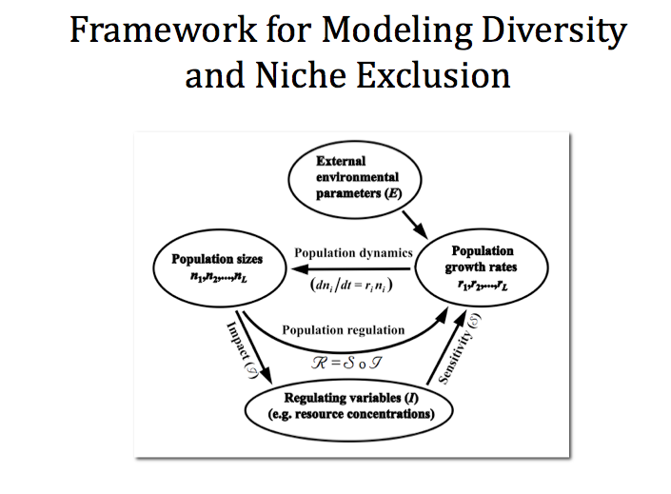
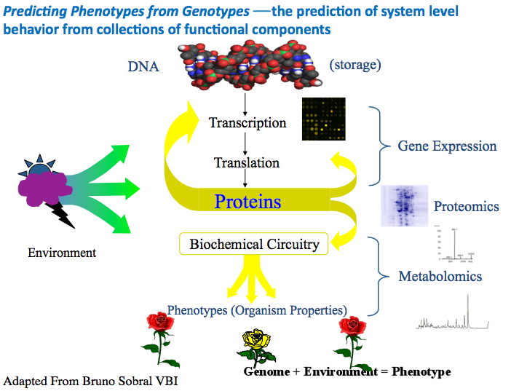
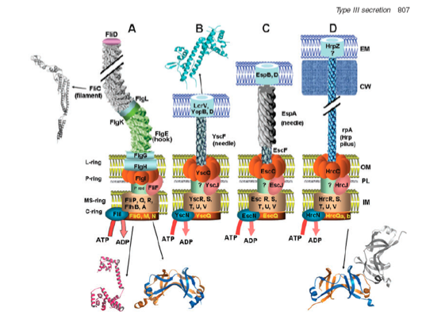
Six Open Problems in Basic Biology Where Computing Can Have an Impact
Applicability of the Competitive Exclusion Principle ⎯ the nature and scale of ecological niches and relationships between competition and diversity
Predicting Phenotypes from Genotypes ⎯ the prediction of system level behavior from collections of functional components
Understanding the Evolution of Biological Networks ⎯ structure, complexity and mechanisms
Reconstruction of Horizontal Gene Transfer Events ⎯ rapid evolution of complexity and non-inherited adaptation mechanisms
Understanding the Range of Permitted Biologies ⎯ possible origins and the fundamental limits to life and life processes
Understanding Convergent Evolution ⎯ the repertoire of form and function, independent evolution of similar structures or functions in similar or different environments

Slide 58
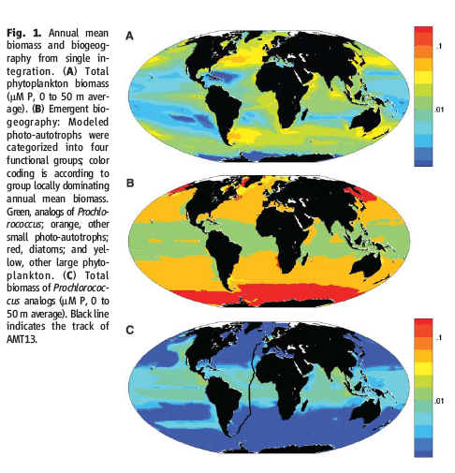
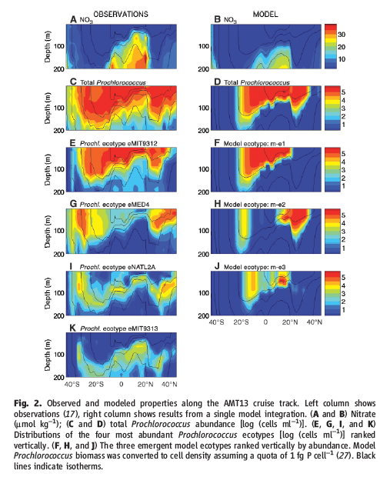
Emergent Biogeography of Microbial
Communities in a Model Ocean
Michael J. Follows,1* Stephanie Dutkiewicz,1 Scott Grant,1,2 Sallie W. Chisholm3
SCIENCE VOL 315 30 MARCH 2007

Slide 59
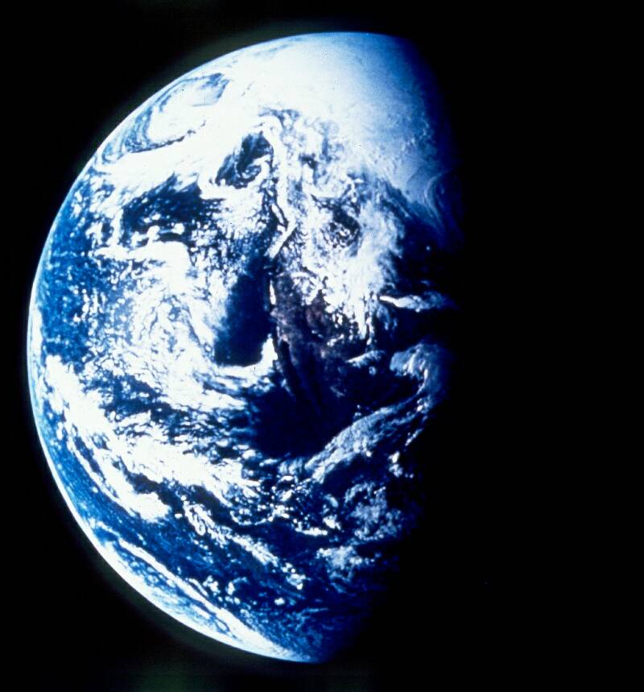
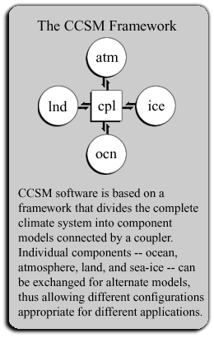
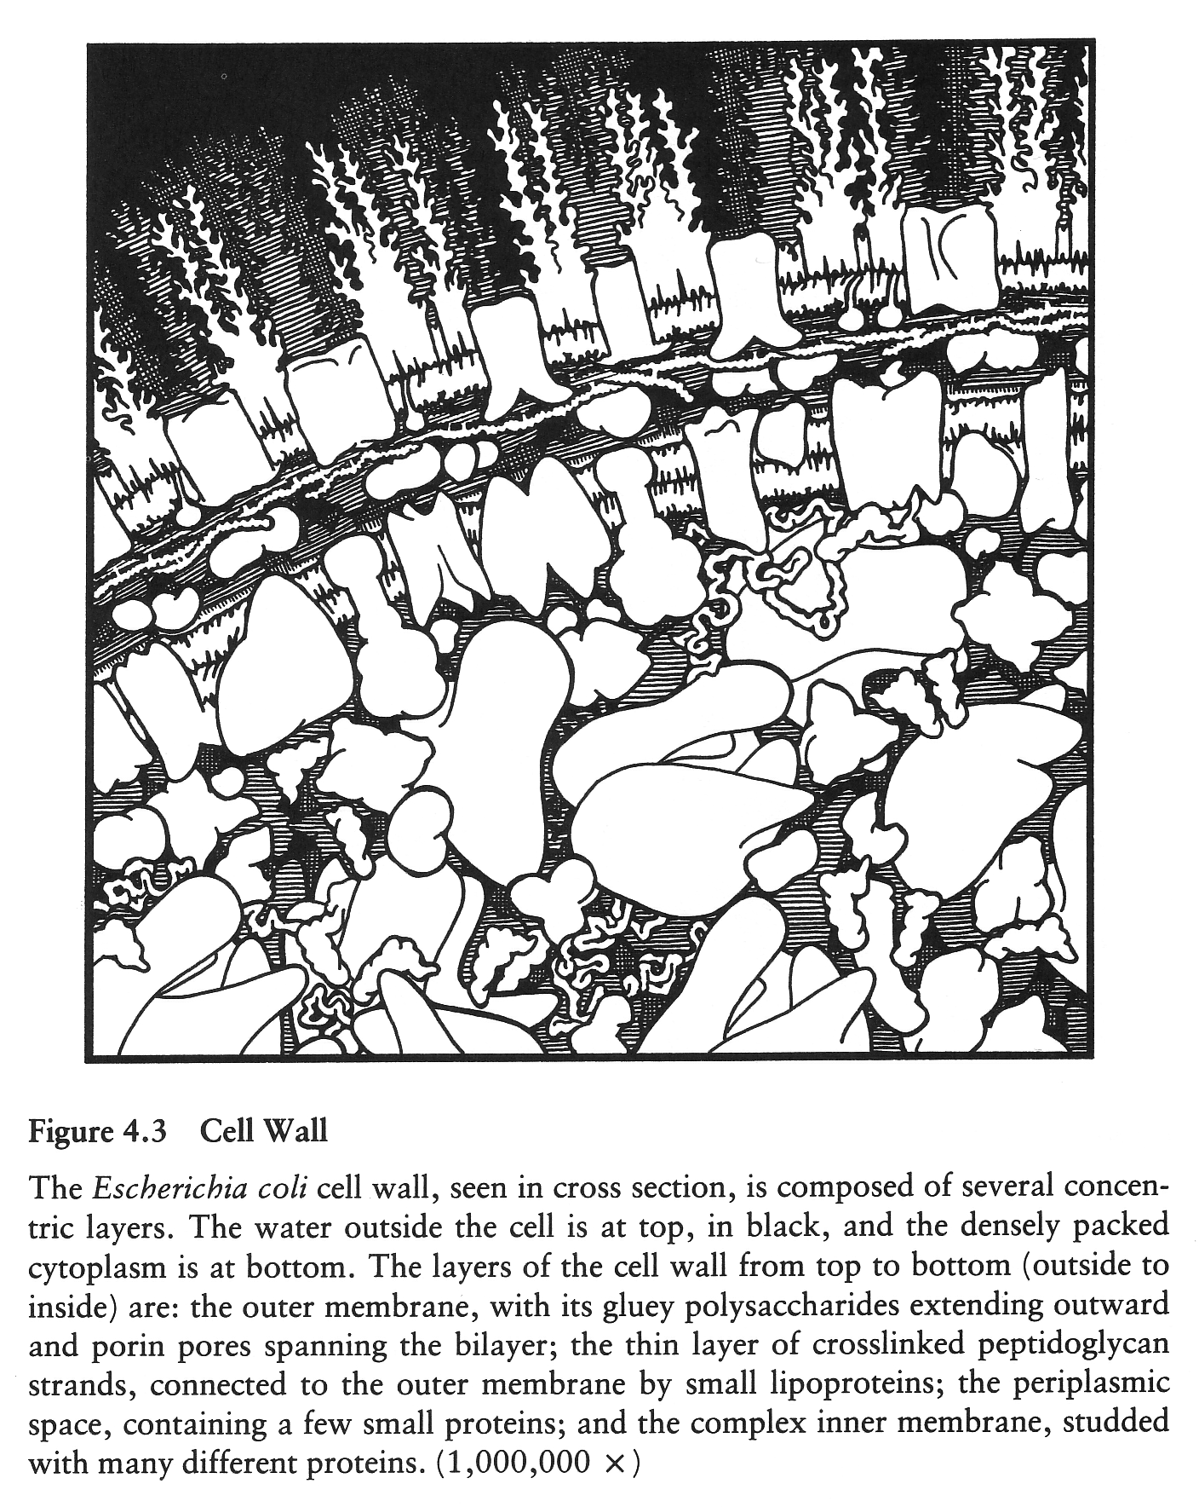
Challenges for Cell and
Ecosystem Simulation
Modeling cells rivals the complexity of climate and earth systems models
  Multiple space and time scales
  Millions of interacting parts
  Populations of cells to understand emergent behavior
  Integrated modeling necessary to advance theory in systems biology
Cell and ecosystems modeling will need Petascale computing and beyond
  Dynamics of evolution
  Genomics driven medicine

Slide 60
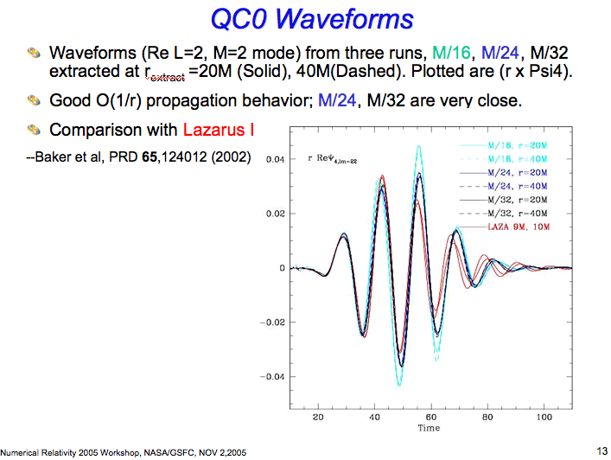



Colliding Black Holes

Slide 61

Quantum
Chromodynamics
BG/P Configuration Generation Plans
Calculate weak interaction matrix elements of strongly interacting particles to the accuracy needed to make precise test of the standard model
Determine the properties of strongly interacting matter at high temperatures and densities, such as those that existed immediately after the big bang
With BG/Q (and beyond) data is cache resident, so memory access is not a factor
However latency could be a big deal at exaflops, bounding scaling of present approaches [IBM Study]
Lattice QCD calculations have 2 stages
  Monte Carlo methods generate representative configurations of the QCD ground state -- time intensive
  Use configurations to calculate a wide variety of quantities of interest in high energy and nuclear physics.
Notes:
MILC on BG/L perfect weak scaling to 2048 cpus

Slide 62





Integrating Leadership Computing Into the International Research Infrastructure

Slide 63
Some Final Words
Scientific breakthroughs require flexibility and abundance of computing resources for serendipity and insight to work.
  One must be able to make lots of mistakes.. therefore cost matters to make mistakes affordable
High-capability platforms require considerable quantities of capacity platforms to make the capability effective.
  We learn this from the distribution of computing allocations at major centers.. most scientific computing is warm-up exercises..
The country needs a long term commitment not just to developing new high-end architectures, but also to deploying them as well supported infrastructure.
  Scientists are very good at optimizing their time and generally will not respond to speculative availability of resources..

Slide 64



Slide 65





Some Conclusions
We understand the role of leadership class computing in science
Building a long-term engagement with the best basic science communities is critical to enable LCC to have maximum scientific impact.
Each lab can effectively do this for a relatively small set of areas Argonne’s focus: Fundamental Physics, Biology, Multi-Physics CFD, Large-Scale Optimization
It critical for the community to have multiple computing platforms to enable the most cost effective science and to mitigate risk
Understanding the arch-app coupling is critical for effective decision making
Significant effort is needed to determine the best match of algorithms to architectures and to estimate performance of future design points
A push to the exascale is a ten year vision to keep the US at the forefront of what is
possible in high-end computing. The challenges are many and it is likely that it will need
to be a global effort in both research and development and the development of codes.

