Slide 1
PBGL: A High-Performance Distributed-Memory Parallel Graph Library
Andrew Lumsdaine
Indiana University
lums@osl.iu.edu

Slide 2
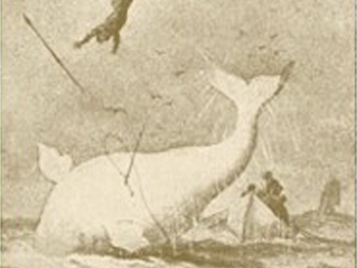
My Goal in Life
Performance with elegance

Slide 3
Introduction
Overview of our high-performance, industrial strength, graph library
Comprehensive features
Impressive results
Separation of concerns
Lessons on software use and reuse
Thoughts on advancing high-performance (parallel) software

Slide 4
Advancing HPC Software
Why is writing high performance software so hard?
Because writing software is hard!
High performance software is software
All the old lessons apply
No silver bullets
Not a language
Not a library
Not a paradigm
Things do get better
but slowly

Slide 5
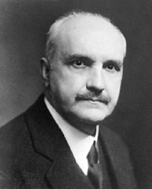
Advancing HPC Software
Progress, far from consisting in change, depends on
Progress, far from consisting in change, depends on retentiveness.
Progress, far from consisting in change, depends on retentiveness. Those who cannot remember the past are condemned to repeat it.

Slide 6
Advancing HPC Software
Name the two most important pieces of HPC software over last 20 years
BLAS
MPI
Why are these so important?
Why did they succeed?

Slide 7
Evolution of a Discipline
Science
Production
Professional Engineering
Commercialization
Educated professionals
Analysis and theory
Progress relies on science
Analysis enables new apps
Market segmented by
product variety
Craft
Skilled craftsmen
Established procedure
Training in mechanics
Concern for cost
Manufacture for sale
Virtuosos, talented amateurs
Extravagant use of materials
Design by intuition, brute force
Knowledge transmitted slowly, casually
Manufacture for use rather than sale
Cf. Shaw, Prospects for an engineering
discipline of software, 1990.

Slide 8
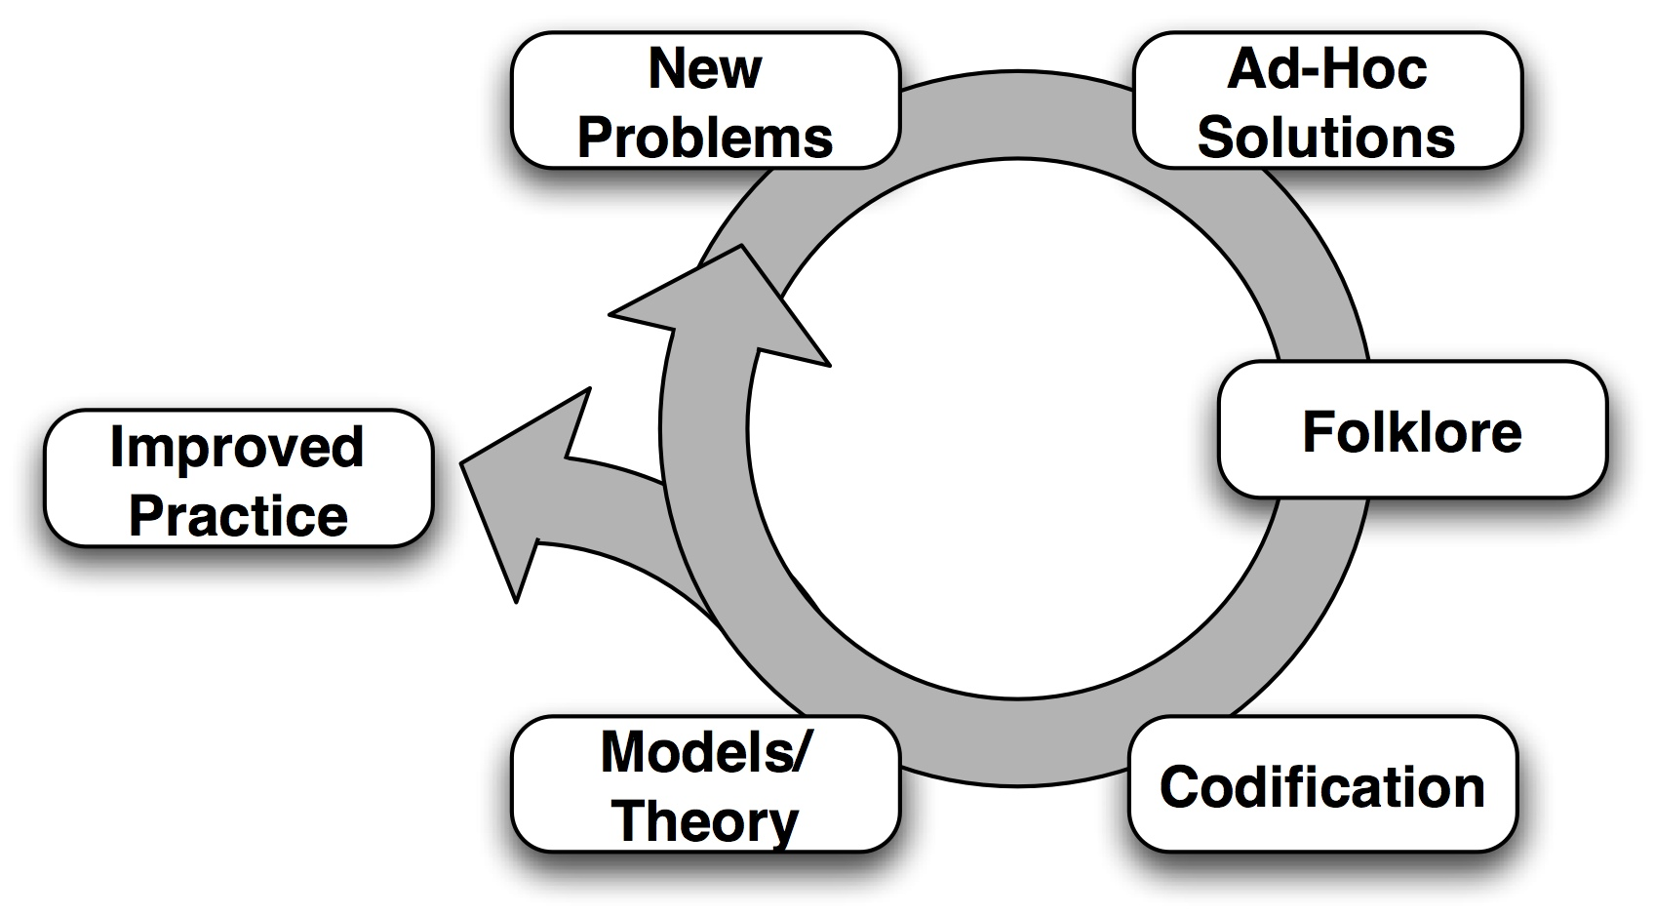
Evolution of Software Practice

Slide 9
Why MPI Worked
NX
Shmem
P4, PVM
Sockets
Distributed
Memory Hardware
Message
Passing
Rules!
“Legacy MPI codes”
MPICH
LAM/MPI
Open MPI
…
MPI

Slide 10
Today
Pthtreads
Cilk
TBB
Charm++
…
Ubiquitous
Multicore
Tasks,
not threads
???
???
???

Slide 11
Tomorrow
MPI + X
Charm++
UPC
???
Hybrid
Dream/Nightmare
Vision/Hallucination
???
???
???
???

Slide 12
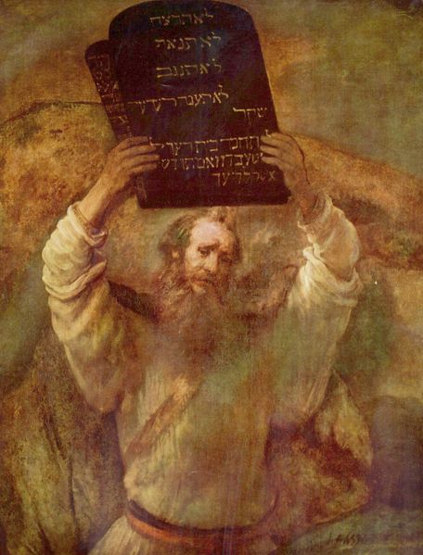
What Doesn’t Work
Codification
Models, Theories
Improved Practice
Languages

Slide 13
Performance with Elegance
Construct high-performance (and elegant!) software that can evolve in robust fashion
Must be an explicit goal

Slide 14
The Parallel Boost Graph Library
Goal: To build a generic library of efficient, scalable, distributed-memory parallel graph algorithms.
Approach: Apply advanced software paradigm (Generic Programming) to categorize and describe the domain of parallel graph algorithms. Separate concerns. Reuse sequential BGL software base.
Result: Parallel BGL. Saved years of effort.

Slide 15
Graph Computations
Irregular and unbalanced
Non-local
Data driven
High data to computation ratio
Intuition from solving PDEs may not apply

Slide 16
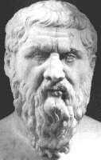
Generic Programming
A methodology for the construction of reusable, efficient software libraries.
Dual focus on abstraction and efficiency.
Used in the C++ Standard Template Library
Platonic Idealism applied to software
Algorithms are naturally abstract, generic (the “higher truth”)
Concrete implementations are just reflections (“concrete forms”)

Slide 17
Generic Programming Methodology
Study the concrete implementations of an algorithm
Lift away unnecessary requirements to produce a more abstract algorithm
Catalog these requirements.
Bundle requirements into concepts.
Repeat the lifting process until we have obtained a generic algorithm that:
Instantiates to efficient concrete implementations.
Captures the essence of the “higher truth” of that algorithm.

Slide 18
Lifting Summation
int sum(int* array, int n) {
int s = 0;
for (int i = 0; i < n; ++i)
s = s + array[i];
return s;
}

Slide 19
Lifting Summation
float sum(float* array, int n) {
float s = 0;
for (int i = 0; i < n; ++i)
s = s + array[i];
return s;
}

Slide 20
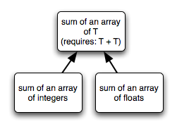
Lifting Summation
template<typename T> T sum(T* array, int n) {
T s = 0;
for (int i = 0; i < n; ++i)
s = s + array[i];
return s;
}

Slide 21
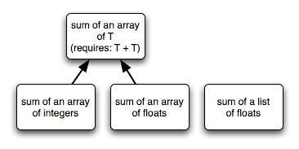
Lifting Summation
double sum(list_node* first, list_node* last) {
double s = 0;
while (first != last) {
s = s + first->data; first = first->next; }
return s;
}

Slide 22
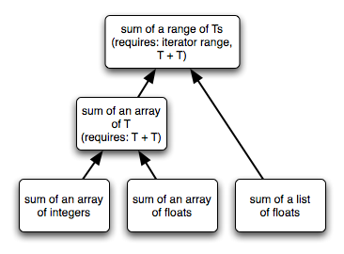
Lifting Summation
template <InputIterator Iter>
value_type sum(Iter first, Iter last) {
value_type s = 0;
while (first != last)
s = s + *first++;
return s;
}

Slide 23
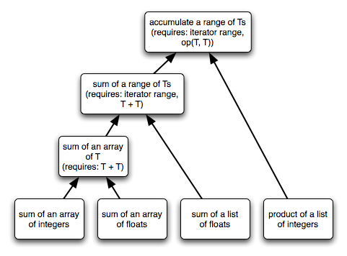
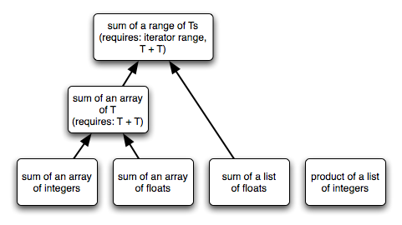
Lifting Summation
float product(list_node* first, list_node* last) {
float s = 1;
while (first != last) {
s = s * first->data; first = first->next; }
return s;
}

Slide 24
Generic Accumulate
template <InputIterator Iter, typename T,
typename Op>
T accumulate(Iter first, Iter last, T s, Op op) {
while (first != last)
s = op(s, *first++);
return s;
}
Generic form captures all accumulation:
Any kind of data (int, float, string)
Any kind of sequence (array, list, file, network)
Any operation (add, multiply, concatenate)
Interface defined by concepts
Instantiates to efficient, concrete implementations

Slide 25
Specialization
Synthesizes efficient code for a particular use of a generic algorithm: int array[20]; accumulate(array, array + 20, 0, std::plus<int>());
… generates the same code as our initial sum function for integer arrays.
Specialization works by breaking down abstractions
Typically, replace type parameters with concrete types.
Lifting can only use abstractions that compiler optimizers can eliminate.

Slide 26
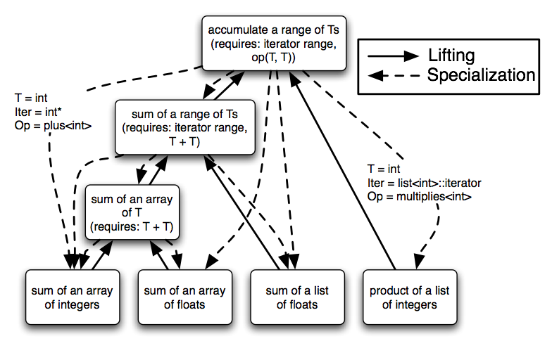
Lifting and Specialization
Specialization is dual to lifting

Slide 27
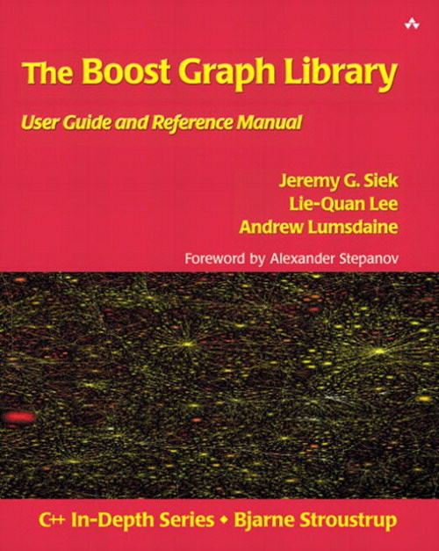
The Boost Graph Library (BGL)
A graph library developed with the generic programming paradigm
Lift requirements on:
Specific graph structure
Edge and vertex types
Edge and vertex properties
Associating properties with vertices and edges
Algorithm-specific data structures (queues, etc.)

Slide 28
The Boost Graph Library (BGL)
Comprehensive and mature
~10 years of research and development
Many users, contributors outside of the OSL
Steadily evolving
Written in C++
Generic
Highly customizable
Highly efficient
Storage and execution

Slide 29
BGL: Algorithms (partial list)
Searches (breadth-first, depth-first, A*)
Single-source shortest paths (Dijkstra, Bellman-Ford, DAG)
All-pairs shortest paths (Johnson, Floyd-Warshall)
Minimum spanning tree (Kruskal, Prim)
Components (connected, strongly connected, biconnected)
Maximum cardinality matching
Max-flow (Edmonds-Karp, push-relabel)
Sparse matrix ordering (Cuthill-McKee, King, Sloan, minimum degree)
Layout (Kamada-Kawai, Fruchterman-Reingold, Gursoy-Atun)
Betweenness centrality
PageRank
Isomorphism
Vertex coloring
Transitive closure
Dominator tree

Slide 30
BGL: Graph Data Structures
Graphs:
adjacency_list: highly configurable with user-specified containers for vertices and edges
adjacency_matrix
compressed_sparse_row
Adaptors:
subgraphs, filtered graphs, reverse graphs
LEDA and Stanford GraphBase
Or, use your own…

Slide 31
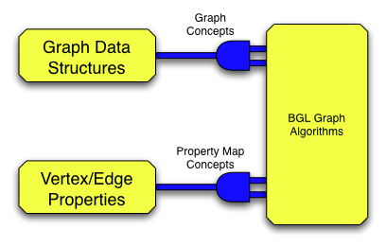
BGL Architecture

Slide 32
Parallelizing the BGL
Starting with the sequential BGL…
Three ways to build new algorithms or data structures
Lift away restrictions that make the component sequential (unifying parallel and sequential)
Wrap the sequential component in a distribution-aware manner.
Implement any entirely new, parallel component.

Slide 33
Lifting for Parallelism
Remove assumptions made by most sequential algorithms:
A single, shared address space.
A single “thread” of execution.
Platonic ideal: unify parallel and sequential algorithms
Our goal: Build the Parallel BGL by lifting the sequential BGL.

Slide 34
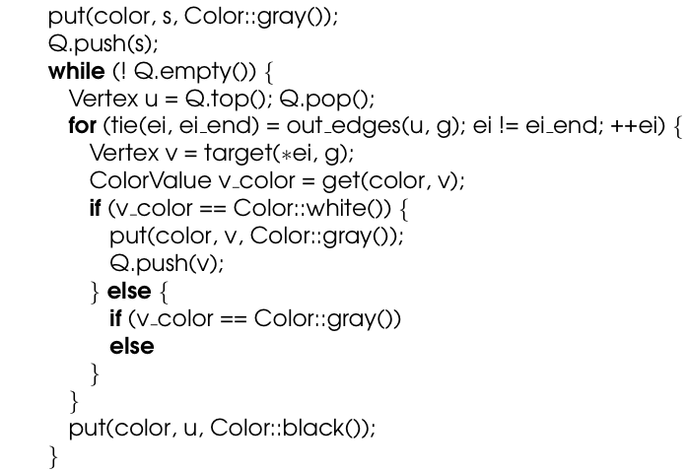
Breadth-First Search

Slide 35
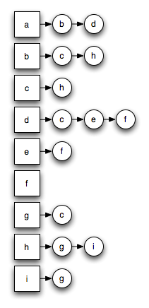
Parallellizing BFS?

Slide 36
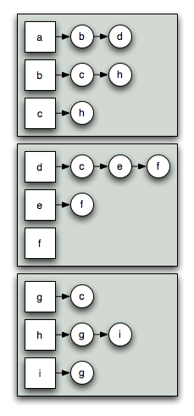
Parallellizing BFS?

Slide 37
Distributed Graph
One fundamental operation:
Enumerate out-edges of a given vertex
Distributed adjacency list:
Distribute vertices
Out-edges stored with the vertices

Slide 38
Parallellizing BFS?

Slide 39
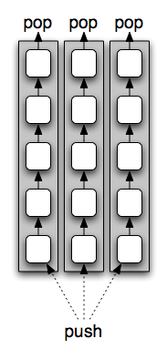
Parallellizing BFS?

Slide 40
Distributed Queue
Three fundamental operations:
top/pop retrieves from queue
push operation adds to queue
empty operation signals termination
Distributed queue:
Separate, local queues
top/pop from local queue
push sends to a remote queue
empty waits for remote sends

Slide 41
Parallellizing BFS?

Slide 42
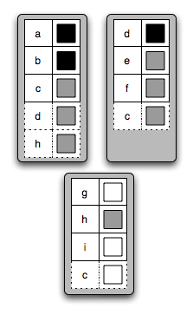
Parallellizing BFS?

Slide 43
Distributed Property Maps
Two fundamental operations:
put sets the value for a vertex/edge
get retrieves the value
Distributed property map:
Store data on same processor as vertex or edge
put/get send messages
Ghost cells cache remote values
Resolver combines puts

Slide 44
“Implementing” Parallel BFS
Generic interface from the Boost Graph Library template<class IncidenceGraph, class Queue, class BFSVisitor, class ColorMap> void breadth_first_search(const IncidenceGraph& g, vertex_descriptor s, Queue& Q, BFSVisitor vis, ColorMap color);
Effect parallelism by using appropriate types:
Distributed graph
Distributed queue
Distributed property map
Our sequential implementation is also parallel!
Parallel BGL can just “wrap up” sequential BFS

Slide 45
BGL Architecture

Slide 46
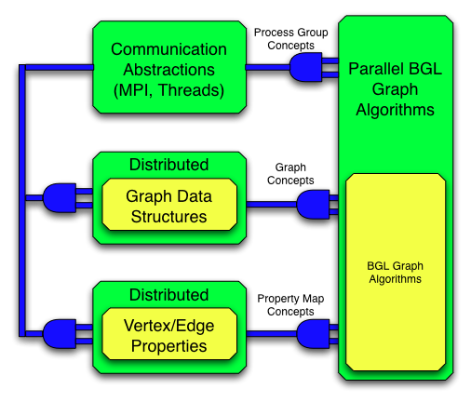
Parallel BGL Architecture

Slide 47
Algorithms in the Parallel BGL
Breadth-first search*
Eager Dijkstra’s single-source shortest paths*
Crauser et al. single-source shortest paths*
Depth-first search
Minimum spanning tree (Boruvka*, Dehne & Götz‡)
Connected components‡
Strongly connected components†
Biconnected components
PageRank*
Graph coloring
Fruchterman-Reingold layout*
Max-flow†
* Algorithms that have been lifted from a sequential implementation † Algorithms built on top of parallel BFS ‡ Algorithms built on top of their sequential counterparts

Slide 48
Lifting for Hybrid Programming?

Slide 49
Abstraction and Performance
Myth: Abstraction is the enemy of performance.
The BGL sparse-matrix ordering routines perform on par with hand-tuned Fortran codes.
Other generic C++ libraries have had similar successes (MTL, Blitz++, POOMA)
Reality: Poor use of abstraction can result in poor performance.
Use abstractions the compiler can eliminate.

Slide 50
Weak Scaling Dijkstra SSSP
Erdos-Renyi graph with 2.5M vertices and 12.5M (directed) edges per processor. Maximum graph
size is 240M vertices and 1.2B edges on 96 processors.

Slide 51
Strong Scaling Delta Stepping
Delta-Stepping on an Erdos-Renyi graph with average degree 4. The largest problem solved is
1B vertices and 4B edges using 96 processors.

Slide 52
Strong Scaling
Performance of three SSSP algorithms on fixed-sized graphs with ~24M vertices and ~58M edges

Slide 53
Weak Scaling
Weak scalability of three SSSP algorithms using graphs with an average of 1M vertices and
10M edges per processor.

Slide 54
The BGL Family
The Original (sequential) BGL
BGL-Python
The Parallel BGL
Parallel BGL-Python
(Parallel) BGL-VTK

Slide 55
For More Information…
(Sequential) Boost Graph Library http://www.boost.org/libs/graph/doc
Parallel Boost Graph Library http://www.osl.iu.edu/research/pbgl
Python Bindings for (Parallel) BGL http://www.osl.iu.edu/~dgregor/bgl-python
Contacts:
Andrew Lumsdaine lums@osl.iu.edu
Jeremiah Willcock jewillco@osl.iu.edu
Nick Edmonds ngedmonds@osl.iu.edu

Slide 56
Summary
Effective software practices evolve from effective software practices
Explicitly study this in context of HPC
Parallel BGL
Generic parallel graph algorithms for distributed-memory parallel computers
Reusable for different applications, graph structures, communication layers, etc
Efficient, scalable

Slide 57
Questions?

Slide 58
Disclaimer
Some images in this talk were cut and pasted from web sites found with Google Image Search and are used without permission. I claim their inclusion in this talk is permissible as fair use.
Please do not redistribute this talk.

