Slide 1
Hierarchical Load Balancing for Large Scale Supercomputers
Gengbin Zheng
Charm++ Workshop 2010
Parallel Programming Lab, UIUC

Slide 2
Outline
Dynamic Load Balancing framework in Charm++
Motivations
Hierarchical load balancing strategy

Slide 3
Charm++ Dynamic Load-Balancing Framework
One of the most popular reasons to use Charm++/AMPI
Fully automatic
Adaptive
Application independent
Modular, and extendable

Slide 4
Principle of Persistence
Principle of Persistence
  Once an application is expressed in terms of interacting objects, object communication patterns and computational loads tend to persist over time
  In spite of dynamic behavior
    Abrupt and large,but infrequent changes (e.g. AMR)
    Slow and small changes (e.g. particle migration)
Parallel analog of principle of locality
  Heuristics, that holds for most CSE applications

Slide 5
Measurement Based Load Balancing
Based on Principle of persistence
Runtime instrumentation (LB Database)
  communication volume and computation time
Measurement based load balancers
  Use the database periodically to make new decisions
  Many alternative strategies can use the database
    Centralized vs distributed
    Greedy vs refinement
    Taking communication into account
    Taking dependencies into account (More complex)
    Topology-aware

Slide 6
Load Balancer Strategies
Centralized
  Object load data are sent to processor 0
  Integrate to a complete object graph
  Migration decision is broadcasted from processor 0
  Global barrier
Distributed
  Load balancing among neighboring processors
  Build partial object graph
  Migration decision is sent to its neighbors
  No global barrier

Slide 7
Limitations of Centralized Strategies
Now consider an application with 1M objects on 64K processors
Limitations (inherently not scalable)
  Central node - memory/communication bottleneck
  Decision-making algorithms tend to be very slow
We demonstrate these limitations using the simulator we developed

Slide 8
Memory Overhead (simulation results with lb_test)
Run on Lemieux 64 processors
Lb_test benchmark is a parameterized program that creates a
specified number of communicating objects in 2D-mesh.

Slide 9
Load Balancing Execution Time
Execution time of load balancing algorithms on 64K processor simulation

Slide 10
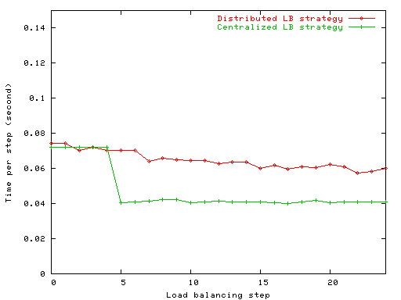
Limitations of Distributed Strategies
Each processor periodically exchange load information and migrate objects among neighboring processors
Performance improved slowly
Lack of global information
Difficult to converge quickly to as good a solution as a centralized strategy
Result with NAMD on 256 processors

Slide 11
A Hybrid Load Balancing Strategy
Dividing processors into independent sets of groups, and groups are organized in hierarchies (decentralized)
  Aggressive load balancing in sub-groups, combined with
  Refinement-based cross-group load balancing
Each group has a leader (the central node) which performs centralized load balancing
  Reuse existing centralized load balancing

Slide 12
Hierarchical Tree (an example)
64K processor hierarchical tree
Level 2
1
Level 1
0
1024
63488
64512
64
Level 0
0
…
1023
1024
…
2047
…...
63488
…
64511
64512
…
65535
1024
Apply different strategies at each level
Notes:
Example
More aggressive one at low level
Take advantage of faster communication
Less aggressive one at higher level
Refine-based algorithm

Slide 13
Issues
Load data reduction
  Semi-centralized load balancing scheme
Reducing data movement
  Token-based local balancing
Topology-aware tree construction

Slide 14
Token-based HybridLB Scheme
Refinement-based Load balancing
1
Load Data
0
1024
63488
64512
Load Data (OCG)
0
…
1023
1024
…
2047
…...
63488
…
64511
64512
…
65535
Greedy-based Load balancing
token
object

Slide 15
Performance Study with Synthetic Benchmark
lb_test benchmark on Ranger Cluster (1M objects)
Notes:
1/64

Slide 16
Load Balancing Time (lb_test)
lb_test benchmark on Ranger Cluster

Slide 17
Performance (lb_test)
lb_test benchmark on Ranger Cluster

Slide 18
NAMD Hierarchical LB
NAMD implements its own specialized load balancing strategies
  Based on Charm++ load balancing framework
Extended NAMD comprehensive and refinement-based solution
  Work on subset of processors

Slide 19
NAMD LB Time

Slide 20
NAMD LB Time (Comprehensive)

Slide 21
NAMD LB Time (Refinement)

Slide 22
NAMD Performance

Slide 23
Conclusions
Scalable LBs are needed due to large machines like BG/P
Avoid memory and communication bottleneck
Achieve similar result to the more expensive centralized load balancer
Take processor topology into account

