Slide 1



Welcome and Introduction
“State of Charm++”
Laxmikant Kale

Slide 2
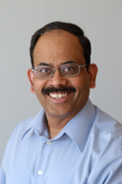
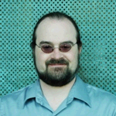
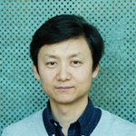
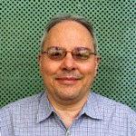
Parallel Programming Laboratory
Sr. STAFF
NSF HECURA
Simplifying Parallel Programming
DOE/ORNL
(NSF: ITR)
Chem-nanotech
OpenAtom NAMD,QM/MM
NIH
Biophysics
NAMD
NSF +
Blue Waters
BigSim
DOE
CSAR
Rocket
Simulation
DOE
HPC-Colony II
NASA
Computational
Cosmology &
Visualization
GRANTS
MITRE
Aircraft allocation
NSF PetaApps
Contagion Spread
Space-time Meshing
(Haber et al, NSF)
Faucets:
Dynamic
Resource
Management
for Grids
Load-Balancing
Scalable, Topology aware
Fault-Tolerance:
Checkpointing,
Fault-Recovery,
Proc. Evacuation
ParFUM:
Supporting
Unstructured Meshes
(Comp. Geometry)
BigSim:
Simulating Big
Machines and
Networks
ENABLING PROJECTS
CharmDebug
Projections:
Perf. Viz
AMPI
Adaptive MPI
Higher Level
Parallel Languages
Charm++ and Converse

Slide 3
A Glance at History
1987: Chare Kernel arose from parallel Prolog work
  Dynamic load balancing for state-space search, Prolog, ..
1992: Charm++
1994: Position Paper:
  Application Oriented yet CS Centered Research
  NAMD : 1994, 1996
Charm++ in almost current form: 1996-1998
  Chare arrays,
  Measurement Based Dynamic Load balancing
1997 : Rocket Center: a trigger for AMPI
2001: Era of ITRs:
  Quantum Chemistry collaboration
  Computational Astronomy collaboration: ChaNGa
2008: Multicore meets Pflop/s, Blue Waters

Slide 4
PPL Mission and Approach
To enhance Performance and Productivity in programming complex parallel applications
  Performance: scalable to thousands of processors
  Productivity: of human programmers
  Complex: irregular structure, dynamic variations
Approach: Application Oriented yet CS centered research
  Develop enabling technology, for a wide collection of apps.
  Develop, use and test it in the context of real applications

Slide 5
Our Guiding Principles
No magic
  Parallelizing compilers have achieved close to technical perfection, but are not enough
  Sequential programs obscure too much information
Seek an optimal division of labor between the system and the programmer
Design abstractions based solidly on use-cases
  Application-oriented yet computer-science centered approach
L. V. Kale, "Application Oriented and Computer Science Centered HPCC Research", Developing a Computer Science Agenda for High-Performance Computing, New York, NY, USA, 1994, ACM Press, pp. 98-105.

Slide 6
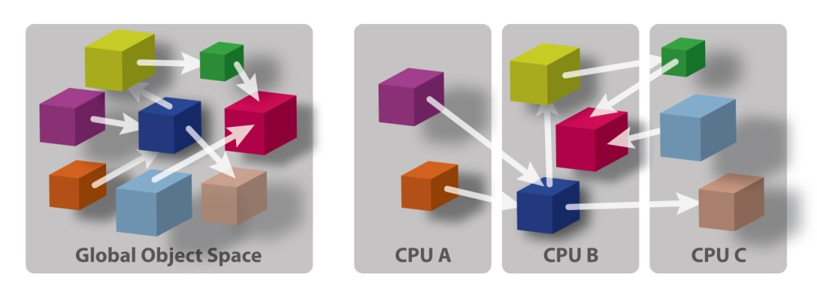
Migratable Objects (aka Processor Virtualization)
Benefits
Software engineering
  Number of virtual processors can be independently controlled
  Separate VPs for different modules
Message driven execution
  Adaptive overlap of communication
  Predictability :
    Automatic out-of-core
  Asynchronous reductions
Dynamic mapping
  Heterogeneous clusters
    Vacate, adjust to speed, share
  Automatic checkpointing
  Change set of processors used
  Automatic dynamic load balancing
  Communication optimization
Programmer: [Over] decomposition into virtual processors
Runtime: Assigns VPs to processors
Enables adaptive runtime strategies
Implementations: Charm++, AMPI
User View
System View

Slide 7
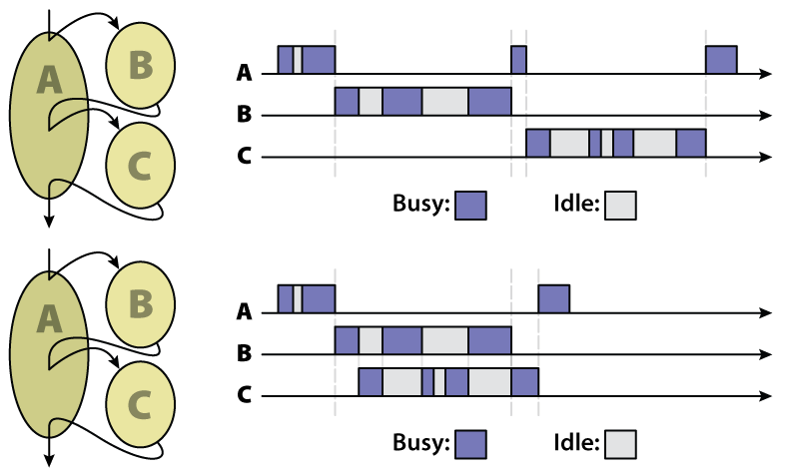
Adaptive overlap and modules
SPMD and Message-Driven Modules
(From A. Gursoy, Simplified expression of message-driven programs and quantification of their impact on performance, Ph.D Thesis, Apr 1994)
Modularity, Reuse, and Efficiency with Message-Driven Libraries: Proc. of the Seventh SIAM Conference on Parallel Processing for Scientific Computing, San Fransisco, 1995
Notes:
This is very nicely illustrated in a figure I borrowed from Attila Gursoy’s thesis. Module A needs to avail services from Module B and C. In a message-passing paradigm, these modules cannot execute concurrently, thus idle times in one modules cannot be substituted by computations from another module. This is possible in message-driven paradigm. We therefore base our component architecture on a message-driven runtime system, called Converse. We describe Converse next.

Slide 8
Realization: Charm++’s Object Arrays
A collection of data-driven objects
  With a single global name for the collection
  Each member addressed by an index
    [sparse] 1D, 2D, 3D, tree, string, ...
  Mapping of element objects to processors handled by the system
A[0]
A[1]
A[2]
A[3]
A[..]
User’s view

Slide 9
Realization: Charm++’s Object Arrays
A collection of data-driven objects
  With a single global name for the collection
  Each member addressed by an index
    [sparse] 1D, 2D, 3D, tree, string, ...
  Mapping of element objects to processors handled by the system
A[0]
A[1]
A[2]
A[3]
A[..]
User’s view
System view
A[0]
A[3]

Slide 10
Charm++: Object Arrays
A collection of data-driven objects
  With a single global name for the collection
  Each member addressed by an index
    [sparse] 1D, 2D, 3D, tree, string, ...
  Mapping of element objects to processors handled by the system
A[0]
A[1]
A[2]
A[3]
A[..]
User’s view
System view
A[0]
A[3]

Slide 11
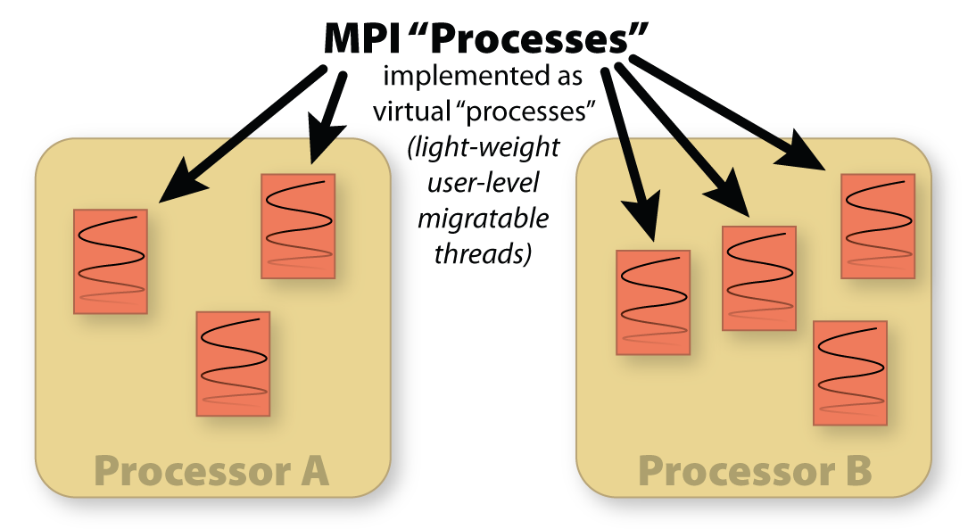
AMPI: Adaptive MPI

Slide 12
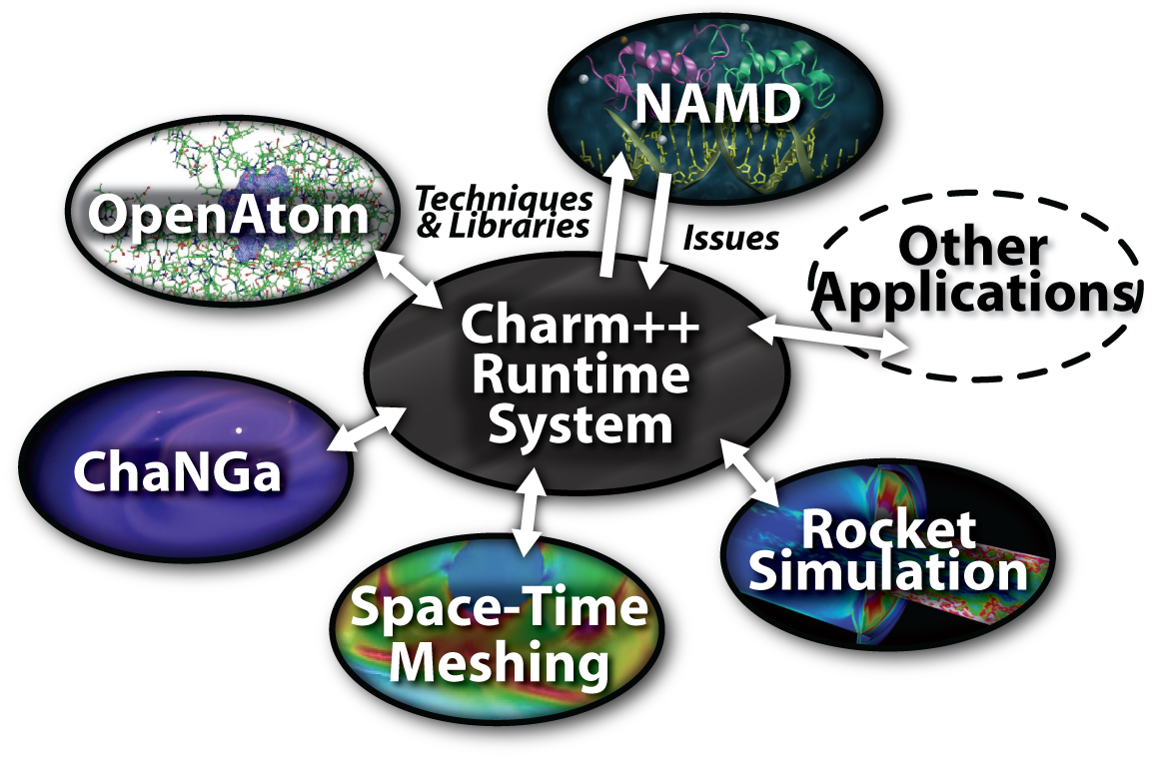
Charm++ and CSE Applications
Well-known molecular simulations application
Gordon Bell Award, 2002
Nano-Materials..
Synergy
Computational Astronomy
Enabling CS technology of parallel objects and intelligent runtime systems has led to several CSE collaborative applications

Slide 13
Collaborations
Topic | Collaborators | Institute
Biophysics | Schulten | UIUC
Rocket Center | Heath, et al | UIUC
Space-Time Meshing | Haber, Erickson | UIUC
Adaptive Meshing | P. Geubelle | UIUC
Quantum Chem. + QM/MM on ORNL LCF | Dongarra, Martyna/Tuckerman, Schulten | IBM/NYU/UTK
Cosmology | T. Quinn | U. Washington
Fault Tolerance, FastOS | Moreira/Jones | IBM/ORNL
Cohesive Fracture | G. Paulino | UIUC
IACAT | V. Adve, R. Johnson, D. Padua D. Johnson, D. Ceperly, P. Ricker | UIUC
UPCRC | Marc Snir, W. Hwu, etc. | UIUC
Contagion (agents sim.) | K. Bisset, M. Marathe, .. | Virginia Tech.

Slide 14
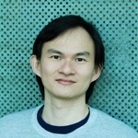
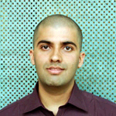
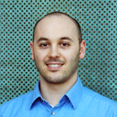
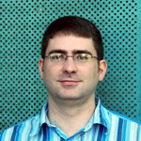
So, What’s new?
Four PhD dissertations completed or soon to be completed:
Chee Wai Lee: Scalable Performance Analysis (now at OSU)
Abhinav Bhatele: Topology-aware mapping
Filippo Gioachin: Parallel debugging
Isaac Dooley: Adaptation via Control Points
I will highlight results from these as well as some other recent results

Slide 15
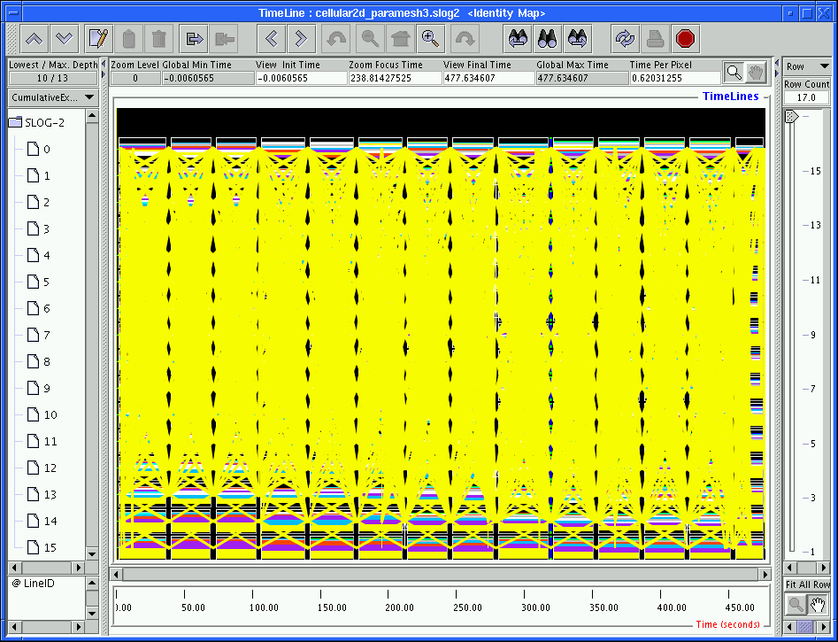
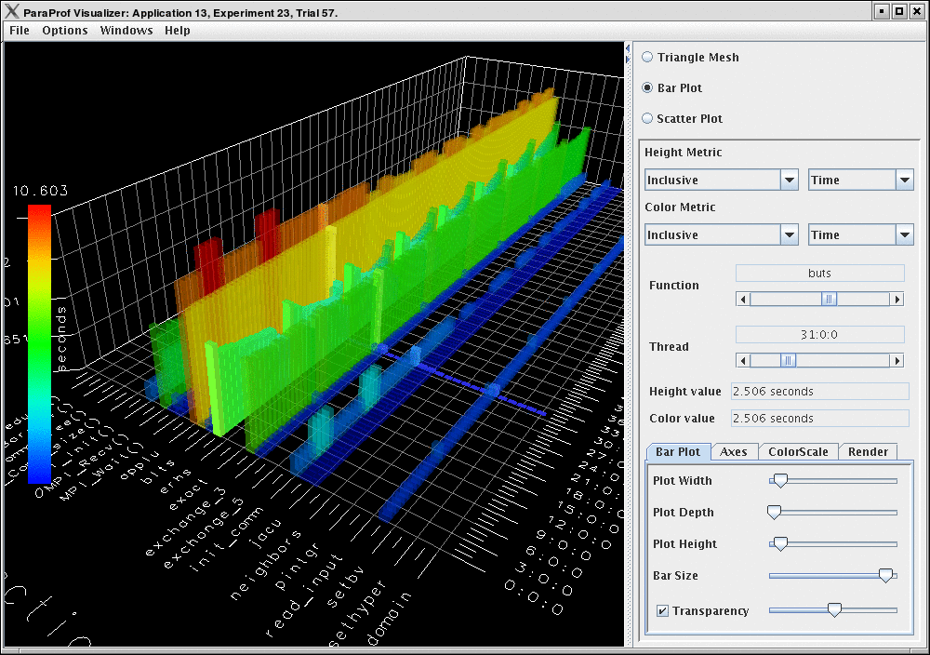
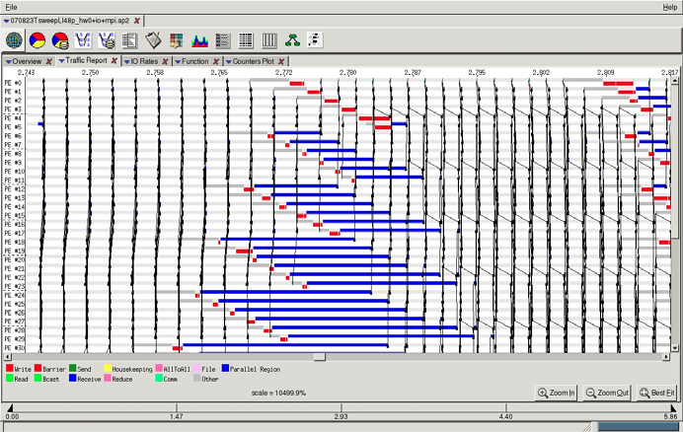
Techniques in Scalable and Effective Performance Analysis
Thesis Defense - 11/10/2009
By Chee Wai Lee
Notes:
Thank Attendees and Committee.
The thesis – investigate and develop techniques to enhance effectiveness of performance analysis process for applications scaled to large numbers of processors.
Lead-out: In this presentation, I will …

Slide 16
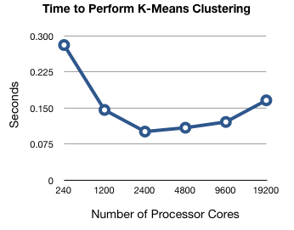
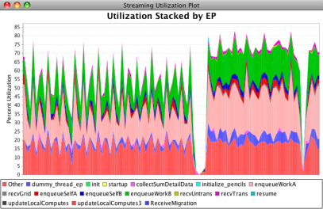
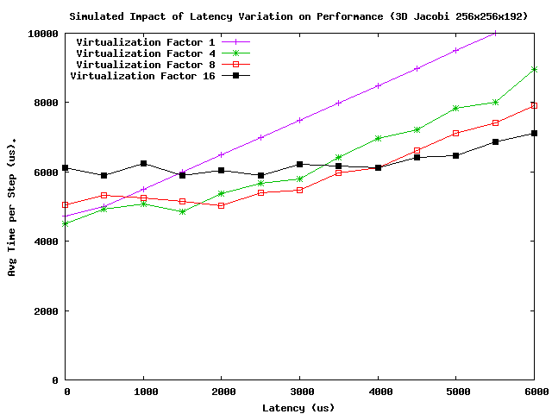
Scalable Performance Analysis
Scalable performance analysis idioms
  And tool support for them
Parallel performance analysis
  Use end-of-run when machine is available to you
  E.g. parallel k-means clustering
Live streaming of performance data
  stream live performance data out-of-band in user-space to enable powerful analysis idioms
What-if analysis using BigSim
  Emulate once, use traces to play with tuning strategies, sensitivity analysis, future machines

Slide 17
Live Streaming System Overview
Notes:
Start Demo video.

Slide 18
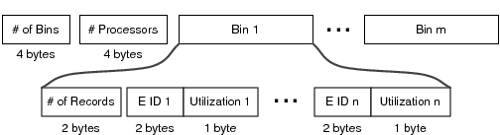
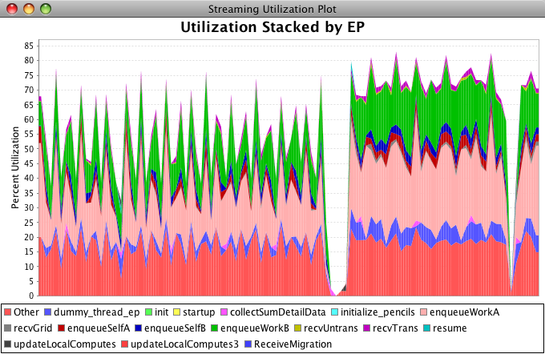
Visualization

Slide 19
Debugging on Large Machines
We use the same communication infrastructure that the application uses to scale
  Attaching to running application
    48 processor cluster
      28 ms with 48 point-to-point queries
      2 ms with a single global query
  Example: Memory statistics collection
    12 to 20 ms up to 4,096 processors
    Counted on the client debugger
F. Gioachin, C. W. Lee, L. V. Kalé: “Scalable Interaction with Parallel Applications”, in Proceedings of TeraGrid'09, June 2009, Arlington, VA.

Slide 20
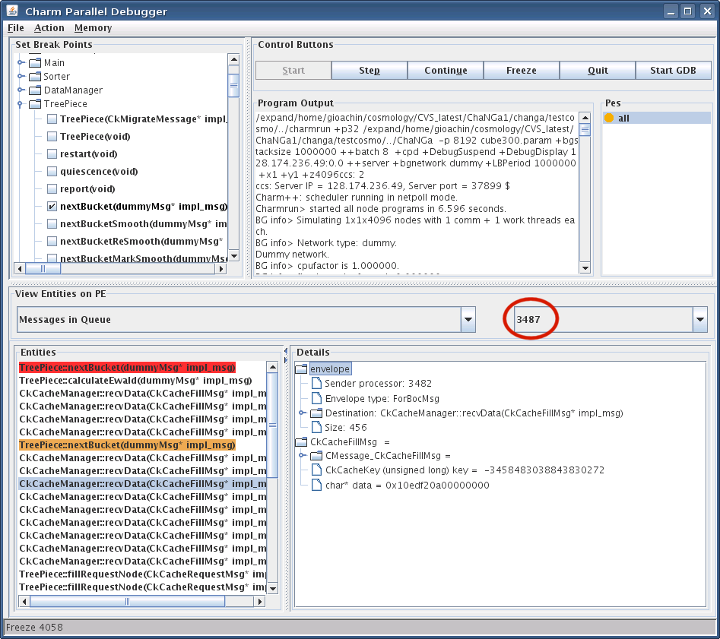

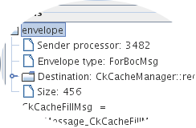
Consuming Fewer Resources
Virtualized Debugging
Processor Extraction
Execute program
recording message
ordering
Step 1
F. Gioachin, G. Zheng, L. V. Kalé: “Robust Record-Replay with Processor Extraction”, PPL Technical Report, April 2010
Has bug
appeared?
Select
processors
to record
Replay application
with detailed
recording enabled
Step 2
Replay selected
processors as
stand-alone
Step 3
F. Gioachin, G. Zheng, L. V. Kalé: “Debugging Large Scale Applications in a Virtualized Environment”, PPL Technical Report, April 2010
Is problem
solved?
Done

Slide 21
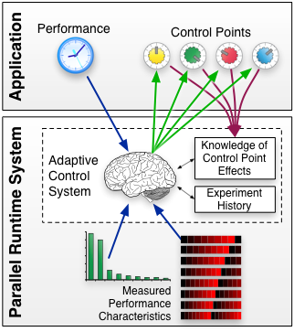
Automatic Performance Tuning
The runtime system dynamically reconfigures applications
Tuning/Steering is based on runtime observations :
  Idle time, overhead time, grain size, # messages, critical paths, etc.
Applications expose tunable parameters AND information about the parameters
Isaac Dooley, and Laxmikant V. Kale, Detecting and Using Critical Paths at Runtime in Message Driven Parallel Programs, 12th Workshop on Advances in Parallel and Distributed Computing Models (APDCM 2010) at IPDPS 2010.

Slide 22

Automatic Performance Tuning
A 2-D stencil computation is dynamically repartitioned into different block sizes.
The performance varies due to cache effects.

Slide 23
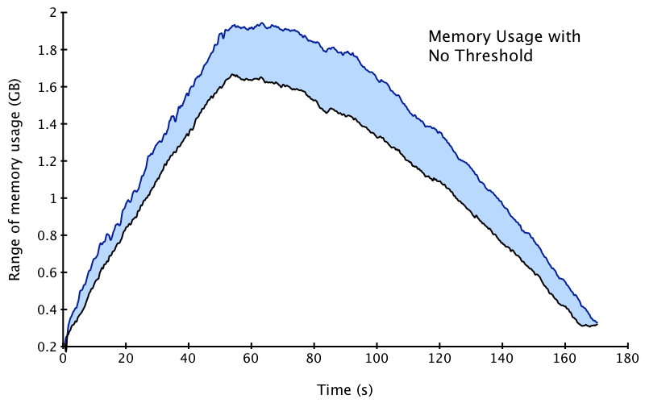
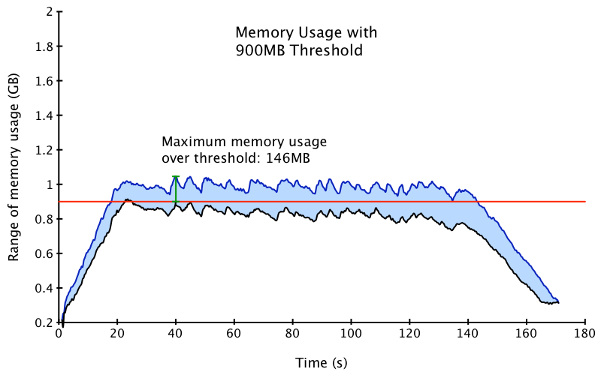
Memory Aware Scheduling
The Charm++ scheduler was modified to adapt its behavior.
It can give preferential treatment to annotated entry methods when available memory is low.
The memory usage for an LU Factorization program is reduced, enabling further scalability.
Isaac Dooley, Chao Mei, Jonathan Lifflander, and Laxmikant V. Kale, A Study of Memory-Aware Scheduling in Message Driven Parallel Programs, PPL Technical Report 2010

Slide 24
Load Balancing at Petascale
Existing load balancing strategies don’t scale on extremely large machines
  Consider an application with 1M objects on 64K processors
Centralized
  Object load data are sent to processor 0
  Integrate to a complete object graph
  Migration decision is broadcast from processor 0
  Global barrier
Distributed
  Load balancing among neighboring processors
  Build partial object graph
  Migration decision is sent to its neighbors
  No global barrier
Topology-aware
  On 3D Torus/Mesh topologies

Slide 25
A Scalable Hybrid Load Balancing Strategy
Dividing processors into independent sets of groups, and groups are organized in hierarchies (decentralized)
Each group has a leader (the central node) which performs centralized load balancing
A particular hybrid strategy that works well for NAMD
NAMD Apoa1 2awayXYZ

Slide 26
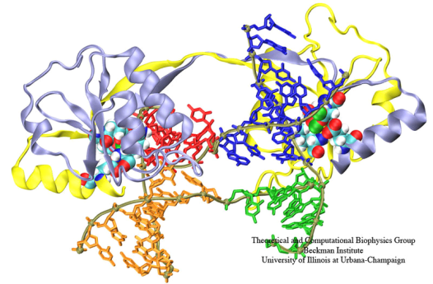
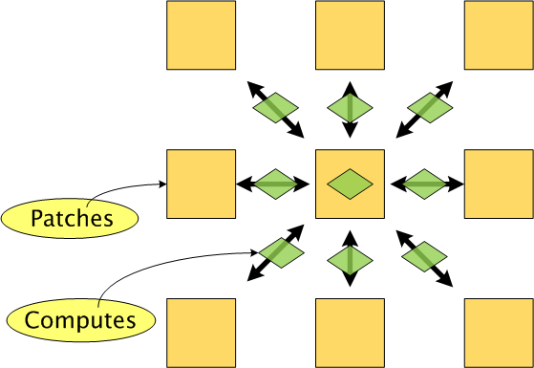
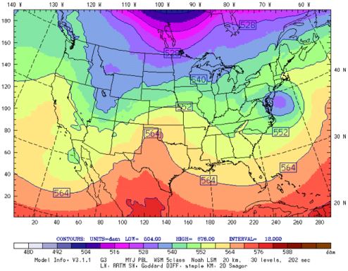
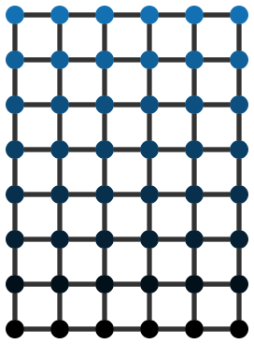
Topology Aware Mapping
Charm++ Applications
MPI Applications
Molecular Dynamics - NAMD
Weather Research & Forecasting Model

Slide 27
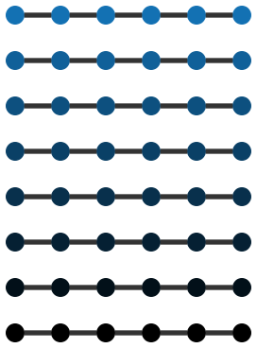




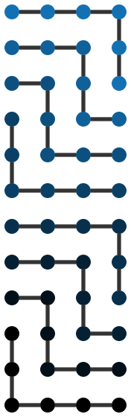
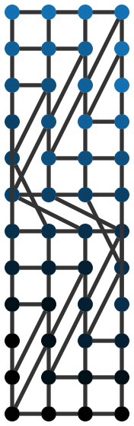
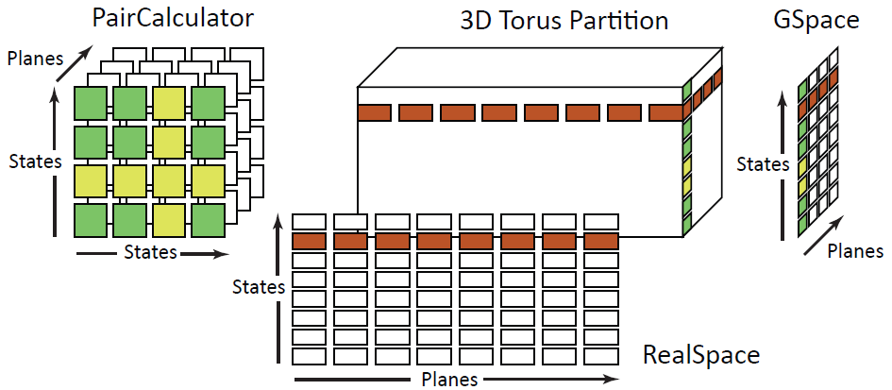
Automating the mapping process
Topology Manager API
Pattern Matching
Two sets of heuristics
  Regular Communication
  Irregular Communication
Object Graph 8 x 6
Abhinav Bhatele, I-Hsin Chung and Laxmikant V. Kale, Automated Mapping of Structured Communication Graphs onto Mesh Interconnects, Computer Science Research and Tech Reports, April 2010, http://hdl.handle.net/2142/15407
Processor Graph 12 x 4
A. Bhatele, E. Bohm, and L. V. Kale. A Case Study of Communication Optimizations on 3D Mesh Interconnects. In Euro-Par 2009, LNCS 5704, pages 1015–1028, 2009. Distinguished Paper Award, Euro-Par 2009, Amsterdam, The Netherlands.

Slide 28
Fault Tolerance
Automatic Checkpointing
  Migrate objects to disk
  In-memory checkpointing as an option
  Automatic fault detection and restart
Proactive Fault Tolerance
  “Impending Fault” Response
  Migrate objects to other processors
  Adjust processor-level parallel data structures
Scalable fault tolerance
  When a processor out of 100,000 fails, all 99,999 shouldn’t have to run back to their checkpoints!
  Sender-side message logging
  Latency tolerance helps mitigate costs
  Restart can be speeded up by spreading out objects from failed processor

Slide 29
Improving in-memory Checkpoint/Restart
Seconds
Application: Molecular3D
92,000 atoms
Checkpoint Size:
624 KB per core (512 cores)
351 KB per core (1024 cores)

Slide 30
Team-based Message Logging
Designed to reduce memory overhead of message logging.
Processor set is split into teams.
Only messages crossing team boundaries are logged.
If one member of a team fails, the whole team rolls back.
Tradeoff between memory overhead and recovery time.

Slide 31
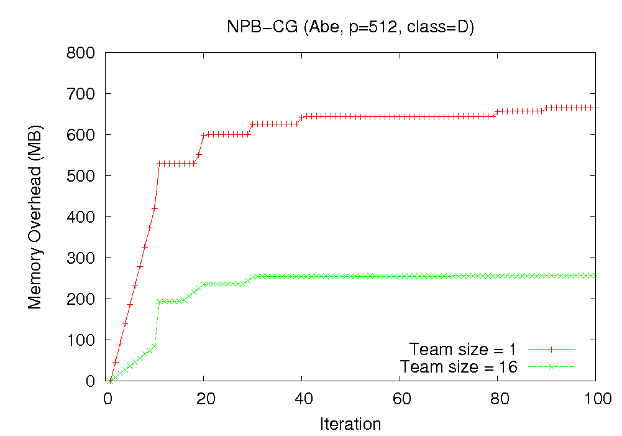
Improving Message Logging
62% memory overhead reduction

Slide 32
Accelerators and Heterogeneity
Reaction to the inadequacy of Cache Hierarchies?
GPUs, IBM Cell processor, Larrabee, ..
It turns out that some of the Charm++ features are a good fit for these
For cell and LRB: extended Charm++ to allow complete portability
Kunzman and Kale, Towards a Framework for Abstracting Accelerators in Parallel Applications: Experience with Cell, finalist for best student paper at SC09

Slide 33
ChaNGa on GPU Clusters
ChaNGa: computational astronomy
Divide tasks between CPU and GPU
CPU cores
  Traverse tree
  Construct and transfer interaction lists
Offload force computation to GPU
  Kernel structure
  Balance traversal and computation
  Remove CPU bottlenecks
    Memory allocation, transfers

Slide 34
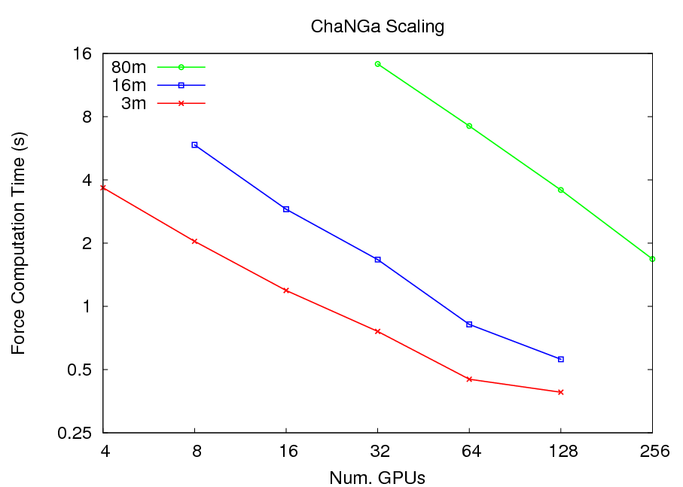
Scaling Performance

Slide 35
CPU-GPU Comparison

Slide 36
Scalable Parallel Sorting
Sample Sort
  O(p²) combined sample becomes a bottleneck
Histogram Sort
  Uses iterative refinement to achieve load balance
  O(p) probe rather than O(p²)
  Allows communication and computation overlap
  Minimal data movement

Slide 37
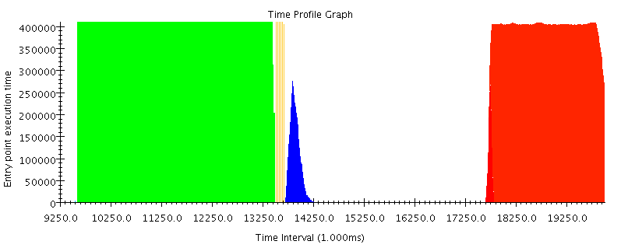
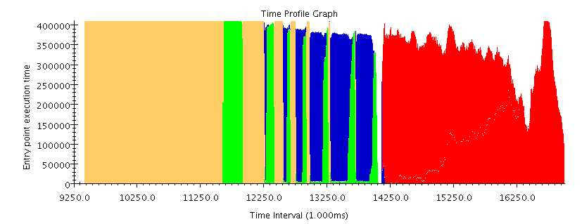
Effect of All-to-All Overlap
100%
Histogram
Processor Utilization
Send data
Sort all data
Idle time
All-to-All
Merge
100%
Sort by chunks
Processor Utilization
Send data
Tests done on 4096 cores of Intrepid (BG/P) with 8 million 64-bit keys per core.
Splice data
Merge

Slide 38
Histogram Sort Parallel Efficiency
Uniform Distribution
Non-uniform Distribution
Tests done on Intrepid (BG/P) and Jaguar (XT4) with 8 million 64-bit keys per core.
Solomonik and Kale, Highly Scalable Parallel Sorting, In Proceedings of IPDPS 2010

Slide 39
BigSim: Performance Prediction
Simulating very large parallel machines
  Using smaller parallel machines
Reasons
  Predict performance on future machines
  Predict performance obstacles for future machines
  Do performance tuning on existing machines that are difficult to get allocations on
Idea:
  Emulation run using virtual processor processors (AMPI)
    Get traces
  Detailed machine simulation using traces

Slide 40
Objectives and Simulation Model
Objectives:
  Develop techniques to facilitate the development of efficient peta-scale applications
  Based on performance prediction of applications on large simulated parallel machines
Simulation-based Performance Prediction:
  Focus on Charm++ and AMPI programming models Performance prediction based on PDES
  Supports varying levels of fidelity
    processor prediction, network prediction.
  Modes of execution :
    online and post-mortem mode

Slide 41
Other work
High level parallel languages
  Charisma, Multiphase Shared Arrays, CharJ, …
Space-time meshing
Operations research: integer programming
State-space search: restarted, plan to update
Common Low-level Runtime System
Blue Waters
Major Applications:
  NAMD, OpenAtom, QM/MM, ChaNGa,

Slide 42
Summary and Messages
We at PPL have advanced migratable objects technology
  We are committed to supporting applications
  We grow our base of reusable techniques via such collaborations
Try using our technology:
  AMPI, Charm++, Faucets, ParFUM, ..
  Available via the web http://charm.cs.uiuc.edu

Slide 43
Workshop 0verview
Keynote: James Browne
Tomorrow morning
System progress talks
Adaptive MPI
BigSim: Performance prediction
Parallel Debugging
Fault Tolerance
Accelerators
….
Applications
Molecular Dynamics
Quantum Chemistry
Computational Cosmology
Weather forecasting
Panel
Exascale by 2018, Really?!

