Slide 1
“"TSUBAME2.0, or the long road from tiny clusters to Petascale, and its Possible Contributions to High-Resolution Natural Disaster Simulations”
Satoshi Matsuoka Global Scientific Information and Computing Center (GSIC)
Tokyo Institute of Technology (Tokyo Tech.)
Charm++ Workshop, UIUC, 2010/04/19

Slide 2
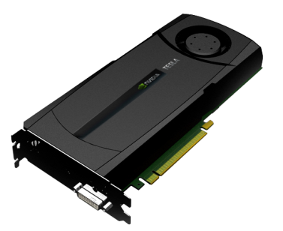
“Accelerator”
Special-purpose HW for accelerated computation
Small production units, special market, expensive
Lack of software inheritance over HW generations
Restriction of application area
Only accelerates special type/portion of computation
Computation that “does not fit” impossible or slow
Restriction of programming model
Specialized programming model, language
Restrictions on pointers, recursion, strucures, etc.
No OS or other system software

Slide 3
GPUs as Modern-Day Vector Engines
Two types of HPC Workloads
High Computational Density
=> Traditional Accelerators
High Memory Access Frequency
=> Traditional Vector SCs
Scalar CPUs are so-so at both
=> Massive system for speedup
GPUs are both modern-day vector engines and high compute density accelerators => Efficient Element of Next-Gen Supercomputers
Small memory, limited CPU-GPU BW, high-overhead communication with CPUs and other GPUs, lack of system-level SW support incl. fault tolerance, programming, …
Accelerators: Grape, ClearSpeed,
N-body
MatMul
GPUs
Computational Density
Cache-based
CPUs
FFT
Vector SCs
Cray, SX…
CFD
Memory Access Frequency
Our Research@ Tokyo Tech
Notes:
Each processor type has their target application area.
At first, vector processors are best for memory intensive applications including FFT.
Today, many of existing processors are cache based processors and works for
many kinds of applications.
And there are many kinds of accelerator devices, such as ClearSpeed, CELL B.E., etc.,
they can achieve high performance especially in compute intensive applications.
Unlike the conventional accelerators, GPUs have very high memory bandwidth,
so they are also good at memory intensive applications.
In addition, latest high-end GPUs support double precision operations.
GPUs now also work as commodity vector processors.
Thus, the target application area of GPUs is very wide.

Slide 4
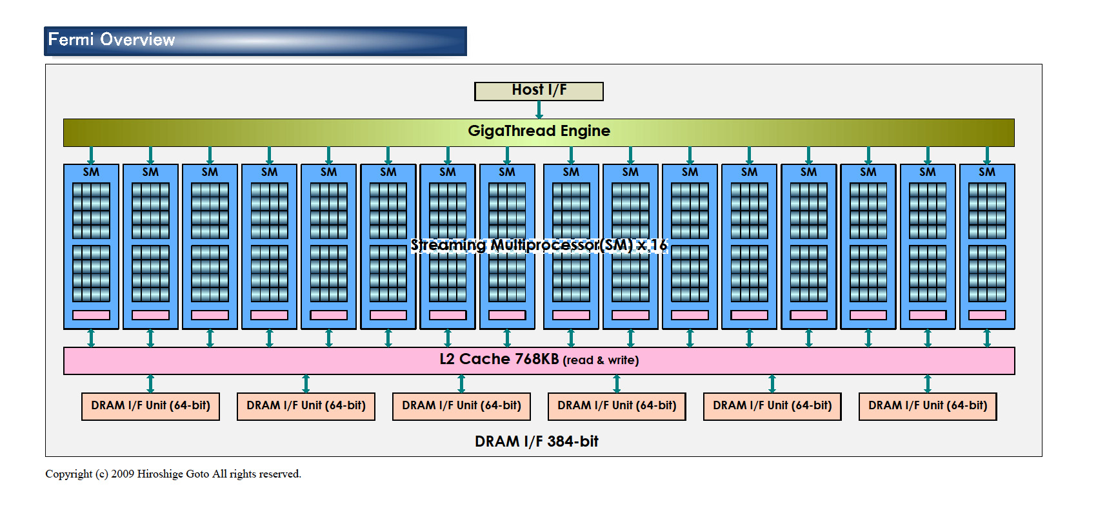
NVIDIA Fermi Many Core, Multhreaded, SIMD-Vector, MIMD Parallel Architecture
(Figure by Kazushige Goto)

Slide 5
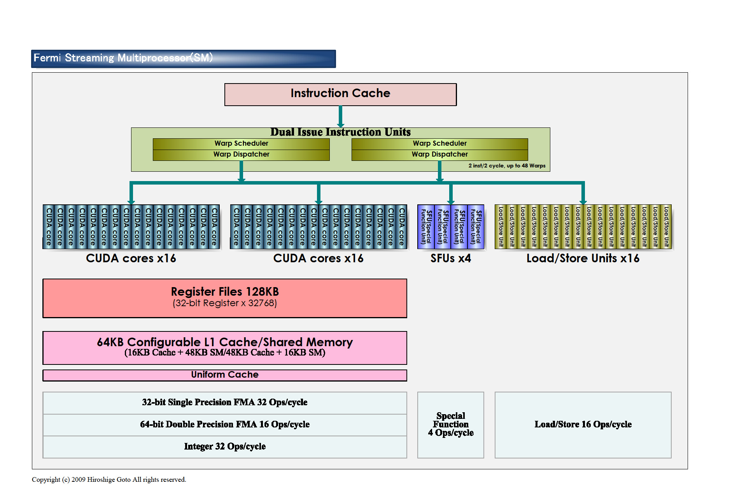
NVIDIA Fermi SM “Core”
(Figure by Kazushige Goto)

Slide 6
Parallelism in CUDA GPUs
SIMD-Vector Parallelism (WARP)
32 (16) way vector parallelism
SPMD Thread Parallelism
Thousands of threads possible
Cyclic pipeline, hides memory latency, like vector processor but allows out-of-order execution
MIMD Parallelism (Kernel)
Up to #SM (16 in Fermi) Kernels with independent instruction streams
GPU-CPU Hybrid Parallelism
Streaming Data Transfer Enginer via PCI-e
Massive Parallelism: GPU, Short Latency: CPU
In single chip sharing memory in Denver generation

Slide 7

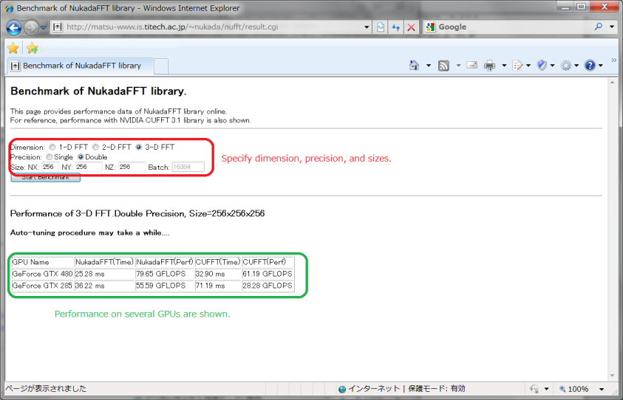
NukadaFFT 1.0 release !?
[SC08,SC09]
NukadaFFT library is a very fast auto-tuning FFT library for CUDA GPUs.
Tuning Parameters:
Factorization of transform size.
# of threads launched per SM.
Padding insertion patters for shared memory
The library generates many kinds of FFT kernels and selects the fastest one. (exhaustive)
For more details, you can see GTC 2010 Research Poster, or catch the author.
You can try online benchmarking as for the size you are interested in.
http://matsu-www.is.titech.ac.jp/~nukada/nufft/
4~5 times more power efficient than CPUs per socket

Slide 8
Compute Intensive or Memory Bound ?
■ 2-dimensional diffusion Equation
FLOP = 9
Byte = 4*6 = 24 byte : read 5, write 1
FLOP/Byte = 9/24 = 0.375

Slide 9
Arithmetic INTENSITY: FLOP/Byte
FLOP = number of FP operation for applications
Byte = Byte number of memory access for applications
F = Peak Performance of floating point operation
B = Peak Memory Bandwidth

Slide 10
GPU vs. CPU Performance
Roofline model: Williams, Patterson 2008
Communication s of the ACM
FLOP/Byte = F/B
5th-
WENO
GeForce
GTX 285
708 GFlops
Performance [GFlops]
6th-order
5th-order
N-Body (N log N)
x10 -20
compute bound
3rd-order
FFT (NUKADA)
SGEMM
2nd-order
MD (N log N)
1st-order
Core i7
Extreme
Riken BMT
LBM
x5-10 memory bound
2
-D diffusion

Slide 11
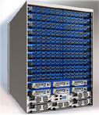

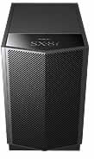
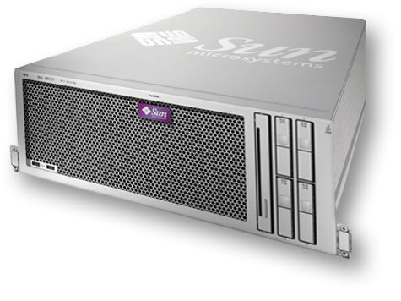

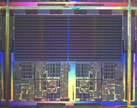
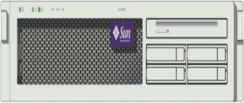
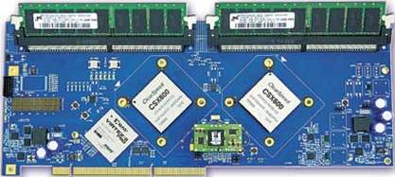
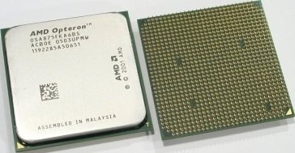
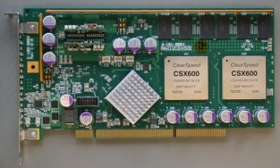
The TSUBAME 1.0 “Supercomputing Grid Cluster” Spring 2006
Unified IB network
Voltaire ISR9288 Infiniband 10Gbps x2 (DDR next ver.) ~1310+50 Ports ~13.5Terabits/s (3Tbits bisection)
Sun Galaxy 4 (Opteron Dual core 8-socket) 10480core/655Nodes 21.4Terabytes 50.4TeraFlops OS Linux (SuSE 9, 10) NAREGI Grid MW
“Fastest Supercomputer in Asia” 7th on the 27th Top500@38.18TF
10Gbps+External Network
NEC SX-8i (for porting)
500GB
48disks
500GB
48disks
500GB
48disks
Storage 1.0 Petabyte (Sun “Thumper”) 0.1Petabyte (NEC iStore) Lustre FS, NFS, WebDAV (over IP) 50GB/s aggregate I/O BW
ClearSpeed CSX600 SIMD accelerator 360 boards, 35TeraFlops(Current))

Slide 12




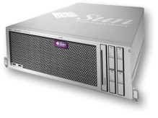
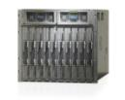
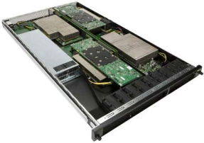

TSUBAME 1.2 Experimental Evolution (Oct. 2008) The first “Petascale” SC in Japan
Storage 1.5 Petabyte (Sun x4500 x 60) 0.1Petabyte (NEC iStore) Lustre FS, NFS, CIF, WebDAV (over IP) 60GB/s aggregate I/O BW
Voltaire ISR9288 Infiniband x8 10Gbps x2 ~1310+50 Ports ~13.5Terabits/s (3Tbits bisection)
NEC SX-8i
500GB
48disks
10Gbps+External NW
Sun x4600 (16 Opteron Cores) 32~128 GBytes/Node 10480core/655Nodes 21.4TeraBytes 50.4TeraFlops OS Linux (SuSE 9, 10) NAREGI Grid MW
Unified Infiniband network
87.1TF Linpack (The First GPU Supercomputer on Top500) [IPDPS10]
NEW Deploy: GCOE TSUBASA Harpertown-Xeon 90Node 720CPU 8.2TeraFlops
PCI-e
ClearSpeed CSX600 SIMD accelerator 648 boards, 52.2TeraFlops SFP/DFP
170 Nvidia Tesla 1070, ~680 Tesla cards High Performance in Many BW-Intensive Apps 10% power increase over TSUBAME 1.0

Slide 13
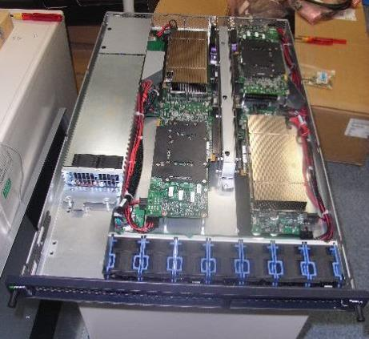
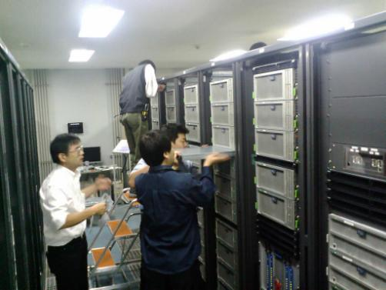
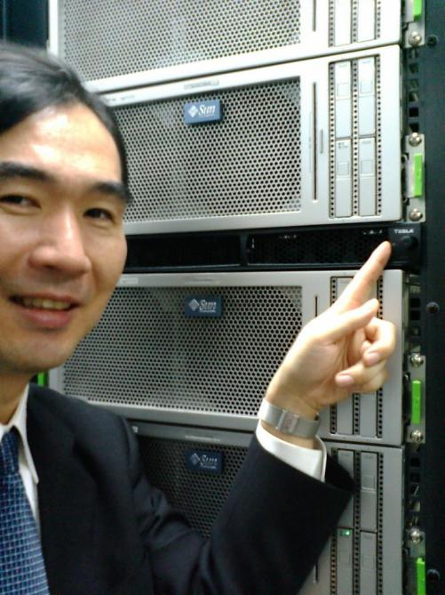
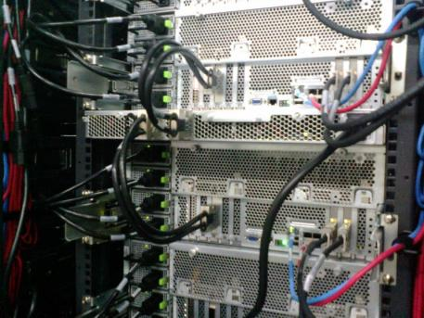
680 Unit Tesla Installation… While TSUBAME in Production Service (!)

Slide 14
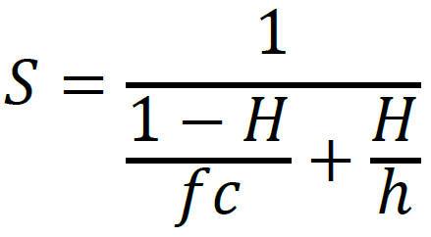
Case for Hybrid Multi/Many-Core Architectures
Apps scaling governed by two components
Weak Scaling part, O(N) concurrency
Strong (Finite) Scaling Part, O(K) concurrency
S: speedup, H: fraction of O(N) execution, h: #weak-scale cores, f: #strong scale cores, c: speedup of strong scaling cores over weak scaling cores
10PF machine analysis
Hybrid (TSUBAME2+): h=500,000, f=10,000, c=4, H=95% => S= 317,460 (Efficiency 63.4%)
Homo (BG/Q): h=800,000, f=10,000, c=1, H=95% => S= 161,616 (Efficiency 20.2%)
Gap will widen with Exascale, 1-10 billion cores
N>>K for peta-exa

Slide 15
DOE SC Applications Overview (following slides courtesy John Shalf @ LBL NERSC)
NAME
Discipline
Problem/Method
Structure
MADCAP
Cosmology
CMB Analysis
Dense Matrix
FVCAM
Climate Modeling
AGCM
3D Grid
CACTUS
Astrophysics
General Relativity
3D Grid
LBMHD
Plasma Physics
MHD
2D/3D Lattice
GTC
Magnetic Fusion
Vlasov-Poisson
Particle in Cell
PARATEC
Material Science
DFT
Fourier/Grid
SuperLU
Multi-Discipline
LU Factorization
Sparse Matrix
PMEMD
Life Sciences
Molecular Dynamics
Particle

Slide 16
Latency Bound vs. Bandwidth Bound?
How large does a message have to be in order to saturate a dedicated circuit on the interconnect?
N^{1/2} from the early days of vector computing
Bandwidth Delay Product in TCP
System
Technology
MPI Latency
Peak Bandwidth
Bandwidth Delay Product
SGI Altix
Numalink-4
1.1us
1.9GB/s
2KB
Cray X1
Cray Custom
7.3us
6.3GB/s
46KB
NEC ES
NEC Custom
5.6us
1.5GB/s
8.4KB
Myrinet Cluster
Myrinet 2000
5.7us
500MB/s
2.8KB
Cray XD1
RapidArray/IB4x
1.7us
2GB/s
3.4KB
Bandwidth Bound if msg size > Bandwidth*Delay
Latency Bound if msg size < Bandwidth*Delay
Except if pipelined (unlikely with MPI due to overhead)
W/HW DMA a few 100ns but not much more
(Original slide courtesy John Shalf @ LBL)
Notes:
In the absence of a discrete event simulator, this metric is a “reasonably good guess” for determining when messages are latency bound. However, a full event simulation would be required to determine this with certainty.
A more accurate model would be LOGP. However, the LOGP model does not make sense unless constructed in the context of a *real* interconnect parameters. For an arbitrary interconnect, the logp model has too many free parameters (not very useful).

Slide 17
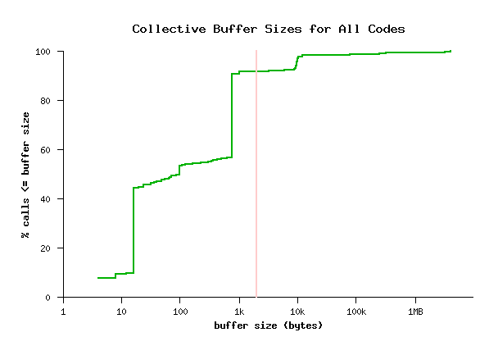
Collective Buffer Sizes are Small(!) - demise of message passing in strong scaling -
95% Latency Bound!!!
Don’t need all that global NW bandwidth?
Great news for weak scaling codeA
Bad news for strong scaling codeD
Weak scaling=> What if O(n²) complexity=> infeasible runtime!
(Original slide courtesy John Shalf @ LBL)

Slide 18
Scaling Peta to Exa Design?
Shorten latency as much as possible
Extreme multi-core incl. vectors
“Fat” nodes, exploit short-distance interconnection
Direct cross-node DMA (e.g., put/get for PGAS)
Hide latency if cannot be shortened
Dynamic multithreading (Old: dataflow, New: GPUs)
Trade Bandwidth for Latency (so we do need BW…)
Departure from simple mesh system scaling
Change Latency-Starved Algorithms
From implicit Methods to direct/hybrid methods
Structural locality, extraploation, stochastics (MC)
Need good programming model/lang/system for this…

Slide 19
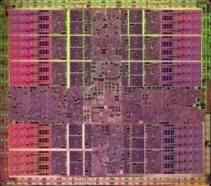

From TSUBAME 1.2 to 2.0: From CPU Centric to GPU Centric Nodes for Scaling High Bandwidth in Network & I/O!!
GDDR5 150GB STREAM 3-6 GB per socket
GPU Vector
CPU “Centric”
Core Dataset
Core Dataset Vector Parallel
DDR3 15-20GB STREAM persocket 2GB/core
CPU Roles - OS - Services - Irregular Sparse
- “Mixed” Algorithms
“These are Isomorphic but much higher BW”
IOH
PCIe x16
4GB/s
PCIe x8
2GB/s
PCIe x8
2GB/s x n
IOH
IOH
54GB
40Gbps IB
IB QDR HCA
IB QDR HCA
CPU
GPU
1GB
IB QDR HCA
Flash 200GB 400MB/s
40Gbps IB x n
Fat I/O

Slide 20
History of TSUBAME
2006
TSUBAME 1.0
85TFlops/1.1PB
2007
TSUBAME 1.1
100TFlops/1.6PB
2008
TSUBAME 1.2
160TFlops/1.6PB
No.1 in Asia
“Everybody’s Supercomputer”
x86 CPU+ClearSpeed
Storage and ClearSpeed Accelerator Enhancement
680 Tesla GPU Enhancement (s1070 x 170)
2010/11/01
TSUBAME 2.0
2.4PFlops/7.1PB
Japan’s First Petascale Supercomputer x30 TSUBAME Performance

Slide 21
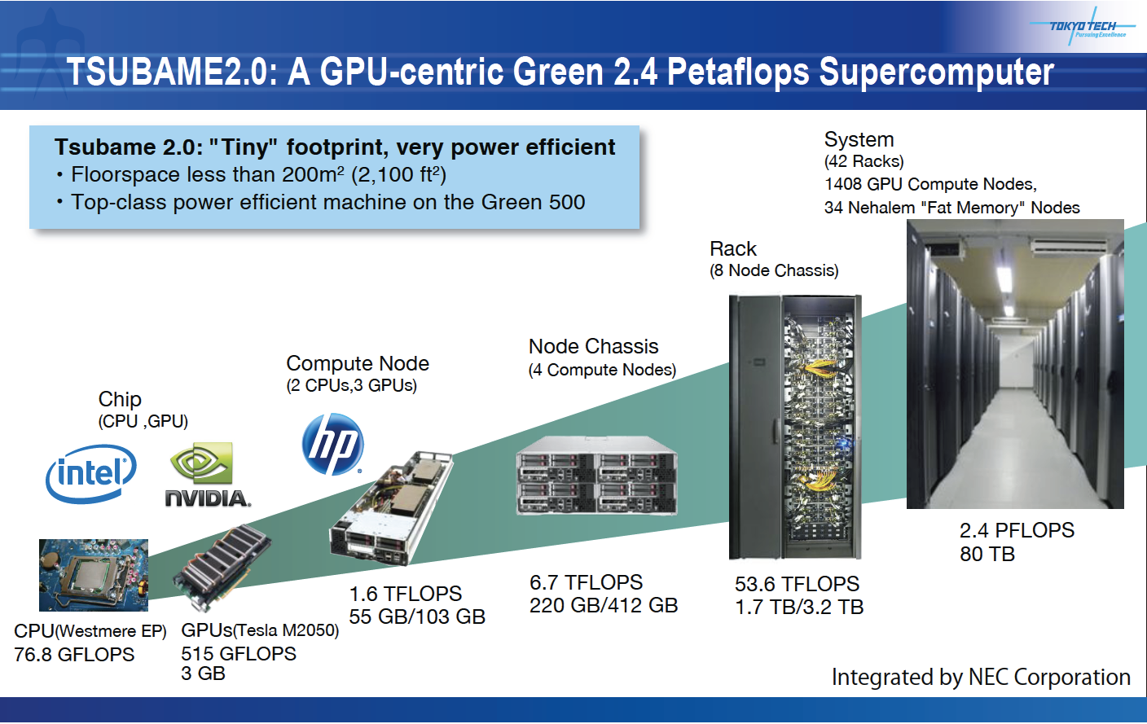
TSUBAME2.0 Nov. 1, 2011 See Live @ Tokyo Tech Booth #1127
TSUBAME 2.0 New Development

Slide 22
Highlights of TSUBAME 2.0 Design (Oct. 2010) w/NEC-HP
2.4 PF multi-core x86 + Fermi GPGPU
1432 nodes, Intel Westmere/Nehalem EX
4224 NVIDIA Tesla (Fermi) M2050 GPUs
>100,000 total CPU and GPU “cores”, High Bandwidth
1.9 million “CUDA cores”, 32K x 4K = 130 million CUDA threads(!)
0.72 Petabyte/s aggregate mem BW,
Effective 0.3-0.5 Bytes/Flop, restrained memory capacity (100TB)
Optical Dual-Rail IB-QDR BW, full bisection BW(Fat Tree)
200Tbits/s, Likely fastest in the world, still scalable
Flash/node, ~200TB (1PB in future), 660GB/s I/O BW
>7 PB IB attached HDDs, 15PB Total HFS incl. LTO tape
Low power & efficient cooling, comparable to TSUBAME 1.0 (~1MW); PUE = 1.28 (60% better c.f. TSUBAME1)
Virtualization and Dynamic Provisioning of Windows HPC + Linux, job migration, etc.

Slide 23








TSUBAME2.0 Global Partnership
NEC: Main Contractor, overall system integration, Cloud-SC mgmt. HP: Node R&D, Green; Microsoft: WindowsHPC, Cloud & VM NVIDIA: Fermi GPUs, CUDA; Voltaire: QDR Infiniband Network DDN: Large-Scale Storage; Intel: Westmere & Nehalem-EX CPUs PGI: GPU Vectorizing Compiler Tokyo Tech. GSIC: Base system design, GPU technologies, Green
US
USA
Israel
Japan

Slide 24
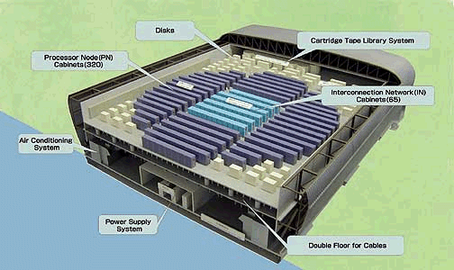


TSUBAME 2.0 Performance
Earth Simulator ⇒ TSUBAME 4years x 40 Downsizing
Japanese NLP >10PF(2012)
TSUBAME2.0 2.4 PF (2010-2H)
US >10P (2011~12)
10PF
US/EU Petascales (Peak) (2008)
US NSF/DoE (2009 2H)
TSUBAME ⇒ TSUBAME 2.0 x40 downsizing again?
1PF
U-Tokyo, Kyoto-U, Tsukuba T2K 61-140TF (2008)
Others
BlueGene/L 360TF(2005)
TSUBAME 1.2 Upgrade (3Q2008) 170TF
100TF
Earth Simulator 40TF (2002)
TSUBAME 1.1 Upgrade 111TF, 1.6 PB, 128GB nodes (1Q2008)
10TF
TSUBAME 1.0 80TF (1Q2006)
Titech (Tokyo Tech) Campus Grid
KEK 59TF BG/L+SR11100
1TF
1.3TF
2002
2004
2006
2008
2010
2012

Slide 25
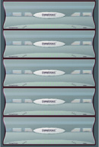




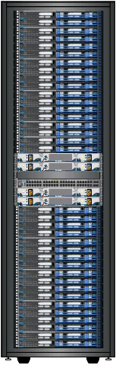
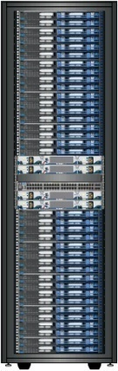

TSUBAME2.0 System Overview (2.4 Pflops/15PB)
Petascale Storage： Total 7.13PB(Lustre + Accelerated NFS Home)
Lustre Partition 5.93PB
Home NFS/ iSCSI
MDS,OSS
HP DL360 G6 30nodes
Storage
DDN SFA10000x5
(10 enclosures x5)
Lustre (5 Filesystems)
OSS: 20 OST: 5.9PB
MDS: 10 MDT: 30TB
Storage Server
HP DL380 G6 4nodes
BlueArc Mercury 100 x2
Storage
DDN SFA10000 x1
（10 enclosures x1）
x5
Tape System Sun SL8500 8PB
SuperTitenet
OSS x20
MDS x10
NFS,CIFS x4
NFS,CIFS,iSCSI Accelerationx2
SuperSinet3
Node Interconnect: Optical, Full Bisection, Non-Blocking, Dual-Rail QDR Infiniband
Core Switch
Edge Switch
Edge Switch(w/10GbE)
12 switches
179 switches
6 switches
Mgmt Servers
Voltaire Grid Director 4700 IB QDR: 324ports
Voltaire Grid Director 4036 IB QDR : 36 ports
Voltaire Grid Director 4036E
IB QDR:34ports 10GbE: 2ports
Compute Nodes： 2.4PFlops(CPU+GPU) 224.69TFlops(CPU)
“Thin” Nodes
NEW DESIGN Hewlett Packard CPU+GPU High BW Compute Nodes x 1408
Intel Westmere-EP 2.93GHz
(TB 3.196GHz） 12Cores/node
Mem:55.8GB(=52GiB)or 103GB(=96GiB)
GPU NVIDIA M2050 515GFlops, 3GPUs/node
SSD 60GB x 2 120GB ※55.8GB node
120GB x 2 240GB ※103GB node
OS: Suse Linux Enterprise + Windows HPC
“Medium” Nodes
“Fat” Nodes
HP 4Socket Server 24nodes
CPU Nehalem-EX 2.0GHz 32Cores/node
Mem:137GB(=128GiB)
SSD 120GB x 4 480GB
OS: Suse Linux Enterprise
HP 4Socket Server 10nodes
CPU Nehalem-EX 2.0GHz 32Core/node
Mem:274GB(=256GiB)x8
549GB(=512GiB) x2
SSD 120GB x 4 480GB
OS: Suse Linux Enterprise
・・・・・・
6.14TFLOPS
24 nodes
2.56TFLOPS
10 nodes
4224 NVIDIA “Fermi” GPUs
Memory Total：80.55TB
SSD Total：173.88TB
PCI –E gen2 x16 x2slot/node
1408nodes (32node x44 Racks)
GSIC:NVIDIA Tesla S1070GPU (34 units)

Slide 26
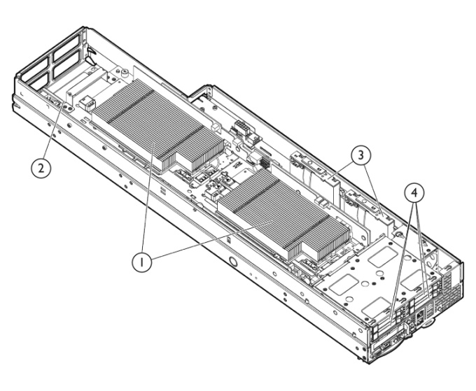

TSUBAME2.0 Compute Nodes
1408nodes：
4224GPUs：59,136 SIMD Vector Cores, 2175.36TFlops (Double FP)
2816CPUs, 16,896 Scalar Cores: 215.99TFlops
Total： 2391.35TFLOPS
Memory： 80.6TB (CPU) + 12.7TB (GPU)
SSD： 173.9TB
Thin Node
Infiniband QDR x2 (80Gbps)
HP SL390G7 (Developed for TSUBAME 2.0)
GPU: NVIDIA Fermi M2050 x 3 515GFlops, 3GByte memory /GPU CPU: Intel Westmere-EP 2.93GHz x2 (12cores/node)
Memory: 54, 96 GB DDR3-1333
SSD：60GBx2, 120GBx2
Total Perf
2.4PFlops
Mem： ~100TB SSD: ~200TB
34 nodes: 8.7TFlops
Memory: 6.0TB+GPU
SSD: 16TB+
IB QDR
PCI-e Gen2x16 x2
NVIDIA Tesla
S1070 GPU
HP 4 Socket Server
CPU: Intel Nehalem-EX 2.0GHz x4 (32cores/node)
Memory: 128, 256, 512GB DDR3-1066
SSD：120GB x4 (480GB/node)
4-1

Slide 27
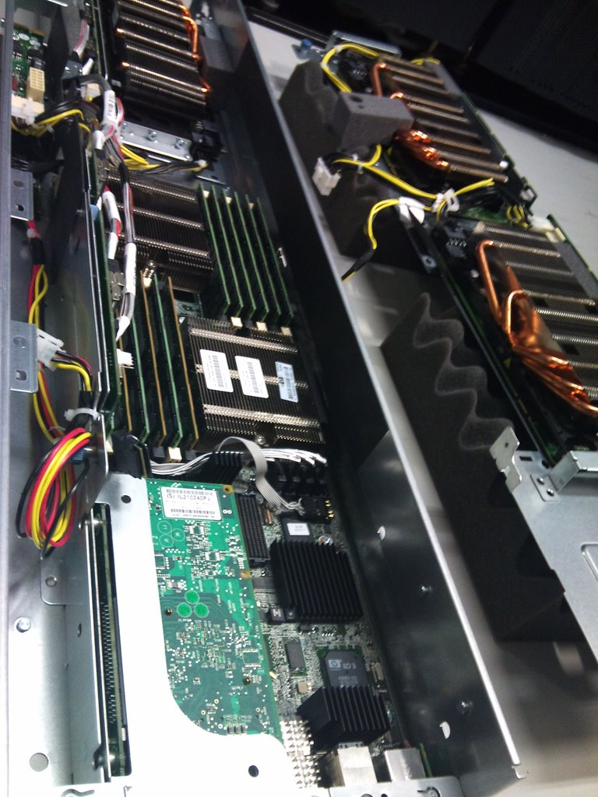
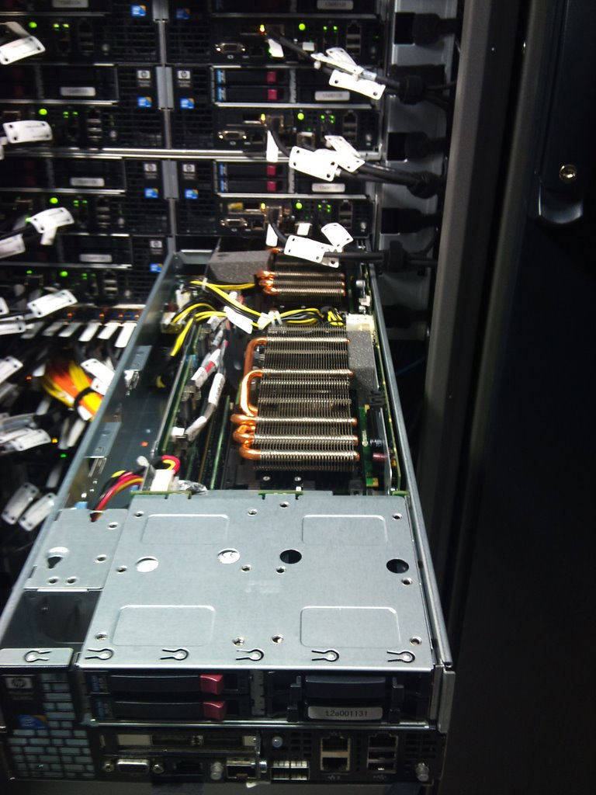

Slide 28
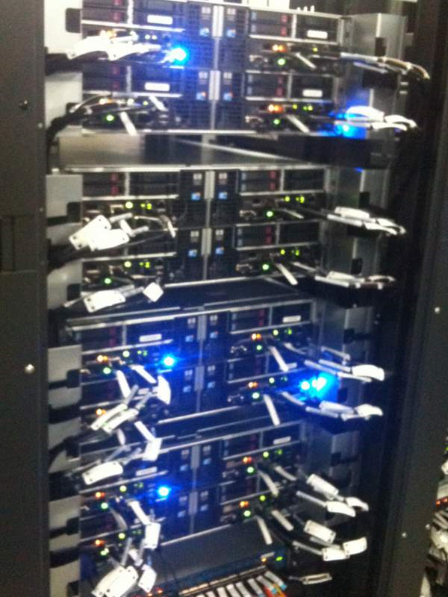
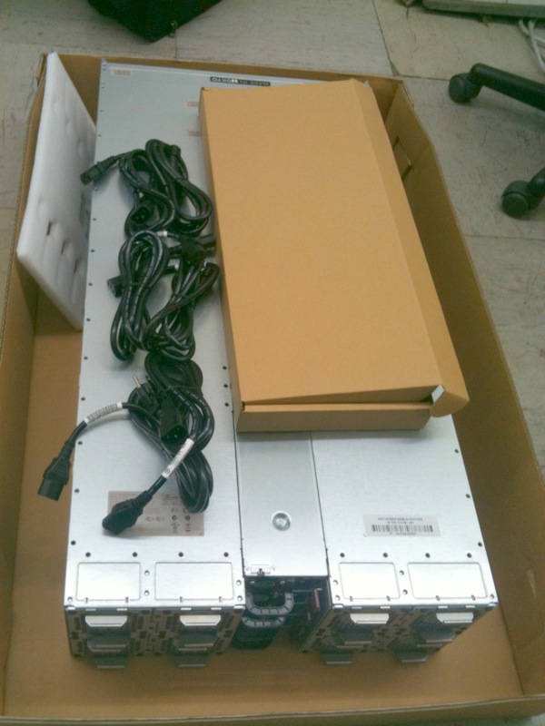

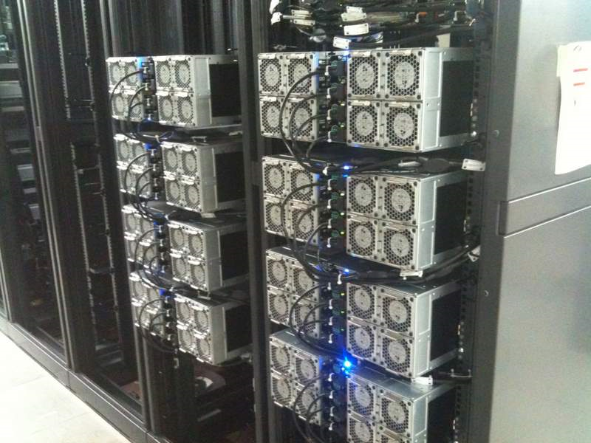

Slide 29
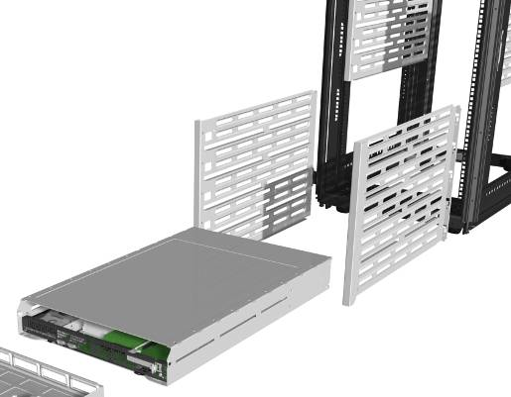
GPU-optimized node in HP Skinless Packaging
Typical Tsubame2 node:
2 Intel® Xeon® Processor X5670 (six-core 2.93Ghz)
54 GB or 96 GB memory
2 SSDs per node
Dual Rail IB
3 NVIDIA M2050 GPU board
Nodes go into chassis with shared fans and power
Chassis mounted into lightweight racks
Easy assembly
Lower weight
Reduced heat retention
Modular and flexible
Standard 19” racks
Notes:
HP introduced skinless packaging with its SL line last year. That concept was used here for Tsubame2

Slide 30
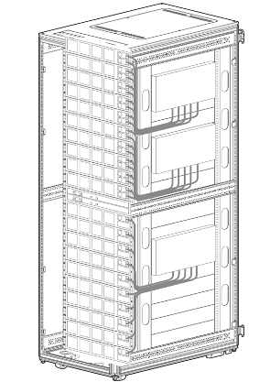

Compute Rack Building Block for Tsubame2
HP Modular Cooling System G2 rack
42U HP Modular Cooling System G2 rack
30 nodes per rack – 90 GPUs
8 chassis with Advanced Power Management
1 HP Network Switch for shared console and admin local area network
2 Airflow Dam (Liquid Cooled)
4 Voltaire 4036 Leaf Switch
Power distribution units
Power per rack approximately 35KW
PDU
Notes:
HP Modular Cooling System (MCS) G2 rack is designed for high density server and blade deployments. It re-circulates and cools the hot server exhaust air through the heat exchanger residing in the MCS G2 unit. The air is then expelled in front of the enclosed rack at a much lower temperature, providing sufficient cool air for a load of 35kW of servers or blades, or two racks at 17.5kW each.

Slide 31
Green and Reliable SC
Advanced Power Management
Dynamic Power Capping
Power monitoring
Node level power off/on
Thermal logic technologies
Shared power and fans
Energy-efficient fans
Three-phase load balancing
94% Platinum Common Slot Power Supplies
Monitoring Sensors (incl. GPUs)
Thermals
Power Consumption
Utilization
HW and SW Health checks
Real-Time Monitoring System
Power, thermals, performance, and health checks per node, thermals per rack．
【SNMP etc.】
Management of Various Sensors
Power
Power
Processes and Filters Info from Sensors and Stores it into the DB
Thermal Sensor
Storage Rack
Compute Nodes
Monitoring DB
Monitor Processor
Mgmt Console
Intake Temperture
【SNMP etc.】
Network Rack
AC Units
Power
Power
Power Consumption
【SNMP etc.】
Operator
4-52

Slide 32
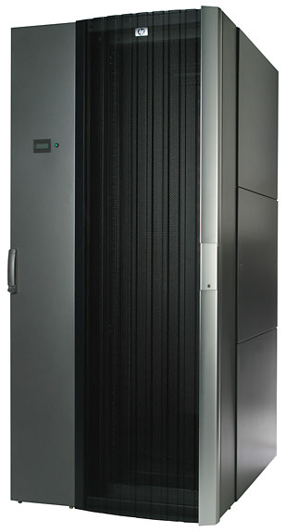
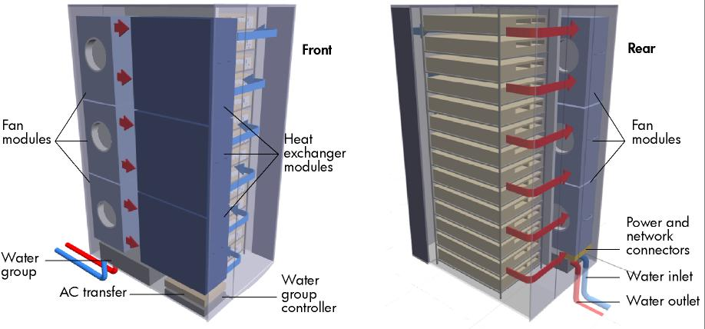
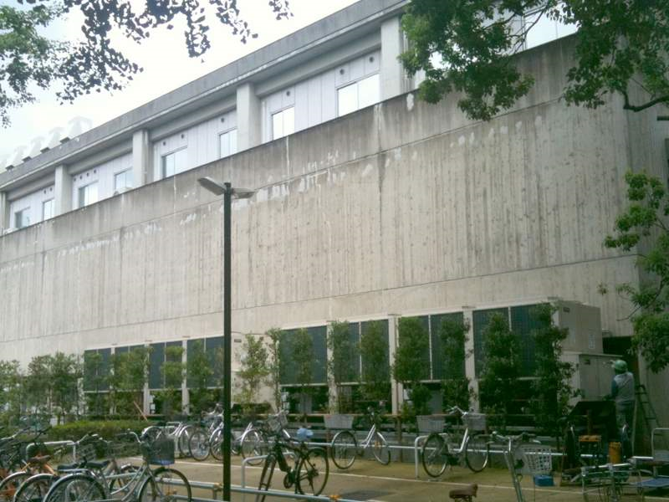
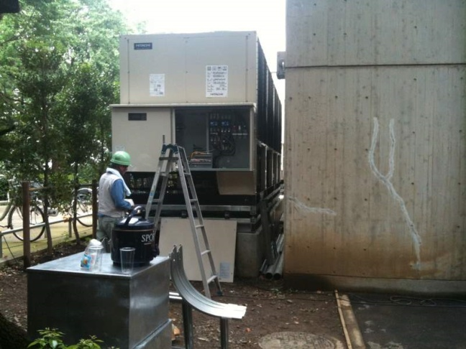
Cooling: Enhanced HP Modular Cooling System G2
HP’s water-cooled rack
Completely closed racks with their own heat exchanger.
1.5 x width of normal rack+rear ext.
Cooling for high density deployments
35kW of cooling capacity single rack
Highest Rack Heat Density ever
3000CFM Intake airflow with 7C chiller water
up to 2000 lbs of IT equipment
Uniform air flow across the front of the servers
Automatic door opening mechanism controlling both racks
Adjustable temperature set point
Removes 95% to 97% of heat inside racks
Polycarbonate front door reduces ambient noise considerably
~= Entire Earth Simulator (rack = 50TF)
Notes:
[Enter any extra notes here; leave the item ID line at the bottom]
Avitage Item ID: {{AFF6A2B1-ACA7-417D-AC97-DEB78CA0B166}}

Slide 33
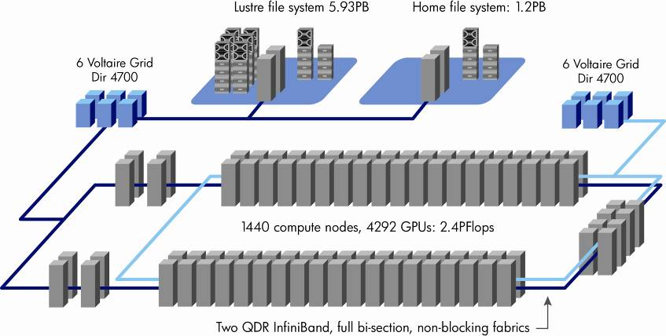
Pulling It All Together

Slide 34



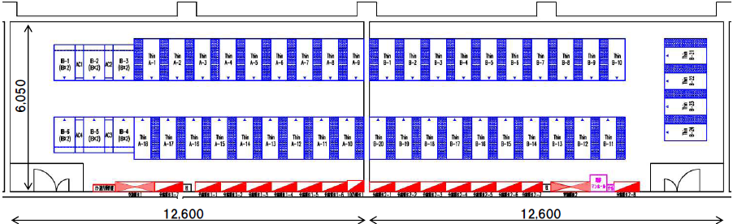
TSUBAME2.0 Layout (200m2 for main compute nodes)

Slide 35
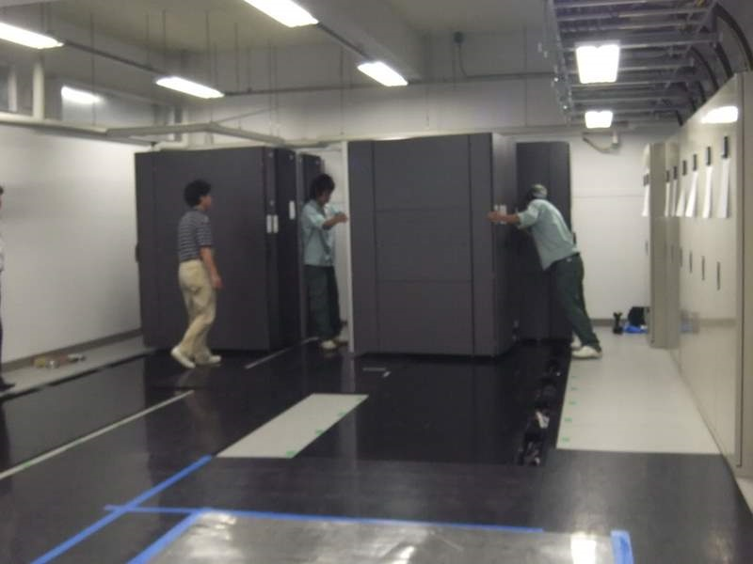
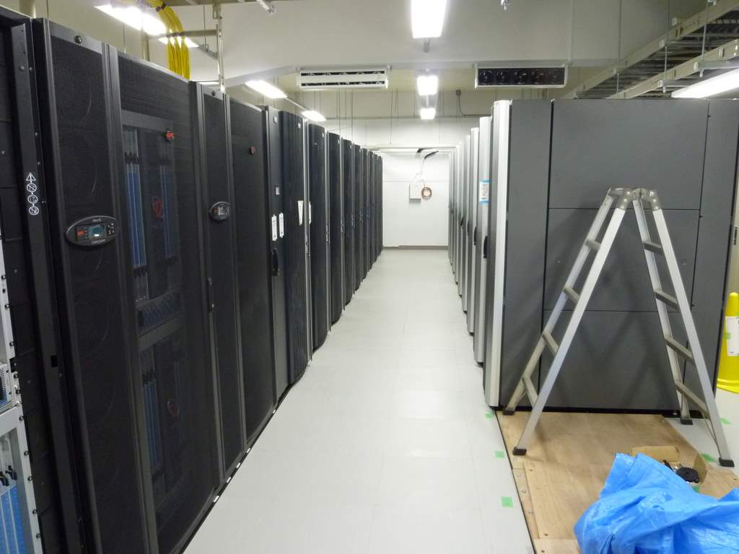
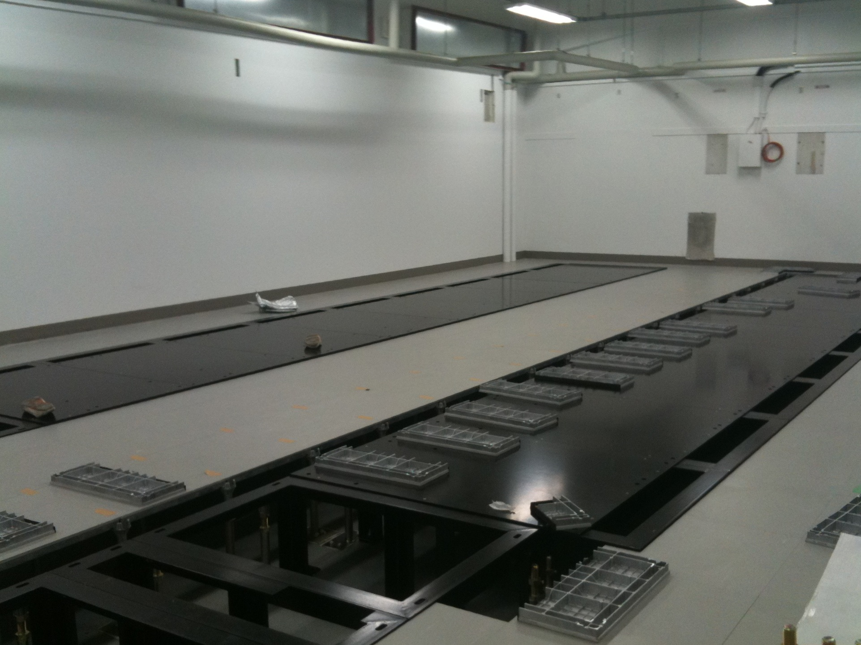
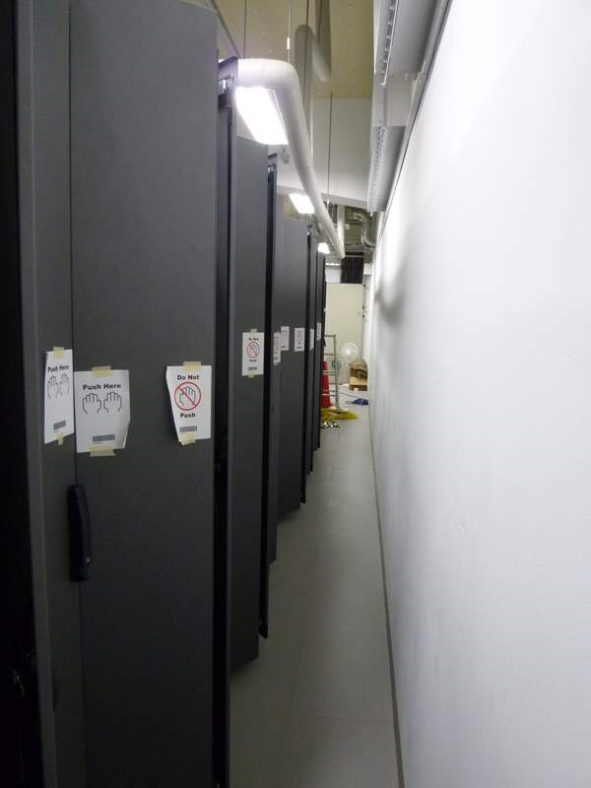
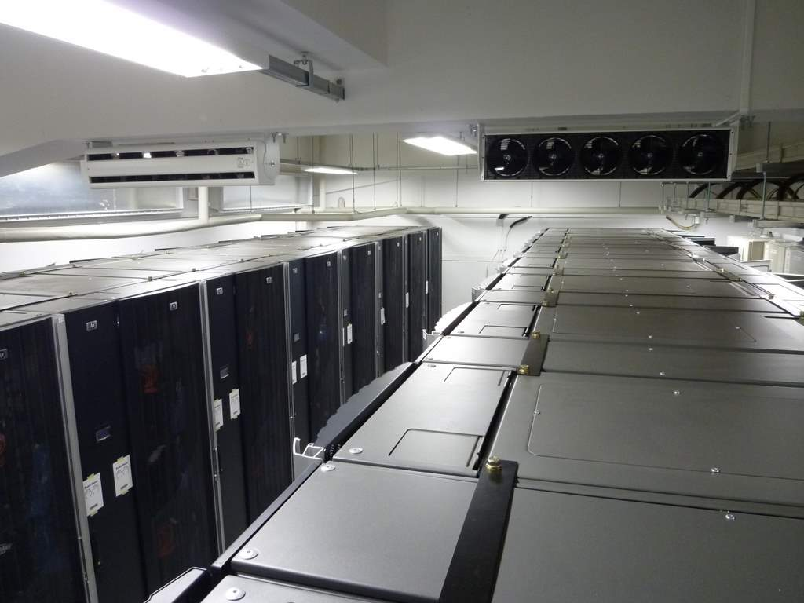

Slide 36
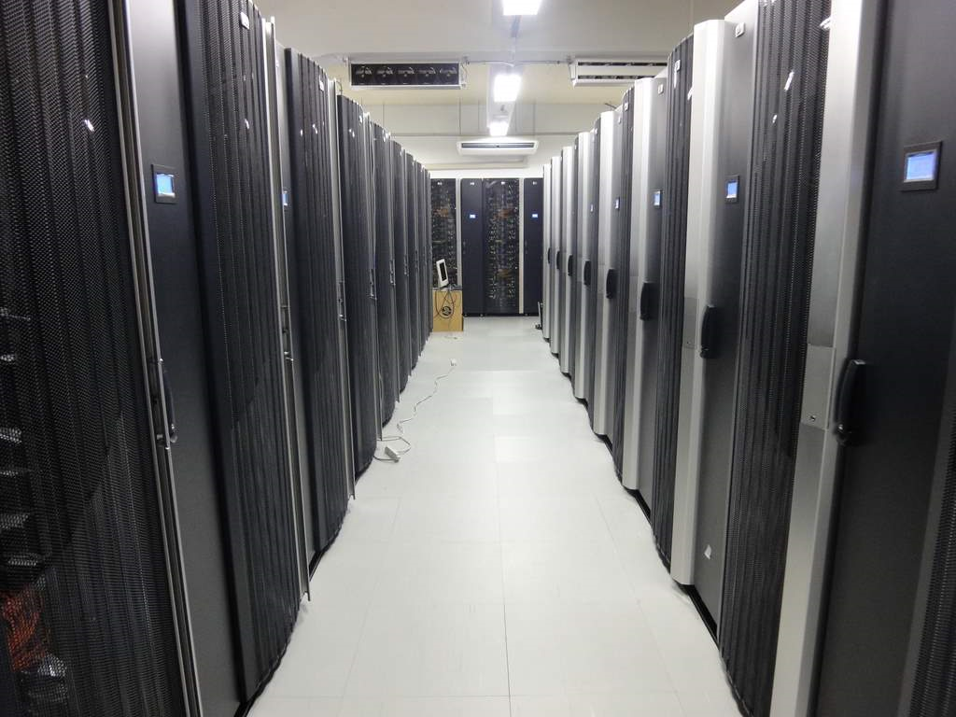
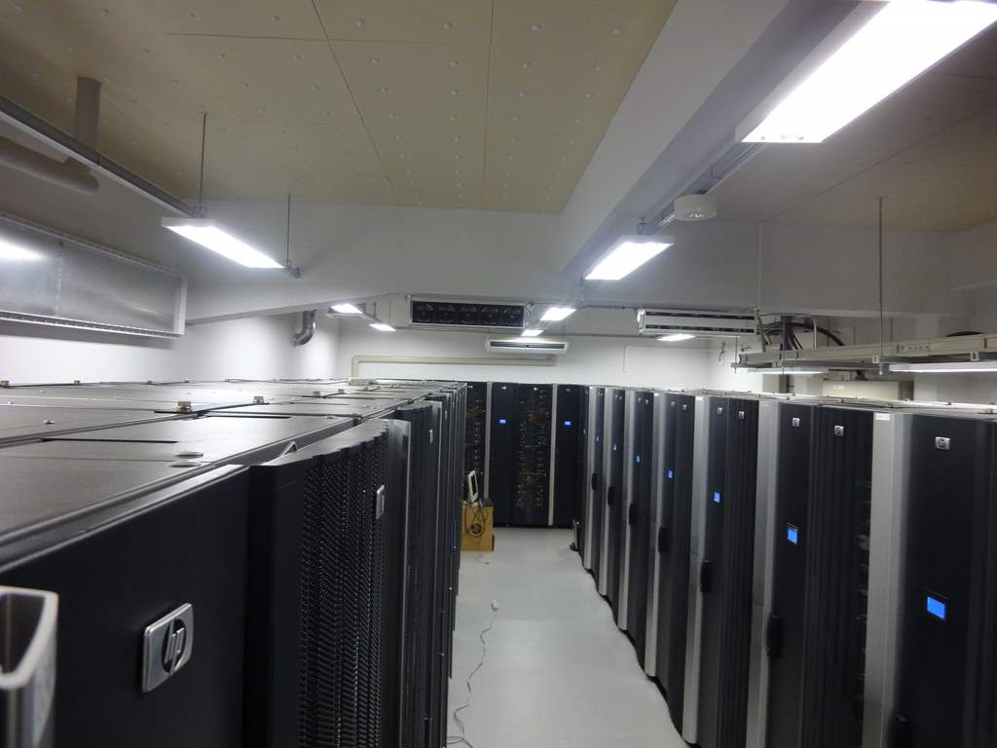
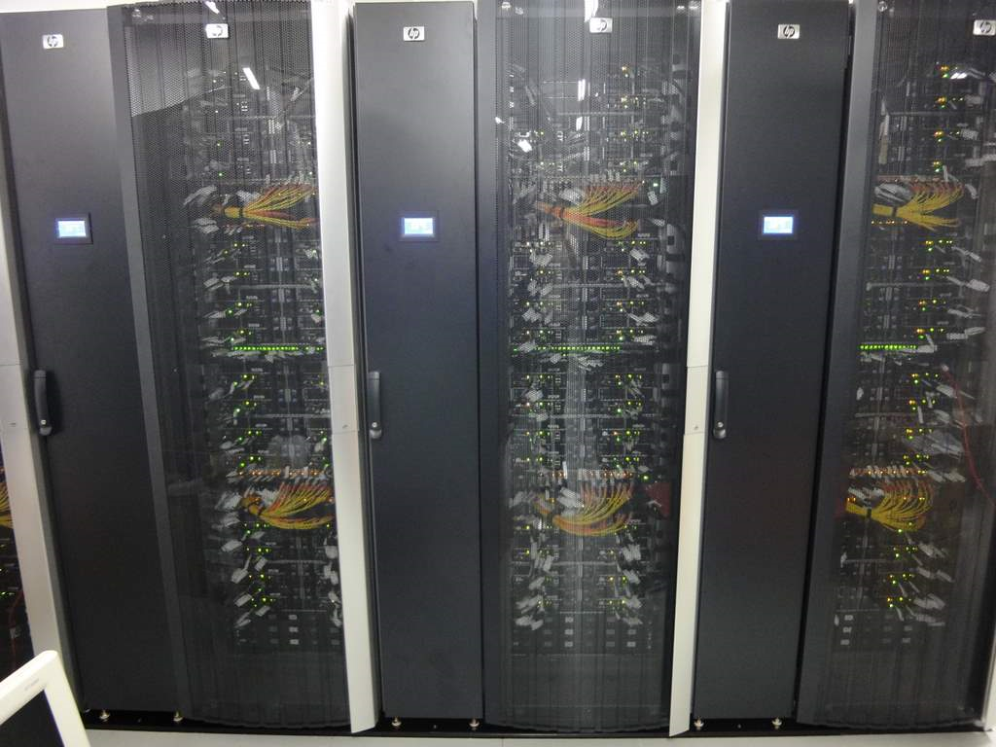
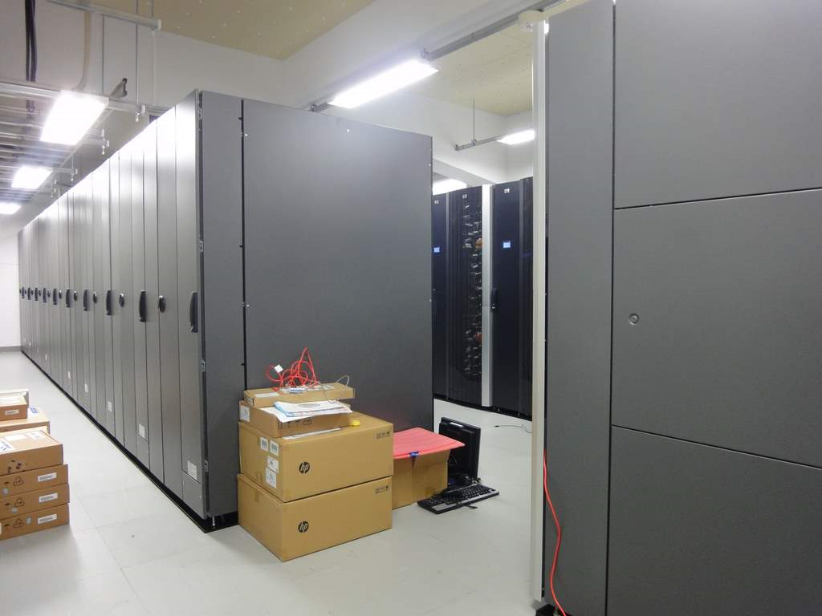
2.4 Petaflops, 1408 nodes
~50 compute racks + 6 switch racks
Two Rooms, Total 160m²
1.4MW (Max, Linpack), 0.48MW (Idle)

Slide 37

ORNL Jaguar and Tsubame 2.0 Similar Peak Performance, 1/4 the Size and Power
TSUBAME2.0 2.4PF

Slide 38

TSUBAME 2.0 Full Bisection Fat Tree, Optical, Dual Rail QDR Infiniband
Mgmt Nodes x51
10Gb Ethernet x2
Lustre Filesystem
Home/iSCSI Nodes
5 Units
20 Nodes
10 Nodes
IB and Ether
4 Nodes
2 Nodes
storage
server
storage
server
mercury
mercury
SFA10K
・・・・・
SFA10K
OSS
OSS
MDS
MDS
MDS
MDS
・・・
OSS
OSS
・・・
Mgmt
Server
Mgmt
Server
・・・
・・・・・・・
10Gb Ethernet x10
Voltarie Grid Director 4036E x6 + Grid Director 4036 x1
Optical Intra-Node Interconnect
8PB Sun SL8500
Voltaire Grid Director 4700 x12
SuperTitanet
Second Rail
First Rail
SuperSINET3
貴学ご提供のシステム
Full Bisection, Non blocking, Optical Fiber Connection
Edge SW#1
Edge SW#2
Edge SW#3
Edge SW#4
Edge Switch x2
・・・
・・・
・・・・・
Fat
Node
・・・・・・
Thin
Node
Thin
Node
Thin
Node
Thin
Node
Thin
Node
Thin
Node
Thin
Node
Thin
Node
Thin
Node
Thin
Node
Thin
Node
Thin
Node
Med.
Node
Med.
Node
Med.
Node
Med.
Node
Fat
Node
16 Nodes
Rack#1
16 Nodes
x44Racks
Medium Nodes x24
Fat Nodes x10
Thin Nodes x1408
TSUBAME2.0ネットワーク全体図
4-7

Slide 39





3500 Fiber Cables > 100Km

Slide 40


TSUBAME2.0 Storage
Multi-Petabyte storage consisting of Luster Parallel Filesystem Partition and NFS/CIFS/iSCSI Home Partition + Node SSD Acceleration
Lustre Parallel Filesystem Partition, 5.93PB
Home Partition 1.2PB
MDS：HP DL360 G6 x10
-CPU:Intel Westmere-EP x2 socket(12 Cores)
-Memory：51GB(=48GiB)
-IB HCA:IB 4X QDR PCI-e G2 x1port
OSS：HP DL360 G6 x20
-CPU:Intel Westmere-EP x2 socket(12 Cores)
-Memory：25GB(=24GiB)
-IB HCA：IB 4X QDR PCI-e G2 x2port
Storage：DDN SFA10000 x5
-Total Capacity：5.93PB
2TB SATA x 2950 Disks + 600GB SAS x 50 Disks
NFS/CIFS：HP DL380 G6 x4
-CPU:Intel Westmere-EP x2 socket(12 Cores)
-Memory：51GB(=48GiB)
-IB HCA:IB 4X QDR PCI-e G2 x2port
NFS/CIFS/iSCSI：BlueArc Mercury100 x2
-10GbE x2
ストレージ：DDN SFA10000 x1
-Total Capacity：1.2PB
2TB SATA x 600 Disks
1
2
3
4
5
Home
SFA10K 600 Disks OST, MDT
SFA10K 600 Disks OST, MDT
SFA10K 600 Disks OST, MDT
SFA10K 600 Disks OST, MDT
SFA10K 600 Disks OST, MDT
SFA10K 600 Disks
SFA6620 100 Disks
7.13PB HDD +200TB SSD + 8PB Tape
4-3

Slide 41



200 TB SSD (SLC, 1PB MLC future) 7.1 PB HDD (Highly redundunt) 4-8 PB Tape (HFS+Backup)
All Inifiniband+10GbE Connected
Lustre + GPFS NFS, CIFS, WebDAV,…
Tivoli HFS
GridScaler + BlueArc

Slide 42

TSUBAME2.0 Tape System HFS of over15PB and Scalable
~8PB HFS Expansion 2010
HFS and Backup Servers

Slide 43


RENKEI-POP Distributed Storage
Objective: SC Centers-Wide Distributed Storage on SINET National NW
RENKEI (MEXT e-Science)Project and R&D and nationwide deployment of RENKEI-PoPs(Point of Presence)
Data transfer server engine with large capacity and fast I/O
“RENKEI-Cloud” on SINET3 with various Grid/Cloud Services including Gfarm distributed filesystem
Allows fast exchange of data between TSUBAME2.0 and other SCs
9 sites, 110TB distributed cloud storage, mountable from SCs
CPU | Core i7 975 Extreme (3.33 GHz)
Memory | 12GB (DDR3 PC3-10600 , 2GB*6)
NIC | 10GbE (without TCP/IP Offload Engine)
System Disk | 500GB HDD
SSD RAID | 30TB (RAID 5, 2TB HDD x 16)
Tokyo Inst. Tech. | Osaka Univ.
National Inst. Inform. | KEK
Nagoya Univ. | Univ. Tsukuba
AIST | Tohoku Univ.

Slide 44




Cloud Provisioning Supercomputing Nodes
Tsubame 2.0 will have a dynamic provisioning system that works with batch queue systems and cluster management systems to dynamically provision compute resources
Pool nodes can be dynamicaly allocated to various supercomputing services
Linux and Windows batch queue systems coordinate to manage the nodes
Dynamic increase/decrease of nodes allocated to particular services
※Increse / Decrease of Windows HPC and Linux nodes of different configurations
Virtual Nodes on VMs on respective OSes can be subject to dynamically allocated and scheduled.
Linux
仮想環境用
Windows
仮想環境用
Job Management (BQ)
Linux
Windows
Allocate necessary resources dynamically
Collect Node Info
Pool nodes
Boot, shutdown, install
Dynamic Provisioning
Boot. shutdown
Change OS
Cluster Management
System Managers
4-35

Slide 45
TSUBAME2.0 Software Stack
GPU Enabled OSS and ISV SW: Amber, Gaussian(2011), BLAST, SW, …
Programming Environment GPU)
CUDA, OpenCL, MATLab, Mathematica, PGI Fortran, CUDA Fortran, …
System Management
- User Management
- Accounting
- Data Backup
- System Management
(Autonomic Operation, Power Management)
- System Monitoring
Grid Middleware
NAREGI，Globus, Gfarm2
Resource Scheduler
PBS professional (w/GPU extensions), Windows HPC Server
FileSystem
Lustre, GPFS, NFS,CIFS，iSCSI
GPU Libraries
CUDA Lib, CULA, NUFFT, … (MKL/AKML)
Message Passing
OpenMPI,MVAPICH2 w/GPU Direct
Compiler
PGI, Intel，TotalView Debugger (GPU/CPU)
Operating Systems/Virtual Machine
SUSE Linux Enterprise Server, Windows HPC Server, KVM
Driver (Voltaire OFED/InfiniBand, CUDA Driver)
Server and Storage Platform
(HP ProLiant SL390z G7，DL580G7，NVIDIA Tesla M2050/M2070, Voltaire InfiniBand) DDN DFA10000, Oracle SL8500, …

Slide 46



TSUBAME2.0 Estimated Performances
1.192 TFlops Linpack [IEEE IPDPS 2010]
Top ranks Green 500?
~0.5 PF 3D Protein Rigid Docking (Node 3-D FFT) [SC08, SC09]
145Tlops ASUCA Weather Forecast [SC10 Best Student Paper Finalist]
Multiscale Simulation of Cardiovascular flows [SC10 Gordon Bell Finalist]
Various FEM, Genomics, MD/MO (w/IMS), CS-Apps: search, optimization, …

Slide 47


TSUBAME2.0 World Rankings (Nov. 2010 Announcement Green500!!!)
The Top 500 (Absolute Performance)
#1：~2.5 PetaFlops: China Defense Univ. Dawning Tianhe 1-A
#2： 1.76 Petaflops: US ORNL Cray XT5 Jaguar
#3： 1.27 PetaFlops: China Shenzen SC Nebulae
#4： 1.19 PetaFlops: Japan Tokyo Tech. HP/NEC TSUBAME2.0
#5： 1.054 PetaFlops: US LLBL Cray XE6 Hopper
#~33 (#2 Japan)： 0.191 Petaflops：JAEA Fujitsu
The Green 500 (Performance/Power Efficiency)
#1: 1684.20 : US IBM Research BG/Q Prototype (116)
#2: 958.35: Japan Tokyo Tech/HP/NEC Tsubame 2.0 (4)
#3: 933.06 : US NCSA Hybrid Cluster Prototype (403)
#4: 828.67: Japan Riken “K” Supercomputer Prototype (170)
#5-7: 773.38: Germany Julich etc.IBM QPACE SFB TR (207-209)
(#2+ 1448.03: Japan NAO Grape-DR Prototype) (383) (Added in Dec.)
Top500 BoF Tue 16th 17:30~
Green 500 BoF Thu 18th 12:15~
“Little Green 500” collaboration w/Microsoft Achieved 1.037 Gigaflops/W in power efficient experimental config.

Slide 48


Slide 49


Petaflops? Gigaflops/W?
x66,000 faster x3 power efficient
<< x44,000 Data
Laptop: SONY Vaio type Z (VPCZ1)
CPU: Intel Core i7 620M (2.66GHz)
MEMORY: DDR3-1066 4GBx2
OS: Microsoft Windows 7 Ultimate 64bit
HPL: Intel(R) Optimized LINPACK Benchmark for Windows (10.2.6.015)
256GB HDD
18.1 GigaFlops Linpack 369 MegaFlops/W
Supercomputer: TSUBAME 2.0
CPU: 2714 Intel Westmere 2.93 Ghz GPU: 4071 nVidia Fermi M2050
MEMORY: DDR3-1333 80TB + GDDR5 12TB
OS: SuSE Linux 11 + Windows HPC Server R2
HPL: Tokyo Tech Heterogeneous HPL
11PB Hierarchical Storage
1.192 PetaFlops Linpack 1043 MegaFlops/W

Slide 50





TSUBAME2.0 (2010) vs. Earth Simulator1 (ES) (2002) vs. Japanese 10PF NexGen “K” @Kobe (2012)
ES1 40TF “High efficiency, Ideal Scaling” 3000m2
Tsubame2.0 3PF
200m2
10PF NextGen “K”
10,000m2

Slide 51
The “IDEAL TSUBAME2.0”
What are architecturally possible without excessive design, power, or SW change
In the REAL TSUBAME2.0, will have to compromise various parameters for cost and other reasons
Almost Equal to “High Bandwidth” TSUBAME2/SL390 Config
GDDR5 Mem 6GB 150+GB/s
nVidia Fermi 600+GF DFP
6 Core x86 CPU 70GF - OS - Services - Sparse access
PCI-e x16 8GB/s
QDR IBx2 ~=8GB/s (up/down)
IOH
16-32GB Mem 30-43GB/s
IB QDR HCA
SSD 200GB 500MB/s
IB QDR HCA
TSUBAME2.0 Node

Slide 52
The “IDEAL TSUBAME2.0” (w/o cost constraints) node vs. ES1 node
GDDR5 Mem 6GB ~150GB/s
To Crossbar NW 12.8GB/s (up/down)
RCU/MNU (NW)
Main Memory (16GB)
nVidia Fermi 515GF DFP
AP 8 GF
256GB/s
6 Core x86 CPU 70GF - OS - Services - Sparse access
AP 8 GF
AP 8 GF
AP 8 GF
AP 8 GF
AP 8 GF
Mem:NW = ~10:1
AP 8 GF
AP 8 GF
PCI-e x16 8GB/s
QDR IBx2 ~=8GB/s (up/down)
IOH
16-32GB Mem 30-43GB/s
Total 64GF
IB QDR HCA
SSD 200GB 500MB/s
ES1 Node Total Mem BW 160TB/s
IB QDR HCA
X4.7 ES1 Mem BW
TSUBAME2.0 Node Total Mem BW 0.72PB/s

Slide 53


The “IDEAL TSUBAME2.0” node vs. 10PF NLP Node (2012)
DDR3-1066 Mem 16GB 64GB/s
GDDR5 Mem 6GB ~150+GB/s
Bytes/Flop =0.3~0.5
Fujitsu Venus 128GF DFP
nVidia Fermi 500+GF DFP
6 Core x86 CPU 70GF - OS - Services - Sparse access
6-D Torus 5GB/s / link up to 4 simultaneous transfers
PCI-e x16 8GB/s
QDR IBx2 ~=8GB/s (up/down)
IOH
16-32GB Mem 30-43GB/s
IB QDR HCA
SSD 200GB 500MB/s
IB QDR HCA
TSUBAME2.0 Node
NLP Node

Slide 54




Comparing the Networks
L1
L1
L1
L1
L1
L1
L1
L1
L1
L1
L1
L1
L1
L1
L1
L1
L1
L1
L1
L1
L2
L2
L2
L2
L2
L2
L2
L2
L2
L1
L1
L1
L1
L1
L1
L1
L1
L1
L1
L1
L1
L1
L1
L1
L1
L1
L1
L1
L1
Ideal TSUBAME2.0 (4+4)GB/s Link 2us latency
Full Bisection Fat Tree
~60TB/s Bisection BW
ES1 12.8GB/s Link 5us latency
Full Crossbar
~8TB/s Bisection BW
10PF NLP 5GB/s Link
?us latency
6-D Torus
~30TB/s? Bisection BW

Slide 55
Summary of Comparisons
(1) ES1 vs. Ideal TSUBAME2.0
Similar (Mem BW : Network BW), full bisection NW
ES1 ∑BW : TSUBAME2 ∑BW = 1 : 6
BW-bound apps (e.g. CFD) should scale equally on both w.r.t. ∑BW (TSUBAME2.0 6 times faster), Other apps drastically faster on TSUBAME2.0
(2) 10PF NLP vs. Ideal TSUBAME2.0
Similar Memory Bytes/Flop (0.3~0.5)
NLP x2 superior on Mem BW : Network BW
TSUBAME2.0 x2 better on Bisection BW?
Most apps similar efficiency and (strong) scalability NLP ~4 times faster on full machine (weak scaling)

Slide 56


(Faster Than) Real-time Tsunami Simulation (Prof. Takayuki Aoki, Tokyo Tech.)
ADPC : Asian Disaster Preparedness Center
Early Warning System:
(Faster than) Real-time CFD
Data Based Extrapolation
high accuracy
Shallow-Water
Equation
Conservative Form:
Assuming hydrostatic balance in the vertical direction,
3D
2D equation
8 GPU 400km×800km
（100m mesh）

Slide 57

SCREEN Capture
×62 Core2 Quad 1 Core

Slide 58


Tsunami Prediction of Northern Japan Pacific Coast
Bathymetry

Slide 59
Multi-node CPU/GPU Comparison *** Strong Scaling ***
Results on TSUBAME1.2
CPU Nodes
16GPUs > 1,000 CPUs
Number of GPUs/CPUs/Nodes

Slide 60
16 nodes

Slide 61



Numerical Weather Prediction[SC10]
Next Generation
Collaboration: Japan Meteorological Agency
Meso-scale Atmosphere Model:
Cloud Resolving Non-hydrostatic model [Shimokawabe et. al. SC10 BSP Finalist]
ex. WRF(Weather Research and Forecast)
Typhoon ~ 1000km
1~ 10km
Tornado,
Down burst,
Heavy Rain
WSM5 (WRF Single Moment 5-tracer) Microphysics*
Represents condensation, precipitation and thermodynamic effects of latent heat release
1 % of lines of code, 25 % of elapsed time
⇒ 20 x boost in microphysics (1.2 - 1.3 x overall improvement）
ASUCA : full GPU Implementation
TSUBAME 2.0 : 145 Tflops
World Record !!!
Block Division
for Advection
developed by Japan Meteorological Agency
ny
nx
Overlapping
nz
Overlapping
Non-overlapping
Non-overlapping
for 1-D
Helmholtz eq.
ny
6956 x 6052 x 48
528 (22 x 24) GPUs
nx
CPU
nz
Typhoon

Slide 62
WRF GPU Computing
WRF (Weather Research and Forecast)
Open Source Community Code （NCAR, NCEP, OU, NOAA/FSL, AFWA）
WSM5 (WRF Single Moment 5-tracer) Microphysics*
Represents condensation, precipitation and thermodynamic effects of latent heat release
1 % of lines of code, 25 % of elapsed time
⇒ 20 x boost in microphysics (1.2 - 1.3 x overall improvement）
WRF-Chem**
provides the capability to simulate chemistry and aerosols from cloud scales to regional
⇒ x 8.5 increase
Initial condition
Dynamics
Physics
output
Accelerator Approach
GPU

Slide 63

ASUCA: Next Gen Weather Simulation Code
Initial condition
Dynamics
Physics
output
Full GPU Approach
GPU

Slide 64


Mesoscale Atmosphere Model ASUCA
Horizontal 5km Resolution
Mesoscale Atmosphere Model ASUCA
Horizontal 5km Resolution (Present)
Mesoscale Atmosphere Model ASUCA
Horizontal 5km Resolution
Mesoscale Atmosphere Model ASUCA x1000
Horizontal 500m Resolution

Slide 65

TSUBAME 2.0 (1 GPU)
x50 speedup
compared to
1 CPU core (SFP)
~x6 speedup
compared to Xeon
X5670 1 socket (DFP)

Slide 66

TSUBAME 2.0 Performance
Weak Scaling
145.0 Tflops
Single precision
76.1 Tflops
Doublele precision
Fermi core Tesla
M2050 3990 GPUs
Previous WRF Record on ORN Jaguar
~ 50 TFLOPS (DFP) x10 Socket-Socket

Slide 67



Earthquake Simulation
TSUBAME 1.2 120 GPUs
for 1920x3072x1152 2.1 TFlops
Prof. Taro Okamoto @ Tokyo Inst. Tech.

Slide 68




Gas-Liquid Two-Phase Flow

Slide 69







Fluid Equations: Dam Breakage
■ Navier-Stokes solver：Fractional Step
■ Time integration：3rd TVD Runge-Kutta
■ Advection term：5th WENO
■ Diffusion term：4th FD
■ Poisson：AMG-BiCGstab
■ Surface tension：CSF model
■ Surface capture：CLSVOF(THINC + Level-Set)
Continuum eq.
Momentum eq.
Level-Set advection
Staggered variable position
u : velocity on x-direction
v : velocity on y-direction
w : velocity on z-direction
p,φ,ψρ : scalar variables
VOF continuum eq.
Level-Set
re-initialization
Notes:
The advection equation is an very important part of CFD, for high-accurate computing. In this study, 3 stencils discretization is adopted. For example 5th-upwind FD or 5th-WENO scheme. And 3rd-order TVD Runge-Kutta is adopted as a time integration.

Slide 70


Slide 71










Pulmonary Airflow Study
Lattice Boltzmann Method
Prof. Takayuki Aoki Collaboration with Tohoku University
Collision step:
Streaming step:
×89
X-Ray CT images
Airway structure Extraction
D3Q19
15
12
5
11
16
8
3
7
Lattice Boltzmann
GPU computing
2
1
10
4
9
17
14
6
13
18

Slide 72

Pulmonary Airflow Study
Collaboration with Tohoku University
X-Ray CT images
Airway structure Extraction
Lattice Boltzmann
GPU computing

Slide 73

MUPHY: Multiphysics simulation of blood flow (Melchionna, Bernaschi et al.)
Combined Lattice-Boltzmann (LB) simulation for plasma and Molecular Dynamics (MD) for Red Blood Cells
Realistic geometry ( from CAT scan)
Two-levels of parallelism: CUDA (on GPU) + MPI
1 Billion mesh node for LB component
100 Million RBCs

Slide 74
Results on Tsubame2 Supercomputer
Cluster of Nvidia M2050 GPUs connected by QDR Infiniband. Scaling study up to 512 nodes (each node has 3 GPUs).
Very fast parallel I/O (read 100 GB in ~10 sec)
1 billion mesh nodes
1 billion mesh nodes + 100 million RBC
GPUs | Time (s) | Efficiency
256 | 0.07616 | N.A.
512 | 0.03852 | 98.86 %
1,024 | 0.01995 | 95.37 %
1,536 | 0.01343 | 94.43 %
GPUs | Time (s) | Efficiency
256 | 0.44453 | N.A.
512 | 0.25601 | 86.82%
1,024 | 0.14062 | 79.03%
Lattice Boltzmann Scaling (time per step)
Lattice Boltzmann +
Cell Dynamics Scaling (time per step)
LB kernel:1 GPU ~200 BG/P cores
1536 GPUs equivalent to full BlueGene/P
Time to completion on stationary flow:
23 minutes
New run on FULL TSUBAME2.0 (4000 GPUs) just completed with an improved algorithm, exhbiting petascale performance(!)

Slide 75




Dendrite Solidification
Allen-Cahn Equation based on Phase Field Model
Thermal Conduction
φ : 19 points to solve
T : 7 points to solve

Slide 76

Dendrite Solidification for Pure Metal Now Scales to flop

Slide 77


PageRank Results (A. Cevahir, A. Nukada, S. Matsuoka)
Huge data is processed -- bigger data scales better
A state-of-the-art PageRank method is implemented
(based on Cevahir, Aykanat, Turk, Cambazoglu: IEEE TPDS June 2010)
(Problem bandwidth restricted – socket - to - socket comparison)
(~1B links)
(~5.5B links)
6.3 times
faster!
6.6 times
faster!
8 times
faster!
7.5 times
faster!
6.9 times
faster!

Slide 78
But it is not just HW Design…SOFTWARE(!)
The entire software stack must preserve bandwidth, hide latency, lower power, heighten reliability for Petascaling
Example: TSUBAME1.2, Inter-node GPU ⬄ GPU achieves only 100-200MB/s in real apps
c.f. 1-2GB/s HW dual rail IB capability
Overhead due to unpinnable buffer memory?
New Mellanox driver will partially resolve this?
Still need programming model for GPU ⬄ GPU
Our SW research as CUDA CoE (and other projects such as Ultra Low Power HPC)

Slide 79
Tokyo Tech GPU Research JST-CREST ULP-HPC (Ultra Low-Power HPC Project) GPU Power Performance Modeling and Heterogeneous Scheduling

Slide 80









JST CREST ULP-HPC Scheme
Ultra Multi-Core Slow & Parallel (& ULP)
Auto-Tuning for Perf. & Power
ULP-HPC SIMD-Vector (GPGPU, etc.)
MRAM PRAM
Flash etc.
0
ULP-HPC Networks
Low Power
High Perf Model
Optimization Point
Power Optimize using Novel Components in HPC
Power
Perf
x10 Power Efficiencty
0
Perf. Model
Algorithms
x1000 Improvement in 10 years
Power-Aware and Optimizable Applications
Notes:
専用計算機は完成すれば目的アプリケーションのピーク性能がほぼ期待できる=>専用故の市場の小ささで開発投資が継続しない=>商業的に成功していない <=GPUのように市場があり商業的に成功している専用計算機は確かに存在
<=汎用設計（SIMD）、アプリで専用計算機化(FPGA, リコンフィギュアラブルチップ）というトレンドが予想される。
Eco-HPCの要請から消費電力当たりの性能向上が求められ、multi-core、many-coreは今後のプロセッサ技術の主流となるのは明らか。専用機はmany-core SIMDコプロセッサとなりmulti-core CPUからなるクラスタとハイブリッドシステムになって行くと予想される。
現在、我が国でmulti-core, many-coreのプログラミングモデルをサブPeta-Flopsスケールで検討できるのはGSICのみである。
各●の位置は登場年と理論ピーク性能を表し
曲線はソフトウェア技術の進展による実効性能向上傾向を表す
2002〜2005 赤：専用機、青：クラスタ、緑：ベクタ ３つとも独立に発展
2005〜2008 赤：専用機、青：クラスタは独立に発展
2008〜2011 赤の専用機と青のクラスタはハイブリッドシステムとして一体となりPeta-scaleシステムを構成
専用計算機は完成すれば目的アプリケーションのピーク性能がほぼ期待できる=>専用故の市場の小ささで開発投資が継続しない=>商業的に成功していない <=GPUのように市場があり商業的に成功している専用計算機は確かに存在
<=汎用設計（SIMD）、アプリで専用計算機化(FPGA, リコンフィギュアラブルチップ）というトレンドが予想される。
Eco-HPCの要請から消費電力当たりの性能向上が求められ、multi-core、many-coreは今後のプロセッサ技術の主流となるのは明らか。専用機はmany-core SIMDコプロセッサとなりmulti-core CPUからなるクラスタとハイブリッドシステムになって行くと予想される。

Slide 81
Tokyo Tech GPU Research 1. Auto-Tuning GPU Numerical Libraries

Slide 82


“Auto-Tuning” Sparse Iterative Solvers on a Multi-GPU Clusters (A. Cevahir, A. Nukada, S. Matsuoka)
High communication due to irregular sparsity
GPU computing is fast, communication bottleneck is more severe
We propose techniques to achieve scalable parallelization
A new sparse matrix-vector multiplication (MxV) kernel [ICCS’09]
Auto-selection of optimal running MxV kernel [ISC’10]
Minimization of communication between GPUs [ISC’10]
Two methods: CG and PageRank (on 100CPUs)
64-bit CG Performance Results
Comparisons of different CG implementations

Slide 83
High performance Linpack on heterogeneous Supercomputers [IPDPS 08,10]
Dense linear computation on large heterogeneous systems
All types of processors are used for kernel (DGEMM)
Even supporting “heterogeneous nodes”
Load balancing techniques, tuning for reducing PCIe communication
Clear
Speed
Tesla
Tesla
Mapping between MPI processes
and heterogeneous processors
16 Opteron cores
Some cores are dedicated for PCI comm
>10,000 CPU cores, >600 Teslas, >600 ClearSpeed are cooperatively used
87.01TFlops, 53% efficiency → 7 times improvements on Top 500 ranking
 | Jun06 | Nov06 | Jun07 | Nov07 | Jun08 | Nov08 | Jun09
Linpack speed | 38.18TF | 47.38 | 48.88 | 56.43 | 67.70 | 77.48 | 87.01
Rank | 7 | 9 | 14 | 16 | 24 | 29 | 41
Opteron
CS x 360
CS x 648
Xeon
Tesla

Slide 84


Measuring GPU Power Consumption
Two power sources
Via PCI Express: < 75 W
Direct inputs from PSU: < 240 W
Uses current clamp sensors around the power inputs
Precise and Accurate Measurement with Current Probes
+
A/D converter
NI PCIe-6259
Measurement PC
Attaches current sensors to two power lines in PCIe
Direct power inputs from PSU
Reads currents at 100 us interval

Slide 85
Statistical Modeling of GPU Power Consumption [IEEE HPPAC10]
Regularized linear regression
Finds linear correlation between per-second PMC values and average power of a kernel execution
Aggregates 3 kinds of global memory loads/stores
gld: gld_32b + gld_64b * 2 + gld_128b * 4
Regularization for avoiding overfitting to training data (Ridge Regression [10])
Average power of a kernel (Watts)
Per-second PMC values

Slide 86
Actual vs. Estimated Power
4.7% error in average

Slide 87
Low Power Scheduling in GPU Clusters [IEEE IPDPS-HPPAC 09]
Objective：Optimize CPU/GPU Heterogeneous
Optimally schedule mixed sets of jobs executable on either CPU or GPU but w/different performance & power
Assume GPU accel. factor (%) known
30% Improvement Energy-Delay Product
TODO: More realistic environment
Different app. power profile
PCI bus vs. memory conflict
GPU applications slow down by 10 % or more when co-scheduled with memory-intensive CPU app.
Fixed
Proposed (static)
ECT
Proposed (on-line)
Slowdown
Background CPU process BW (MB/s)

Slide 88
Intelligent Task Scheduling for GPU clusters - considering conflicts on memory bus and PCI-E bus -
T. Hamano, et al. IPSJ SIGHPC-124 (domestic)
4 processes share a node.
Status of each process is one of the following:
(1) Memory access
(2) PCI transfer (assume blocking cuMemcpy)
(3) No memory access
Speed-down ratio of a process = r (percentage of each status )×α (conflict coefficient)
CPU
C0
C1
C2
C3
GPU0
L3 Cache
PCI&HT
GPU1
Router
GPU2
Access time increases due to conflicts
GPU3
We integrated this model into ECT(Earliest Complete Time) scheduling.
Memory
Enegy reduction of up to 2.3%
Assuming the following information of each job is known
Execution time (at stand alone case)
Total memory access (from performance counter)
Total PCI-E transfer (from CUDA profiler)
Actual execution time is estimated by our model.
ours

Slide 89
Tokyo Tech GPU Research CUDA Center of Excellence GPU Fault Tolerance

Slide 90
NVCR : A Transparent Checkpoint/Restart for CUDA
CUDA Checkpoint using BLCR (Takizawa, 2009)
Save all data on CUDA resource.
Destroy all CUDA context.
BLCR
Reallocate CUDA resource.
Restore data.
After reallocation, the address or handle may differ from previous one.
Handles are Opaque pointers : can be virtualized.
Addresses must be visible for user application.
Our answer is `REPLAY’.
NVCR records calls of all APIs related to device memory address such as;
cuMem*(), cuArray*(), cuModule*().
We added some optimization of reducing the API records. For example, locally resolved alloc-free pairs are removed from the record.
Overhead of single checkpoint
Sec.
The time for Replaying is quite negligible compared with the main BLCR procedure to write image to HDD.
NVCR supports
All CUDA 3.0 APIs
OpenMPI
Both CUDA runtime and CUDA driver API.
CUDA pinned memory is supported partially … Full support requires NVIDIA’s official support.

Slide 91
MPI CUDA Checkpointing
Checkpoint Overhead
Checkpointer for MPI+CUDA applications
Very important in large-scale GPU systems
Supports a majority of the CUDA RT API
Based on BLCR and OpenMPI
CPU
GPU
Checkpoint signal arrival
GPU state saving and restoring has little overall performance impact.
Can be significantly faster with our scalable checkpointing algorithms
Running kernel
Evacuate states on GPU to CPU
Waiting until communication of CPU-GPU and kernel execution finish
Open MPI+BLCR checkpoint
Program resumes
More details at the Research Poster Session
Restore the states on GPU

Slide 92

Hybrid Diskless Checkpoint
Problem: Decrease the ckpt. overhead with erasure codes on large-scale GPU systems.
Scalable encoding algorithm and efficient group mapping [CCGrid10]
Fast encoding work on idle resource (CPU/GPU) [HiPC10]
P1
P2
P3
P4
P1
P2
P3
P4
P5
Time
Ckpt.
overhead
Execution
Local ckpt.
RS encoding

Slide 93
Hybrid Diskless Checkpoint
Less than 3% of ckpt. overhead using idle resources
We are currently combining this technique with our MPI CUDA Checkpoint.

Slide 94

Software Framework for GPGPU Memory FT [IEEE IPDPS 2010]
Error detection in CUDA global memory + Checkpoint/Restart
Works with existing NVIDIA CUDA GPUs
Lightweight Error Detection
Cross Parity for 128B blocks of data
Detects a single-bit error in a 4B word
Detects a two-bit error in a 128B block
No on-the-fly correction → Rollback upon errors
Exploit the latency hiding capability of GPUs for data correctness

Slide 95
Tokyo Tech GPU Research JST-ANR GPU Higher-Level Programming Model

Slide 96
Physis: A Domain Specific Framework for Large-Scale GPU Clusters
Portable programming environment for stencil computing on structured grids
Implicitly parallel
Distributed shared memory
Provides concise, declarative abstractions for stencil computing
Preliminary Performance Results
Source-to-source translations
C w/ Physis extensions
CPU Backend
MPI Backend
CUDA Backend
MPI+CUDA Backend

Slide 97
A five-point stencil
T : time
X,Y : space
for (t = 0.0; t < T; t += dt) {
for (y = 0; y < Y; y++) {
for (x = 0; x < X; x++) {
new_f(x,y) = e1*old(y,x)
+ e2*old(y,x-1) + e3*old(y,x+1)
+ e4*old(y-1,x) + e5*old(y+1,x);
}
}
}

Slide 98





Implementation on GPU clusters
GPU Cluster
boundary
MPI
CPU
CUDA
Domain decomposition
GPU

Slide 99
Complexity of implementation
CPU,GPU,MPI
Code for omputation is concise, code for parallelization isn’t.
Problem decomposition
Boundary exchange
GPUs cannot communicate directly
GPU->CPU -> CPU->GPU
Code for optimization brings more complicacy
Most difficult parts are non-essential for stencil computation
Node 0
CPU
GPU
Node 1
Node 2
Procedure of boundary exchange

Slide 100
Overview of the framework
Archtecture independent, global view description
CPU,GPU,MPI code generation
Code 2 Code
Optimization
Auto-tuning
Checkpointing
Optimal resource allocation
Target Processors
NVidia GPUs
AMD GPUs
.c
Nehalem
a.out
Framework
Opteron
…
Parallerization
MPI …

Slide 101
An example of a 7-point stencil
__stencil__ void average(int x, int y, int z, grid3d_real g) {
float ret = psGridGet(g,0,0,0)
+ psGridGet(g,-1,0,0) + psGridGet(g,1,0,0)
+ psGridGet(g,0,-1,0) + psGridGet(g,0,1,0)
+ psGridGet(g,0,0,-1) + psGridGet(g,0,0,1);
psGridEmit(g, ret / 7.0);
}
void computation(float *inbuff, float *outbuff) {
PS_Grid g = psGridNew(float, N,N,N);
psGridCopyIn(g, inbuff);
for (int t = 0; t < T; t += dt) psStencilMap(average, g);
psGridCopyOut(g, outbuff);
}
Parallel execution
Apply stencil kernel to a grid

Slide 102
Execution Model
__stencil__
void kernel(int x, int y, int z, grid g) {
float val = (psGridGet(-1,0,0)
+ psGridGet(1,0,0)) / 2.0;
psGridEmit(g, val));
}
int main(int argc, char *argv[]) {
psInit(&argc, &argv);
int i;
PS_Grid g =psGridNew(float, 256, 256, 256);
printf(“start\n”);
int *buff = (int *)malloc(256*256*256*4);
for (i = 0; i < 256; i++) {
buff[i] = rand();
}
psGridCopyIn(g, buff);
PS_Dom dom = psDom(0,255,0,255,0,255);
for (i = 0; i < 100000; i++) {
psStencilMap(kernel, dom, g);
}
psGridCopyOut(g, buff);
printf(“end\n”);
psFinalize();
reutrn 0;
}
main
operation on grids
seaquential execution
operation on grids

Slide 103
Evaluation
Evaluated the performance and scalability of Physis on TSUBAME 2.0
1D/2D decomposition
Overlapping of boundary exchange and computation
Target applications
3D diffusion equation
Himeno benchmark
Seismic wave simulation code
Free surface boundary condition is not supported

Slide 104
Productivity

Slide 105
Weak Scalability

Slide 106
Strong scalability – Himeno bench
World Record!

Slide 107
Towards Auto-Tuning of Stencil Computation on GPU-accelerated Clusters
Programming on GPU clusters gets harder because of
Hybrid programming with CUDA/MPI/threads
# of tuning parameters is increasing
Hiding latency
→ Auto-tuning is more important
3-HOP communication has been required, for GPU<->CPU<->CPU<->GPU
→ 1-HOP method is proposed, and auto-tune between communication methods
Up to 20% speed-up with 1-HOP method
We find the optimal parameters, such as block size, by auto-tuning
→ x60 faster than 1 CPU core
526GFlops is achieved with 32GPUs on TSUBAME 1.2
→ x1170 faster than 1 CPU core

Slide 108


MapReduce for GPU-based Heterogeneous Clusters [MAPRED'2010]
Problem :
Map Task Scheduling for efficient execution
Depends on running task characteristics and underlying environments
Hybrid Map Task Scheduling
Automatically detects map task characteristics by monitoring
Scheduling map tasks to minimize overall MapReduce job execution time
1.93 times faster than the Hadoop original scheduling

Slide 109
DoE Exascale Targets
System attributes | “2010” |  | “2015” |  | “2018-20”
System peak | 2 PetaFlops |  | 100-200 PetaFlops |  | 1 ExaFlop
Power | 6 MW | 1.3 MW | 15 MW |  | 20 MW
System Memory | 0.3PB | 0.1PB | 5 PB |  | 32-64PB
Node Perf | 125GF | 1.6TF | 0.5TF | 7TF | 1TF | 10TF
Node Mem BW | 25GB/s | 0.5TB/s | 0.1TB/s | 1TB/s | 0.4TB/s | 4TB/s
Node Concurrency | 12 | O(1000) | O(100) | O(1000) | O(1000) | O(10000)
#Nodes | 18,700 | 1442 | 50,000 | 5,000 | 1 million | 100,000
Total Node Interconnect BW | 1.5GB/s | 8GB/s | 20GB/s |  | 200GB/s
MTTI | O(days) |  | O(1 day) |  | O(1 day)

Slide 110
#Cores & Rmax/Core on #1 Top500
Alternating core increase vs. perf/core increase
Next generation (10PF) will mainly be # core increase, and thereafter…
Intel P4>Core1
perf
core
perf
core
perf

Slide 111



Extreme Many Core, Slow&Parallel is the Key to Low Power [Kogge08]

Slide 112
“Accelerator”
Special-purpose HW for accelerated computation
Small production, special market, expensive
Lack of software inheritance over HW generation
Restriction of application area
Only accelerates special type/portion of computation
Computation that “does not fit” impossible or slow
Restriction of programming model
Specialized programming model, language
Restrictions on pointers, recursion, strucures, etc.
No OS or other system software
No
No
No
No w/ hybrid
Improving
Improving
No with hybrid

Slide 113




Titech TSUBAME ~76 racks 350m2 floor area 1.2 MW (peak), PUE=1.44

Slide 114











TSUBAME’s Lifetime Achievements
* The Top500 * Six Consecutive No.1 in Japan and performance improvements 1st hetero arch. to rank in Top 10
* Industry Collab. Programs and Grants *
Ministry of Education Innovative Industrial Usage Program
Ministry of Education Global Center of Excellence HPC Ph.D. Education Program
Microsoft HPC Institute and other vendor research collab.
NAREGI/CyberScience Infrastructure Core Center
TSUBAME in Nature and on TV
* Supercomputing for Everyone *
Institution-wide usage: > 1000 users, accounts for undergrads
New QoS and Market-based Scheduling
New HPC Services (Grid Services / ASP)
General Datacenter Server Hosting via VM
Use very little resources for institutional IT Consolidation

Slide 115

You know you have a problem when, …

Slide 116
Biggest Problem is Power…
TSUBAME 2.0 x24 improvement in 4.5 years…? ➔ ~ x1000 over 10 years

Slide 117

Bioinformatics: BLAST on GPUs
CUDA-BLASTP (NTU) http://www.nvidia.com/object/blastp_on_tesla.html
GPU-BLAST (CMU) http://eudoxus.cheme.cmu.edu/gpublast/gpublast.html “4 times speedup on Fermi GPUs”
Previous-Generation CPU/GPU x3~x5 GPU per socket speedup
TSUBAME2.0 equivalent to 16,000 sockets (100,000 cores)

Slide 118

GPU Enabled Amber 11
1GPU ~= 8 Core CPU node x 4~20
Already in service on TSUBAME2.0
Waiting for Multi-GPU version presented at GTC 2010…
Equivalent to 300,000 CPU cores on TSUBAME2.0
Assuming x10 speedup per socket
FactorIX NVE = 90,906 atoms
~TSUBAME2 1GPU
~TSUBAME1 1node

Slide 119



Electric Power Consumption for Multiple-GPU Applications
CFD Applications
Comparing to TSUBAME Opteron CPU 1 core,
Weather Prediction: x80 （10 GPU = 1000 CPU）
Lattice Boltzmann: ～ x100
Phase Field Model: x170
When we assume the acceleration is typically x100,
1 GPU < 200W for our applications
100 GPU： 20 kW
10000 CPU core of TSUBAME 1.2 : 1MW (1000kW)
1/50 Ultra low Power
MAX 200W/GPU
TSUBAME ～ 1MW/10000CPU

Slide 120




Aoki and Nukada “The First CUDA Programming” Textbook
Matsuoka, Endo, Nukada, Aoki et. al. Special Issue IPSJ Magazine 2009, “Accelerators, Reborn”
TSUBAME E-Science Journal
(Vol.2 at SC10)
GPU Computing Consortium
Established Sep. 1, 2009 in GSIC 607 Members as of Sep. 2010 8 CUDA Lectures (Hands-on) 1 International Workshop
1 Symposium (Oct., 2010)
3 Seminars by World-famous researchers

Slide 121




朝日20101119(夕刊)
日経20101121
朝日20101118
朝日20101119

Slide 122




Supercomputing 2010 @ New Orleans
東工大ブース

