Slide 1
Temperature Aware Load Balancing For Parallel Applications
Osman Sarood
Parallel Programming Lab (PPL)
University of Illinois Urbana Champaign

Slide 2
Why Energy?
Data centers consume 2% of US Energy Budget in 2006
Costed $4.1 billion consumed 59 billion KWh
The 3-year cost of powering and cooling servers exceeds the cost of purchasing the server hardware
2.5X system level power efficiency improvement in last three years (100X needed for exascale)
Notes:
Data centers have been reported to have consumed energy equivalent to 2% of the total US energy budget in 2006
Their operation costed 4.1 billion and consumed a total of 59 billion
There have also been estimates to show that the cost of powering the server for only 3 years exceeds the cost of purchasing them
Now, although there has been a 2.5 times improvement in system level energy consumption, it is still far away from the 100 times improvement required for moving to exascale computing

Slide 3
Why Cooling?
Cooling accounts for 50% of total cost
Most data centers face HotSpots responsible for lower temperatures in machine rooms
Data center managers can save*:
  4% (7%) for every degree F (C)
  50% going from 68F(20C )to 80F(26.6C)
Room temperatures can be increased provided:
  No Hotposts
  Cores temperatures don’t get too high
*according to Mark Monroe of Sun Microsystem
Notes:
Cooling costs form a major part of the total energy budget for data centers. Infact they account for 50% of the total energy consumed
This high figure can also be attributed to hotspots which force data center operators to decrease the room temperature for the entire room
Studies show that for every 1C increase in room temperature, 7% of total cooling energy can be saved. In fact data centers can save half of the total cooling cost by raising the room temperature from 20C to 26.6C.
Data center operators can increase the room temperatures if they can be confident that there would be no hotspot formation and cpu cores wont reach very high temperatures.

Slide 4
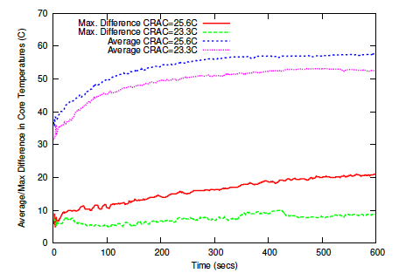
Core Temperatures
Hotspot!
*CRAC stands for Computer Room Air Conditioning
Reducing cooling results for Wave2D:
  Difference of 6C in average temperature
  Difference of 12C in deviation from average
Notes:
To see the behavior of core temperatures, we ran a Charm++ application (Wave2D) on 128 cores and measured the core temperatures.
The figure shows the average core temperature over 10 minutes using different CRAC set points.
We noticed a difference of about 6C due to reduced cooling by moving from 23.3C to 25.6C
The lower two curves in the figure represent the maximum difference of any core from the average. There is a difference of 11C between the max difference after increasing CRAC set point. A difference of 20C from an average of 57C clearly points towards existence of Hotspots

Slide 5
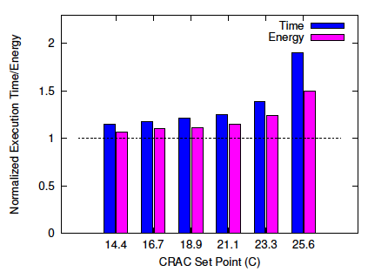
Constraining Core Temperatures using DVFS
Periodic check on core temperatures
Timing penalty grows with a decrease in cooling
Machine energy increases as well!
Not useful due to tightly coupled nature of applications
Normalization w.r.t all cores running at maximum frequency without temperature control
Notes:
We tried to constrain core temperatures using Dynamic Voltage and Frequency scaling. It is a technique widely used to change core frequency and voltage in order to save power.
While doing these runs, we periodically measured core temperatures and scaled down cores that crossed a specified maximum threshold
The figure shows the normalized execution times and energy after constraining core temperatures. The numbers are normalized based on the run where all cores are working at maximum frequency without any temperature control.
The results don’t show an encouraging picture, as we end up spending more time and machine power in order to constrain core temperatures.
The main reason behind such high penalties is the tightly coupled nature of applications under consideration.

Slide 6
Temperature Aware Load Balancer
Specify temperature threshold and sampling interval
Runtime system periodically checks core temperatures
Scale down/up if temperature exceeds/below maximum threshold at each decision time
Transfer tasks from slow cores to faster ones
Notes:
Our scheme, Temperature aware load balancing, combines DVFS and temperature control in an efficient way to reduce timing penalty and total energy
Each application can define the maximum threshold along with the interval after which it periodically wants to check core tempeartures
At each decision time, the core temperature is compared to the threshold and the frequency is shifted depending on whether core temperature exceeds or falls below the threshold
The frequency scaling for each core results in speed differential with which the cores can complete tasks. We transfer tasks from slow cores to fast cores in order to load balancer the application
We take a refinement based approach instead of re-assigning each task in order to make our load balancer scalable.

Slide 7
Charm++
Object-based over-decomposition
  Helpful for refinement load balancing
Migrateable objects
  Mandatory for our scheme to work
Time logging for all objects
  Central to load balancing decisions
Notes:
Charm++ is a perfect match for our technique.
Its object based over-decomposition coupled with migrateability of objects allows us to trasnfer tasks to load balance the application
Time logging of task, provided by charm++, is also an essential part of our scheme. We use these times to come up with decisions about which tasks to migrate in order to restore load balance.

Slide 8
Experimental Setup
128 cores (32 nodes), 10 different frequency levels (1.2GHz – 2.4GHz)
Direct power measurement
Dedicated CRAC
Power estimation based on
Applications: Jacobi2D, Mol3D, and Wave2D
  Different power profiles
Max threshold: 44C
Notes:
To test our scheme, we used a testbed having 40 single socket nodes connected through a 48-port gigabit switch. The power consumption of these machines were measured using Liebert Power unit
All our experiments were done using 128 cores. The machine room had a dedicated CRAC.
We used temperature sensors at the CRAC air inlet and outlet to measure air temperatures for hot air entering and cold air leaving the CRAC.
For all our experiments, we used a max threshold of 44C which got from some preliminary studies

Slide 9
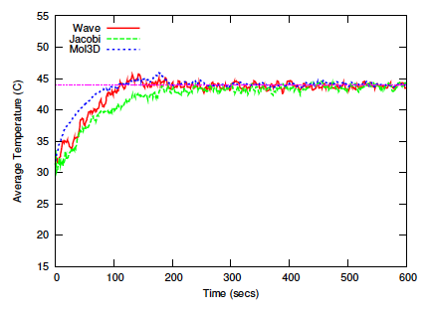
Average Core Temperatures in Check
Avg. core temperature within 1-2 C of threshold
Can handle applications having different temperature gradients
Notes:
Here is the result of some experiments where we tried to constrain the core temperatures within the threshold.
As can be seen once the cores reach the threshold we were able to maintain a very tight control over the core temperatures
This was true for all the 3 apps even though they had different temperature gradient to start with

Slide 10
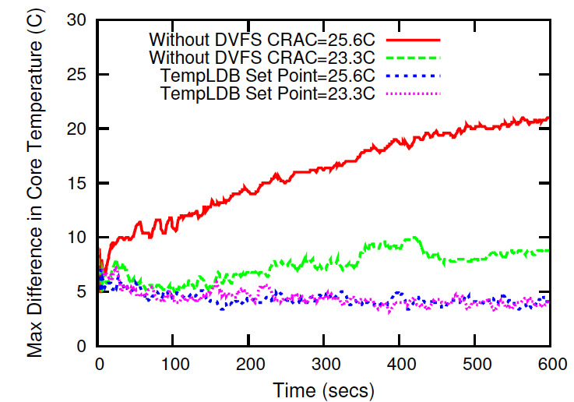
Hotspot Avoidance
Without our scheme max. difference:
  Increases over time
  Increases with CRAC set point
With our scheme
  Max. temperature decreases with time
  Insensitive to CRAC set point
Our scheme avoids Hotspots
Wave2D on 128 Cores
Hot Spots Avoided!
Notes:
In here we show the results to see how well our scheme does in terms of hot spot aviodance.
The graph shows the maximum difference of any core’s temperature from the average.
The red and green curves represent different CRAC set points where we do not use our scheme. As you can see, that w/o our scheme the core temperature on some nodes keep on deviating more and more from the average which gets worse with the passage of time.
The CRAC setpoint also affects the temperature deviations which can be seen by the seperation between the red and green curves. The higher the CRAC setpoint the greater the deviation.
On the other hand, with our scheme we were able to constrain the max temperature deviation to within 4C of the average.
This shows the success of our scheme in avoiding hotspots

Slide 11
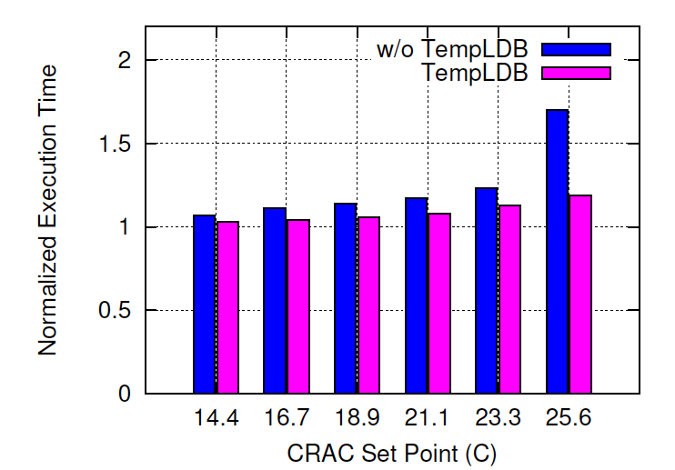
Timing Penalty
Jacobi2D on 128 Cores
Our load balancer performs better
Decrease in cooling, increases:
  Timing penalty
  Advantage of our scheme
Notes:
Now we compare the timing penalties for both the schemes. The figure shows the normalized execution times for all three applications using different CRAC set points.
Our scheme consistently performs better than the other scheme.
We can that the timing penalty increases with a decrease in cooling but also the advantage of our scheme increases at the same time.

Slide 12
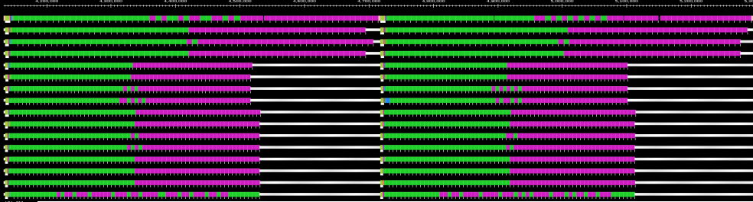
Processor Timelines for Wave2D
Idle Time
No TempLB
Shows processor utilization during execution time (green and pink correspond to computations)
Execution time dependent on slowest core
One core can cause timing penalty/slowdown
Notes:
In order to see the difference in both the schemes, we present the processor timelines for both.
The top part shows the scheme without our load balancing whereas the bottom one uses our load balancing.
The white lines in the yellow rectangle show the idle time cores 4-12 are spending due the first four cores shifting to lower frequency. This results in a big penalty as only 4 cores now dictate the execution time
We can see that our scheme doesn’t suffer from any such problem.
In order to understand it better we enlarged the area in the yellow rectangle and reproduced it. The two shaded portions represent the idle time due to first 4 cores operating at lower frequency.

Slide 13
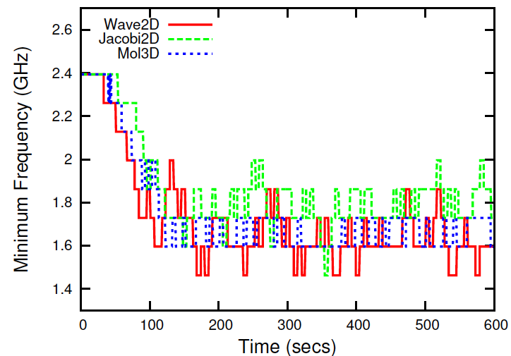
Minimum Frequency (No TempLB)
Frequency of slowest core for (CRAC 23.3C)
Wave2D and Mol3D
  Lower minimum frequencies
  Higher timing penalties
Application | Time Penalty(%)
Wave | 38
Mol3D | 28
Jacobi2D | 23
Notes:
The figure shows the minimum frequency of any core when we are not using our load balancer.
We can see that Wave2D and Mol3D has much lower minimum frequencies as compared to Jacobi2D. And hence, the face higher timing penalty.

Slide 14
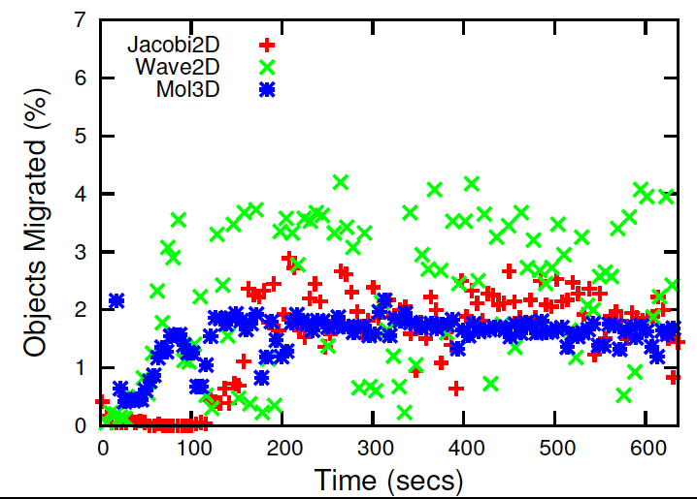
Timing Overhead
Dependent on:
  How frequently temperatures checked
  How many migrations
Wave2D has the highest migration percentage
Notes:
The overhead of our scheme mainly results migrations to do load balance as the frequency scaling and temperature comparison hardly takes any time
The figure here shows the percentage of objects migrated at each decision time. We can see that these numbers are too small to cause any sizeable overhead.
However we can see that wave2D has the highest migrations as it undergoes the most frequency transitions

Slide 15
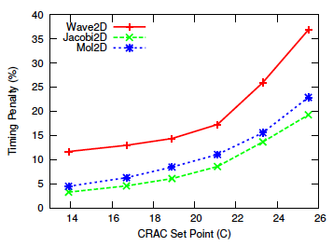
Timing Penalty and CRAC Set Point
Slope: timing penalty (secs) per 1C increase in CRAC set point
Correlation between Timing penalty and MFLOP/s
Application | MFLOP/s
Wave | 292
Mol3D | 252
Jacobi2D | 240
Notes:
To see the response of Applications to increasing CRAC set points i.e. decreasing cooling, we plotted the timing penalty against CRAC set point
The slope of these curves represent timing penalty in seconds for every 1C increase in CRAC set point.
Combining these curves with the table from previous slide, we can conclude that the timing penalty depends on the MFLOP/s given by the application. This is why Wave2D ends up the the largest penalty followed by Mol3D and Jacobi2D.

Slide 16
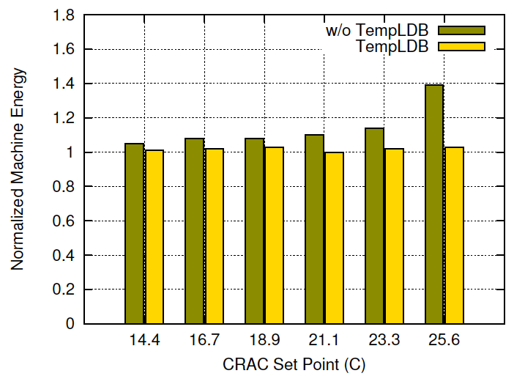
Machine Energy Consumption
Mol3D on 128 Cores
Our scheme consistently saves machine power in comparison to `w/o TempLB’.
High idle power coupled with timing penalty doesn’t allow machine energy savings.
Notes:
This figure shows the normalized machine energy consumption for all three applications.
The normalized energy increases in case of the other scheme whereas our scheme keeps it very close to 1.
The high idle power was the cause due to which we couldn’t get any machine energy savings. Still we keep the machine energy to within 4% of the base case.

Slide 17
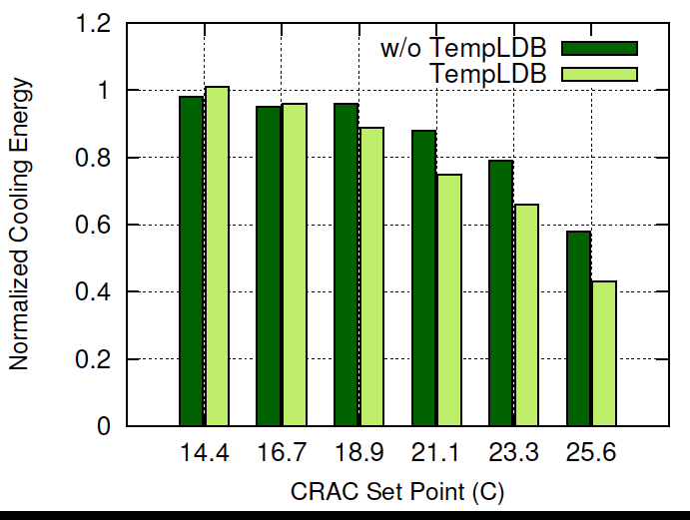

Cooling Energy Consumption
Jacobi2D on 128 Cores
Both schemes save energy (TempLDB better)
Our scheme saves upto 57%
Notes:
Saving cooling energy was the motive of our research. To gauge cooling energy saved, we normalized the cooling energy for each run according to the base run where all cores were running with max frequency without temperature control
The figure shows the normalized cooling energy for both the schemes. Both the schemes end up saving some cooling energy but these savings are more in case of our temperature aware load balancer
We end up saving as high as 57% of the cooling cost.

Slide 18
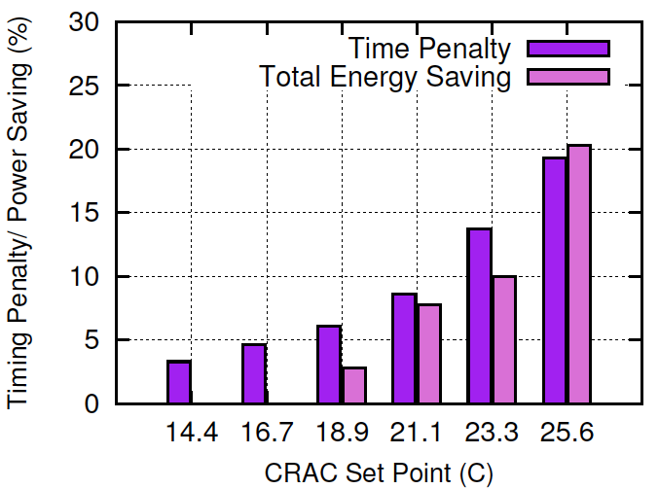
Timing Penalty/ Total Energy Savings
Jacobi2D on 128 Cores
Mol3D and Jacobi2D show good energy savings
Wave2D not appropriate for energy savings?
Notes:
To get the bigger picture, we plotted % savings in total energy savings with percent timing penalties.
This Figure shows the great potential of saving energy in case of Mol3D and Jacobi2D.
However, it seems that Wave2D is not a good candidate for energy savings.

Slide 19
Temperature range instead of Threshold
Temperature Range: 44C – 49C
Scale down if core temperature > upper limit
Scale up if core temperature < lower limit
CRAC Set Point | Timing Penalty: Range (%) | Timing Penalty: Threshold(%) | Power Saving: Range (%) | Power Saving: Threshold (%)
23.3 | 3 | 15 | 19 | 11
25.6 | 12 | 22 | 23 | 20
Notes:
It should be mentioned that our constraints for these experiments were too tight. We trying to maintain a very low average temperature.
In order to demonstrate what could be expected from our scheme, we did another experiment with Mol3D where instead of setting a hard threhold, we defined an accpetable temperature range.
The figure shows that we were able to save a lot of energy with very little timing penalties.

Slide 20
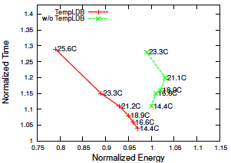
Energy Vs Execution Time
Mol3D on 128 Cores
Normalization w.r.t all cores running at maximum frequency without temperature control
Our scheme brings green line to red line
  Moving left: saving total energy
  Moving down: saving execution time penalty
Slope: timing penalty (secs) per joule saved in energy
Notes:
To sum everything up we came up with these figures where we plotted the normalized execution time against normalized energy.
The slope of these curves represent the increase in execution time that would result in saving 1 joule of total energy.
We can also see the impact of our scheme on both time and energy. Our load balancer brings the green curve onto the red where a movenment to the left results in energy savings and to right corresponds to execution time savings

Slide 21
Contributions
Stabilizing core temperatures
Avoiding Hotspot
Minimize timing penalty/ slowdown
Minimize Cooling costs
  Saved 48% cooling moving from 18.9C – 25.6C

Slide 22
Questions

Slide 23
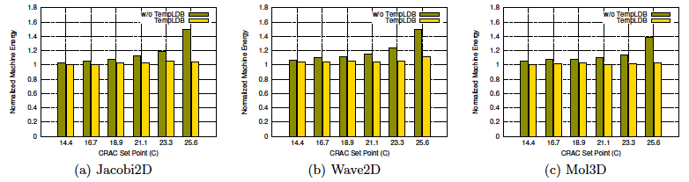
Machine Energy Consumption
Notes:
This figure shows the normalized machine energy consumption for all three applications.
The normalized energy increases in case of the other scheme whereas our scheme keeps it very close to 1.
The high idle power was the cause due to which we couldn’t get any machine energy savings. Still we keep the machine energy to within 4% of the base case.

Slide 24
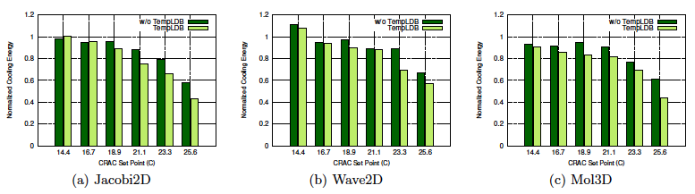
Cooling Energy Savings

Slide 25
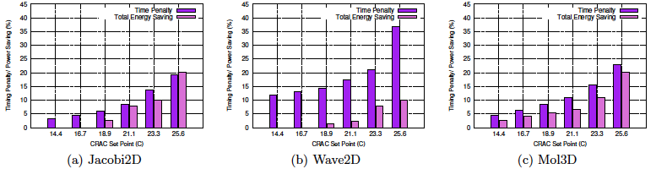
Timing Penalty/ Total Energy Savings

Slide 26
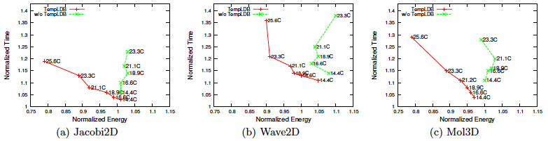
Energy Vs Execution Time

Slide 27
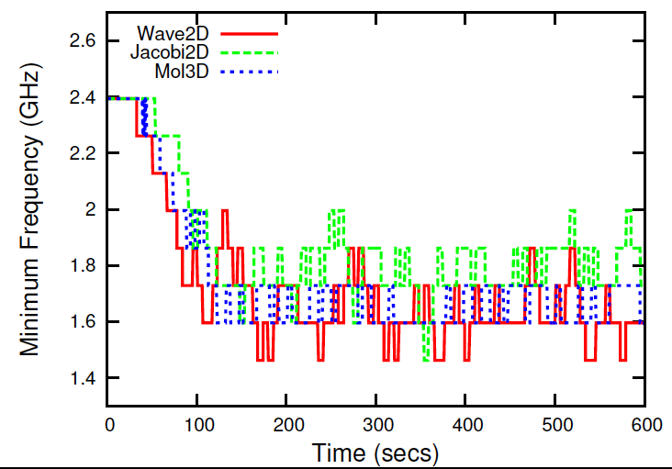
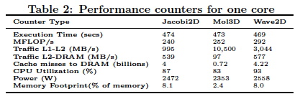
Average Frequency
Mol3D’s average frequency lower than Jacobi even with less power/CPU utilization
High total power for Jacobi
  Greater number of DRAM accesses
  Overall large memory footprint
High MFLOP/s for Mol3D considering low CPU utilization
  Data readily available in L1+L2
Notes:
The upper figure shows the average frequency across all 128 cores over ten minutes of execution with CRAC set at 23.3C
Mol3D’s average frequency is lesser than Jacobi2D whereas the CPU utilization and power draw of Jacobi is greater than it
Now the question arises, why are cores getting heated resulting in frequency dropping in case of Mol3D?
This can only happen if the CPU power consumption for Mol3D is greater than Jacobi2D. But there are no counters of meters to perform that measurement
In order to verify our claim, we ran all three applications using the profiling abilities of Perfsuite. The results are tabulated in the lower figure
There are two important things to be noted here. 1. 10 times higher data traffic between L1-L2 cache and 5-6 times lesser DRAM misses for Mol3D as compared to Jacobi2D

Slide 28
Cooling Energy Savings
Jacobi
Mol3D
TempLB
TempLB
TempLB
Wave2D
No TempLB
No TempLB
No TempLB
57 | 0.83008303 | 0.92662993 | 0.9535189 | 0.9825494 | 1.08436118 | 1.10835359
62 | 0.91371415 | 0.91630064 | 1.02676076 | 0.94843724 | 0.94017829 | 0.94566919
66 | 0.87636352 | 0.95424306 | 0.89537819 | 0.95016447 | 0.89775714 | 0.9712767
70 | 0.84932621 | 0.90341406 | 0.75526485 | 0.87756626 | 0.87606527 | 0.88519665
74 | 0.69208677 | 0.76990626 | 0.66527495 | 0.79335206 | 0.71963512 | 0.89981607

Slide 29
Timing Penalty
Wave2D
Mol3D
Jacobi
57 | TempLDB | w/o TempLDB | TempLDB | w/o TempLDB | TempLDB | w/o TempLDB
57 | 1.04 | 1.11 | 1.03 | 1.06 | 1.11 | 1.14
62 | 1.06 | 1.15 | 1.04 | 1.10 | 1.13 | 1.18
66 | 1.08 | 1.16 | 1.06 | 1.14 | 1.14 | 1.21
70 | 1.11 | 1.20 | 1.08 | 1.17 | 1.17 | 1.25
74 | 1.15 | 1.28 | 1.13 | 1.23 | 1.26 | 1.38
78 | 1.22 | 1.70 | 1.19 | 1.80 | 1.36 | 1.90

Slide 30
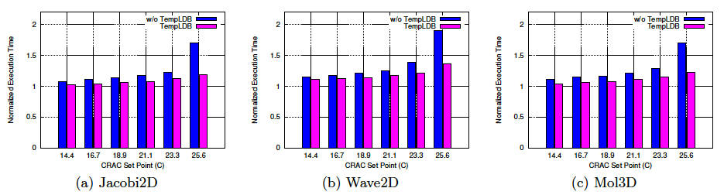
Timing Penalty

