Slide 1
Adventures in Load Balancing at Scale: Successes, Fizzles, and Next Steps
Rusty Lusk
Mathematics and Computer Science Division
Argonne National Laboratory

Slide 2
Outline
Introduction
Two abstract programming models
Load balancing and master/slave algorithms
A collaboration on modeling small nuclei
The Asynchronous, Dynamic, Load-Balancing Library (ADLB)
The model
The API
An implementation
Results
Serious – GFMC: complex Monte Carlo physics application
Fun – Sudoku solver
Parallel programming for beginners: Parameter sweeps
Useful – batcher: running independent jobs
An interesting alternate implementation that scales less well
Future directions
for the API
yet another implementation

Slide 3
Two Classes of Parallel Programming Models
Data Parallelism
Parallelism arises from the fact that physics is largely local
Same operations carried out on different data representing different patches of space
Communication usually necessary between patches (local)
global (collective) communication sometimes also needed
Load balancing sometimes needed
Task Parallelism
Work to be done consists of largely independent tasks, perhaps not all of the same type
Little or no communication between tasks
Traditionally needs a separate “master” task for scheduling
Load balancing fundamental

Slide 4
Load Balancing
Definition: the assignment (scheduling) of tasks (code + data) to processes so as to minimize the total idle times of processes
Static load balancing
all tasks are known in advance and pre-assigned to processes
works well if all tasks take the same amount of time
requires no coordination process
Dynamic load balancing
tasks are assigned to processes by coordinating process when processes become available
Requires communication between manager and worker processes
Tasks may create additional tasks
Tasks may be quite different from one another

Slide 5
Green’s Function Monte Carlo – A Complex Application
Green’s Function Monte Carlo -- the “gold standard” for ab initio calculations in nuclear physics at Argonne (Steve Pieper, PHY)
A non-trivial master/slave algorithm, with assorted work types and priorities; multiple processes create work dynamically; large work units
Had scaled to 2000 processors on BG/L a little over four years ago, then hit scalability wall.
Need to get to 10’s of thousands of processors at least, in order to carry out calculations on ¹²C, an explicit goal of the UNEDF SciDAC project.
The algorithm threatened to become even more complex, with more types and dependencies among work units, together with smaller work units
Wanted to maintain master/slave structure of physics code
This situation brought forth ADLB
Achieving scalability has been a multi-step process
balancing processing
balancing memory
balancing communication

Slide 6
The Plan
Design a library that would:
allow GFMC to retain its basic master/slave structure
eliminate visibility of MPI in the application, thus simplifying the programming model
scale to the largest machines

Slide 7
Generic Master/Slave Algorithm
Shared
Work queue
Master
Slave
Slave
Slave
Slave
Slave
Easily implemented in MPI
Solves some problems
implements dynamic load balancing
termination
dynamic task creation
can implement workflow structure of tasks
Scalability problems
Master can become a communication bottleneck (granularity dependent)
Memory can become a bottleneck (depends on task description size)

Slide 8
The ADLB Vision
No explicit master for load balancing; slaves make calls to ADLB library; those subroutines access local and remote data structures (remote ones via MPI).
Simple Put/Get interface from application code to distributed work queue hides MPI calls
Advantage: multiple applications may benefit
Wrinkle: variable-size work units, in Fortran, introduce some complexity in memory management
Proactive load balancing in background
Advantage: application never delayed by search for work from other slaves
Wrinkle: scalable work-stealing algorithms not obvious

Slide 9
The ADLB Model (no master)
Slave
Slave
Slave
Slave
Slave
Shared
Work queue
Doesn’t really change algorithms in slaves
Not a new idea (e.g. Linda)
But need scalable, portable, distributed implementation of shared work queue
MPI complexity hidden here

Slide 10
API for a Simple Programming Model
Basic calls
ADLB_Init( num_servers, am_server, app_comm)
ADLB_Server()
ADLB_Put( type, priority, len, buf, target_rank, answer_dest )
ADLB_Reserve( req_types, handle, len, type, prio, answer_dest)
ADLB_Ireserve( … )
ADLB_Get_Reserved( handle, buffer )
ADLB_Set_Done()
ADLB_Finalize()
A few others, for tuning and debugging
ADLB_{Begin,End}_Batch_Put()
Getting performance statistics with ADLB_Get_info(key)

Slide 11
API Notes
Return codes (defined constants)
ADLB_SUCCESS
ADLB_NO_MORE_WORK
ADLB_DONE_BY_EXHAUSTION
ADLB_NO_CURRENT_WORK (for ADLB_Ireserve)
Batch puts are for inserting work units that share a large proportion of their data
Types, answer_rank, target_rank can be used to implement some common patterns
Sending a message
Decomposing a task into subtasks
Maybe should be built into API

Slide 12
More API Notes
If some parameters are allowed to default, this becomes a simple, high-level, work-stealing API
examples follow
Use of the “fancy” parameters on Puts and Reserve-Gets allows variations that allow more elaborate patterns to be constructed
This allows ADLB to be used as a low-level execution engine for higher-level models
API’s being considered as part of other projects

Slide 13
How It Works
put/get
Application Processes
ADLB Servers

Slide 14
Early Experiments with GFMC/ADLB on BG/P
Using GFMC to compute the binding energy of 14 neutrons in an artificial well ( “neutron drop” = teeny-weeny neutron star )
A weak scaling experiment
Recent work: “micro-parallelization” needed for ¹²C, OpenMP in GFMC.
a successful example of hybrid programming, with ADLB + MPI + OpenMP
BG/P cores | ADLB Servers | Configs | Time (min.) | Efficiency (incl. serv.)
4K | 130 | 20 | 38.1 | 93.8%
8K | 230 | 40 | 38.2 | 93.7%
16K | 455 | 80 | 39.6 | 89.8%
32K | 905 | 160 | 44.2 | 80.4%

Slide 15
Progress with GFMC

Slide 16
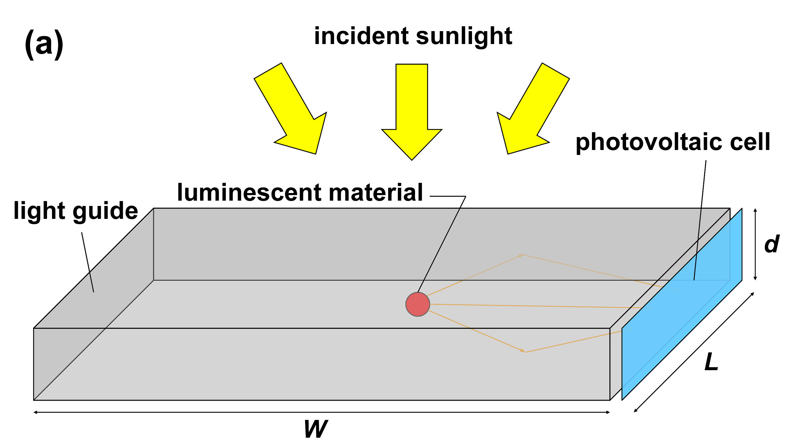
Another Physics Application – Parameter Sweep
Luminescent solar concentrators
Stationary, no moving parts
Operate efficiently under diffuse light conditions (northern climates)
Inexpensive collector, concentrate light on high-performance solar cell
In this case, the authors never learned any parallel programming approach before ADLB

Slide 17
The “Batcher”
Simple but potentially useful
Input is a file of Unix command lines
ADLB worker processes execute each one with the Unix “system” call

Slide 18
A Tutorial Example: Sudoku
1
2
9
7
3
6
1
7
8
5
3
7
9
1
8
2
6
5
6
1
9
6
7
1
2
5
3
8

Slide 19
Parallel Sudoku Solver with ADLB
Program:
if (rank = 0)
ADLB_Put initial board
ADLB_Get board (Reserve+Get)
while success (else done)
ooh
find first blank square
if failure (problem solved!)
print solution
ADLB_Set_Done
else
for each valid value
set blank square to value
ADLB_Put new board
ADLB_Get board
end while
1
2
9
7
3
6
1
7
8
5
3
7
9
1
8
2
6
5
6
1
9
6
7
1
2
5
3
8
Work unit =
partially completed “board”

Slide 20
How it Works
1
2
9
7
3
6
1
7
8
5
3
7
9
1
8
2
6
1
2
9
7
5
6
3
6
1
Get
1
9
7
8
6
7
1
5
3
Pool
of
Work
Units
2
5
3
8
7
9
1
8
2
6
5
6
4
6
1
9
6
7
1
8
2
5
3
8
1
2
4
9
7
1
2
6
9
7
1
2
8
9
7
3
6
1
3
6
1
3
6
1
7
8
7
8
7
8
5
3
5
3
5
3
7
9
1
8
2
6
7
9
1
8
2
6
7
9
1
8
2
6
5
6
5
6
5
6
1
9
1
9
1
9
6
7
1
6
7
1
6
7
1
2
5
3
8
2
5
3
8
2
5
3
8
Put
After initial Put, all processes execute same loop (no master)

Slide 21
Optimizing Within the ADLB Framework
Can embed smarter strategies in this algorithm
ooh = “optional optimization here”, to fill in more squares
Even so, potentially a lot of work units for ADLB to manage
Can use priorities to address this problem
On ADLB_Put, set priority to the number of filled squares
This will guide depth-first search while ensuring that there is enough work to go around
How one would do it sequentially
Exhaustion automatically detected by ADLB (e.g., proof that there is only one solution, or the case of an invalid input board)

Slide 22
The ADLB Server Logic
Main loop:
MPI_Iprobe for message in busy loop
MPI_Recv message
Process according to type
Update status vector of work stored on remote servers
Manage work queue and request queue
(may involve posting MPI_Isends to isend queue)
MPI_Test all requests in isend queue
Return to top of loop
The status vector replaces single master or shared memory
Circulates every .1 second at high priority
Multiple ways to achieve priority

Slide 23
ADLB Uses Multiple MPI Features
ADLB_Init returns separate application communicator, so application can use MPI for its own purposes if it needs to.
Servers are in MPI_Iprobe loop for responsiveness.
MPI_Datatypes for some complex, structured messages (status)
Servers use nonblocking sends and receives, maintain queue of active MPI_Request objects.
Queue is traversed and each request kicked with MPI_Test each time through loop; could use MPI_Testany. No MPI_Wait.
Client side uses MPI_Ssend to implement ADLB_Put in order to conserve memory on servers, MPI_Send for other actions.
Servers respond to requests with MPI_Rsend since MPI_Irecvs are known to be posted by clients before requests.
MPI provides portability: laptop, Linux cluster, SiCortex, BG/P
MPI profiling library is used to understand application/ADLB behavior.

Slide 24
An Alternate Implementation of the Same API
Motivation for 1-sided, single-server version
Eliminate multiple views of “shared” queue data structure and the effort required to keep them (almost) coherent)
Free up more processors for application calculations by eliminating most servers.
Use larger client memory to store work packages
Relies on “passive target” MPI-2 remote memory operations
Single master proved to be a scalability bottleneck at 32,000 processors (8K nodes on BG/P) not because of processing capability but because of network congestion.
Have not yet experimented with hybrid version
ADLB_Put
ADLB_Get
MPI_Put
MPI_Get

Slide 25
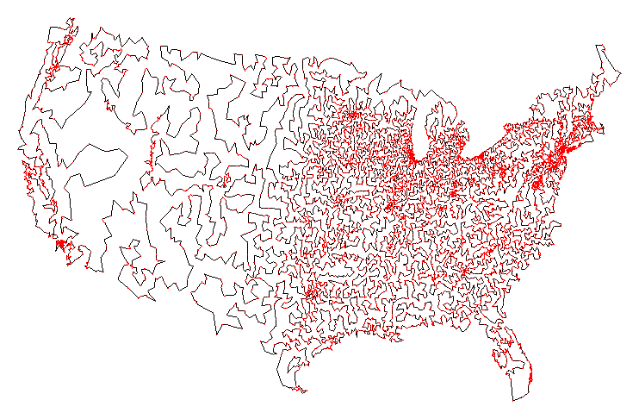
Getting ADLB
Web site is http://www.cs.mtsu.edu/~rbutler/adlb
To download adlb:
svn co http://svn.cs.mtsu.edu/svn/adlbm/trunk adlbm
What you get:
source code (both versions)
configure script and Makefile
README, with API documentation
Examples
Sudoku
Batcher
Batcher README
Traveling Salesman Problem
To run your application
configure, make to build ADLB library
Compile your application with mpicc, use Makefile as example
Run with mpiexec
Problems/complaints/kudos to {lusk,rbutler}@mcs.anl.gov

Slide 26
Future Directions
API design
Some higher-level function calls might be useful
User community will generate these
Implementations
The one-sided version
implemented
single server to coordinate matching of requests to work units
stores work units on client processes
Uses MPI_Put/Get (passive target) to move work
Hit scalability wall for GFMC at about 8000 processes
The thread version
uses separate thread on each client; no servers
the original plan
maybe for BG/Q, where there are more threads per node
not re-implemented (yet)

Slide 27
Conclusions
The Philosophical Accomplishment: Scalability need not come at the expense of complexity
The Practical Accomplishment: Multiple uses
As high-level library to make simple applications scalable
As execution engine for
complicated applications (like GFMC)
higher-level “many-task” programming models

Slide 28
The End

