Slide 1
Towards reducing total energy consumption while constraining core temperatures
Osman Sarood and Laxmikant Kale
Parallel Programming Lab (PPL)
University of Illinois Urbana Champaign

Slide 2
Why Energy?
Data centers consume 2% of US Energy Budget in 2006
Costed $4.1 billion consumed 59 billion KWh
The 3-year cost of powering and cooling servers exceeds the cost of purchasing the server hardware
Notes:
Data centers have been reported to have consumed energy equivalent to 2% of the total US energy budget in 2006
Their operation costed 4.1 billion and consumed a total of 59 billion
There have also been estimates to show that the cost of powering the server for only 3 years exceeds the cost of purchasing them
Now, although there has been a 2.5 times improvement in system level energy consumption, it is still far away from the 100 times improvement required for moving to exascale computing

Slide 3
Cooling Energy
Cooling accounts for 40-50% of total cost
Most data centers face hot spots responsible for lower temperatures in machine rooms
Data center managers can save*:
4% (7%) for every degree F (C)
50% going from 68F(20C )to 80F(26.6C)
Earlier work:
Reduce up to 63% in cooling energy with 11% penalty in execution time
Constraining core temperatures below 44C
*according to Mark Monroe of Sun Microsystem
Notes:
Cooling costs form a major part of the total energy budget for data centers. Infact they account for 50% of the total energy consumed
This high figure can also be attributed to hotspots which force data center operators to decrease the room temperature for the entire room
Studies show that for every 1C increase in room temperature, 7% of total cooling energy can be saved. In fact data centers can save half of the total cooling cost by raising the room temperature from 20C to 26.6C.
Data center operators can increase the room temperatures if they can be confident that there would be no hotspot formation and cpu cores wont reach very high temperatures.

Slide 4
Machine Energy
Accounts for 50%-60% of total cost
Earlier work: limited machine energy savings
Is it possible to reduce execution time penalty and machine energy while constraining core temperatures?

Slide 5
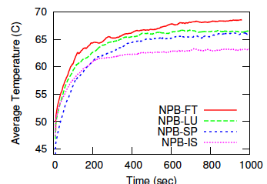
Core Temperatures
All results are on a quad core machine having Sandy Bridge Core i7-2600

Slide 6
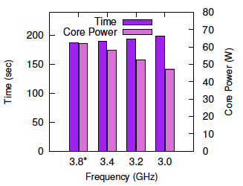
Frequency, Time and Power for NPB-FT
Reduce core power/temperature by reducing frequency with little impact on time

Slide 7
Temperature Control - Naïve Scheme
Monitor temperature periodically
Above threshold: decrease frequency
Below threshold: increase frequency
Use DVFS to change processor voltage/frequency at runtime

Slide 8
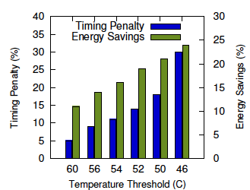
Naive Scheme – NPB-FT
Energy savings but timing penalty high!

Slide 9
Can we do something to reduce the execution time penalty?

Slide 10
Execution Blocks
Divide each iteration into Execution blocks (EBs)
different sections based on sensitivity to frequency
Manually done using HW performance counters
Profile each EB for different frequency levels
Wall clock time (system clock)
Core power consumption (fast on-chip MSRs)
Iteration
EB 1
EB 2
EB 3

Slide 11
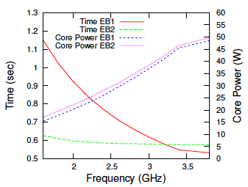
Execution Blocks (EBs) (NPB-IS)
EB2 wastes a lot of energy while running at max frequency!
EB1 much more sensitive to frequency with the same power as EB2

Slide 12
EBTuner
Profile each EB for all frequency values
Can be completed in milliseconds using energy MSRs of Sandy Bridge
Temperature > Threshold
EB that results in minimum timing penalty
Change its frequency down one notch
Temperature < Threshold
EB that results in maximum time reduction
Change its frequency up one notch

Slide 13
Problem formulation
Minimize:
subject to:
Heuristic for best EB ( ):
Difference in power after reducing frequency
Maximize ratio for temperature > T_max
Difference in time after reducing frequency

Slide 14
EBTuner: Framework
Profiler
Very fast using MSR energy counters
Iteration
Frequency Control
EB 1
Runs each EB at the specified frequency
Frequency Control
EB 2
Determines if the temperature crosses threshold
Temp Check
Specifies new frequency for each EB
EBTuner

Slide 15
Evaluation
On a single quad core machine
Metrics
Ability to constrain core temperature
Timing penalty
Reduction in energy consumption

Slide 16
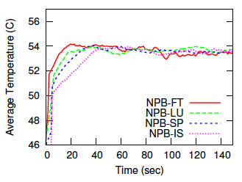
Temperature Control
Using EBTuner - Temperature Threshold 54C

Slide 17
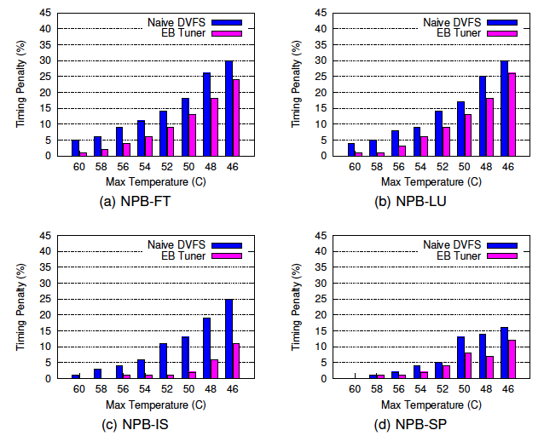
Timing penalty
Increase in execution time compared to runs with no temperature control and all cores working at maximum possible frequency

Slide 18
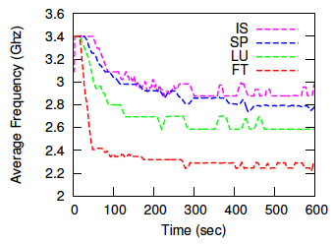
Steady State Frequencies
Counter | NPB-LU | NPB-FT
MFLOPS | 1032 | 640
L1-L2 (MB/sec) | 2114 | 2416
L2-L3 (MB/sec) | 3365 | 6806
Penalty (%) | 6 | 6
~ 400MHz
Using EBTuner - Temperature Threshold 54C

Slide 19
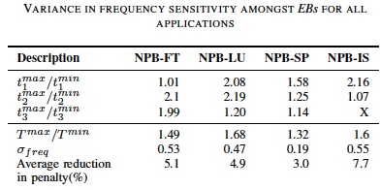
Variance in sensitivity to frequency for different parts of an application
Correlation

Slide 20
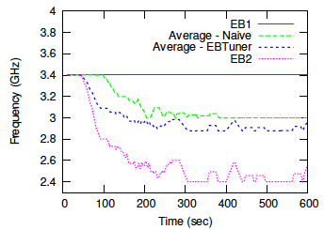
EB Tuner Vs. Naïve (NPB-IS)
EBTuner increases CPU utilization

Slide 21
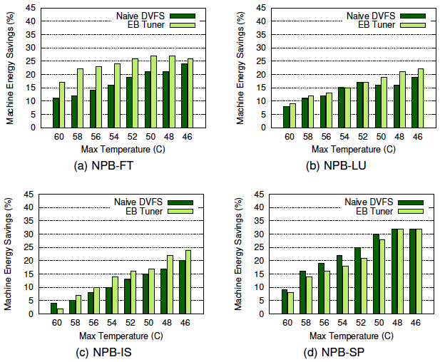
Reduction in machine energy

Slide 22
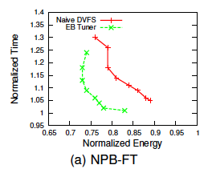
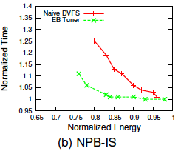
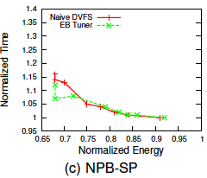
Energy Time tradeoff
: 0.53
: 0.55
: 0.19

Slide 23
Summary and Future Work
Our scheme consistently better than Naïve version in terms of reducing timing penalty and machine energy consumption
EBTuner was able to reduce machine energy by 17% with <1% timing penalty while constraining core temperature below 60C
Combine this work with earlier work that saves cooling energy consumption

Slide 24
Thank You
Questions?

