Slide 1
uGNI-based Charm++ Runtime for Cray Gemini Interconnect
10th Annual Workshop on Charm++ Applications
Yanhua Sun, Gengbin Zheng, Laximant(Sanjay) Kale
Parallel Programming Lab
University of Illinois at Urbana-Champaign
Ryan Olson, Cray Inc
Terry R. Jones, Oak Ridge National Lab

Slide 2
Motivation
Modern Interconnects are complex
Challenging to obtain good performance for applications with various communication patterns
Multiple programming models/languages are developed
Notes:
For example NQueens

Slide 3
Motivation
How to attain good performance for applications in alternative models on different interconnects ?
Notes:
For example NQueens

Slide 4
Motivation
How to attain good performance for applications in alternative models?
Focus:
Exploit the performance of
Charm++ programming model on
Gemini Interconnect
Notes:
For example NQueens

Slide 5
Why not MPI-based Charm++
It works
Not best one
Unnecessary features in MPI lead to overhead
Data interaction pattern in Charm++ is different from MPI
Only sender-involving
Notes:
For example NQueens

Slide 6
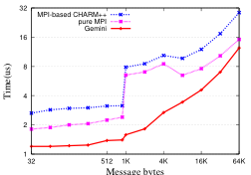
Initial Pingpong Performance
Notes:
This motivated

Slide 7
Outline
Overview of Gemini and uGNI
Design of uGNI-based Charm++
Optimization to improve performance
Micro-benchmark and application results
Notes:
This motivated

Slide 8
Gemini Interconnect
Upgraded from SeaStar+
Low latency (700ns)
High bandwidth (8GBytes/sec)
Scale to 100,000 nodes
Hardware support for one-sided communication
Fast Memory Access (FMA)
Block Transfer Engine (BTE)
Notes:
Framework . User do not need to know any of these problems and techniques

Slide 9
uGNI
Two libraries
Distributed Memory Applications (DMAPP)
User-level Generic Network Interface (uGNI)
uGNI Charm++

Slide 10
uGNI APIs
Memory Registration/de-
Post FMA/BTE transactions
Completion Queues

Slide 11
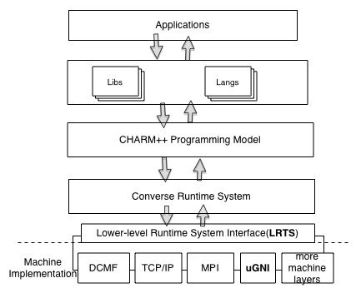
Charm++ Software Architecture

Slide 12
Lower Runtime System (LRTS)
LrtsInit()
LrtsSyncSend()
LrtsAdvanceCommunication()

Slide 13
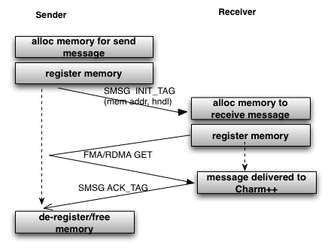
Design of uGNI-based Charm++

Slide 14
Design of uGNI-based Charm++
Small messages
SMSG directly send with data_tag
1024 bytes default
Registered memory increases linearly with maximum msg size and the number of nodes

Slide 15
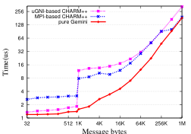
Baseline Pingpong Performance

Slide 16
Performance Issues?

Slide 17
Optimizing Performance
Persistent Message
Memory Pool
Intra-node Communication

Slide 18
Persistent Messages
Communication with fixed pattern
Communication processors
Data size
Re-use memory
Avoid memory allocation for messages
Match better one-sided uGNI lib

Slide 19
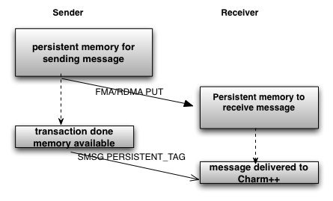
Persistent
Base Design to transfer data
transfer persistent data

Slide 20
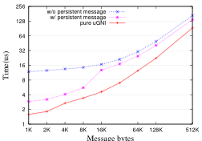
Performance of persistent msg

Slide 21
Memory Pool
Memory registration/de-registration costs a lot
Charm++ controls all memory allocation/de-allocation

Slide 22
Memory Pool
Memory registration/de-registration costs a lot
Charm++ controls all memory allocation/de-allocation
Register big chucks of memory
Allocation/de- is from memory pool

Slide 23
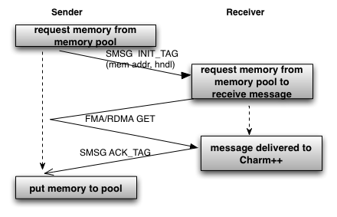
Base Design
memory pool

Slide 24
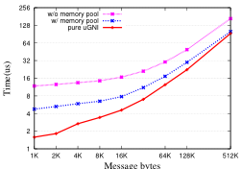
Performance of Memory Pool

Slide 25
Intra-node Communication
uGNI is pure network protocol
All messages pass network stack
Resource contention
POSIX share memory

Slide 26
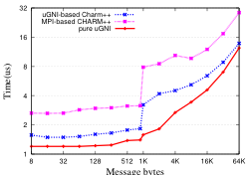
Performance – Message Latency

Slide 27
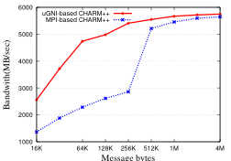
Performance - Bandwidth

Slide 28
kNeighbor Performance

Slide 29
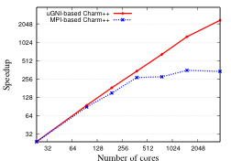
N-Queens (fine-grained)

Slide 30
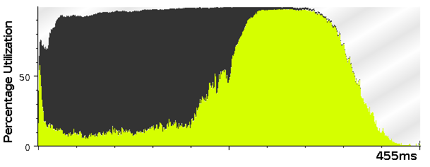
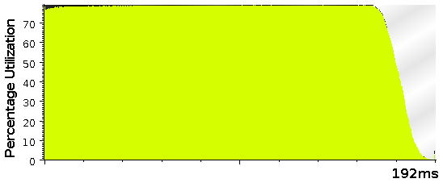
Time profile for running 17Queens on 384 cores
MPI-based Charm
uGNI-based Charm

Slide 31
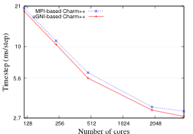
NAMD Performance

Slide 32
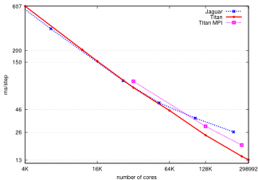
NAMD 100M-atom on Titan

Slide 33
Conclusion
Gemini Interconnect
Charm++ LRTS Interface
Memory Pool Optimization
Reference
Yanhua Sun, Gengbin Zheng, Ryan Olson, Terry Jones, Laxmikant Kale. A uGNI-Based Asynchronous Message-driven Runtime System for Cray Supercomputers with Gemini Interconnect [IPDPS 2012]

