Slide 1
Exascale Algorithms for Balanced Spanning Tree Construction in System-ranked Process Groups
Akhil Langer, Ramprasad Venkataraman, Laxmikant Kale Parallel Programming Laboratory

Slide 2
Overview
Introduction
Problem Statement
Distributed Algorithms
Shrink-and-balance
Shrink-and-hash
Analysis and Results
Summary
Notes:
This is the overview of my presentation. I will briefly introduce process groups and motivate the need for distributed algorithms for their creation and storage.
Then I will give the problem statement for the challenge that we have tried to address.
Then I will present the two distributed algorithms that we developed and their performance comparison.

Slide 3
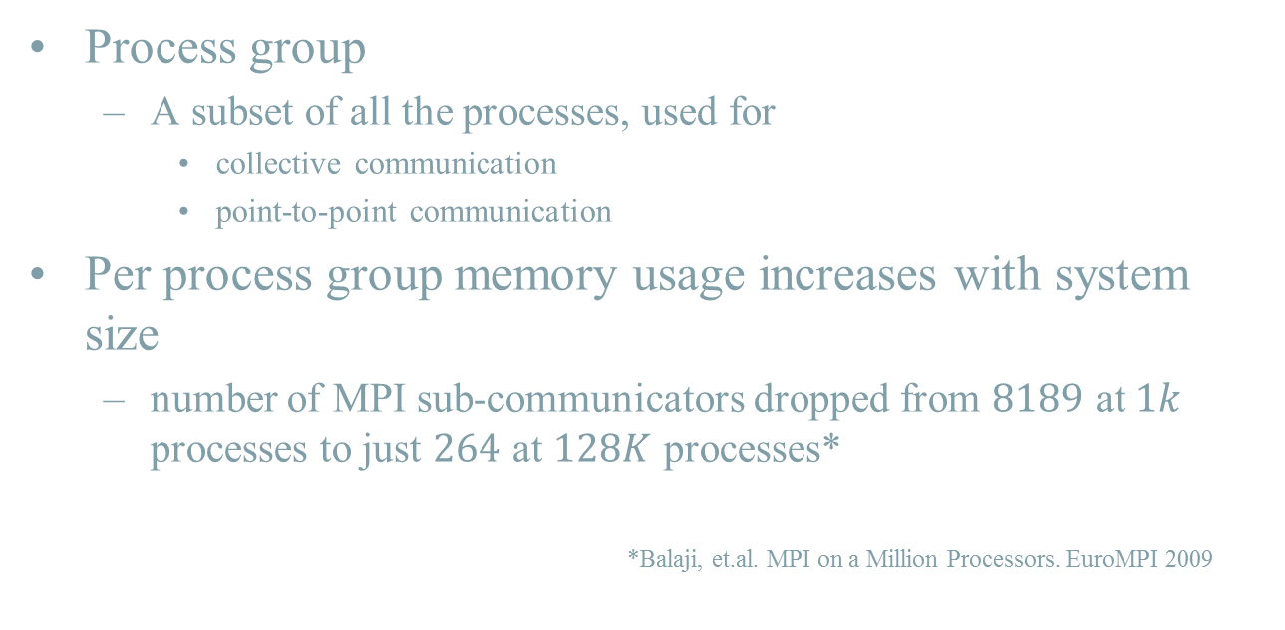
Introduction
Process group
A subset of all the processes, used for
collective communication
point-to-point communication
Per process group memory usage increases with system size
number of MPI sub-communicators dropped from $8189$ at $1k$ processes to just $264$ at $128K$ processes*
*Balaji, et.al. MPI on a Million Processors. EuroMPI 2009
Notes:
Parallel programs often express operations on a subset of all the participating processes or ranks. These groups are used to do collective communication and point-to-point communication amongst the members of the group. Subcommunicators in MPI are an example of such process groups.
Current approaches to create and store process groups tend to be centralized schemes which store data structures of size proportional to the number of members in the group.
So each process will store the process id of every other
In extreme scale architectures these algorithms will pose memory bottleneck and suffer from scalability limits. E.g. in a per

Slide 4
Introduction
Process-groups often used for simple collective operations
reductions, broadcasts, all-reduce, barriers, etc.
e.g. LU, Quantum Chemistry codes (OpenAtom), Histogram sorting, Branch-and-bound, etc.
Result independent of the ranks
Notes:
Results are independent of the ranks from which the individual data contributions come from

Slide 5
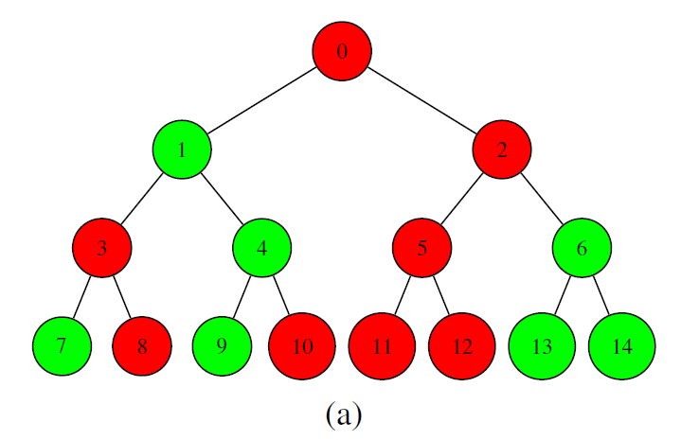

Problem Statement
Balanced spanning trees
Reference centralized approach
Collect list of participating processes at process 0
Select k child vertices, split rest into k partitions
Repeat at child vertices
$O(n)$ memory, $O(n)$ time
Construct balanced spanning tree without collecting the list of processes

Slide 6
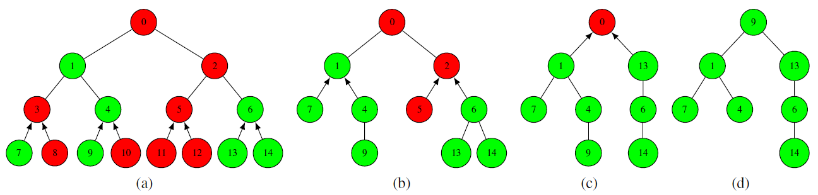
Algo 1: Shrink-and-balance
Shrink and then balance
Level-by-level demonstration of shrinking
Notes:
The centralized scheme collects the enrollment information but does not act on this information until it reaches the root of the spanning tree.
Because we’d like to avoid gathering O(N) enrollment data, we look for algorithms that can use the enrolment information earlier during the upward pass.
This scheme is based on the idea of immediately using the enrolment information to shrink the original spanning tree by excluding processes which
Will not be members in the new process group.
Lets call this red-color non-participating processes as holes.
In order to obtain a spanning tree of only the participating processes, these holes need to be replaced by member processes.
I will present one scheme here to identify filler vertices. Leaves are used as fillers. Each node sends number of leaf nodes sufficient to fill the hles along the path fro its parent to the root.

Slide 7
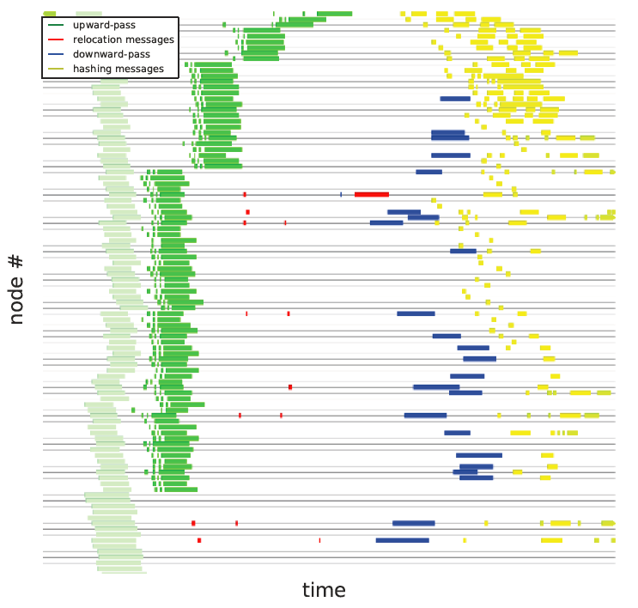
Algo 1: Shrink-and-balance
Shrinking taking place in parallel to upward-pass

Slide 8
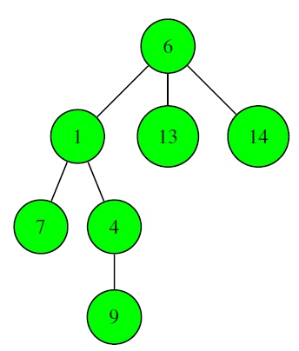
Algo 1: Shrink-and-balance
Balance
Notes:
Once a participating only spanning tree is realized during the upward pass, further communcation to complete all pending step takes place over this tree and non-participating processes are not involved.
The algorithms continues with a downward pass to balance the spanning tree obtained after the upward pass. Tries to keep the number of vertex migrations to a minimum.
At the end of upward pass, the root of the tree is aware of the size of process group using which it can calculate the size of a perfectly balanced spanning tree. The trget height can be used to deduce the maximum number of vertices that can fit within each of the subtrees of the root.
If the size of any of the vertices exceeds the maximum limit then we know thje minimum number of vertices that must move out in otder to limit the height.
The subtree with excess vetices are marked as vertex suppliers and are assigned to child vertices that have sufficient leftover capacity, otherwise they are split amognst the children. If the vertex itself does not have k children, it requests a vertex from the supplier and assigns rest of the suppliers to the children.

Slide 9
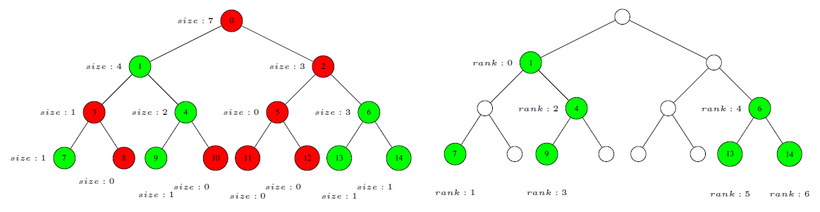
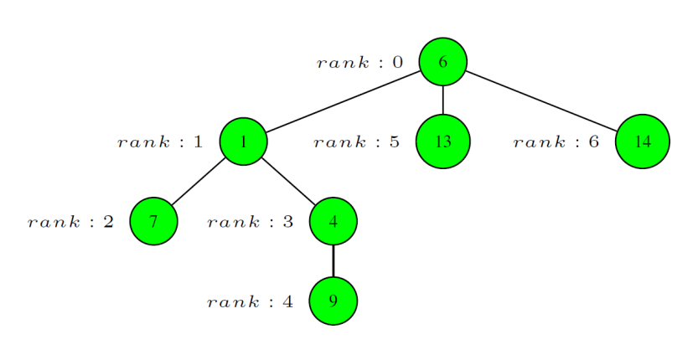
Algo 2: Shrink-and-hash
Notes:
This approach is based on the knowledge of size of each subtree available at the root. These sizes are used to assign ranges of ranks to each child vertex which progressively distribute the ranks down the tree.

Slide 10
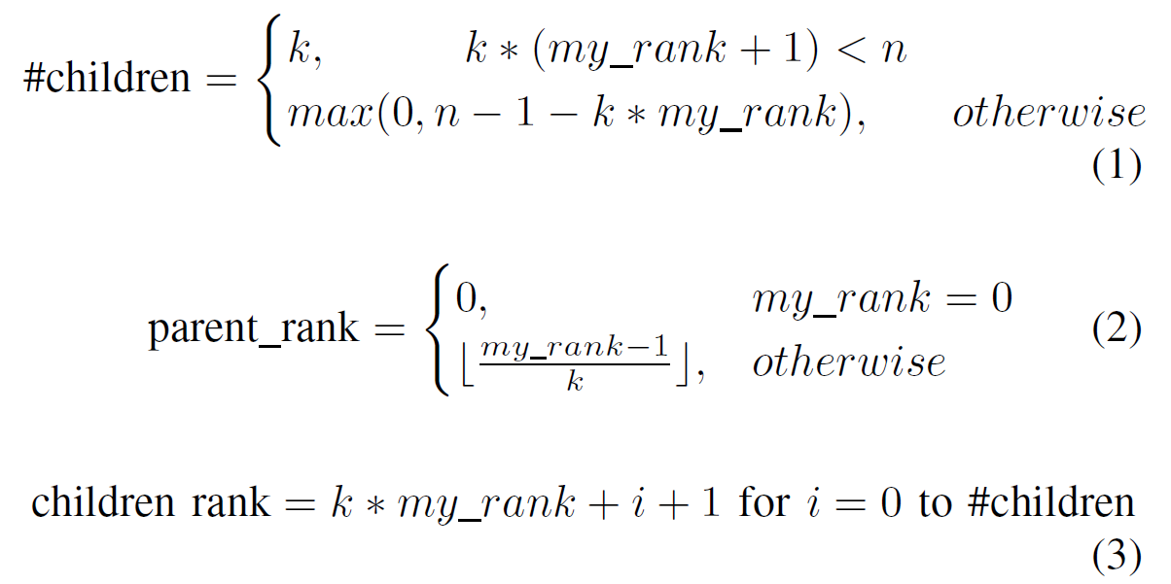

Algo 2: Shrink-and-hash
Hashing enables finding process ids corresponding to parent and child ranks.
hash: rank $i$ -> process id $H_{i}$

Slide 11
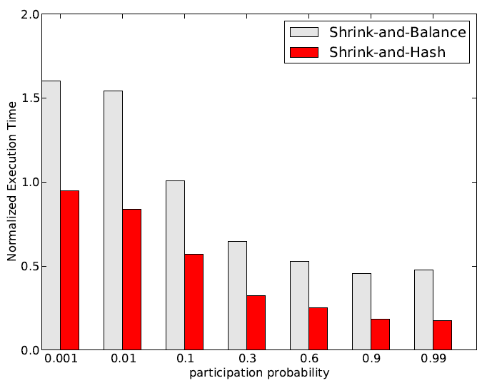
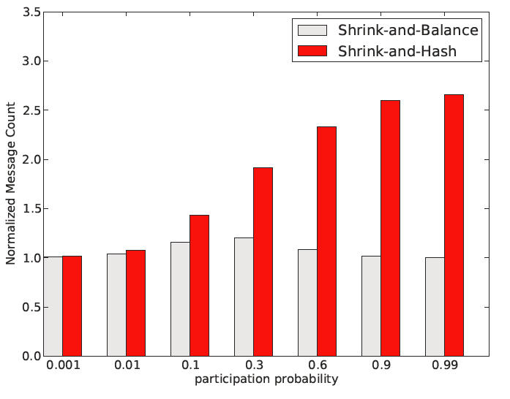
Performance BG/P 64k cores
Shrink-and-balance
Message conservative but longer critical path
Shrink-and-hash
large number of messages but short critical path

Slide 12
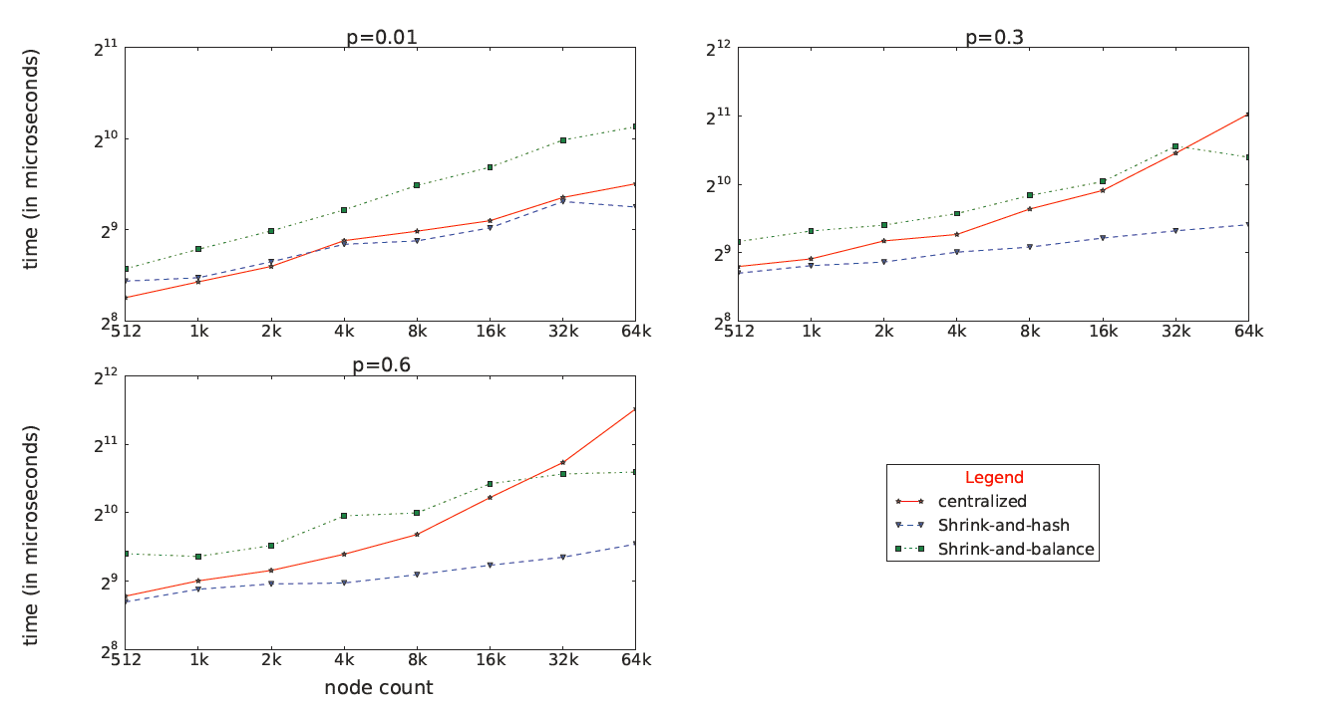
Results

Slide 13
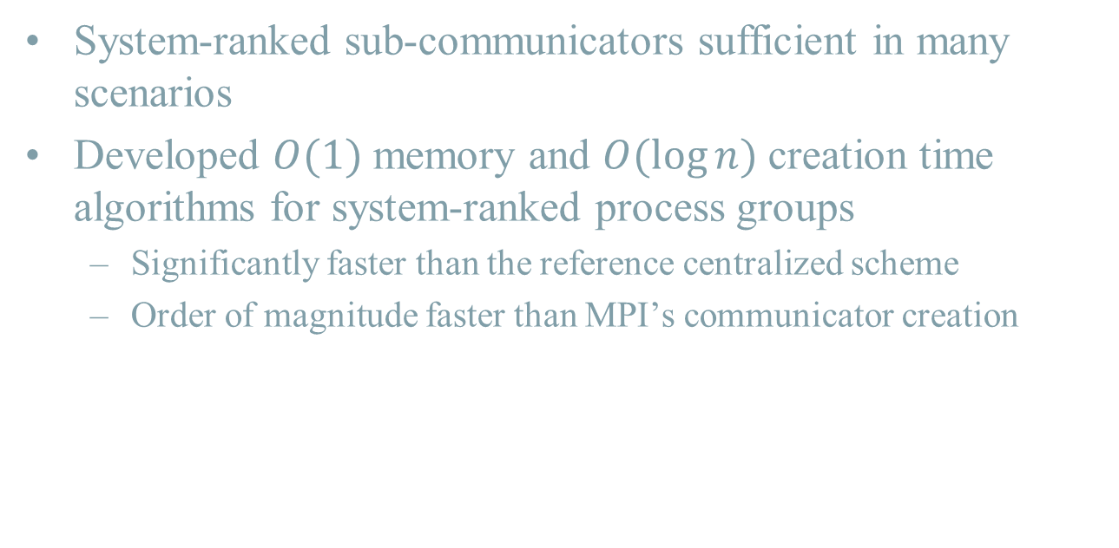
Summary
System-ranked sub-communicators sufficient in many scenarios
Developed $O(1)$ memory and $O(\log{n})$ creation time algorithms for system-ranked process groups
Significantly faster than the reference centralized scheme
Order of magnitude faster than MPI’s communicator creation

Slide 14
Questions?

