Slide 1
Load Balancing in Charm++
Eric Bohm

Slide 2
How to diagnose load imbalance?
Often hidden in statements such as:
Very high synchronization overhead
Most processors are waiting at a reduction
Count total amount of computation (ops/flops) per processor
In each phase!
Because the balance may change from phase to phase
2

Slide 3
Golden Rule of Load Balancing
Fallacy: objective of load balancing is to minimize variance in load across processors
Example: 50,000 tasks of equal size, 500 processors:
A: All processors get 99, except last 5 gets 100+99 = 199
OR, B: All processors have 101, except last 5 get 1
Identical variance, but situation A is much worse!
Golden Rule: It is ok if a few processors idle, but avoid having processors that are overloaded with work
Finish time = max_{i}{Time on processor i}, excepting data dependence and communication overhead issues

Slide 4
Amdahls’s Law and grainsize
Before we get to load balancing:
Original “law”:
If a program has K % sequential section, then speedup is limited to 100/K.
If the rest of the program is parallelized completely
Grainsize corollary:
If any individual piece of work is > K time units, and the sequential program takes T_{seq} ,
Speedup is limited to T_{seq} / K
So:
Examine performance data via histograms to find the sizes of remappable work units
If some are too big, change the decomposition method to make smaller units
4

Slide 5
Grainsize
(working) Definition: the amount of computation per potentially parallel event (task creation, enqueue/dequeue, messaging, locking. .)
Time
1 processor
p processors
Grainsize

Slide 6
Grainsize and Overhead
What is the ideal grainsize?
Should it depend on the number of processors?
V: overhead per message
Tp: p processor completion time
G: grainsize (computation per message)

Slide 7
Rules of thumb for grainsize
Make it as small as possible, as long as it amortizes the overhead
More specifically, ensure:
Average grainsize is greater than kv (say 10v)
No single grain should be allowed to be too large
Must be smaller than T/p, but actually we can express it as
Must be smaller than kmv (say 100v)
Important corollary:
You can be at close to optimal grainsize without having to think about P, the number of processors
7

Slide 8
How to determine/ensure grainsize
Compiler techniques can help, but only in some cases
Note that they don’t need precise determination of grainsize, just one that will satisfy a broad inequality
kv < g < mkv (10v < g < 100v)
8

Slide 9
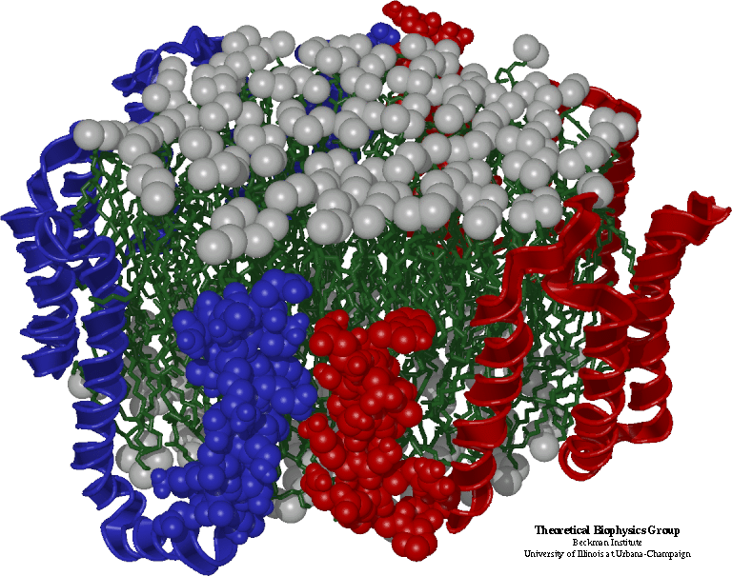
Molecular Dynamics in NAMD
Collection of [charged] atoms, with bonds
Newtonian mechanics
Thousands of atoms (1,000 - 500,000)
1 femtosecond time-step, millions needed!
At each time-step
Calculate forces on each atom
Bonds:
Non-bonded: electrostatic and van der Waal’s
Short-distance: every timestep
Long-distance: every 4 timesteps using PME (3D FFT)
Multiple Time Stepping
Calculate velocities and advance positions
Collaboration with K. Schulten, R. Skeel, and coworkers
9

Slide 10
Hybrid Decomposition
Object Based Parallelization for MD: Force Decomp. + Spatial Decomp.
We have many objects to load balance:
Each diamond can be assigned to any proc.
Number of diamonds (3D):
14·Number of Patches

Slide 11
Grainsize Example: Molecular Dynamics
In Molecular Dynamics Program NAMD:
While trying to scale it to 2000 processors
Sequential step time was 57 seconds
To run on 2000 processors, no object should be more than 28 msecs.
11

Slide 12
Grainsize analysis via Histograms
Solution:
Split compute objects that may have too much work:
using a heuristic based on number of interacting atoms
Problem

Slide 13
Grainsize: for Blue Gene/L
BG/L is an IBM machine with 128k processors
Here, we need even more objects:
Generalize hybrid decomposition scheme
1-away to k-away
2-away :
cubes are half the size.
13

Slide 14
Grainsize reduced
14

Slide 15
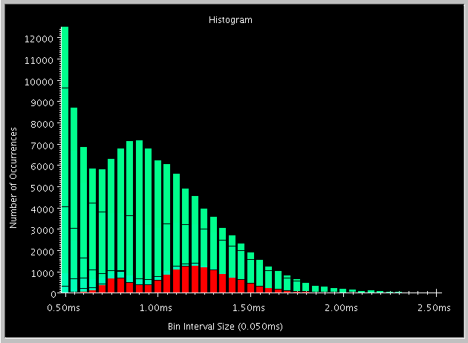
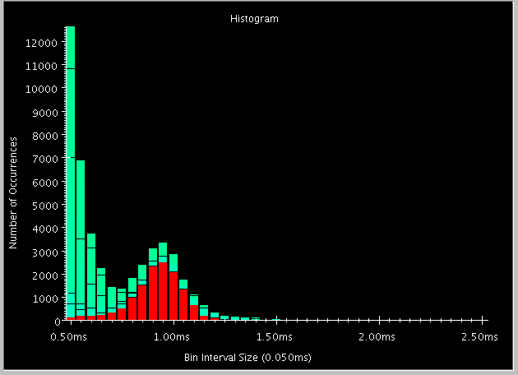
Fine Grained Decomposition on BlueGene
Force Evaluation
Integration
Decomposing atoms into smaller bricks gives finer grained parallelism
15

Slide 16
Load Balancing Strategies
Classified by when it is done:
Initially
Dynamic: Periodically
Dynamic: Continuously
Classified by whether decisions are taken with global information
Fully centralized
Quite good a choice when load balancing period is high
Fully distributed
Each processor knows only about a constant number of neighbors
Extreme case: totally local decision (send work to a random destination processor, with some probability).
Use aggregated global information, and detailed neighborhood info.
16

Slide 17
Dynamic Load Balancing Scenarios:
Examples representing typical classes of situations
Particles distributed over simulation space
Dynamic: because Particles move.
Cases:
Highly non-uniform distribution (cosmology)
Relatively Uniform distribution
Structured grids, with dynamic refinements/coarsening
Unstructured grids with dynamic refinements/coarsening
17

Slide 18
Example Case: Particles
Orthogonal Recursive Bisection (ORB)
At each stage: divide Particles equally
Processor don’t need to be a power of 2:
Divide in proportion
2:3 with 5 processors
How to choose the dimension along which to cut?
Choose the longest one
How to draw the line?
All data on one processor? Sort along each dimension
Otherwise: run a distributed histogramming algorithm to find the line, recursively
Find the entire tree, and then do all data movement at once
Or do it in two-three steps.
But no reason to redistribute particles after drawing each line.
18

Slide 19
Dynamic Load Balancing using Objects
Object based decomposition (I.e. virtualized decomposition) helps
Allows RTS to remap them to balance load
But how does the RTS decide where to map objects?
Just move objects away from overloaded processors to underloaded processors
19

Slide 20
Measurement Based Load Balancing
Principle of persistence
Object communication patterns and computational loads tend to persist over time
In spite of dynamic behavior
Abrupt but infrequent changes
Slow and small changes
Runtime instrumentation
Measures communication volume and computation time
Measurement based load balancers
Use the instrumented data-base periodically to make new decisions
Many alternative strategies can use the database
20

Slide 21
Periodic Load balancing Strategies
Stop the computation?
Centralized strategies:
Charm RTS collects data (on one processor) about:
Computational Load and Communication for each pair
If you are not using AMPI/Charm, you can do the same instrumentation and data collection
Partition the graph of objects across processors
Take communication into account
Pt-to-pt, as well as multicast over a subset
As you map an object, add to the load on both sending and receiving processor
The red communication is free, if it is a multicast.
21

Slide 22
Load Balancing Steps
Regular Timesteps
Detailed, aggressive Load Balancing
Time
Instrumented Timesteps
Refinement Load Balancing
22

Slide 23
Object partitioning strategies
You can use graph partitioners like METIS, K-R
BUT: graphs are smaller, and optimization criteria are different
Greedy strategies
If communication costs are low: use a simple greedy strategy
Sort objects by decreasing load
Maintain processors in a heap (by assigned load)
In each step:
assign the heaviest remaining object to the least loaded processor
With small-to-moderate communication cost:
Same strategy, but add communication costs as you add an object to a processor
Always add a refinement step at the end:
Swap work from heaviest loaded processor to “some other processor”
Repeat a few times or until no improvement
23

Slide 24
Charm++ Strategies
GreedyLB
GreedyCommLB
RecBisectBfLB
MetisLB
TopoCentLB
RefineLB
RefineCommLB
ComboCentLB
OrbLB
NeighborLB
NeighborCommLB
WSLB
HybridLB
Combine strategies hierarchically

Slide 25
Object partitioning strategies
When communication cost is significant:
Still use greedy strategy, but:
At each assignment step, choose between assigning O to least loaded processor and the processor that already has objects that communicate most with O.
Based on the degree of difference in the two metrics
Two-stage assignments:
In early stages, consider communication costs as long as the processors are in the same (broad) load “class”,
In later stages, decide based on load
Branch-and-bound
Searches for optimal, but can be stopped after a fixed time
25

Slide 26
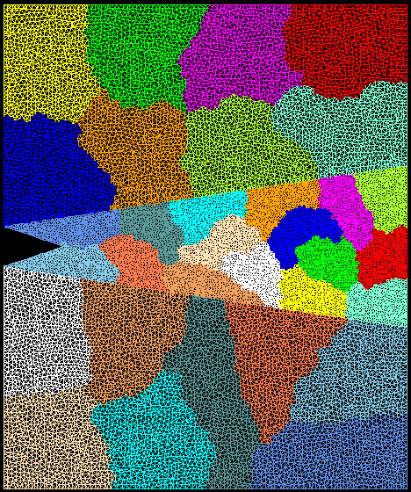
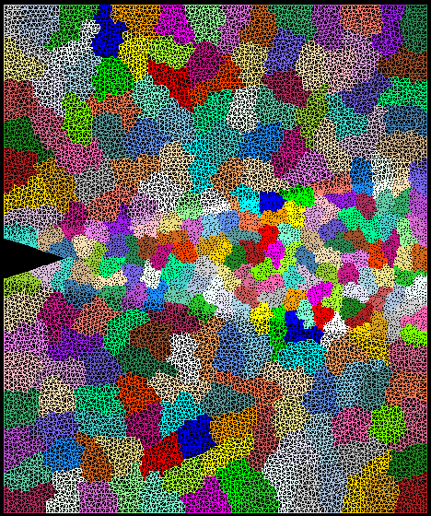
Crack Propagation
Decomposition into 16 chunks (left) and 128 chunks, 8 for each PE (right). The middle area contains cohesive elements. Both decompositions obtained using Metis. Pictures: S. Breitenfeld, and P. Geubelle
As computation progresses, crack propagates, and new elements are added, leading to more complex computations in some chunks
26

Slide 27
Load balancer in action
Automatic Load Balancing in Crack Propagation
1. Elements
Added
3. Chunks Migrated
2. Load
Balancer
Invoked
27

Slide 28
Distributed Load balancing
Centralized strategies
Still ok for 3000 processors for NAMD
Distributed balancing is needed when:
Number of processors is large and/or
load variation is rapid
Large machines:
Need to handle locality of communication
Topology sensitive placement
Need to work with scant global information
Approximate or aggregated global information (average/max load)
Incomplete global info (only “neighborhood”)
Work diffusion strategies (1980s work by Kale and others!)
Achieving global effects by local action…
28

Slide 29
Load Balancing on Large Machines
Existing load balancing strategies don’t scale on extremely large machines
Limitations of centralized strategies:
Central node: memory/communication bottleneck
Decision-making algorithms tend to be very slow
Limitations of distributed strategies:
Difficult to achieve well-informed load balancing decisions
29
Notes:
For extremely large parallel machines, existing load balancing strategies don’t scale.
In fact, load balancing on very large machines is a highly challenging problem due to the large scale of the parallel system and the number of migratable objects to balance.
Don’t work on machine.
For example, bg/L 64K procs and 1M objects (16 objects per processor)
There are a many limitations to the existing centralized and distributed load balancing strategies.

Slide 30
Simulation Study - Memory Overhead
Simulation performed with the performance simulator BigSim
lb_test benchmark is a parameterized program that creates a specified number of communicating objects in 2D-mesh.
Notes:
Lb_test is a bechmark program for load balancing.
It is a parameterized program that creates a specified number of migratable objects communicating in certain virtual topology.
In order to create load imbalance, the work done by each object is randomized in a parameterized range.
The figure shows the memory overhead due to load balancing on 32K and 64K processor simulation. The memory overhead is measured on the central node where the load database (ocg) is constructed for load balancing.
For different tests with varying number of objects, we measured the memory overhead used for the database as shown in this figure.
We can see the memory overhead increases significantly as the number of objects increases. For the run with 1M objects on 64K processors, the load database uses about 450MB of memory, which will barely fit on a node of a BlueGene/L which has 512MB total memory on each node.

Slide 31
Load Balancing Execution Time
Execution time of load balancing algorithms on a 64K processor simulation
Notes:
We compared the strategy execution time for making load balancing decision on 64K processor simulation for three different load balancing strategies.
The total execution time is measured with varying number of objects.
These figure compares

Slide 32
Hierarchical Load Balancers
Hierarchical distributed load balancers
Divide into processor groups
Apply different strategies at each level
Scalable to a large number of processors

Slide 33
Our HybridLB Scheme
Refinement-based Load balancing
1
Load Data
0
1024
63488
64512
Load Data (OCG)
0
…
1023
1024
…
2047
…...
63488
…
64511
64512
…
65535
Greedy-based Load balancing
token
object
Notes:
Example
(ocg)
(total load)
Other schemes can also be done
Send percentage
After each intermediate node receives all load data from its domain, it sends up the load to process 1 in the level 2.

Slide 34
Hybrid Load Balancing Performance
Load Balance Time
Application Time
N procs | 4096 | 8192 | 16384
Memory | 6.8MB | 22.57MB | 22.63MB
lb_test benchmark’s actual run on BG/L at IBM (512K objects)

Slide 35
Load Balancing: Hands on
[Insert graphic of someone balancing heavy load here]

Slide 36
Simple Imbalance
LB_Test.C
1D Array of chares
Half of which have 2x computation load
Strong scaling
Make will produce LB_Test
Run LB_Test with these parameters
Arguments:
Chares per core, iterations, workload multiplier, array size
10 100 1 14000
Use at least 7 processors (precede those arguments with -np 7)‏

Slide 37
Output without balancing
Charm++> cpu topology info is being gathered.
Charm++> 1 unique compute nodes detected.
Running on 7 processors with 40 chares per pe
All array elements ready at 0.009405 seconds. Computation Begins
[0] Element 0 took 0.008136 seconds for work 1 at iteration 0 sumC 4.664e+13
[1] Element 40 took 0.015659 seconds for work 2 at iteration 0 sumC 8.748e+14
[0] Element 0 took 0.008161 seconds for work 1 at iteration 99 sumC 4.664e+13
[1] Element 40 took 0.015753 seconds for work 2 at iteration 99 sumC 8.748e+14
Total work performed = 322.062557 seconds
Average total chare work per iteration = 3.220626 seconds
Average iteration time = 0.646274 seconds
Done after 64.636830 seconds

Slide 38
Analyze Performance
Productivity => not wasting your time
Measure twice, cut once
Make projections
Produces LB_Test_prj
Change your job script to run LB_Test_prj
mkdir nobalancetrace
Add arguments
+tracemode projections +logsize 1000000 +traceroot $PWD/nobalancetrace
Execution will create trace files in nobalancetrace

Slide 39
Download and visualize
Download the contents of nobalancetrace
Or extract sample from nobalancetrace.tar
tar xf nobalancetrace.tar
Run projections
Load LB_Test_prj.sts
Run timeprofile on several steps
4s to 8s for sample

Slide 40
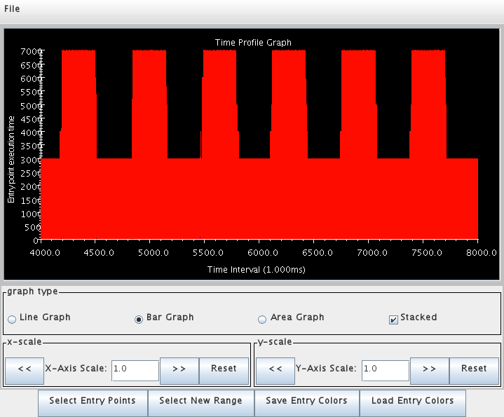
Time Profile no balance

Slide 41
Fix Migration
Fix the pup routine for the LB_Test chare
PUP each member variable
p|varname;
Need to do memory allocation when unpacking
if(p.isUnpacking){ /* allocate dynamic members */ }
PUP dynamically created arrays
PUParray(p, varname, numelements);
Remove the CkAbort

Slide 42
Add Load Balancer Support
Add call to AtSync in LB_Test::next_iter
if ((iteration == balance_iteration) && usesAtSync) {
AtSync();
} else {
compute();
}
Add ResumeFromSync
void ResumeFromSync(void) { // Called by Load-balancing framework
compute();
}
Answer is in LB_Test_final.C

Slide 43
Use GreedyLB
Change job script to run LB_Test_LB
Add argument +balancer GreedyLB
Run on the same number of processors with the same arguments
10 100 1 14000

Slide 44
Output with Balancing
Charm++> cpu topology info is being gathered.
Charm++> 1 unique compute nodes detected.
[0] GreedyLB created
Running on 7 processors with 40 chares per pe
All array elements ready at 1.321699 seconds. Computation Begins
[0] Element 0 took 0.008051 seconds for work 1 at iteration 0 sumC 4.664e+13
[1] Element 40 took 0.016682 seconds for work 2 at iteration 0 sumC 8.748e+14
[6] Element 0 took 0.008228 seconds for work 1 at iteration 99 sumC 4.664e+13
[6] Element 40 took 0.016420 seconds for work 2 at iteration 99 sumC 8.748e+14
Total work performed = 348.857247 seconds
Average total chare work per iteration = 3.488572 seconds
Average iteration time = 0.561590 seconds
Done after 57.480725 seconds

Slide 45
Compare
Consider iteration time
Consider total CPU time
Walltime * number of processors
The more processors you use, the more important it is to reduce iteration time through efficiency
Look for overloaded processors
Underloading is just a symptom
Overload implies bottleneck

Slide 46
Usage Profile
Run Usage Profile from Tools menu
Examine area before load balancing
Note, intervals are in 100ms
3000ms to 4000ms works for the sample

Slide 47
Analyze Performance Again
Productivity => not wasting your time
Measure twice, cut once
Make projections
Produces LB_Test_LB_prj
Change your job script to run LB_Test_LB_prj
mkdir balancetrace
Add arguments
+tracemode projections +logsize 1000000 +traceroot $PWD/balancetrace
Execution will create trace files in balancetrace

Slide 48
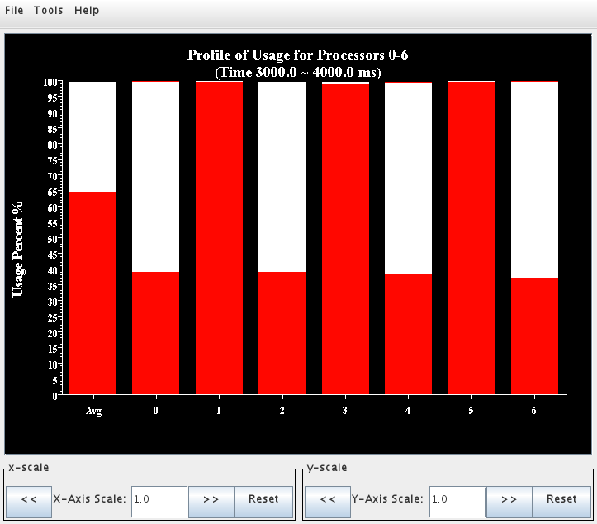
Usage Profile before balance

Slide 49
Timeline across balancer
Open timeline spanning load balancing
4s to 8s works for sample
Try a large time span on a few cores then zoom in

Slide 50
The life of a chare
Migration out:
ckAboutToMigrate()
Sizing
Packing
Destructor
Migration in:
Migration constructor
UnPacking
ckJustMigrated()

Slide 51
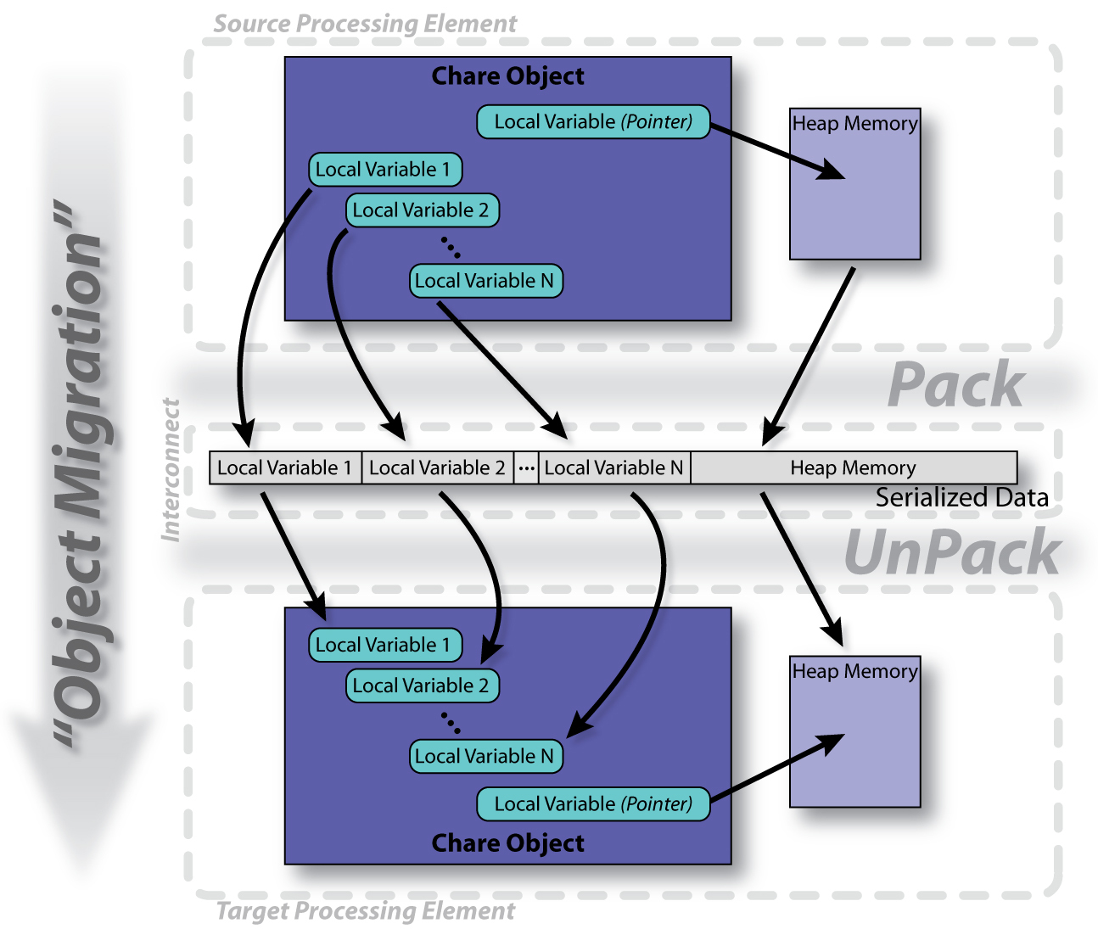
The PUP process

Slide 52
Writing a PUP routine
or:
void operator|(PUP::er &p, MyChare &c)
void pup(PUP::er &p) {
CBase_MyChare::pup(p);
p | a;
p | b;
p | c;
p(localArray, LOCAL_SIZE);
p | heapArraySize;
if (p.isUnpacking()) {
heapArray = new float[heapArraySize];
}
p(heapArray, heapArraySize);
int isNull = (pointer==NULL) ? 1 : 0;
p | isNull;
if (!isNull) {
if (p.isUnpacking()) pointer = new MyClass();
p | *pointer;
}
}
};
class MyChare : public CBase_MyChare {
int a;
float b;
char c;
float localArray[LOCAL_SIZE];
int heapArraySize;
float* heapArray;
MyClass *pointer;
public:
MyChare();
MyChare(CkMigrateMessage *msg) {};
~MyChare() {
if (heapArray != NULL) {
delete [] heapArray;
heapArray = NULL;
}
}

Slide 53
PUP: what to look for
If variables are added to an object, update the PUP routine
If the object allocates data on the heap, copy it recursively, not just the pointer
Remember to allocate memory while unpacking
Sizing, Packing, and Unpacking must scan the same variables in the same order
Test PUP routines with “+balancer RotateLB”

Slide 54
Using the Load Balancer
link a LB module
-module <strategy>
RefineLB, NeighborLB, GreedyCommLB, others…
EveryLB will include all load balancing strategies
compile time option (specify default balancer)
-balancer RefineLB
runtime option
+balancer RefineLB

Slide 55
The code
void Jacobi::attemptCompute() {
if (ghostReceived == numGhosts) {
.... do computation
if (step & 0x0F == 0) AtSync();
else ResumeFromSync();
}
}
void Jacobi::ResumeFromSync() {
CkCallback cb (CkIndex_Main::stepCheckin(CkReductionMsg*), mainProxy);
contribute(sizeof(double), &maxDiff, CkReduction::max_double, cb);
}

Slide 56
Fault Tolerance
Disk Checkpointing
Simply PUP all Charm ++ entities to disk
Trigger with CkStartCheckpoint(“dir”, cb)
Callback cb called upon checkpoint completion
Called both after checkpoint and upon restart
To restart: “+restart<logDir>”
Double in-memory checkpoint: CkStartMemCheckPoint(cb)
Message logging
Only faulty processor rolls back
Notes:
56
56

Slide 57
Fault Tolerance: Example
Main::Main(CkMigrateMessage *m) : CBase_Main(m) {
// Subtle: Chare proxy readonly needs to be updated
// manually because of the object pointer inside it!
mainProxy = thisProxy;
}
void Main::pup(PUP::er &p) { .... }
void Main::next(CkReductionMsg *m) {
if ((++step % 10) == 0) {
CkCallback cb(CkIndex_Hello::SayHi(),helloProxy);
CkStartCheckpoint("log",cb);
} else {
helloProxy.SayHi();
}
delete m;
}
readonly CProxy_Main mainProxy;
mainchare [migratable] Main { .... };
group [migratable] MyGroup { .... };
Notes:
57
57

Slide 58
Summary
Look for load imbalance
Migratable object are not hard to use
Charm++ has significant infrastructure to help
On your own try this benchmark
at various processor numbers
See the impact on scaling with different array sizes
See the impact on total runtime when the number of iterations grows large.
Try other load balancers
http://charm.cs.uiuc.edu/manuals/html/charm++/manual-1p.html#lbFramework

