Slide 1

Scalable Algorithms for Structured Adaptive Mesh Refinement
Akhil Langer, Jonathan Lifflander, Phil Miller, Laxmikant Kale
Parallel Programming Laboratory
University of Illinois at Urbana-Champaign
Kuo-Chuan Pan, Paul Ricker
Department of Astronomy
University of Illinois at Urbana-Champaign

Slide 2
Outline
Introduction to Adaptive Mesh Refinement (AMR)
Traditional Approach
  Existing Frameworks
  Algorithm
  Disadvantages
New Scalable Approach
  Doing it the Charm++ way
  The Mesh Restructuring Algorithm
  Dynamic Distributed Load Balancing
Comparison with Traditional Approach
Experimental Results/ Performance

Slide 3
Outline
Introduction to Adaptive Mesh Refinement
Traditional Approach
  Existing Frameworks
  Algorithm
  Disadvantages
New Scalable Approach
  Doing it the Charm++ way
  The Mesh Restructuring Algorithm
  Dynamic Distributed Load Balancing
Comparison with Traditional Approach
Experimental Results/ Performance

Slide 4
Adaptive Mesh Refinement
Introduction
Solving Partial Differential Equations (PDEs)
  PDEs solved using discrete domain
  Algebraic equations estimate values of unknowns at the mesh points
  Resolution/Spacing of mesh points determines error

Slide 5
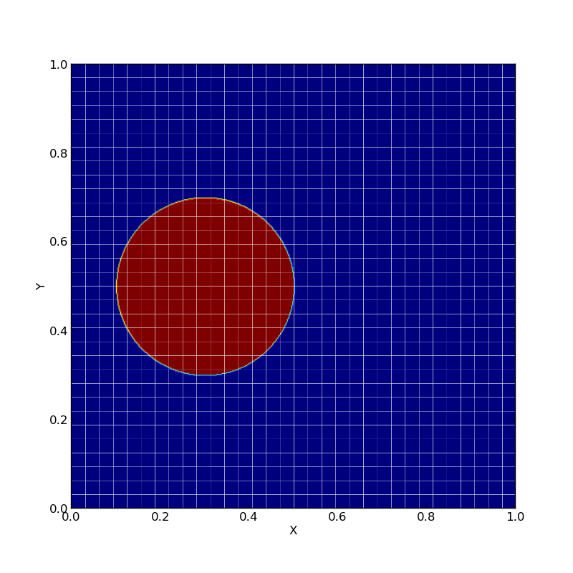
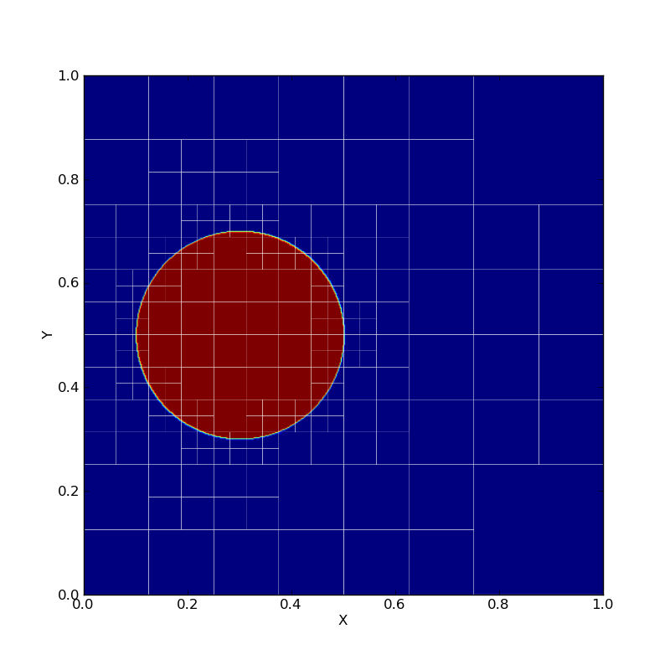
Adaptive Mesh Refinement
Introduction
Uniform Mesh
Adaptively Refined Mesh
Uniform meshes
High resolution required for handling difficult regions (discontinuities, steep gradients, shocks, etc.)
Computationally extremely costly
Adaptive Mesh Refinement
Start with a coarse grid
Identify regions that need finer resolution
Superimpose finer subgrids only on those regions
AMR makes it feasible to solve problems that are intractable on uniform grid

Slide 6

Adaptive Mesh Refinement
Applications
CFD
Astrophysics
Climate Modeling
Turbulence
Mantle Convection Modeling
Combustion
Biophysics
and many more
Impact of Type Ia super nova explosion on a main –sequence binary companion, rendered using FLASH

Slide 7
Outline
Introduction to Adaptive Mesh Refinement
Traditional Approach
  Existing Frameworks
  Algorithm
  Disadvantages
New Scalable Approach
  Doing it the Charm++ way
  The Mesh Restructuring Algorithm
  Dynamic Distributed Load Balancing
Comparison with Traditional Approach
Experimental Results/ Performance

Slide 8
Traditional Approach
Existing Frameworks
PARAMESH
SAMRAI
FLASH
p4est
Enzo
Chombo
deal.II
and many more
Our current work focusses on Oct-tree based simulations

Slide 9
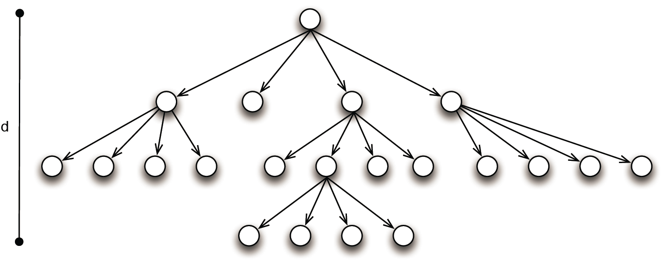
Little more background on AMR
Refinement structure can be represented using a quad-tree (2D)/ oct-tree (3D)
An important condition in AMR
Refinement levels of neighboring blocks differ by ±1

Slide 10
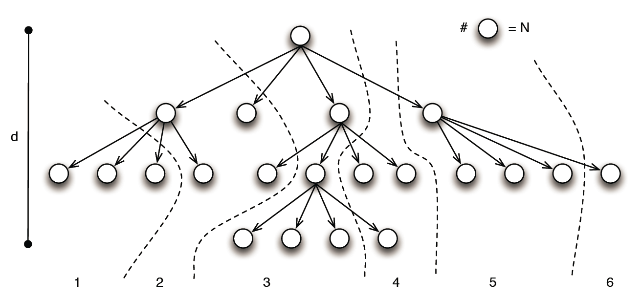
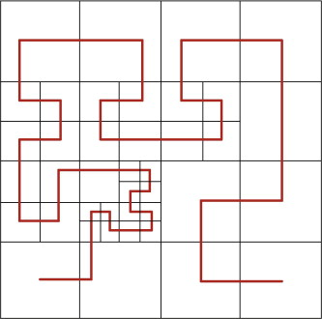
Traditional Approach
Typical Implementations
A set of blocks assigned to a process
Use space-filling curves for load balancing

Slide 11
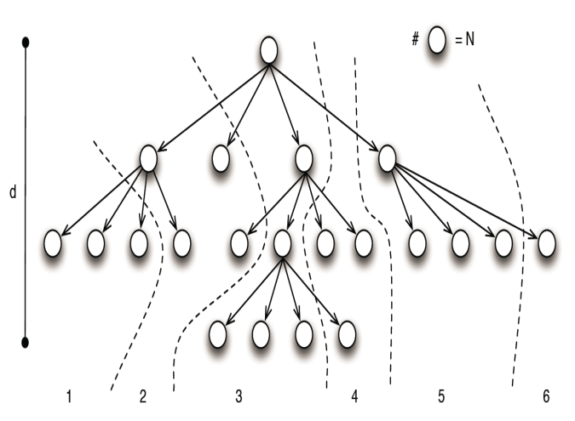
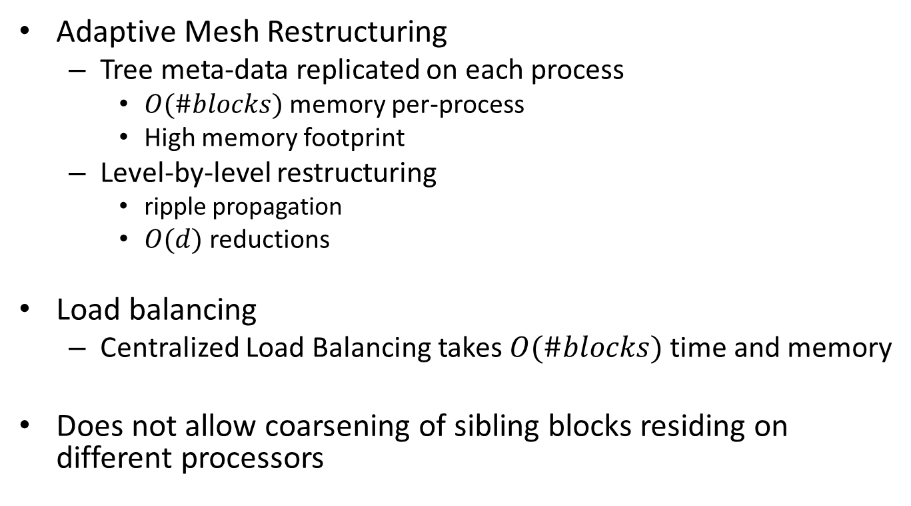
Traditional Approach
Disadvantages
Adaptive Mesh Restructuring
  Tree meta-data replicated on each process
    $O(\#blocks)$ memory per-process
    High memory footprint
  Level-by-level restructuring
    ripple propagation
    $O(d)$ reductions
Load balancing
  Centralized Load Balancing takes $O(\#blocks)$time and memory
Does not allow coarsening of sibling blocks residing on different processors
O(#blocks) memory per-process
O(d) reductions
Memory bottlenecks!!!
Synchronization overheads!!!
O(#blocks)

Slide 12
Outline
Introduction to Adaptive Mesh Refinement
Traditional Approach
  Existing Frameworks
  Algorithm
  Disadvantages
New Scalable Approach
  Doing it the Charm++ way
  The Mesh Restructuring Algorithm
  Dynamic Distributed Load Balancing
Comparison with Traditional Approach
Experimental Results/ Performance

Slide 13
Scalable Approach
Doing it the Charm++ way
Instead of processes, promote individual blocks to first class entities
  chare array with custom indices
  A chare corresponds to a block
  A block is now the end point of communication

Slide 14
Scalable Approach
Doing it the Charm++ way
Block Naming
  Bitvector describing path from root to block’s node
  One bit per dimension at each level
  Easy to compute parent, children, siblings
    using bit manipulation
Block acts as a virtual processor
  Run time handles communication between arbitrary blocks
  overlap of computation with communication of other blocks on same physical process
Dynamic placement of blocks (chares) on processes
  Facilitates dynamic load balancing
Block is a unit of algorithm expression
  Simplifies implementation complexity
0
1
00
01
10
11
p0
computing
Waiting for boundary layers

Slide 15
Scalable Approach
The Mesh Restructuring (Remeshing) Algorithm
Based on local error estimate, each block makes one of the following decisions: refine, coarse or stay
refine and stay decisions are communicated to neighbors
  coarse decision is implied if either refine, stay message is not received

Slide 16
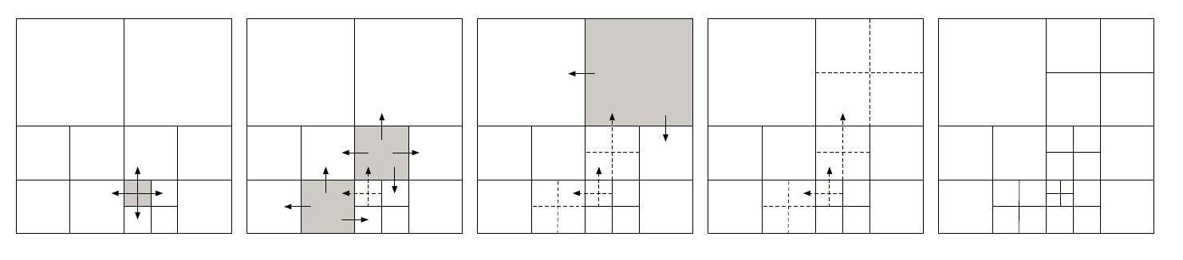
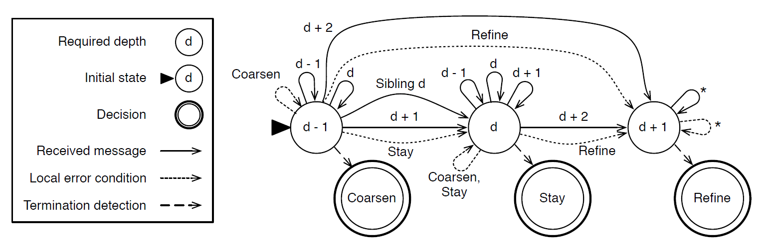
Scalable Approach
The Mesh Restructuring Algorithm
refine, stay decisions will propagate
Decisions are updated based on the DFA and change in decisions are again communicated

Slide 17
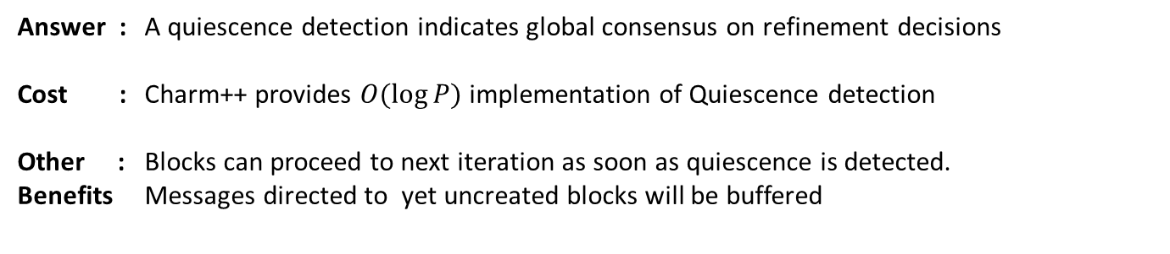
Scalable Approach
The Mesh Restructuring Algorithm
When to stop?
Answer : A quiescence detection indicates global consensus on refinement decisions
Cost : Charm++ provides $O(\log{P})$implementation of Quiescence detection
Other : Blocks can proceed to next iteration as soon as quiescence is detected.
Benefits Messages directed to yet uncreated blocks will be buffered

Slide 18

Dynamic Load Balancing
Blocks are created and destroyed as simulation progresses, creating load imbalance
Need for dynamic load balancing of blocks
Use Grapevine – Charm++ provided distributed load balancer
  $O(log⁡P)$ space and $O(log⁡P + \frac{\#blocks}{P})$time complexity

Slide 19
Outline
Introduction to Adaptive Mesh Refinement
Traditional Approach
  Existing Frameworks
  Algorithm
  Disadvantages
New Scalable Approach
  Doing it the Charm++ way
  The Mesh Restructuring Algorithm
  Dynamic Distributed Load Balancing
Comparison with Traditional Approach
Experimental Results/ Performance

Slide 20
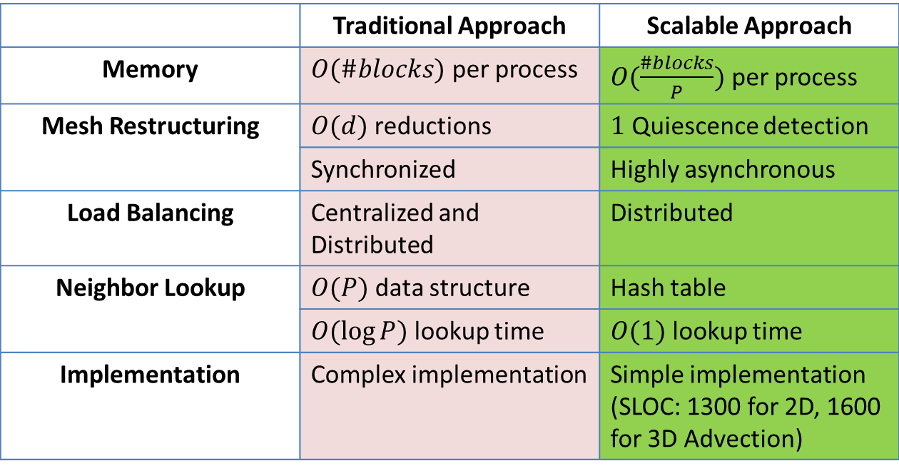
Comparison with the Traditional Approach
 | Traditional Approach | Scalable Approach
Memory | $O(\#blocks)$ per process | $O(\frac{\#blocks}{P})$ per process
Mesh Restructuring | $O(d)$ reductions | $1$ Quiescence detection
 | Synchronized | Highly asynchronous
Load Balancing | Centralized and Distributed | Distributed
Neighbor Lookup | $O(P)$data structure | Hash table
 | $O(\log{P})$ lookup time | $O(1)$ lookup time
Implementation | Complex implementation | Simple implementation (SLOC: 1300 for 2D, 1600 for 3D Advection)
Conclusion
New approach promises high performance for much more deeply refined computations than are currently practiced

Slide 21
Outline
Introduction to Adaptive Mesh Refinement
Traditional Approach
  Existing Frameworks
  Algorithm
  Disadvantages
New Scalable Approach
  Doing it the Charm++ way
  The Mesh Restructuring Algorithm
  Dynamic Distributed Load Balancing
Comparison with Traditional Approach
Experimental Results/ Performance

Slide 22
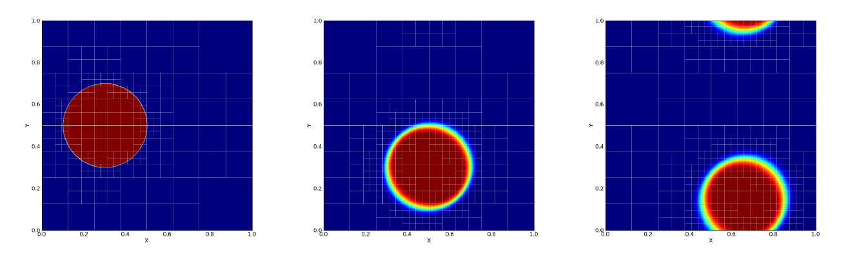
Performance
Benchmark
Advection benchmark
First-order upwind method in 2D space
Advection of a tracer along with the fluid

Slide 23
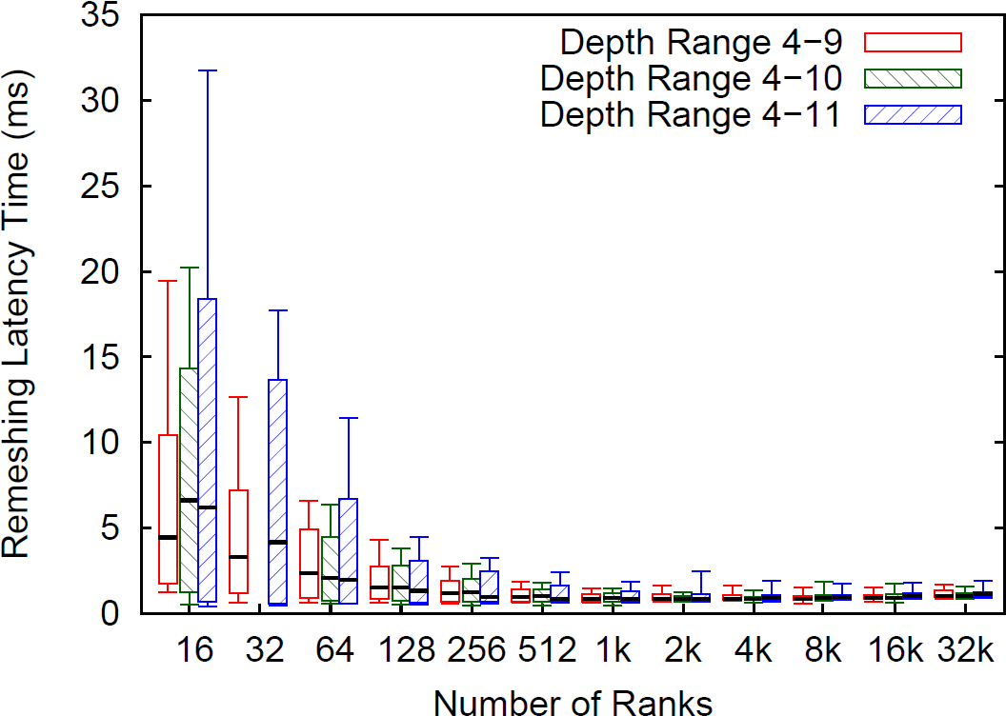
Performance
Mesh Restructuring Latency
Two components
Remeshing decisions and communication
  scales well
Termination detection time
  Logarithmic in #processes
2D Advection on BG/Q

Slide 24
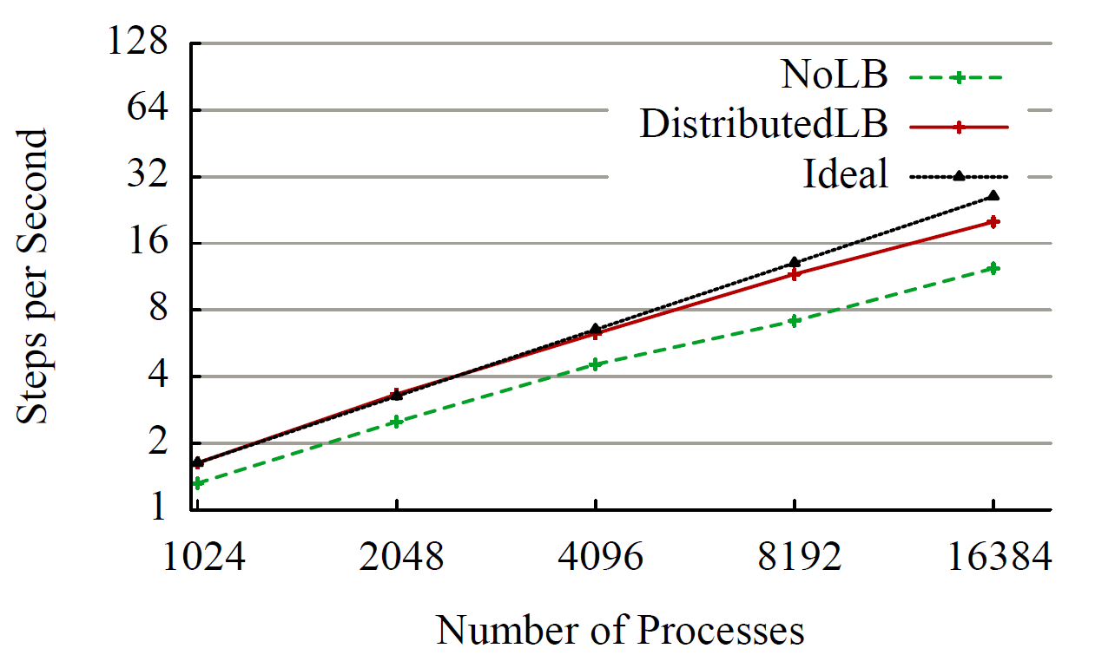
Performance
Strong Scaling
2D Advection on BG/Q with max-depth of 15

Slide 25

Scalable Algorithms for Structured Adaptive Mesh Refinement
Thank you!
Questions??
Akhil Langer, Jonathan Lifflander, Phil Miller
Parallel Programming Laboratory
University of Illinois at Urbana-Champaign
Kuo-Chuan Pan, Paul Ricker
Department of Astronomy
University of Illinois at Urbana-Champaign

