Slide 1
Improving HPC Application Performance in Cloud through Dynamic Load Balancing
Abhishek Gupta, Osman Sarood, Laxmikant V. Kale
Dejan Milojicic (HP labs)
04/15/2013

Slide 2
Motivation: Why Clouds for HPC ?
Rent vs. own, pay-as-you-go
No startup/maintenance cost, cluster create time
Elastic Resources
No risk e.g. in under-provisioning
Power savings, prevents underutilization
Benefits of virtualization
Flexibility and Customization
Security and Isolation
Migration
Resource Control
Hence, a cost-effective and timely solution
e.g. substitute/addition when Supercomputers are heavily loaded

Slide 3
Motivation: HPC-Cloud Gap
Today’s HPC not Cloud-aware, Clouds not HPC-aware!
Only embarrassingly parallel or small scale HPC apps run in Clouds
Typical Cloud interconnect, scheduler, heterogeneity, multi-tenancy largest obstacles for HPC apps
Notes:
As an example, on 100 processors, if
one processor is 30% slower compared to the rest, application
will slowdown by 30% even though the system has 99:7% raw
CPU power compared to the case when all processors are fast.

Slide 4
HPC in Cloud
Performance Evaluation
Cost Evaluation
Challenges/Bottlenecks
Opportunities
Poor Network Performance
Multi-tenancy
VM consolidation
Elasticity
Virtualization - customization
Pay-as-you-go/
rent vs. own
Heterogeneity
Security
Noise
Commodity Interconnect
Virtualization overhead
Thin VMs/Containers
Mapping
Applications to Platforms
Application-Aware
Cloud Schedulers
Cloud Aware
HPC Load Balancer
Malleable Parallel Jobs (Runtime Shrink/Expand)
MAPPING
SCHEDULING/PLACEMENT
HPC Aware Clouds
EXECUTION
Cloud Aware HPC

Slide 5
NEED FOR LOAD BALANCER FOR HPC IN CLOUD
Heterogeneity and multi-tenancy intrinsic in clouds
Heterogeneity: Cloud economics is based on:
Creation of a cluster from existing pool of resources and
Incremental addition of new resources.
Multi-tenancy: Cloud providers run a profitable business by improving utilization of underutilized resources
Cluster-level by serving large number of users,
Server-level by consolidating VMs of complementary nature (such as memory- and compute-intensive) on same server.
Hence multi-tenancy can be at resource-level (memory, CPU), node-level, rack-level, zone-level, or data center level.

Slide 6
Research Goals
Can we reduce the divide between HPC and Cloud?
Make Clouds HPC-aware
Make HPC cloud-aware
Address Heterogeneity, Multi-tenancy by adaptive runtime system
Challenge: Running in VMs makes it difficult to determine if (and how much of) the load imbalance is
Application-intrinsic or
Caused by extraneous factors.
Notes:
First, we assumed that we can get accurate compute time for tasks, that is independent of the background load. However, in cloud, it may not be possible to separate the time taken by background load from application load since virtualization hides the presence of time-sharing of physical nodes among VMs.

Slide 7
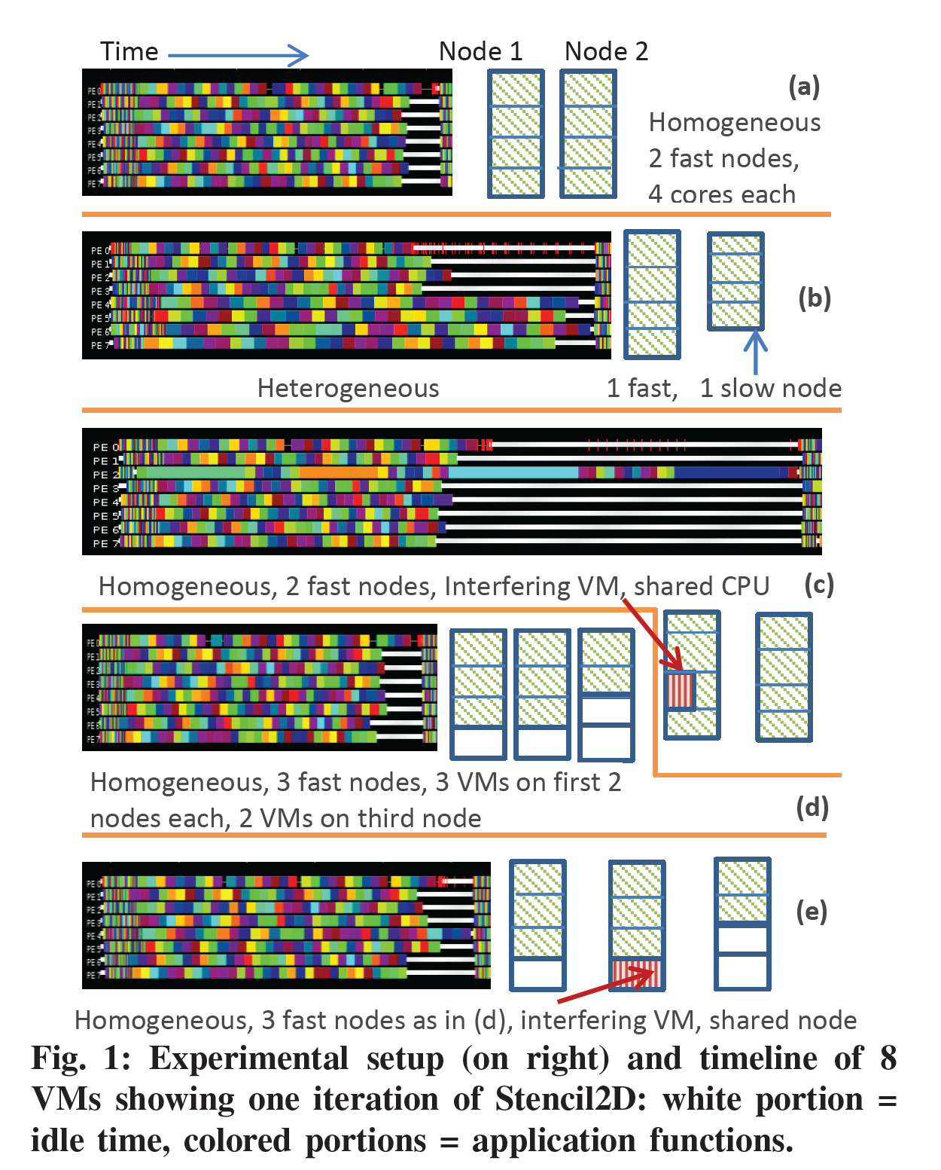
NEED FOR LOAD BALANCER FOR HPC IN CLOUD
Idle time
Notes:
To
demonstrate its severity, we conducted a simple experiment
where we ran a tightly-coupled 5-point stencil benchmark,
referred to as Stencil2D (2K 2K matrix), on 8-VMs, each
with a single virtual core (VCPU), pinned to a different
physical core of 4-core nodes. More details of our experimental
setup and benchmarks are given in Section V. To
study the impact of heterogeneity, we ran this benchmark in
2 cases - first, we used two physical nodes of same fast (3.00
GHz) processor type (Figure 1a) and second, we used two
physical nodes with different processor types – fast (3.00 GHz)
and slow (2.13 GHz) (Figure 1b).
In the context of cloud, the execution environment depends
on VM to physical machine mapping, which makes it (a)
dynamic and (b) inconsistent across multiple runs. Hence,
would be inefficient. Most existing dynama static allocation of compute tasks to parallel processes
ic load balancing
techniques operate based exclusively on the imbalance internal
to the application, whereas in cloud, the imbalance might be
due to the effect of extraneous factors. These factor originate
from two characteristics, which are intrinsic to cloud:
1) Heterogeneity: Cloud economics is based on the creation
of a cluster from existing pool of resources and
incremental addition of new resources. While doing this,
homogeneity is lost.
2) Multi-tenancy: Cloud providers run a profitable business
by improving utilization of underutilized resources. This
is achieved at cluster-level by serving large number
of users, and at server-level by consolidating VMs of
complementary nature (such as memory- and computeintensive)
on same server. Hence, multi-tenancy can be
at resource-level (memory, CPU), node-level, rack-level,
zone-level, or data center level.

Slide 8
Charm++’s and Load Balancing!
Migratable objects
Mandatory for our scheme to work
Supports fault tolerance
Object-based over-decomposition
Helpful for refinement load balancing
Time logging for all objects
Central to load balancing decisions
Supports plugin load balancer
Notes:
Charm++ is a perfect match for our technique.
Its object based over-decomposition coupled with migrateability of objects allows us to trasnfer tasks to load balance the application
Time logging of task, provided by charm++, is also an essential part of our scheme. We use these times to come up with decisions about which tasks to migrate in order to restore load balance.

Slide 9
CLOUD-AWARE LOAD BALANCER FOR HPC
Static Heterogeneity: estimate the CPU capabilities for each VCPU, and use those estimates to drive the load balancing.
Simple estimation strategy + periodic refinement of load distribution
Dynamic Heterogeneity (Interfering VMs): Periodic object(task) redistribution

Slide 10
Load Balancer migrates objects from overloaded
to under loaded VM
HPC VM1
HPC VM2
Background/ Interfering VM running on same host
Physical Host 1
Physical Host 2
Objects
(Work/Data Units)

Slide 11
CLOUD-AWARE LOAD BALANCER FOR HPC
Instrumenting the time spent on each task,
Predict future load based on the execution time of recently completed iterations.
Impact of interference: instrument the load external to the application under consideration, referred to as the background load

Slide 12
Load balancing approach
To get a processor-independent
measure of task loads, normalize the execution times to number of ticks
All processors should have load close to average load
Average load depends on task execution time and overhead
Overhead is the time processor is not executing tasks and not in idle mode.
Charm++ load balancing database
from /proc/stat file
T_{lb}: wall clock time between two load balancing steps,
T_{i}: CPU time consumed by task i on VCPU p
Notes:
The main challenge is that the CPU time may include the time taken by interfering VM, so they may be inaccurate.
P is the total number of VCPUs, Np is the number
of tasks assigned to VCPU p, ti is the CPU time consumed
by task i running on VCPU p, fp is the frequency for VCPU
p estimated using the loop in Figure 2, and Op is the total
background load for VCPU p.
normalize the execution times to number of ticks by
multiplying the execution times for each task and the overhead
to the estimated VCPU frequency. The conversion from CPU
time to ticks is performed to get a processor-independent
measure of task loads, which is necessary for balancing load
across heterogeneous configuration, where the same task can
take different time when executing on a different CPU.

Slide 13
Load balancing approach
After each user defined time interval
Categorize each VCPU as overloaded/underloaded
Create a heap of overloaded processors (H)
Create a set of underloaded processors (S)
Until H is not empty:
Transfer tasks from most overloaded processor from the H to any processor from S
The largest task currently placed on donor such that it can be transferred to a core from underloaded Set without overloading it
Update task mappings

Slide 14
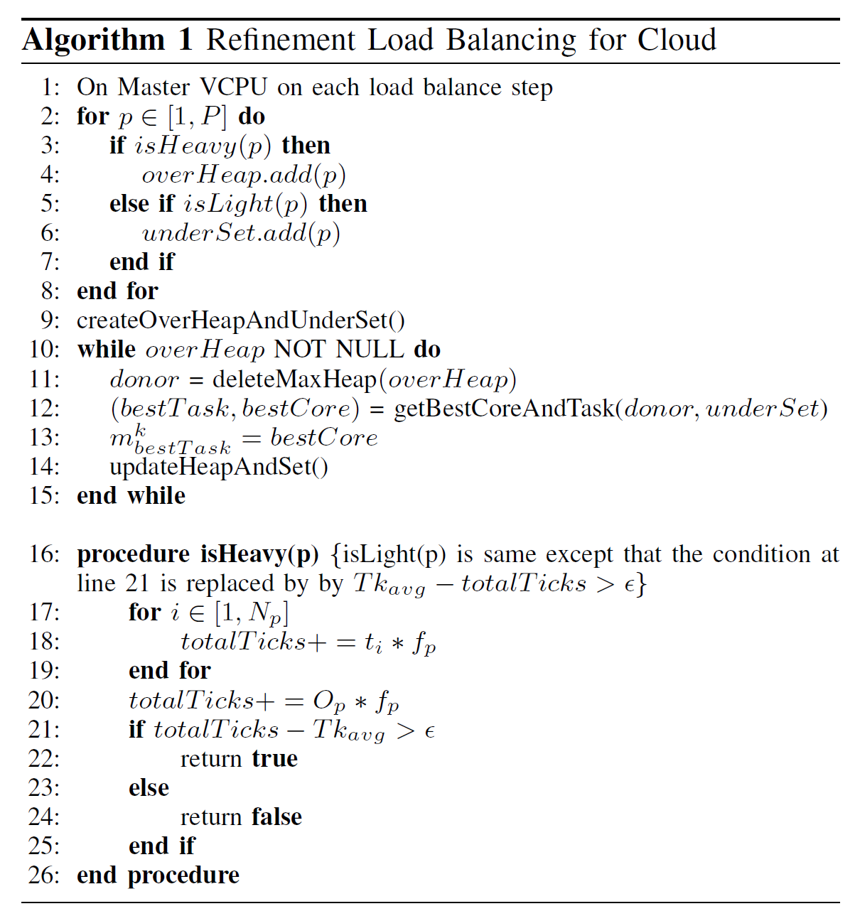
Load balancing approach

Slide 15
Evaluation: Experimental Testbed
OpenStack on Open Cirrus test bed at HP Labs site, 3 types of servers:
Intel Xeon E5450 (12M Cache, 3.00 GHz) - Fast
Intel Xeon X3370 (12M Cache, 3.00 GHz) - Fast
Intel Xeon X3210 (8M Cache, 2.13 GHz) - Slow
KVM as hypervisor, virtio-net for n/w virtualization
VMs: m1.small (1 core, 2 GB RAM, 20 GB disk)
Connected using commodity Ethernet – 1Gbps internal to rack and 10Gbps cross-rack.
Pin the virtual cores to physical cores using vcpupin command.

Slide 16
Benchmarks and Applications
Stencil2D – 5-point stencil computation kernel
Wave2D – finite differencing to calculate pressure information over a discretized 2D grid, for simulation of a wave motion.
Mol3D – A 3-D molecular dynamics simulation application. We used the Apoa1 dataset (92K atoms).
Written in Charm++
net-linux-x86-64 machine layer
–O3 optimization level.
For Stencil2D, problem size 8K × 8K. For Wave2D, problem size 12K × 12K. Each object size is kept 256 × 256.
Interference:
Sequential NPB-FT (NAS Parallel Benchmark - Fourier Transform) Class A as source of interference
Interfering VM pinned to one of the cores that the VMs of our parallel runs use

Slide 17
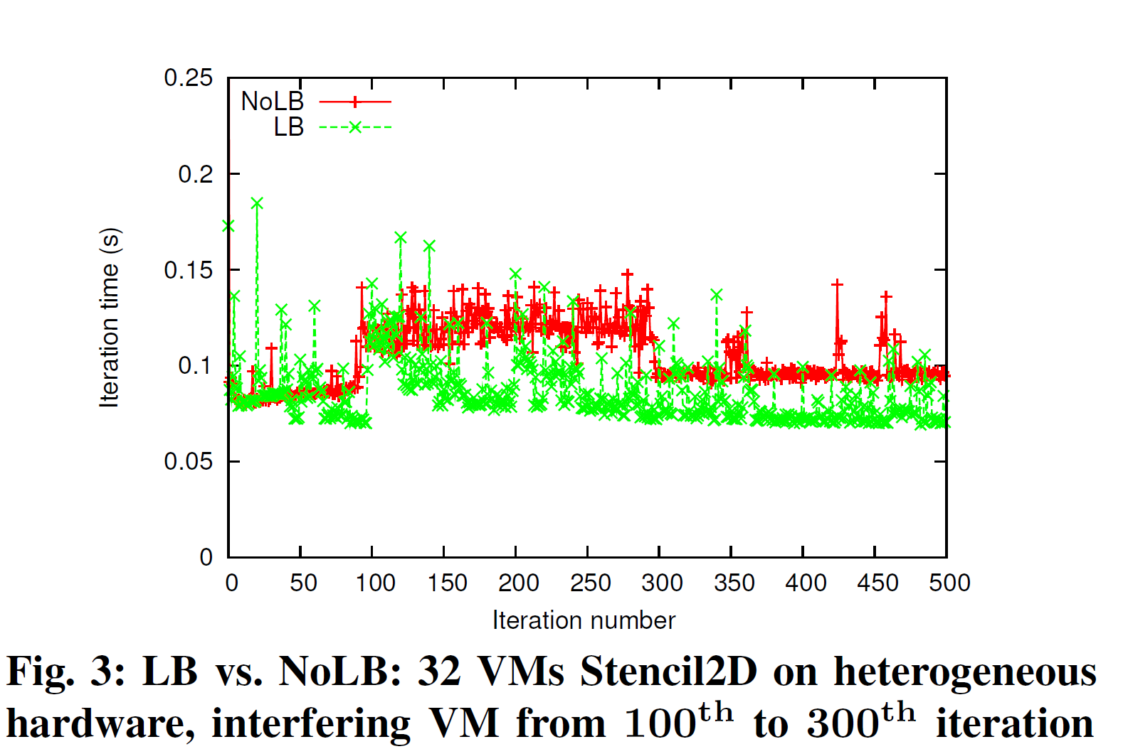
Results: Analysis using stencil3d
Notes:
To understand the effect of our load balancer under heterogeneity
and interference, we ran 500 iterations of Stencil2D
on 32 VMs (8 physical nodes – one Slow, rest Fast), and
plotted the iteration time (execution time of an iteration) vs.
iteration number in Figure 3. In this experiment, we started the
job in interfering VM after 100 iterations of parallel job had
completed. Load balancing was performed after every 20 steps,
which manifests itself as spikes in the iteration time every
20th step. We report execution times averaged across three
runs and use wall clock time, which includes the time taken
for object migration. The LB curve starts to show benefits
as we reach 100 iterations, due to heterogeneity-aware load
balancing. After 100 iterations, interfering job starts. When the
load balancer kicks in, it restores load balance by redistributing
tasks among VMs according to Algorithm 1. Now, there is a
large gap between the two curves demonstrating the benefits
of our refinement based approach, which takes around 3 load
balancing steps to gradually reduce the iteration time after
interference appears. The interfering job finishes at iteration
300 and hence the NoLB curve comes down. There is little
reduction in LB curve, since the previous load balancing steps
had reduced the impact of interference to a very small amount.
The difference between the two curves after that is due to
heterogeneity-awareness in load distribution.

Slide 18
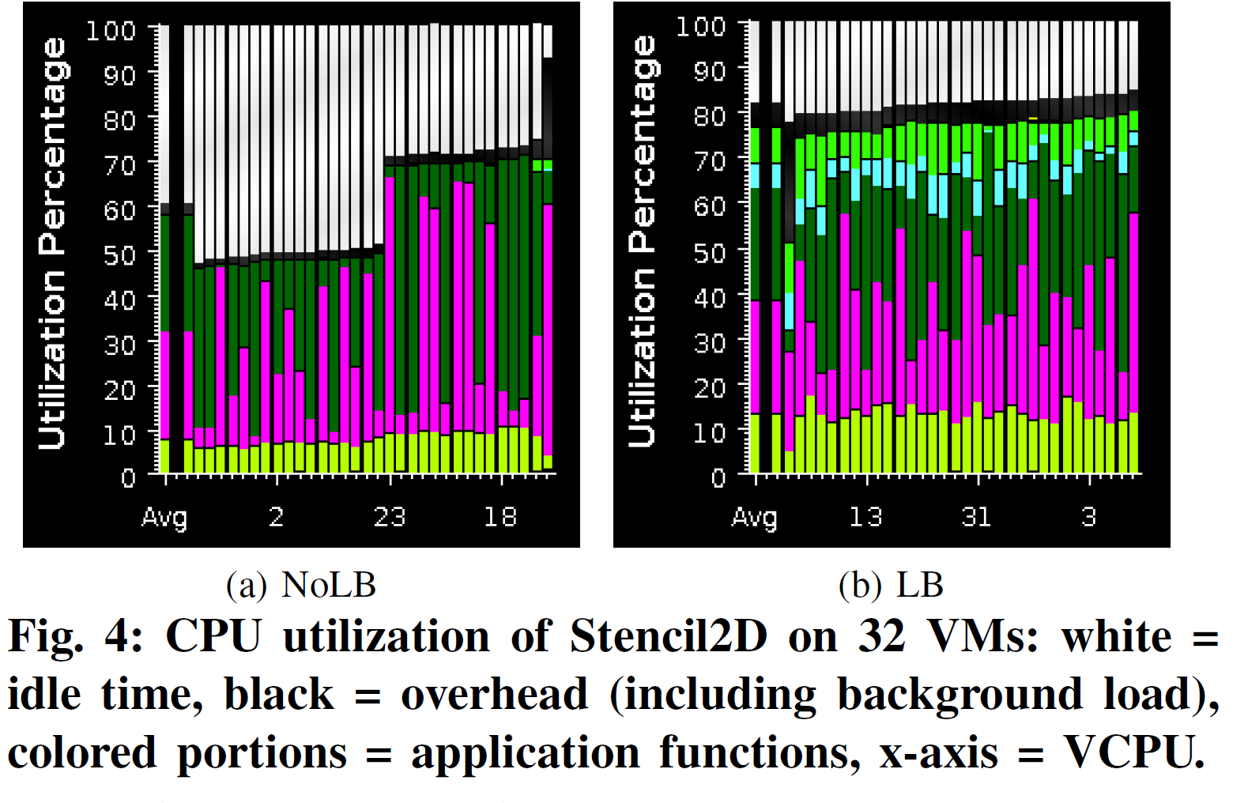
Results
Notes:
Observing
Figure 4a, it is clear that there are Observing
Figure 4a, it is clear that there are 3 different clusters –
50%, 70%, and 90% utilization level. The difference between
first two is due to the use of 2 types of processors. Though
they have same processor frequency, the actual performance
achieved is significantly different. There is very little load
imbalance among processors in the same cluster, indicating
that the distribution of work to processors is equal. The third
cluster belongs to the VM which incurs interference. Figure 4b
balances load. Here the idle time is due to the communication
time, and is uniform across all CPUs. Overall, the average
utilization increased from 60% to 82% using load balancing.–
50%, 70%, and 90% utilization level. The difference between
first two is due to the use of 2 types of processors. Though
they have same processor frequency, the actual performance
achieved is significantly different. There is very little load
imbalance among processors in the same cluster, indicating
that the distribution of work to processors is equal. The third
cluster belongs to the VM which incurs interference. Figure 4b
balances load. Here the idle time is due to the communication
time, and is uniform across all CPUs. Overall, the average
utilization increased from 60% to 82% using load balancing.

Slide 19
Results: Effect of Grain Size
Stencil2d (8K × 8K) on 32 VMs (Fast processors, one interfering VM), 500 iterations. For LB case, load balancing every 20 steps
Lower is better
Notes:
1 Grain size
2. No lb
3. With lb
256 by 256 ideal with lb
Grain size refers to the amount of work performed by a single task (object
in Charm++ terminology). For Stencil2D, it can be represented
by the matrix size of an object. Figure 5a shows the variation
in execution time with object sizes. First, consider the NoLB
case. As we decrease the grain size, hence increasing number
of objects per processor, execution time decreases due to
the benefits of overdecomposition: (a) better cache reuse by
exploiting temporal locality and (b) hiding network latency
through automatic overlap of computation and communication.
After a threshold, time starts increasing, due to the overhead
incurred by the scheduler and runtime for managing large
number of objects. Hence, as we make objects very fine
grained, performance degrades. Here, best performance is
obtained with grain size = 512 512 elements.
The LB case (load balancing every 20 steps) introduces
additional factors – (a) time spent in load balancing and (b)
load balancing quality, which affect the overall performance.
From Figure 5a, we see that the total load balancing time (LB
time), which includes time to make migration decisions and
time spent in migrating objects, is negligible compared to the
total time. However, LB time will be important as the computation
time decreases (e.g. strong scaling), and the ratio of LB

Slide 20
Results: Effect of LB Period
Stencil2d (8K × 8K) on 32 VMs (Fast processors, one interfering VM), 500 iterations. Grain size of 256 × 256
Lower is better
Notes:
Very
frequent load balancing (small LB period) results in most of
the time being spent in making task migration decisions and
migrating the data associated with objects, which degrades
application performance. Moreover, it also results in lack of
enough instrumented data for the load balancer to make intelligent
decisions, leading to large residual imbalance. With very
infrequent load balancing, such as LB period = 100 iterations,
load balancer will be slow to adapt to the dynamic variations,
leading to large residual imbalance. Hence, we settle for LB
period = 20 iterations (which equals approximately 2 seconds
here) except for runs on 64 VMs, where we used a period =
50 iterations. The optimal LB period depends on the iteration
time and should be larger for small iteration time so that the
gains achieved by improved load balance are not offset by
time spent in balancing load.

Slide 21
Results: Effect of Problem Size
Stencil2d on 32 VMs (Fast processors, one interfering VM), 500 iterations.
Grain size of 256 × 256, load balancing every 20 steps
Lower is better
Notes:
Figure 5c shows
that the benefits increase with increasing problem size. With
larger problem size, the computation granularity increases,
reducing communication-to-computation ratio. Hence, any improvement
in computation time through load balancing will
result in higher impact on the total execution time. Also, we
get better load balance quality as we increase problem size –
for 16K 16K matrix, we get residual imbalance of 1.05.
Application which are less communication-intensive are the
most cloud-friendly one and are expected to be run in the cloud
most because of better scalability. Also, the model expected to
work better in cloud is weak scaling (same problem size per
core with increasing cores) rather than strong scaling (same
total problem size with increasing cores) [22]. In that context,
our approach will be extremely useful for HPC in cloud.

Slide 22
Results: Improvements by LB
(a) Interference - one interfering VM, all Fast nodes,
(b) Heterogeneity – one Slow node, hence four Slow VMs, rest Fast
(c) Heterogeneity and Interference – one Slow node, hence four Slow VMs, rest Fast, one interfering VM (on a Fast core) which starts at iteration 50.
500 iterations for Stencil2D and Wave2D and 200 iterations for
Mol3D, with load balancing every 20th step
Notes:
an interfering VM, we achieve up to 45% improvement in
execution time (Figure 6a).
The amount of benefits is different
for different applications, especially in Figure 6b. We studied
this behavior using Projections tool and found that our load
balancer is distributing tasks well for all applications, but the
difference in achieved benefits is due to the different sensitivity
of these applications to CPU type and frequency. It can be
inferred from Figure 6b that Mol3D is the most sensitive to
CPU frequency, having most scope for improvement. Next,
Figure 6c shows that our techniques are also effective in the
presence of both the effects – the inherent hardware heterogeneity
and the heterogeneity introduced by multi-tenancy.
Another observation from Figure 6 is the variation in the
achieved benefits with increasing number of VMs. This is
attributed to the tradeoff between two factors: (1) Since there
is only one VM sharing physical CPU with interfering VM,
running on larger number of VMs implies distributing the work
of the overloaded VM to an increasing number of underutilized
VMs, which results in larger reduction in execution time (e.g.
Figure 6a Mol3D, 8 VM vs. 16 VM). (2) As we scale, the
average compute load per VM decreases. Hence, other factors,
such as communication time, dominate the total execution
time. This implies that even with better load balance and
higher % reduction in compute time, overall benefit is small,
since communication time is unaffected. Hence, as we scale
further, benefits decrease, but they still remain substantial.
Moreover, as we scale, benefits can actually be more important
because we save across larger number of processors. As
an example, from Figure 6b Stencil2D, we save 18.8% over 32
VMs, with absolute savings = 32 0:188 48:09 = 289:28
CPU-seconds, where application took 48.09 seconds on 32
VMs. Juxtaposing this with 20.5% reduction in time over 16
VMs which results in absolute savings = 160:20586:77 =
284:32 CPU-seconds, where application took 86.77 seconds on
16 VMs, we see that the overall savings are more for 32 VM
case compared to 16 VMs. Also, since we achieve higher %
benefits with larger problem sizes (Section VI-A3, Figure 5c),
the benefits will be even higher for weak scaling compared to
strong scaling as the impact of factor 2 above is minimized.

Slide 23
Results: Parallel Scaling
Notes:
The primary objective of running in parallel is to get reduced
execution time with increasing compute power. However, it is
not clear from Figure 6 whether we achieve that goal. Hence,
we plot execution time vs. number of VMs for same exp
For the purpose of comparison,
we also include the runs without any interfering VMs, with all
VMs mapped to Fast nodes (Homo curve in Figure 7). Figure 7
shows that our load balancer brings the NoLB curves down
and close to the Homo curve. At some data points, the LB
curves are below the homo curve, since even the Homo curves
can benefit from load balancing (shown earlier in Figure 4
that application performance on two types of Fast processors
is somewhat different). The superlinear speedup achieved in
some cases can be attributed to better cache performance.
The scale of our experiments was limited by the availability
of nodes in our cloud setup since we needed administrative
privileges from provider perspective. However, we believe that
our techniques will be equally applicable to larger scales since
the effectiveness of similar load balancing strategies have been
demonstrated on large-scale supercomputer applications [23]eriments

Slide 24
Related work
Studies on HPC in cloud
Walker, He et al., Ekanayake et al., DoE’s Magellan project
Cloud can be potentially more cost-effective than supercomputers for some HPC applications
Challenges: insufficient network and I/O performance in cloud, resource heterogeneity, and unpredictable interference arising from other VMs.
Bridging the gap between HPC and Cloud
Bring clouds closer to HPC
HPC-optimized clouds: Amazon Cluster Compute, DoE’s Magellan
HPC-aware cloud scheduler
Gupta et al.: HPC Aware VM Placement in Infrastructure Clouds
OpenStack scheduler architecture-aware
Bring HPC closer to clouds.
Fan et al. proposed topology aware deployment of scientific applications in cloud, and mapped the communication topology of an HPC application to the VM physical topology
http://charm.cs.uiuc.edu/research/cloud

Slide 25
Lessons Learned
Heterogeneity-awareness: significant performance improvement for HPC in cloud.
Besides the static heterogeneity, multi-tenancy in cloud introduces dynamic heterogeneity, which is random and unpredictable.
Poor performance of tightly-coupled iterative HPC applications.
Even without the accurate information of the nature and amount of heterogeneity (static and dynamic but hidden from user as an artifact of virtualization), the approach of periodically measuring idle time and migrating load away from time-shared VMs works well in practice.
Tuning the parallel application for efficient execution in cloud is non-trivial.
Choice of load balancing period and computational granularity can have significant impact on performance
Optimal values depend on application characteristics, size, and scale.
Runtime systems which can automate the selection and dynamic adjustment of such decisions will be increasingly useful in future.

Slide 26
Conclusions and future work
A load balancing technique
Accounts for heterogeneity
Handles interfering VMs in cloud
Uses object migration to restore load balance.
Experimental results on actual cloud showed that we were able to reduce execution time by up to 45% compared to no load balancing
Future Work
Extend our load balancer such that data migration is performed only if we expect gains that can offset the cost of migration.
Evaluate our techniques on a larger scale – on an actual cloud, if available in future, or through simulated or emulated environment.
Explore the use of VM steal cycles, where supported

Slide 27
Acknowledgements
This work was supported by HP Labs’ 2012 IRP award
Notes:
We note that different VM technologies can expose different
time semantics to the guest – virtual vs. real. Hence, the CPU
times of tasks (ti) (and hence Op) can be inaccurate on the
VCPUs which incur interference because they may include
the time spent in background tasks. In this work, we used
KVM hypervisor where CPU time (ti) measurements include
the time stolen by the interfering VM. Still, periodic migration
of tasks from overloaded to underloaded VCPUs ensures that
good load balance is achieved after a few steps, illustrating
the wide applicability of our approach (Section VI).

Slide 28
Related work
We extend our previous work on HPC-aware scheduler*
First, we assumed that we can get accurate compute time for tasks, that is independent of the background load. However, in cloud, it may not be possible to separate the time taken by background load from application load since virtualization hides the presence of time-sharing of physical nodes among VMs.
We make the load balancer aware of both – hardware heterogeneity and multitenancy in cloud.
we evaluate our techniques on an actual cloud with VMs whereas in the earlier work, we did not consider effects of virtualization

Slide 29
Motivation: HPC-Cloud Gap
Today’s HPC not Cloud-aware, Clouds not HPC-aware!
Only embarrassingly parallel or small scale HPC apps run in Clouds
Typical Cloud interconnect, scheduler, heterogeneity, multi-tenancy largest obstacles for HPC apps
Resource heterogeneity and multi-tenancy
Fundamental artifacts of running in cloud
Driven by cloud economics
Interference: sharing of CPU, cache, memory access, interconnect
Severe performance degradation for tightly-coupled HPC apps
Notes:
As an example, on 100 processors, if
one processor is 30% slower compared to the rest, application
will slowdown by 30% even though the system has 99:7% raw
CPU power compared to the case when all processors are fast.

Slide 30
Contributions
Dynamic load balancing for efficient execution of tightly-coupled iterative HPC applications in heterogeneous and dynamic cloud environment.
Main idea: periodic refinement of task distribution using measured CPU loads, task loads, and idle times
Implement these techniques in Charm++ and evaluate their performance and scalability on a real cloud setup on Open Cirrus testbed
45% reduction in execution time compared to no LB
Analyze the impact of load balancing frequency, grain size, and problem size on achieved performance

