Slide 1
Charm++ Implementation of a Detonation Shock Dynamics Algorithm
Brian McCandless

Slide 2
This project has three main objectives.
A project to gain experience with Charm++.
Investigate ways to improve the scalability of the Detonation Shock Dynamics (DSD) algorithm over the current MPI implementation.
Evaluate the MPI Interoperability feature to call the Charm++ version of DSD from within an MPI application.
A mini-app has been written as part of this work

Slide 3
First, an overview of Detonation Shock Dynamics (DSD).
DSD is used to simulate the propagation of a detonation through an explosive charge with a complex shape.
The DSD algorithm defines the motion of a detonation shock based on the geometry of the shock surface, the normal acceleration, and total curvature.
The narrowband algorithm is fast and accurate. Only the data associated with mesh elements and nodes near the detonation shock are accessed and updated during each time-step.
It works on an unstructured mesh.
It is easy to parallelize, although it is not easy to parallelize in a scalable way.
Our algorithm has two variations. A linear approximation and a curved approximation of the detonation front. The curved approximation is more expensive and more accurate.

Slide 4
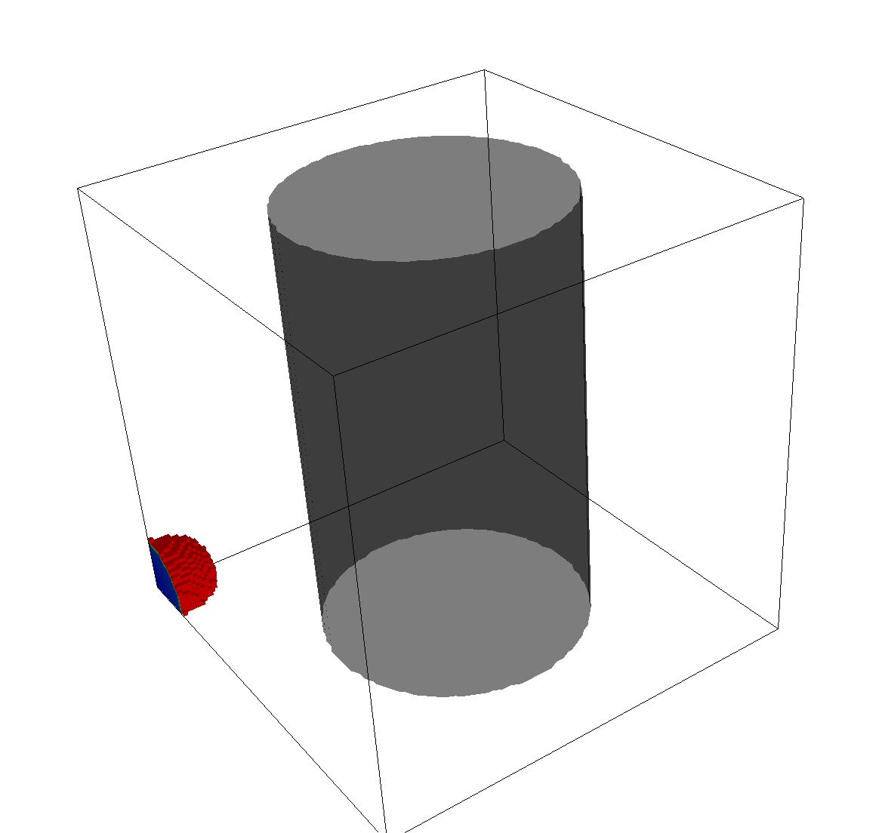
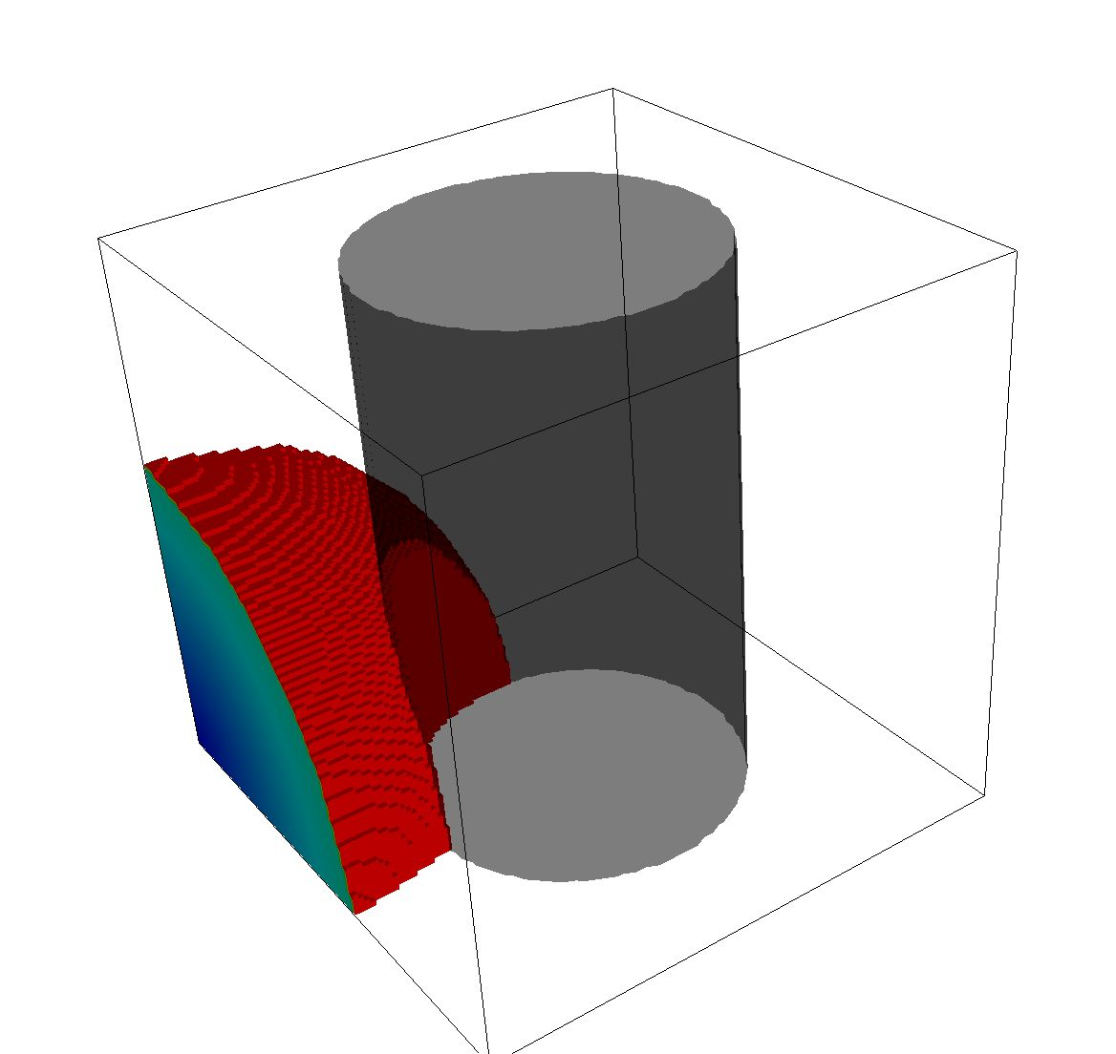
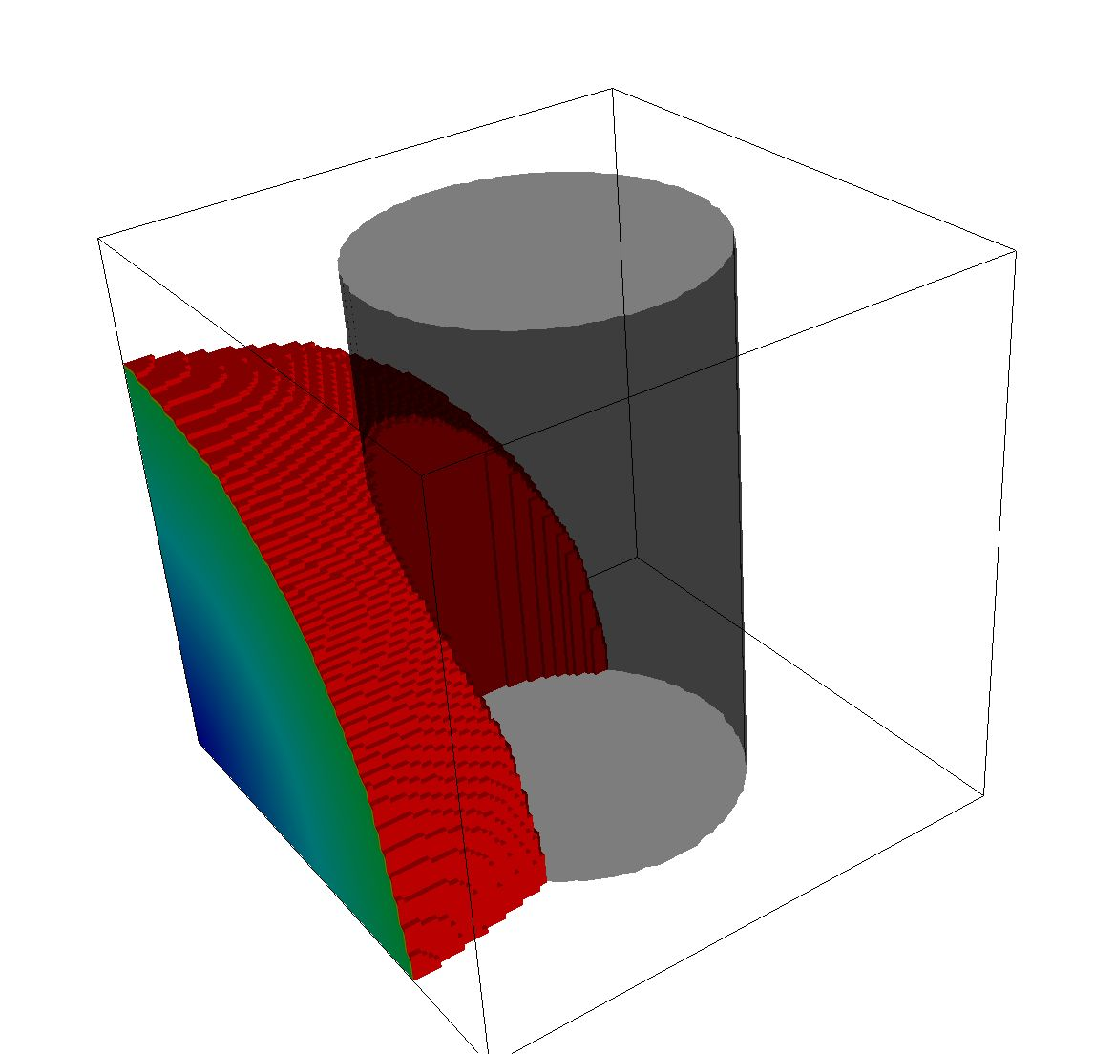
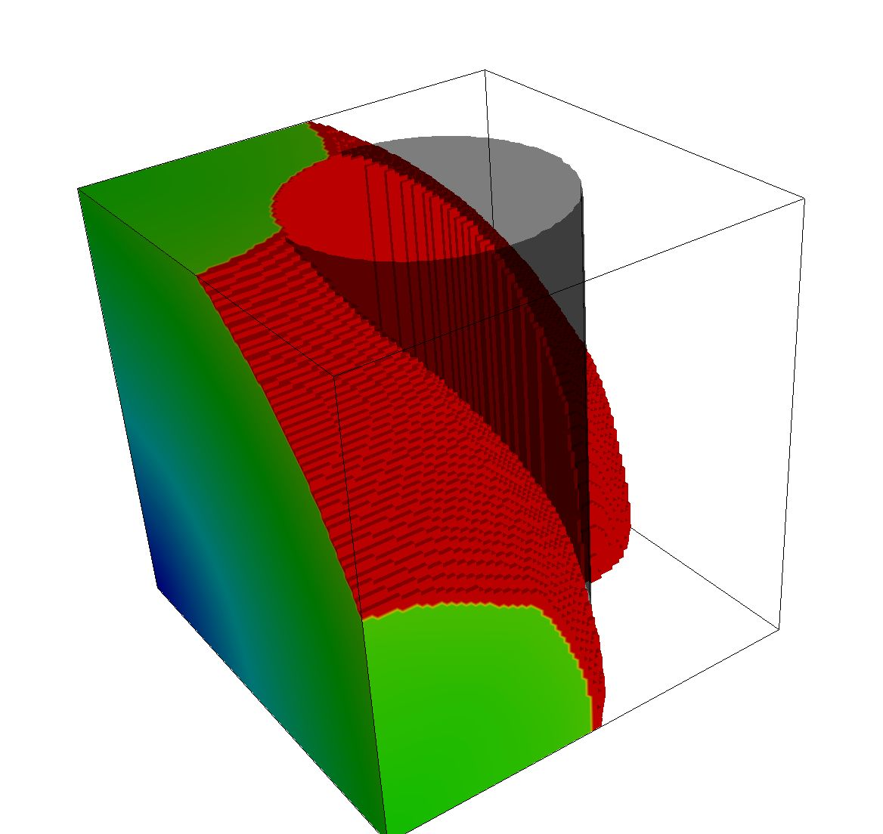
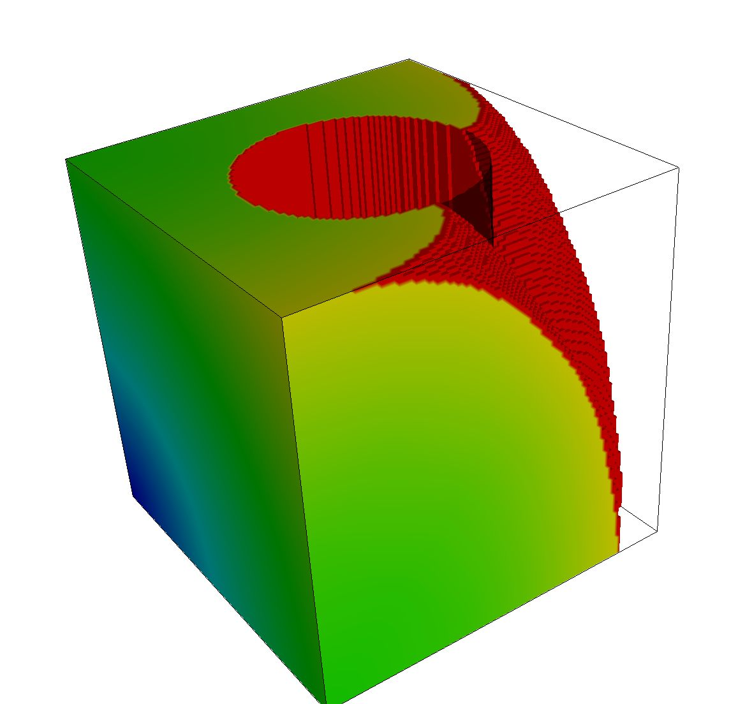
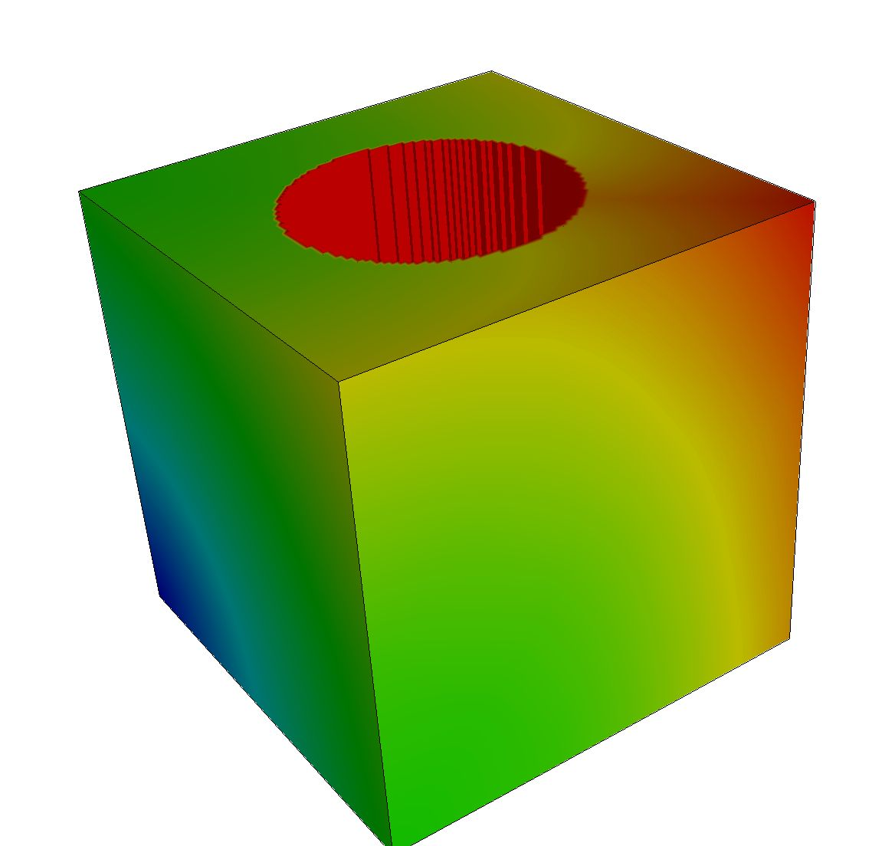
A test case showing a detonation burning passed a cylinder.

Slide 5

A slightly more fun example.

Slide 6
The basic DSD algorithm has these steps.
Until done
  Process new detonation sources.
  Update Narrowband region:
    Identify the nodes and zones on the narrow band, and the nearby nodes, for this time-step.
  Construct the Detonation Front:
    Construct a geometric representation of the burn front for this step.
  Compute distances to the Detonation Front:
    Compute the shortest distance from each narrowband node to the front.
    Based on distances (not connectivity)
  Compute lighting times
    Compute the lighting time for nodes that are behind the detonation front.
  Compute delta time for the next time step
Notes:
----- Meeting Notes (4/13/13 18:36) -----
fix title

Slide 7
In parallel, a few communication steps are needed.
Until done
  Process new detonation sources.
  Update Narrowband:
  Construct Detonation Front:
  Communicate Detonation front
    The representation of the front is communicated from the host processor to any processor within a fixed distance.
  Compute distances to Detonation Front:
  Compute lighting times
  Compute next time step
  Allreduce the next time step
  Synchronize node data
    The narrowband information is communicated.

Slide 8
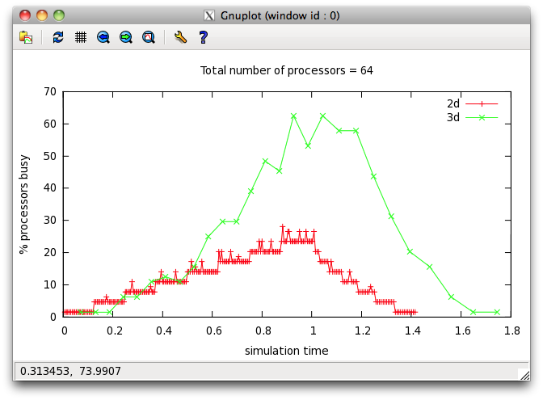
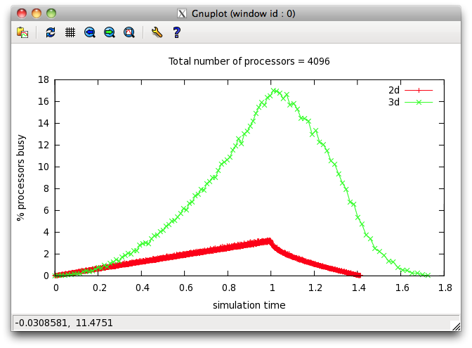
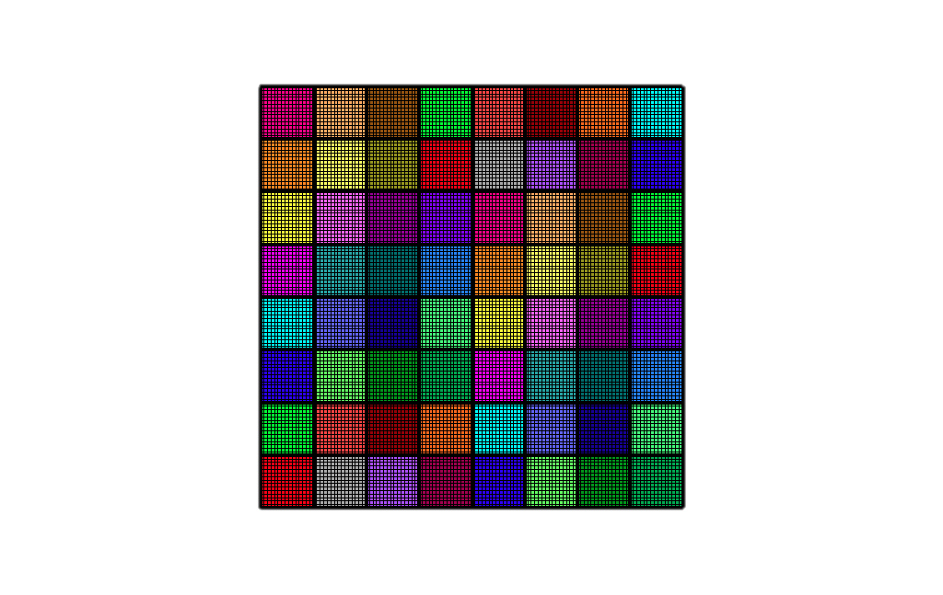
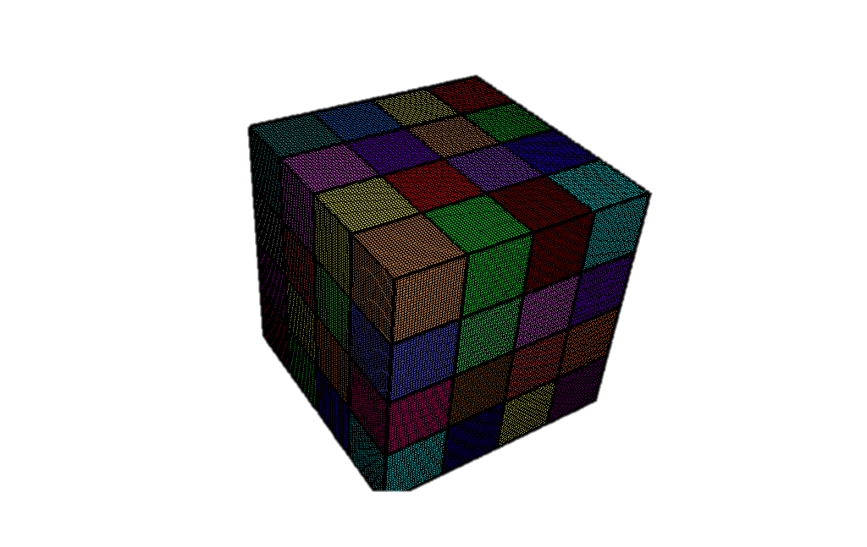
However, simple domain decomposition does not scale well.
As the number of domains increase, the percentage of domains that intersect the narrowband around the detonation front decreases.
The problem is more severe for 2D than 3D.
This algorithm clearly will not scale to high processor counts.
Example: regular 2D and 3D problem with a detonation source in one corner, with 64 and 4096 domains.

Slide 9
Over decomposition can help solve this problem.
One simple way to improve the parallel scalability is to over-decompose the problem. More domains than processors are created.
If a processor owns many domains, scattered in different locations of the problem, then that processor will be busy more often.
The detonation front will sweep past a domain owned by a processor at different times.

Slide 10
Over-decomposition improves performance.
Domains/ processor | Domains | Time to solution
1 | 512 | 17.72
2 | 1024 | 13.94
4 | 2048 | 11.01
8 | 4096 | 11.44
16 | 8192 | 15.55
32 | 16384 | 15.27
64 | 32768 | 24.03
Test problem: a simple regular 3D box with a detonation source in one corner
512 processors with varying amounts of over decomposition.
16M total mesh zones (256 x 256 x 256)
Round robin assignment of domains to processors.
Intel Xeon, 16 cores/node, 2.6GHz, InfiniBand

Slide 11
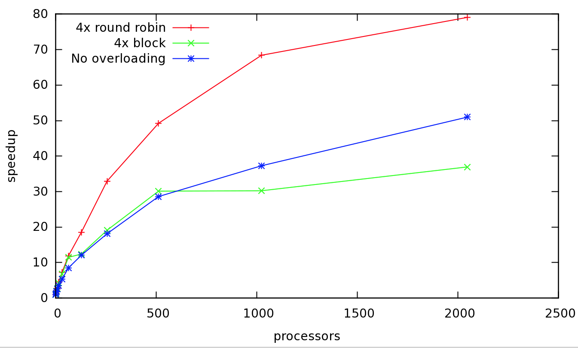
Scaling study demonstrates speedup with over-decomposition.
Strong scaling study.
3D Cube with 256**3 zones.
Over-decomposition works better when round robin assignment is used instead of the default (block assignment).
The scaling is poor

Slide 12
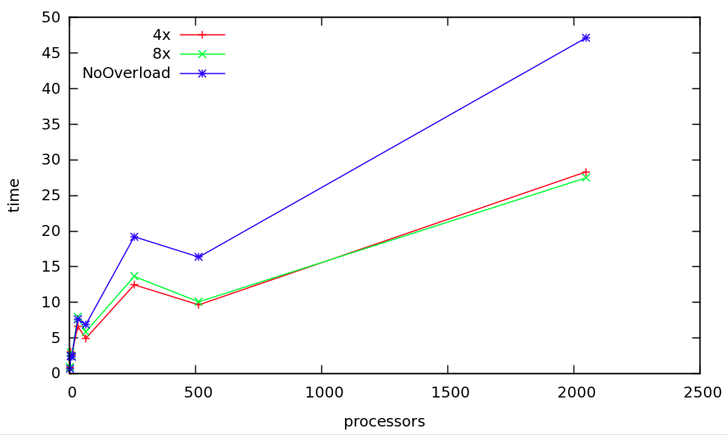
Weak scaling study also shows speedup with over-decomposition.
Weak scaling study.
  Number of zones per processor remains equal
  Due to the nature or the problem, the time to solution is not expected to be constant.
3D block geometry.
  Each processor owns a 32x32x32 block of zones
  The problem size increases (doubles) first in x, then y, then z.
Round-robin assignment is used.

Slide 13
Can performance be further improved using load balancing?
The principle of persistence does not apply to the DSD algorithm.
The workload on each domain is different at each time-step.
However, some information known to the application can be used to predict the near term work load.
The UserSetLBLoad function has been implemented to set this load value.

Slide 14
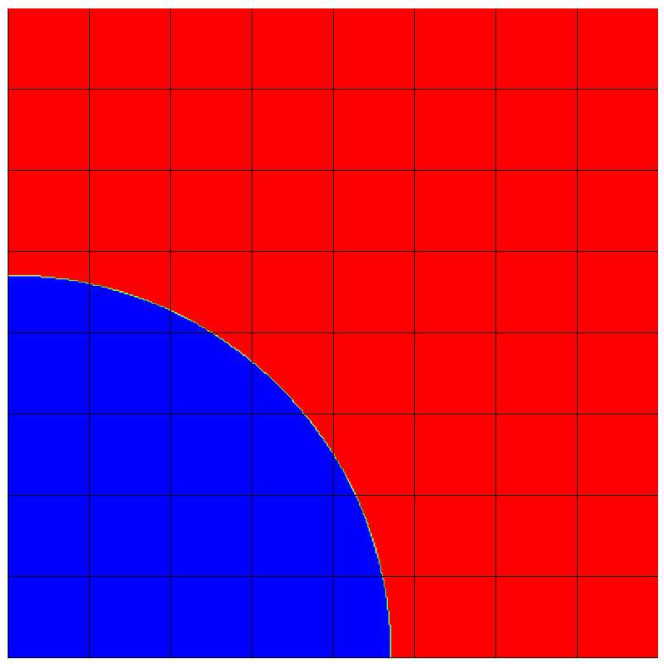
A custom ‘UserSetLBLoad’ function is needed to approximate the load.
We assign categories to domains in order to predict near term load:
  Domains that are completely behind the detonation front (will never have more work to do).
    Load = 0
  Active domains that currently intersect the detonation front. Work is proportional to the number of mesh nodes ahead of the front.
    Load = A + B * nodes_left/nodes
  Idle domains that are adjacent to active domains.
    Load = C
  Other Idle domains
    Load = D

Slide 15
Load balancing improves performance, in some cases.
Experiment:
  4x over decomposition
  1024 processors
  3D cube (256**3 zones)
  Detonates in one corner
  Curved approximation
  Initial round robin placement.
  Parameters
    A=50, B=100, C=50, D=40
  Frequency of load balancing:
    Every 50 cycles (approximately 14 times)
Time | Balancer
653. | GreedyLB
665. | CommLB
670 | None
674. | NeighborLB
680. | RefineLB
These results are not impressive. However, there is a big parameter space to explore, and other possible load balancing ideas.

Slide 16
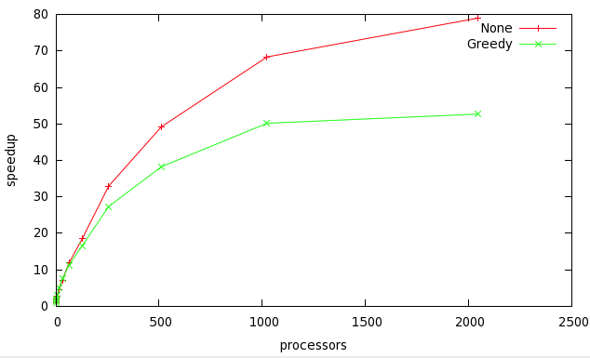
Load balancing has a negative impact in other cases
Experiment:
  Strong scaling study
  4x domain overloading
  3D cube (256**3 zones)
  Detonates in one corner
  Linear approximation
  Initial Round Robin placement
  Same parameters (A/B/C/D) and load balancing frequency as prior example
Observations
  Load balancing hurts performance in this case
  Parallel speedup is poor in both cases.
Speedup

Slide 17
Increasingly complex approaches may improve scalability more.
Over-decomposition, and load balancing give some improvements on the simple domain decomposition approach.
  These are minor code changes from the original approach.
An entirely new approach may do better:
  Domains do not model the work load well.
  Modeling the detonation front more directly with dynamically constructed and evolving chares may show improvements.
  This is an area to be more fully explored at a later time
The fundamental problem is that detonation shock dynamics does not have a lot of parallelism.

Slide 18
Alternative formulations of the DSD algorithm may increase scalability
In the production version of DSD, there are two modes: A linear approximation and a curved approximation.
The curved approximation is 3rd order accurate, but it much more expensive (approximately 10 times slower).
One possibility is to run the linear approximation out ahead of the curved approximation (on a subset of the processors), and use those results to inform load balancing decisions for the curved approximation.

Slide 19
The DSD algorithm is a small part of a much larger application
Charm++/MPI interoperability is required.
Ideally a module can be written with Charm++, and not have any other side effects on the user, or other parts of the code base.
The new Charm++/MPI interoperability feature in version 6.4.0 is perfect for my needs.
This feature has been implemented in my mini-app version. It should be straightforward to extend to the multi-physics code.

Slide 20
There are challenges with interoperability for load balancing.
The multi-physics application creates a single domain to pass into the DSD algorithm.
The Charm++ version needs to over-decompose to improve performance
Challenges:
  The domains will need to be partitioned for Charm++
  The domains require a layer of ghost zones and knowledge of who their neighbors are, requiring additional communication between processors.
  The parallelism works best if the domains on a process are spatially distributed throughout the problem. This will also require communication.

Slide 21
Load balancing can improve performance in MPI Interoperability
The chares need to be migrated away from the processor on which they were created.
  Otherwise, the processor will be idle for a larger percentage of the simulation.
Charm++ load balancing addresses the question of when and where to migrate chares.

Slide 22
Some final thoughts
In two months time, I was able to become familiar with Charm++, owing to the good software, good documentation, and helpful discussion with current and former members of the Charm++ project.
In my first attempt, I struggled to stop thinking in MPI. In my second attempt, I fully embraced the Charm++ programming model.
The MPI and Charm++ version share a great deal of coding.
I found the SDAG feature very useful and easy to program with. (Although there were debugging challenges.)
The load balancing feature was extremely easy to put into the coding. This would have been significantly more work to do in an MPI only code.

