Slide 1
Dynamic Thermal Management in Charm++
Osman Sarood, Phil Miller, Esteban Meneses, Ehsan Totoni, Sanjay Kale
Parallel Programming Lab (PPL)

Slide 2
Why care about energy?
Data centers consume 2% of US Energy Budget in 2010[1]
Cost $5.1 billion consumed 77 billion KWh
Energy bill per annum[2]:
Sequoia: $4.47M
Blue waters: $5 M
K computer: $7.4M
Growth in data center electricity use 2005 to 2010, Jonathan Koomey
Based on 7 cent/Kwh
Notes:
Data centers have been reported to have consumed energy equivalent to 2% of the total US energy budget in 2006
Their operation costed 4.1 billion and consumed a total of 59 billion
There have also been estimates to show that the cost of powering the server for only 3 years exceeds the cost of purchasing them
Now, although there has been a 2.5 times improvement in system level energy consumption, it is still far away from the 100 times improvement required for moving to exascale computing

Slide 3
Why Cooling?
Cooling accounts for 40-50% of total cost
Average PUE ratio was 1.8 in 2011
Most data centers face hot spots responsible for lower temperatures in machine rooms
Data center managers can save*:
4% (7%) for every degree F (C)
50% going from 68F(20C )to 80F(26.6C)
*according to Mark Monroe of Sun Microsystem
Notes:
Cooling costs form a major part of the total energy budget for data centers. Infact they account for 50% of the total energy consumed
This high figure can also be attributed to hotspots which force data center operators to decrease the room temperature for the entire room
Studies show that for every 1C increase in room temperature, 7% of total cooling energy can be saved. In fact data centers can save half of the total cooling cost by raising the room temperature from 20C to 26.6C.
Data center operators can increase the room temperatures if they can be confident that there would be no hotspot formation and cpu cores wont reach very high temperatures.

Slide 4
Need for thermal management
High core temperatures can increase:
Cooling energy consumption – (1st part)
Failure rate since it doubles for every 10C increase in temperature – (2nd part)
Machine machine energy consumption – (in progress)

Slide 5
1st Part: Reducing cooling energy consumption using thermal constraints

Slide 6
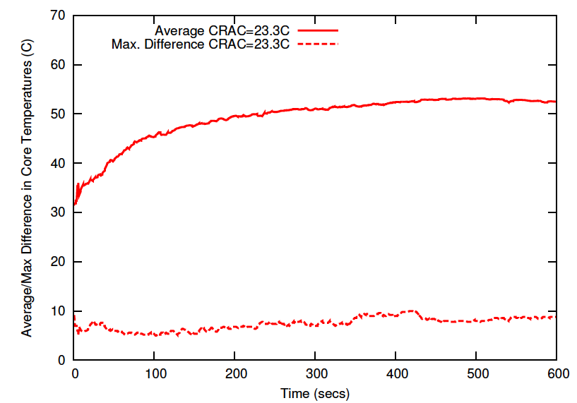
Core Temperatures
*CRAC stands for Computer Room Air Conditioning
Running Wave2D on 128 cores:
Temperature measurements after every second
Average temperature goes from 32C to 52C
Hottest core ends up 9C above the average
Notes:
Cooling costs form a major part of the total energy budget for data centers. Infact they account for 50% of the total energy consumed
This high figure can also be attributed to hotspots which force data center operators to decrease the room temperature for the entire room
Studies show that for every 1C increase in room temperature, 7% of total cooling energy can be saved. In fact data centers can save half of the total cooling cost by raising the room temperature from 20C to 26.6C.
Data center operators can increase the room temperatures if they can be confident that there would be no hotspot formation and cpu cores wont reach very high temperatures.

Slide 7
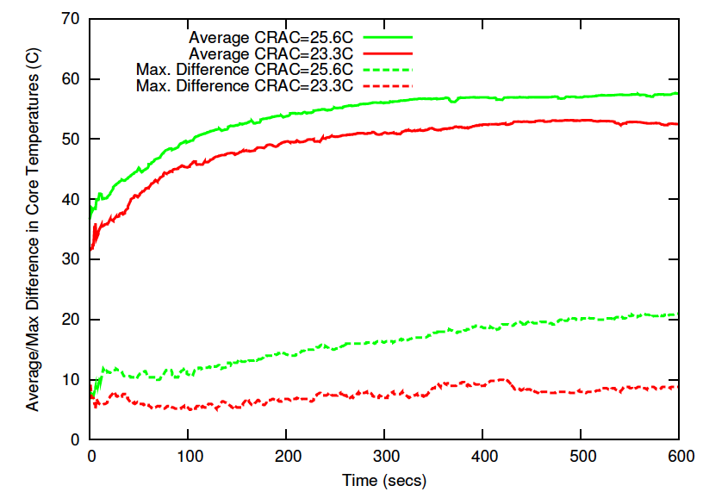
Core Temperatures
Hotspot!
Reducing cooling results:
increase of 6C in average temperature i.e. 58C
With reduced cooling (CRAC set-point 25.6) hottest core is 20C above average core temperature
Notes:
To see the behavior of core temperatures, we ran a Charm++ application (Wave2D) on 128 cores and measured the core temperatures.
The figure shows the average core temperature over 10 minutes using different CRAC set points.
We noticed a difference of about 6C due to reduced cooling by moving from 23.3C to 25.6C
The lower two curves in the figure represent the maximum difference of any core from the average. There is a difference of 11C between the max difference after increasing CRAC set point. A difference of 20C from an average of 57C clearly points towards existence of Hotspots

Slide 8
Dynamic Voltage and Frequency Scaling (DVFS)
changing processor frequency/voltage to save power
used cpufreq module from linux to change frequency/voltage pairs

Slide 9
Processor Timelines for 2 iterations of Wave2D
Idle Time
w/o TempLDB
Shows processor utilization during execution time (green & pink correspond to computations, white is idle time)
One core can cause timing penalty/slowdown!
Notes:
In order to see the difference in both the schemes, we present the processor timelines for both.
The top part shows the scheme without our load balancing whereas the bottom one uses our load balancing.
The white lines in the yellow rectangle show the idle time cores 4-12 are spending due the first four cores shifting to lower frequency. This results in a big penalty as only 4 cores now dictate the execution time
We can see that our scheme doesn’t suffer from any such problem.
In order to understand it better we enlarged the area in the yellow rectangle and reproduced it. The two shaded portions represent the idle time due to first 4 cores operating at lower frequency.

Slide 10
Charm++ to the rescue!
Object-based over-decomposition
Helpful for refinement load balancing
Migratable objects
Mandatory for our scheme to work
supports fault tolerance
Time logging for all objects
Central to load balancing decisions
Supports plugin load balancer
Production-quality system used by many applications
For more info, see http://charm.cs.illinois.edu/why/
Notes:
Charm++ is a perfect match for our technique.
Its object based over-decomposition coupled with migrateability of objects allows us to trasnfer tasks to load balance the application
Time logging of task, provided by charm++, is also an essential part of our scheme. We use these times to come up with decisions about which tasks to migrate in order to restore load balance.

Slide 11
Temperature Aware Load Balancer
Specify temperature range and sampling interval
Runtime system periodically checks core temperatures
Scale down/up frequency (by one level) if temperature exceeds/below maximum threshold at each decision time
Transfer tasks from slow cores to faster ones
See ‘‘Cool’ Load Balancing for HPC Data Centers’, IEEE Transactions on computers for details
Notes:
Our scheme, Temperature aware load balancing, combines DVFS and temperature control in an efficient way to reduce timing penalty and total energy
Each application can define the maximum threshold along with the interval after which it periodically wants to check core tempeartures
At each decision time, the core temperature is compared to the threshold and the frequency is shifted depending on whether core temperature exceeds or falls below the threshold
The frequency scaling for each core results in speed differential with which the cores can complete tasks. We transfer tasks from slow cores to fast cores in order to load balancer the application
We take a refinement based approach instead of re-assigning each task in order to make our load balancer scalable.

Slide 12
Experimental Setup
128 cores (32 nodes), 10 different frequency levels (1.2GHz – 2.4GHz)
Direct power measurement
Dedicated CRAC
Power estimation based on
Applications: Jacobi2D, Mol3D, and Wave2D
Different power profiles
Temperature range: 47C-49C
Notes:
To test our scheme, we used a testbed having 40 single socket nodes connected through a 48-port gigabit switch. The power consumption of these machines were measured using Liebert Power unit
All our experiments were done using 128 cores. The machine room had a dedicated CRAC.
We used temperature sensors at the CRAC air inlet and outlet to measure air temperatures for hot air entering and cold air leaving the CRAC.
For all our experiments, we used a max threshold of 44C which got from some preliminary studies

Slide 13
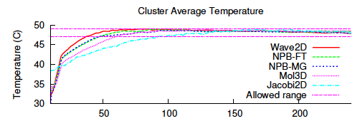
Average Core Temperatures in Check
CRAC set-point = 25.6C Temperature range: 47C-49C
Avg. core temperature within 2 C range
Can handle applications having different temperature gradients
Notes:
Here is the result of some experiments where we tried to constrain the core temperatures within the threshold.
As can be seen once the cores reach the threshold we were able to maintain a very tight control over the core temperatures
This was true for all the 3 apps even though they had different temperature gradient to start with

Slide 14
Hotspot Avoidance
Maximum Difference without our scheme (w/o TempLDB)
Increases over time
Increases with CRAC set point
Maximum Difference with our scheme (TempLDB)
Decreases with time
Insensitive to CRAC set point
Notes:
In here we show the results to see how well our scheme does in terms of hot spot aviodance.
The graph shows the maximum difference of any core’s temperature from the average.
The red and green curves represent different CRAC set points where we do not use our scheme. As you can see, that w/o our scheme the core temperature on some nodes keep on deviating more and more from the average which gets worse with the passage of time.
The CRAC setpoint also affects the temperature deviations which can be seen by the seperation between the red and green curves. The higher the CRAC setpoint the greater the deviation.
On the other hand, with our scheme we were able to constrain the max temperature deviation to within 4C of the average.
This shows the success of our scheme in avoiding hotspots

Slide 15
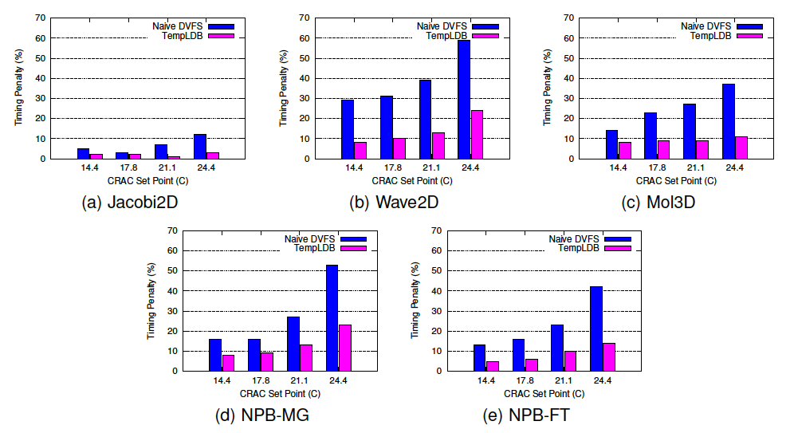
Timing Penalty
Decrease in cooling, increases:
Timing penalty
Advantage of our scheme
Notes:
Now we compare the timing penalties for both the schemes. The figure shows the normalized execution times for all three applications using different CRAC set points.
Our scheme consistently performs better than the other scheme.
We can that the timing penalty increases with a decrease in cooling but also the advantage of our scheme increases at the same time.

Slide 16
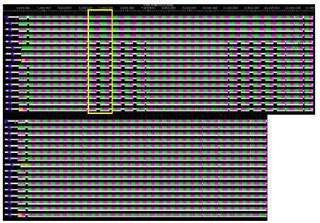
Processor Timelines for Wave2D
w/o TempLB
TempLB
Notes:
In order to see the difference in both the schemes, we present the processor timelines for both.
The top part shows the scheme without our load balancing whereas the bottom one uses our load balancing.
The white lines in the yellow rectangle show the idle time cores 4-12 are spending due the first four cores shifting to lower frequency. This results in a big penalty as only 4 cores now dictate the execution time
We can see that our scheme doesn’t suffer from any such problem.
In order to understand it better we enlarged the area in the yellow rectangle and reproduced it. The two shaded portions represent the idle time due to first 4 cores operating at lower frequency.

Slide 17
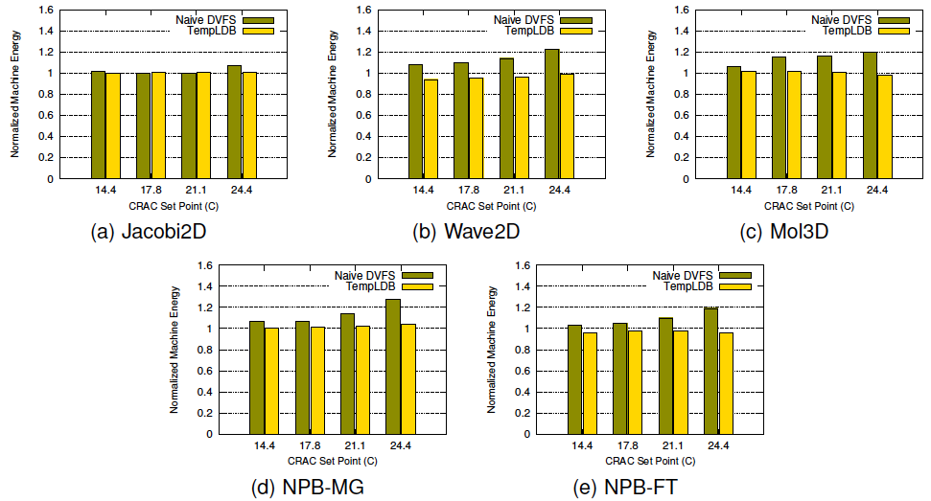
Machine Energy Consumption
High base power coupled with timing penalty doesn’t allow machine energy savings.
Notes:
This figure shows the normalized machine energy consumption for all three applications.
The normalized energy increases in case of the other scheme whereas our scheme keeps it very close to 1.
The high idle power was the cause due to which we couldn’t get any machine energy savings. Still we keep the machine energy to within 4% of the base case.

Slide 18
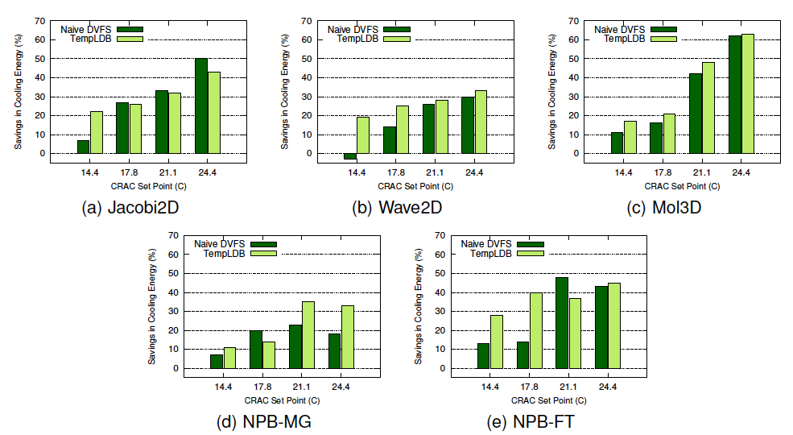
Cooling Energy Consumption
Our scheme saves up to 57% (better than w/o TempLDB) due to smaller timing penalty
Notes:
Saving cooling energy was the motive of our research. To gauge cooling energy saved, we normalized the cooling energy for each run according to the base run where all cores were running with max frequency without temperature control
The figure shows the normalized cooling energy for both the schemes. Both the schemes end up saving some cooling energy but these savings are more in case of our temperature aware load balancer
We end up saving as high as 57% of the cooling cost.

Slide 19
Related Publications
Osman Sarood, Laxmikant Kale, A `Cool’ Load Balancer for Parallel Applications, SC 11
Osman Sarood, Phil Miller, Ehsan Totoni, Laxmikant Kale, `Cool’ Load Balancing for High Performance Computing Data Centers, IEEE Transactions of Computers

Slide 20
2nd Part: Improving Reliability using Thermal Constraints

Slide 21
Temperature and Mean Time to Failure (MTBF)
MTBF halves (failure rate doubles) for every 10C increase in temperature
MTBF (M) can be modeled as
where ‘A’ and ‘b’ are constants and ‘T’ is the temperature

Slide 22
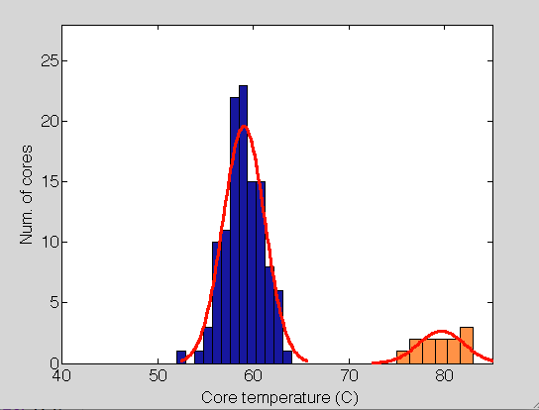
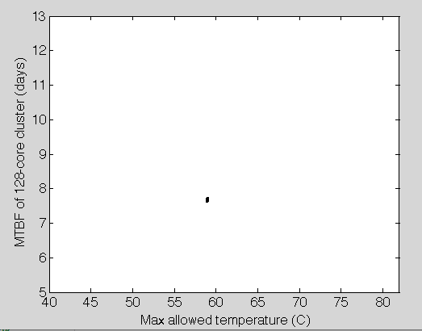
Core temperatures and MTBF
Temperature histogram Wave2D on 128 cores (blue – cool cores, orange – hot cores)

Slide 23
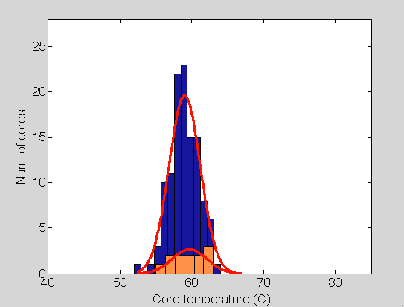
Removing the hot spot
Remove hot spot:
Avg. of hot cores = Avg. of cool cores
Generate random temperature values for hot cores and calculate ‘M’

Slide 24
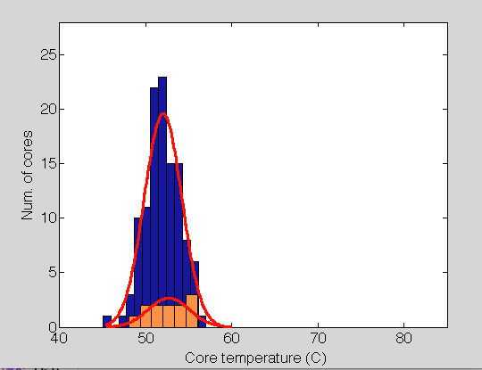
Constraining core temperature to lower values
Remove hot spot:
Avg. of hot cores = Avg. of cool cores
Generate random temperature values for all the cores and calculate ‘M’

Slide 25
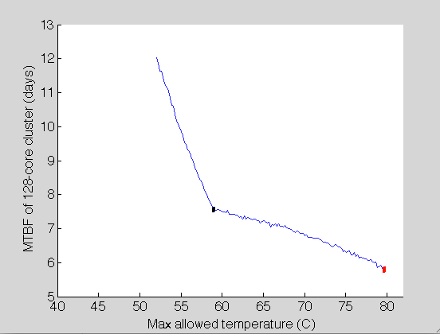
Core temperature-MTBF relation

Slide 26
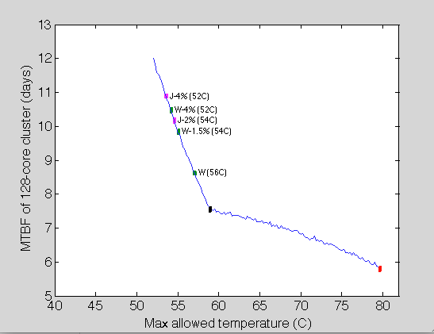
Core temperature-MTBF relation Experimental data

Slide 27
What did we learn?
By constraining core temperatures one can select an MTBF (within a range)
Execution time (slowdown) penalty associated with selecting the MTBF
Each application can give rise to a different MTBF for the cluster due to temperature variations

Slide 28
Benefits?
Is the decrease in MTBF good enough to reduce total execution time given the slowdown associated inusing DVFS?

Slide 29
Performance model
Symbol | Meaning
T | Total execution time
W | Useful work
τ | Check pointing period
δ | Check pointing time
R | Restart time
μ | slowdown

Slide 30
Strategy
Combine temperature control with fault tolerance
Migrateable objects key for reducing DVFS associated slowdown

Slide 31
Improved temperature aware load balancing
Communication friendly load balancing:
Instead of randomly picking a task to migrate to any overloaded processor, migrate a task that communicates the most with a given underloaded processor
Always try to converge to the initial mapping
Select ‘foreign’ task to migrate before ‘home’ tasks

Slide 32
Experimental setup
Ran experiments on a 128-core cluster (no simulations) to see the prediction of the model
Scaled down M: 4 hours
Introduced random faults based on exponential distribution with a mean of ‘M’
Three applications
Jacobi2D: 5-point stencil application
Lulesh: Unstructured Lagrangian Explicit Shock Hydrodynamics application developed @ LLNL
Wave2D: finite difference for pressure propagation

Slide 33
Experimental setup
Baseline for each application:
Run without temperature control
‘M’ calculated using the actual temperature values we get without temperature constraint
`τ’ calculated using Daly’s formula:
Temperature constrained experiment:
`M’ calculated using the max allowed temperature
`τ’ calculated using Daly’s formula

Slide 34
Reduction in execution time
Each experiment was longer than 1 hour having at least 40 faults
Model closely matches the experiments

Slide 35
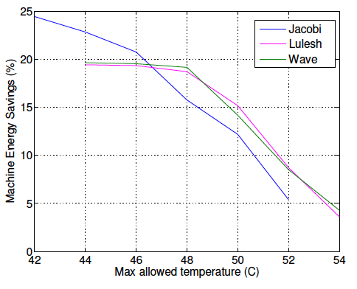
Savings in machine energy consumption
Actual measurements based on power meters installed in the PDUs

Slide 36
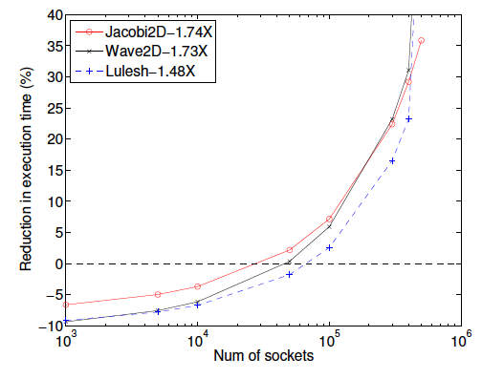
Prediction for larger machines
Improvement in MTBF
MTBF/socket: 20 years, checkpointing time (δ): 240 secs

Slide 37
Future work
Evaluating benefits of thermal control for message logging and parallel recovery
Scheduling jobs for a data center under a fixed thermal and/or power budget
Reducing frequency for least sensitive parts of code to reduce slowdown for TempLDB

Slide 38
Hot spot in Blue Waters?
This shows a possibility of Inter-row hot spot.
There might be Intra-row hot spots!
The readings showing cold water temperature for each row
Row 1
63F 62F
63F 63F
63F 64F
65F 65F
68F 68F
69F 69F
Row 7
70F 69F

Slide 39
Acknowledgements
We are thankful to Prof. Tarek Abdelzaher for using tarekc cluster

Slide 40
Questions

Slide 41
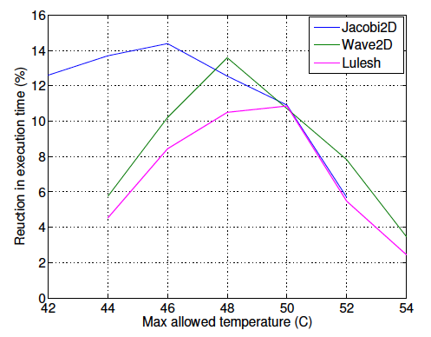
Optimum points for applications
Jacobi2D gets the max benefit
Different optimum temperature thresholds along with maximum benefits

Slide 42
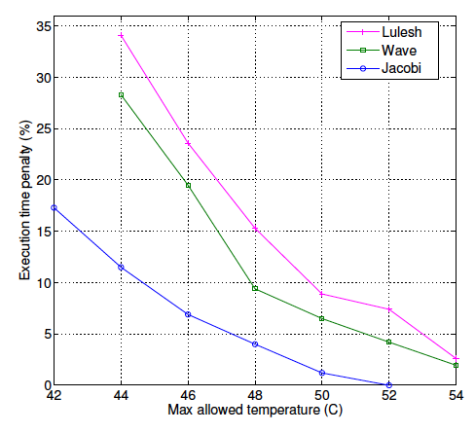
Reason for different optimum temperature thresholds
A move to the left (decrease in temperature threshold):
Increases reliability (gain)
Increases the slowdown due to temperature control (cost)

Slide 43
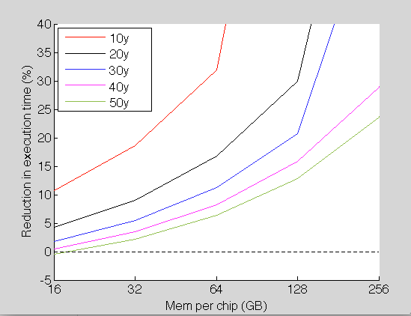
Prediction for larger machines
Proposed Exascale machine in ‘ExaScale Computing Study’ by Peter Kogge has an incredibly low Memory/FLOPS ratio
Temperature threshold of 46C

Slide 44
Machine Energy
Accounts for 50%-60% of total cost
Earlier work:
A `Cool’ Balancer for Parallel Applications (SC11) concentrated on saving cooling energy
`Cool’ Load balancing for HPC Data Centers (IEEE Transactions on Computers Sept 2012) extended our work and its usefulness with MPI applications
limited machine energy savings
Is it possible to reduce execution time penalty and machine energy while reducing cooling energy?

Slide 45
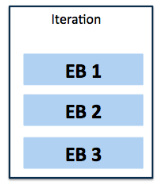
Execution Blocks for iterative applications
Divide each iteration into Execution blocks (EBs)
different sections based on sensitivity to frequency
Manually done using HW performance counters
Profile each EB for different frequency levels
Wall clock time (system clock)
Core power consumption (fast on-chip MSRs)

Slide 46
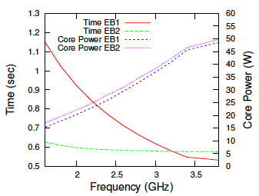
Execution Blocks (EBs) (NPB-IS)
EB2 wastes a lot of energy while running at max frequency!
EB1 much more sensitive to frequency with the same power as EB2

Slide 47
EBTuner
Profile each EB for all frequency values
Can be completed in milliseconds using energy MSRs of Sandy Bridge
Periodic sampling of core temperatures
Temperature > Threshold
Decrease frequency one notch for EB that results in minimum timing penalty
Temperature < Threshold
Increase frequency one notch for EB that results in maximum time reduction

Slide 48
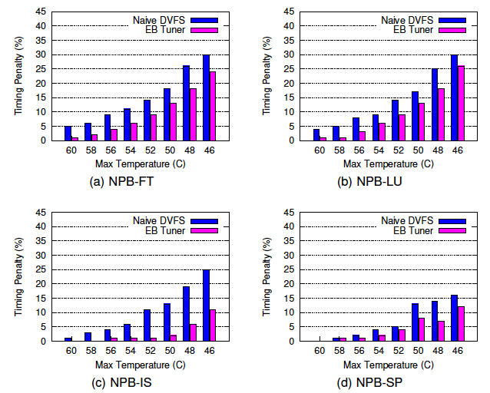
Timing penalty
Increase in execution time compared to runs with no temperature control and all cores working at maximum possible frequency

Slide 49
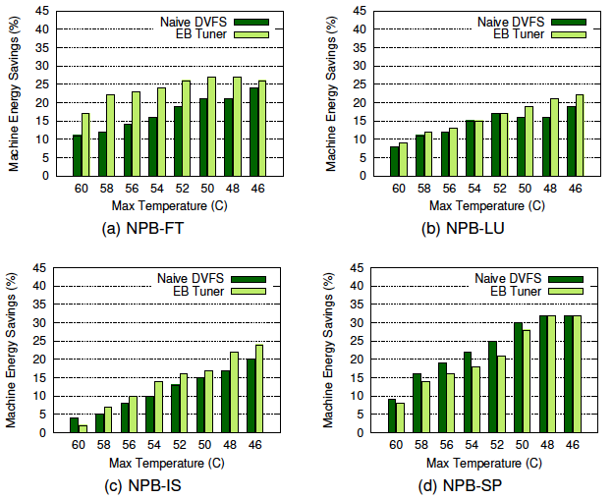
Reduction in machine energy

Slide 50
Work in progress
Extend the work to multiple nodes.
Use Charm++ since load balancing would be necessary
Solution for the incapability of present day chips to apply DVFS to individual cores

Slide 51
Timing Penalty/ Total Energy Savings
Normalization w.r.t all cores running at maximum frequency without temperature control
Our scheme brings green line to red line
Moving left: saving total energy
Moving down: saving execution time penalty
Slope: timing penalty (secs) per joule of energy saved
Notes:
To get the bigger picture, we plotted % savings in total energy savings with percent timing penalties.
This Figure shows the great potential of saving energy in case of Mol3D and Jacobi2D.
However, it seems that Wave2D is not a good candidate for energy savings.

