Slide 1


Welcome to the 2014 Charm++ Workshop!
Laxmikant (Sanjay) Kale
http://charm.cs.illinois.edu
Parallel Programming Laboratory
Department of Computer Science
University of Illinois at Urbana Champaign

Slide 2
Charm++
Charm++ began as an adaptive runtime system for dealing with application variability:
Dynamic load imbalances
Task parallelism first (state-space search)
Iterative (but irregular/dynamic) apps in mid-1990s
But it turns out to be useful for future hardware, which is also charcterized by variability
Recap of some points I made at Salishan last week:

Slide 3
Exascale Challenges
Main challenge: variability
Static/dynamic
Heterogeneity: processor types, process variation, ..
Power/Temperature/Energy
Component failure
Exacerbated by strong scaling needs from apps
Why?
To deal with these, we must seek
Not full automation
Not full burden on app-developers
But: a good division of labor between the system and app developers

Slide 4
My Mantra
O
M
I call it a mantra because I will repeat it a lot in this talk. And its going to be my message to App Developers on how to get ready for Adaptive Runtimes

Slide 5
My Mantra
a
O
M

Slide 6
My Mantra
Oh….Maybe the order doesn’t matter
O
M
a

Slide 7
My Mantra
verdecomposition
O
a
M
synchrony
igratability

Slide 8
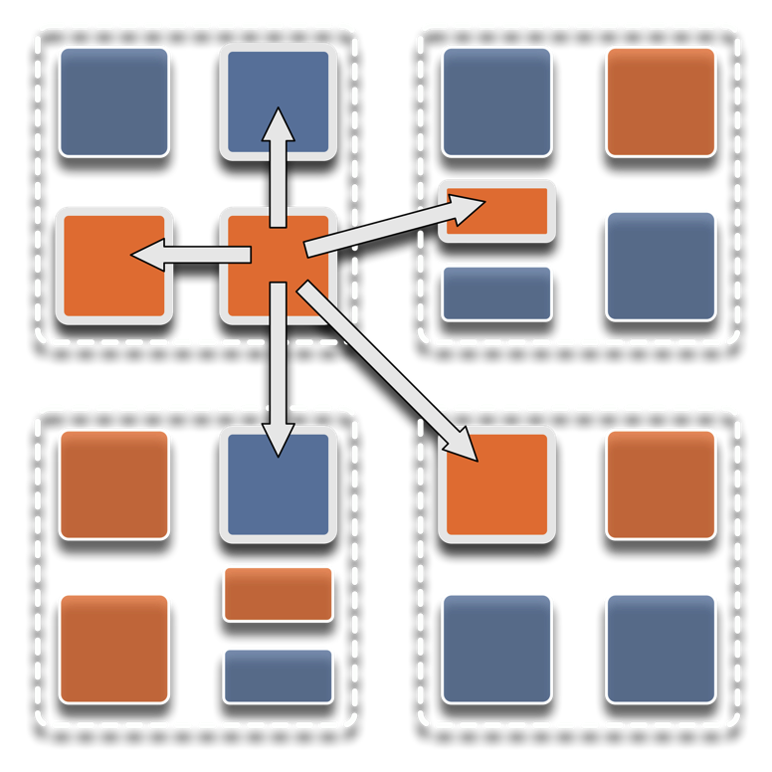
Overdecomposition
Decompose the work units & data units into many more pieces than execution units
Cores/Nodes/..
Not so hard: we do decomposition anyway

Slide 9
Migratability
Allow these work and data units to be migratable at runtime
i.e. the programmer or runtime, can move them
Consequences for the app-developer
Communication must now be addressed to logical units with global names, not to physical processors
But this is a good thing
Consequences for RTS
Must keep track of where each unit is
Naming and location management

Slide 10
Asynchrony: Message-Driven Execution
Now:
You have multiple units on each processor
They address each other via logical names
Need for scheduling:
What sequence should the work units execute in?
One answer: let the programmer sequence them
Seen in current codes, e.g. some AMR frameworks
Message-driven execution:
Let the work-unit that happens to have data (“message”) available for it execute next
Let the RTS select among ready work units
Programmer should not specify what executes next, but can influence it via priorities

Slide 11
Message-driven Execution
A[..].foo(…)

Slide 12
Empowering the RTS
Adaptive
Runtime System
Introspection
Adaptivity
Asynchrony
Overdecomposition
Migratability
The Adaptive RTS can:
Dynamically balance loads
Optimize communication:
Spread over time, async collectives
Automatic latency tolerance
Prefetch data with almost perfect predictability
Notes:
You can have asynchrony without overdecomposition or vice versa, you can have migratability without asynchrony, but you need all three to empower the RTS.You need to add introspection and adaptivity to make a powerful Adaptive Runtime System

Slide 13
Application Examples
to
Demonstrate the Utility of
Overdecomposition,
Migratability,
Asynchrony!

Slide 14
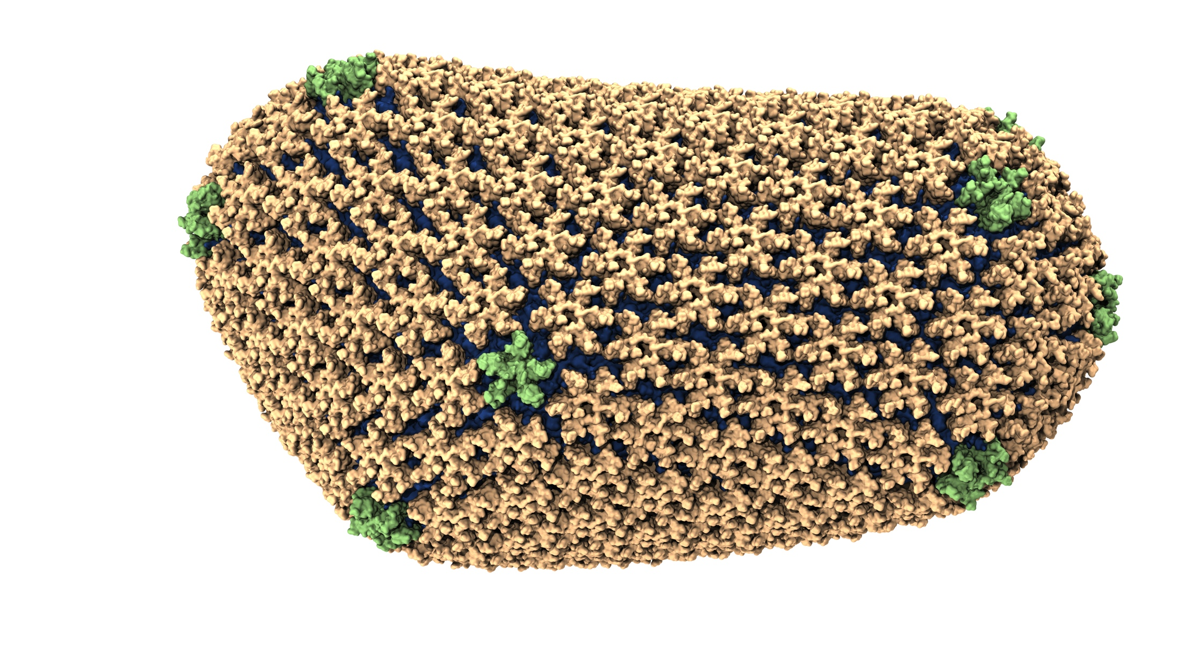
NAMD: Biomolecular Simulations
Collaboration with K. Schulten
With over 45,000 registered users
Scaled to most top US supercomputers
In production use on supercomputers and clusters and desktops
Gordon Bell award in 2002
Recent success: Determination of the structure of HIV capsid by researchers including Prof Schulten

Slide 15
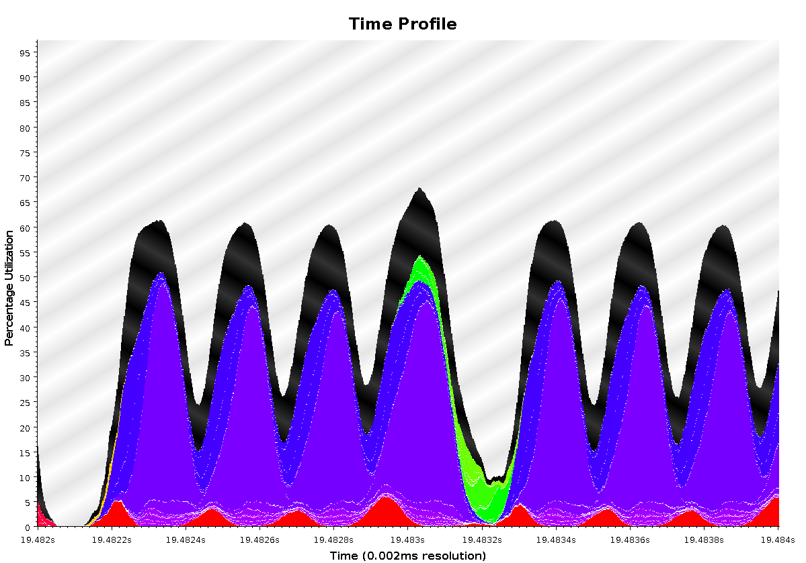
Time Profile of ApoA1 on Power7 PERCS
92,000 atom system, on 500+ nodes (16k cores)
2ms total
A snapshot of optimization in progress.. Not the final result
Overlapped steps, as a result of asynchrony

Slide 16
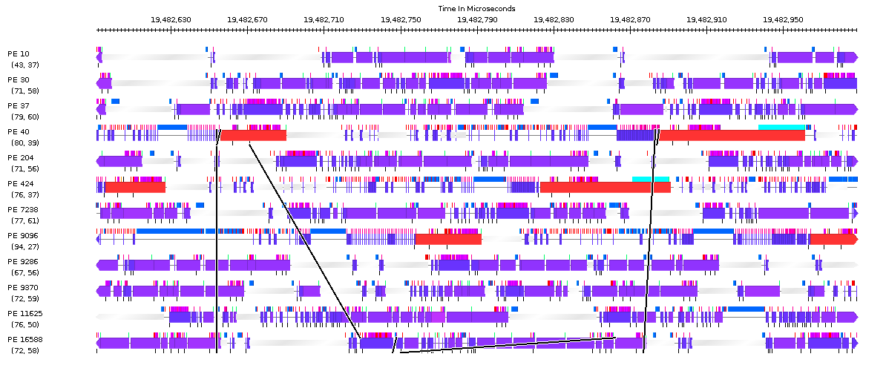
Timeline of ApoA1 on Power7 PERCS
230us

Slide 17
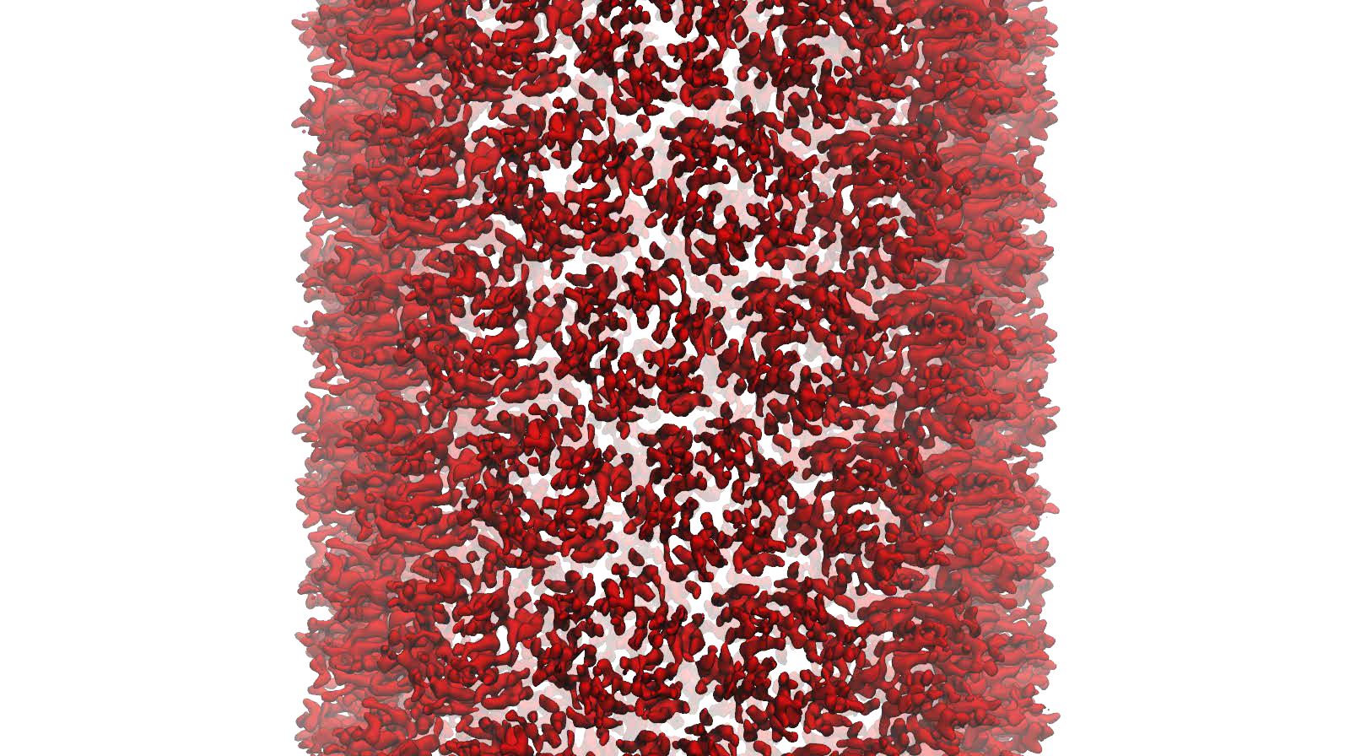
NAMD: Strong Scaling
HIV Capsid was a 64 million atom simulation, including explicit water atoms
Most biophysics systems of interests are 10M atoms or less… maybe 100M
Strong scaling desired to billions of steps

Slide 18
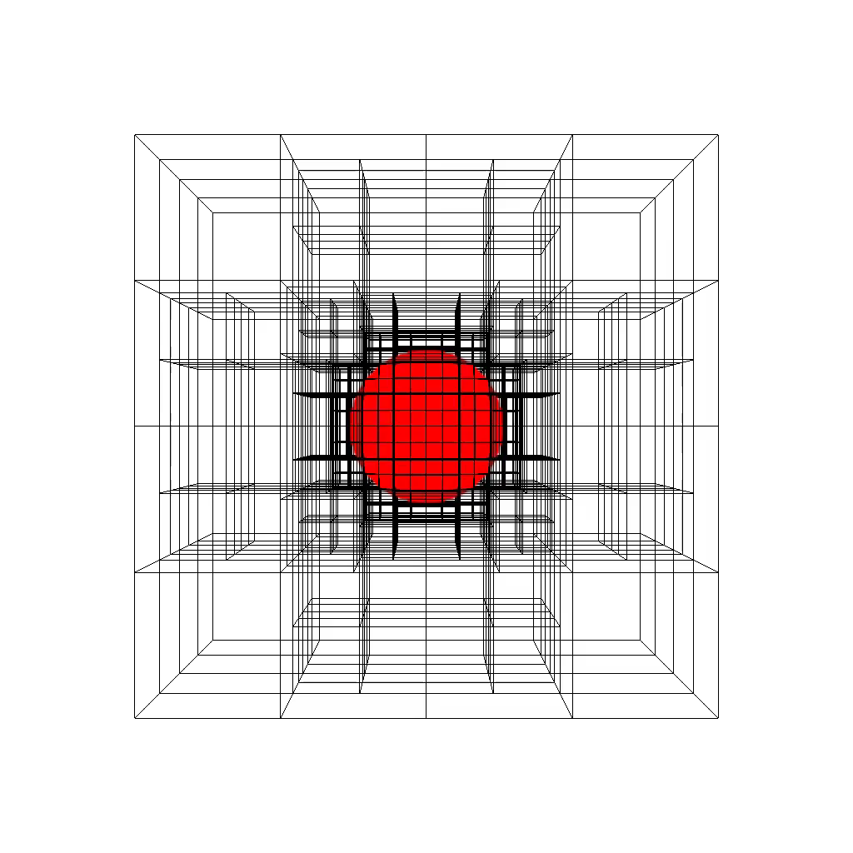
Structured AMR
Structured AMR miniApp
Notes:
Points: how overecomposition was leveraged, logical naming, with location management, Dynamic load balancing, Most importantly, highly asynchronous re-meshing

Slide 19
Structured AMR
Typical MPI Approach
Charm++ Approach
d
00
01
10
11
00
0000
0001
0010
0011
1000
1010
1011
1100
1101
1110
1111
100100
100101
100110
100111
P0
P1
P2
P3
P4
P5
Process based
Contiguous blocks
assigned to a process
Object based
Each block is an independent object
is the basic execution unit
can be mapped to any physical process
is uniquely addressable
is migratable

Slide 20
Structured AMR
Typical MPI Approach
Charm++ Approach
d
00
01
10
11
00
0000
0001
0010
0011
1000
1010
1011
1100
1101
1110
1111
100100
100101
100110
100111
P0
P1
P2
P3
P4
P5
Mesh Restructuring

Slide 21
Structured AMR
Typical MPI Approach
Charm++ Approach
d
00
01
10
11
00
0000
0001
0010
0011
1000
1010
1011
1100
1101
1110
1111
100100
100101
100110
100111
P0
P1
P2
P3
P4
P5
Mesh Restructuring

Slide 22
Structured AMR
Typical MPI Approach
Charm++ Approach
d
00
01
10
11
00
0000
0001
0010
0011
1000
1010
1011
1100
1101
1110
1111
100100
100101
100110
100111
P0
P1
P2
P3
P4
P5
Mesh Restructuring
Ripple Propagation Algorithm
Level-by-level
O(d) global reductions ≈ O(d*logP)
Tree-replication on each process
O(#blocks) memory per process
Mesh Restructuring
Exchange messages with neighboring blocks
Update state using a state machine
Quiescence to detect global consensus
Blocks save current level of neighbors
O(#blocks/P) memory per process
O(log P) time
Synchronization overhead
O(#blocks/P) space
Memory overhead

Slide 23
Structured AMR: State Machine

Slide 24
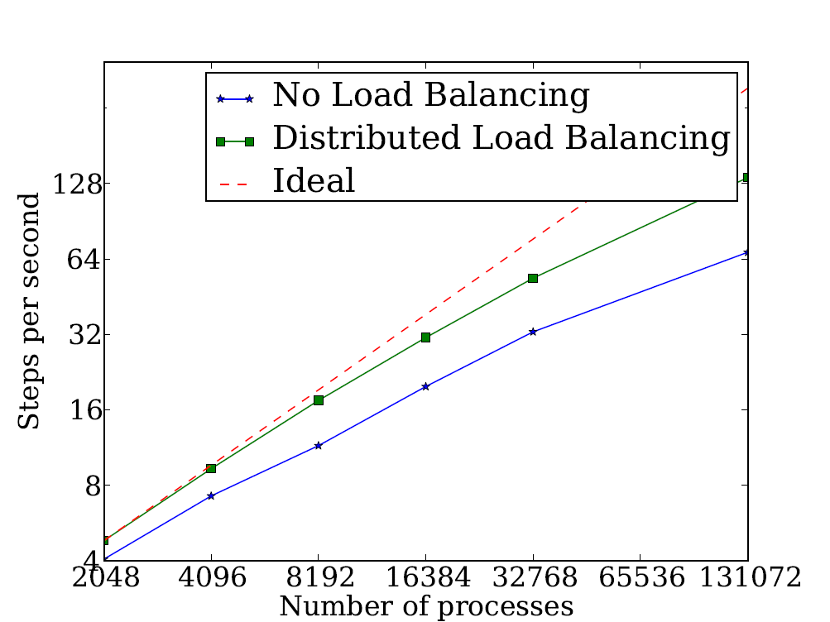
Structured AMR: Performance
Advection Benchmark
First order method in 3d-space
Testbed: IBM BG/Q Mira Cray XK/6 Titan
Number of Cores

Slide 25
Where are Exascale Issues?
I didn’t bring up exascale at all so far..
Overdecomposition, migratability, asynchrony were needed on yesterday’s machines too
And the app community has been using them
But:
On *some* of the applications, and maybe without a common general-purpose RTS
The same concepts help at exascale
Not just help, they are necessary, and adequate
As long as the RTS capabilities are improved
We have to apply overdecomposition to all (most) apps

Slide 26
Fault Tolerance in Charm++/AMPI
Four approaches available:
Disk-based checkpoint/restart
In-memory double checkpoint w auto. restart
Proactive object migration
Message-logging: scalable fault tolerance
Common Features:
Easy checkpoint: migrate-to-disk
Based on dynamic runtime capabilities
Use of object-migration
Can be used in concert with load-balancing schemes
Notes:
26

Slide 27
Extensions to fault recovery
Based on the same over-decomposition ideas
Use NVRAM instead of DRAM for checkpoints
Non-blocking variants
[Cluster 2012] Xiang Ni et al.
Replica-based soft-and-hard-error handling
As a “gold-standard” to optimize against
[SC 13] Xiang Ni, E. Meneses, N. Jain, et al.

Slide 28
Saving Cooling Energy
Easy: increase A/C setting
But: some cores may get too hot
So, reduce frequency if temperature is high (DVFS)
Independently for each chip
But, this creates a load imbalance!
No problem, we can handle that:
Migrate objects away from the slowed-down processors
Balance load using an existing strategy
Strategies take speed of processors into account
Implemented in experimental version
SC 2011 paper, IEEE TC paper
Several new power/energy-related strategies
PASA ‘12: Exploiting differential sensitivities of code segments to frequency change
optimizing execution under a global power cap using malleable jobs in an over-provisioned machine [cluster 2013, ..]
A cool way of improving reliability of HPC machines [SC13]
Controlling Network Links to save power [HPPAC 2013]

Slide 29
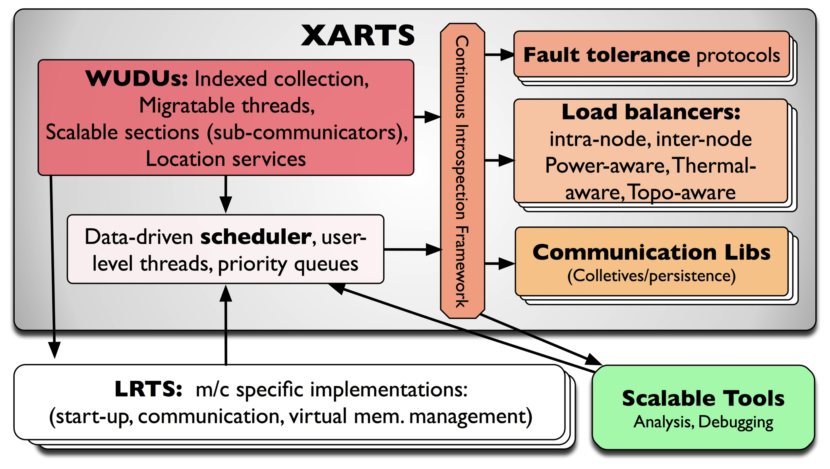
What Do RTSs Look Like: Charm++

Slide 30
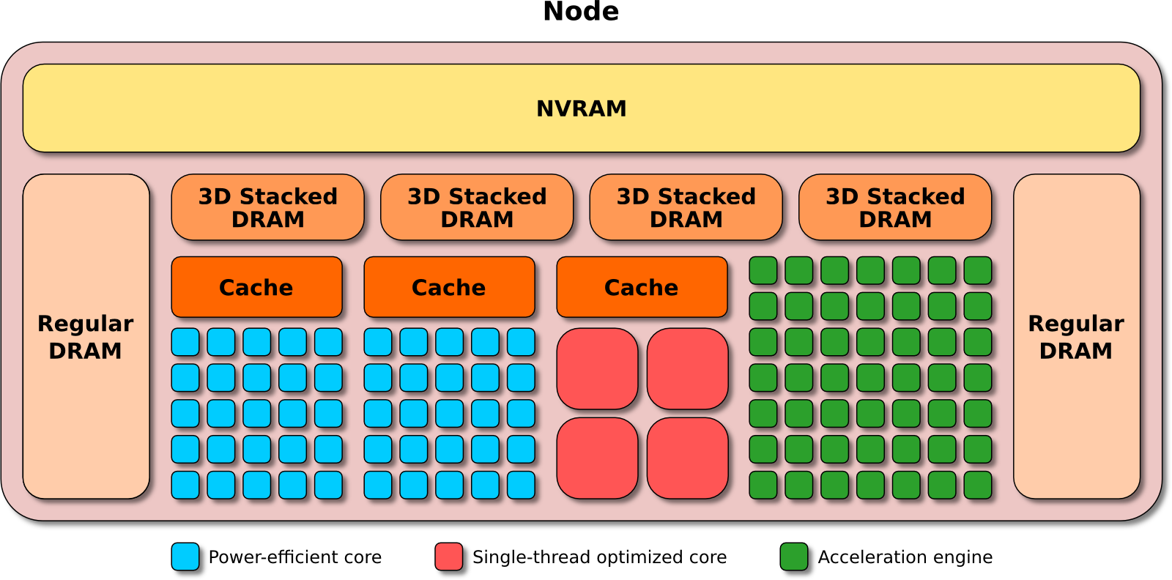
Argo
An Exascale Operating System and Runtime
Key Areas of Innovation:
NodeOS/R
Core-specialization permits multiple, concurrent kernels
Lightweight Concurrency
Embed fine-grained tasks and lightweight threads into OS for massive parallelism
Backplane
Event, Control, and Performance backplanes to support global optimizations
Global View
“Enclave” abstraction to allow global optimization of power, resilience, perf.
$9.7M ASCR DOE
3 year project, launched Aug 2013
The Crew of the Argo:
Argonne National Laboratory;
Principle Investigator and Chief Architect: Pete Beckman
Chief Scientist: Marc Snir
P. Balaji, R. Gupta, K. Iskra, R. Thakur, K. Yoshii, F. Cappello
Boston University: J. Appavoo, O. Krieger
Lawrence Livermore National Laboratory:
M. Gokhale, E. Leon, B. Rountree, M. Schulz, B. Van Essen
Pacific Northwest National Laboratory: S. Krishnamoorthy, R. Gioiosa
University of Chicago: H. Hoffmann
University of Illinois at UC: L. Kale, E. Bohm, R. Venkataraman
University of Oregon: A. Malony, S. Shende, K. Huck
University of Tennesee Knoxville: J. Dongarra, G. Bosilca

Slide 31
Workshop Overview
Keynotes
Robert Harrison (Today)
Vivek Sarkar
Invited talks:
Robert Wisniewski, Intel
Brian Van Straalen, LBNL
Work horses – Petascale Applications
ChaNGa by Tom Quinn
NAMD by Jim Phillips
EpiSimdemics by Jae-Seung
MITRE by Akhil Langer
OpenAtom by Glenn Martyna, Sohrab Ismail-Beigi

Slide 32
Workshop Overview
Collaborative New Applications
Cloth Simulation (Rasmus Tamstorf with Xiang Ni)
ROSS on Charm++ (Christopher Carothers)
PPL talks on enhancement to the runtime capabilities
Yanhua, Harshitha, Abhishek, Akhil, Ehsan
Other external talks:
Nicolas Bock, Abhinav Bhatele, Alex Brooks, Hassan Eslami
Laercio Pilla, Suraj Prabhakaran
Collaborations in the offing:
LSU/Cactus/Chemora, .. Next year?
Panel: HPC in the cloud: how much water does it hold?

