Slide 1
Describing exited electrons:
what, why, how,
and
what it has to do with charm++
Sohrab Ismail-Beigi
Applied Physics, Physics, Materials Science
Yale University

Slide 2

Density Functional Theory
For the ground-state of an interacting electron system
we solve a Schrodinger-like equation for electrons
Approximations needed for V_{xc}(r) : LDA, GGA, etc.
Tempting: use these electron energies ϵ_{j}
to describe processes where
electrons change energy
(absorb light, current flow, etc.)
Hohenberg & Kohn, Phys. Rev. (1964); Kohn and Sham, Phys. Rev. (1965).

Slide 3
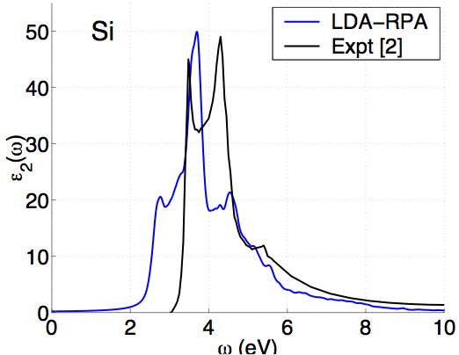
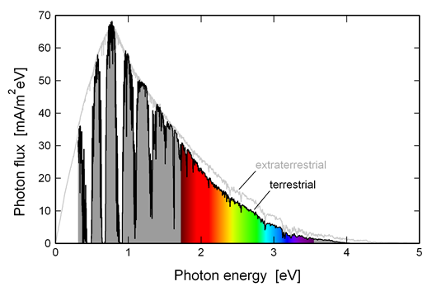
DFT: problems with excitations
Energy gaps (eV)
Material | LDA | Expt. [1]
Diamond | 3.9 | 5.48
Si | 0.5 | 1.17
LiCl | 6.0 | 9.4
[1] Landolt-Bornstien, vol. III; Baldini & Bosacchi, Phys. Stat. Solidi (1970).
Solar spectrum
[2] Aspnes & Studna, Phys. Rev. B (1983)

Slide 4
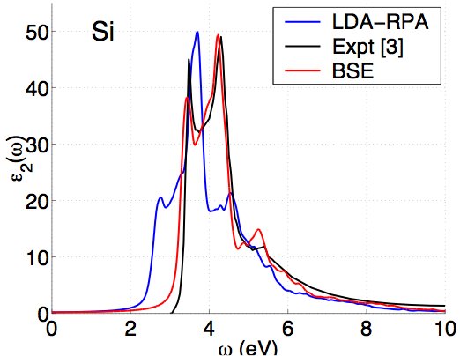
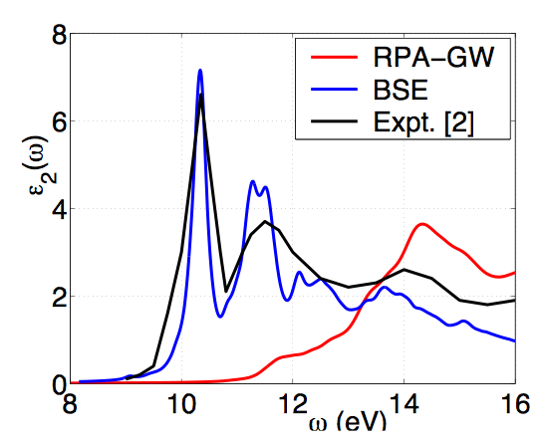
Green’s functions successes
Energy gaps (eV)
Material | DFT-LDA | GW* | Expt.
Diamond | 3.9 | 5.6 | 5.48
Si | 0.5 | 1.3 | 1.17
LiCl | 6.0 | 9.1 | 9.4
* Hybertsen & Louie, Phys. Rev. B (1986)
SiO₂

Slide 5
GW-BSE: what is it about?
DFT is a ground-state theory for electrons
But many processes involve exciting electrons:
Transport of electrons in a material or across
an interface: dynamically adding an electron
e⁻

Slide 6
GW-BSE: what is it about?
DFT is a ground-state theory for electrons
But many processes involve exciting electrons:
Transport of electrons in a material or across
an interface: dynamically adding an electron
→ The other electrons
respond to this and modify
energy of added electron
e⁻

Slide 7
GW-BSE: what is it about?
DFT is a ground-state theory for electrons
But many processes involve exciting electrons:
Transport of electrons
Excited electrons: optical absorption
promotes electron to higher energy
e⁻
h⁺

Slide 8
Optical excitations
Single-particle view
  Photon absorbed
  one e⁻ kicked into an empty state
Problem:
  e⁻ & h+ are charged & interact
  their motion must be correlated
E_{n}
c
e⁻
ħω
h⁺
v

Slide 9
Optical excitations: excitons
Exciton: correlated e⁻-h⁺ pair excitation
Low-energy (bound) excitons: hydrogenic picture
Material | r (Å)
InP | 220
Si | 64
SiO₂ | 4
e⁻
r
h⁺
Marder, Condensed Matter Physics (2000)

Slide 10
GW-BSE: what is it about?
DFT is a ground-state theory for electrons
But many processes involve exciting electrons:
Transport of electrons
Excited electrons: optical absorption
promotes electron to higher energy
→ The missing electron (hole)
has + charge, attracts electron:
modifies excitation energy and absorption strength
e⁻
h⁺

Slide 11
GW-BSE: what is it about?
DFT is a ground-state theory for electrons
But many processes involve exciting electrons:
Transport of electrons, electron energy levels
Excited electrons
Each/both critical in many materials problems, e.g.
Photovoltaics
Photochemistry
“Ordinary” chemistry involving electron transfer

Slide 12
GW-BSE: what is it for?
DFT is a ground-state theory for electrons
But many processes involve exciting electrons:
Transport of electrons, electron energy levels
Excited electrons
DFT --- in principle and in practice --- does a poor job of describing both
GW : describe added electron energies
including response of other electrons
BSE (Bethe-Salpeter Equation): describe optical processes
including electron-hole interaction and GW energies

Slide 13
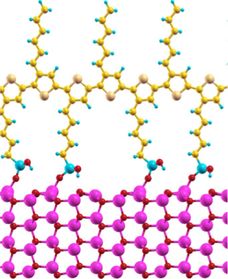
A system I’d love to do GW-BSE on…
P3HT polymer
But with available
GW-BSE methods
it would take
“forever”
i.e. use up all my
supercomputer
allocation time
Zinc oxide nanowire

Slide 14
GW-BSE is expensive
Scaling with number of atoms N
DFT : N³
GW : N⁴
BSE : N⁶

Slide 15
GW-BSE is expensive
Scaling with number of atoms N
DFT : N³
GW : N⁴
BSE : N⁶
But in practice the GW is the killer
e.g. a system with 50-75 atoms (GaN)
DFT : 1 cpu x hours
GW : 91 cpu x hours
BSE : 2 cpu x hours

Slide 16
GW-BSE is expensive
Scaling with number of atoms N
DFT : N³
GW : N⁴
BSE : N⁶
But in practice the GW is the killer
e.g. a system with 50-75 atoms (GaN)
DFT : 1 cpu x hours
GW : 91 cpu x hours
BSE : 2 cpu x hours
Hence, our first focus is on GW
Once that is scaling well, we will attack the BSE

Slide 17
What’s in the GW?
Key element : compute response of electrons to perturbation
P(r,r’) = Response of electron density n(r) at position r
to change of potential V(r’) at position r’
Notes:
The factor fi=1 if a state if filled with electron and 0 if empty in the ground state. The sum over j this in theory goes to infinity

Slide 18
What’s in the GW?
Key element : compute response of electrons to perturbation
P(r,r’) = Response of electron density n(r) at position r
to change of potential V(r’) at position r’
Challenges
Many FFTs to get wave functions 𝜓_{i}(r) functions
Large outer product to form P
Dense r grid : P(r,r’) is huge in memory
Sum over j is very large
Notes:
The factor fi=1 if a state if filled with electron and 0 if empty in the ground state. The sum over j this in theory goes to infinity

Slide 19
What’s in the GW?
Key element : compute response of electrons to perturbation
P(r,r’) = Response of electron density n(r) at position r
to change of potential V(r’) at position r’
Challenges
Many FFTs to get wave functions 𝜓_{i}(r) functions
Large outer product to form P
Dense r grid : P(r,r’) is huge in memory
Sum over j is very large
1 & 2 : Efficient parallel FFTs and linear algebra
3 : Effective memory parallelization
4 : replace explicit j sum by implicit inversion
(many matrix-vector multiplies)
Notes:
The factor fi=1 if a state if filled with electron and 0 if empty in the ground state. The sum over j this in theory goes to infinity

Slide 20
Summary
GW-BSE is promising as it contains the right physics
Very expensive : computation and memory
Plan to implement high performance version in
OpenAtom for the community (SI2-SSI NSF grant)
Two sets of challenges
How to best parallelize existing GW-BSE algorithms?
Will rely on Charm++ to deliver high performance
Coding, maintenance, migration to other computers
much easier for user
Need to improve GW-BSE algorithms to use the computers
more effective (theoretical physicist/chemist’s job)

Slide 22
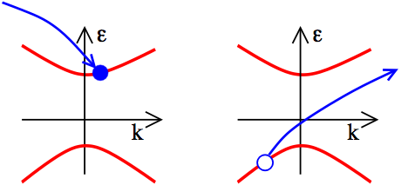
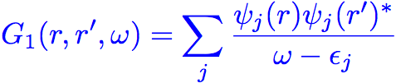


One particle Green’s function
(r’,0)
(r,t)
Dyson Equation:
DFT:
Hedin, Phys. Rev. (1965); Hybertsen & Louie, Phys. Rev. B (1986).

Slide 23



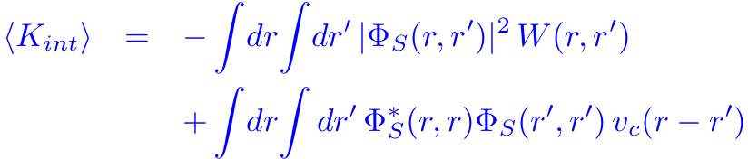
Two particle Green’s function
(r’,t)
e⁻
c
(r’’,0)
(r’’’,0)
(r,t)
v
h⁺
Exciton amplitude:
Bethe-Salpeter Equation:
(BSE)
attractive
(screened direct)
repulsive
(exchange)
Rohlfing & Louie; Albrecht et al.; Benedict et al.: PRL (1998)

Slide 24
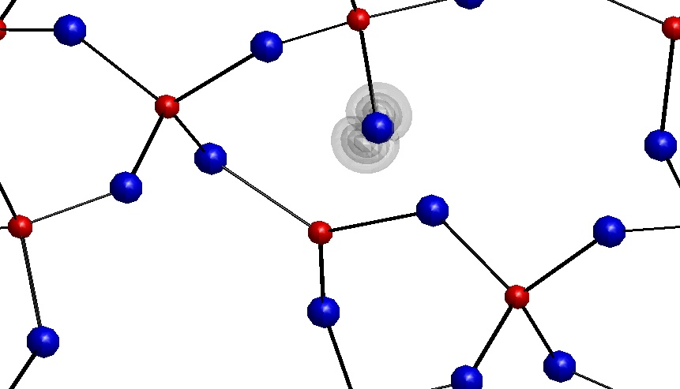
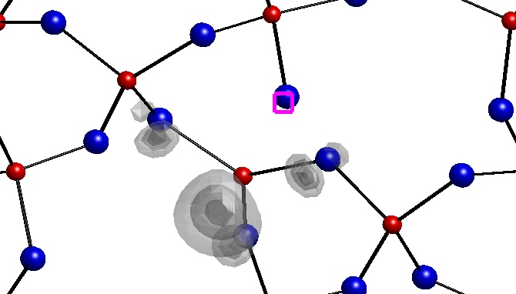
STE geometry
Prob : 20,40,60,80% max
Si₂
O₁
Si₁
Bond (Å) | Bulk | STE
Si₁-O₁ | 1.60 | 1.97 (+23%)
Si₂-O₁ | 1.60 | 1.68 (+5%)
Si₁-O_{other} | 1.60 | 1.66 (+4%)
Angles | Bulk | STE
O₁-Si₁-O_{other} | 109º | ≈ 85º
O_{other}-Si₁-O_{other} | 109º | ≈ 120º

Slide 25
Exciton self-trapping
Defects → localized states: exciton can get trapped
Interesting case: self-trapping
If exciton in ideal
crystal can lower
its energy by
localizing
defect forms
spontaneously
→ traps exciton
e⁻
h⁺
e⁻
h⁺

