Slide 1



POWER-AWARE JOB SCHEDULING Maximizing Data Center Performance Under Strict Power Budget
Osman Sarood, Akhil Langer, Abhishek Gupta, Laxmikant Kale
Parallel Programming Laboratory
Department of Computer Science
University of Illinois at Urbana-Champaign
29th April 2014

Slide 2
Major Challenges to Achieve Exascale¹
Energy and Power Challenge
Memory and Storage Challenge
Concurrency and Locality Challenge
Resiliency Challenge
Kogge, Peter, et al. "Exascale computing study: Technology challenges in achieving exascale systems." (2008).

Slide 3
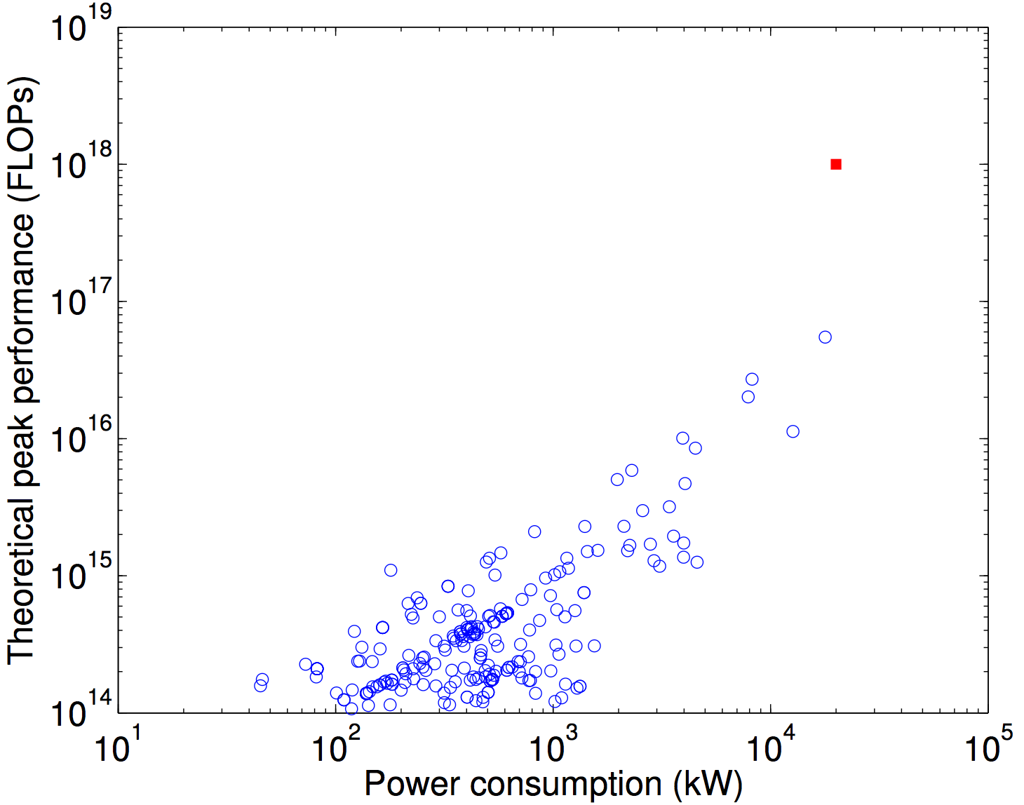
Major Challenges to Achieve Exascale¹
Power consumption for Top500
Exascale in 20MW!
Kogge, Peter, et al. "Exascale computing study: Technology challenges in achieving exascale systems." (2008).

Slide 4
Data Center Power
How is data center power need calculated?
using Thermal Design Power (TDP) of nodes
However, TDP is hardly reached!!
Solution
constrain power consumption of nodes
Overprovisioning - Use more nodes than conventional data center for the same power budget

Slide 5
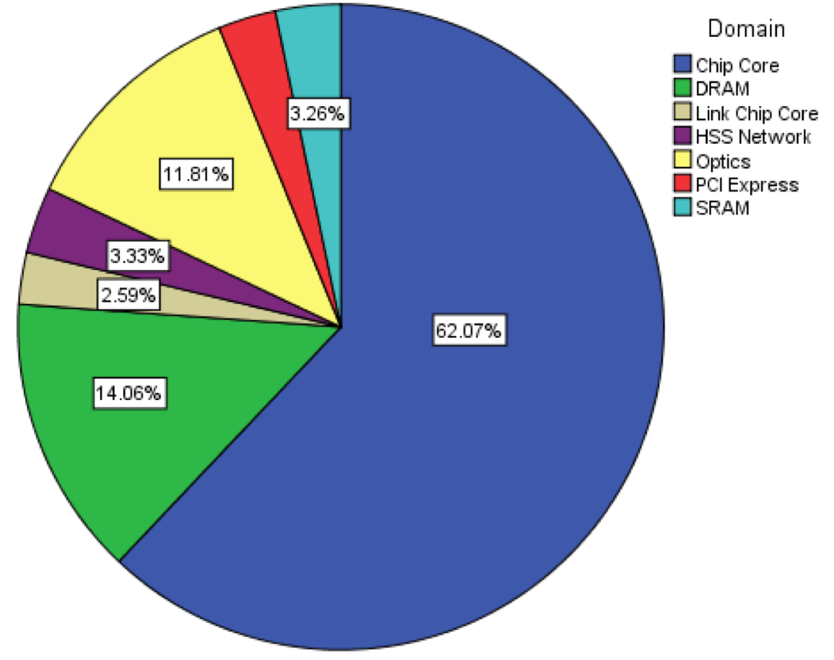
Distribution of Node Power Consumption
Power distribution for BG/Q processor on Mira
76% by CPU/Memory
No good mechanism for controlling other power domains
Pie Chart: Sean Wallace, Measuring Power Consumption on IBM Blue Gene/Q

Slide 6




Constraining CPU/Memory Power
Intel Sandy Bridge
Running Average Power Limit (RAPL) library
measure and set CPU/memory power

Slide 7
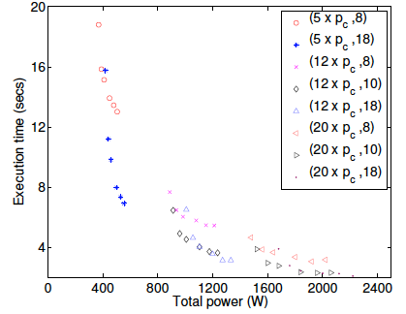
Application Performance with Power
p_{c}: CPU power cap
P_{m}:Memory power cap
Configuration
(n x pc, pm )
Application performance does not improve proportionately with increase in power cap
Better is to run on larger number of nodes each capped at lower power level
(12x44,18)
(20x32,10)
Performance of LULESH at different configurations

Slide 8
Problem Statement
Maximizing Data Center Performance Under Strict Power Budget
Data center capabilities and job features
Power capping ability
Overprovisioning
Moldability (Optional)
Malleability (Optional)
Charm++
Dynamic MPI

Slide 9
Power Aware Resource Manager (PARM)
JOB PROFILER
PASS MODEL
SCHEDULER
EXECUTION FRAMEWORK
SHRINK/EXPAND JOBS
APPLY POWER CAPS
JOB QUEUE
JOB ARRIVAL
JOB TERMINATION
TRIGGERS

Slide 10
JOB PROFILER
Measure job performance at various scales and cpu power caps
Power Aware Strong Scaling (PASS) Model
Predict job performance at any (n, p)

Slide 11
Power Aware Strong Scaling (PASS) Model
Time vs Scale
Downey’s strong scaling
Time vs Frequency
p_{core}: core power
g_{i}: cost level I cache access
L_{i}: #level I accesses
g_{m}: cost of mem access
M: #mem accesses
p_{base}: idle power
n: number of nodes
A: Average Parallelism
σ : duration of parallelism A
Frequency vs Power
W_{cpu}: CPU work
T_{mem}: memory work
T_{h} : minimum exec time
Time as a function of power and number of nodes

Slide 12
Power Aware Resource Manager (PARM)
JOB PROFILER
PASS MODEL
SCHEDULER
EXECUTION FRAMEWORK
SHRINK/EXPAND JOBS
APPLY POWER CAPS
JOB QUEUE
JOB ARRIVAL
JOB TERMINATION
TRIGGERS

Slide 13
Scheduler: Integer Linear Program Formulation

Slide 14
Scheduler: Objective Function
Maximizing throughput makes ILP optimization infeasible
Maximize sum of power-aware speedup of selected jobs:

Slide 15
Power Aware Resource Manager (PARM)
JOB PROFILER
PASS MODEL
SCHEDULER
EXECUTION FRAMEWORK
SHRINK/EXPAND JOBS
APPLY POWER CAPS
JOB QUEUE
JOB ARRIVAL
JOB TERMINATION
TRIGGERS

Slide 16
Experimental Setup
Applications
Memory-intensive
Jacobi and Wave2D
Computation-intensive
LeanMD
Mixed
AMR and Lulesh
Testbed
38-node Intel Sandy Bridge
6 physical cores, 16GB RAM
Power capping using RAPL
CPU power cap range [25-95]W
Job Dataset
β corresponds to CPU sensitivity
SetL: Mix of apps with average β=0.1
SetH: Mix of apps with average β=0.27
Power Budget
CPU power levels={30, 32, 34, 39, 45, 55}W
Node power consumption= 116W
Power Budget = 3000W
#nodes in traditional data center = 28

Slide 17
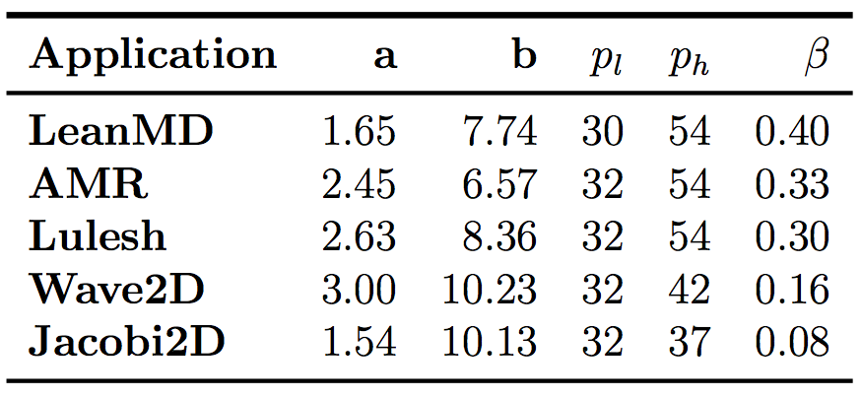
Estimating Performance using PASS
Model Parameters

Slide 18
PARM Performance Results
Average Completion times
Description
noMM: without Malleability and Moldability
noSE: with Moldability but no Malleability
wSE: with Moldability and Malleability
Performance
32% improvement with nMM over SLURM
13.9% improvement with noSE over noMM
7.5% improvement with wSE over noSE
1.7X improvement in throughput

Slide 19
Large Scale Projections
SLURM simulator vs PARM simulator
Modeling cost of shrinking and expansion of jobs
Boot times
Communication cost for data transfer
Total cost

Slide 20
Large Scale Projections Experimental Setup
Job Datasets
Intrepid job traces
3 subsets: Set 1, Set 2, Set3
1000 jobs
Application Characteristics
Model parameters chosen randomly from range defined by computationally and memory intensive apps
Node Range for Moldable/Malleable jobs
min nodes = θ*max(N)
θ ε[0.2, 0.6]
Power Budget
40,960 nodes -> 4.75MW
CPU power levels ={30,33,36,44,50,60}W

Slide 21
Large Scale Projections Performance
Description
baseline: SLURM scheduling
noSE: with Moldability but no Malleability
wSE: with Moldability and Malleability
Arrival times multiplied by γ
Gives diversity in job arrival rates
5.2X speedup with wSE!

Slide 22
Comparison with Naïve Overprovisioning

Slide 23
Tradeoff between Throughput and Job Fairness
Objective function multiplier: ω^{α}

Slide 24
CONCLUSIONS/TAKEAWAYS
Conclusion
Significant improvement in throughputs
Power-aware characteristics (PASS model)
CPU power capping
Overprovisioning
Sophisticated ILP scheduling methodology useful for resource assignment
Adaptive runtime system further increases benefits by allowing malleability
Non-malleable jobs also benefit
Future Work
Enable/disable caches
Thermal constraints
To improve system reliability and improve cooling costs
Rich support for user priorities

Slide 25
THANK YOU! POWER-AWARE JOB SCHEDULING Maximizing Data Center Performance Under Strict Power Budget
Osman Sarood, Akhil Langer, Abhishek Gupta, Laxmikant Kale
Parallel Programming Laboratory
Department of Computer Science
University of Illinois at Urbana-Champaign
29th April 2014

