Slide 1
Efficient High Performance Computing in the Cloud
Abhishek Gupta (gupta59@illinois.edu)
5th year Ph.D. student
Parallel Programming Laboratory
Department of Computer Science,
University of Illinois at Urbana Champaign, Urbana, IL

Slide 2
On-demand Self-service
Broad Network Access
Measured Service
Rapid Elasticity
Resource Pooling (Multi-tenancy)
Public
Private
Hybrid
Community
Essential characteristics
Deployment Models
Cloud Computing
Service Models
Software
(SaaS)
Platform (PaaS)
Infrastructure (IaaS)
Applications running on cloud infrastructure,
Examples - Google Apps, Salesforce
Computing platforms including programming language execution framework, database, OS.
Examples - Google App Engine, Microsoft Azure
Physical or virtual computing infrastructure, processing, storage, network.
Examples - Amazon EC2, HP cloud
Notes:
A model for provind computing as a service .. Shared pool of resources..
Cloud computing is a model for enabling ubiquitous, convenient, on-demand network access to a shared
pool of configurable computing resources (e.g., networks, servers, storage, applications, and services) that
can be rapidly provisioned and released with minimal management effort or service provider interaction.
This cloud model is composed of five essential characteristics, three service models, and four deployment
models.

Slide 3
Motivation: Why Clouds for HPC ?
Rent vs. own, pay-as-you-go
No startup/maintenance cost, cluster create time
Elastic resources
No risk e.g. in under-provisioning
Prevents underutilization
Benefits of virtualization
Flexibility and customization
Migration and resource control
Cloud for HPC: A cost-effective and timely solution?

Slide 4
Experimental Testbed and Applications
Platform/ Resource | Ranger (TACC) | Taub (UIUC) | Open Cirrus (HP) | Private Cloud (HP) | Public Cloud
Network | Infiniband (10Gbps) | Voltaire QDR Infiniband | 10 Gbps Ethernet internal; 1 Gbps Ethernet x-rack | Emulated network card under KVM hypervisor (1Gbps Physical Ethernet) | Emulated network under KVM hypervisor (1Gbps Physical Ethernet)
NAS Parallel Benchmarks class B (NPB3.3-MPI)
NAMD - Highly scalable molecular dynamics
ChaNGa - Cosmology, N-body
Sweep3D - A particle in ASCI code
Jacobi2D - 5-point stencil computation kernel
Nqueens - Backtracking state space search
Notes:
Todo: Change table, keep only relevant aspects which I will discuss
Details in report

Slide 5
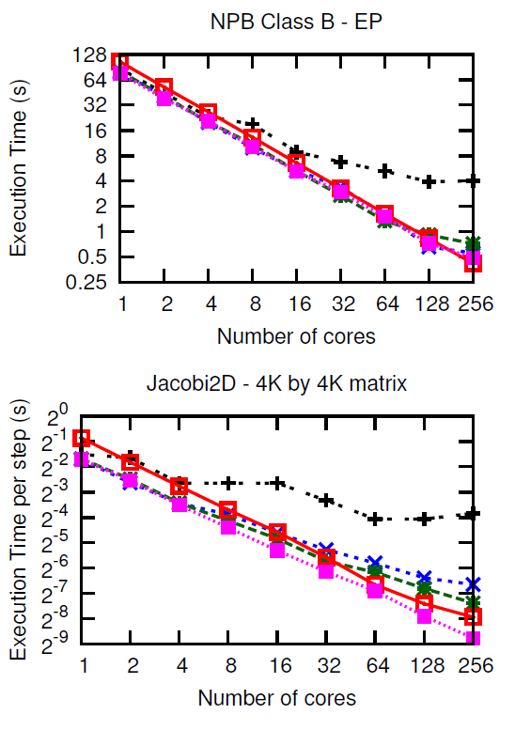
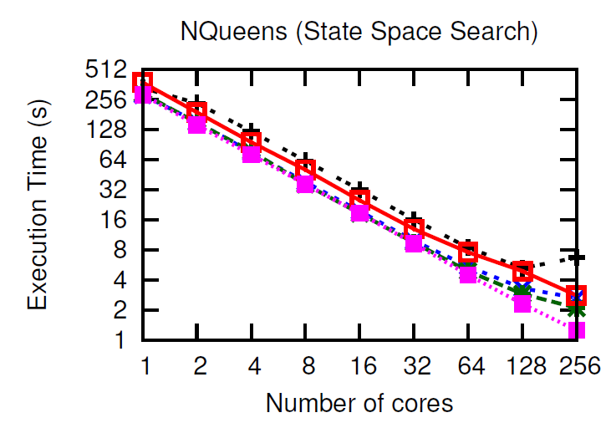
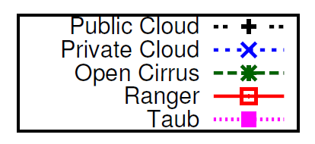
Performance (1/3)
Some applications cloud-friendly
Notes:
Execution Time vs. Number of cores (strong scaling for all except Sweep3D) for different applications. All
applications scale very well on Taub and Ranger and moderately well on Open Cirrus. On Private Cloud, IS does not
scale at all, LU and NAMD stop scaling after 32 cores whereas EP, Jacobi2D and NQueens scale well. Public cloud
exhibits poor scalability.
For NPB, we present results for only Embarrassingly
parallel (EP), LU solver (LU), and Integer sort (IS)
benchmarks due to space constraints. The first observation is
the difference in sequential performance: Ranger takes almost
twice as long as the other platforms, primarily because of the
older and slower processors.
The slope of the curve shows how
the applications scale on different platforms. Despite the poor
sequential speed, Ranger’s performance crosses Open Cirrus,
private cloud and public cloud for some applications at around
32 cores, yielding a much more linearly scalable parallel
performance. We investigated the reasons for better scalability
of these applications on Ranger using application profiling,
performance tools and microbenchmarking the platforms and
found that network performance is a dominant factor (section
IV-A). While all applications scale well on Ranger and
Taub, some applications, especially the NPB IS (Integer Sort)
benchmark, fail to scale on the clouds and Open Cirrus. IS
is a communication intensive benchmark and involves data
reshuffling and permutation operations for sorting. Sweep3D
also exhibits poor weak scaling after 4–8 cores on cloud. Other
communication intensive applications such as LU, NAMD
and ChaNGa also stop scaling on private cloud around 32
cores, but do reasonably well on Open Cirrus, because of the
impact of virtualization on network performance (which we
confirm below). The remaining applications, EP, Jacobi2D,
and NQueens, scale well on all the platforms up to 256 cores
except the public cloud where most applications suffer a hit
above 4 cores. On public cloud, we used VM instances with
4 virtual cores, hence there is no inter-VM communication
up to 4 cores, resulting in good parallel scaling and a sudden
performance penalty as the communication starts happening
across VMs.
Split into 3 sub-plots.
-- apps doing well on all
-- IS
-- all except public and private (and diff bw public, private)
---- what are the reasons??
Comm – why ?? (we went ahead?? – what factors – thin VM, … amazon ec2 clouds…) – extensive researched…
Public and private? … not much has been done for these?? – attribute this to multi-tenancy, scheduling..
Cost

Slide 6
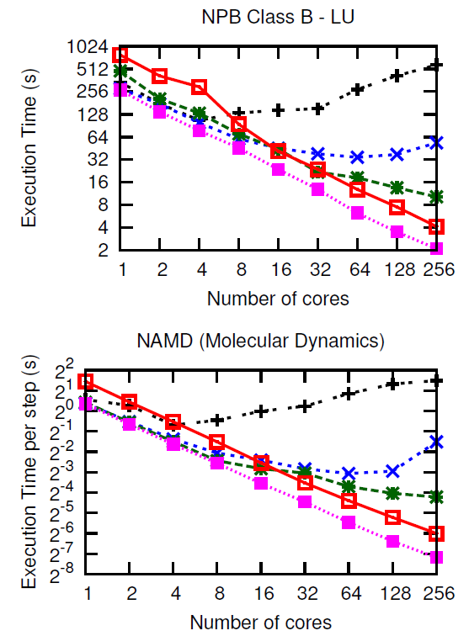
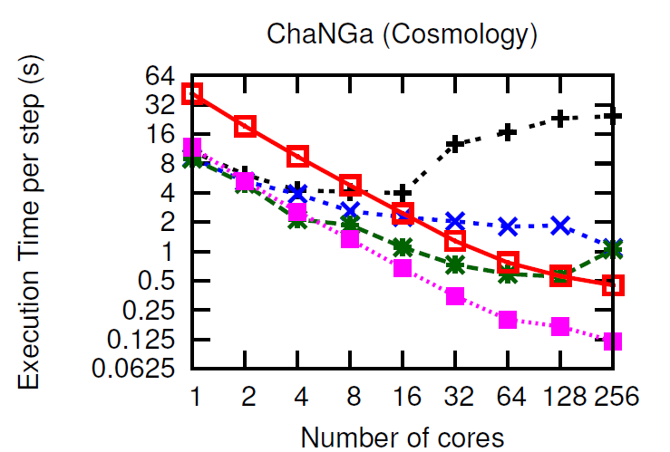
Performance (2/3)
Some applications scale till 16-64 cores
Notes:
Execution Time vs. Number of cores (strong scaling for all except Sweep3D) for different applications. All
applications scale very well on Taub and Ranger and moderately well on Open Cirrus. On Private Cloud, IS does not
scale at all, LU and NAMD stop scaling after 32 cores whereas EP, Jacobi2D and NQueens scale well. Public cloud
exhibits poor scalability.
For NPB, we present results for only Embarrassingly
parallel (EP), LU solver (LU), and Integer sort (IS)
benchmarks due to space constraints. The first observation is
the difference in sequential performance: Ranger takes almost
twice as long as the other platforms, primarily because of the
older and slower processors.
The slope of the curve shows how
the applications scale on different platforms. Despite the poor
sequential speed, Ranger’s performance crosses Open Cirrus,
private cloud and public cloud for some applications at around
32 cores, yielding a much more linearly scalable parallel
performance. We investigated the reasons for better scalability
of these applications on Ranger using application profiling,
performance tools and microbenchmarking the platforms and
found that network performance is a dominant factor (section
IV-A). While all applications scale well on Ranger and
Taub, some applications, especially the NPB IS (Integer Sort)
benchmark, fail to scale on the clouds and Open Cirrus. IS
is a communication intensive benchmark and involves data
reshuffling and permutation operations for sorting. Sweep3D
also exhibits poor weak scaling after 4–8 cores on cloud. Other
communication intensive applications such as LU, NAMD
and ChaNGa also stop scaling on private cloud around 32
cores, but do reasonably well on Open Cirrus, because of the
impact of virtualization on network performance (which we
confirm below). The remaining applications, EP, Jacobi2D,
and NQueens, scale well on all the platforms up to 256 cores
except the public cloud where most applications suffer a hit
above 4 cores. On public cloud, we used VM instances with
4 virtual cores, hence there is no inter-VM communication
up to 4 cores, resulting in good parallel scaling and a sudden
performance penalty as the communication starts happening
across VMs.
Split into 3 sub-plots.
-- apps doing well on all
-- IS
-- all except public and private (and diff bw public, private)
---- what are the reasons??
Comm – why ?? (we went ahead?? – what factors – thin VM, … amazon ec2 clouds…) – extensive researched…
Public and private? … not much has been done for these?? – attribute this to multi-tenancy, scheduling..
Cost

Slide 7
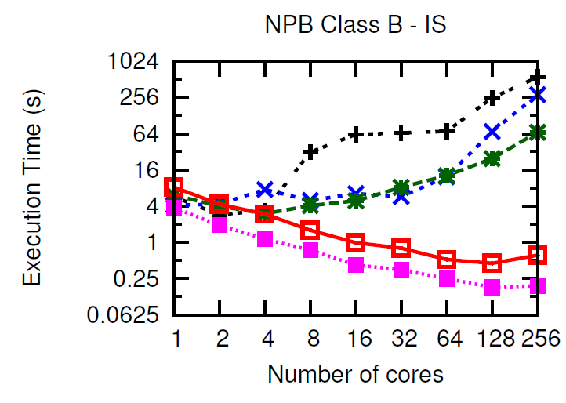
Performance (3/3)
Some applications cannot survive in cloud
A. Gupta and D. Milojicic, “Evaluation of HPC Applications on Cloud,” in IEEE Open Cirrus Summit Best Student Paper, Atlanta, GA, Oct. 2011
A. Gupta et al. “The Who, What, Why, and How of High Performance Computing in the Cloud” in IEEE CloudCom 2013 Best paper
Notes:
Execution Time vs. Number of cores (strong scaling for all except Sweep3D) for different applications. All
applications scale very well on Taub and Ranger and moderately well on Open Cirrus. On Private Cloud, IS does not
scale at all, LU and NAMD stop scaling after 32 cores whereas EP, Jacobi2D and NQueens scale well. Public cloud
exhibits poor scalability.
For NPB, we present results for only Embarrassingly
parallel (EP), LU solver (LU), and Integer sort (IS)
benchmarks due to space constraints. The first observation is
the difference in sequential performance: Ranger takes almost
twice as long as the other platforms, primarily because of the
older and slower processors.
The slope of the curve shows how
the applications scale on different platforms. Despite the poor
sequential speed, Ranger’s performance crosses Open Cirrus,
private cloud and public cloud for some applications at around
32 cores, yielding a much more linearly scalable parallel
performance. We investigated the reasons for better scalability
of these applications on Ranger using application profiling,
performance tools and microbenchmarking the platforms and
found that network performance is a dominant factor (section
IV-A). While all applications scale well on Ranger and
Taub, some applications, especially the NPB IS (Integer Sort)
benchmark, fail to scale on the clouds and Open Cirrus. IS
is a communication intensive benchmark and involves data
reshuffling and permutation operations for sorting. Sweep3D
also exhibits poor weak scaling after 4–8 cores on cloud. Other
communication intensive applications such as LU, NAMD
and ChaNGa also stop scaling on private cloud around 32
cores, but do reasonably well on Open Cirrus, because of the
impact of virtualization on network performance (which we
confirm below). The remaining applications, EP, Jacobi2D,
and NQueens, scale well on all the platforms up to 256 cores
except the public cloud where most applications suffer a hit
above 4 cores. On public cloud, we used VM instances with
4 virtual cores, hence there is no inter-VM communication
up to 4 cores, resulting in good parallel scaling and a sudden
performance penalty as the communication starts happening
across VMs.
Split into 3 sub-plots.
-- apps doing well on all
-- IS
-- all except public and private (and diff bw public, private)
---- what are the reasons??
Comm – why ?? (we went ahead?? – what factors – thin VM, … amazon ec2 clouds…) – extensive researched…
Public and private? … not much has been done for these?? – attribute this to multi-tenancy, scheduling..
Cost

Slide 8
Objectives
HPC in cloud
HPC-cloud: What, why, who
How:
Bridge HPC-cloud Gap
Improve HPC performance
Improve cloud utilization=> Reduce cost
Notes:
Cloud provider + User perspective
HPC-aware Cloud + Cloud-aware HPC
Performance achieved on cloud vs. supercomputer?
The bigger and more important question: why and who should choose (or not choose) cloud for HPC, for what applications, and how should cloud be used for HPC?
2 ways how : improve performance or reduce cost by improving utilization

Slide 9
Outline
Performance of HPC in cloud
Trends
Challenges and Opportunities
Application-aware cloud schedulers
HPC-aware schedulers: improve HPC performance
Application-aware consolidation: improve cloud utilization => reduce cost
Cloud-aware HPC runtime
Dynamic Load balancing: improve HPC performance
Conclusions
9

Slide 10
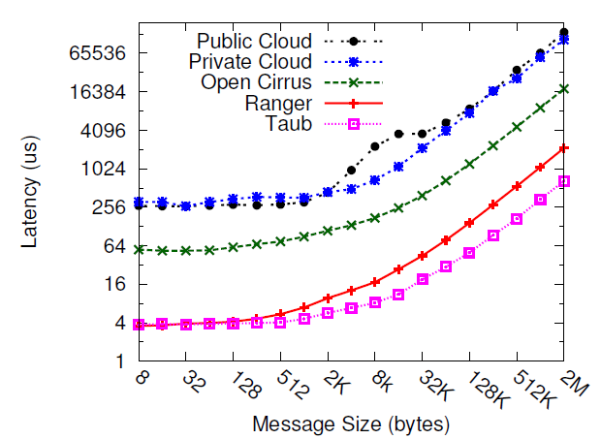
Bottlenecks in Cloud: Communication Latency
Low is better
Cloud message latencies (256μs) off by 2 orders of magnitude compared to supercomputers (4μs)
Notes:
Public vs private cloud – almost similar network perf.. Then why so much difference.. Scheduler was OpenStack

Slide 11
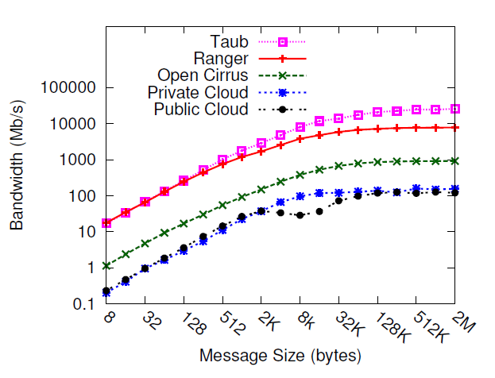
Bottlenecks in Cloud: Communication Bandwidth
High is better
Cloud communication performance off by 2 orders of magnitude – why?
Notes:
Public vs private cloud – almost similar network perf.. Then why so much difference.. Scheduler was OpenStack

Slide 12
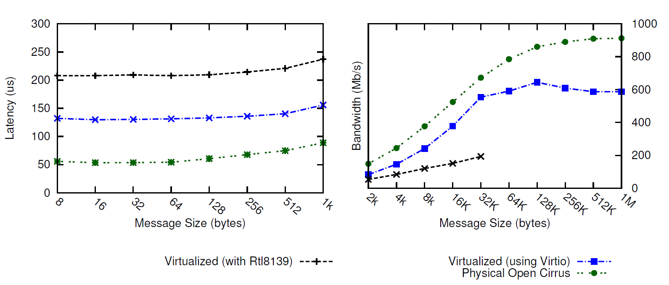
Commodity Network or Virtualization Overhead (or both?)
Low is better
High is better
Significant virtualization overhead (Physical vs. virtual)
Led to collaborative work on “Optimizing virtualization for HPC – Thin VMs, Containers, CPU affinity” with HP labs, Singapore.
Notes:
This thesis does not address improving network perf but the less explored challenges for HPC-Clouds.
Fix this slide.

Slide 13
Public vs. Private Cloud
Low is better
Similar network performance for public and private cloud. Then, why does public cloud perform worse?
Multi-tenancy
Notes:
Public vs private cloud – almost similar network perf.. Then why so much difference.. Scheduler was OpenStack
To sustain low cost.. Which motivates us to study cloud eco for HPC a bit more detail…

Slide 14
Challenge: HPC-Cloud Divide
HPC
Cloud
Application performance
Dedicated execution
HPC-optimized interconnects, OS
Not cloud-aware
Service, cost, resource utilization
Multi-tenancy
Commodity network, virtualization
Not HPC-aware
Mismatch: HPC requirements and cloud characteristics Only embarrassingly parallel, small scale HPC applications in clouds
14
Notes:
If we focus on perf, and provide dedicated resources for all HPC, cost advantage goes away..
So, the question is can we improve performance without having to increase cost or can we reduce cost without having to sacrifice on perf..
Tell what is multi-tenancy…
Critical factors: cloud commodity interconnect, network virtualization overhead, heterogeneity, and multi-tenancy
For HPC, one slow processor => all underutilized processors
Critical factors: cloud commodity interconnect, network virtualization overhead, heterogeneity, and multi-tenancy
For HPC, one slow processor => all underutilized processors
Critical factors: cloud commodity interconnect, network virtualization overhead, heterogeneity, and multi-tenancy
For HPC, one slow processor => all underutilized processors

Slide 15
Outline
Performance of HPC in cloud
Trends
Challenges and Opportunities
Application-aware cloud schedulers
HPC-aware schedulers: improve HPC performance
Application-aware consolidation: improve cloud utilization => reduce cost
Cloud-aware HPC runtime
Conclusions and Future work
15
Notes:
Challenges:
Critical factors: cloud commodity interconnect, network virtualization overhead, heterogeneity, and multi-tenancy

Slide 16
Next …
HPC in
HPC-aware cloud
Challenges/Bottlenecks
Opportunities
Heterogeneity
Multi-tenancy
VM consolidation
Application-aware
Cloud schedulers
SCHEDULING/PLACEMENT
Notes:
Cloud offerings use application-agnostic VM placement
Poor performance of HPC apps in Cloud
Cost savings potential through application aware consolidation

Slide 17
HPC performance vs. Resource utilization
(prefers dedicated execution) (shared usage in cloud)?
Up to 23% savings
How much interference?
Notes:
Cloud offerings use application-agnostic VM placement
Poor performance of HPC apps in Cloud
Cost savings potential through application aware consolidation

Slide 18
VM Consolidation for HPC in Cloud
Experiment: Shared mode (2 apps on each node – 2 cores each on 4 core node) performance normalized wrt. dedicated mode
Challenge: Interference
4 VM per app
Scope
High is better
EP = Embarrisingly Parallel
LU = LU factorization
IS = Integer Sort
ChaNGa = Cosmology
Careful co-locations can actually improve performance. Why?
Correlation : LLC misses/sec and shared mode performance.
18
Notes:
Co-relation between LLC misses/sec and shared mode perf.
Apps with high LLC misses/s benefit when sharing node with apps with low LLC misses/s – e.g. LU
Apps with low LLC misses/s marginally affected when sharing node with apps with high LLC misses/s e.g. EP
But what about IS?
IS is network-intensive, so local vs. remote dominates

Slide 19
HPC-Aware Cloud Schedulers
Characterize applications along two dimensions:
Cache intensiveness
Assign each application a cache score (LLC misses/sec)
Representative of the pressure they put on the last level cache and memory controller subsystem
Parallel Synchronization and network sensitivity
19
Notes:
ExtremeHPC: Extremely tightly coupled or topology sensitive
applications for which the best will be to provide
dedicated nodes, example – IS.
SyncHPC: Sensitive to interference, but less compared to
ExtremeHPC and can sustain small degree of interference
to get consolidation benefits, examples – LU, ChaNGa.
AsyncHPC: Asynchronous (and less communication sensitive)
and can sustain more interference than SyncHPC,
examples – EP, MapReduce applications.
NonHPC: Do not perform any communication, can sustain
more interference, and can be placed on heterogeneous
hardware, example – Web applications.

Slide 20
HPC-Aware Cloud Schedulers
Co-locate applications with complementary profiles
Dedicated execution for extremely tightly-coupled HPC applications (up to 20% improvement, implemented in OpenStack)
For rest, Multi-dimensional Online Bin Packing (MDOBP): Memory, CPU
Dimension aware heuristic
Cross application interference aware (up to 45% performance improvement for single application, limit interference to 8%)
Improve throughput by 32.3% (simulation using CloudSim)
A. Gupta, L. Kale, D. Milojicic, P. Faraboschi, and S. Balle, “HPC-Aware VM Placement in Infrastructure Clouds ,” at IEEE Intl. Conf. on Cloud Engineering IC2E ’13
20
Notes:
ExtremeHPC: Extremely tightly coupled or topology sensitive
applications for which the best will be to provide
dedicated nodes, example – IS.
SyncHPC: Sensitive to interference, but less compared to
ExtremeHPC and can sustain small degree of interference
to get consolidation benefits, examples – LU, ChaNGa.
AsyncHPC: Asynchronous (and less communication sensitive)
and can sustain more interference than SyncHPC,
examples – EP, MapReduce applications.
NonHPC: Do not perform any communication, can sustain
more interference, and can be placed on heterogeneous
hardware, example – Web applications.

Slide 21
Outline
Performance of HPC in cloud
Trends
Challenges and Opportunities
Application-aware cloud schedulers
HPC-aware schedulers: improve HPC performance
Application-aware consolidation: improve cloud utilization => reduce cost
Cloud-aware HPC runtime
Dynamic Load balancing: improve HPC performance
Conclusions
21

Slide 22
Heterogeneity and multi-tenancy
Multi-tenancy => Dynamic heterogeneity
Interference random and unpredictable
Challenge: Running in VMs makes it difficult to determine if (and how much of) the load imbalance is
Application-intrinsic or
Caused by extraneous factors such as interference
Idle times
CPU/VM
VMs sharing CPU: application functions appear to be taking longer time
Time
Existing HPC load balancers ignore effect of extraneous factors
22
Notes:
Existing LB do not consider extraneous factors
Heterogeneity-awareness: significant performance improvement for HPC in cloud.
Besides the static heterogeneity, multi-tenancy in cloud introduces dynamic heterogeneity, which is random and unpredictable.
Poor performance of tightly-coupled iterative HPC applications.
To
demonstrate its severity, we conducted a simple experiment
where we ran a tightly-coupled 5-point stencil benchmark,
referred to as Stencil2D (2K 2K matrix), on 8-VMs, each
with a single virtual core (VCPU), pinned to a different
physical core of 4-core nodes. More details of our experimental
setup and benchmarks are given in Section V. To
study the impact of heterogeneity, we ran this benchmark in
2 cases - first, we used two physical nodes of same fast (3.00
GHz) processor type (Figure 1a) and second, we used two
physical nodes with different processor types – fast (3.00 GHz)
and slow (2.13 GHz) (Figure 1b).
In the context of cloud, the execution environment depends
on VM to physical machine mapping, which makes it (a)
dynamic and (b) inconsistent across multiple runs. Hence,
would be inefficient. Most existing dynama static allocation of compute tasks to parallel processes
ic load balancing
techniques operate based exclusively on the imbalance internal
to the application, whereas in cloud, the imbalance might be
due to the effect of extraneous factors. These factor originate
from two characteristics, which are intrinsic to cloud:
1) Heterogeneity: Cloud economics is based on the creation
of a cluster from existing pool of resources and
incremental addition of new resources. While doing this,
homogeneity is lost.
2) Multi-tenancy: Cloud providers run a profitable business
by improving utilization of underutilized resources. This
is achieved at cluster-level by serving large number
of users, and at server-level by consolidating VMs of
complementary nature (such as memory- and computeintensive)
on same server. Hence, multi-tenancy can be
at resource-level (memory, CPU), node-level, rack-level,
zone-level, or data center level.

Slide 23
Charm++ and Load Balancing
Migratable objects (chares)
Object-based over-decomposition
Load balancer migrates objects from overloaded
to under loaded VM
HPC VM1
HPC VM2
Background/ Interfering VM running on same host
23
Physical Host 1
Objects
(Work/Data Units)
Physical Host 2
Notes:
Charm++ is a perfect match for our technique.
Its object based over-decomposition coupled with migrateability of objects allows us to trasnfer tasks to load balance the application
Time logging of task, provided by charm++, is also an essential part of our scheme. We use these times to come up with decisions about which tasks to migrate in order to restore load balance.

Slide 24
Cloud-Aware Load Balancer
Static Heterogeneity:
Estimate the CPU capabilities for each VCPU, and use those estimates to drive the load balancing.
Simple estimation strategy + periodic load re-distribution
Dynamic Heterogeneity
Instrument the time spent on each task
Impact of interference: instrument the load external to the application under consideration (background load)
Normalize execution time to number of ticks (processor-independent)
Predict future load based on the loads of recently completed iterations (principle of persistence).
Create sets of overloaded and under loaded cores
Migrate objects based on projected loads from overloaded to underloaded VMs (Periodic refinement)
24

Slide 25
Load balancing approach
To get a processor-independent
measure of task loads, normalize the execution times to number of ticks
All processors should have load close to average load
Average load depends on task execution time and overhead
Overhead is the time processor is not executing tasks and not in idle mode.
Charm++ LB database
T_{lb}: wall clock time between two load balancing steps,
T_{i}: CPU time consumed by task i on VCPU p
from /proc/stat file
Notes:
The main challenge is that the CPU time may include the time taken by interfering VM, so they may be inaccurate.
P is the total number of VCPUs, Np is the number
of tasks assigned to VCPU p, ti is the CPU time consumed
by task i running on VCPU p, fp is the frequency for VCPU
p estimated using the loop in Figure 2, and Op is the total
background load for VCPU p.
normalize the execution times to number of ticks by
multiplying the execution times for each task and the overhead
to the estimated VCPU frequency. The conversion from CPU
time to ticks is performed to get a processor-independent
measure of task loads, which is necessary for balancing load
across heterogeneous configuration, where the same task can
take different time when executing on a different CPU.

Slide 26
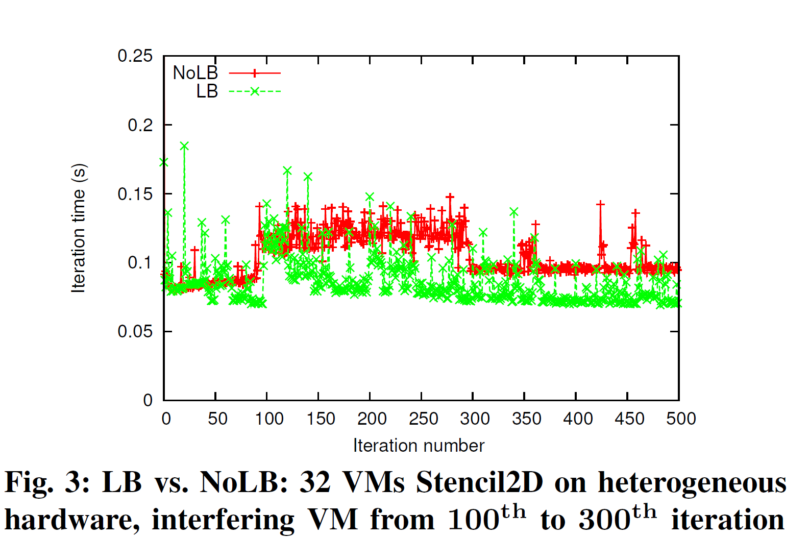
Results: Stencil3d
OpenStack on Open Cirrus test bed (3 types of processors), KVM, virtio-net, VMs: m1.small, vcpupin for pinning VCPU to physical cores
Sequential NPB-FT as interference, Interfering VM pinned to one of the cores that the VMs of our parallel runs use
Multi-tenancy
awareness
Low is better
Heterogeneity
awareness
Periodically measuring idle time and migrating load away from time-shared VMs works well in practice.
26
Notes:
To understand the effect of our load balancer under heterogeneity
and interference, we ran 500 iterations of Stencil2D
on 32 VMs (8 physical nodes – one Slow, rest Fast), and
plotted the iteration time (execution time of an iteration) vs.
iteration number in Figure 3. In this experiment, we started the
job in interfering VM after 100 iterations of parallel job had
completed. Load balancing was performed after every 20 steps,
which manifests itself as spikes in the iteration time every
20th step. We report execution times averaged across three
runs and use wall clock time, which includes the time taken
for object migration. The LB curve starts to show benefits
as we reach 100 iterations, due to heterogeneity-aware load
balancing. After 100 iterations, interfering job starts. When the
load balancer kicks in, it restores load balance by redistributing
tasks among VMs according to Algorithm 1. Now, there is a
large gap between the two curves demonstrating the benefits
of our refinement based approach, which takes around 3 load
balancing steps to gradually reduce the iteration time after
interference appears. The interfering job finishes at iteration
300 and hence the NoLB curve comes down. There is little
reduction in LB curve, since the previous load balancing steps
had reduced the impact of interference to a very small amount.
The difference between the two curves after that is due to
heterogeneity-awareness in load distribution.

Slide 27
Results: Improvements by LB
High is better
Heterogeneity and Interference – one slow node, hence four slow VMs, rest fast, one interfering VM (on a Fast core) which starts at iteration 50.
Up to 40% Benefits
A. Gupta, O. Sarood, L. Kale, and D. Milojicic, “Improving HPC Application Performance in Cloud through Dynamic Load Balancing,” accepted at IEEE/ACM CCGRID ’13
27
Notes:
an interfering VM, we achieve up to 45% improvement in
500 iterations for Stencil2D and Wave2D and 200 iterations for
Mol3D, with load balancing every 20th step
execution time (Figure 6a).
The amount of benefits is different
for different applications, especially in Figure 6b. We studied
this behavior using Projections tool and found that our load
balancer is distributing tasks well for all applications, but the
difference in achieved benefits is due to the different sensitivity
of these applications to CPU type and frequency. It can be
inferred from Figure 6b that Mol3D is the most sensitive to
CPU frequency, having most scope for improvement. Next,
Figure 6c shows that our techniques are also effective in the
presence of both the effects – the inherent hardware heterogeneity
and the heterogeneity introduced by multi-tenancy.
Another observation from Figure 6 is the variation in the
achieved benefits with increasing number of VMs. This is
attributed to the tradeoff between two factors: (1) Since there
is only one VM sharing physical CPU with interfering VM,
running on larger number of VMs implies distributing the work
of the overloaded VM to an increasing number of underutilized
VMs, which results in larger reduction in execution time (e.g.
Figure 6a Mol3D, 8 VM vs. 16 VM). (2) As we scale, the
average compute load per VM decreases. Hence, other factors,
such as communication time, dominate the total execution
time. This implies that even with better load balance and
higher % reduction in compute time, overall benefit is small,
since communication time is unaffected. Hence, as we scale
further, benefits decrease, but they still remain substantial.
Moreover, as we scale, benefits can actually be more important
because we save across larger number of processors. As
an example, from Figure 6b Stencil2D, we save 18.8% over 32
VMs, with absolute savings = 32 0:188 48:09 = 289:28
CPU-seconds, where application took 48.09 seconds on 32
VMs. Juxtaposing this with 20.5% reduction in time over 16
VMs which results in absolute savings = 160:20586:77 =
284:32 CPU-seconds, where application took 86.77 seconds on
16 VMs, we see that the overall savings are more for 32 VM
case compared to 16 VMs. Also, since we achieve higher %
benefits with larger problem sizes (Section VI-A3, Figure 5c),
the benefits will be even higher for weak scaling compared to
strong scaling as the impact of factor 2 above is minimized.

Slide 28
Conclusions and Insights
Question | Answers
Who | Small and medium scale organizations (pay-as-you-go benefits) Owning applications which result in best performance/cost ratio in cloud vs. other platforms.
What | Applications with less-intensive communication patterns Less sensitivity to noise/interference Small to medium scale
Why | HPC users in small-medium enterprises much more sensitive to the CAPEX/OPEX argument. Ability to exploit a large variety of different architectures (Better utilization at global scale, potential consumer savings)
How | Technical: Lightweight virtualization, CPU affinity, HPC-aware Cloud schedulers, Cloud-Aware HPC runtime HPC in the cloud models: cloud bursting, hybrid supercomputer–cloud approach: application-aware mapping

Slide 29
Questions?
http://charm.cs.uiuc.edu/research/cloud
Email: gupta59@illinois.edu
Special Thanks to Dr. Dejan Milojicic (HP Labs) and HP Lab’s Innovation Research Award (IRP)
29

Slide 30
Panel: HPC in the cloud: how much water does it hold?
High performance computing connotes science and engineering applications running on supercomputers. One imagines tightly coupled, latency sensitive, jitter-sensitive applications in this space. On the other hand, cloud platforms create the promise of computation on demand, with a flexible infrastructure, and pay-as-you-go cost structure
Can the two really meet?
Is it the case that only a subset of CSE applications can run on this platform?
Can the increasing role of adaptive schemes in HPC work well with the need for adaptivity in cloud environment?
Should national agencies like NSF fund computation time indirectly, and let CSE researchers rent time in the cloud?
Panelists:
Roy Campbell (Professor, University of Illinois at Urbana Champaign),
Kate Keahey (Fellow, Computation Institute University of Chicago),
Dejan S Milojicic (Senior Research Manager, HP Labs),
Landon Curt Noll (Resident Astronomer and HPC Specialist, Cisco)
Laxmikant Kale (Professor, University of Illinois at Urbana-Champaign)

Slide 31
Roy Campbell
Roy Campbell leads the System Software Research Group. He is the Sohaib and Sara Abbasi Professor of Computer Science and also the Director of the NSA Designated Center of Excellence at the University of Illinois Urbana-Champaign. He is director of CARIS, the Center for Advanced Research in Information Security. He is an IEEE Fellow. He has supervised over forty four Ph.D. Dissertations, one hundred twenty four M.S. theses, and is the author of over two hundred and ninety research papers

Slide 32
Kate Keahey
Kate Keahey is one of the pioneers of infrastructure cloud computing. She leads the development of Nimbus project which provides an open source Infrastructure-as-a-Service implementation as well as an integrated set of platform-level tools allowing users to build elastic application by combining on-demand commercial and scientific cloud resources. Kate is a Scientist in the Distributed Systems Lab at Argonne National Laboratory and a Fellow at the Computation Institute at the University of Chicago.

Slide 33
Dejan Milojicic
Dejan Milojicic is a senior researcher at HP Labs, Palo Alto, CA. He is IEEE Computer Society 2014 President. He is a founding Editor-in-Chief of IEEE Computing Now. He has been on many conference program committees and journal editorial boards. Dejan is an IEEE Fellow, ACM Distinguished Engineer, and USENIX member. Dejan has published over 130 papers and 2 books; he has 12 patents and 25 patent applications.

Slide 34
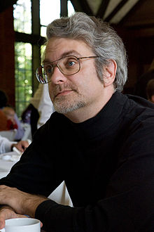
Landon Curt Noll
Landon Curt Noll is a Resident Astronomer and HPC Specialist.
By day his Cisco responsibilities encompass high-performance computing, security analysis, and standards. By night he serves as an Astronomer focusing on our inner solar system, as well as the origins of solar systems throughout our Universe.
Landon Curt Noll is the ‘N’ in the widely used FNV hash
As a mathematician, he developed or co-developed several high-speed computational methods and as held or co-held eight world records related to the discovery of large prime numbers..

Slide 35
Laxmikant Kale
Professor Laxmikant Kale is the director of the Parallel Programming Laboratory and a Professor of Computer Science at the University of Illinois at Urbana-Champaign. Prof. Kale has been working on various aspects of parallel computing, with a focus on enhancing performance and productivity via adaptive runtime systems. His collaborations include the widely used Gordon-Bell award winning (SC'2002) biomolecular simulation program NAMD. He and his team recently won the HPC Challenge award at Supercomputing 2011, for their entry based on Charm++.
Prof. Kale is a fellow of the IEEE, and a winner of the 2012 IEEE Sidney Fernbach award.

Slide 36
Backup Slides

Slide 37
Conclusions
Bridge the gap between HPC and cloud
Performance and utilization
HPC-aware clouds and cloud-aware HPC
Key ideas can be extended beyond HPC-clouds
Application-aware scheduling
Characterization and interference-aware consolidation
Load balancing
Malleable jobs
HPC in the cloud for some applications not all
Application characteristics and scale
Performance-cost tradeoffs
37
Notes:
Goal of increasing the utilization of underutilized resources through
The high-level question I wanted to answer in this talk is, can we build a large-scale update-intensive Internet service using and make it cheap, fast, manageable, available at the same time. And I think I answered the question affirmatively. The key insight I used to answer this question is the exploitation of A. S. For example, ….. By using application-specific requirements, we can achieve goals that are often contradicting, such as in cheapness and availability.
A system for cloud providers..
A system for HPC-cloud users..
Many ideas applicaton to exascale RTS..

Slide 38
Heterogeneity and multi-tenancy
Multi-tenancy => Dynamic heterogeneity
Interference random and unpredictable
Challenge: Running in VMs makes it difficult to determine if (and how much of) the load imbalance is
Application-intrinsic or
Caused by extraneous factors such as interference
Most existing HPC load balancers ignore effect of extraneous factors
38
Notes:
Existing LB do not consider extraneous factors
Heterogeneity-awareness: significant performance improvement for HPC in cloud.
Besides the static heterogeneity, multi-tenancy in cloud introduces dynamic heterogeneity, which is random and unpredictable.
Poor performance of tightly-coupled iterative HPC applications.
To
demonstrate its severity, we conducted a simple experiment
where we ran a tightly-coupled 5-point stencil benchmark,
referred to as Stencil2D (2K 2K matrix), on 8-VMs, each
with a single virtual core (VCPU), pinned to a different
physical core of 4-core nodes. More details of our experimental
setup and benchmarks are given in Section V. To
study the impact of heterogeneity, we ran this benchmark in
2 cases - first, we used two physical nodes of same fast (3.00
GHz) processor type (Figure 1a) and second, we used two
physical nodes with different processor types – fast (3.00 GHz)
and slow (2.13 GHz) (Figure 1b).
In the context of cloud, the execution environment depends
on VM to physical machine mapping, which makes it (a)
dynamic and (b) inconsistent across multiple runs. Hence,
would be inefficient. Most existing dynama static allocation of compute tasks to parallel processes
ic load balancing
techniques operate based exclusively on the imbalance internal
to the application, whereas in cloud, the imbalance might be
due to the effect of extraneous factors. These factor originate
from two characteristics, which are intrinsic to cloud:
1) Heterogeneity: Cloud economics is based on the creation
of a cluster from existing pool of resources and
incremental addition of new resources. While doing this,
homogeneity is lost.
2) Multi-tenancy: Cloud providers run a profitable business
by improving utilization of underutilized resources. This
is achieved at cluster-level by serving large number
of users, and at server-level by consolidating VMs of
complementary nature (such as memory- and computeintensive)
on same server. Hence, multi-tenancy can be
at resource-level (memory, CPU), node-level, rack-level,
zone-level, or data center level.

Slide 39
Future Work
Application-aware cloud consolidation + cloud-aware HPC load balancer
Mapping applications to platforms
HPC runtime for malleable jobs
39
Notes:
Goal of increasing the utilization of underutilized resources through
The high-level question I wanted to answer in this talk is, can we build a large-scale update-intensive Internet service using and make it cheap, fast, manageable, available at the same time. And I think I answered the question affirmatively. The key insight I used to answer this question is the exploitation of A. S. For example, ….. By using application-specific requirements, we can achieve goals that are often contradicting, such as in cheapness and availability.

Slide 40
Objectives and Contributions
Goals
HPC in cloud
HPC-cloud: What, why, who
How:
Bridge HPC-cloud Gap
Techniques
Perf, cost Analysis
Smart selection of platforms for applications
Application-aware VM consolidation
Heterogeneity, Multi-tenancy aware HPC
Malleable jobs: Dynamic shrink/expand
Papers
‘The Who, What, Why and How of High Performance Computing Applications in the Cloud’ IEEE CloudCom 2013
‘HPC-Aware VM Placement in Infrastructure Clouds’ IEEE IC2E 2013
‘Improving HPC Application Performance in Cloud through Dynamic Load Balancing’ IEEE/ACM CCGrid 2013
Notes:
Cloud provider + User perspective
HPC-aware Cloud + Cloud-aware HPC
My focus today will be on How part, but I will tocuh on what is the performance to motivate that there is significant gap…
Performance achieved on cloud vs. supercomputer?
The bigger and more important question: why and who should choose (or not choose) cloud for HPC, for what applications, and how should cloud be used for HPC?
2 ways how : improve performance or reduce cost by improving utilization

Slide 41
HPC-Cloud Economics
Then why cloud for HPC?
Small-medium enterprises, startups with HPC needs
Lower cost of running in cloud vs. supercomputer?
For some applications?
Notes:
Why Cloud ?
Variable usage in time (resulting in lower utilization)
Trading CAPEX for OPEX
Shift towards a delivery model of Software as a Service
Cloud users perspective
Use cloud when their applications fit the profile above
Cloud providers perspective
Aggregated resource utilization of all their tenants can sustain a profitable pricing model when compared to the substantial infrastructure investments required to offer computing and storage resources through a cloud interface.

Slide 42
HPC-Cloud Economics*
Cost = Charging rate($ per core-hour) × P × Time
$ per CPU-hour on SC
$ per CPU-hour on cloud
High means cheaper to run in cloud
Cloud can be cost-effective till some scale but what about performance?
* Ack to Dejan Milojicic and Paolo Faraboschi who originally drew this figure
Notes:
We will come back to this point in proposed work section.

Slide 43
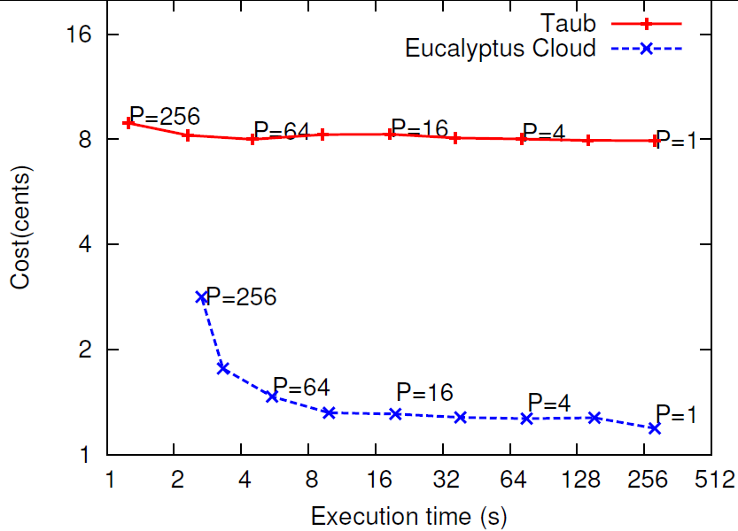
HPC-Cloud Economics
Cost = Charging rate($ per core-hour) × P × Time
Low is better
Best platform depends on application characteristics. How to select a platform for an application?
Notes:
We will come back to this point in proposed work section.

Slide 44
Proposed work(1): App-to-platform
Application characterization and relative performance estimation for structured applications
One-time benchmarking + interpolation for complex apps.
Platform selection algorithms (cloud user perspective)
Minimize cost meeting performance target
Maximize performance under cost constraint
Consider an application set as a whole
Which application, which cloud
Benefits: Performance, Cost
Notes:
What if we use naïve mapping – may exhaust all resources on cloud-friendly apps.
. For example, we can minimize cost of a set of applications under a hard allocation limitation while providing performance guarantees.

Slide 45
Impact
Effective HPC in cloud (Performance, cost)
Some techniques applicable beyond clouds
Charm++ production system
OpenStack scheduler
CloudSim
Industry participation (HP Lab’s award, internships)
2 patents

Slide 46
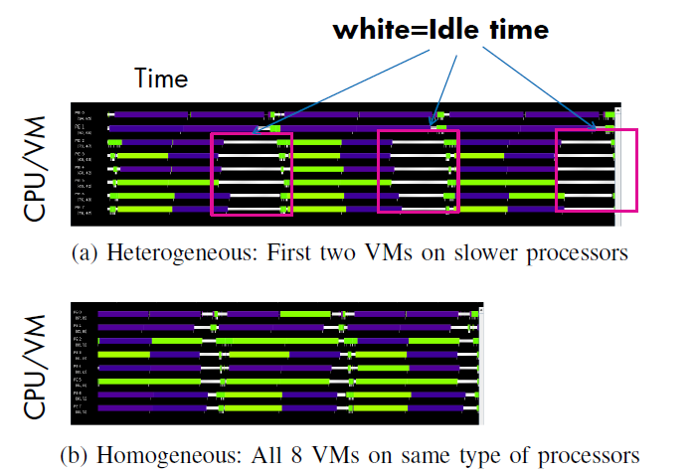
Hardware, topology-Aware VM Placement
OpenStack on Open Cirrus test bed at HP Labs. 3 types of servers:
Intel Xeon E5450 (3.00 GHz)
Intel Xeon X3370 (3.00 GHz)
Intel Xeon X3210 (2.13 GHz)
KVM as hypervisor, virtio-net for n/w virtualization, VMs: m1.small
CPU Timelines of 8 VMs running Jacobi2D – one iteration
Decrease in execution time
20% improvement in time, across all processors
46

