Slide 1


Welcome to the 2015 Charm++ Workshop!
Laxmikant (Sanjay) Kale
http://charm.cs.illinois.edu
Parallel Programming Laboratory
Department of Computer Science
University of Illinois at Urbana Champaign

Slide 2
A couple of forks
Overdecomposition +
Migratability
MPI + x
“Task Models”
Asynchrony
Overdecomposition and migratability:
Most adaptivity
MPI+X
Task
Models

Slide 3
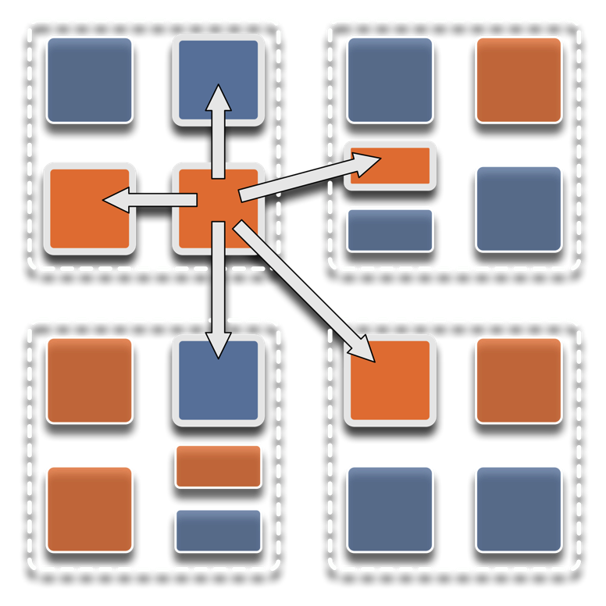
Overdecomposition
Decompose the work units & data units into many more pieces than execution units
Cores/Nodes/..
Not so hard: we do decomposition anyway

Slide 4
Migratability
Allow these work and data units to be migratable at runtime
i.e. the programmer or runtime, can move them
Consequences for the app-developer
Communication must now be addressed to logical units with global names, not to physical processors
But this is a good thing
Consequences for RTS
Must keep track of where each unit is
Naming and location management

Slide 5
Asynchrony: Message-Driven Execution
Now:
You have multiple units on each processor
They address each other via logical names
Need for scheduling:
What sequence should the work units execute in?
One answer: let the programmer sequence them
Seen in current codes, e.g. some AMR frameworks
Message-driven execution:
Let the work-unit that happens to have data (“message”) available for it execute next
Let the RTS select among ready work units
Programmer should not specify what executes next, but can influence it via priorities

Slide 6
Charm++
Charm++ began as an adaptive runtime system for dealing with application variability:
Dynamic load imbalances
Task parallelism first (state-space search)
Iterative (but irregular/dynamic) apps in mid-1990s
But it turns out to be useful for future hardware, which is also characterized by variability

Slide 7
Message-driven Execution
A[..].foo(…)

Slide 8
Empowering the RTS
Adaptive
Runtime System
Introspection
Adaptivity
Asynchrony
Overdecomposition
Migratability
The Adaptive RTS can:
Dynamically balance loads
Optimize communication:
Spread over time, async collectives
Automatic latency tolerance
Prefetch data with almost perfect predictability
Notes:
You can have asynchrony without overdecomposition or vice versa, you can have migratability without asynchrony, but you need all three to empower the RTS.You need to add introspection and adaptivity to make a powerful Adaptive Runtime System

Slide 9
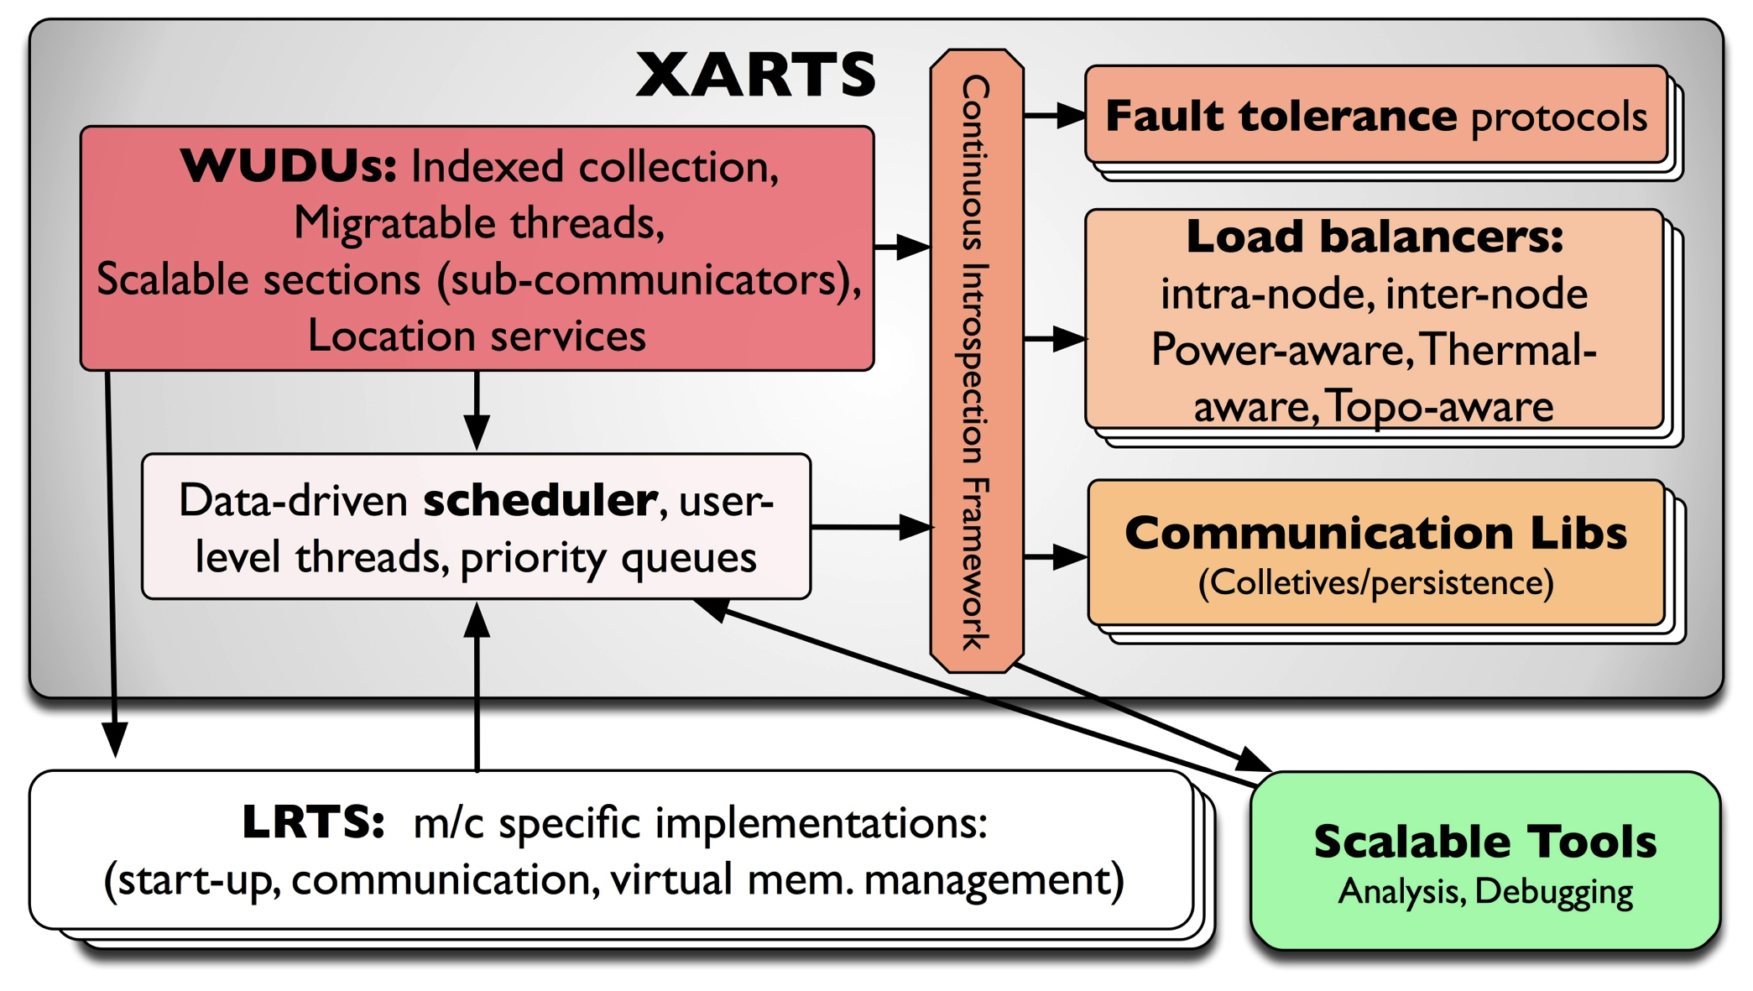
What Do RTSs Look Like: Charm++

Slide 10
Fault Tolerance in Charm++/AMPI
Four approaches available:
Disk-based checkpoint/restart
In-local-storage double checkpoint w auto restart
Demonstrated on 64k cores
Proactive object migration
Message-logging: scalable fault tolerance
Can tolerate frequent faults
Parallel restart and potential for handling faults during recovery
Notes:
10

Slide 11
Scalable Fault tolerance
Faults will be frequent at exascale (true??)
Failstop, and soft failures are both important
Checkpoint-restart may not scale
Or will it?
Requires all nodes to roll back even when just one fails
Inefficient: computation and power
As MTBF goes lower, it becomes infeasible

Slide 12
Message-Logging
Basic Idea:
Only the processes/objects on the failed node go back to the checkpoint!
Messages are stored by senders during execution
Periodic checkpoints still maintained
After a crash, reprocess “resent” messages to regain state
Does it help at exascale?
Not really, or only a bit: Same time for recovery!
But with over-decomposition,
work in one processor is divided across multiple virtual processors; thus, restart can be parallelized
Virtualization helps fault-free case as well
Notes:
12

Slide 13
Power
Power consumption is continuous
Normal Checkpoint-Resart method
Progress
Progress is slowed down with failures
Time

Slide 14
Power consumption is lower during recovery
Message logging + Object-based virtualization
Progress is faster with failures

Slide 15
Fail-stop recovery with message logging: A research vision
Cylinder surface: nodes of the machine
Application progress

Slide 18
A fault hits a node
It regresses..
Its objects start re-execution,
IN PARALLEL on neighboring nodes!

Slide 19
Re-execution continues even as other nodes continue forward
Due to “parallel re-execution” the neighborhood catches up

Slide 20
Back to normal execution

Slide 21
Another fault

Slide 22
Even as its neighborhood is helping recover,
A 3rd fault hits
Concurrent recovery is possible as long as the two failed nodes are not checkpoint buddies

Slide 25
Review of last year at PPL
SC14!
6 papers at the main conference
Including a state-of-practice paper on Charm++
Charm++ tutorial, Resilience tutorial
Charm++ BoF
Harshitha Menon: George Michael Fellowship
Publications:
Applications: SC, ParCo, ICPP, ICORES, IPDPS’14, IPDPS’15
Resilience : TPDS, TJS, Parco, Cluster (Best paper)
Runtime Systems: SC, ROSS, ICPP, HiPC, IPDPS’15
Interconnect/topologies: SC, HiPC, IPDPS’15
Energy: SC, TOPC, PMAM
Parallel Discrete Event Simulations
Petascale Applications made excellent progress
ChaNGa, NAMD, EpiSimdemics, OpenAtom
Exploration of Charm++ for exascale by DOE Labs, Intel,..

Slide 26
Charmworks, Inc.
A path to long-term sustainability of Charm++
Commercially supported version
Focus on 10-1000 nodes at Charmworks
Existing collaborative apps to continue with same licensing (NAMD, OpenAtom) as before
University version continues to be distributed
Freely, in source code form, for non-profits
Code base:
Committed to avoiding divergence for a few years
Charmworks codebase will be streamlined
We will be happy to take your feedback

Slide 27
Workshop Overview
Keynotes
Martin Berzins
Jesus Labarta
Applications
Christoph Junghans, Tom Quinn (ChaNGa), Jim Phillips (NAMD), Xiang Ni (Cloth Simulation), Eric Bohm, Sohrab Ismail-Beigi, Glenn Martyna (OpenAtom)
New Applications and MiniApps
Esteban Meneses, Robert Steinke (ADHydro), David Hollman (miniAero), Sam White (PlasComCM), Chen Meng (SC_Tanagram), Eric Mikida (ROSS), Hassan Eslami (Graphs), Cyril Bordage, Huiwei Lu (ArgoBots)
Charm++ features and capabilities
Akhil Langer (Power), Bilge Acun (TraceR & Malleability), Phil Miller (64-bit ID)
Tools
Xu Liu, Kate Isaacs, Nikhil Jain, Abhinav Bhatele, Todd Gamblin
Panel: Sustainable community software in academia

