Slide 1
An Organized View of
MPI and Charm++ Traces
Kate Isaacs
Institute for Data Analysis and Visualization
University of California, Davis
May 7, 2015

Slide 2
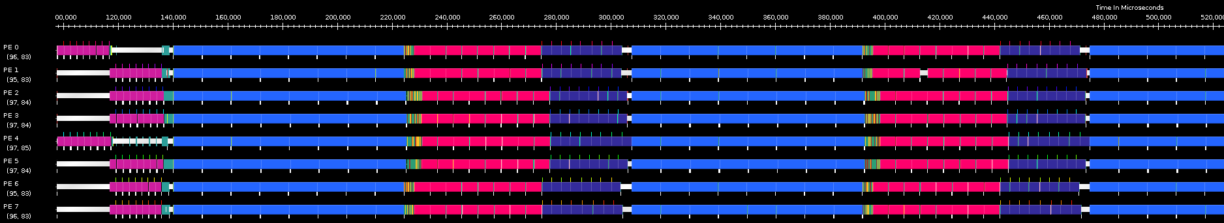
Trace data is collected to understand the behavior of applications as they executed
Potentially reconstruct exactly what occurred
Quickly become large, complicated
Projections Timelines

Slide 3
Parallel execution traces are commonly visualized using Gantt charts
  process ID vs time
  bars represent function duration
  dependencies overlaid as lines between timelines

Slide 4
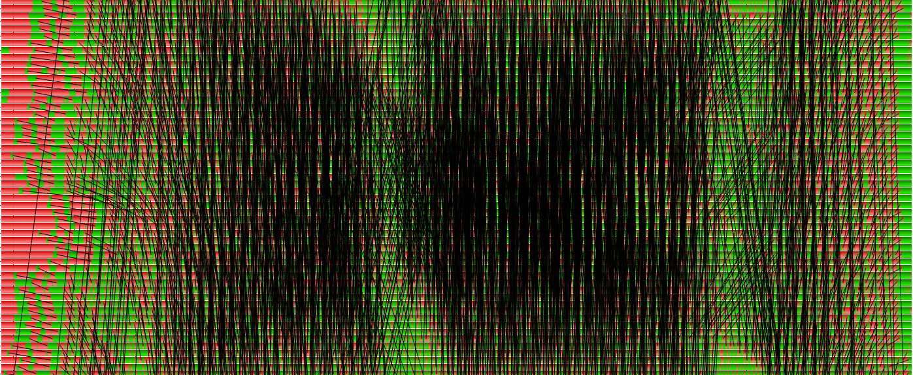
Problem: Gantt chart views quickly become cluttered and difficult to interpret
64 Process Trace visualized by Vampir

Slide 5
Problem: Gantt chart views quickly become cluttered and difficult to interpret
Visualization Goals:
Be effective for increasing parallelism
Preserve patterns and dependencies
64 Process Trace visualized by Vampir

Slide 6
Encode structure as horizontal position rather than physical time
Show the developers’ intuitive parallel organization
→ Horizontal axis is in logical time
Physical time:
Logical time:

Slide 7
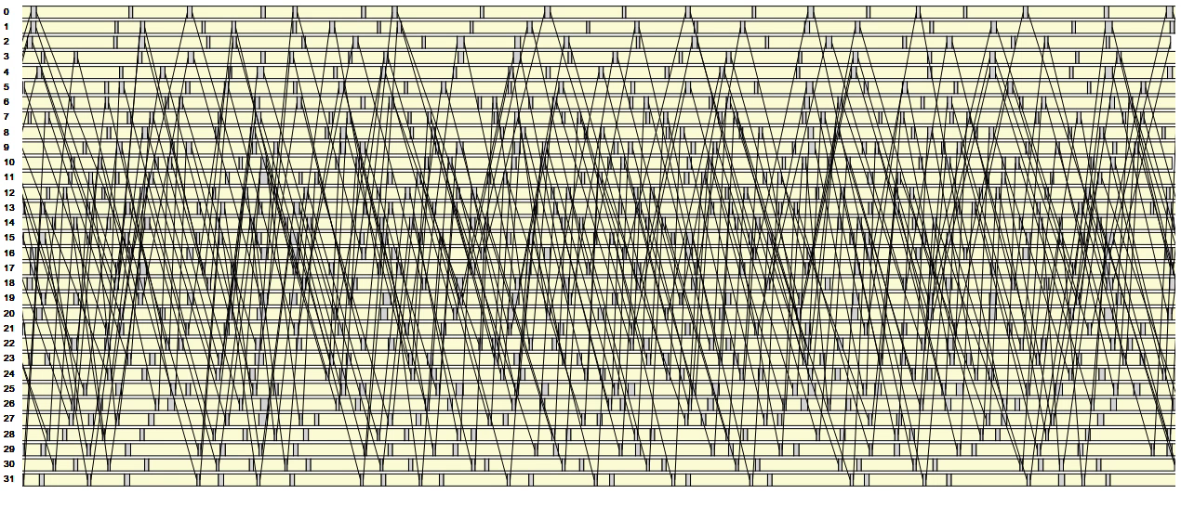
Logical structure is easier to understand

Slide 8
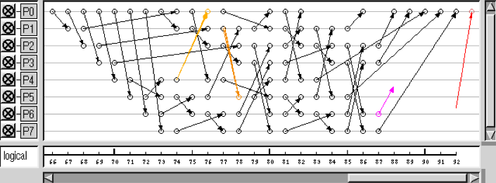
Our logical structure differs from traditional logical time
Traditional Logical Time:
Local happened-before relationships
Used for debugging
Our Logical Structure:
Takes into account developer intuition
Used for comprehension
[Schaubschläger et al. 2003]

Slide 9
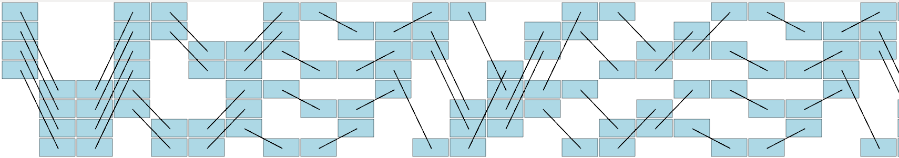
Our logical structure differs from traditional logical time
Traditional Logical Time
Traditional logical time is based on local happened-before relationships

Slide 10
Our logical structure differs from traditional logical time
Traditional Logical Time
In logical structure, communication phases also have happened-before relationships

Slide 11
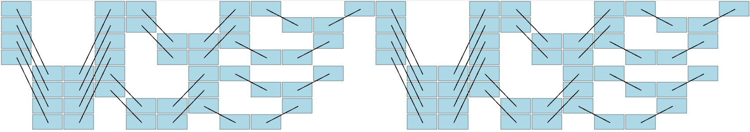
Our logical structure differs from traditional logical time
Traditional Logical Time
Logical Time by Communication Phase

Slide 12
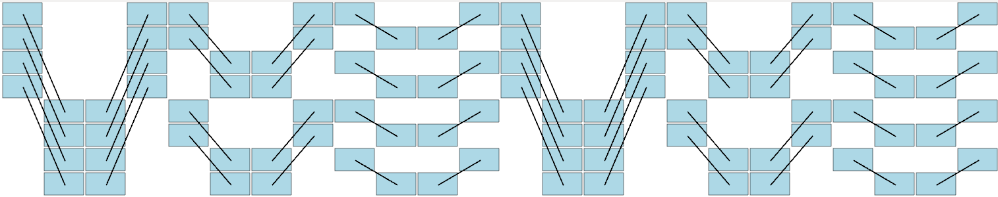
Our logical structure differs from traditional logical time
Traditional Logical Time
Logical Structure

Slide 13
Semantically deriving communication phases from trace data
Ordering
Message
MPI Call
Initially:
  Each call is its own phase
  Happened-before relationships preserved

Slide 14
Matching operations belong to the same communication phase
Ordering
Message
MPI Call
Merge:
  sends and receives
  same collective
    (e.g. barrier)

Slide 15
Happened-before cycles indicate same communication phase
Ordering
Message
MPI Call

Slide 16
Logical structure contains no information about physical time
Logical Structure

Slide 17
Encode physical time as derived lateness metric indicating delays
Lateness: exit time with respect to peers
Physical time:
Logical time:

Slide 18
Encode physical time as derived lateness metric indicating delays
Lateness: exit time with respect to peers
Physical time:
Logical time:

Slide 19
Lateness shows propagation of delays along dependencies
Logical Structure
visualization by Ravel
Physical time

Slide 20
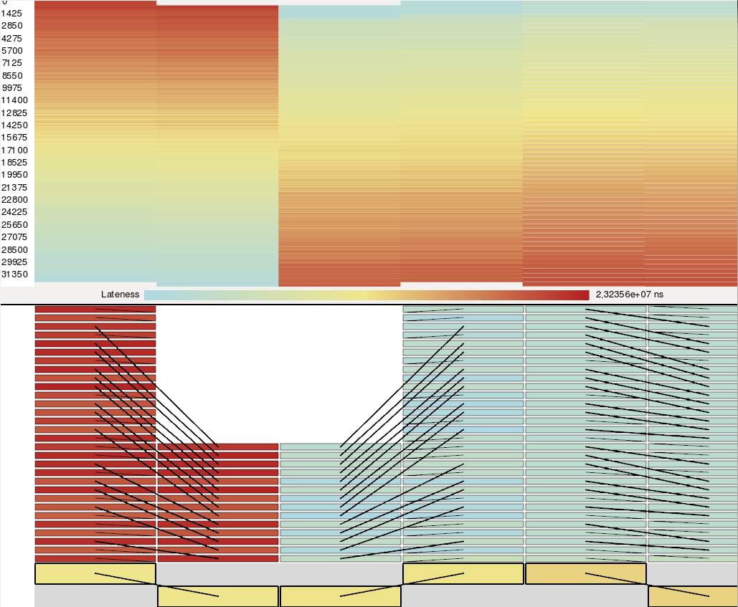
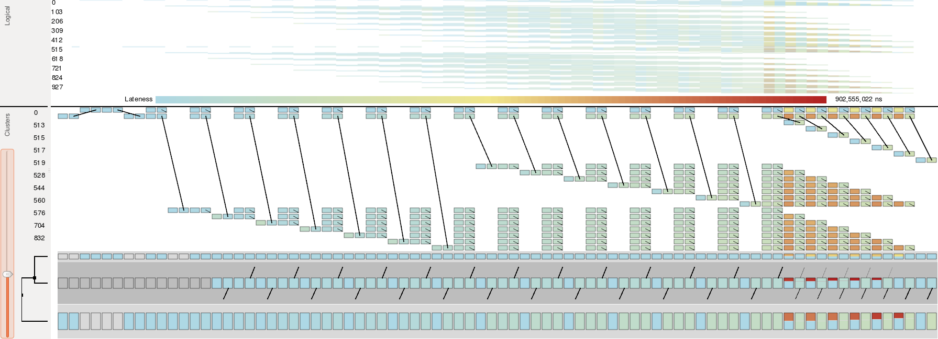
Structure permits showing representative patterns and clustering

Slide 21
Logical structure in Charm++ requires different considerations
Ordering
Message
MPI Call
Entry Method
Processes
Chares
Patterns in terms of chares rather than processes
  Initial partition units are entry methods
  No more implicit happened-before in time

Slide 22
Logical structure in Charm++ requires different considerations
Ordering
Message
MPI Call
Entry Method
Processes
Chares
Patterns in terms of chares rather than processes
  Initial partition units are entry methods
  No more implicit happened-before in time

Slide 23
Merge phases when the lack of relationships between them prevent ordering

Slide 24
Merge phases when the lack of relationships between them prevent ordering

Slide 25
Merge phases when the lack of relationships between them prevent ordering

Slide 26
Merge phases when the lack of relationships between them prevent ordering

Slide 27
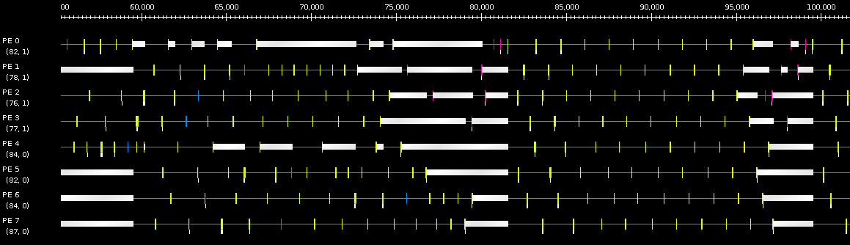
Logical structure centers around chares rather than processes
Projections Timelines
Processing Element
Entry Method
Idling
Physical Time

Slide 28
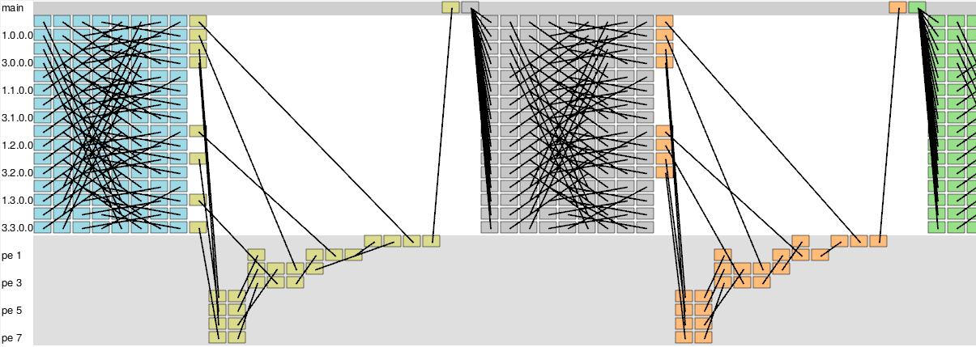
Logical structure centers around chares rather than processes
Application
Chares
Runtime
Chares
Chare
Ravel
Logical Time

Slide 29
Logical structure centers around chares rather than processes
Chare
Ravel
Logical Time

Slide 30
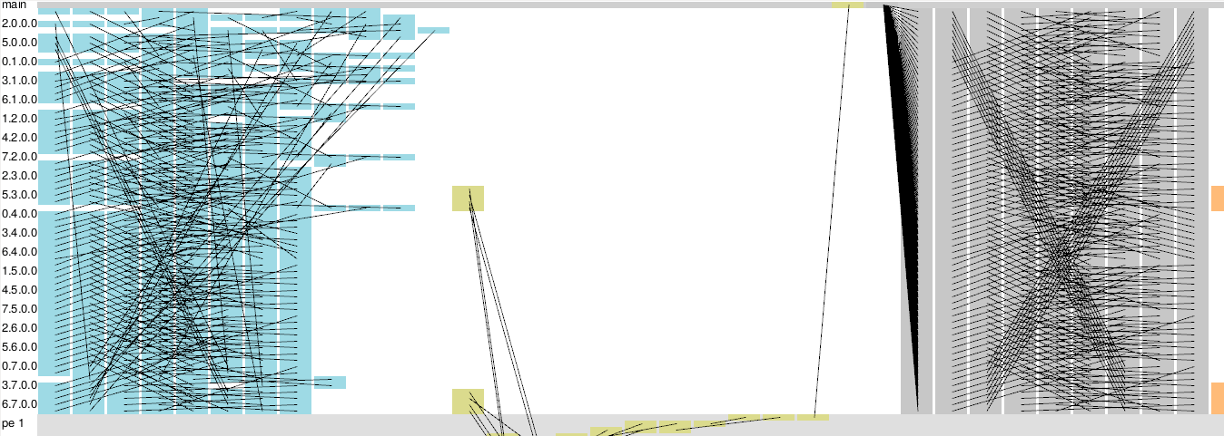
Events within a phase may be out-of-order in comparison to developer intuition

Slide 31
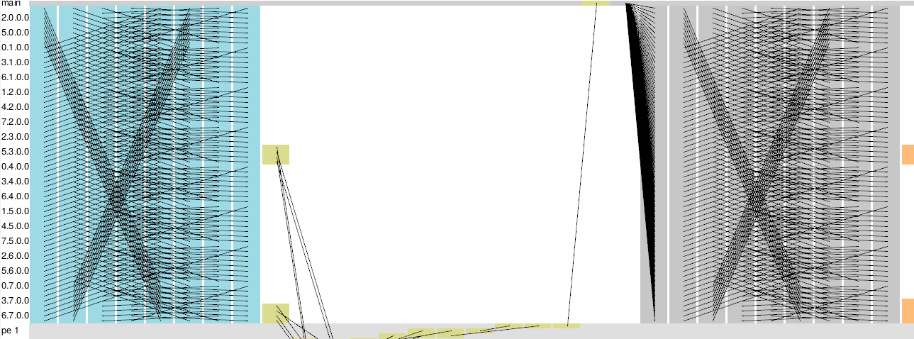
Events within a phase may be out-of-order in comparison to developer intuition

Slide 32
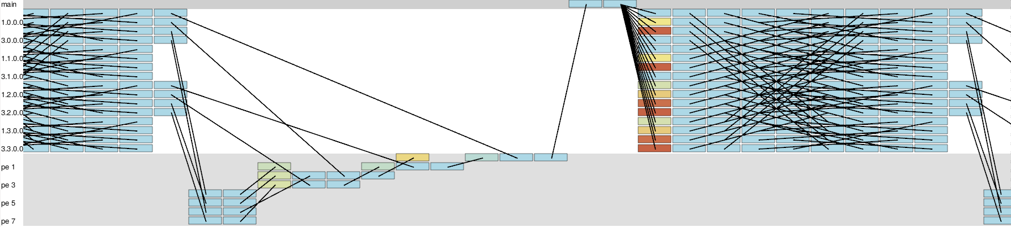
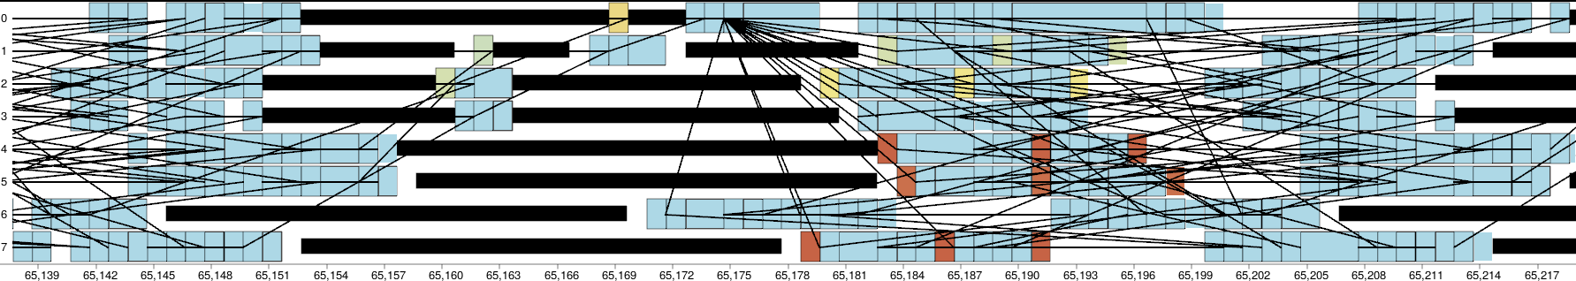
Instead of delays (lateness), idling and contributors to idling is of interest
→ Show which events follow idling
Logical structure
Physical time

Slide 33
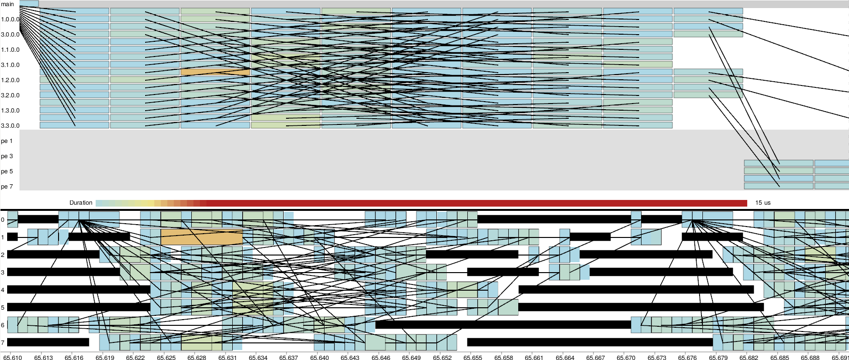
Instead of delays (lateness), idling and contributors to idling is of interest
→ Compare duration related concurrent events
Logical structure
Physical time

Slide 34
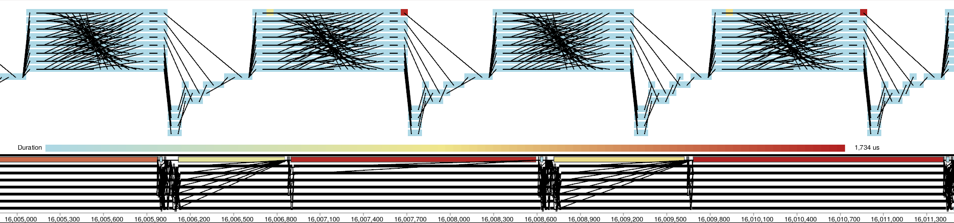
LASSEN wavefront mini-app logical structure shows repeating pattern of long event
Logical structure
Physical time
Idling
Long Entry Method

Slide 35
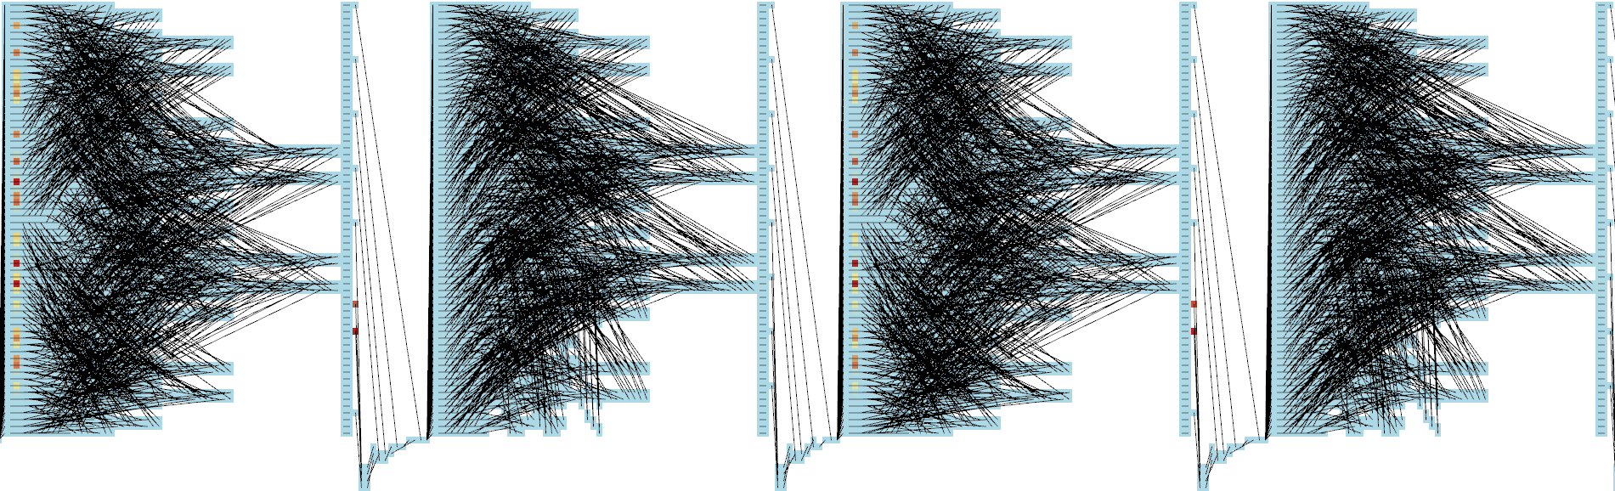
LASSEN wavefront mini-app logical structure shows repeating pattern of long event

Slide 36
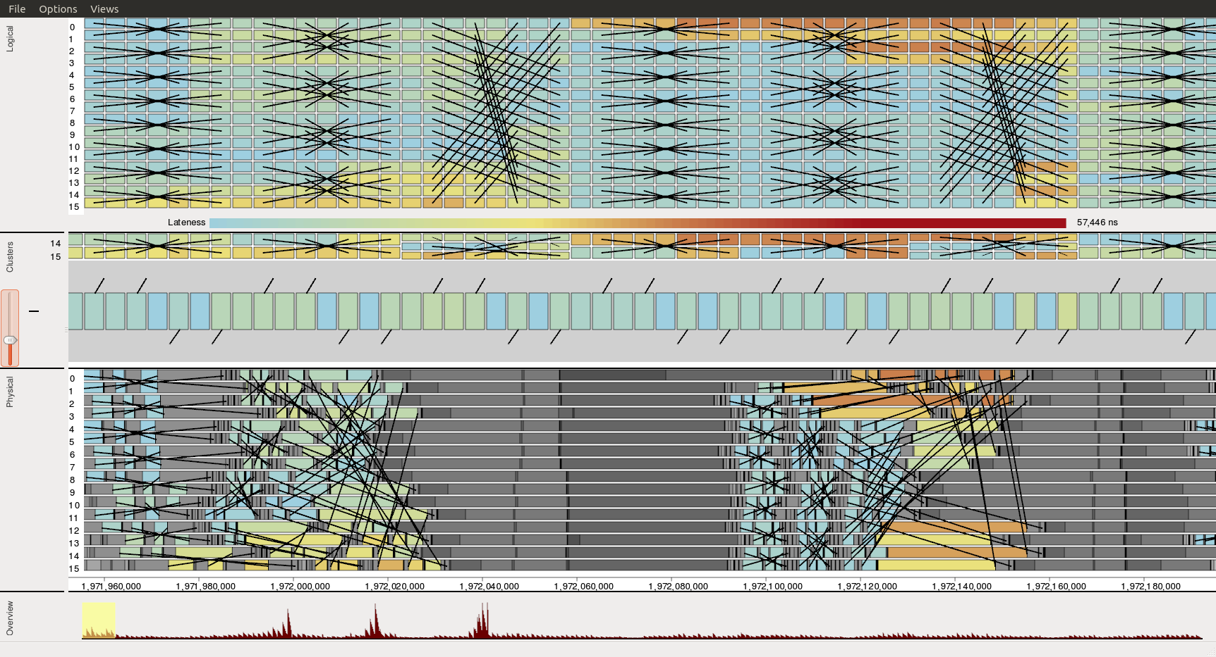
Positioning trace events by structure instead of time yields a more intuitive visualization
Structure captures developer understanding through phases and logical time
Still a lot of room for improvement in terms of visualizing structure and trace data
http://github.com/scalability-llnl/ravel

