Slide 1

SC_Tangram:A Charm++-based parallel framework for cosmological simulations
Chen Meng
2015/05/07
Notes:
大家好，下面我向大家介绍一个基于Charm++的面向计算宇宙学应用的并行框架软件和一些讨论。
Hello,everyone,I will talk about a Charm++ based parallel framework.

Slide 2
Motivation
Not all the charm++ users are domain experts slash CS experts.
  Hard： think in the message-driven way
  Bother to：deal with Fault Tolerance(FT)、Load Balance(LB)
  A lot of work：spent to migrate old software on new algorithms and architectures
Application Complexity has grown
  Team work：collaboration
  Module Reuse：increase productivity
  Hot Plug：componentization
  High level abstract：user interface
So，we need a Charm++-based parallel framework！
Notes:
Why do we need a framework?
I have 3 reasons. First of all, This programming model 使用门槛比较高。Charm++ enhances the …but user should used to thinking in ..
Secondely,not….
And,has grown.There are more than one in the development team. The platform that support collaboration needed.To increase productivity, will should consider module reusing , componentization.
Because of all above, a framework is needed, it can provide abstract user interface and hide the complex paralleization operations。 It can make user focus on domain-specific computing.
Charm++ programming model raise the threshold of using it
Enhances the parallel scalability and runtime adaptivity, but…
Think in object-oriented and message-driven style

Slide 3

Objective
Two critical problems
  Runtime adaptivity
    Charm++, parallel execution model
    XMAPP features
    Fault Tolerance(FT),Load Balance(LB) issues
  Componentization and Collaboration
    Cactus：flesh（1）+thorns（n）+CCLs
    CST: Cactus Specification Tool，parse CCL files to generate “glue”code for each thorn.
Combine advantages of Charm++ and Cactus
  Design Pattern
    Make use of mature design pattern
      Iterator, adaptor, interpreter…
Then，what is Cactus?
Notes:
Our framework focus on two ciritical problems.
It combine advantages of Charm++ and Cactus.

Slide 4
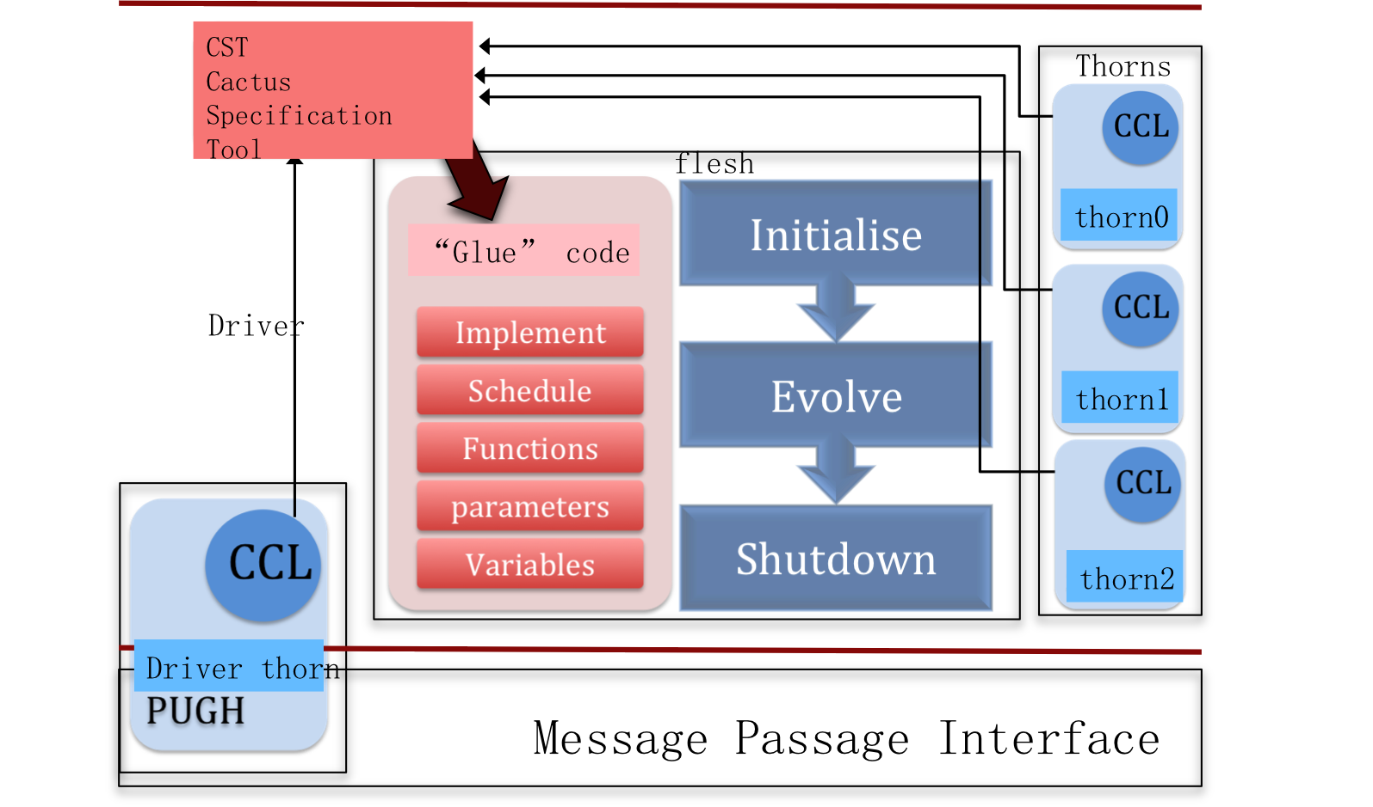
Cactus
*ccl
INT mn 5
INT global_n 256
param.CCL
implements: weno
inherits: grid
cctk_real Evolve[mnp] type=GF Dim=3
{
uc,…
}
Interface.CCL
Schedule Func at CCTK_EVOL
{ LANG：C
SYNC：uc }
Schedule Func1 after Func at CCTK_EVOL
{
LANG：C
}
Schedule.CCL
Is it enough to add a Charm++ driver “thorn” to replace the original MPI one？
Subroutine Func(CCTK_ARGUMENTS)
{
DECLARE_CCTK_ARGUMENTS;
DECLARE_CCTK_PARAMETERS;
…
source code
*.C/C++/Fortran

Slide 5
Parallelization
Data privatization is so manual labor. But it is a start!
Charm++ -based parallel driver
Data：
  Chare Array：data encapsulation for parallel objects
    Private for each element chare：Patch of mesh
    Data Privatization: global/static variables of Cactus Interface
  Node Group：for performance
    Retain global/static variables: Initialization of circumstance parameters
Communication：
  P2P:ghost cell exchange
  Global：reduce operations

Slide 6
.C:
contribute(varSize,&varName,CkReduction::max_double,CkCallback(CkIndex_main::forcast(NULL),mainProxy));
void main::forcast(CkReductionMsg* msg){
int len=msg->getSize();
void* data=msg->getData();
parghProxy.getReduction(len,(char*)data);
}
*.C
thisProxy(wrap_x(thisIndex.x-1), thisIndex.y, thisIndex.z)
.receiveGhosts(RIGHT, Xgh*mnp,leftGhost);
thisProxy(wrap_x(thisIndex.x+1), thisIndex.y, thisIndex.z)
.receiveGhosts(LEFT, Xgh*mnp, rightGhost);
thisProxy(thisIndex.x, wrap_y(thisIndex.y-1), thisIndex.z)
.receiveGhosts(BACK, Ygh*mnp, frontGhost);
thisProxy(thisIndex.x, wrap_y(thisIndex.y+1), thisIndex.z)
.receiveGhosts(FRONT,Ygh*mnp, backGhost);
thisProxy(thisIndex.x, thisIndex.y, wrap_z(thisIndex.z-1))
.receiveGhosts(TOP, Zgh*mnp , bottomGhost);
thisProxy(thisIndex.x, thisIndex.y, wrap_z(thisIndex.z+1))
.receiveGhosts(BOTTOM, Zgh*mnp , topGhost);
}
Example:WENO5
schedule funcName at CCTK_EVOL
{
LANG: C
MAX：varName
}
Schedule.CCL
Get Max value
Reduce Comm
Keyword:
  Max(MIN，SUM，etc)
schedule funcName at CCTK_EVOL
{
LANG: C
SYNC: groupName
}
Schedule.CCL
Ghost cells transfer
P2P Com
Keyword:
  SYNC
Charm++

Slide 7
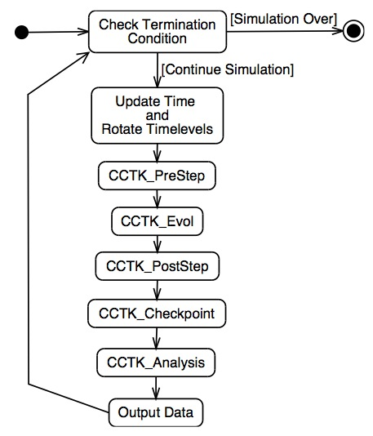
Scheduler
“Procedure-driven” driven by “message-driven”
Schedule FB at CCTK_EVOL
{ LANG：C
SYNC：uc}
Schedule FC after FB at CCTK_EVOL
{LANG：C}
Schedule.CCL
Function pointer linked list…
Function pointer linked list: FA->FB-->comm->FC->reduce->FD
Function pointer linked list…
Communication in message-driven
  Method invocation
  Non-reentrant functions

Slide 8
*.ci
Mainmodule jacobi{
mainchare Main{entry report();}
array [1D] jacobi{
entry void doInit();
entry void doStep(double* buf)
entry void ProA(double* buf);
entry void ProB(double* buf);
entry void ReceiveGhosts(int len, double* buf);
}
}
*.C
Void Main::Main(){
nchares=10;
array=Cproxy_jacobi::cknew(nchares);
array.doInit();
}
void jacobi::doInit(){
Init(&data);
doStep(&data);
}
Void jacobi::doStep(double* data){
if(f!inish)
ProA(&data);
else
CkExit();
}
Void jacobi::ProA(double* data){
ProcessA(&data);
myid=thisIndex;
thisProxy(myid+1).receiveGhosts(Xgh,leftghosts);
}
Void jacobi::receiveGhosts(int len,double* buf){
Finish(len,buf);
ProcessB(&data);
}
Void jacobi::ProB(double* data){
ProcessB(&data);
doStep(&data);
}
Example:Comm in func
Schedule Init at CCTK_INIT
{
LANG: C
}
Schedule ProcessA at CCTK_EVOL
{
LANG: C
SYNC: Evolve
}
Schedule ProcessB After ProcessA at CCTK_EVOL
{
LANG: C
}
Schedule.CCL
Method invocation；
  Object Dependent
  Code fragmented
Event Message；
  Message producer
  Message consumer
Threaded entry
  Reentrant funcs
  User level thread
Charm++

Slide 9
Scheduler
“Procedure-driven” driven by “message-driven”
Structured Dagger (sdag)
  It can generate message-driven codes from the procedure-oriented script(nK lines code)
  also keep the baseline Charm++ method running on system-level thread.
*.ci:
when getReduction(int len,char data[len])
serial{
FinishReduction(len,data);
}
*.ci
for(imsg=0;imsg<6;imsg++){
when ReceiveGhostsGA[iteration-1](int iter,int dir,int buffer_sz,char buffer[buffer_sz],int first_var,int n_vars,int sync_timelevel)
serial{FinishReceiveGA(dir,buffer_sz,buffer,first_var,n_vars,sync_timelevel);}
}

Slide 10
Interface
Reduce operation
CCTKi_ScheduleFunction(
(void *)Func,
"CCTK_EVOL",
"C",
…
0, /* Number of SYNC groups */
1, /* Number of MAX variables */
"weno::aam",
"",
…
);
User
Number of max vars
Var names
…
Schedule.CCL
Schedule Func at CCTK_EVOL
{ LANG：C
Max：aam}
CST
PScheduleParser.pl
CreateScheduleBindings.pl
CCTK_BindingsSchedule_xx.C
Func.Attributes
Message Producer
if(attribute->FunctionData.n_max > 0)
{
CCTK_MaxI(data->GH,
attribute->FunctionData.n_max,
attribute->FunctionData.maxVars);
printf("after reduce.c\n\n");
attribute->synchronised = 0;
}
Message Consumer
reduce_num=((t_attribute*)(group->scheditems[group->order[pre_item]].attributes))->FunctionData.n_max;
if(reduce_num>0&&pre_if_check){ FinishReduction(vindex,len,data);
}
ScheduleTraverseFunction(group->scheditems[group->order[item]].function, group->scheditems[group->order[item]].attributes, CCTKi_ScheduleCallExit,…);
CCTKi_ScheduleCallExit.C
*.ci

Slide 11
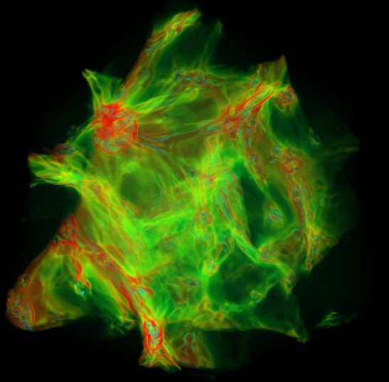
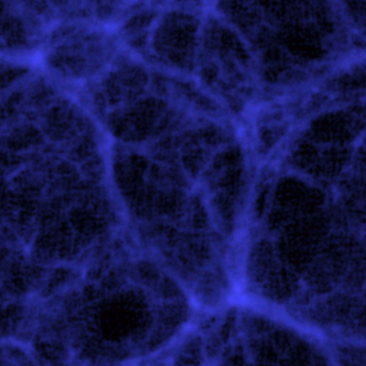
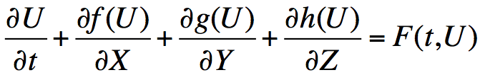
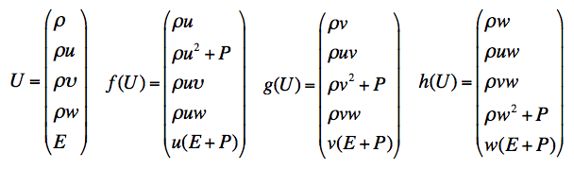
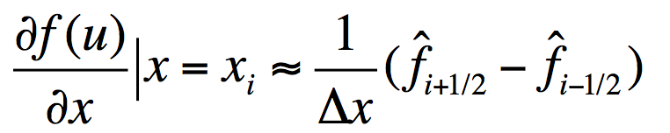
Application
Cosmological simulations
  Advances directly driven by improvements of supercomputer, large scale ,long time
    Partial Difference Equation(PDE) for fluids simulation
    N-body for particles simulation
PDE based on weighted essentially non- oscillatory (WENO) schemes
  5th order.
  Designed for problems involving both shocks and complicated smooth solution structures

Slide 12
Example： fluids simulation based on 5th order WENO algorithm
 | Charm++ code from scratch | Using SC_Tangram | PDE | Others
Data | 1.Class declaration and definition 2.Mesh patches distributed 3.Memory mallocation | ^{INT global_n 256} ^{INT ghost_size 5} cctk_real Evolve[6] type=GF Dim=3 { ^{uc,…} } | Define ghost_size | Define new Variables Type
computation | 1.Member functions declaration and definition 2.Arguments design 3.Function Implementation | ^{subroutine} ^{weno(CCTK_ARGUMENTS)} { ^{DECLARE_CCTK_ARGUMENTS;} ^{DECLARE_CCTK_PARAMETERS;} … | Define new Functions for different stencils
Communication | 1.Entry method in File *.ci definition 2.Define size of Ghost zones and initial address. 3.Define the index of objects that will be comm with. 4.Remote Invocation to overlap computing. 5.Implement P2P other global operations | ^{Schedule weno at CCTK_EVOL} ^{{ LANG：C} ^{SYNC：uc} } ^{Schedule cflc at CCTK_EVOL} ^{{ LANG：C} ^{MAX：aam} } |  | Implement communication pattern of the new VarType
Control flow | 1.Use the remote invocation in the end of functions. 2.Use SDAG in *.ci | ^{Schedule Init at CCTK_INIT} ^{{ LANG：C }} ^{Schedule weno at CCTK_EVOL} ^{{ LANG：C }} …
Components | 1.All other modules and write *.ci files 2.Rewrite the whole control flow. | ^{New Thorn：} ^{Rewrite *.ccl} ^{Change *.par}
param.CCL
Interface.CCL
*.C
reuse
Schedule.CCL
reuse
Schedule.CCL
reuse
*.par

Slide 13
Strong Scaling Test
Strong scaling
Iterative steps:10
Mesh:1024*1024*1024

Slide 14
Overhead of Framework
Framework
 | Cost of Initialization | Compiled Thorns (Fig.1) | Cost per Iteration
 |  | Active Thorns (Fig.2)
 |  | Each thorn’s information
Cactus Interface | Implementations (Fig.3)
 | Parameters (Fig.3)
 | Parse File *.par
 | Variables‘ Types (Fig.3)
 | Scheduling/Communication (Fig.4) |  | Scheduled Function call (Fig.4)
Charm++ driver | Charm++ Initialize |  | SDAG overhead(Fig.4)

Slide 15
Cost of Initialization
Compiled Thorns：66
Active Thorns：10，20，30，40，50，60，66
Parameters：775
VarTypes：159
Schedule：309
When the total time exceeds 10s
Cost is less than 1%

Slide 16
Cost of Initialization
Cost increases linearly with increase of the numbers of parameters、variables and scheduled functions.

Slide 17
Cost of Iterations
5 scheduled functions
in CCTK_EVOL
When the total time exceeds 4s per 200steps.
Cost is less than 1%
Notes:
Printf出现问题，CkPrintf才好，为什么？

Slide 18


SC_Tangram
Tangram Puzzle：
A Game
SC_Tangram：
A parallel Framework.Just a metopher.
They have in common:
Modules
Reuse
Compose them into different things

Slide 19
Future Work
Feature enrich
  FT，LB
  From user variables parsing in CST
Components enrich
  N-body simulation
    Particle-Mesh, Local Tree based on grids
    Define new parallel varTypes with certain communication pattern
    Abstract reusable and variable modules.
  GPU or MIC
    Provides well optimized template codes
    Auto-tuning and DSL
There is a lot of research to do!
To be continued~

Slide 20
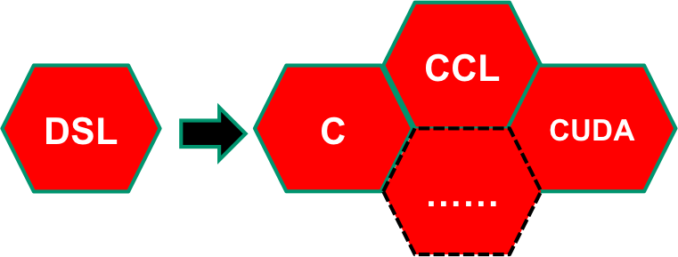
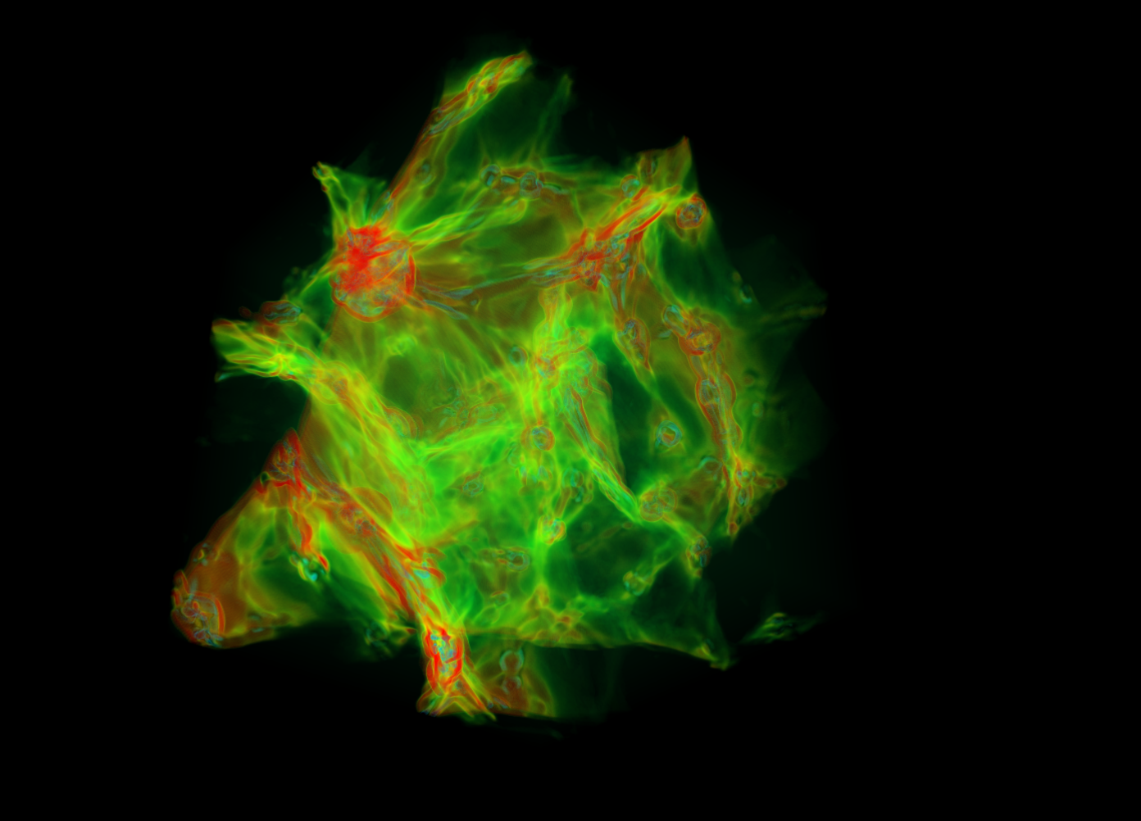
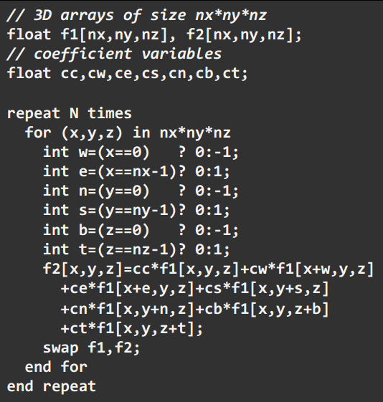
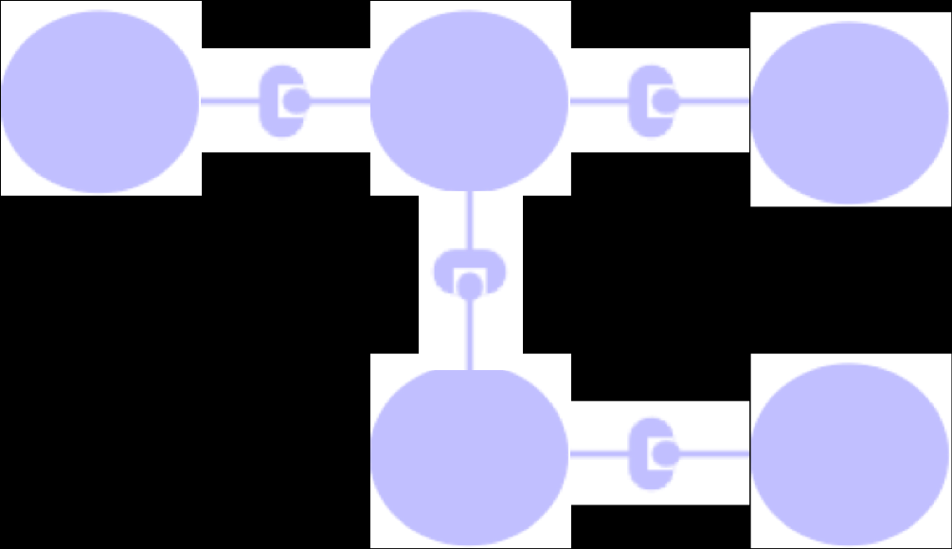
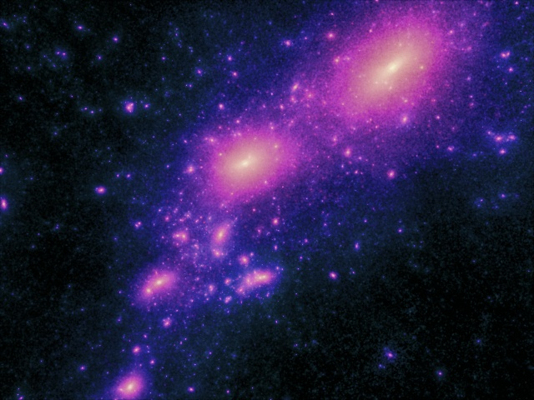

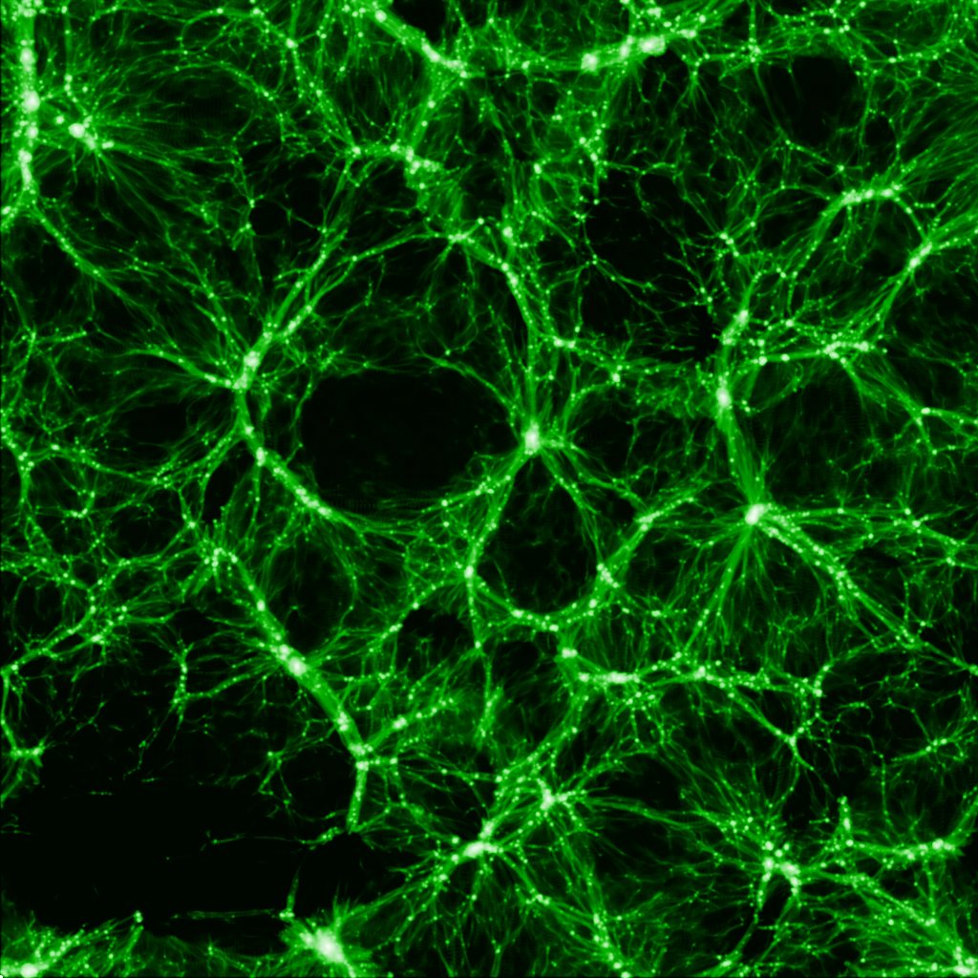

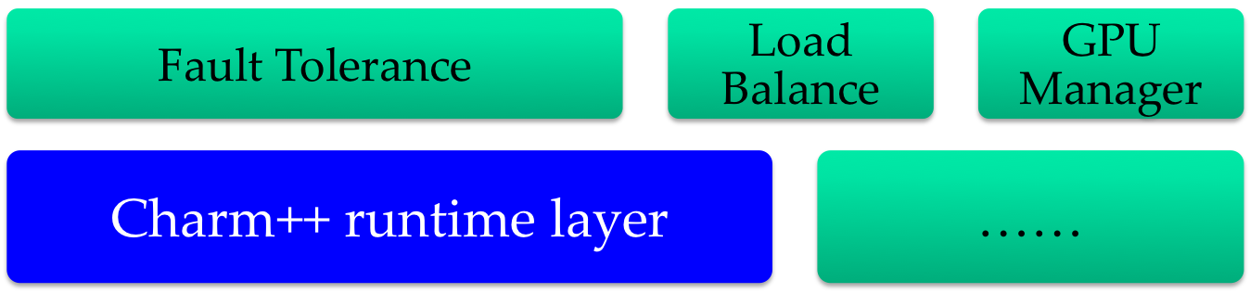

Conclusion
Why？ Charm++ runtime、componenzation、increase productivity
How？
What？ A charm++-based parallel framework for cosmological simulations. And overhead can be acceptable.
Transparent
DSL
Compiler
flesh
component
Out
DSL
PUGH
In
ccl
WENO
Charmpp

Slide 21
Thank you！

Slide 22
Conclusion
SC_Tangram
  Charm++-based
    XMAPP features
    Runtime adaptivity
  parallel framework
    Collaboration
    Components
    High level abstract user interface
  Acceptable overhead
cosmological simulations
    key components aims at structured uniform meshes for solving partial differential equation (PDE) in hydrodynamics
    Nbody
Transparent
DSL
Compiler
In
flesh
Out
ccl
components
To be continued~

Slide 23
02
Communication
Charm++ VS MPI
    X：Overcomposition(fined-grain，CPU utility)
    M：Migratable(FT,BL)
    A：Asynchronous & Adaptive (Latency covered)
    PP: Parallel Programming
    Control flow：driven by messages, all messages composite whole fragmented operation flow
    Global comm：not much except reduce operation
Notes:
----- 会议笔记(15-1-26 14:57) -----
Charm++有三个重要的特性。叫做XMA，X表示过分解，Charm++支持细粒度并行，每个线程上有多个对象，CPU的利用率更高。M表示迁移，对象可以在不同的线程上迁移，为负载均衡和容错提供天然支持。A表示异步性和自适应。异步性更好的掩盖延迟。自适应性可以根据运行时情况创建更多的对象。
左图是MPI和Charm++的一个对比，主要区别一个面向过程、操作流驱动、与CPU核数对等，另一个面向对象，消息驱动，且引入虚拟处理器的概念，对象数与物理处理器数无关。右图是从编程的难易角度来对比，其中Charm++有两个问题，一个是全局的操作流难控制，一个是全局通信难控制。但由于运行时交由框架软件全权代理，对用户透明。

Slide 24
Overhead of Cactus
Implementations overhead
  Register “herits” and “friends” information in SKTreeNode
Parameters overhead
  CCTKi_CreateParameters
  Check and Storage in SKTreeNode
Scheduling && Communication overhead
  Check and Storage in SKTreeNode
  CCTKi_ScheduleFunction
    Link list
  Register schedulng call in Linklist
  sdag overhead that amounts to tens to a hundred nanoseconds
    System-level thread
  a few function calls about function pointer generating.
Parsing File overhead
  *.par
VarTypes overhead
  CCTKi_CreateGroup
  Check and Storage in Type Array

