Slide 1
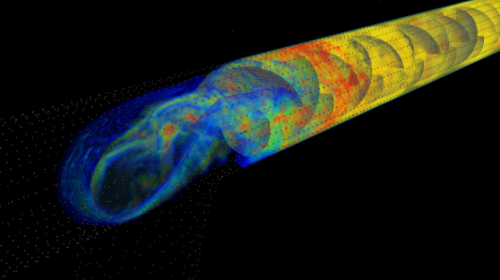


The Romance and Reality of Task Based Frameworks -Experiences with Uintah
www.uintah.utah.edu
Martin Berzins
Introduction, history, machines
Uintah and its scalability
Tackling Radiative Heat Transfer
Dealing with node performance
Thanks to DOE ASCI (97-10), NSF , DOE NETL+NNSA ARL,NSF , INCITE, XSEDE

Slide 2
INTRODUCTION,
DAGs, SOFTWARE,
MACHINES, HYPE?
Peak computer power grows by a factor of a thousand every decade and has a profound impact on our ability to undertake science
Often in the past we have had to change our codes…
A very large change is coming as we try to go forward for the next decade.
Are task-based approaches a key technology for this?

Slide 3
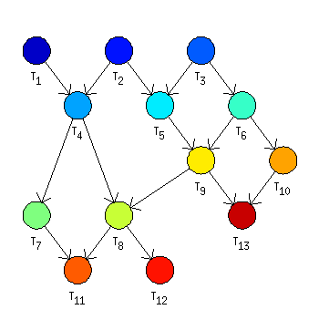

The Exascale challenge for Future Software?
The vision?
Harrod SC12: “today’s bulk synchronous (BSP), distributed memory, execution model is approaching an efficiency, scalability, and power wall.”
The romance ?
Sarkar et al. “Exascale programming will require prioritization of critical-path and non-critical path tasks, adaptive directed acyclic graph scheduling of critical-path tasks, and adaptive rebalancing of all tasks…...”
The reality ???????
“ DAG Task-based programming has always been a bad idea. It was a bad idea when it was introduced and it is a bad idea now “ Parallel Processing Award Winner
Compute
-----------------
Communicate
-----------------
Compute

Slide 4
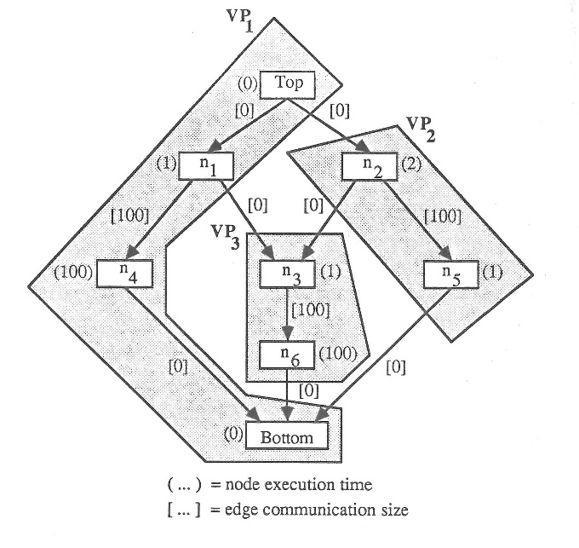
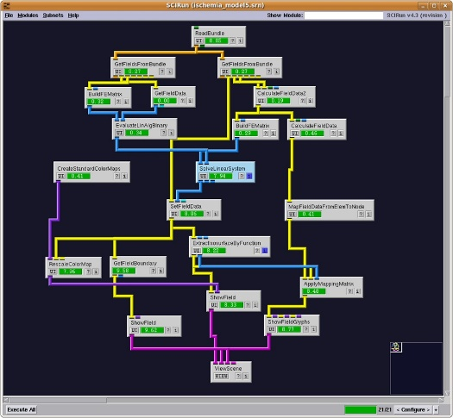
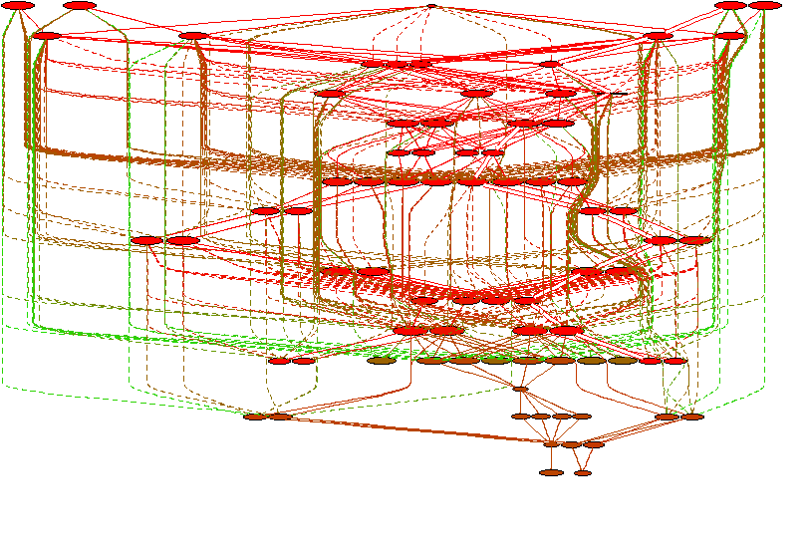
Some Historical Background
Ideas go back to 1960s
Vivek Sarkar’s thesis (1989)
Graphical rep. for parallel programs with cost model (20 procs)
Compile time cost assignment and schedule
Macro-data flow for execution
Charm++ Sanjay Kale et al. 1988 onwards. Profound and deep influence
Uintah Steve Parker 1998 onwards (developed independently, starting from SCIRun)
Habanero Java Vivek Sarkar 2007 onwards
Many Recent developments
CNC, Plasma, Wasatch, ParallelX

Slide 5
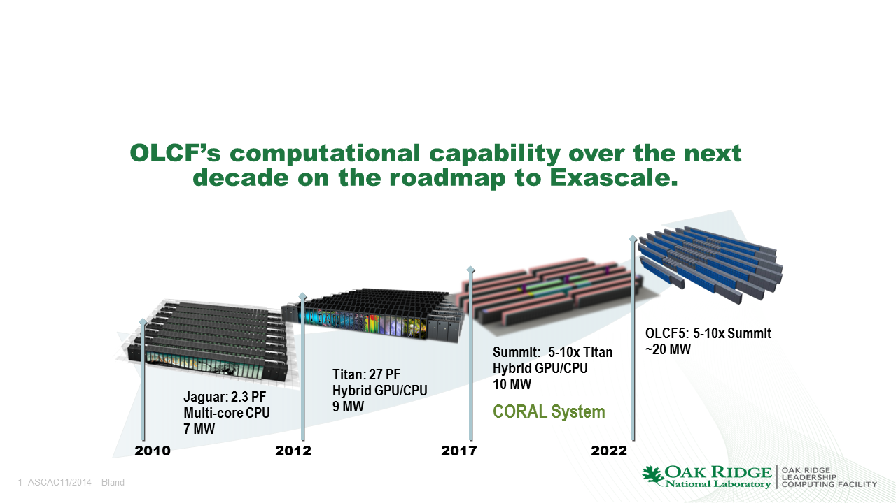
FUTURE MACHINES Energy is the defining issue
Of current approaches, standard cores, many low powered cores and accelerators only hybrid accelerator architectures seem to have exascale potential due to energy requirements
Situation complicated by vertically stacked memory, NVRam, NVlink, poor Xeon Phi KnC and uncertain (KnL KnH) performance
DOE roadmap gives clear plan to 2018
DOE Exascale initiative gives plan to 2024 if funded. NSF? DOD?
Dealing with machine uncertainty part of next decade. Summit 3.5K GPU+P9 nodes. Aurora 50K Intel KnH nodes. ARM?

Slide 6
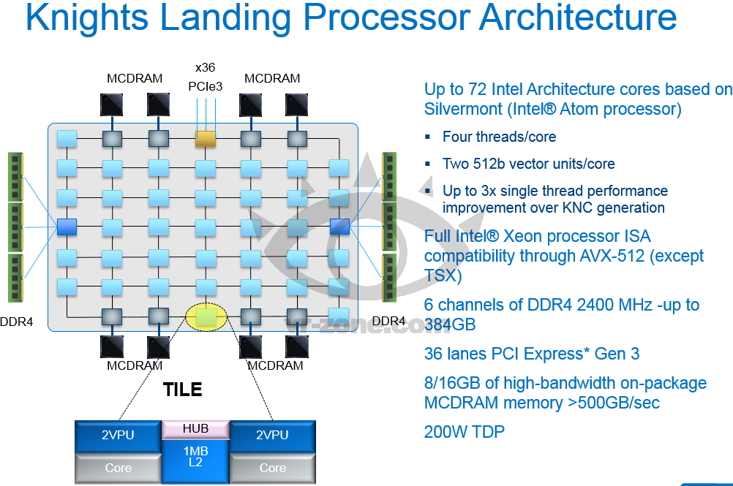
INTEL
SCI at Utah is an Intel parallel computing Center
14nm technology 2016
The basis for next 2 big DOE machines

Slide 7
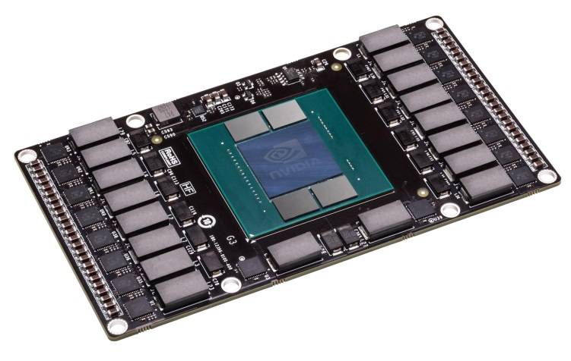
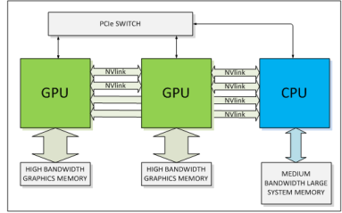
NVIDIA PASCAL (2016 using 14nm Processes)
3D Memory: Stacks DRAM chips into dense modules with wide interfaces, inside the same package as the GPU: several times greater bandwidth, 2X memory capacity 4X energy efficiency.
Unified Memory: allowing the CPU and GPU to access each others memory
NVLink fatter pipe between the CPU and GPU, allowing data flow at > 80GB per second, (16GB per second now).
Size one-third the size of the boards used today,
20 Gflops per Watt?
BUT ONLY IF YOU CONNECT GPUs TO ARM OR IBM
SCI at Utah is an NVIDIA Cuda Center

Slide 8
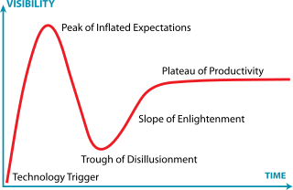
How do we write code that runs on these as well as existing cpu/gpu/phi architectures?
How do we ensure that code persists through the coming architectural changes of the next decade?
“The asynchronous approach on its own is enough isn’t it? “ [DOE Reviewer]
Where are we on the
hype curve?

Slide 9
Scalability of
Uintah Open Source Software

Slide 10
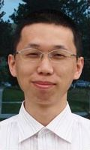


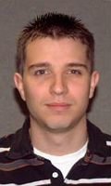


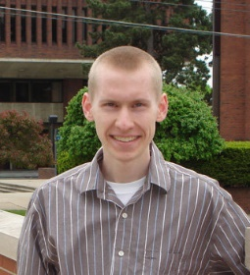
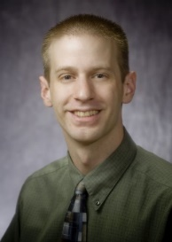

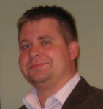

Uintah Software Team
Phase 1 Uintah software developed 1998-2008 by a team led by Steve Parker
Novel design and reasonable scalability (~1000 cores 2005)
Phase 2 (2008 …)NSF and DOE funded expansion of both scalability and software
Research team: NSF PetaApps
Qingyu Meng* John Schmidt,, Todd Harman Justin Luitjens*, Jacqueline Beckvermit
* Now at NVIDIA
* Now at Google
PSAAP Extreme Scaling team SANDIA NSFXPS Nan Harish
Alan Humphrey John Holmen Dan Sunderland Brad Peterson Xiao Dasari

Slide 11
Applications code
Programing model
UQ DRIVERS
ARCHES
ICE
DSL: NEBO
WASATCH
Some components have not changed as we have gone from 600 to 600K cores
MPM
Abstract C++ Task Graph Form
Compilation into C++ Cuda etc
Adaptive Execution of tasks
Intermediate layer for node
Performance on specific cores/processors
Simulation
Controller
Runtime System
Load
Balancer
asynchronous out-of-order execution, work stealing, Overlap communication & computation.
Scheduler
PIDX
VisIT
Kokkos Intermediate Layer
GPUs
CPUs
Xeon Phis
Uintah(X) Architecture

Slide 12
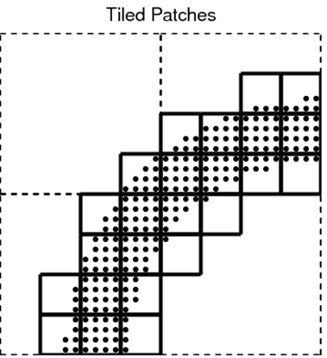
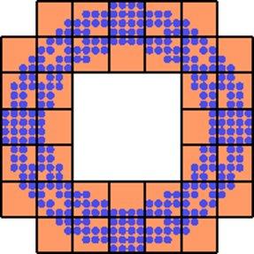
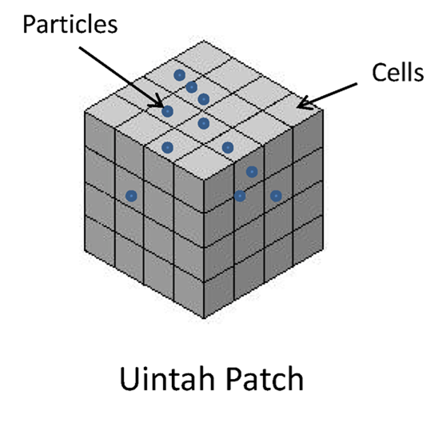
Uintah Patch, Variables and AMR Outline
ICE is a cell-centered finite volume method for Navier Stokes equations
Structured Grid + Unstructured Points
Patch-based Domain Decomposition
Regular scalable local Adaptive Mesh Refinement
Dynamic Load Balancing
Profiling + Forecasting Model
Parallel Space Filling Curves
Works on MPI and/or thread level
ICE Structured Grid Variable (for Flows) are Cell Centered Nodes, Face Centered Nodes.
Unstructured Points (for Solids) are MPM Particles
ARCHES is a combustion code using several
different radiation models and linear solvers
Uintah:MD based on Lucretius is a new molecular dynamics component

Slide 13
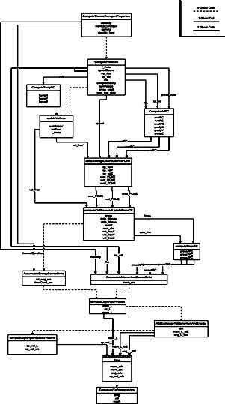
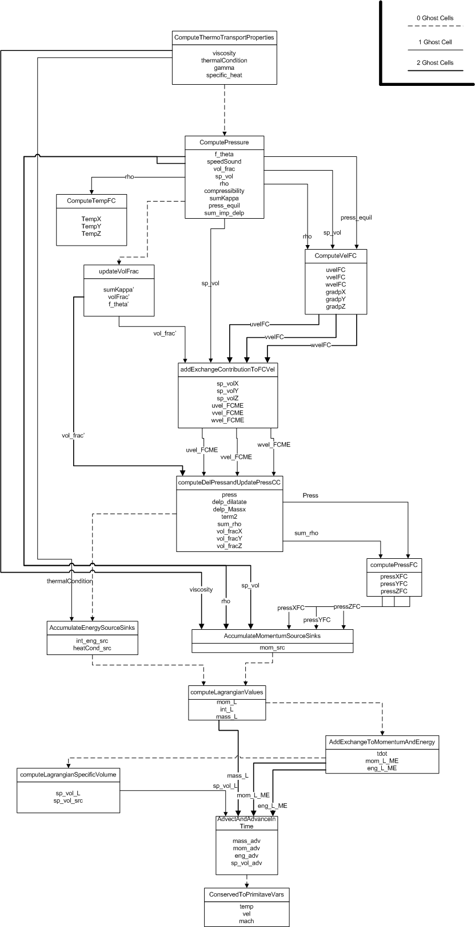
Uintah Directed Acyclic (Task) Graph-Based Computational Framework
Each task defines its computation with required inputs and outputs
Uintah uses this information to create a task graph of computation (nodes) + communication (along edges)
Tasks do not explicitly define communications but only what inputs they need from a data warehouse and which tasks need to execute before each other.
Communication is overlapped with computation
Taskgraph is executed adaptively and sometimes out of order, inputs to tasks are saved
Tasks get data from OLD Data Warehouse and put results into NEW Data Warehouse

Slide 14
Programing Model for Stencil Computation on a Timestep
MPI
Network
Unew = Uold + dt*F(Uold,Uhalo)
Halo sends
Example Stencil Task
Old Data
Warehouse
GET
Uold Uhalo
Halo receives Uhalo
New Data
Warehouse
PUT
Unew

Slide 15
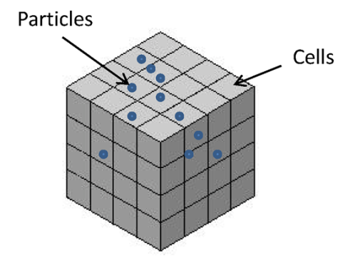
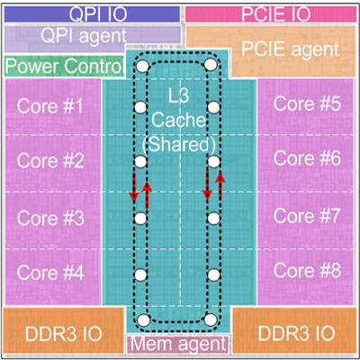
Task Graph Structure on a Multicore Node with multiple patches
external
halos
halos
halos
external
halos
The nodal task soup
This is not a single graph. Multiscale and Multi-Physics merely add flavor to the “soup”.
There are many adaptive strategies and tricks that are used in the execution of this graph soup.

Slide 16
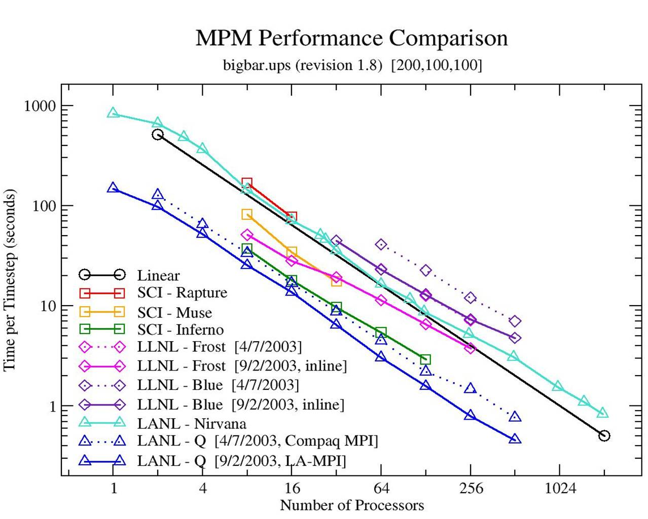
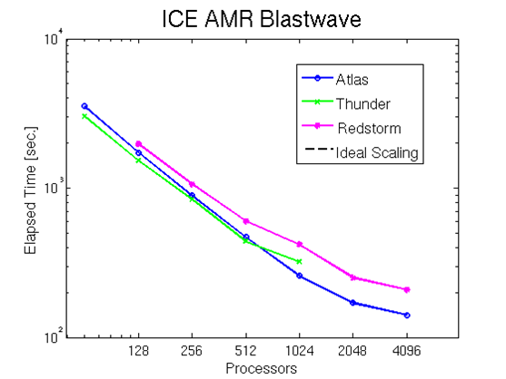
The DAG Approach is not a silver bullet
Uintah Phase 1 1998-2005 – overlap communications with computation. Static task graph execution standard data structures one MPI process per core. No AMR.
Uintah Phase 2 2005-2010 improved fast data structures, load balancer. AMR to 12k cores, then 100K cores using new approach before data structures cause problems.
Out of order and dynamic task execution.
Uintah Phase 3 2010- Hybrid model. Theaded runtine system on node. One MPI process and one data warehouse per node. Multiple cores and GPUs grab tasks as needed. Fast scalable use of hypre for linear equations.
OLD CSAFE
RESULTS 2005
OLD CSAFE
RESULTS
2005

Slide 17
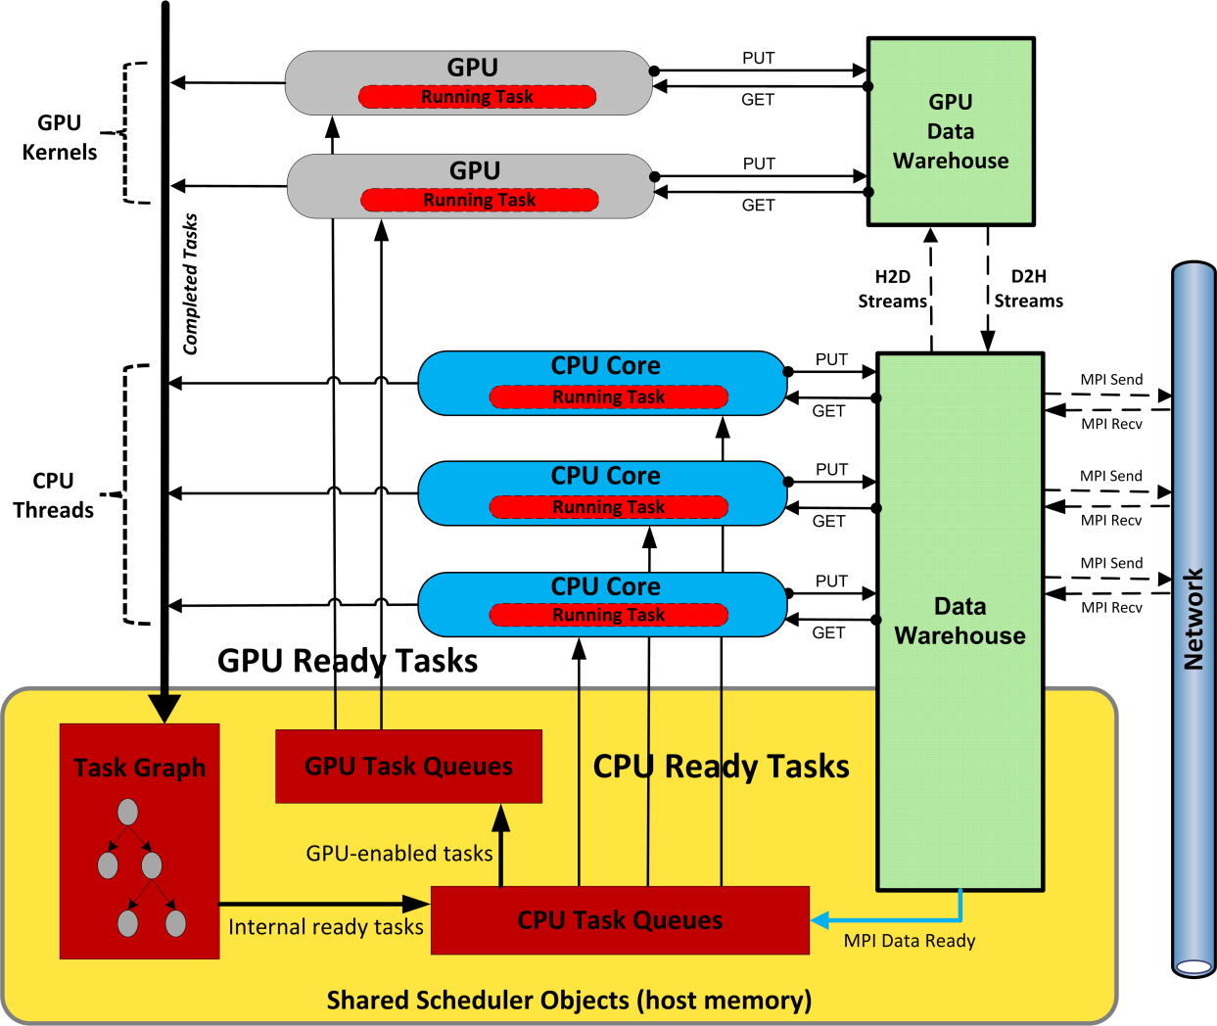
Uintah Heterogeneous Runtime System (Multiple GPUs and Intel Xeon Phis
Notes:
Shared memory model on-node: 1 MPI rank per node - MPI+ Pthreads
Better load-balancing
Decentralized: All threads access task queues and process their own MPI
Scalable, efficient, lock-free data structures

Slide 18
New Hybrid Model Memory Savings: Ghost Cells
MPI:
Thread/MPI:
Local Patch
Ghost Cells
Raw Data: 49152 doubles 31360 doubles
MPI buffer: 28416 doubles 10624 doubles
Total: 75K doubles 40K doubles
(example on Kraken, 12 cores/node, 98K core 11% of memory needed

Slide 19
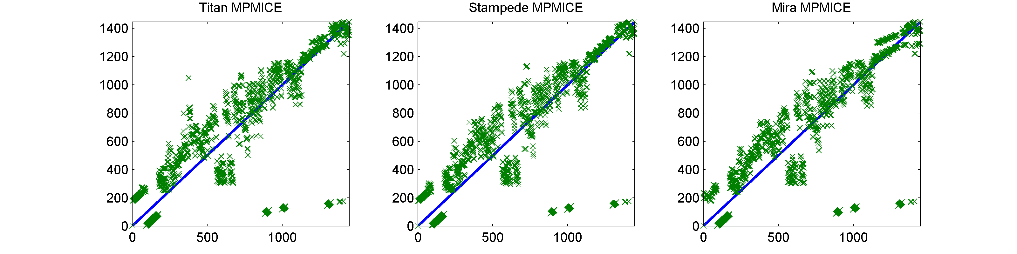
Scalability is at least partially achieved by not executing tasks in order e.g. AMR fluid-structure interaction
Straight line represents given order of tasks Green X shows when a task is actually executed.
Above the line means late execution while below the line means early execution took place. More “late” tasks than “early” ones as e.g.
TASKS: 1 2 3 4 5 1 4 2 3 5
Early
Late execution

Slide 20
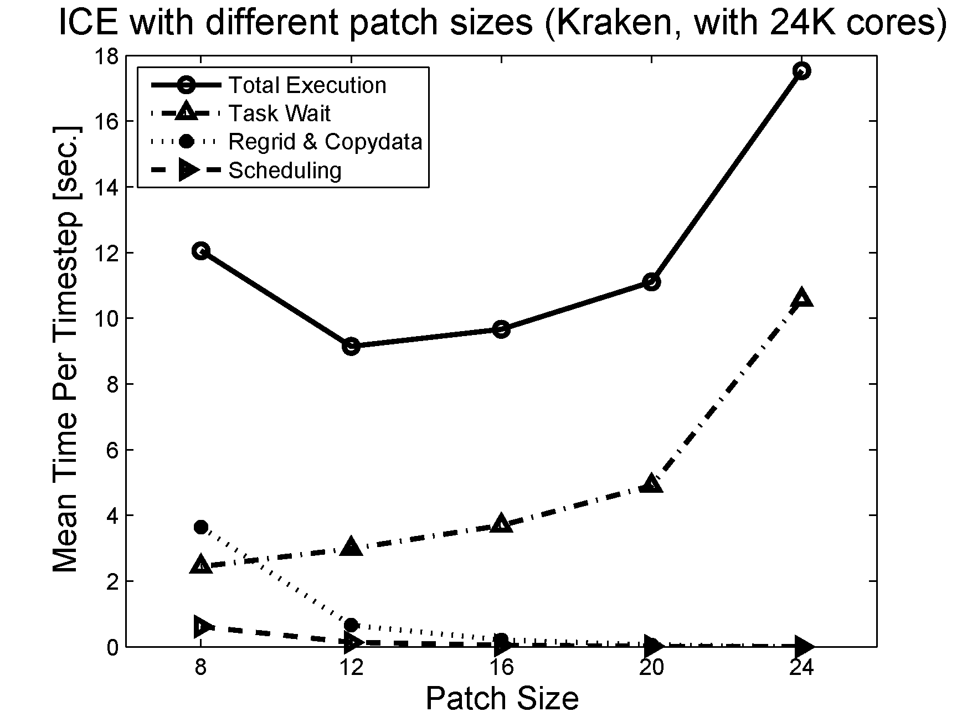
Summary of Uintah Scalability Improvements
Move to a one MPI process per multicore node reduces memory to less than 10% of previous for 100K+ cores
Work on Runtime System involved substantial rewrites
Use optimal size patches to balance overhead and granularity
Use only one data warehouse but allow all cores fast access to it, through the use of atomic operations.
Prioritize tasks with the most external communications
Use out-of-order execution
Algorithm | Random | FCFS | PatchOrder | Most Msg.
Queue Length | 3.11 | 3.16 | 4.05 | 4.29
Wait Time | 18.9 | 18.0 | 7.0 | 2.6
Overall Time | 315.35 | 308.73 | 187.19 | 139.39

Slide 21
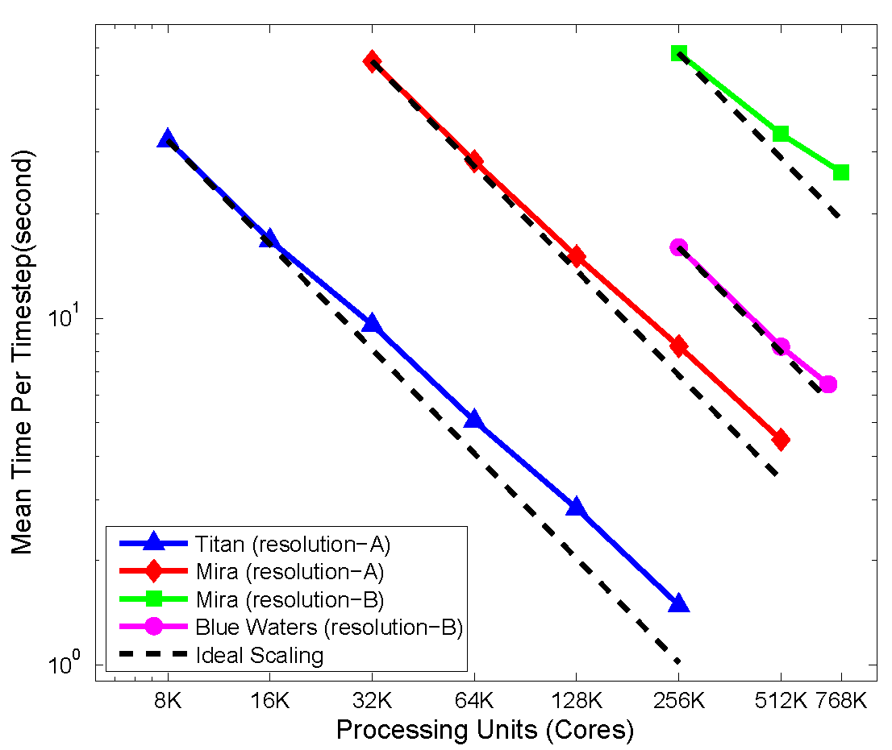
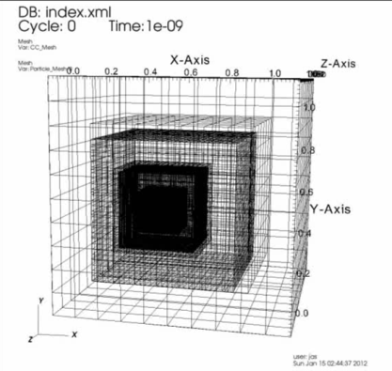
MPM AMR ICE Strong Scaling
Mira DOE BG/Q
768K cores
Blue Waters Cray XE6/XK7 700K+ cores
Resolution B
29 Billion particles
4 Billion mesh cells
1.2 Million mesh patches
*
Complex fluid-structure interaction problem
with adaptive mesh refinement, see SC13/14 paper
NSF funding.

Slide 22
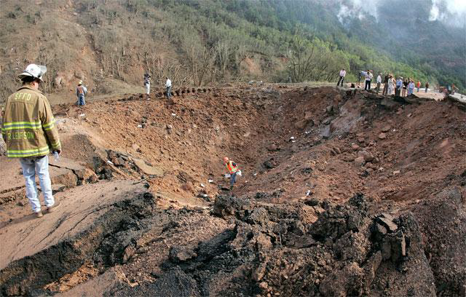
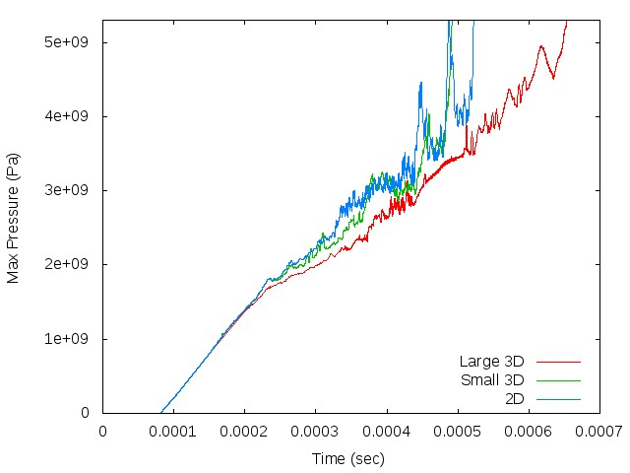
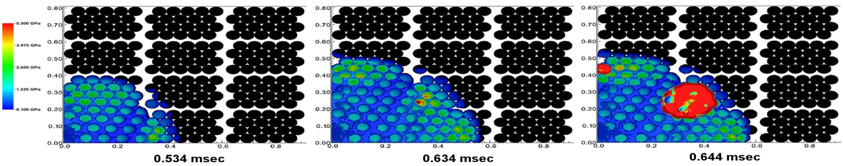
NSF funded modeling of Spanish Fork Accident 8/10/05
Speeding truck with 8000 explosive boosters each with 2.5-5.5 lbs of explosive overturned and caught fire
Experimental evidence for a transition from deflagration to detonation?
Deflagration wave moves at ~400m/s not all explosive consumed. Detonation wave moves 8500m/s all explosive consumed.

Slide 23
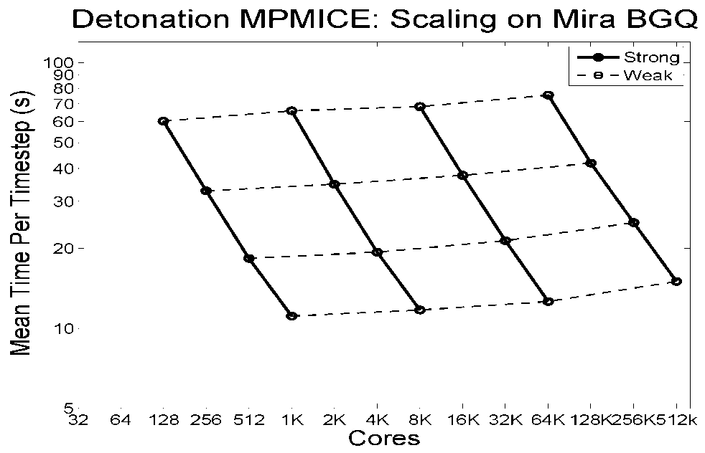
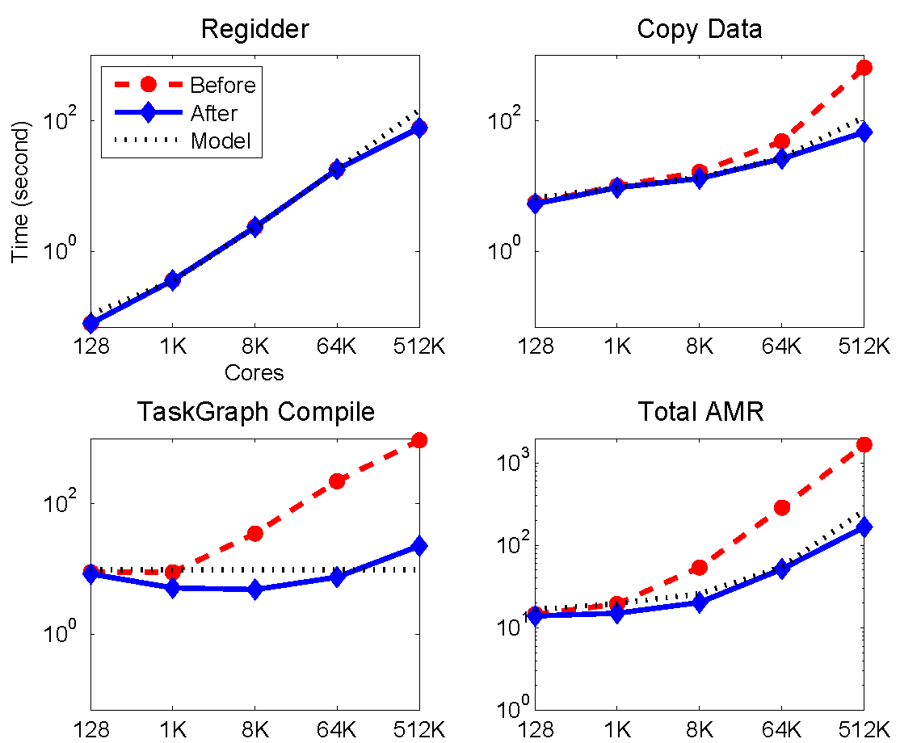
Spanish Fork Accident
500K mesh patches
1.3 Billion mesh cells
7.8 Billion particles
At every stage when we move
to the next generation of problems
Some of the algorithms and data structures need to be replaced .
Scalability at one level is no certain
Indicator fro problems or machines
An order of magnitude larger

Slide 24
Utah PSAAP2 Center
Radiative Heat Transfer

Slide 25
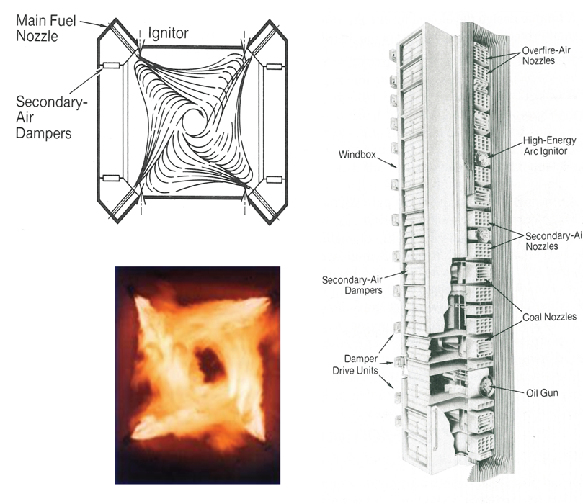
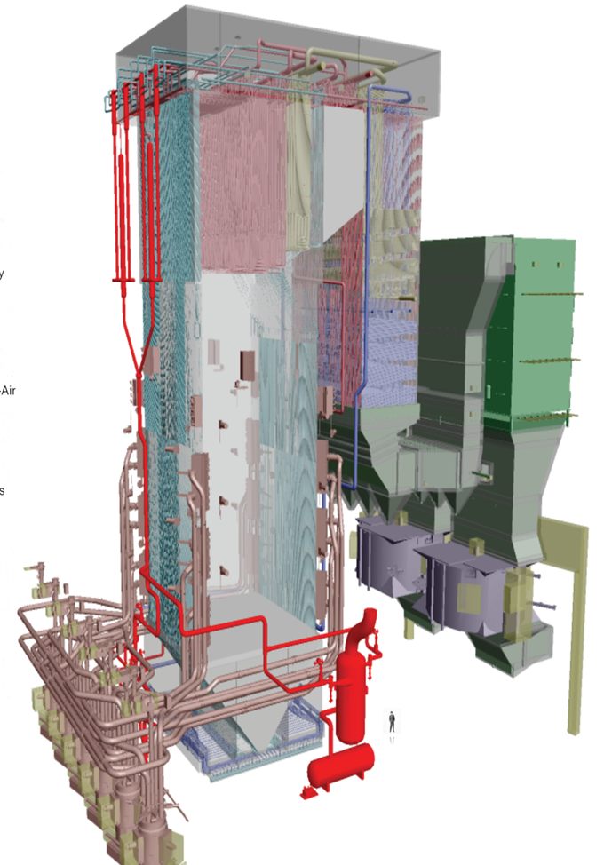
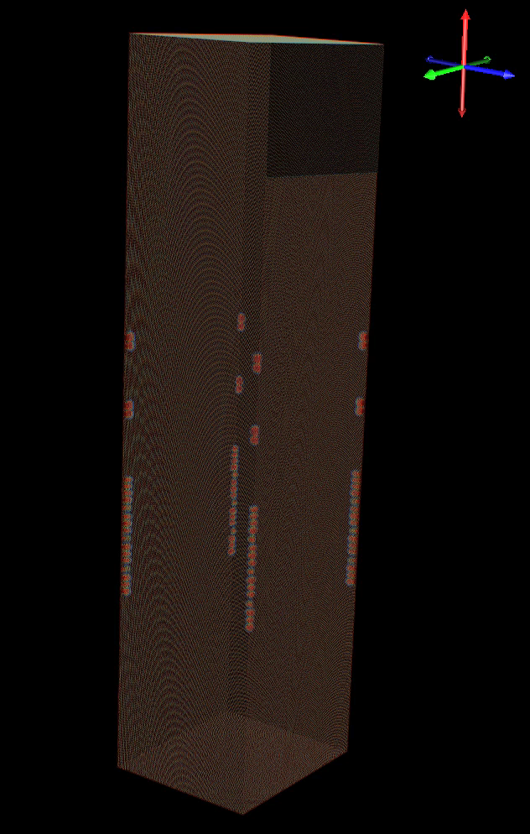
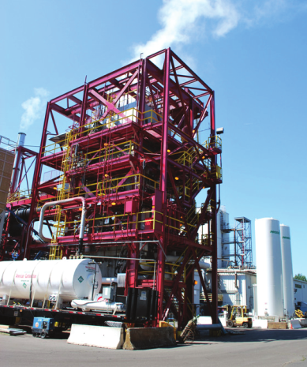
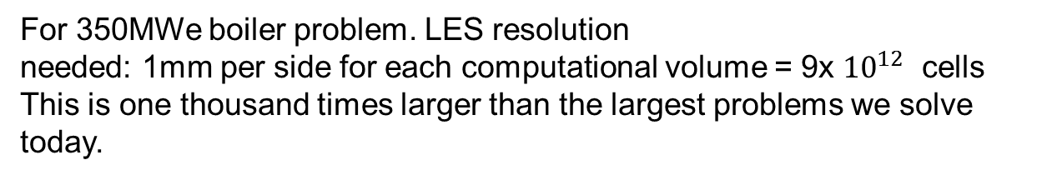
An Exascale Design Problem - Alstom Clean Coal Boiler for 2018 to 2024
Temperature field
For 350MWe boiler problem. LES resolution
needed: 1mm per side for each computational volume = 9x ${10}^{12}$ cells
This is one thousand times larger than the largest problems we solve today.
Prof. Phil Smith Dr Jeremy Thornock ICSE

Slide 26

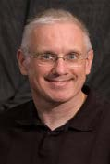
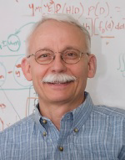
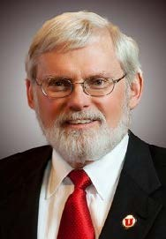
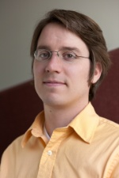
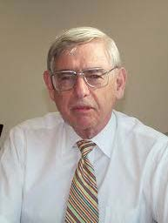
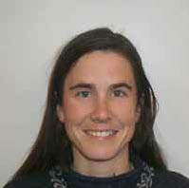

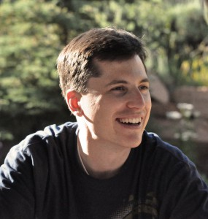
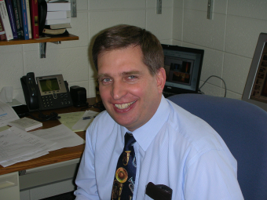


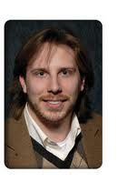

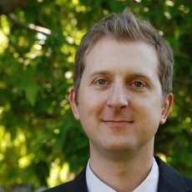
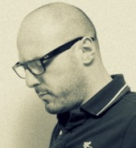

The team
The Exec
Computer Science Predictive Modeling Uncertainty Quantification

Slide 27


Existing Simulations of Clean coal Boilers using ARCHES in Uintah
(i) Traditional Lagrangian/RANS approaches do not address well particle effects
(ii) LES has potential to predict oxy--‐coal flames and to be an important design tool
(iii) LES is “like DNS” for coal
Structured, high order finite-volume
Mass, momentum, energy conservation
LES closure
Tabulated chemistry
PDF mixing models
DQMOM (many small linear solves)
Low mach number approx. (pressure Poisson solve up to variables
Radiation via Discrete Ordinates – massive solves or Ray tracing.
Uncertainty quantification
Red is expt
Blue is sim.
Green is consistent

Slide 28



Radiation: Algorithmic Alternatives
Loose coupling to CFD due to time-scale separation.
Radiation timescales are typically longer than turbulent mixing timescales.
Required resolution decreases with distance → AMR.
Discrete Ordinates Method : large linear solves.
RMCRT:
For optically thin media, this involves all-to-all coupling but no linear solve
AMR is a natural fit.
Phenomena nearby have a greater effect than phenomena at a distance.
Coarse representation of nonlocal features
Global replication of semi-coarsened form of global radiation mesh on each node – gives a local calculation

Slide 29
Radiation Overview
Solving energy and radiative heat transfer equations simultaneously
Diffusion – Convection + Source/Sinks
Radiation-energy coupling incorporated by radiative source term
Energy equation conventionally solved by ARCHES (finite volume)
Temperature field, T used to compute net radiative source term
requires integration of incoming intensity about a sphere
Global replication of semi-coarsened form of global radiation mesh on each node – gives a local calculation
Notes:
The net radiative source term consists of two terms, one of which requires integration of incoming intensity about a sphere
RMCRT approximates the second term using Monte-Carlo methods

Slide 30

Reverse Monte Carlo Ray Tracing
Incorporate dominant physics
Emitting / Absorbing Media
Emitting and Reflective Walls
Ray Scattering
User controls # rays per cell
Each cell has Temp Absorb and Scattering Coeffs
Radiative Heat Transfer key
Replicate Geometry on every node
Calculate heat fluxes on Geometry
Transfer cell info e.g etc from all nodes to all nodes
Reverse ray tracing back from
Heat flux at walls to origin
More efficient than forward ray tracing
Notes:
Virtual Radiometer - Computationally mimics an experimental heat flux sensor. - Allows for direct comparison with experimental results, validation - Easy to implement inside of RMCRT, very difficult in DOM. - User can place VR anyplace in the flow at any orientation

Slide 31

RMCRT Compute Nodes and Mesh Notation
Original global mesh Nnode each with Npatches x (Npoints)^3
Now Coarse mesh Nnode each with Npatches x (Npoints/Nrefine)^3
Each node has its own fine mesh + fine mesh
halos and a global coarse mesh
Radiative properties for each node need to be updated
for every radiation calculation. each processor shares the temperature and radiative-properties fields (absorption
coefficients, scattering coefficients, and cell types) with all
other processors.
Global all to all on coarse mesh Local halo fine mesh updates

Slide 32

Strong Scaling Results for RMCRT on Titan

Slide 33
Communications Volume: Number of Messages in Strong Scaling
Cores / Mesh size | 128 | 256 | 512 | 1K | 4K | 8K | 16K | 32K | 64K | 128K
128^3 | 377 | 1K | 3K | 6K | 36K
256^3 |  |  |  | 9K | 52K | 105K | 212K | 437K
512^3 |  |  |  |  |  | 340K | 670K | 1.4M | 2.7M | 5.4M
How much volume can the communications network take?

Slide 34

GPU Single Mesh Scaling

Slide 35
Current Efforts on porting RMCRT to Xeon Phi
Native execution experiments have explored :
optimal run configurations
use of the 61st (reserved) core on the Xeon Phi
thread affinity
mesh decomposition
Key Outcomes:
two Xeon E5s outperformed one Xeon Phi by 40%
mesh decomposition had a profound impact on performance
No one thread placement strategy dominated performance
Differing caches of Sandy Bridge and MIC matter
Simple vectorization approaches failed (e.g. SIMD directives)
Many options are available to explore (e.g. manual intrinsics and software packages such as Kokkos (SNL) or RAJA (LLNL))
Complete code overhaul necessary

Slide 36

Initial Radiation Experiments on INTEL Xeon PHI
Native execution of single-level RMCRT on a single coprocessor
Target impact of thread affinity, thread count, and patch size on performance
Key Takeaways
The Xeon E5 outperformed the Xeon Phi by about 40%
No one thread placement strategy and/or thread count best
Thread affinity during coprocessor-side experiments was on par with that of Xeon
Challenge
Domain decomposition and coprocessor-based memory footprint restrictions
CPU
Xeon Phi
No use of AVX vector instructions yet

Slide 37
Portability and Node Performance
Even if we scale can we get both portability and performance at node level?
Use Domain Specific Language
Or use abstraction layer that maps loops onto machine efficiently (e.g. Kokkos Rajah)

Slide 38


NEBO/Wasatch Example
Express complex pde functions as DAG - automatically construct algorithms from expressions
Define field operations needed to execute tasks (fine grained vector parallelism on the mesh)
User writes only field operations code . Supports field & stencil operations directly - no loops!
Strongly typed fields ensure valid operations at compile time. Allows implementations to be tried without modifying application code.
Scalability on a node - use Uintah infrastructure to get scalability across whole system
Energy equation
Enthalpy diffusive flux
Dependency
specification
Execution
order
[Sutherland Earl Might]

Slide 39
GPU Task and Data Management
Framework Manages Data Movement
Host ← → Device
Normal
Page-locked Memory
Data Transfer
Kernel Execution
Data Transfer
Kernel Execution
Pin this memory with CudaHostRegister()
Use CUDA Asynchronous API
Automatically generate CUDA streams for task dependencies
Concurrently execute kernels and memory copies
Preload data before task kernel executes
Multi-GPU support
Call-back executed here
(kernel run)
existing host memory
cudaMemcpyAsync(H2D)
hostRequires
devRequires
Page locked buffer
computation
Result back on host
hostComputes
devComputes
cudaMemcpyAsync(D2H)
Free pinned host memory
Automatic D2H copy here
Notes:
With Uintah’s knowledge of the task-graph, task data is automatically transferred asynchronously to the device before a GPU task executes
Stream - sequence of operations that execute in order on GPU
Operations from different streams can be interleaved

Slide 40
Keeping Data on the GPU
New GPU engine can now keep data resident on the GPU, avoiding unnecessary PCIe bus data transfers and automatically handles ghost/halo cells across multiple CPU threads, multiple GPUs per node, and multiple nodes.
Poisson Problem | Problem Size | Number of Patches | Avg Time Per Iteration
CPU engine (Xeon 12 cores) | 400x400x400 | 12 (3x2x2) | 0.653
Current GPU engine (K20) | 400x400x400 | 12 (3x2x2) | 0.344
New GPU engine (K20) | 400x400x400 | 2 (1x1x2) | 0.098

Slide 41


Consolidating GPU Data Transfers
Current GPU scheduler performs a cudaMalloc and a cudaMemcpy for each variable per patch per material. For some tasks, hundreds of pieces of variable data needed to be copied, and the slowdown of these API calls is severe.
The new GPU scheduler's support for consolidating data is nearing completion. Early results show fewer API calls.

Slide 42
DESIGNING FOR EXASCALE
Clear trend towards accelerators e.g. GPU but also Intel MIC – NSF “Stampede” Balance factor = flops/bandwidth – high.PORTABILITY IS THE KEY ISSUE:NEW CODE - use Wasatch to generate code for GPUs and MICs .How do we handle the challenge of existing code?
Kokkos: A Layered Collection of Libraries
Standard C++, Not a language extension
In spirit of TBB, Thrust & CUSP, C++AMP, LLNL’s RAJA, ...
Not a language extension like OpenMP, OpenACC, OpenCL, CUDA, ...
Uses C++ template meta-programming
Multidimensional Arrays, with a twist
Layout mapping: multi-index (i,j,k,...) ↔ memory location
Choose layout to satisfy device-specific memory access pattern
Layout changes are invisible to the user code
[source Carter Edwards and Dan Sunderland]

Slide 43

Evaluate Performance Impact of Array Layout [Edwards and Sunderland]
Molecular dynamics computational kernel in miniMD
Simple Lennard Jones force model:
Atom neighbor list to avoid N² computations
Test Problem
864k atoms, ~77 neighbors
2D neighbor array
Different layouts CPU vs GPU
Random read ‘pos’ through
GPU texture cache
Large performance loss
with wrong array layout
pos_i = pos(i);
for( jj = 0; jj < num_neighbors(i); jj++) {
j = neighbors(i,jj);
r_ij = pos_i – pos(j); //random read 3 floats for pos
if (|r_ij| < r_cut) f_i += 6*e*((s/r_ij)^7 – 2*(s/r_ij)^13)
}
f(i) = f_i;

Slide 44


Sandia (Bennett) Evaluation of Uintah /Legion/Charm++ on MiniAero MiniApp
2 Day integration/porting effort Utah/Sandia (12/14).
Rewrite using Uintah constructs
MiniAero is a new Uintah component -Uintah & DOE developers are contributing to code base
In 7 days, 90% of the core features working within Uintah .
Uintah- MiniAero scales “out of the box” to 131K cores on Titan.
Further scaling/tuning by Sandia
Uintah software development
Motivation Uintah team to improve documentation etc
Todd Harman, Alan Humphrey
Dav de St Germain John Schmidt

Slide 45

Summary
Layered DAG abstraction important for portability, scaling and for not needing to change applications code
Scalability still requires tuning the runtime system. Cannot develop nodal code in isolation.
Future Portability: use Kokkos for rewriting legacy applications +Wasach/Nebo DSL for new code. MIC and GPU ongoing. Aiming at future DOE machines Summit and Aurora.
Linear Solvers Hypre and AMGX ? Trilinos Petsc?

Slide 46
Backup slides

Slide 47

Runtime System

Slide 48

Existing Simulations of Boilers using ARCHES in Uintah
(i) Traditional Lagrangian/RANS approaches do not address well particle effects
(ii) LES has potential to predict oxy--‐coal flames and to be an important design tool
(iii) LES is “like DNS” for coal, but 1mm mesh needed to capture key phenomena
Mesh spacing filter

Slide 49



Linear Solves arises from Low Mach Number Navier –Stokes Equations
Use Hypre Solver from LLNL
Preconditioned Conjugate Gradients on regular mesh patches used
Multi-grid pre-conditioner used
Careful adaptive strategies needed to get scalability
2.2 Trillion
DOF
Each Mira Run is scaled wrt the Titan Run at 256 cores
Note these times are not the same for different patch sizes.
Weak Scalability of Hypre Code
One radiation solve
every 10 timesteps

Slide 50


Strong Scaling of AMR Algorithms
GBR is Global
Berger-Rigoutsos
– problem size fixed as number of cores increases
should lead to decreasing execution time.
No strong scaling
Strong Scaling
T: GBRv1 = c1 (Flags/Proc) log(npatches ) + c2 M(GBRv1)
T: Tiled = c5 Nmeshcells / Proc
T: LBR = GBR on a compute node
Dots are data and lines are models

Slide 51
Burgers Example I
<Grid>
<Level>
<Box label = "1">
<lower> [0,0,0] </lower>
<upper> [1.0,1.0,1.0] </upper>
<resolution> [50,50,50] </resolution>
<patches> [2,2,2] </patches>
<extraCells> [1,1,1] </extraCells>
</Box>
</Level>
</Grid>
25 cubed patches
8 patches
One level of halos
void Burger::scheduleTimeAdvance( const LevelP& level,
SchedulerP& sched)
{
…..
task->requires(Task::OldDW, u_label, Ghost::AroundNodes, 1);
task->requires(Task::OldDW, sharedState_->get_delt_label());
task->computes(u_label);
sched->addTask(task, level->eachPatch(), sharedState_->allMaterials());
}
Get old solution from old data warehouse
One level of halos
Compute new solution

Slide 52
Burgers Equation code
void Burger::timeAdvance(const ProcessorGroup*, const PatchSubset* patches,
const MaterialSubset* matls, DataWarehouse* old_dw, DataWarehouse* new_dw)
//Loop for all patches on this processor
{ for(int p=0;p<patches->size();p++){
//Get data from data warehouse including 1 layer of "ghost" nodes from surrounding patches
old_dw->get(u, lb_->u, matl, patch, Ghost::AroundNodes, 1);
// dt, dx Time and space increments
Vector dx = patch->getLevel()->dCell();
old_dw->get(dt, sharedState_->get_delt_label());
// allocate memory for results new_u
new_dw->allocateAndPut(new_u, lb_->u, matl, patch);
// define iterator range l and h …… lots missing here and Iterate through all the nodes
for(NodeIterator iter(l, h);!iter.done(); iter++){
IntVector n = *iter;
double dudx = (u[n+IntVector(1,0,0)] - u[n-IntVector(1,0,0)]) /(2.0 * dx.x());
double du = - u[n] * dt * (dudx);
new_u[n]= u[n] + du;
}

Slide 53





ARCHES or WASATCH/NEBO
xml
Task Compile
Run Time
(each timestep)
RUNTIME SYSTEM
Calculate Residuals
Solve Equations
Parallel I/O
Visus PIDX
VisIt
UINTAH ARCHITECTURE

Slide 54

RMCRT Computational Complexity
abskg: (double) absorption coefficient - property of the medium ray travels through.
sigmaT4: (double) physical constant, (sigma)) * T ^ 4
divQ: (double) divergence of the heat flux in and out of each computational cell
cellType (int) flag to indicate type of cell
Communication:
( (abskg + sigmaT4 + cellType) * DomainSize for each patch )
Computation cost per patch
= C1 * #rays * (#cells ^ 1.4)
Doubling resolution from
32^3-> 64^3, the cost goes up
by a factor of 20.

Slide 55
Radiation: Algorithmic Alternatives
Loose coupling to CFD due to time-scale separation.
Radiation timescales are typically longer than turbulent mixing timescales.
Required resolution decreases with distance → AMR.
Discrete Ordinates Method : large linear solves.
RMCRT:
For optically thin media, this involves all-to-all coupling but no linear solve
AMR is a natural fit.
Phenomena nearby have a greater effect than phenomena at a distance.
Coarse representation of nonlocal features

Slide 56

Task prioritization algorithms
Executing the task pool in different ways leads to different communications patterns
Task pool
to be executed
MPI sends
Sub-domain
Algorithm | Random | FCFS | PatchOrder | MostMsg.
Queue Length | 3.11 | 3.16 | 4.05 | 4.29
Wait Time | 18.9 | 18.0 | 7.0 | 2.6
Overall Time | 315.35 | 308.73 | 187.19 | 139.39
Prioritize tasks with external communications over purely internal ones

Slide 57

Granularity Effect
Decrease patch size
(+) Increase queue length
(+) More overlap, lower task wait time
(+) More patches, better load balance
(-) More MPI messages
(-) More regrid overheads
Other Factors
Problem size
Implied task level parallelism
Interconnection bandwidth and legacy
CPU cache size
Solution- Self Tuning?

Slide 58

Intel Xeon Phi
Adoption of Intel’s MIC Architecture in large-scale HPC infrastructures is increasing
Uintah MUST be capable of leveraging this adoption
Xeon Phi Knight’s Corner MIC Architecture
Up to 61 cores, 244 threads
Up to 1208 GFLOPS peak
Up to 352 GB/s peak memory bandwidth 8 GB or 16 GB GDDR5 memory
512-bit SIMD instructions
Intel Xeon Phi Coprocessor Core Architecture
John Holmen

Slide 59

K20 and K40
Internal 200- 300 GB/sec
External 8-16 GB/sec (the Dixie straw)
NVIDIA K20m GPU ~order of magnitude speedup over
16 CPU cores
(Intel Xeon E5-2660 @2.20 GHz)

