Slide 1


Welcome to the
2016 Charm++ Workshop!
Laxmikant (Sanjay) Kale
http://charm.cs.illinois.edu
Parallel Programming Laboratory
Department of Computer Science
University of Illinois at Urbana Champaign

Slide 2
A couple of forks
Overdecomposition +
Migratability
MPI + x
“Task Models”
  Asynchrony
Overdecomposition and migratability:
  Most adaptivity
MPI+X
Task
Models

Slide 3
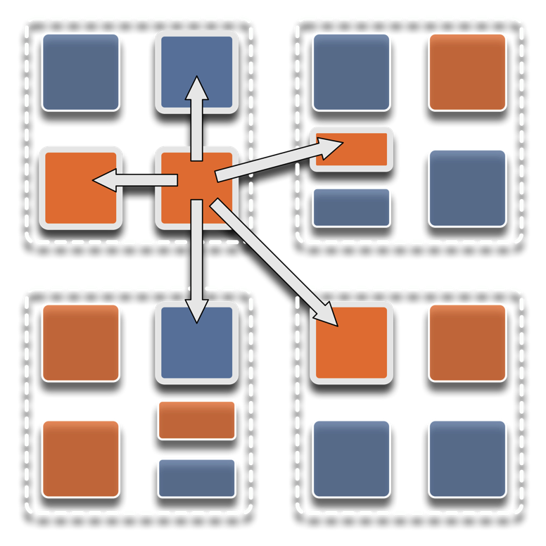
Overdecomposition
Decompose the work units & data units into many more pieces than execution units
  Cores/Nodes/..
Not so hard: we do decomposition anyway

Slide 4
Migratability
Allow these work and data units to be migratable at runtime
  i.e. the programmer or runtime, can move them
Consequences for the app-developer
  Communication must now be addressed to logical units with global names, not to physical processors
  But this is a good thing
Consequences for RTS
  Must keep track of where each unit is
  Naming and location management

Slide 5
Asynchrony:
Message-Driven Execution
Now:
  You have multiple units on each processor
  They address each other via logical names
Need for scheduling:
  What sequence should the work units execute in?
  One answer: let the programmer sequence them
    Seen in current codes, e.g. some AMR frameworks
  Message-driven execution:
    Let the work-unit that happens to have data (“message”) available for it execute next
    Let the RTS select among ready work units
    Programmer should not specify what executes next, but can influence it via priorities

Slide 6
Charm++
Charm++ began as an adaptive runtime system for dealing with application variability:
  Dynamic load imbalances
  Task parallelism first (state-space search)
  Iterative (but irregular/dynamic) apps in mid-1990s
But it turns out to be useful for future hardware, which is also characterized by variability

Slide 7
Message-driven Execution
A[..].foo(…)

Slide 8
Empowering the RTS
Adaptive
Runtime System
Introspection
Adaptivity
Asynchrony
Overdecomposition
Migratability
The Adaptive RTS can:
  Dynamically balance loads
  Optimize communication:
    Spread over time, async collectives
  Automatic latency tolerance
  Prefetch data with almost perfect predictability
Notes:
You can have asynchrony without overdecomposition or vice versa, you can have migratability without asynchrony, but you need all three to empower the RTS.You need to add introspection and adaptivity to make a powerful Adaptive Runtime System

Slide 9
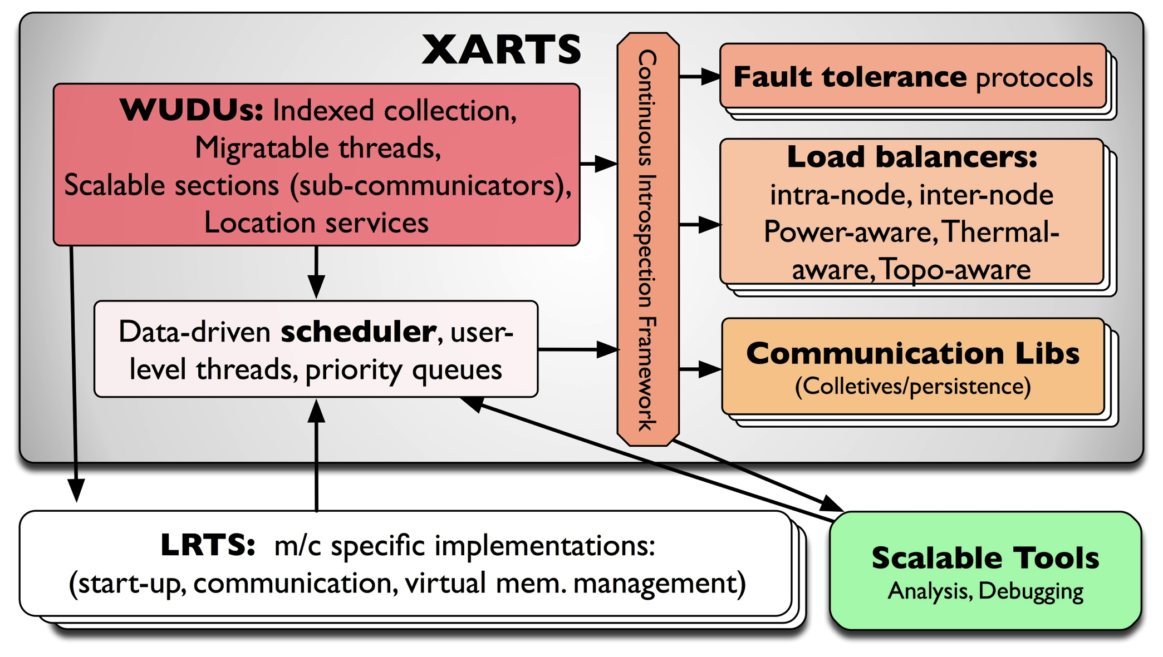
What Do RTSs Look Like: Charm++

Slide 10
PPL Highlights of last year
Petascale Applications made excellent progress
  ChaNGa, NAMD, EpiSimdemics, OpenAtom
  They are all current, past or upcoming PRAC applications, selected by NSF for large allocations for science on Blue Waters!

Slide 11
External Evaluation of Charm++
Sandia@Livermore evaluated Charm++
  Robert Clay, Janine Bennett, David Hollman, Jeremiah Wilkes, and Sandia team
  Selected Charm++ along with Legion and Uintah
  Week-long exploration by a team
    Eric Mikida and Nikhil Jain from PPL
  Mini-aero was implemented..
    With load balancing, resilience, etc. !
  Sandia report
Intel exploration continues
  Tim Mattson, Robert Wijngaart, [Jeff Hammond]
  Summer intern implemented PRK benchmarks

Slide 12
Episimdemics
Simulation of epidemics:
  Collaboration with Madhav Marathe et al a Virginia Tech, and Livermore
  Converted from original MPI to Charm++
  Recent results scale to most of blue waters
  Many optimizations that exploit asynchrony of Charm++

Slide 13
Charmworks, Inc.
A path to long-term sustainability of Charm++
Commercially supported version
  Focus on 10-1000 nodes at Charmworks
  Existing collaborative apps to continue with same licensing (NAMD, OpenAtom) as before
University version continues to be distributed
  Freely, in source code form, for non-profits
Code base:
  Committed to avoiding divergence for a few years
  Charmworks codebase will be streamlined
We will be happy to take your feedback

Slide 14
Charmworks contributions
Past or ongoing relevant work:
  Eclipse plugin
  Charmdebug improvements
  Significantly improved robust parsing of .ci files
  Packaging scripts: spack, …
  GPU manager with shared memory nodes
  Accel framework
  Default parameter choices
  Automation of checkpoint/restart scheduling
  Metabalancer integration
  Performance report

Slide 15
Graduating Doctoral Students!
In the first half of 2016, mostly
Nikhil Jain (LLNL)
Jonathan Lifflander (Sandia @ Livermore)
Xiang Ni (IBM Research)
Phil Miller (charmworks)
Harshitha Menon

Slide 16
Workshop Overview
Keynotes
  Barbara Chapman (today)
  Thomas Sterling (tomorrow morning)
Invited talks:
Applications
Charm++ features and capabilities
  Within-node parallelism,
  AMPI,
Panel: Higher Level Abstractions

