Slide 1
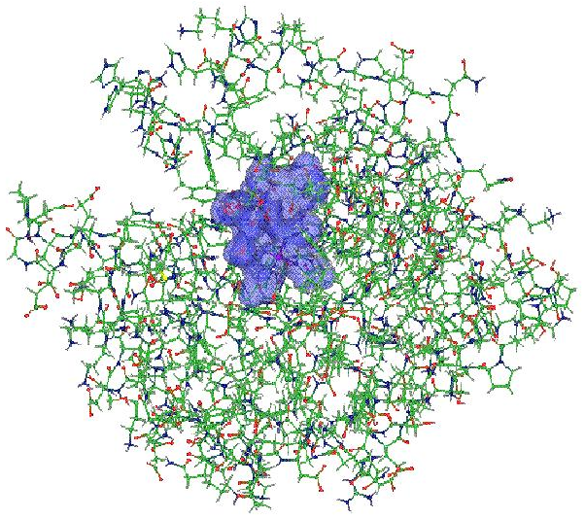
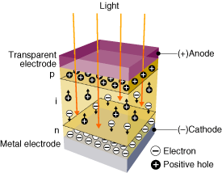
OpenAtom: On the fly ab initio molecular dynamics on the ground state surface with instantaneous GW-BSE level spectra
PIs: G.J. Martyna, IBM; S. Ismail-Beigi, Yale; L. Kale, UIUC;
Team: Q. Li, IBM, M. Kim, Yale; S. Mandal, Yale;
E. Bohm, UIUC; N. Jain, UIUC; M. Robson, UIUC; E. Mikida, UIUC; P. Jindal, UIUC; T. Wicky, UIUC.
Light in
1

Slide 2
Outline:
Introduction to the OpenAtom project
Statistical sampling of complex systems on the ground state surface
Optimization under charm++
GW-BSE – a new charm++ application.
Light in
2

Slide 3
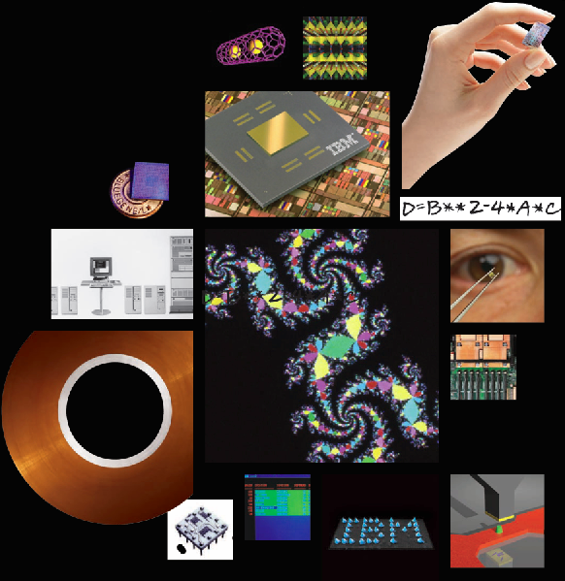
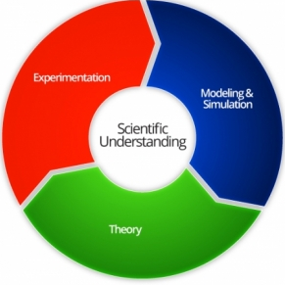
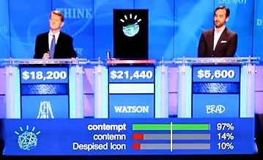

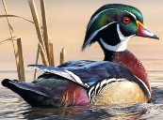
IBM : A History of Multidisciplinary Research
Exploratory work: Yorktown, Almaden & Zurich
2012 Excimer Laser Surgey (Nation Medal of Technology)
2009 Nano MRI
World’s First Petaflop Supercomputer
Francis Allen: 1st Female Turing Award winner & 1st Female IBM Fellow
Cell Architecture
2004 Blue Gene (National Medal of Technology)
2003 Carbon Nanotube Transistors
1997 Copper Interconnect Wiring
1994 Silicon Germanium (SiGe)
1987 High-Temperature Superconductivity (Nobel Prize)
1986 Scanning Tunneling Microscope (Nobel Prize)
1980 RISC
1971 Speech Recognition
1970 Relational Database
1967 Fractals
One-Device Memory Cell
1965 FFT (Cooley and Tukey).
1957 FORTRAN (Program lang)
RAMAC (comput. w. mag. disk)
Science & Solutions
IBM’s Watson Cognitive Computer
“Treasure wild ducks”
James Watson, Jr.
(from Kierkegaard)
www-03.ibm.com/ibm/history/ibm100/us/en
D. Ferrucci Wild Duck
3

Slide 4
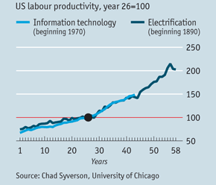
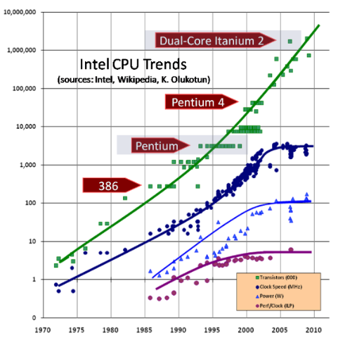
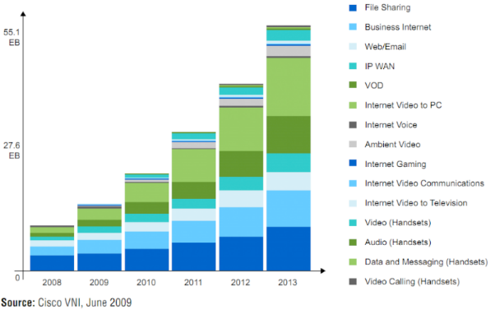
Where is IT today and where is it going?
IT industry has driven giant productivity gains in the last 40 years – are we done?
IT continues like
Electrification??
It’d better!!
Power: A Cause for Concern
Power is limiting progress in the IT world – CMOS has reached fundamental limits.
Data-centric: communication is expensive.
Dark silicon/on-chip power savings will not deliver enough savings - Microsoft Project Natick – underwater data centers!!!!!! (projectnatick.com)
Sensor revolution requires on-board low-power computing to preprocess
data avoiding power cost of wireless communication.
Wireless Communication and Radar: New demands for high performance
The spectrum is congested and/or contested.
Higher performance electronics for agile radars and communications are needed to move forward - RF FPGA’s
New efficient methodology and implementations required for progress!
4

Slide 5
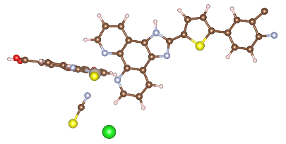
Philosophy: Statistical Sampling of Complex
Environments is Key to Understanding many Physical Systems across Science and Solutions
Biological function is enabled by fluctuations in both the environment and the biomolecules.
Pollutant detection requires sampling complex aqueous systems and then exporting the results to a GW/GW-BSE app for computation of spectra.
Understanding chemical reactions in dense arrays
requires non-trivial sampling of the full system due to complex many-body reaction paths.
Light in
5

Slide 6
Simulating materials with atomic detail on the Ground State Born-Oppenheimer Surface: Reaching Long Time Scales via Parallel Software and Novel Physics Based Methodology
PI: Glenn Martyna, IBM TJ Watson Research Center,
Honorary Professor of Physics, University of Edinburgh,
2016 IPAM Senior Fellow
Postdoc: Qi Li, IBM TJ Watson Research Center
Light in
6

Slide 7
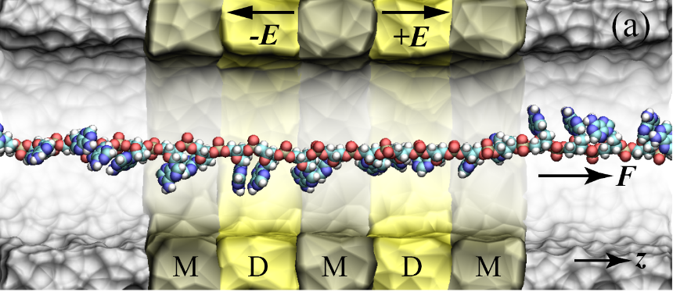

Goal : The accurate treatment of complex heterogeneous
systems to gain physical insight.
Light in
7

Slide 8
Where we were at the start of the project from previous collaboration with Kale group:
OpenAtom
Charm++ implementation of the Car Parinello Ab initio Molecular
Dynamics based on KS-DFT within Generalized Gradient Approx.
Features include:
Order N² log(N) Euler Exponential Spline (EES) method for norm conserving non-local pseudopotentials.
Order N log(N) EES method for local pseudopotential and Ewald interactions.
High parallel scaling on BlueGene/L and BlueGene/P (10k procs).
Roughed in path Integrals, k-point sampling, LSDA and parallel tempering sampling.
Parallel 3D-FFTs handwritten by scientists.
Great for main group systems, achieve nanosecond time scales- a breakthrough in its day (just a few years ago)!
IBM Journal of Research and Development 52 (1.2), 159-175 (2008).
8

Slide 9
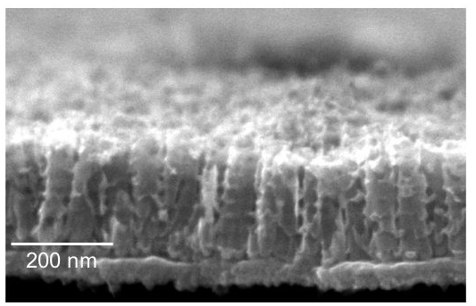
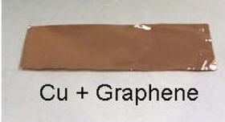
Transparent Conducting Electrodes (TCEs)
for thin film amorphous silicon solar cells
Conventional TCEs:
Indium Tin Oxide (ITO)
Zinc Oxide (ZnO)
Light in
Graphene TCEs:
1 – 8 atomic layers
Performance:
Transparency 95%
Sheet resistance 10Ω
Performance:
Transparency 85%
Sheet resistance 100Ω
Manufacturing:
Manufacturing:
cm X cm size sheets
Science, 324, p. 1312 (2009).
9

Slide 10
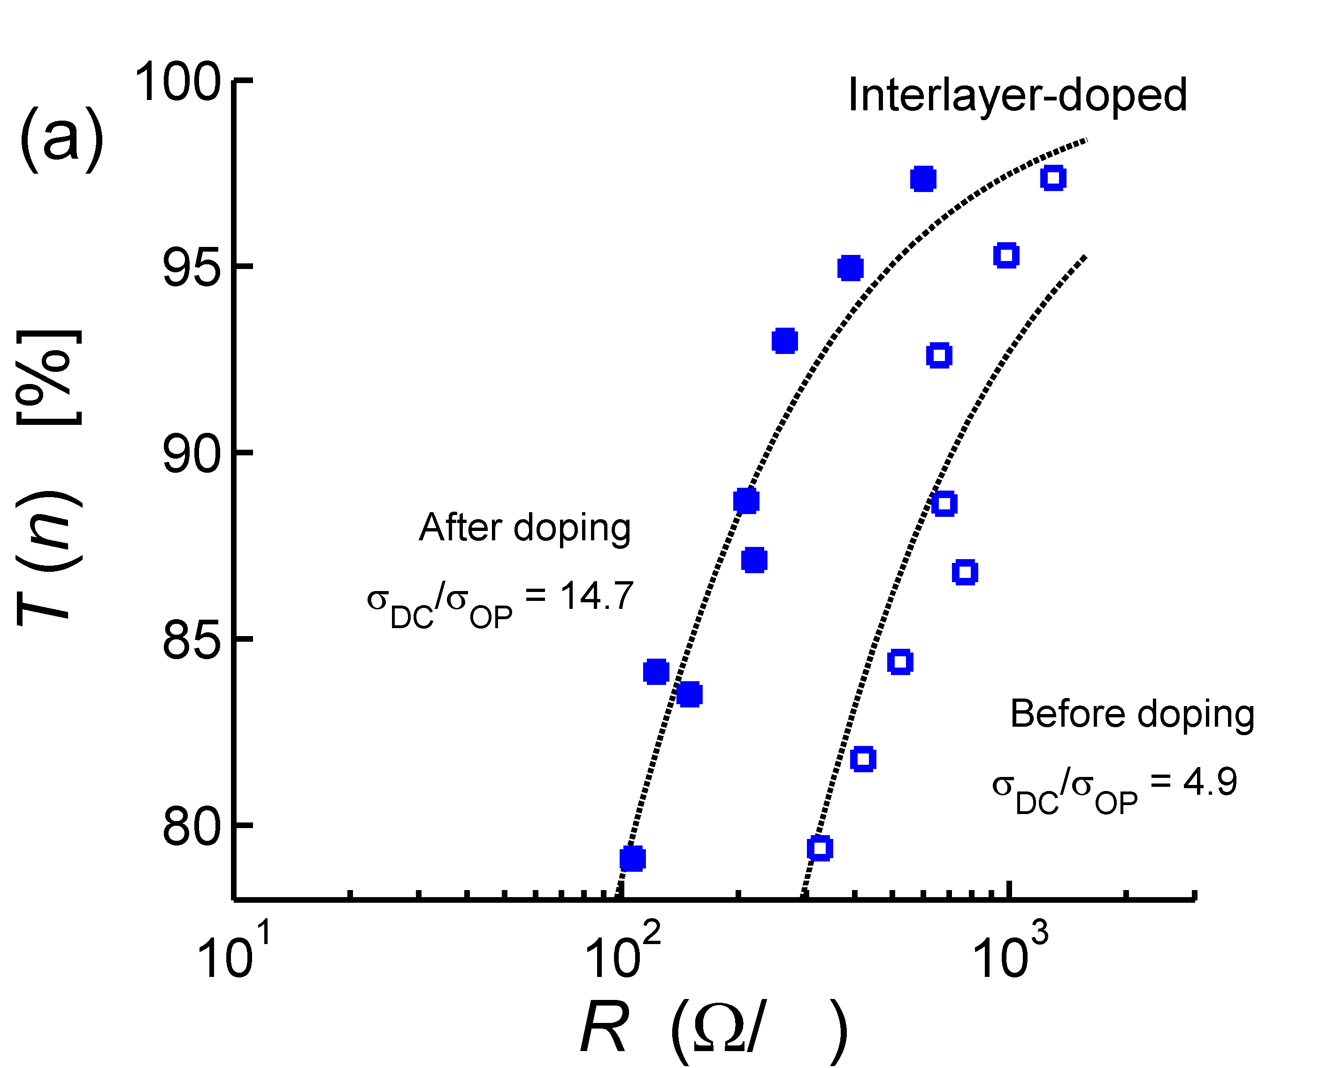
Engineering goal
Doping mechanism?
How to meet goal?
Goal
# layers
Experimental data: G. Tulevski (IBM), A. Kasry (EGNC), A. Boll (IBM)
ACS nano 4 (7), 3839-3844 (2010)
10

Slide 11
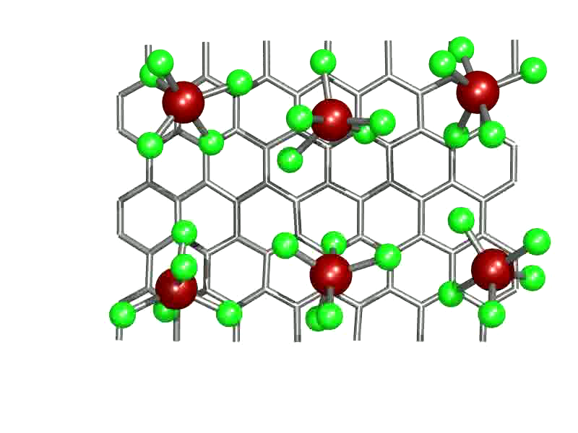
6SbCl₅ +C₈₄ → C₈₄²⁺(2SbCl₆⁻) + SbCl₃ + 3SbCl₅
ACS nano 5 (4), 3096-3103 (2011)
11

Slide 12


Project Goals: Improve sampling, accuracy, applicability and parallel performance of OpenAtom to achieve breakthrough performance
Transition Metals: Plane Augmented Wave method, LSDA, k-point sampling.
Reactive Chem: Hybrid functionals (beyond GGA) – Exact exchange (HF).
Nuclear Quantum Effects: Path Integral Molecular Dynamics.
Sampling Rough Energy Landscapes: Parallel tempering (PT).
Metric Factors : Improve baseline CPAIMD with phase space metrics (PSM).
Extension to Analytics: Use power of OpenAtom in Discovery Projects.
Addressing complex systems and sampling problems requires
significant collaborative development!!!!
OPENATOM
12

Slide 13
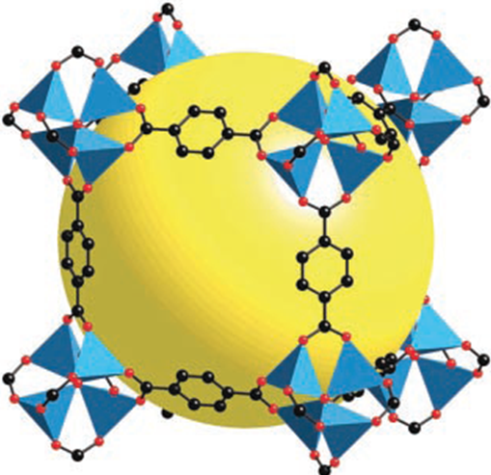
Project Goals: Improve sampling, accuracy, applicability and parallel performance of OpenAtom
UIUC tasks:
3D-FFT library – beyond GJM.
Flow of control refactor.
Bringing Tempering, Path integrals, k-points, LSDA to life – “Übers”.
Parallelization of “Übers”.
GPGPUs for orthogonality.
Parallelization of “Advanced methods” (PAW, HF, PSM, …).
IBM tasks:
Derive order N² log(N) PAW.
Implement Grimme van der Waals.
Derive reduced order HF exch.
Derive selection rule for parallel tempering on sampled potential surfaces – penalty method.
Derive improved CPAIMD via PSM.
Write toy codes and scientific papers.
Joint work:
Framework new methods.
Implement new methods.
Develop test suite for new methods – implement in OpenAtom’s Jenkins app.
Apply OpenAtom to important systems across S&T .e.g.
Metal Organic Framework with Yale & UIUC.
Hero System
13

Slide 14
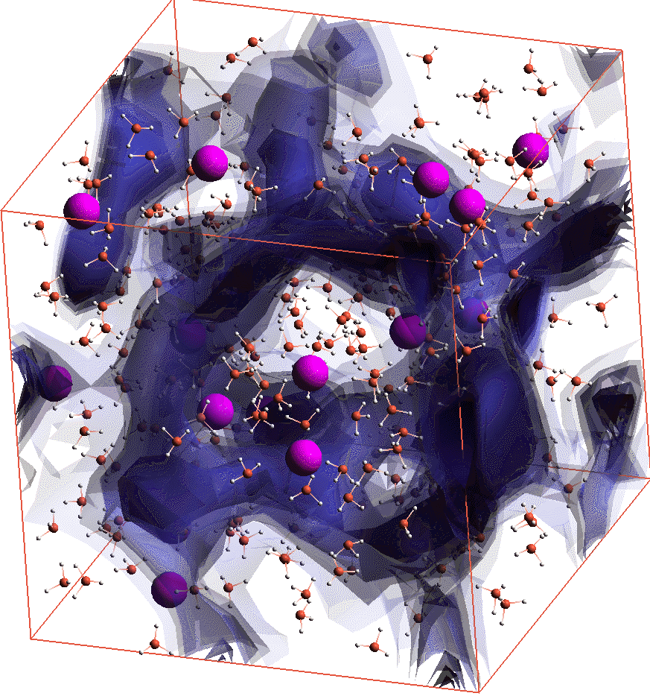
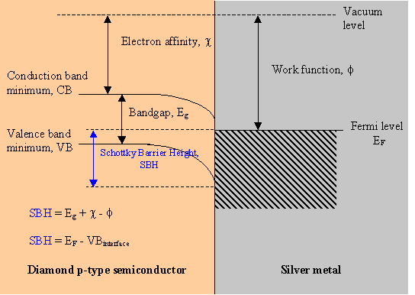
Reduced order Hartree-Fock Exchange for Extended States – in 3 minutes or less
Challenge: Reduced order methods for HF exchange are all formulated
for localized states. Metal-insulator transitions,
Metal-Semiconductor-Metal junctions → “no-go”.
Solution: A collaboratively developed r-space outer product formulation
motivates a new r-space/g-space decomposition to
reduce HF exch. computational complexity by N^{2/3}, N³ → N^{7/3} for the plane-wave (pw) basis.
14

Slide 15
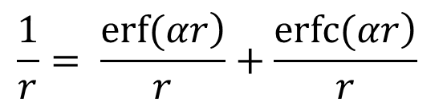
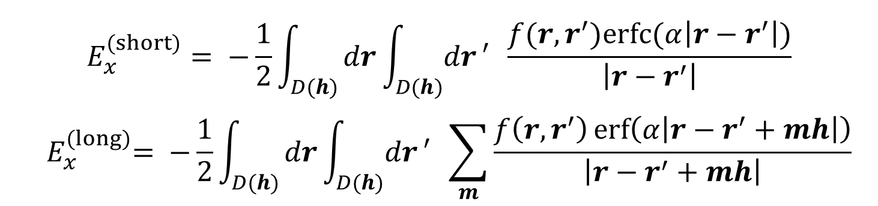

The proof – in a nutshell (2 slides)
$${ E}_{x} = −\frac{1}{2}\int_{D(h)}{dr\int_{D(h)}{dr}′}\sum_{m}{\frac{f\left(r,r^{′}\right)}{\left|r−r^{′}+mh\right|}} \\ ρ\left(r,r^{′}\right)=\sum_{i∋occ}{{φ_{i}^{∗}\left(r^{′}\right)φ}_{i}\left(r\right)} \\ f\left(r,r^{′}\right)= {\left|ρ\left(r,r^{′}\right)\right|}^{2}$$
HF exch. under PBC:
sum over periodic
images, m.
Outer product of orbitals on
the discrete pw mesh ~ N³.
Following Ewald - insert long/short-range decomp. of Coulomb interaction.
$$\frac{1}{r}= \frac{\left.erf⁡(αr\right)}{r}+\frac{\left.erfc(αr\right)}{r}$$
$$E_{x}^{(short)}= −\frac{1}{2}\int_{D(h)}{dr\int_{D(h)}{dr}′} \frac{f(r,r^{′})erfc(α\left|r−r^{′}\right|)}{\left|r−r^{′}\right|}$$
$${ E}_{x}^{(long)}= −\frac{1}{2}\int_{D(h)}{dr\int_{D(h)}{dr}′} \sum_{m}{\frac{f\left(r,r^{′}\right)\operatorname{erf}\left(α\left|r−r^{′}+mh\right|\right)}{\left|r−r^{′}+mh\right|}}$$
1st image
sufficient
15

Slide 16
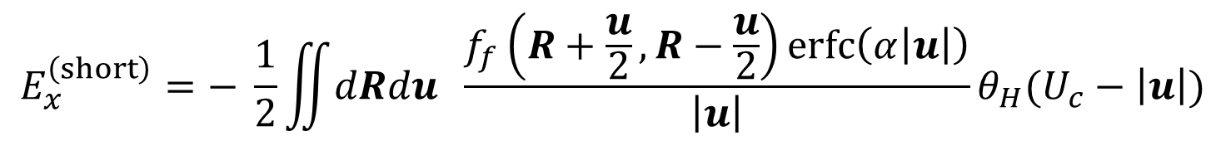
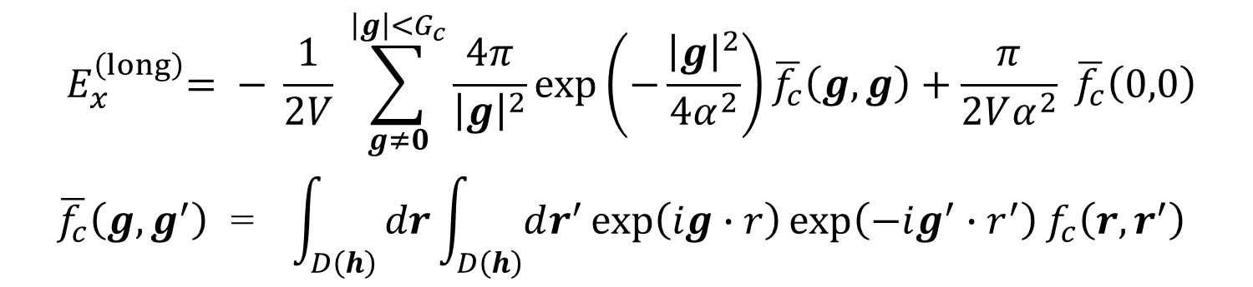
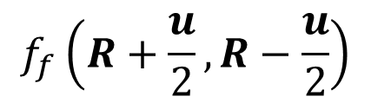


The proof – in a nutshell (2 slides)
Simplify* and introduce matrices on coarse, $f_{c}$, and fine $f_{f}$, meshes:
$$E_{x}^{\left(short\right)}=− \frac{1}{2}\iint{dRdu} \frac{f_{f}\left(R+\frac{u}{2},R−\frac{u}{2}\right)erfc\left(α\left|u\right|\right)}{\left|u\right|}θ_{H}(U_{c}−\left|u\right|)$$
$${ E}_{x}^{\left(long\right)}= − \frac{1}{2V} \sum_{g≠0}^{\left|g\right|<G_{c}}{\frac{4π}{{\left|g\right|}^{2}}\exp\left(−\frac{{\left|g\right|}^{2}}{4α^{2}}\right)}\overline{f_{c}}\left(g,g\right)+\frac{π}{2Vα^{2}} \overline{f_{c}}\left(0,0\right) \\ \overline{f_{c}}\left(g,g^{′}\right) \text{=} \int_{D\left(h\right)}{dr\int_{D\left(h\right)}{dr^{′}}}\exp\left(ig∙r\right)\exp\left(−ig^{′}∙r^{′}\right)f_{c}\left(r,r^{′}\right)$$
FFT’s
$$f_{f}\left(R+\frac{u}{2},R−\frac{u}{2}\right)$$
Create sparse-matrix on fine mesh: N² $U_{c}^{3}$ ~ N²${α }^{−3}$
$$f_{c}\left(r,r′\right)$$
Create dense-matrix on coarse mesh: N³$G_{c}^{6}$ ~ N³ ${α }^{6}$
$$α\sim N^{−1/9}$$
Choose α to equalize scaling: N^{7/3} (add log N for FFT’s)
$$∗\sum_{m}{p\left(r+mh\right)}= \frac{1}{\det\left(h\right)} \sum_{g}{\tilde{p}\left(g\right)}e^{ig∙r}, V=\det\left(h\right), g=\hat{g}h^{−1}, \hat{g}=\left\{j,k,l\right\}, \tilde{ p}\left(g\right)=\int_{−∞}^{∞}{dr^{′}}e^{−ig∙r^{′}}p(r′)$$
*
16

Slide 17
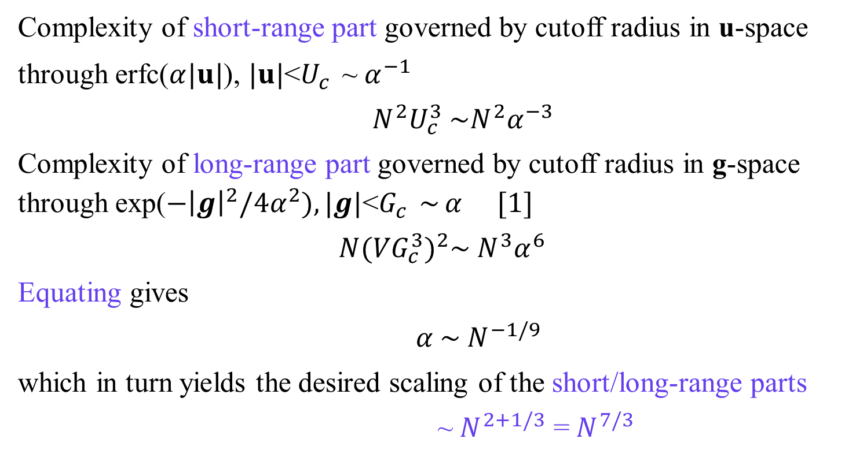
Reduced order Hartree-Fock Exchange: Scaling
Complexity of short-range part governed by cutoff radius in u-space
through erfc($α|u|$), $|u|$<$U_{c}^{}$~${ α}^{−1}$
${N^{2}U}_{c}^{3} \sim N^{2}α^{−3}$
Complexity of long-range part governed by cutoff radius in g-space through exp($−{\left|g\right|}^{2}/4α^{2}), |g|\text{<}G_{c}^{}$~ $α^{}$ [1]
$${ N(VG}_{c}^{3})^{2}\sim {N^{3}α}^{6}$$
Equating gives
${α \sim N}^{−1/9}$
which in turn yields the desired scaling of the short/long-range parts
~${ N}^{2+1/3}$ =${ N}^{7/3}$
[1] A plane wave basis with cutoff $G_{c}$ contains ${\sim VG}_{c}^{3 }$basis functions where V~N.
17

Slide 18
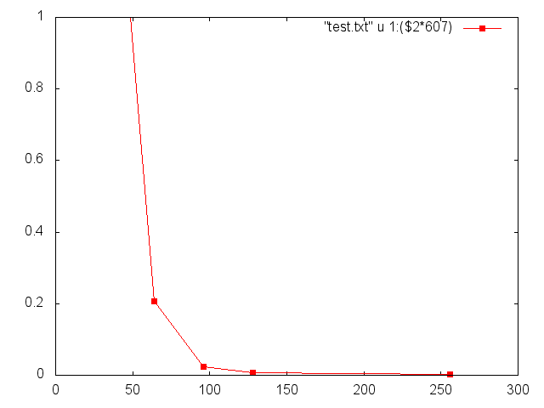


Reduced order Hartree-Fock Exchange: Accuracy
Short-range HF exchange requires treating an integrable singularity (Coulomb)
The plane wave mesh is equally spaced in Cartesian coordinates.
Develop a method to treat integrable singularities on simple meshes.
Consider integration in 1 spatial dimension for simplicity:
$$I=\sum_{i=0}^{n−1}{I_{cell}\left(i\right)}{ , I}_{cell}\left(i\right)=\int_{i∆+a}^{\left(i+1\right)∆+a}{dx f\left(x\right)k(x)}, ∆=\frac{b−a}{n}$$
Introduce a 1st order interpolation of f(x) in each cell
$$f\left(x\right)=\left[\frac{\left(\hat{x}\left(i+1\right)−x\right) }{∆}\right]f\left(i\right)+\left[\frac{\left(x−\hat{x}\left(i\right)\right) }{∆}\right]f\left(i+1\right)$$
where $f\left(i\right)=f(i∆+a)$ and $\hat{x}\left(i\right)$= ($i∆+a$). This can be input into $I_{cell}\left(i\right)$ and the integral over x performed analytically. Combing terms, the 1st order approximation to I, is
$$I^{\left(1\right)}(∆)=∆\sum_{i=0}^{n}{f\left(i\right)K(i)}$$
where for k(x)=1 the result is trapezoidal rule integration and K(i) is the “grid” function of k(x). This is employed only in cells where k(x) is rapidly varying – otherwise trap. rule integration of product function, f(x)k(x), is used, $K\left(i\right)→k\left(i\right).$
3D Generalization
Short-range
Coulomb over
a Gaussian density
$∆E (kcal/mol$)
Model for 32 waters (ambient conditions)
at 70 Ry pw cutoff
Integration pts on edge
of equally spaced
3D-Cartesian grid
18

Slide 19
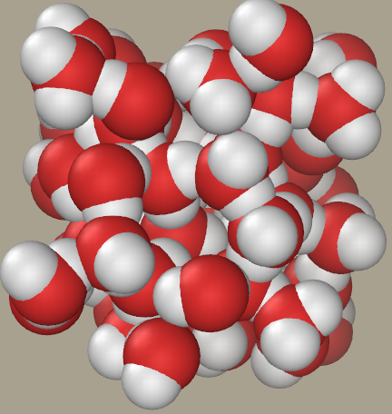

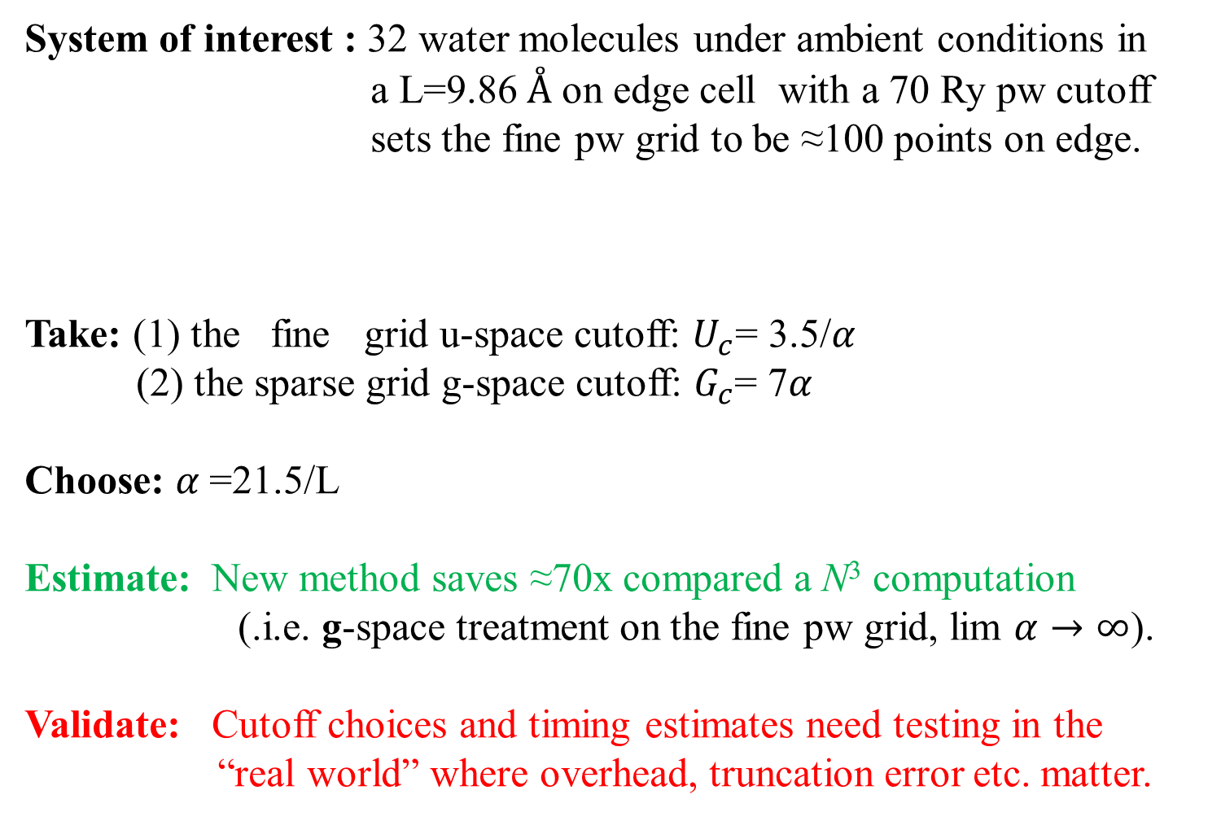
Reduced order Hartree-Fock Exchange: Sizing
System of interest : 32 water molecules under ambient conditions in a L=9.86$Å$ on edge cell with a 70 Ry pw cutoff sets the fine pw grid to be ≈100 points on edge.
Take: (1) the fine grid u-space cutoff: $U_{c}$= 3.5/$α$
(2) the sparse grid g-space cutoff: $G_{c}$= 7$α$
Choose: $α$=21.5/L
Estimate: New method saves ≈70x compared a N³ computation
(.i.e. g-space treatment on the fine pw grid, lim $α→∞$).
Validate: Cutoff choices and timing estimates need testing in the “real world” where overhead, truncation error etc. matter.
9.86 $Å$
19

Slide 20
Progress towards project goals
UIUC tasks:
3D-FFT library – beyond GJM.
Flow of control refactor.
Bring Tempering, Path integrals, k-points, LSDA to life – “Übers”.
Parallelization of “Übers”.
GPGPUs for orthogonality.
Parallelization of “Advanced methods”
(PAW, HF, PSM, …).
IBM tasks:
Derive N² log(N) scaling PAW.
Implement Grimme van der Waals.
Derive reduced order HF exch.
Derive selection rule for parallel tempering with sampled. potential surfaces – penalty method.
Derive improved CPAIMD via PSM.
Write toy codes and scientific papers.
Joint work:
Framework new methods.
Implement new methods.
Develop test suite for new methods – implement in OpenAtom’s Jenkins app.
Apply OpenAtom to important systems across S&T,
e.g. Metal Organic Framework with Yale & UIUC.
Develop analytics application for discovery.
Hero System
accomplished
ongoing
TBD
20

Slide 21
OpenAtom Ground State Software Overview
PPL Contributors: Eric Bohm, Nikhil Jain, Prateek Jindal, Eric Mikida, Michael Robson

Slide 22
Software Infrastructure
GIT (Gerrit) based repository:
http://charm.cs.illinois.edu/gerrit/openatom
Or https://github.com/ericbohm/OpenAtom/
Test system datasets available in git
Make test - Basic feature verification
Make full_test - Extensive use case verification
Jenkins testing
Release branch in nightly Charm++ testing
Release branch in Charm++ continuous integration testing

Slide 23


Ground State Feature Status
Feature | Minimization Status | Dynamics Status | Test Integration
CPAIMD Dynamics | NA | Production | Automated
Path Integrals | Production | Production | Automated
K-Points | Production | Needs Verification | Manual
Spin Orbitals | Production | Production | Manual
Tempering | NA | Production | Manual
Born Oppenheimer Dynamics | NA | Production | Automated
Band Generation | Needs Verification | Needs Verification | Manual

Slide 24
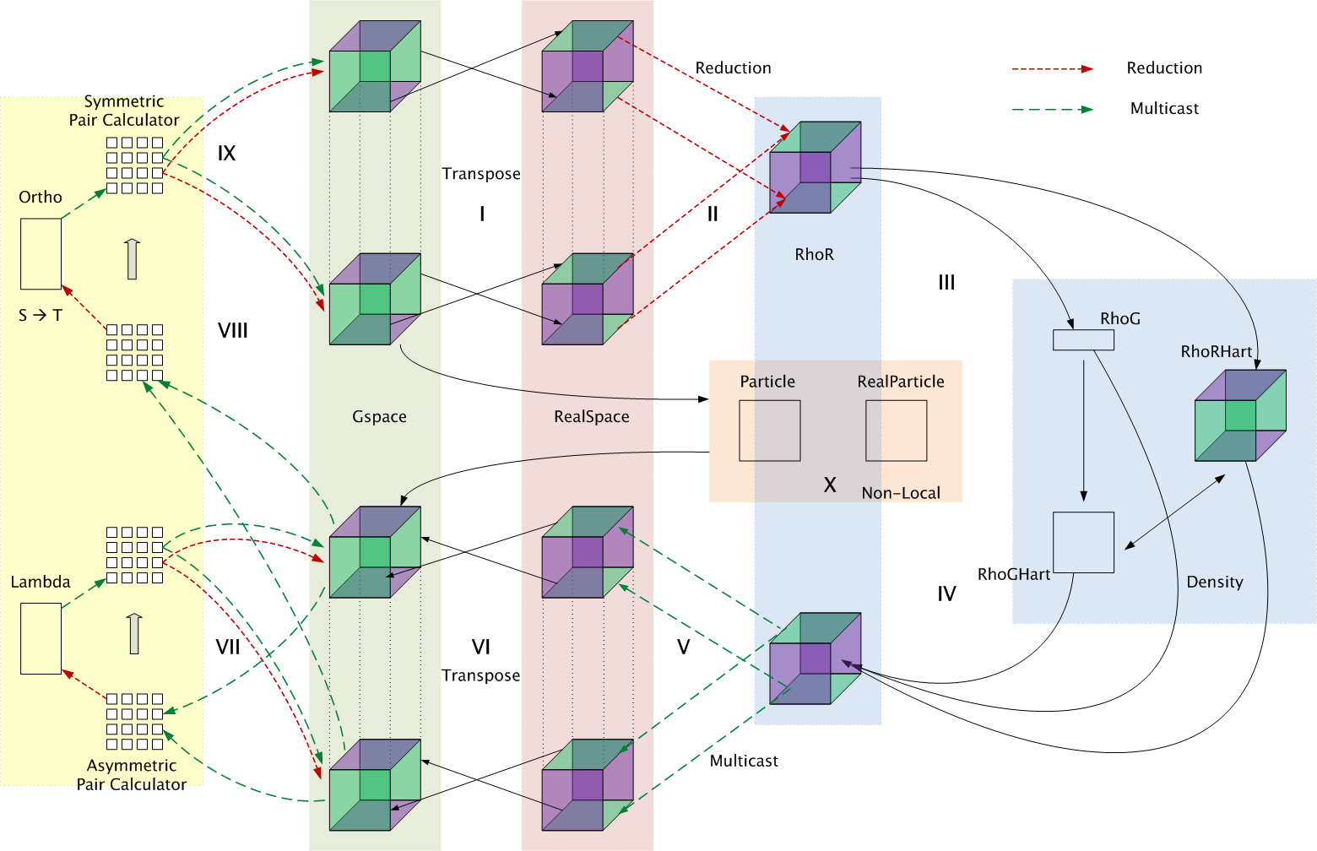
Data Structures and control flow in OpenAtom

Slide 25
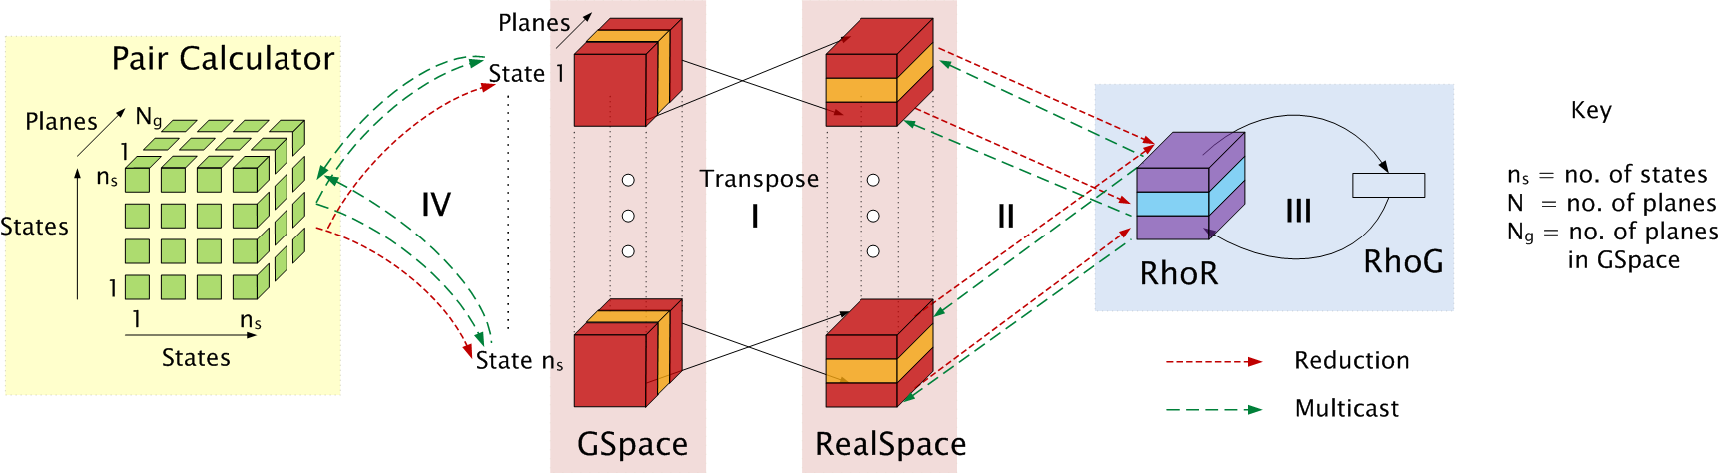
Object Decomposition
Showing a subset of object collections

Slide 26
Object Placement
Nikhil Jain

Slide 27
Topology aware mapping

Slide 28
Adapting to different systems
Separate the logical operations and machine-specific operations. Example:
Logical operation: get an ordered list of nodes
Machine specific: Hilbert curve traversal, blocked traversal, plane-traversal
Density FFTs: require use of full bisection bandwidth – spread throughout the allocation.
Matrix-matrix multiplies (pair calculators): place near the GSpace planes, but load balance is important.

Slide 29
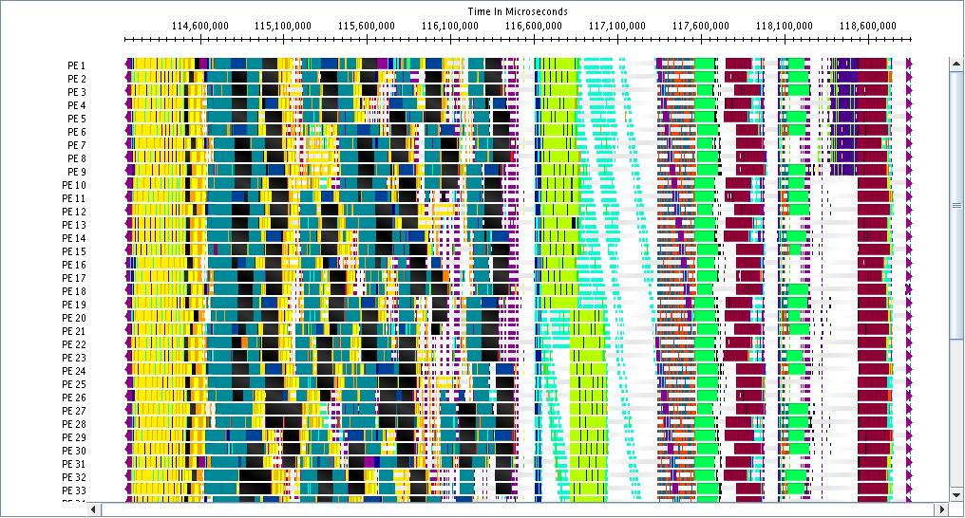
System utilization without mapping (barriers introduced for clarity)
States: Many
G -> R FFTs
Density: G -> R -> G
Non-local G-> R -> G
Density to States
States R-> G
Force correction
Ortho-normalizaton

Slide 30
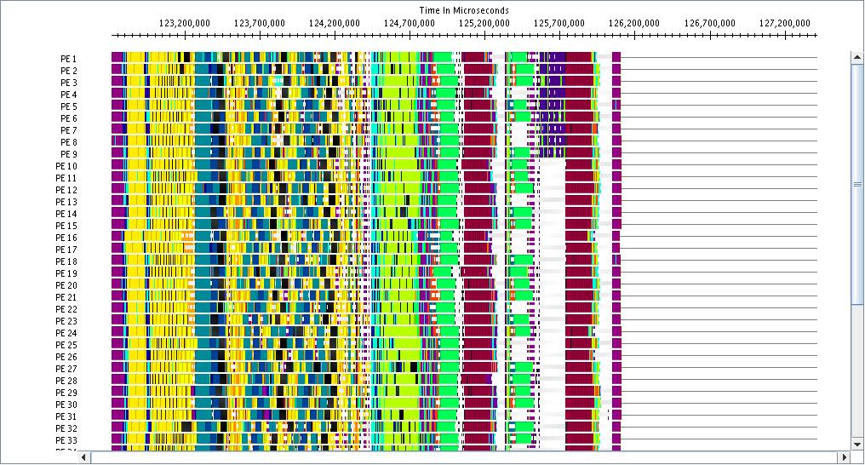
System utilization with mapping

Slide 31
Impact of mapping on Blue Gene/Q: up to 30% improvement

Slide 32
Impact of mapping on Blue Waters: up to 32% improvement

Slide 33
Charm FFT
Nikhil Jain

Slide 34
Optimizing FFTs in the density
Charm-FFT implemented to help improve the performance of the density phase.
Features:
Concurrent FFTs
2D decomposition
Overlaps with other work
Cutoff aware
Mapped by the application

Slide 35
Simulating 32 molecules of Water on Blue Waters

Slide 36
Multi-Instance Methods
Eric Bohm

Slide 37
Multi Instance Methods
Retain all existing code with minimal changes
Any feature available for CP minimization or dynamics automatically available for multi-instance use
Add Master Index of objects
Uber[temper][bead][k-point][spin]
Objects in any instance can be referenced by any object
Support simulations with many kinds of multi instance physics
Instance Controller
Temper Controller
Sum energies across Tempers and Beads
Switch Energies and Temperatures
Bead Controller
Intrapolymer force evaluation and integration

Slide 38
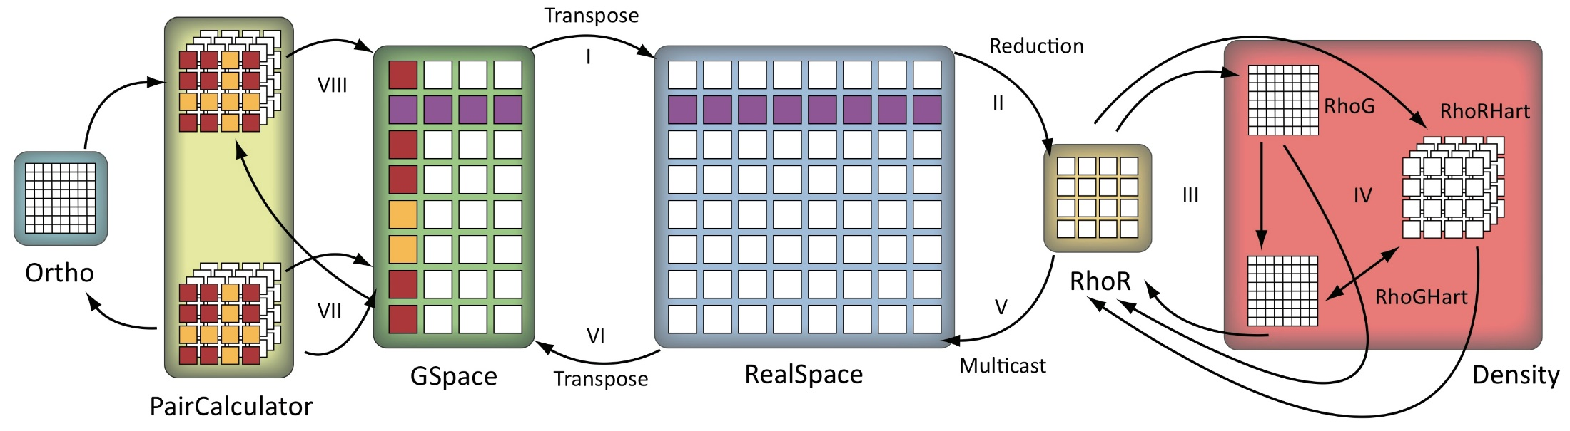
Spin Orbitals (LSDA)
Each Spin shares : atom and energy chares
Electron density from down passed to up
VKS computed for each spin
Returns to standard flow of control
Independent I/O for state data
Independent placement for instance chares

Slide 39
K-Points
Each k-point shares:
electron density, atoms, energy chares
Electron density = sum over KP electron states
Wave functions outside the first Brillouin zone forces use of complex (e.g., ZGEMM)
Instead of the “doublepack” optimization used at the Γ point
Independent I/O for state data
Independent placement for electron state instance chares
ρ

Slide 40
Path Integral Beads
Path Integral Bead replica contains independent instances of all phases of CPAIMD
May contain k-point and spin ensembles
Intrapolymer force evaluation in PIBeadAtoms
Interacts with each Bead instance's AtomsCompute
Supplements CPAIMD nucleic force integration phase
Computation Parallelized across NumAtoms and NumBeads
Independent I/O for state and coordinate data
Independent placement for instance chares
Bead1
Bead2
Bead4
Bead3
Bead5
Bead6
Bead
Ctrl

Slide 41
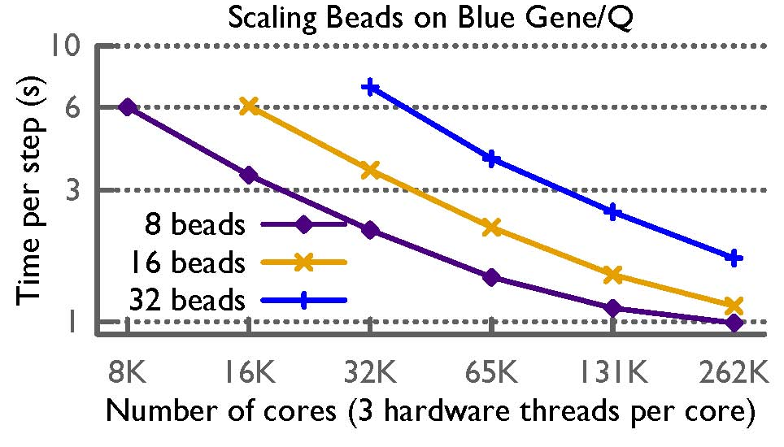
Path Integral Performance

Slide 42
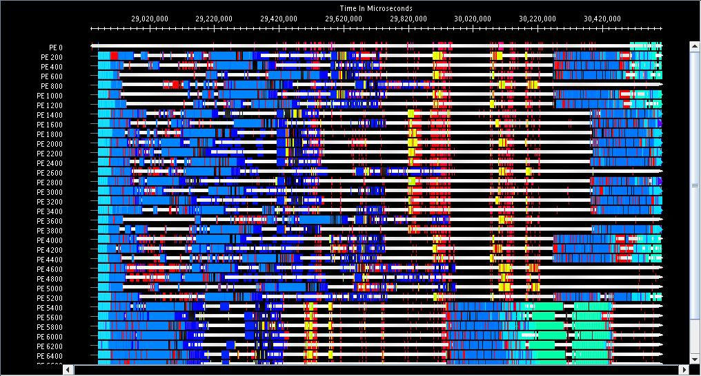
Multi Instance Challenge: cross bead interference

Slide 43
Cross FFT Interference

Slide 44
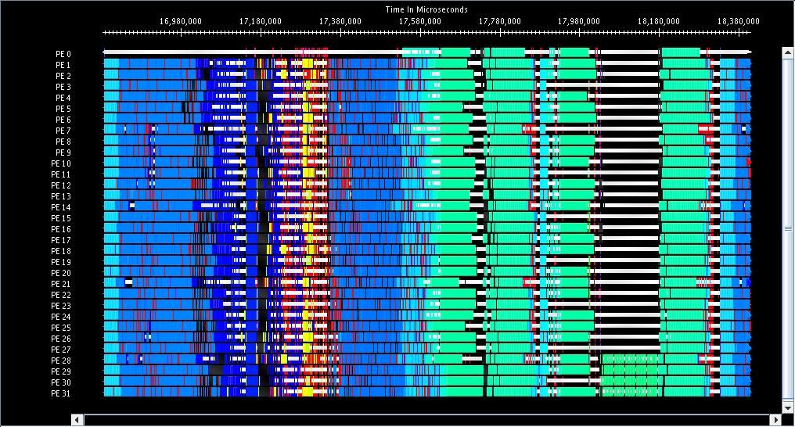
After Scheduling Improvements

Slide 45
Tempers
Contains independent instances of all phases of CPAIMD
Each temper may contain Beads, K-points, and Spin instances
Temper controller manages random neighbor shuffle to exchange temperatures across temper replicas
Independent I/O for state and coordinate data
Independent placement for instance chares
280⁰
290⁰
300⁰
310⁰

Slide 46
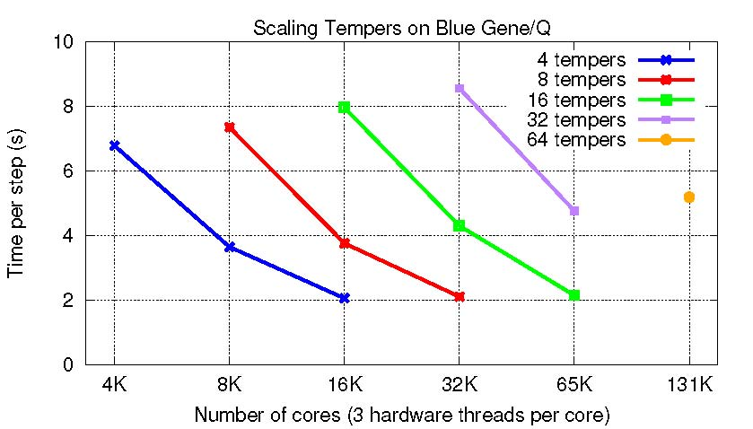
Temper Performance

Slide 47
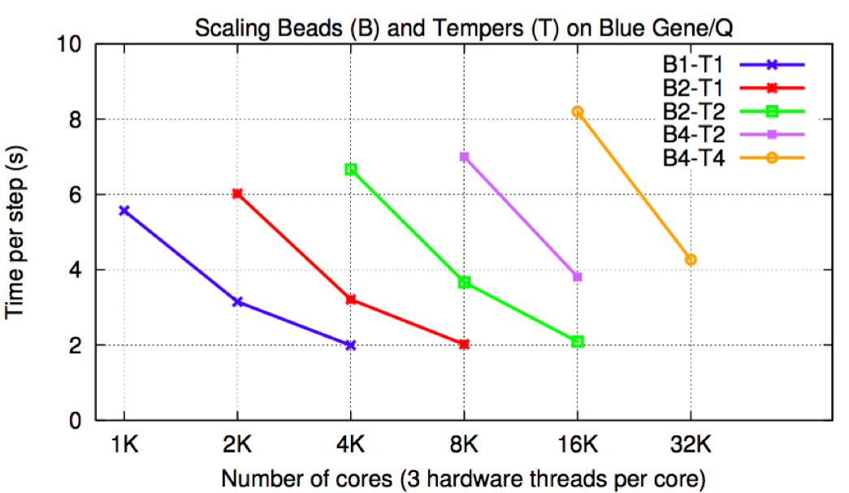
Combined Performance

Slide 48
GPGPU
Michael Robson

Slide 49
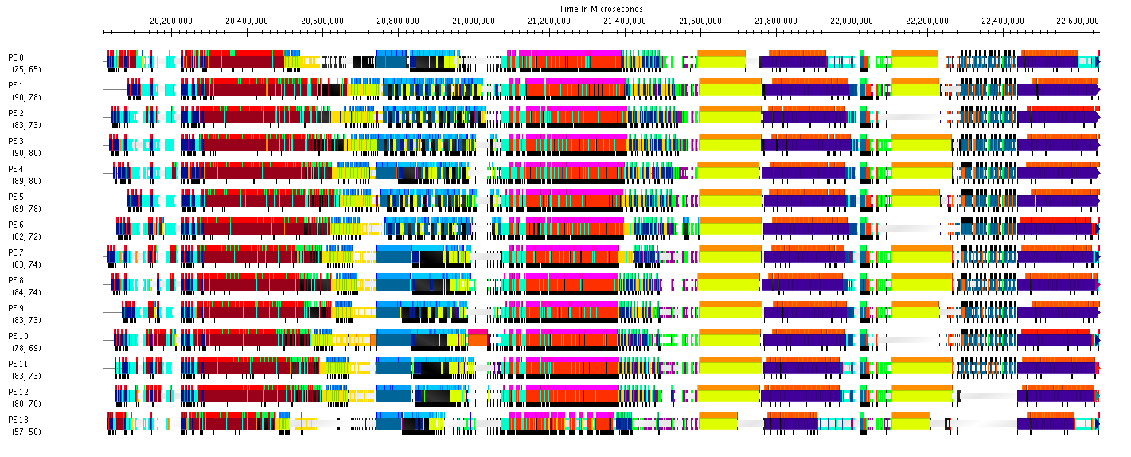
Opportunities for GPUs
PC
PC
PC
ORTHO
PC

Slide 50
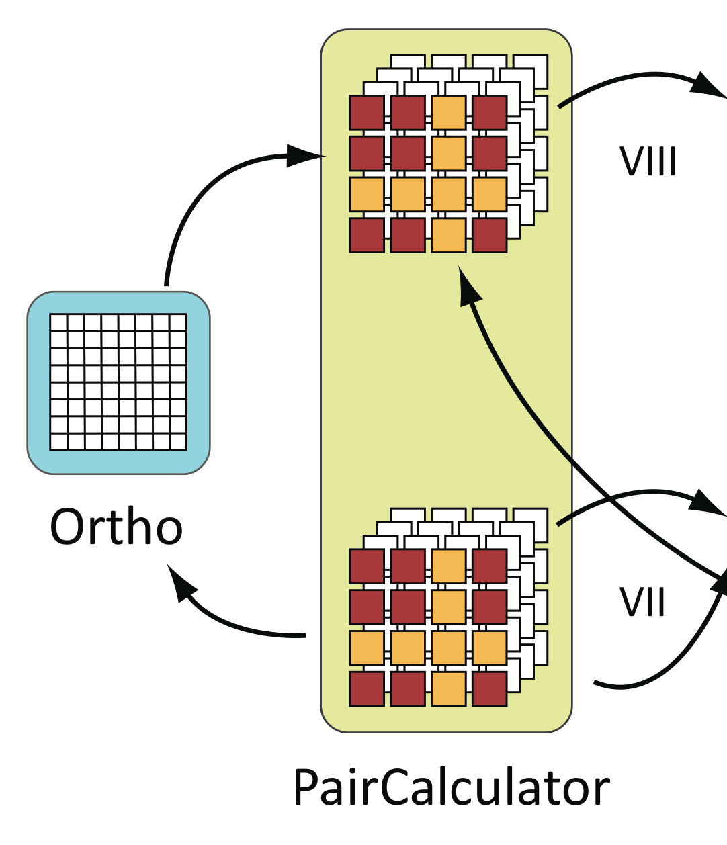
Ortho Integration
T = S^{-½}
Kernel developed by summer intern
Changes from distributed to centralized
Gather pieces of S from PCs
S -> T

Slide 51
Opportunities for GPUs
Orthonormalization (Ortho)
Inverse Square Root of Matrix
Pair Calculator (PC)
Matrix Matrix Multiplication
Both make good GPU targets

Slide 52
Results for MOF System
1 iteration, 1PE, 64 XK Nodes of Blue Waters
Centralized Ortho, No CUDA
148 ms
153 + 1684 ms
Centralized Ortho, CUDA
210 ms
198 + 69 ms
Distributed Ortho, No CUDA
174 ms
75 + 88 ms
Notes:
Late Breaking Results: Competitive!

Slide 53
Results for 256 Water Molecules
1 iteration, 1 PE, 64 XK Nodes of Blue Waters
Centralized Ortho, No CUDA
296 ms
297 + 2781 ms
Centralized Ortho, CUDA
312 ms
297 + 105ms
Distributed Ortho, No CUDA
78 ms
72 + 172 ms
Notes:
2 Logical Node Example

Slide 54
Pair Calculator Results
Baseline CUBLAS implementation
Offload forward and backward multiply
CUDA Streams
Directly allocate memory
Synchronize on data move
Fine because we don’t have other work

Slide 55
Results for 256 Water Molecules
1 iterations, 1 PE, 64 XK Nodes of Blue Waters
Baseline
164 ms
205 ms
163 ms
216 ms
CUBLAS
47 ms
113 ms
90 ms
142 ms
 | Forward | Speedup
Baseline | 327 ms
CUBLAS | 137 ms | 2.39x
Backward | Speedup
421 ms
255 ms | 1.65x
Per Iter | Speedup
2.582796 s
2.346571 s | 1.10x
Notes:
2 Logical Node Example

Slide 56
Ground State Future Work
Test automation and feature verification
Multi-Instance Performance Tuning
CharmFFT integration for State and Non-local
Fast Hartree Fock
PAW
GPU
GPU Manager integration
Backward path PC
CharmFFT
Communication optimization (NVLink, etc)
Auto-tuning controls in PICS

Slide 57


Towards high scalable GW calculations
Subhasish Mandal¹, Minjung Kim¹, Eric Mikida², Eric Bohm², Prateek Jindal², Nikhil Jain², Laxmikant V. Kale², Glenn Martyna³,
& Sohrab Ismail-Beigi¹
¹Dept. Of Applied Physics, Yale University
²Department of Computer Science, University of Illinois at Urbana–Champaign
³IBM T. J. Watson research Center

Slide 58
Towards high scalable GW calculations
OpenAtom + GW
University of Illinois
IBM Watson Research
Yale University
git clone http://charm.cs.illinois.edu/gerrit/openatom.git

Slide 59
Outline
Introduction & Motivation of GW
Stages of GW calculation
Static Polarizibility : Methods & Scaling
Computing self-energy Σ(ω)
Summary

Slide 60
GW-BSE: what is it about?
e⁻
DFT is a ground-state theory for electrons
But many processes involve exciting electrons:
Transport of electrons in a material or across an interface: dynamically adding an electron
→ The other electrons respond to this and modify energy of added electron
“GW” method solves this problem

Slide 61
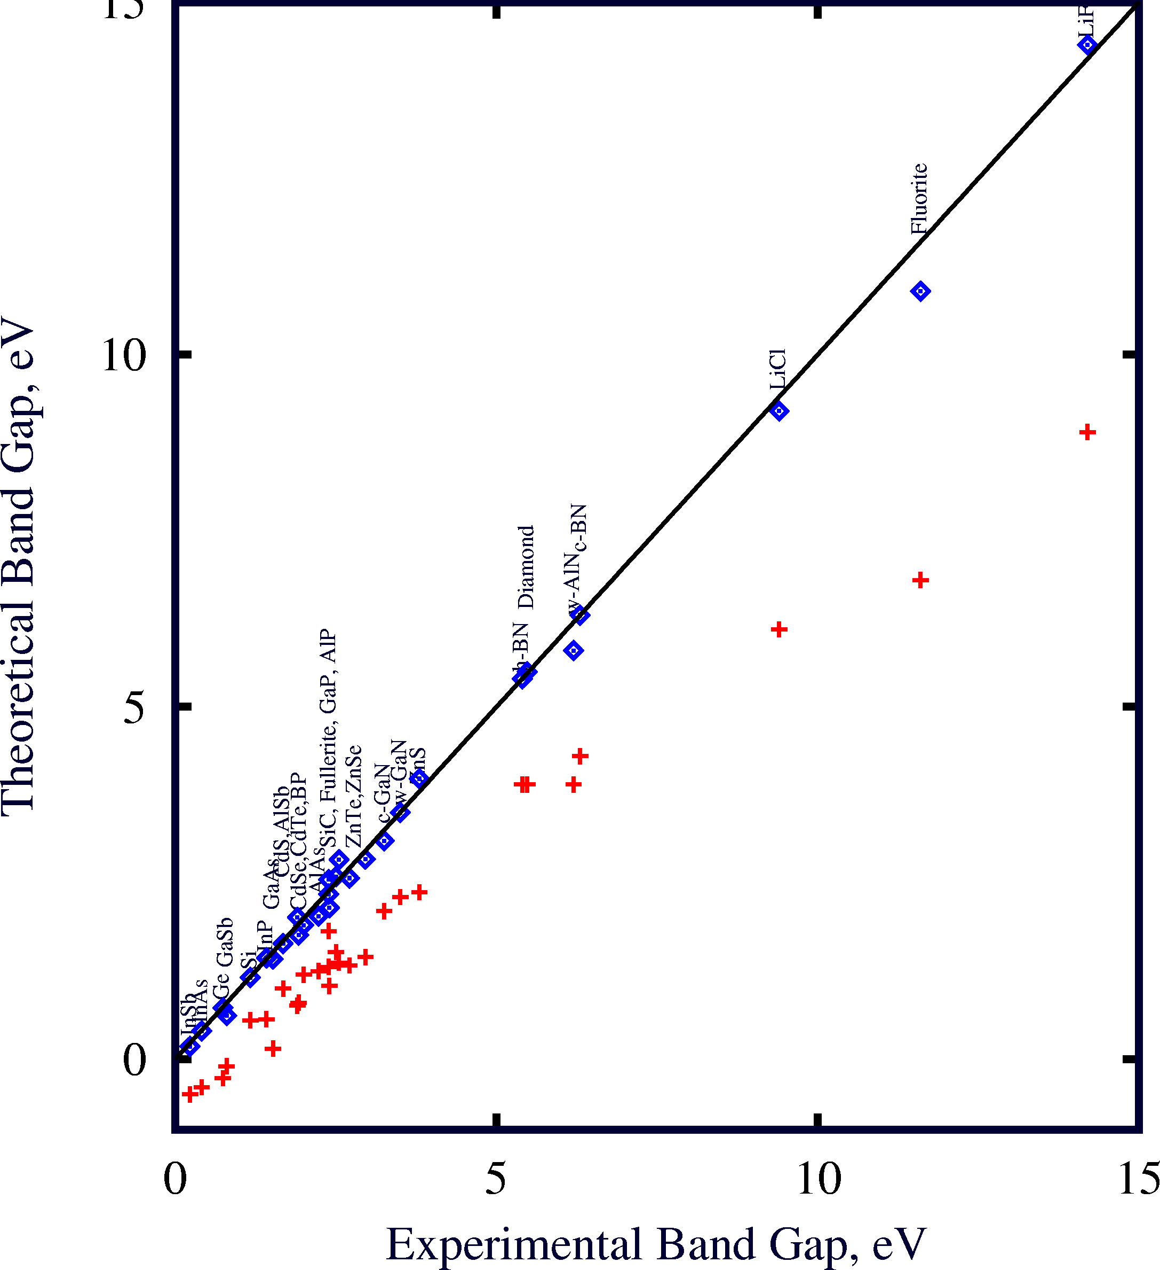
Successes of GW
Energy gaps (eV)
Material | DFT-LDA | GW* | Expt.
Diamond | 3.9 | 5.6 | 5.48
Si | 0.5 | 1.3 | 1.17
LiCl | 6.0 | 9.1 | 9.4
* Hybertsen & Louie, Phys. Rev. B (1986)

Slide 62
Motivation (Cont. )
GW-BSE is computationally challenging:
Huge number of FFTs
Huge memory footprints
Large and dense matrix multiplications
Theoretical scaling
DFT: | N³
GW: | N⁴
BSE: | N⁶
Ex. 50-75 atoms (GaN)
DFT: | 1 cpu x hours
GW: | 91 cpu x hours
BSE: | 2 cpu x hours
Goal:
Developing highly scalable GW-BSE software
to tackle these challenges

Slide 63
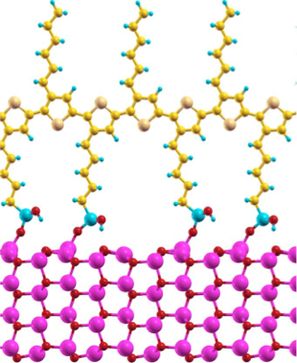
Motivation (Cont. )
Would love to do GW-BSE on this photovoltaic system…
P3HT polymer
But with available GW-BSE methods
it would take “forever”
i.e. use up all my supercomputer allocation time
Zinc oxide nanowire

Slide 64
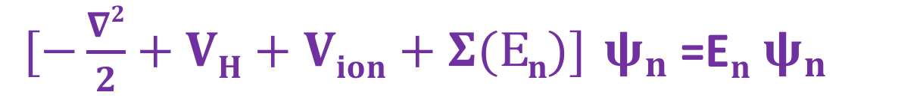
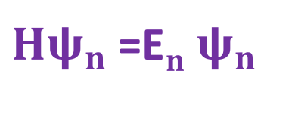

GW
Physicist’s favorite :
=E
self-energy
Dyson equation for many-body problem:
=E
GW Equation:
Hedin, Phy Rev, 139, 1965; Hybertsen, Louie, PRB, 34,1986

Slide 65
Stages of GW calculation
Stage 1 : Run DFT calc. on structure → output : Ε_{i} and 𝜓_{i}(r)
Stage 2.1 : compute Polarizability matrix
Stage 2.2 : double FFT rows and columns → P(G,G’)
Stage 3 : compute and invert dielectric screening function
Stage 4 : “plasmon-pole” method → dynamic screening
Stage 5 : put together Ε_{i} , 𝜓_{i}(r) and → self-energy Σ(ω)

Slide 66
Hardest parts
Stage 1 : Run DFT calc. on structure → output : Ε_{i} and 𝜓_{i}(r)
Stage 2.1 : compute Polarizability matrix
Stage 2.2 : double FFT rows and columns → P(G,G’)
Stage 3 : compute and invert dielectric screening function
Stage 4 : “plasmon-pole” method → dynamic screening
Stage 5 : put together Ε_{i} , 𝜓_{i}(r) and → self-energy Σ(ω)
Most expensive

Slide 67
Static Polarizability
Standard G-space approach:
Directly compute P in G space
A huge number of FFTs (N_{v}N_{c})
N_{v} : # occupied states
N_{c} : # unoccupied states
R-space approach: Much fewer number of FFTs

Slide 68
Static Polarizability
New R-space approach:
1) Calculate static polarizability in real space
2) FFTs for columns
# FFTs: N_{r}
N_{r}: # R grid
N_{r} ≈ 4Nc
3) FFTs for rows
# FFTs: N_{r}
 | G-space approach | R-space approach
#FFT | N_{v}N_{c} | 8N_{c}
N_{v}=500 N_{c}=1,500 | 750,000 | 12,000
N_{v} : # occupied states
N_{c} : # unoccupied states

Slide 69
Static Polarizability
What R grid should we use?:
3D FFT box
N
Si crystal
Dense FFT grid: 24×24×24
P and ε⁻¹ converge at: 12×12×12
reduced to 1/8 !!
Notes:
Add another materials

Slide 70

Test system
Scaling of Polarizibility
Si bulk
Total number of atom : 54
108 occupied states
892 unoccupied states
3 k-points
289,008 total f vectors
Each state and f vector ~0.5 MB

Slide 71

Performance
* Results on 1024 nodes of Vesta, 32 threads per node
Calculation | Time (seconds)
 | SMP, BLAS3 (2D decomposition) | No SMP, BLAS 2 (1D decomposition)
Compute f vectors for a single unocc state | 0.005 | 0.08
Total for 2,676 sets of f vectors | 14.17 | 378.04
Total wall time | 105.79 | 416.22
Overhead (comm, synchronization) | 90.50 | 38.18
SMP: shared memory programming: takes advantage of node level parallelism
Eric M, UIUC

Slide 72
Performance
Computing P-matrix
Total Wall Time (Seconds)
Number of Nodes
32 Threads per node on Vesta

Slide 73
GW-Self-Energy (Σ)
Stage 5 : Put together Ε_{i} , 𝜓_{i}(r) and → self-energy Σ(ω)

Slide 74
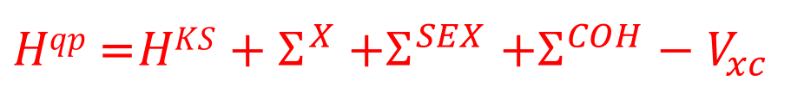
GW-Static Self-Energy (COHSEX)
Static self-energy approximation: a useful simplification
W(r,r’,E) → W(r,r’,E=0)=W(r,r’)
=

Slide 75
GW-Static Self-Energy (COHSEX)
Static self-energy approximation: a useful simplification
W(r,r’,E) → W(r,r’,E=0)=W(r,r’)
Band Gaps (eV)
System | Experiment | DFT-LDA | COHSEX | Corrected COHSEX* | GW(full)
Diamond | 5.48 | 4.20 | 6.99 | 5.93 | 5.70
Si | 1.17 | 0.49 | 1.70 | 1.18 | 1.29
*Kang & Hybertsen, Phy Rev B, 82, 2010

Slide 76
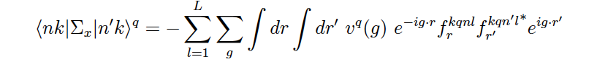
GW-Bare Exchange
v
Coulomb
Strategy 1:
(Motivated from P(G,G’) )
Strategy 2:
‘
Single FFT
Double FFT
Coded and tested
Coded and tested

Slide 77
GW-Bare Exchange
GW In-house code
Strategy 1:
Strategy 2:
Real time required on Si calculation:
135.369 sec
Real time required on Si calculation:
2.783 ssec
FFT of vector
FFT of rank 2 matrix
Strategy 2 wins
Screened Exchange: followed with Strategy 2
Coulomb-Hole: followed with Strategy 2

Slide 78
Summary
New R-space approach of Polarizibility
Polarizibility is parallelized with Charm++ & take the advantage of SMP
We have investigated various ways to calculate static self-energy.
Strategy 1 is effective for P(G,G’) But for COHSEX Strategy 2 wins
Acknowledgement
NCSA & ALCF@Argonne National Laboratory.
QUESTION ?

Slide 79
Static polarizability calculations
The most time consuming part
Standard G-space approach:
Directly compute P in G space
A huge number of FFTs (N_{v}N_{c})
Nv : # occupied states
Nc : # unoccupied states
R-space approach: Much fewer number of FFTs

Slide 80
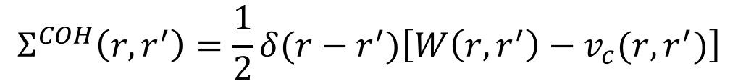
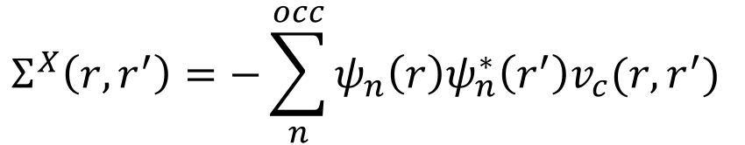
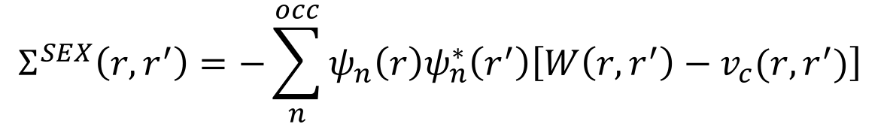
GW-Static Self-Energy (COHSEX)
Static self-energy approximation: a useful simplification
W(r,r’,E) → W(r,r’,E=0)=W(r,r’)
=

Slide 81


GW-Bare Exchange
v
Coulomb
Strategy 1: Motivated from P(G,G’)
Sum over l & compute:
‘
Double FFT
Strategy 1:
Coded and tested

Slide 82


GW-Bare Exchange
Strategy 2:
v
Compute f_{r} (vector) and do FFT:
Multiply: v_{g} f_{g} f_{g’} and take sum over g
Strategy 2:
Coded and tested

Slide 83

Density Functional Theory
For the ground-state of an interacting electron system we solve a Schrodinger-like equation for electrons
Approximations needed for V_{xc}(r) : LDA, GGA, etc.
Tempting: use these electron energies ϵ_{j}
to describe processes where
electrons change energy
(absorb light, current flow, etc.)
Hohenberg & Kohn, Phys. Rev. (1964); Kohn and Sham, Phys. Rev. (1965).

Slide 84
Step 2 – FFT P to G-Space
Performance
FFT each row of P locally:
Transpose P
FFT each row locally again
Transpose P again:
Total time: 13.93s
* Results on 1024 nodes of Vesta, 32 threads per node

Slide 85




GW-Bare Exchange
GW In-house code
Strategy 1:
Strategy 2:
FFT of rank 2 matrix
FFT of vector
Real time required on Si calculation:
135.369 sec
Real time required on Si calculation:
2.783 ssec
Strategy 2 wins
Screened Exchange:
Coulomb-Hole:
=
Summary:

Slide 86




GW-Static Self-Energy (COHSEX)
Static self-energy approximation: a useful simplification
W(r,r’,E) → W(r,r’,E=0)=W(r,r’)
=
Band Gaps (eV)
System | Experiment | DFT-LDA | COHSEX | Corrected COHSEX* | GW(full)
Diamond | 5.48 | 4.20 | 6.99 | 5.93 | 5.70
Si | 1.17 | 0.49 | 1.70 | 1.18 | 1.29
*Kang & Hybertsen, Phy Rev B, 82, 2010

Slide 87
Scaling of Polarizibility
Stage 2.1 : compute Polarizability matrix
Stage 2.2 : double FFT rows and columns → P(G,G’)
Most expensive

Slide 88
GW-Bare Exchange
Strategy 1:
Computational load (on pen & paper)
Step 1:
Step 3:
Step 2:
N_{L}: # of occupied bands
Strategy 2:
Step 1:
Step 2:

Slide 89
GW-BSE: what is it about?
DFT is a ground-state theory for electrons
But many processes involve exciting electrons:
Transport of electrons
Excited electrons: optical absorption promotes electron to higher energy
→ The missing electron (hole) has + charge, attracts electron:
modifies excitation energy and absorption strength
e⁻
h⁺
“BSE” method solves this problem

Slide 90



Would love to do GW on this interfacial oxide/semiconductor system…
Si interface with SrTiO₃
Full unit cell

Slide 91
Would love to do GW on this interfacial oxide/semiconductor system…
Si interface with SrTiO₃
Full unit cell

Slide 92
GW-Bare Exchange
Biggest Computational load (on pen & paper)
Strategy 1:
N_{L}: # of occupied bands
Strategy 2:

Slide 93
Performance
Step 1 – P in R-Space
Berkeley GW
OpenAtom
Total Wall Time (Seconds)
Step 2 – FFT P to G-Space
….Work in progress

Slide 94
Performance
Step 1 – P in R-Space
Total Wall Time (Seconds)
Number of Nodes
32 Threads per node on Vesta
Step 2 – FFT P to G-Space
….Work in progress

Slide 95


DFT: problems with excitations
Energy gaps (eV)
Material | DFT-LDA | Expt. [1]
Diamond | 3.9 | 5.48
Si | 0.5 | 1.17
LiCl | 6.0 | 9.4
Solar spectrum
[1] Landolt-Bornstien, vol. III; Baldini & Bosacchi, Phys. Stat. Solidi (1970).
[2] Aspnes & Studna, Phys. Rev. B (1983)

Slide 96

Green’s functions successes
Energy gaps (eV)
Material | DFT-LDA | GW* | Expt.
Diamond | 3.9 | 5.6 | 5.48
Si | 0.5 | 1.3 | 1.17
LiCl | 6.0 | 9.1 | 9.4
Solar spectrum
* Hybertsen & Louie, Phys. Rev. B (1986)

