Slide 1
The Parallel Research Kernels; an Objective Tool for Parallel System* Research
Maria Garzaran, Rob Van der Wijngaart, Tim Mattson
Intel Corporation
https://github.com/ParRes/Kernels
*Parallel system=hardware system + OS + parallel programming environment (ProgEnv: programming model + API + compiler + runtime)
Notes:
The PRK can be and have been used to study many aspects of parallel systems. The definition of such systems given here could even be extended to schedulers, assembler, network stacks, linkers, libraries, etc. In this talk we will focus on the most prominent software components of the system from the application programmer’s point of view.

Slide 2
Agenda
Parallel Research Kernels (PRK) motivation
Philosophy
Reference implementations
PRKs you should care about
Results
Notes:
I’ll give you the background on what went into our decision to create the PRK, the philosophy behind their design, the growing collection of open source reference implementations, the most important kernels for large-scale parallel systems and applications research, and a subset of results obtained with the kernels that we use to compare parallel systems. It is important to recognize, though, that these kernels are not benchmarks, as I hope will become clear during this talk.

Slide 3
PRK Motivation
Observations
Performance of full app is mixture of multiple effects/interactions: hard to apply learnings to other apps
Hard to obtain useful data of full app on simulator (1 s * 1M = 11.6 days)
Can’t predict which apps (or languages, or ProgEnvs) important in 10 years
But: Can predict which fundamental parallel constructs/patterns will matter
Proposal: provide something simpler
Generic parallel-specific app patterns, i.e. parallel kernels
Each kernel contains only one pattern
Notes:
Many papers have been published about performance of important applications on particular systems. But unless your own is from the same field and uses the same methods, it is very difficult to translate performance of one application to that of another. And when the system of interest doesn’t exist yet and I need to use a simulator, which may incur a slowdown of 1M X, I cannot wait for my application to read my HDF5 files and do other prepping before the actual hot loops start. Also, apps and algorithms evolve and I don’t know which will be the most important 10 years from now, so it is tricky to use full apps for future system design.

Slide 4
PRK Motivation, cont’d
Limitations:
Focused (mostly) on features stressed by parallel parts of application
Emphasize parallel overhead, so may exaggerate parallelization impact
Not designed for full application performance projections
Single data structure, one or two hot loops: small data layout/alignment details may dominate performance
Not designed to measure robustness: fault tolerance, I/O performance
Not designed to measure ProgEnv productivity, due to kernel simplicity
Not designed to measure ProgEnv expressiveness; that battle had been fought … we thought
Notes:
The kernels of interest represent those patterns in which parallel applications often spend a lot of time on representative parallel systems—particularly when those patterns involve communication and synchronization. Because we focus on them, this may give a exaggerated, pessimistic view of the systems studied.
The kernels are parameterized, but can still never cover all the possible variations encountered in applications, and also do not fully cover interactions between the multiple patterns occurring within real applications if these kernels operate on the same data structures. So we cannot use the kernels for full application performance projections.
Small implementation details of a single simple pattern may highlight performance differences that would often get washed out between many different kernels occurring in a full application. The PRK are like a microscope!
An important property of a large scale parallel system is robustness, which often involves moving data to non-volatile storage or other locations in the system. We didn’t design the PRK to measure that—though we’re in the process of adding it.
When the PRK were designed, there was really only one large-scale generally accepted parallel programming environment, MPI (sometimes + OpenMP). The productivity and expressiveness of that were well known, so we didn’t design the PRK to test them. But in our implementation efforts we actually found remarkable differences in the ease with which certain patterns can be implemented. Some environments, for example, make it much harder to avoid global synchronizations than others. And some have more difficulty with patterns that are not data parallel than others.

Slide 5
PRK Philosophy
Useage model
Analyze app, map patterns to kernels, study performance of kernels
If system does well on all relevant kernels, move to mini-app or actual application (method of elimination)
Example parallel application analysis:
read lists of data
do local sort into buckets
send one bucket each to all other nodes
merge incoming buckets
Useful PRKs: 1: Nstream, 2: Sparse or Random, 3: Transpose, 4: Nstream
Notes:
The idea is that if even just one of the important parallel patterns in your whole app does poorly in a certain environment, you can spare yourself the trouble of painstakingly analyzing the entire app; usually, Amdahl’s Law will cut you down.

Slide 6
PRK Philosophy
Broad range of important patterns found in real parallel applications
Reasonably self-contained for all of HPC
Paper-and-pencil specifications
Simple, understood by non-domain scientists (not algorithms, but patterns!)
Each kernel does some real work. Corollaries:
Uniform performance metric = work/time
Work can be tested for correctness
Compact reference codes O(1-3 pages): easy porting to new ProgEnv
Performance expectations (simplified performance models)
Notes:
We actually also added some kernels that do not stress the communication and synchronization aspects of a parallel system to make the suite potentially a one-stop shop. But you don’t have to use these. We at Intel often do, though, as the whole PRK suite provides a convenient performance regression test.
The most important aspect of the PRK are the paper and pencil specifications, which allow many different implementations.
The patterns covered by the kernels are so simple that they (mostly) do not invite gaming or smart algorithmic tricks, and can be understood by anyone with the most elementary knowledge of mathematics and physics. So they have meaning to scientists from any kind of discipline.
Real work=transforming data. In the process we often need to move data, and that is usually the biggest performance cost in HPC applications. But that is almost never what we are after. Some suites hammer on, say, the barrier, but just placing 100M barriers in a row does not tell you much. The system may (inadvertently) skip 99% of them, or a really smart runtime can remove them as dead code, and you would never know. So we make sure there is some work between those barriers, and if anything goes wrong, it shows up in the numerical results. This allows us to check for correctness of the tested pattern.
Because the patterns are so simple, they can always be specified in less than half a page of prose, and their serial reference implementations are very short, which makes porting to other programming environments quite simple—unless there are pathologies in the target environment!
An important aspect of the PRK project is the provision of Performance Expectations, which are simple, parameterized performance models that function as sanity checks on the performance. The parameters contain both workload-specific and (hardware) system parameters.

Slide 7
Reference implementations
Portable:
plain C/Fortran serial reference implementations, no excessive tuning
no assembly/intrinsics/ libraries (except MKL’s DGEMM, optional)
Multiple parallel versions:
“Traditional”: OpenMP, MPI: one- and two-sided + hybrid (OpenMP, MPI3 SHM), AMPI, FG-MPI
Disruptive: Charm++, Grappa, UPC, OpenSHMEM, CAF, Legion, HPX, OCR, Chapel, HClib, …
Parameterized: problem size, #iterations, algorithmic choices
No input files; all initialization data synthesized
Automatic verification test
keeps users honest
facilitates porting/debugging
CAF=Fortran with co-arrays, OCR=Open Community Runtime
Notes:
We provide serial reference implementations of all the kernels, and also, with the help of the HPC community, a growing collection of parallel implementations of the most important kernels. These need to be portable, so no system-specific or extreme tuning—though you can always do that yourself, of course, and publish about it!
We already have relatively conventional parallel implementations in OpenMP, MPI with and one- and two-sided communications, MPI with MPI 3 shared memory, MPI with (local) OpenMP, Adaptive MPI and Fine-grain MPI (sources mostly conventional, but runtimes quite unconventional!). And then there are the more disruptive environments in blue, those in green already exist in some form but haven’t been vetted and incorporated yet. Those in red are forthcoming, stay tuned!
Here’s an important point: the kernels do not have a particular size, and some other properties are kept variable as well, including some important parallel algorithmic variations (e.g. local barrier versus point-to-point synchronizations for hybrid implementations). This allows you to learn many different things from just one kernel. The PRK aren’t benchmarks! Though you could use them as such when you freeze all the parameters.
Because the problem parameters (including problem size) aren’t fixed, we cannot supply input files; all data must be synthesized. That is a great convenience: no GB of data to lug around, quick initialization, known problem data characteristics.
The most difficult PRK requirement to satisfy is the verification test. Because we cannot precompute all possible solutions and store them, we need to have analytical solutions that are sensitive to anything that can go wrong. So no convergence (may stop prematurely without effect on solution), no exponential growth (blowup), no independent iterations that overwrite earlier result, etc. Also do not want verification to affect behavior of pattern of interest, or take inordinate amounts of time and memory. Much harder than you may think. The use is mostly to help with debugging during porting, though it also tries to keep potential cheaters honest.

Slide 8
PRKs you should care about
Because they:
Exhibit a range of granularities
Feature drastically different communication patterns
Proxy very important patterns in HPC
Contain both data parallel and non-data-parallel patterns
Allow assessment of ProgEnv load balancing capabilities at modest scale
Notes:
Let’s now focus on the most important subset of the PRK that we and our collaborators use to evaluate ProgEnvs and machines. Some of these are contained in some form in benchmark suites. We picked them because they have broad coverage of execution, communication, synchronization, and load balancing patterns in real applications.

Slide 9
Dense matrix transposition (transpose)
Operation: A += (B++)^{T}, A and B distributed identically, whole columns, column-major storage format
Proxy for: global data redistribution (cf FFT)
Granularity from very coarse to very fine, especially with strong scaling
ranks
ranks
0
1
2
3
0
1
2
3
Global
transpose
Local
transpose
Notes:
This kernel proxies a global rearrangement of data. In the picture we show whole matrix columns owned by individual (MPI) ranks, but you could also consider these threads in OpenMP, OpenSHMEM or UPC, chares in Charm++, cores in Grappa, etc. In the transpose operation we flip the matrix on its side, which, on a distributed memory system, involves both a global transpose to move chunks of data between coherence domains (often nodes) and a local transpose to flip column segments onto rows. This pattern is very common in multi-dimensional FFTs. Note the particulars of A += (B++)^{T}. The first + ensures that if anything goes wrong in one iteration, its error piles into the result matrix. The second ++ ensures that the “input” matrix changes with each iteration, so that you cannot keep a communicated tile of the matrix in place and never move it again; you cannot skip the intended communication.
The Ptrans kernel in HPCC is called coarse grain, but in transpose with strong scaling (fixed problem size) the size of communicated tiles shrinks with the square of the number of ranks, so the kernel ranges from very coarse grain to very fine grain.

Slide 10
Point-to-point synchronization (synch_p2p)
Operation: A(i,j) = A(i-1,j) + A(i,j-1) – A(i-1,j-1) A(0,0) = -A(m-1,n-1) [to couple successive sweeps over the grid]
Proxy for: pipelined solution of problem with non-trivial 2-way dependencies
m
Granularity very fine, no data parallelism
Thread 0
Thread 1
Thread 2
Thread 3
n
j
i
Notes:
This kernel has the same type of dependencies as canonical Gauss-Seidel iterations, the LU-SGS NAS Parallel Benchmark, and SNAP (proxy for PARTISN code, very important to DOE). They are resolved using software pipelining. There are two rules. 1: You may only compute a red array element (corresponding to a red grid point) when the blue elements on the RHS have already been updated. 2: You may not group communications of multiple grid lines together for a valid performance result (though you can see what would happen if you did—the result is flagged as cheating).

Slide 11
Data parallel stencil (stencil)
Operation: For all points in 2D grid, compute a += S(b++), where S is a stencil operation (box or star-shaped), a and b are scalar grid variables (2D arrays)
Proxy for: multi-dimensional array operations with spatial locality
Granularity medium, reuse factor depends on radius of stencil (tunable)
Star-shaped
stencil
Box-shaped
stencil
Notes:
This is the prototypical operation for (almost) all explicit and many implicit structured-grid-based applications. It uses nearest neighor communication/synchronization only. The radius of the stencil can be changed, which means you can control spatial and temporal locality. Note again the use of the plus signs in a += S(b++), which enable a tight correctness test.

Slide 12
Reference counting (refcount)
Operation: Update pair(s) of reference “counters” (c₁,c₂) in tandem
Independent: (c1 c2)′ = (c1 c2)++
Coupled: (c1 c2)′ = R(α) (c1 c2)
Proxy for: mutual exclusion, high and low contention, simple and compound
C′
α
C = (1,0)
Counters can be integer (independent only) or floating point
Mutex can be atomic, lock, or none
Counter update can be overlapped with independent work (tunable)
Notes:
This kernel tests the efficiency of mutual exclusion, which has meaning in environments with variables that can be accessed by multiple threads/ranks simultaneously. The idea is that multiple threads update two non-collocated shared variables in a single “transaction” at potentially the same time. We specify two kinds of compound transactions. In the first (independent) you can actually allow threads to interleave access, which means simple atomic operations can do the trick. In the second (coupled), which can be viewed as a rotation through an angle αλπηα of the vector (c1,c2), interleaving will invariably lead to errors, so you cannot use simple atomics, and a kind of lock must protect the compound transaction.
In order to reward threads taking turns committing their transaction (fairness) the user can specify an amount of work for threads to do independently after each transaction.
The user can also give private counters to each thread, to simulate very low-contended access. This is the common situation in hot loops with access to shared variables in HPC. You’d see the overhead of using locks that are always available.

Slide 13
Particle In Cell (PIC)
Operation: Advance cloud of charged particles ( ) through grid of static charges ( ), using only local electrostatic forces: physics: F= Σγ*Q_{p}*Q_{g}/r² = m*a
Proxy for: workloads requiring dynamic load balancing due to evolving interdependent data structures
Allows comparison of ProgEnvs that support automatic dynamic load balancing
F
Notes:
The idea is that as charged particles move through the grid of fixed charges, they need information from different parts of the grid. For a large problem the grid as well as the particles need to be distributed. If you assign a fixed subset of particles to a rank/thread, which can balance the load perfectly, you have to communicate a lot of grid values during each time step. It is usually better to give a part of the grid to each thread/rank, together with all the particles contained in that part. Then you only need to track particles as they cross subdomain boundaries. But with a non-uniform particles distribution that moves as a cloud, a static assignment of a single domain to a rank/thread leads to a severe load imbalance. The problem is how to balance the load dynamically. This can be done by the application writer, or by the runtime. PIC is designed specifically to rate automatic runtime load balancing capabilities.

Slide 14
Results
Obtained on NERSC Cray XC30 (Edison)
two 12-core Intel® Xeon® E5-2695 processors per node
Aries interconnect in a Dragonfly topology.
Intel 15.0.1.133 C/C++ compiler for all codes, except Cray Compiler Environment (CCE) 8.4.0.219 for Cray UPC, and GCC 4.9.2 was used for Grappa. Berkeley UPC compiler 2.20.2 was used with the same Intel C/C++ compiler. System library versions Cray MPT (MPI and SHMEM) 7.2.1, uGNI 6.0, and DMAPP 7.0.1
Software and workloads used in performance tests may have been optimized for performance only on Intel microprocessors. Performance tests, such as SYSmark and MobileMark, are measured using specific computer systems, components, software, operations and functions. Any change to any of those factors may cause the results to vary. You should consult other information and performance tests to assist you in fully evaluating your contemplated purchases, including the performance of that product when combined with other products.
For more complete information visit http://www.intel.com/performance

Slide 15
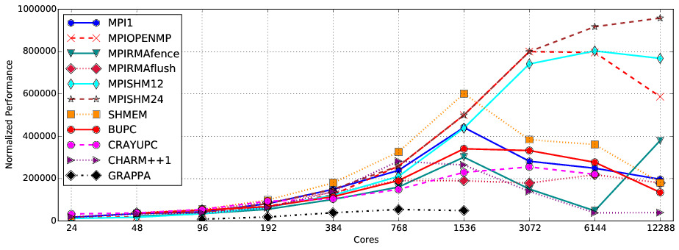
Transpose, strong scaled (49152x49152*)
MPI+X based models win
(X=OpenMP/MPI3)
Aggregate performance MB/s
* Charm++: (47104x47104)
Notes:
Here we show results for a number of ProgEnvs. The Charm++ problem is a little different from all the others to account for the fact that it uses a communication core per node. We make a few observations: 1. The hybrid models (MPI+X) win at large scale, because they are coarser grain than the “flat” models. 2. ProgEnvs requiring a global barrier between iterations (UPC, MPIRMA) don’t scale well. 3. Charm++ runtime overhead dominates at scale. 4. Grappa too fine-grain.

Slide 16
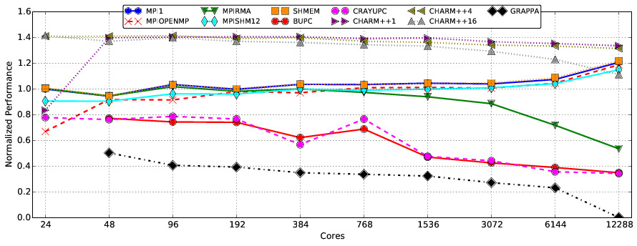
Stencil, radius=4, strong scaled (49152x49152*)
Normalized performance (Mflops/#nodes)/Mflops_single_node_MPI1
* Charm++: (47104x47104)
Notes:
1. Hybrid methods all on par, and the same as flat MPI. 2. ProgEnvs requiring a global barrier between iterations (UPC, MPIRMA) don’t scale well. 3. Grappa too fine-grain. 4. Charm++ scaling very well for overdecomposition factors of 1 and 4.

Slide 17
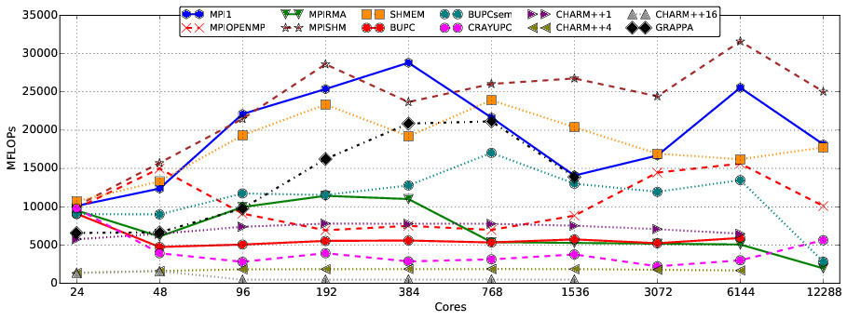
Synch_p2p, strong scaled (49152x49152*)
Aggregate performance MFlops
* Charm++: (47104x47104)
Notes:
1. This is Grappa’s best result, because the runtime automatically aggregates small messages. 2. Charm++ suffers due to fine granularity, 3. MPIRMA and UPC again fare poorly due to global barriers. 4. flat MPI, SHMEM and MPISHM essentially the same. 5. MPI + OpenMP fares poorly because of communication serialization within ranks.

Slide 18
PIC experiments
Grid of static charges of alternating sign, depending on column
Exponentionally decreasing particle distribution, r=0.999
Particles initially at rest
Doubly periodic boundary conditions
Domain decompositions: 2D
If applicable: overdecomposition, load balancing frequency, threshold optimal for each case
Methods:
MPI-2d: MPI without load balancing
MPI-2d-LB: MPI with 1D diffusion-based load balancing
AMPI: Adaptive MPI, using PUP, greedy load balancer
Particle
density
Notes:
Particles move to the right as a cloud, reenter on the left. Very non-uniform particle distribution.

Slide 19
PIC: 3Kx3K grid, 600K particles, 6K steps
Strong scaling
Notes:
Higher is worse in this plot. Adaptive MPI doesn’t scale as well as traditional MPI due to very fine granularity. MPI implementation with application level load balancing scales better than without load balancing (1.5X at 384 cores)

Slide 20
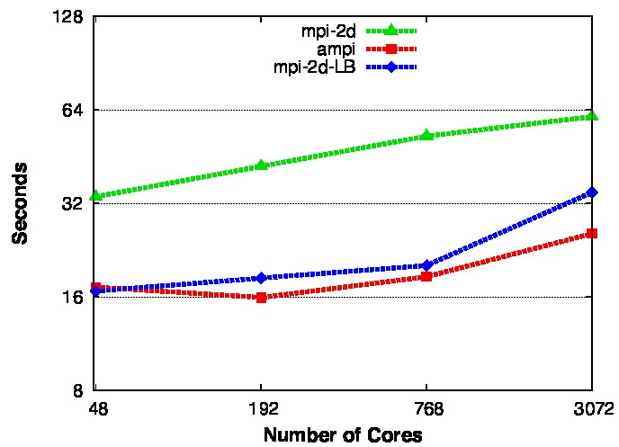
PIC: 12Kx12K grid, 200K particles/node, 6K steps
Weak scaling/
particles
only
Notes:
With weak scaling Adaptive MPI runtime overhead much less significant, and it beats out MPI with app level load balancing. AMPI code as simple as MPI without any load balancing!

Slide 21
Summary
PRK can be used to compare different aspects of parallel programming environments
Growing set of reference implementations available: https://github.com/ParRes/Kernels
Join the PRK community to contribute or review implementations!

