Slide 1

Accelerating Large Charm++ Messages using RDMA
Nitin Bhat, Vipul Harsh
Nitin Bhat
Master’s Student
Parallel Programming Lab
UIUC

Slide 2
Motivation
Major bottleneck in HPC Applications – Communication
Strategies to address communication bottlenecks
Overlap communication and computation
Topology aware mapping
Reduce message sending times
Avoiding copying for large messages

Slide 3
Charm++ Programming Model
Asynchronous Message Driven Execution
Naturally One-sided
Cell_Proxy[8].recv_forces(forces, 1000000, 4.0);
3
8
PE 0 on Node 0
PE 0 on Node 1

Slide 4
forcecalculations.ci
Module forcecalculations{
…...
array [1D] Cell {
entry forces( ) ;
entry void recv_forces (double forces [size], int size, double value);
}
….....
}
Charm Interface File - Declarations
forcecalculations.C
void recv_forces(double * forces, int size, double value){
….
}
C++ Code File – Entry method
forcecalculations.C
Cell_Proxy[n].recv_forces(forces, 1000000, 4.0);
C++ Code File – Call site

Slide 5
What happens under the hood?
Node 0
Node 1
Charm++.
......
Cell_Proxy [n]. recv_force (forces, size, value);
.......
Charm++
void recv_force ( double * forces, int size, int value) {
}
size
size
forces
forces
Marshalling of Parameters
value
value
Un-marshalling of Parameters
Header
Header
Header
size
value
forces
size
value
Header
forces
size
value
LRTS
LRTS

Slide 6
In Rdma enabled networks for large messages:
Node 0
Node 1
Charm++.
......
Cell_Proxy [n]. recv_force (forces, size, value);
.......
Charm++
void recv_force ( double * forces, int size, int value) {
}
size
size
forces
forces
Marshalling of
Parameters
value
value
Un-marshalling of Parameters
Header
Header
size
value
forces
size
value
Header
forces
size
value
metadata
LRTS
LRTS
Allocate Memory
Perform Get

Slide 7
How to accelerate large messages?
Avoid sender side copy of a large messages
Small parameters will be marshalled into contiguous memory and sent.
Large arrays will be sent through Rdma Get Operations.

Slide 8
Regular Charm++
forcecalculations.ci
Module forcecalculations{
…...
array [1D] Cell {
entry forces( ) ;
entry void recv_forces (double forces [size], int size, double value);
}
….....
}
No copy Rdma API
forcecalculations.ci
Module forcecalculations{
…...
array [1D] Cell {
entry forces( ) ;
entry void recv_forces (Rdma double forces [size], int size, double value);
}
….....
}

Slide 9
Regular Charm++
forcecalculations.C
Cell_Proxy[98].recv_forces(forces, 1000000, 4.0);
C++ Code File – Call site
No copy Rdma API
forcecalculations.C
Callback Cb = new Callback(CkIndex_Cell::completed, cellArrayID);
Cell_Proxy[98].recv_forces( RDMA(forces, Cb), 1000000, 4.0);
C++ Code File – Call site

Slide 10
No Copy One-sided API
Node 0
Node 1
Charm++.
......
Cell_Proxy [n]. recv_force (RDMA(forces, Cb), size, value);
.......
Charm++
void recv_force ( double * forces, int size, int value) {
}
size
size
forces
Callback
value
value
Un-marshalling of Parameters
Header
Marshalling of non Rdma Parameters with metadata
size
Header
size
value
metadata
value
Header
size
value
metadata
forces
LRTS
LRTS
Allocate Memory
Perform Get
ack

Slide 11
Results on Bluegene/Q Vesta – Pingpong Benchmark

Slide 12
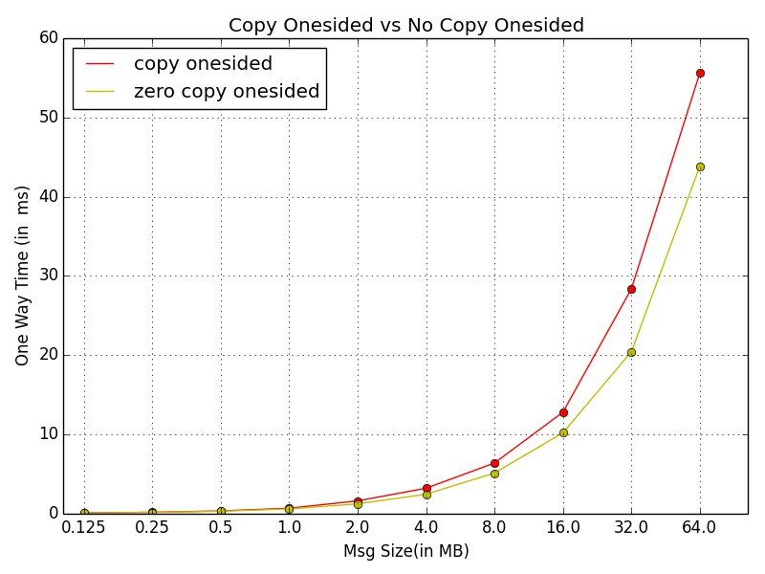
Performance Improvement
1.3x speedup

Slide 13
Conclusions and Future Work
Saving copy for large messages in RDMA supported networks improves performance
On the receiver side, the user can pre-allocate a buffer and post a receive.
Persistent RDMA
Use cases in :
Charm++ with a posted receive
Charm++ sdag when clause
AMPI non blocking receive

Slide 14
Questions?

