Slide 1
Heterogeneous Task Execution Frameworks in Charm++
Michael Robson
Parallel Programming Lab
Charm Workshop 2016

Slide 2
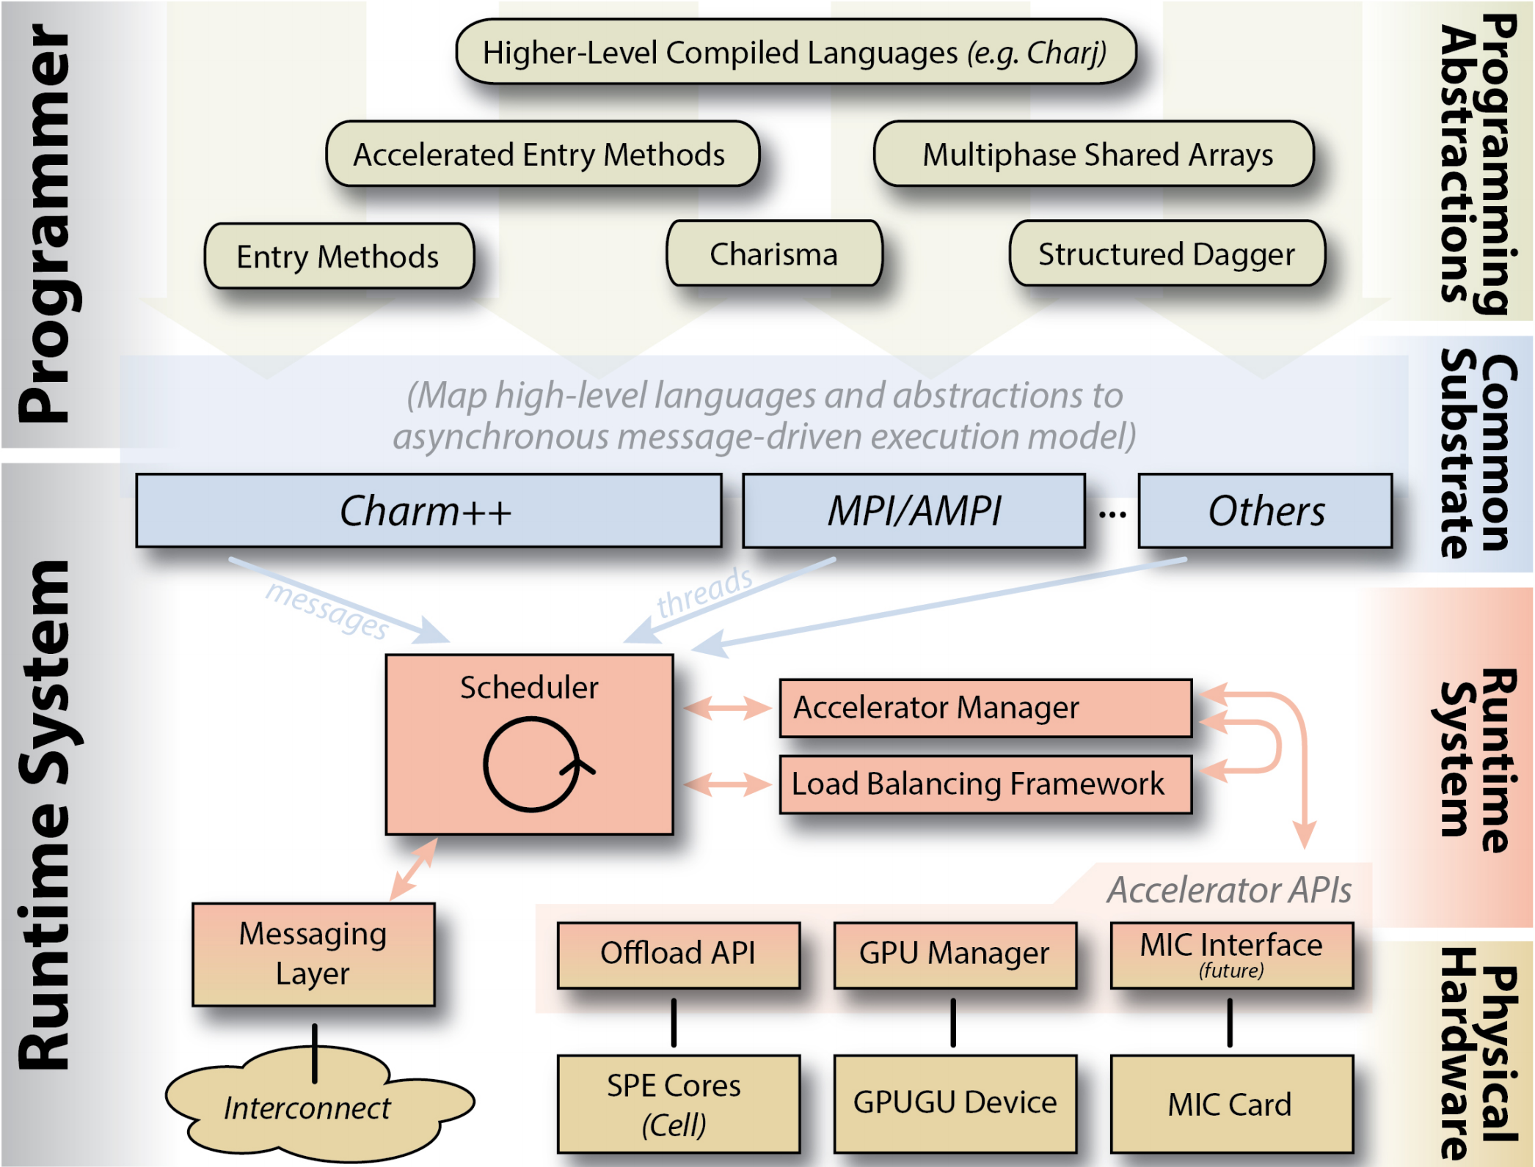
Charm++ GPU Frameworks
Notes:
Charm++ GPU Frameworks
GPU-enabled Applications
Future Work
(Brief) Accelerator Overview

Slide 3
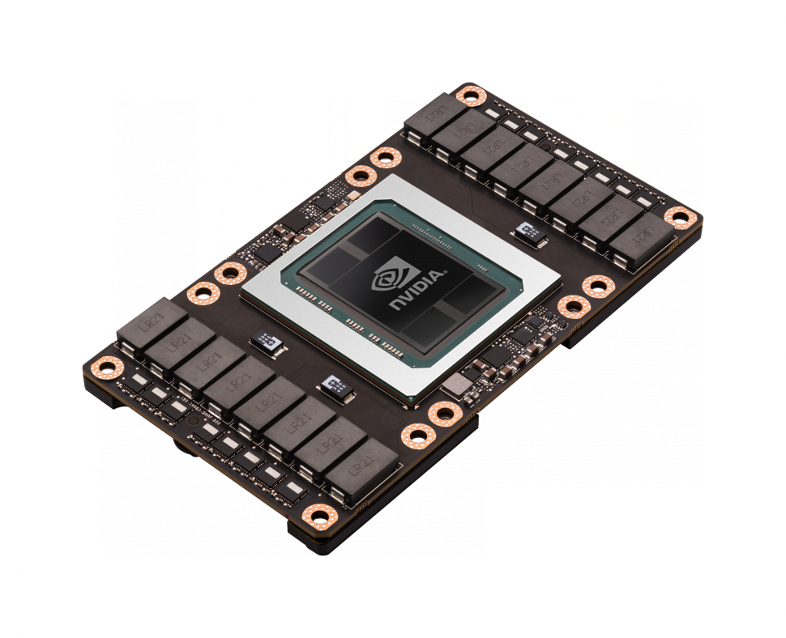
Accelerator Overview
NVIDIA GPUs
  Programmed with CUDA
  1,000s of threads
  100s GB/s bandwidth
  ~16 GB of memory
  ~300 GFLOPS Double Precision

Slide 4
Charm++ GPU Frameworks

Slide 5
GPU Manager
Task Offload and Management Library
Advantages:
  Automatic task management and synch.
  Overlap data transfer and kernel invocation
  Simplified workflow via callbacks
  Reduce overhead via centralized management

Slide 6
GPU Manager
One queue of GPU requests per process
Utilize pinned memory pools
Integrated in mainline
Visualization in projections
http://charm.cs.illinois.edu/manuals/html/libraries/7.html

Slide 7
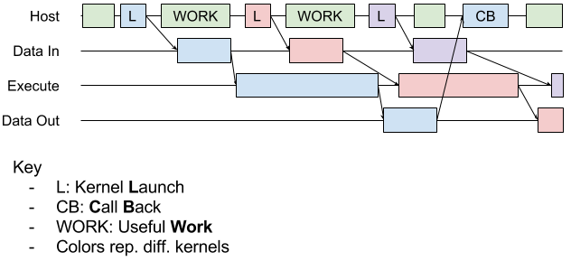

GPU Manager

Slide 8
GPU Manager

Slide 9
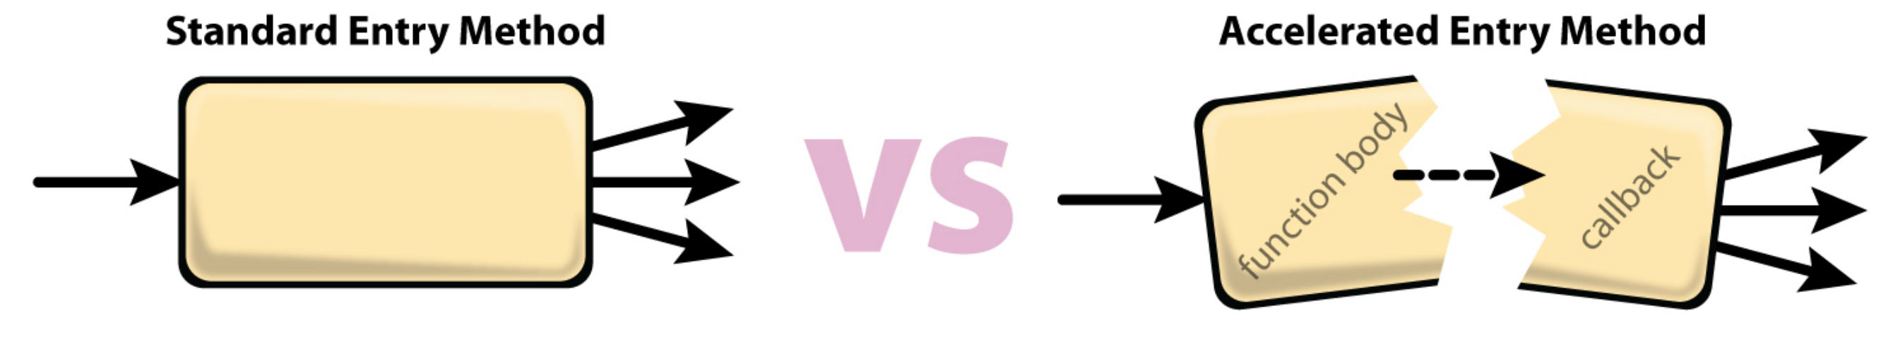
Using GPU Manager
Build charm with cuda target
Create and enqueue a work request
  Mark/pass buffers
  Give a callback to resume work
Write kernel launch functions

Slide 11
nodeGPU Manager
“Node-level” version of GPU Manager
One centralized queue per GPU
Enable GPU applications to run (well) in SMP mode
https://charm.cs.illinois.edu/gerrit/#/c/802/ or branch: mprobson/nodeGPU_ff

Slide 12
nodeGPU Manager Improved API
Replace globals with functions
Register kernel launching functions
Convenience functions for marking buffers
Build with or without CUDA code

Slide 13
Improved API Example
enqueue(wrQueue, wr); -> enqueue (wr);
kernel<<…, kernel_stream>> ->
kernel<<…, getKernelStream()>>
dataInfo *info = new dataInfo;
  info->hostBuffer = hapi_poolMalloc(size);
  info->size = size;
  memcpy(info->hostBuffer, data, size);
  info->bufferID = -1;
  info->transferToDevice = YES;
  info->transferFromDevice = NO;
  info->freeBuffer = YES;
initBuffer(info, siez, data, true, false, true);

Slide 14
Charm++ GPU Frameworks

Slide 15
[accel] Framework
Allow the runtime systems (RTS) to choose to execute on the host or device
RTS can proactively move needed data
RTS can map to various platforms
Originally targeted at cell processor
Notes:
Goals

Slide 16
[accel] Framework
Builds on top of GPU manager
Annotate charm entry methods
Mark data as read, write, persistent, etc
Automatically generate accelerated code
Batch fine grained kernel launches
https://charm.cs.illinois.edu/gerrit/#/c/824/ and branch: mprobson/accel-doc
Notes:
Mechanism

Slide 17
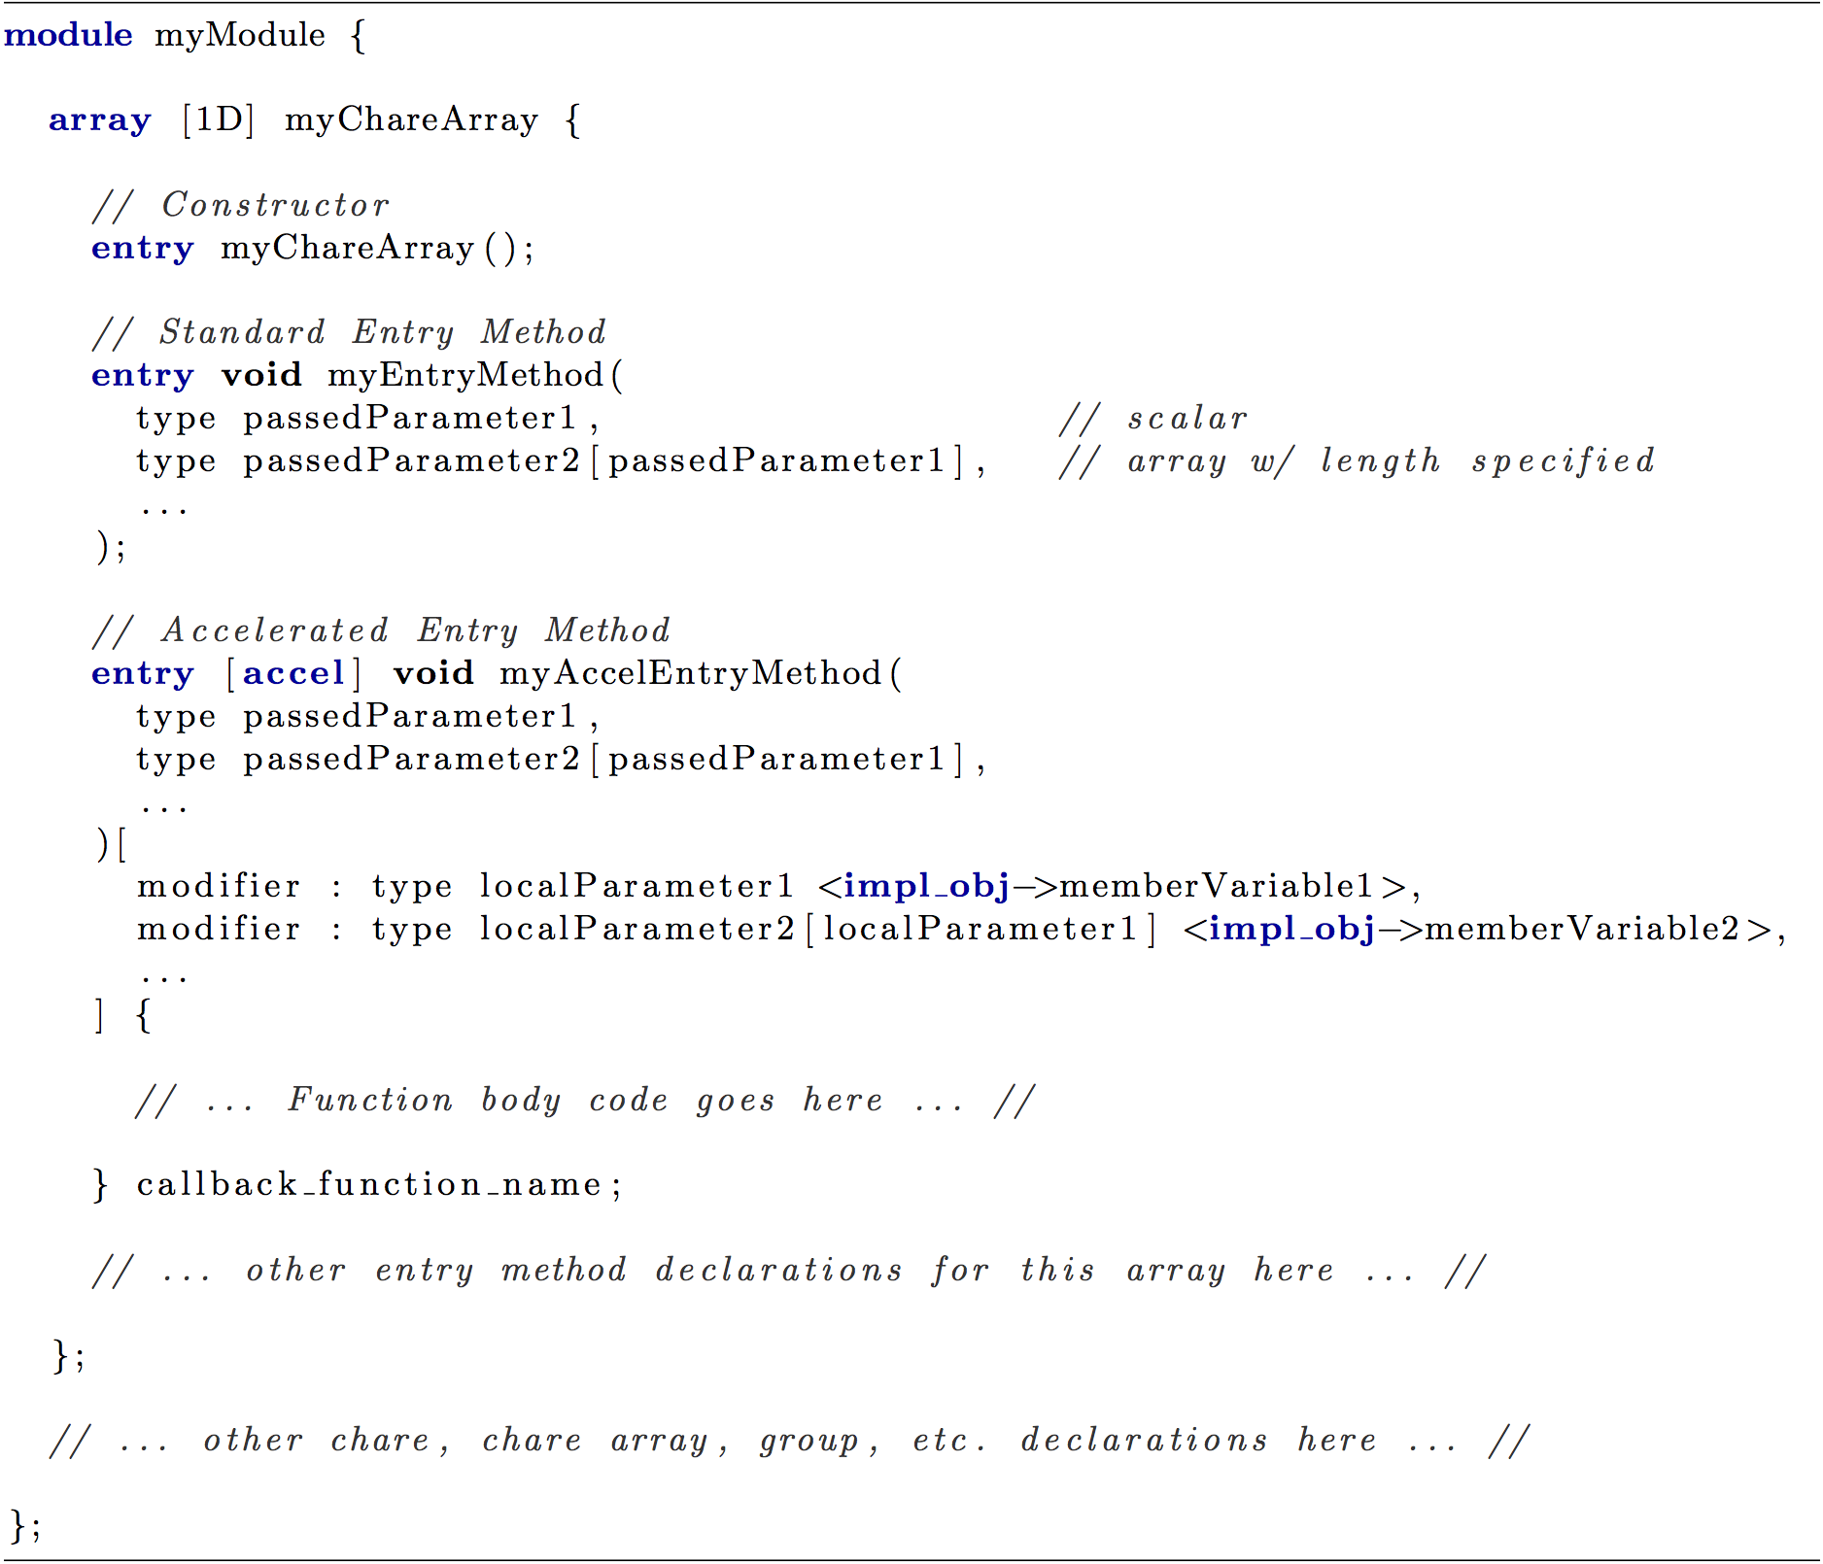
[accel] Framework Example

Slide 18
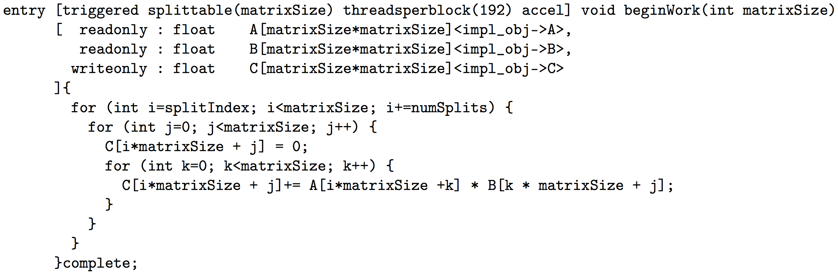
[accel] Framework Example

Slide 19
[accel] Framework Usage
modifiers:
  read-only, write-only, read-write
  shared – one copy per batch
  persist – resident in device memory
parameters:
  triggered – one invocation per chare in array
  splittable (int) – AEM does part of work
  threadsPerBlock (int) – specify block size

Slide 20
$version
Allow users to write platform specific accelerator code
Either as two separate, equivalent kernels
Or machine specific sections/tweaks
Automatically generate multiple kernels
https://charm.cs.illinois.edu/gerrit/#/c/1104/

Slide 21
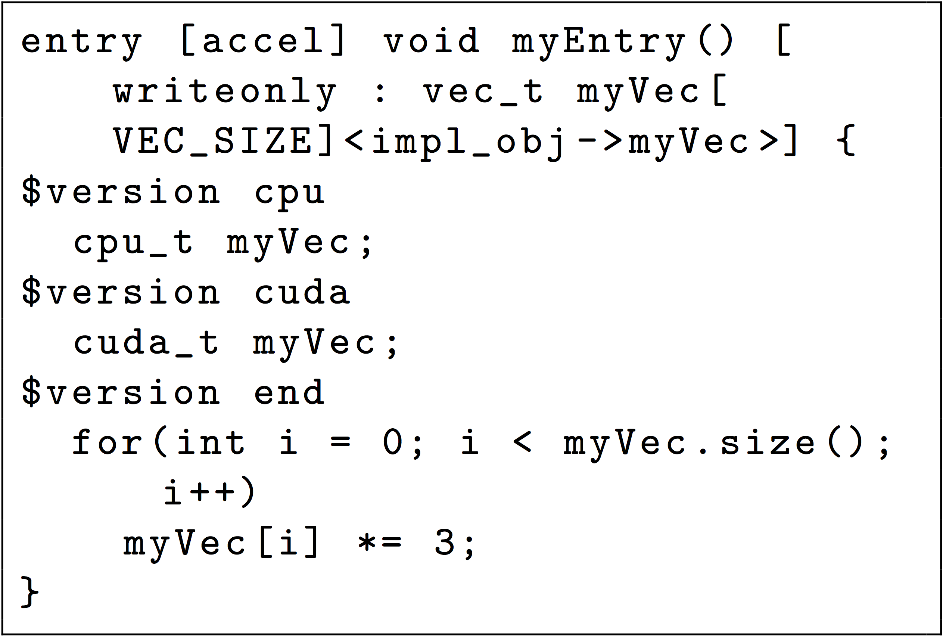
$version Target Specific

Slide 22
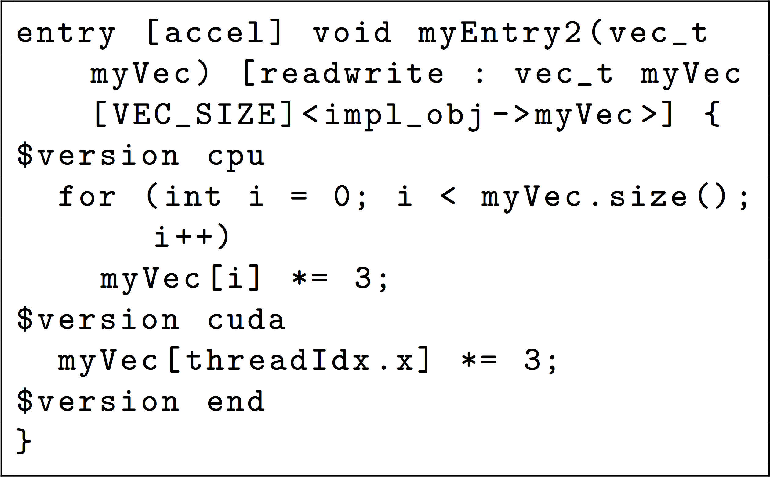
$version Two Implementations

Slide 23
Charm++ GPU Frameworks

Slide 24
NAMD GPU Acceleration
NAMD GPU code is about 5x faster than the CPU code
  CPU version is becoming somewhat obsolete
General requirements
  Keep data on device as much as possible
  Use pinned host memory
  Hide CUDA kernel launch latency
    Merge all computation into few kernels
    Avoid unnecessary cudaStreamSynchronize()

Slide 25
NAMD GPU Performance
Explicit solvent: 30% - 57% faster simulations
Notes:
Dihydrofolate reductase (DHFR)

Slide 26
NAMD GPU Performance
GB implicit solvent: Up to 3.5x faster simulations

Slide 27
NAMD PME computation – case for direct GPU-GPU communication
Particle Mesh Ewald (PME) reciprocal computation requires a 3D FFT, which in turn requires repeated communications between GPUs
Communication is the bottleneck
In the current implementation, we must handle intra- and inter-node cases separately

Slide 28
Intra-node
Sending PE
transposeDataOnGPU(d_data, stream); // Transpose data locally
copyDataToPeerDevice(destGPU, d_data, stream); // Copy data to GPU on same node
cudaStreamSynchronize(stream); // Wait for CUDA stream to finish
PmeMsg* msg = new (0) PmeMsg(); // Allocate empty message
pmePencil.recvData(msg); // Send message to PE that has “destGPU”
Receiving PE
void recvData(PmeMsg* msg) { // Receiving empty message lets PE
// know its GPU now has the data in “d_data”
fftWork(d_data, stream); // Perform work on data
…
}
Requires lots of tedious work from the user
Error prone

Slide 29
Inter-node
Sending PE
transposeDataOnGPU(d_data, stream); // Transpose data locally
PmeMsg* msg = new (dataSize) PmeMsg(); // Create message
copyDataToHost(d_data, msg->data, stream); // Copy data to host
cudaStreamSynchronize(stream); // Wait for CUDA stream to finish
pmePencil.recvData(msg); // Send data to PE on different node
Receiving PE
void recvData(PmeMsg* msg) {
copyDataToDevice(msg->data, d_data, stream); // Copy data to device buffer d_data
cudaStreamSynchronize(stream); // Wait for CUDA stream to finish
fftWork(d_data, stream); // Perform work on data
….
}
Stalls PE at cudaStreamSynchronize()
Host buffer is non-pinned, slow memcopy

Slide 30
How it could be
Sending PE
PmeMsg* msg = new (dataSize) PmeMsg(); // Create message, data on device
transposeDataOnGPU(msg->data, stream); // Transpose data locally
pmePencil.recvData(msg, stream); // Send data using CUDA stream
Receiving PE
void recvData(PmeMsg* msg) {
fftWork(msg->data, stream); // Perform work on data
…
}
Details hidden from user
Works seamlessly on any node configuration

Slide 31
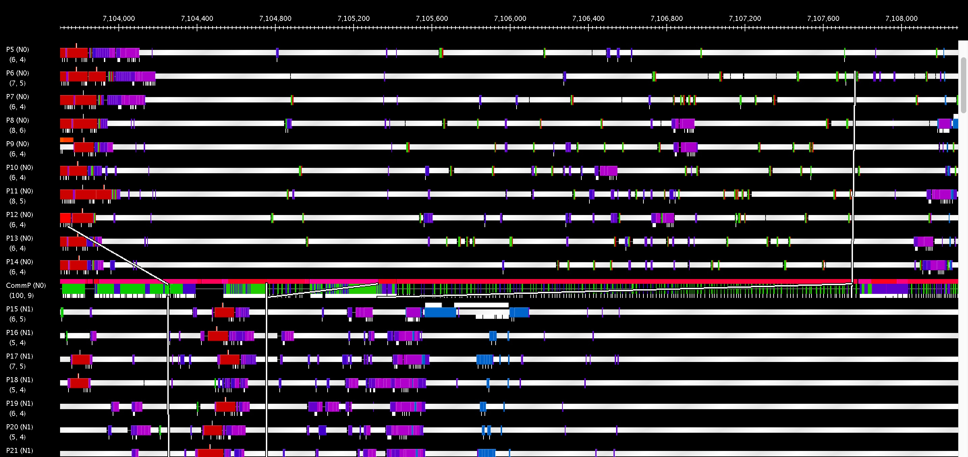
High message latency
On idle nodes high message latency observed

Slide 32

ChaNGa
Cosmological N-body simulations
Leverages nodeGPU and GPU Manager
Offloads gravity kernels
Active work in optimization

Slide 33
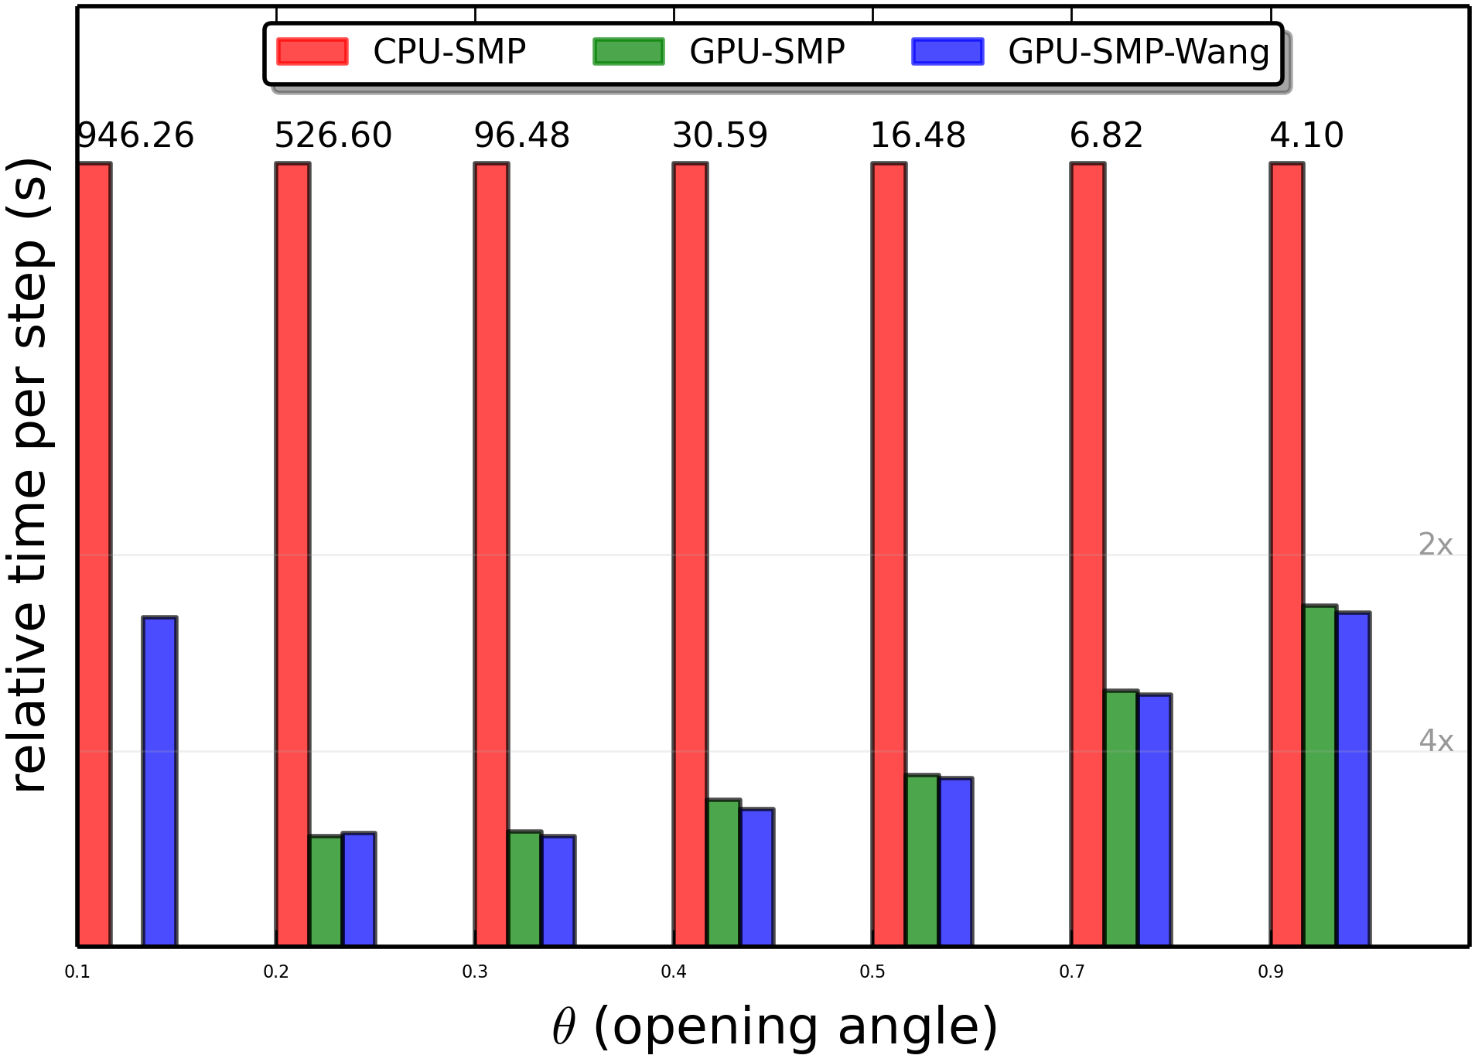
ChaNGa Performance
Notes:
Collaborator, Tim Haines

Slide 34
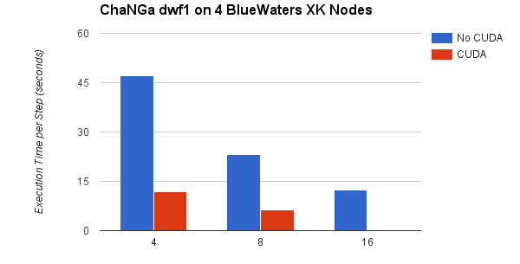
ChaNGa Performance

Slide 35
Charm++ GPU Frameworks

Slide 36
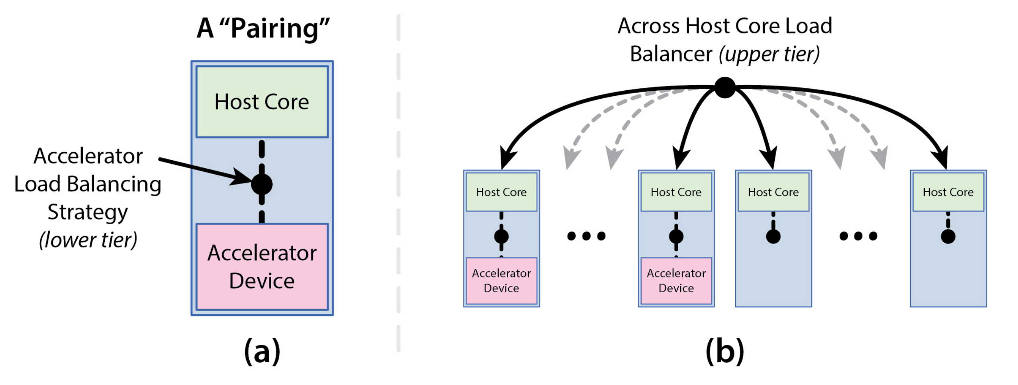
Heterogeneous Load Balancing
Automatically overlap useful work between CPU and GPU
Based on various parameters:
  Idle time, latency, load
Exists in accel branch currently
Notes:
Extend this to Xeon Phi

Slide 37
GPU Thread
Much like today’s comm-thread
Spawn threads per-node equal to GPUs
Part of a larger threads project
  Comm threads
  GPU threads
  Drone threads
  Worker threads

Slide 38
Questions?
Michael Robson
mprobson@illinois.edu

Slide 39
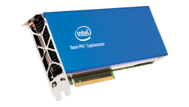
Accelerator Overview
Intel Xeon Phi
  Programmed using icc -mmic
  ~60 modified Pentiums
  4 hardware threads
  512-bit vectors
  ~300 GB/S bandwidth
  ~ 1 TFLOPS (Double Precision)
Notes:
32 registers per core
Make the stats similar?
Mmic
61 Pentium cores
X GB memory
Y bandwidth
Z peak perfomance

Slide 40
Steps to Get Xeon Phi Working
Build two (almost) identical versions of charm
  Regular and passsing -mmic option
Modify makefile to build two binaries, mic ending in .mic
Properly configure nodelist
  ++cpus aka nodesize
  repeated for each node
  ++ext .mic
On Stampede:
  ++usehostname
  -br0
  -mic0
Run! branch: mprobson/mic-fix

