Slide 1
An implicit specification of “The Real Solution for Exascale”
Laxmikant (Sanjay) Kale

Slide 2
Building Abstractions
Applications
Machines

Slide 3
Catering to heterogeneous architectures: doable

Slide 4
Main questions:
Which abstractions to develop?
How to go about doing it?

Slide 5
Main questions:
Which abstractions to develop?
Driven by multiple apps
How to go about doing it?
Bottom up

Slide 6
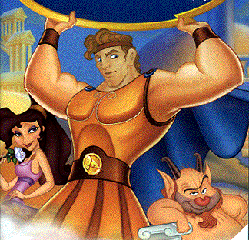
Abstractions must be driven by application needs

Slide 7
Abstractions must be driven by application needs

Slide 8
What not to do: Platonic Beauty
APP
Machines

Slide 9
What not to do: pie in the sky
I.e. A solution that connects to th application, but no realistic reason to believe that it can be implemented: E.g. parallelizing compilers
My guiding principle: No Magic, …
At least, No Magic until you have learned the trick

Slide 10
Bottom up development:
always helping some applications to some extent
Slowly accrete useful abstractions
Make elegance-enhancing consolidation passes over your abstractions periodically
If you are smart, try to do some middle-out design of abstractions
At least as explorations

Slide 11
My “solutions”?
The narrow point of the hour-glass:
Message-driven scheduler, communication abstractions
Adaptive RTS
with a Charm++ like API as the common layer for interoperability
Higher-level constructs:
Communication-pattern specific mini-languages
Other languages
DSLs
Frameworks
Adaptive RTS

Slide 12
Our interoperable suite
Charm++, AMPI
MSA (Multiphase Shared Arrays)
Charisma (global control flow)
Divcon
Treelib
Charj

Slide 13
Compiler Support
Needed, but in a low-brow way
Not for auto-parallelization
A basic compiler infrastructure
Easy to extend
Allows code restructuring
Supports syntax that improves productivity
Basic, well-understood analyses
E.g. live-variables analysis for checkpointing
Inserting Control-points to provide knobs to RTS
Rose? LLVM/Clang? Home-grown infrastructure

Slide 14
Revolution = Shock to an evolving ecosystem
Once we absorb the “shock” of exascale issues, and start designing programming models (r/evolutionary):
Interoperability allows faster evolution of programming models
Evolution doesn’t lead to a single winner species, but to a stable and effective ecosystem.
Similarly, we will get to a collection of viable programming models that co-exists well together.
Contexts of different application use-cases, and different individual insights will lead to a fruitful exploration of design space

