Slide 1


Welcome to the
2017 Charm++ Workshop!
Laxmikant (Sanjay) Kale
http://charm.cs.illinois.edu
Parallel Programming Laboratory
Department of Computer Science
University of Illinois at Urbana Champaign

Slide 2
A bit of history
This is the 15th workshop in a series that began in 2001

Slide 3
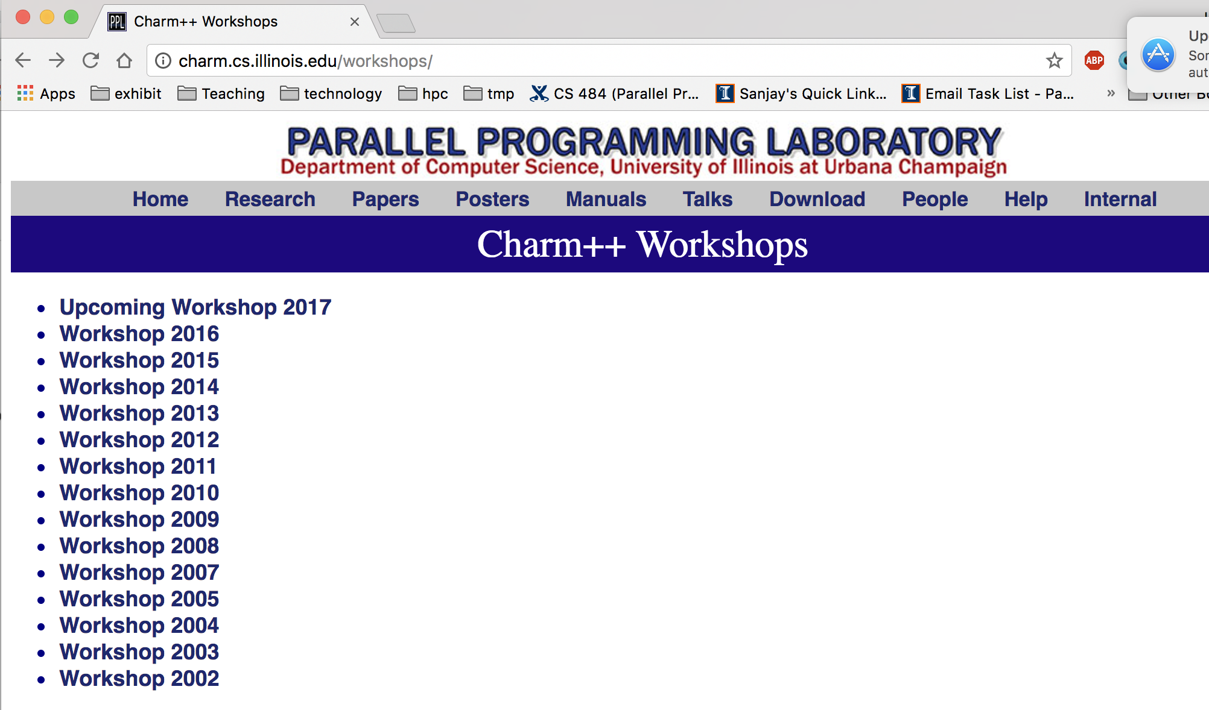

Slide 4
A Reflection on the History
Charm++, the name, is from 1993
Most of the foundational concepts : by 2002
So, what does this long period of 15 years signify?
Maybe I was too slow
But I prefer the interpretation:
  We have been enhancing and adding features based on large-scale application development.
    A long co-design cycle
  The research agenda opened up by the foundational concepts is vast
  Although the foundations were done in 2002, the fleshing out of adaptive runtime capabilities is where many intellectual challenges, and engineering work, lay.

Slide 5
What is Charm++?
Charm++ is a generalized approach to writing parallel programs
  An alternative to the likes of MPI, UPC, GA etc.
  But not to sequential languages such as C, C++, Fortran
Represents:
  The style of writing parallel programs
  The runtime system
  And the entire ecosystem that surrounds it
Three design principles:
  Overdecomposition, Migratability, Asynchrony

Slide 6
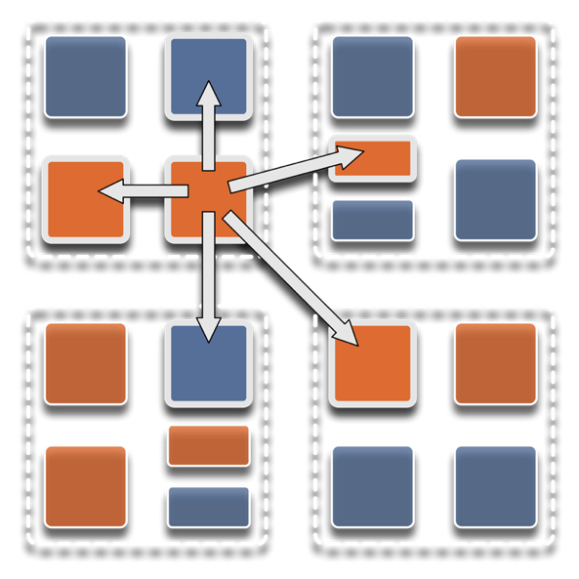
Overdecomposition
Decompose the work units & data units into many more pieces than execution units
  Cores/Nodes/..
Not so hard: we do decomposition anyway

Slide 7
Migratability
Allow these work and data units to be migratable at runtime
  i.e. the programmer or runtime, can move them
Consequences for the app-developer
  Communication must now be addressed to logical units with global names, not to physical processors
  But this is a good thing
Consequences for RTS
  Must keep track of where each unit is
  Naming and location management

Slide 8
Asynchrony: Message-Driven Execution
With over decomposition and Migratibility:
  You have multiple units on each processor
  They address each other via logical names
Need for scheduling:
  What sequence should the work units execute in?
  One answer: let the programmer sequence them
    Seen in current codes, e.g. some AMR frameworks
  Message-driven execution:
    Let the work-unit that happens to have data (“message”) available for it execute next
    Let the RTS select among ready work units
    Programmer should not specify what executes next, but can influence it via priorities

Slide 9
Realization of this model in Charm++
Overdecomposed entities: chares
  Chares are C++ objects
  With methods designated as “entry” methods
    Which can be invoked asynchronously by remote chares
  Chares are organized into indexed collections
    Each collection may have its own indexing scheme
      1D, ..7D
      Sparse
      Bitvector or string as an index
  Chares communicate via asynchronous method invocations
    A[i].foo(….); A is the name of a collection, i is the index of the particular chare.

Slide 10
Parallel Address Space
Processor 0
Processor 1
Scheduler
Scheduler
Message Queue
Message Queue
Processor 2
Processor 3
Scheduler
Scheduler
Message Queue
Message Queue

Slide 11
Message-driven Execution
A[23].foo(…)
Processor 0
Processor 1
Scheduler
Scheduler
Message Queue
Message Queue
Notes:
Certain member functions of certain classes are globally visible
Invocation of a member function may lead to communication

Slide 12
Processor 0
Processor 1
Scheduler
Scheduler
Message Queue
Message Queue
Processor 2
Processor 3
Scheduler
Scheduler
Message Queue
Message Queue

Slide 13
Processor 0
Processor 1
Scheduler
Scheduler
Message Queue
Message Queue
Processor 2
Processor 3
Scheduler
Scheduler
Message Queue
Message Queue

Slide 14
Processor 0
Processor 1
Scheduler
Scheduler
Message Queue
Message Queue
Processor 2
Processor 3
Scheduler
Scheduler
Message Queue
Message Queue

Slide 15
Empowering the RTS
Adaptive
Runtime System
Introspection
Adaptivity
Asynchrony
Overdecomposition
Migratability
The Adaptive RTS can:
  Dynamically balance loads
  Optimize communication:
    Spread over time, async collectives
  Automatic latency tolerance
  Prefetch data with almost perfect predictability

Slide 16
Some Production Applications
Application | Domain | Previous parallelization | Scale
NAMD | Classical MD | PVM | 500k
ChaNGa | N-body gravity & SPH | MPI | 500k
EpiSimdemics | Agent-based epidemiology | MPI | 500k
OpenAtom | Electronic Structure | MPI | 128k
Spectre | Relativistic MHD |  | 100k
FreeON/SpAMM | Quantum Chemistry | OpenMP | 50k
Enzo-P/Cello | Astrophysics/Cosmology | MPI | 32k
ROSS | PDES | MPI | 16k
SDG | Elastodynamic fracture |  | 10k
ADHydro | Systems Hydrology |  | 1000
Disney ClothSim | Textile & rigid body dynamics | TBB | 768
Particle Tracking | Velocimetry reconstruction |  | 512
JetAlloc | Stochastic MIP optimization |  | 480

Slide 17
Relevance to Exascale
Intelligent, introspective, Adaptive Runtime Systems, developed for handling application’s dynamic variability, already have features that can deal with challenges posed by exascale hardware

Slide 18
Relevant capabilities for Exascale
Load balancing
Data-driven execution in support of task-based models
Resilience
  multiple approaches: in-memory checkpoint, leveraging NVM, message-logging for low MTBF
  all leveraging object-based overdecomposition
Power/Thermal optimizations
Shrink/Expand sets of processors allocated during execution
Adaptivity-aware resource management for whole-machine optimizations

Slide 19

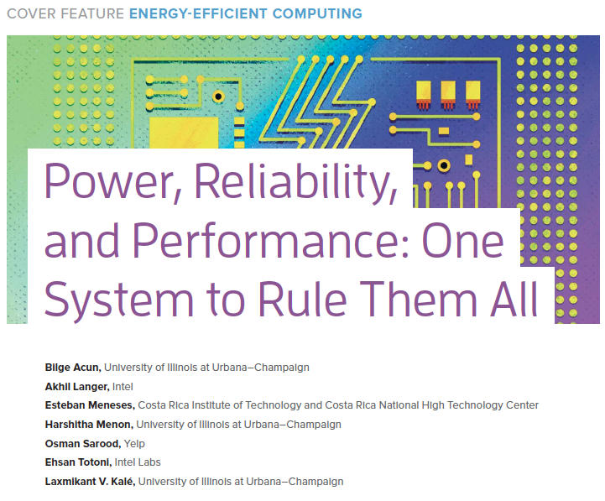
IEEE Computer highlights Charm++ energy efficient runtime

Slide 20
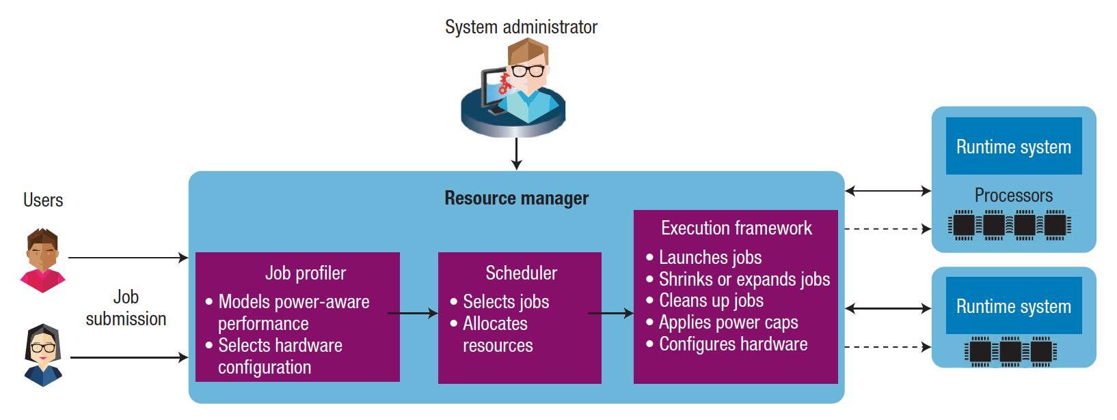
Interaction Between the Runtime System and the Resource Manager
Allows dynamic interaction between the system resource manager or scheduler and the job runtime system
Meets system-level constraints such as power caps and hardware configurations
Achieves the objectives of both datacenter users and system administrators

Slide 21
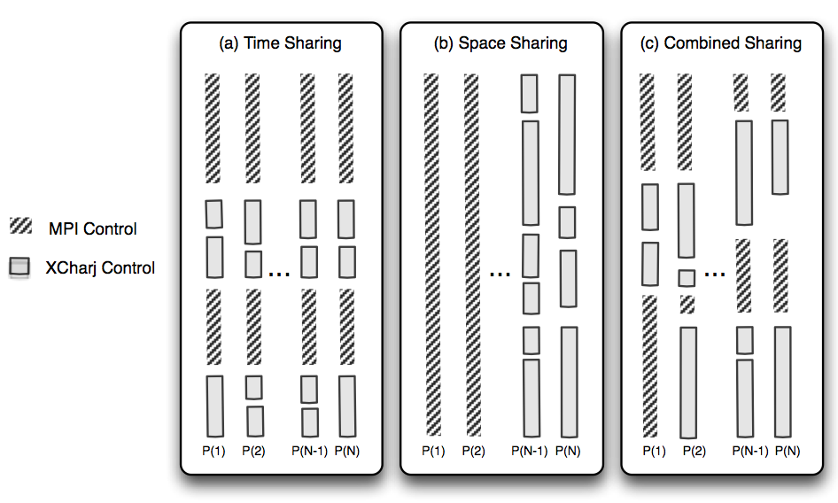
Charm++ interoperates with MPI
So, you can write one module in Charm++, while keeping the rest in MPI
Charm++ Control

Slide 22
Integration of Loop Parallelism
  Used for transient load balancing within a node
Mechanisms:
  Charm++’s old CkLoop construct
  New integration with OpenMP (gomp, and now llvm)
  BSC’s OMPSS integration is orthogonal
  Other new OpenMP schedulers
RTS splits a loop into Charm++ messages
  Pushed into each local work stealing queue
    where idle threads within the same node can steal tasks

Slide 23
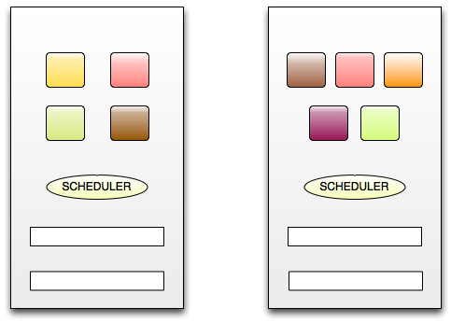



Core0
Core1
Message Queue
Message Queue
Task Queue
Task Queue
Integrated RTS
(Using Charm++ construct or OpenMP pragmas)
for ( i = 0; i < n ; i++) {
…
}

Slide 24
Recent Developments: Charmworks, Inc.
Charm++ is now a commercially supported system
  Charmworks, Inc.
  Supported by DoE SBIR and small set of initial customers
Non profit use (academia, US Govt. Labs..) remains free
We are bringing improvements made by Charmworks into the University version (no forking of code so far)
Specific improvements have included:
  Better handling of errors
  Robustness and ease of use improvements
  Production versions of research capabilities
A new project at Charmworks for support and improvements to Adaptive MPI (AMPI)

Slide 25
Upcoming Challenges and Opportunities
Fatter nodes
Improved global load balancing support in presence of GPGPUs
Complex memory hierarchies (e.g. HBM)
  I think we are well-equipped for that, with prefetch
Fine-grained messaging and lots of tiny chares:
  Graph algorithms, some solvers, DES, ..
Subscale-simulations, multiple simulations
In-situ analytics
Funding!

Slide 26
A glance at the Workshop
Keynotes: Michael Norman, Rajeev Thakur
PPL taks:
  Capabilities: load balancing*, heterogenity, DES
  Algorithms: sorting, connected components
Languages: DARMA, Green-Marl, HPX (non-charm)
Applications:
  NAMD, ChaNGA, OpenAtom, multi-level summation
  TaBaSCo (LANL, proxy app),
  Quinoa (LANL, Adaptive CFD)
  SpECTRE ( Relativistic Astrophysics)
Panel: relevance of exascale to mid-range HPC

