Slide 1


Charm++ as an Energy Efficient Runtime

Slide 2
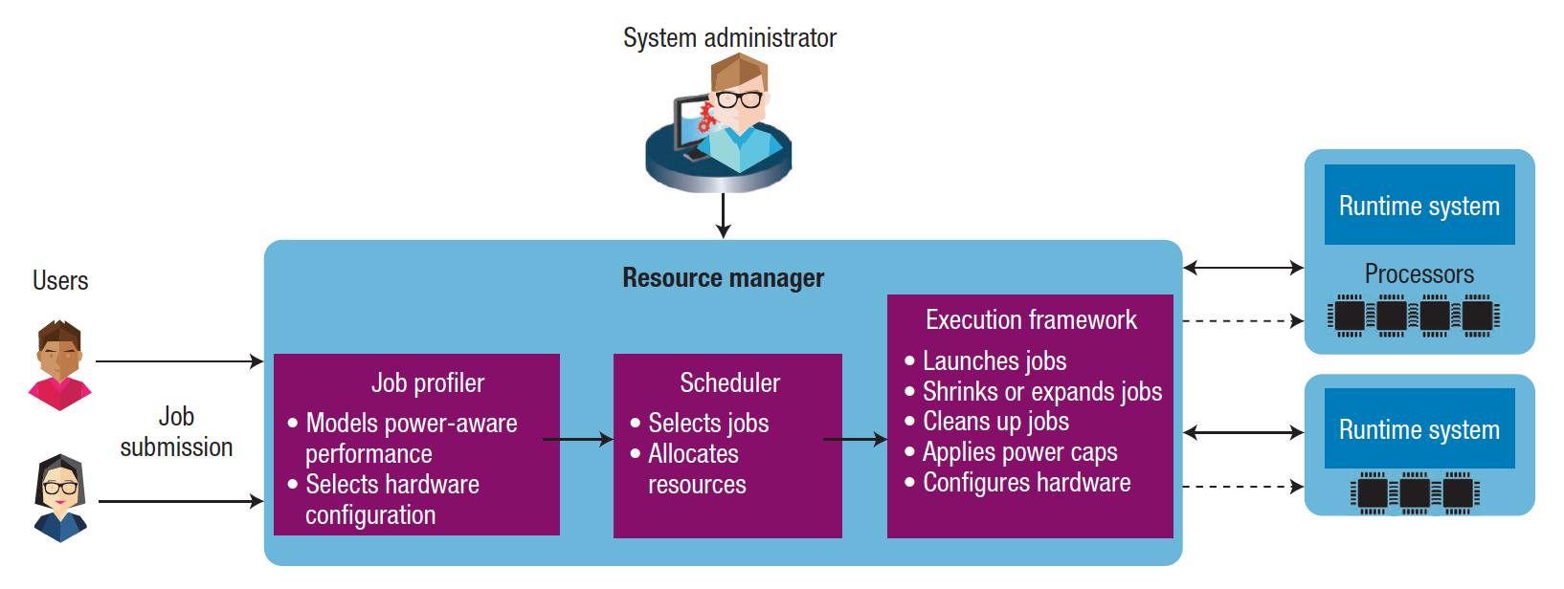
Interaction Between the Runtime System and the Resource Manager
Allows dynamic interaction between the system resource manager or scheduler and the job runtime system
Meets system-level constraints such as power caps and hardware configurations
Achieves the objectives of both datacenter users and system administrators

Slide 3
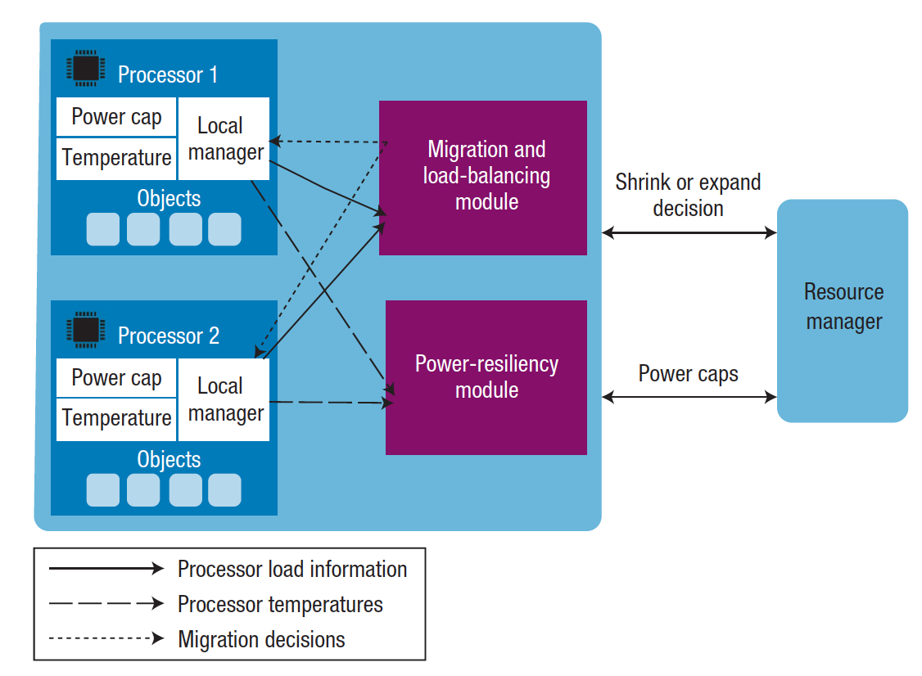
Components of Charm++ with Its Interactions
Charm++ has three main components:
Local manager: tracks local information such as object loads, CPU temperatures
Load-balancing module: makes load-balancing
decisions and redistributes load
Power-resiliency module: ensures that the CPU temperatures remain below the temperature threshold, change the power cap

Slide 4


Support for Proactive Cooling Decisions with Neural Network-Based Temperature ^{Prediction}
Bilge Acun¹, Eun Kyung Lee¹, Yoonho Park¹, Laxmikant V. Kale²
¹ IBM T.J. Watson Research Center
² University of Illinois at Urbana-Champaign

Slide 5
Motivation
Pressure of reducing the power consumption and carbon footprint of datacenters and supercomputers is increasing
Other expected problems include:
Larger process variations, temperature variations
More heat dissipation
Denser nodes with different components in the node such as GPUs, co-processors that have different temperature, cooling characteristics

Slide 6
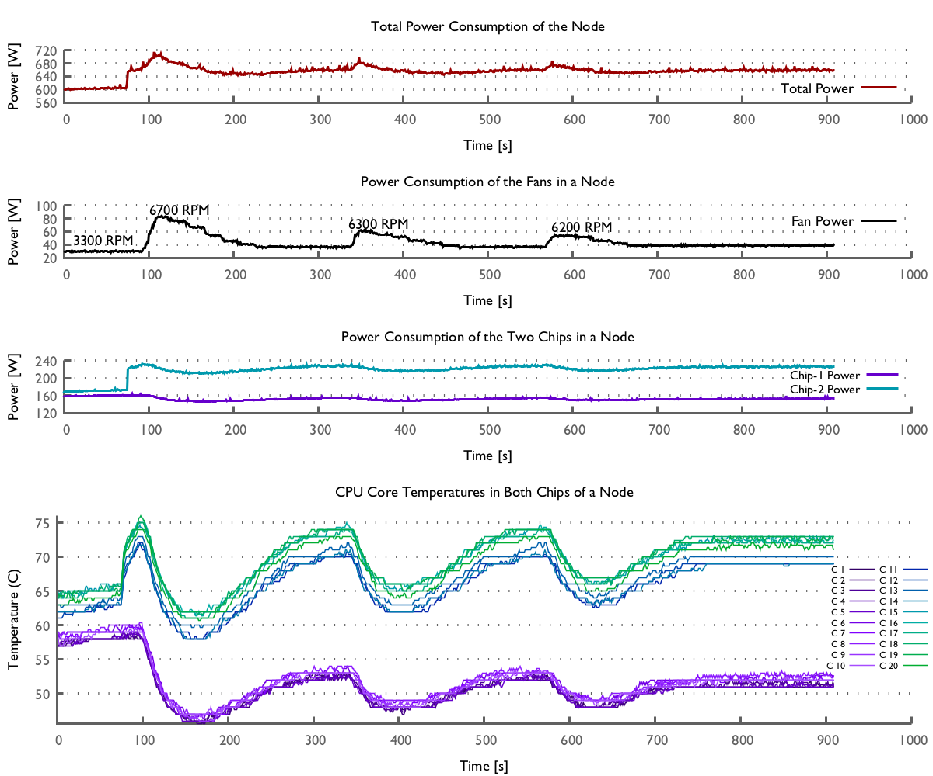
Motivation
Temperature variations among cores:
7 C in idle temperatures
9 C in all active temperatures
20 C idle/active mixed
Synchronous fan control:
4 independent fans in the node
Fans all act together and cause even further temperature variation
Reactive cooling behavior:
54 W jump in fan power
10 minutes stabilization time with a regular workload
7C
20 C
Notes:
3 different problems and opportunities for improvement

Slide 7
Temperature Variation in Large Scale
Temperature distribution of 1800 cores
Cori at NERSC – Intel Haswell
Minsky at IBM POWER8

Slide 8
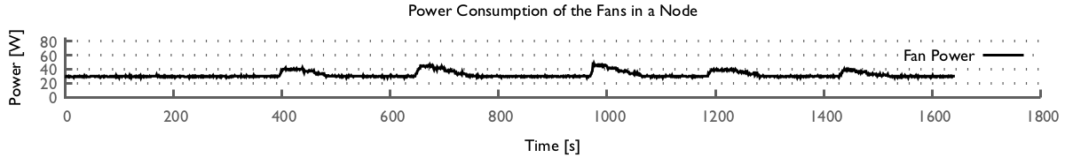
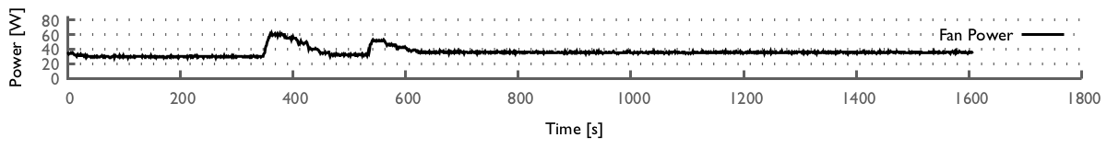
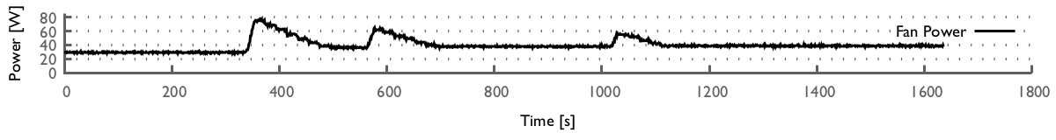
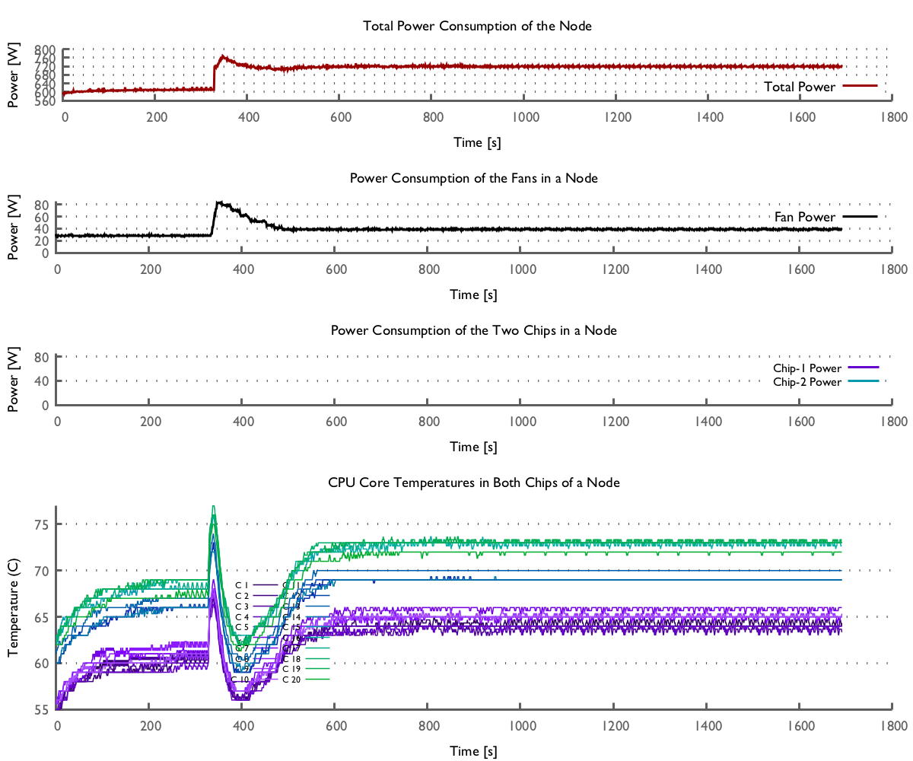
Oscillatory Cooling Behavior
CPU Utilization
Workload starts
10 %
30 %
60 %
99 %

Slide 9
Fan Behavior of Different Applications

Slide 10

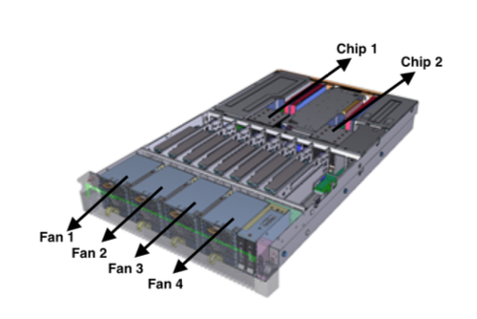
Why Temperature Modeling is Difficult?
There are lots of parameters affecting the core temperatures:
Complex workloads
Ambient temperature
Core frequencies
Fan speed level
Physical layout
Hardware variations
Combination of these parameters create an exponential modeling space
10 different cores
0-100 CPU utilization levels
44 different frequency levels
3000 RPM-10000 RPM fan speed levels
4 fans
(10^10) * 44 * (10^4) = ~ 2^52
Notes:
core-to-core interactions

Slide 11
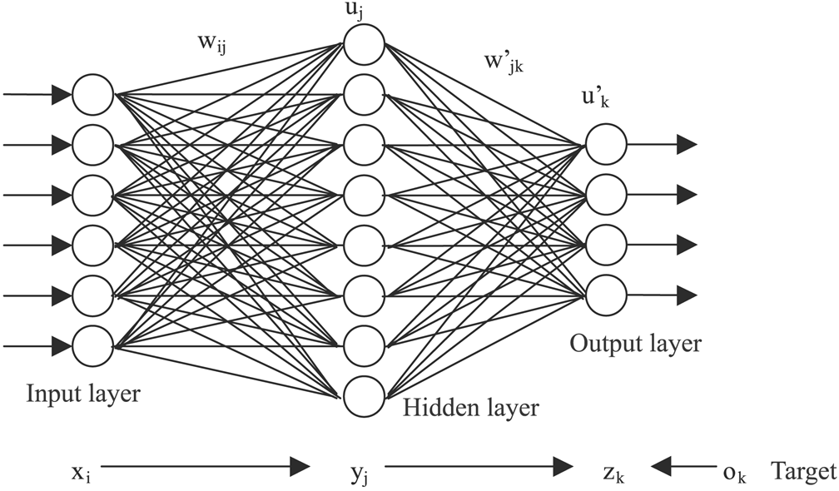
Neural Networks for Temperature Modeling
Neural networks are good because:
They can capture linear and non-linear behavior between input and output parameters
They work well in noisy data
They do not need for formulation of an objective function
Neural networks has been used in HPC for:
Energy and power modeling [1]
Performance modeling [2]
Temperature modeling
For GPU temperature modeling [3]
For coarse-grained data center level modeling [4]
A. Tiwari, M. A. Laurenzano, L. Carrington, and A. Snavely. Modeling power and energy usage of HPC kernels. In Parallel and Distributed Processing Symposium Workshops & PhD Forum (IPDPSW), IEEE, 2012.
B. C. Lee, D. M. Brooks, B. R. de Supinski, M. Schulz, K. Singh, and S. A. McKee. Methods of inference and learning for performance modeling of parallel applications. In Proceedings of the 12th ACM SIGPLAN Symposium on Principles and Practice of Parallel Programming, PPoPP '07, 2007.
A. Sridhar, A. Vincenzi, M. Ruggiero, and D. Atienza. Neural network-based thermal simulation of integrated circuits on GPUs. IEEE Transactions on Computer-Aided Design of Integrated Circuits and Systems 31.
L. Wang, G. von Laszewski, F. Huang, J. Dayal, T. Frulani, and G. Fox. Task scheduling with ann-based temperature prediction in a data center: a simulation-based study. Engineering with Computers, 2011.

Slide 12
Neural Networks for Temperature Prediction
Experimental Setup:
Firestone cluster at IBM with Power 8 processors
1 node = 2 sockets, 20 physical cores, 160 SMT cores
OCC, and BMC for temperature, power readings

Slide 13
Neural Network Configuration and Validation
We test different back-propagation algorithms with different time and memory requirements.
Other configurations include number of layers, and number of neurons.

Slide 14
Model Guided Proactive Cooling Decisions
Fan control
This can reduce chip-to-chip temperature variations.
What should be the fan speed level to be able keep the chips at a certain temperature limit?
Load balancing
This can remove core-to-core, as well as chip-to-chip temperature variations.
What would the core temperatures become if a certain amount of data is moved from one core to another?
DVFS
Chip-level DVFS can reduce chip-to-chip, core level DVFS core-to-core temperature variations.
What frequency level we need to set for the cores to stay under a temperature limit for a workload?

Slide 15
Model Guided Proactive Cooling Decisions
Fan control
This can reduce chip-to-chip temperature variations.
What should be the fan speed level to be able keep the chips at a certain temperature limit?

Slide 16
Proactive Fan Control Mechanism
The key idea is cool the processor proactively, for example, before the application starts.
Preemptive fan-control removes temperature peaks, and is able to keep the temperature as the same level as reactive fan control.
It can be done via job scheduler, and/or runtime without taking over the total control of the fan.
Notes:
*independent fan control

Slide 17
Power Reductions With Proactive Cooling
35% reduction in fan power
Power Reduction = Maximum Power – Stable Power

Slide 18
Decoupling the Fans
18% reduction in fan power
BEFORE
AFTER

Slide 19
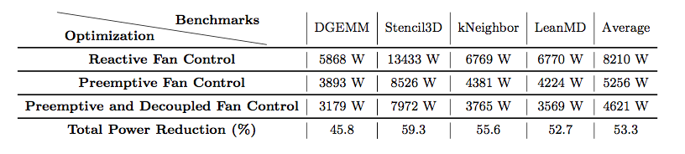
Total Reduction in Fan Power
53% reduction in fan power on average

Slide 20
Remaining Temperature Variation
DVFS?
Load Balancing?

Slide 21
Temperature-Aware Load Balancing With Charm++
Load balancing can help reduce the temperature variations, but how do we decide how much load to move?
Charm++ [1] has an runtime database which stores:
Number of tasks per process
Load of each object (in terms of execution time)
Communication load of each object
Load balancing is triggered periodically with customizable periods
We implement our temperature-aware model guided load balancing algorithm.
Load balancing has potential to remove both chip and core level variations.
1. B. Acun, et al. Parallel programming with migratable objects: charm++ in practice. In SC14: International Conference for High Performance Computing, Networking, Storage and Analysis, pages 647-658. IEEE, 2014.

Slide 22
Conclusion
In summary, we propose:
A neural-network based temperature prediction model
Proactive cooling mechanisms:
Fan control
Load balancing
Our results shows:
We can accurately predict core temperatures
Peak fan power can be reduced by 53%
Air cooling systems can be made more efficient

Slide 23
Thank you!

Slide 24
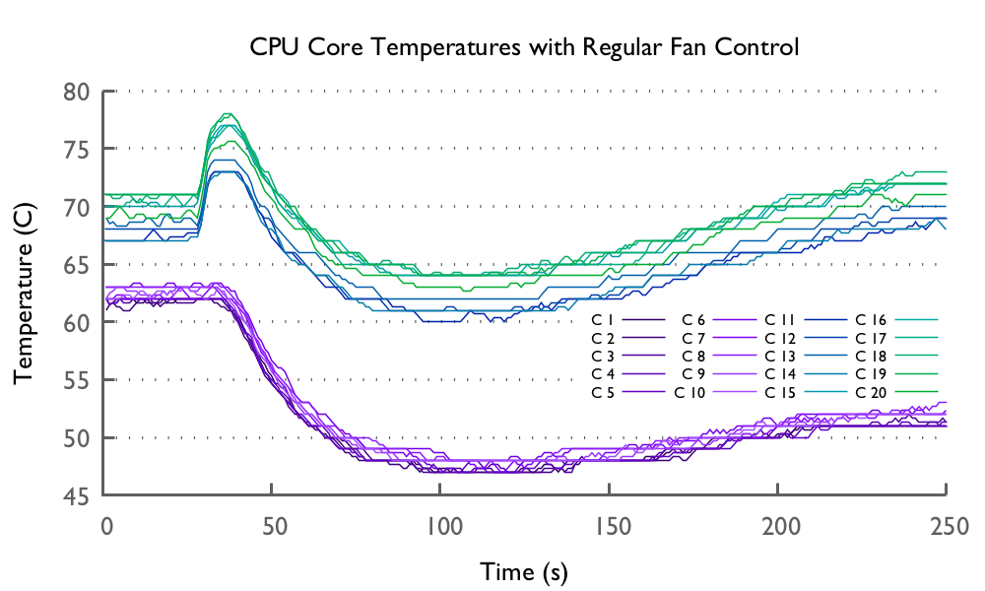
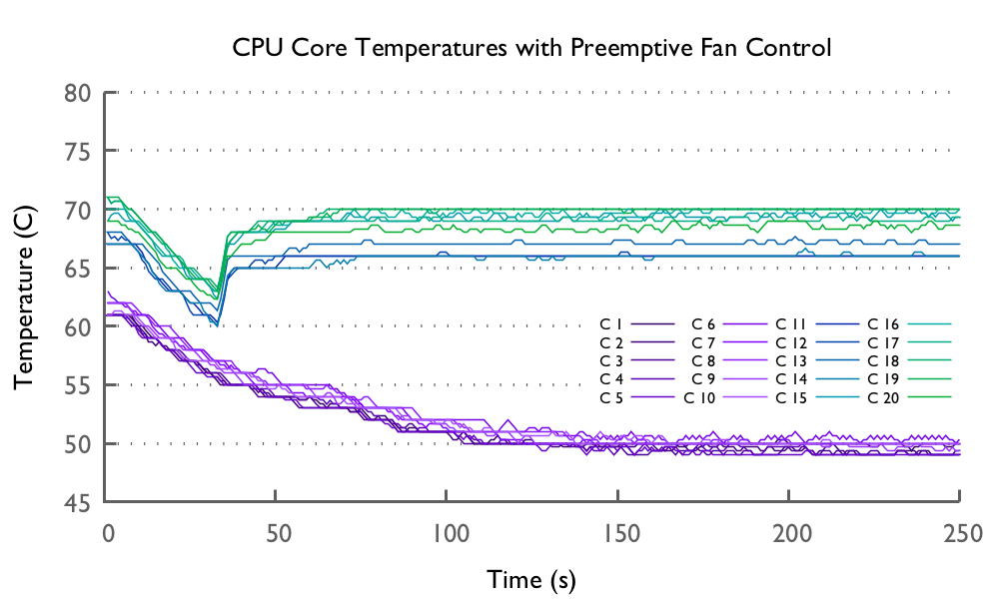
Comparison of Reactive vs Preemptive Fan Control
The key idea is cool the processor proactively, for example, before the application starts.
Preemptive fan-control removes temperature peaks, and is able to keep the temperature as the same level as reactive fan control.
It can be done via job scheduler, and/or runtime without taking over the total control of the fan.
Notes:
*independent fan control

Slide 25
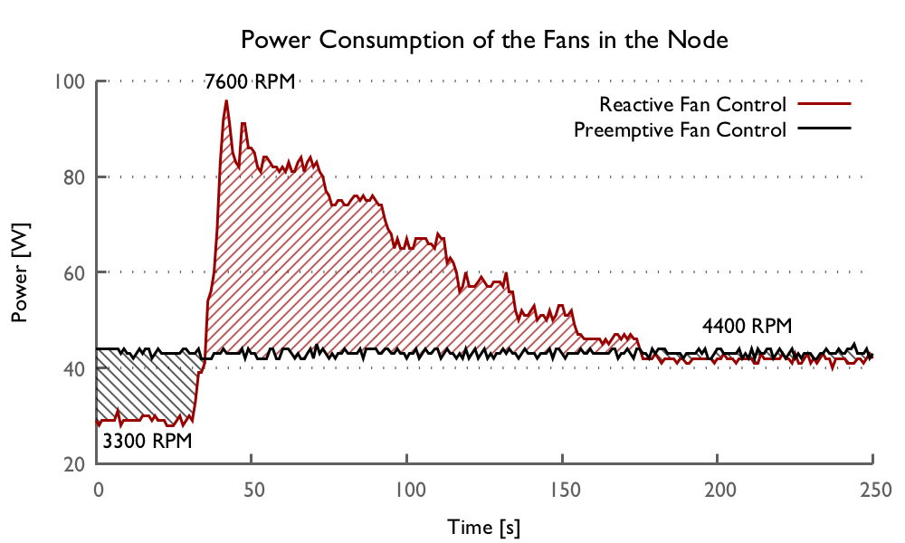
Power Reductions in Preemptive Fan Control
Peak fan power can be reduced by 54 Watts = 58% reduction in cooling power.
2790 Joules of energy is saved = Red area – black area
How early to set the cooling speed?
Workload Starts
Notes:
* add findings

