Slide 1
Title
Meta-Balancer:
Automated Selection of Load Balancing Strategies
Presenter: Kavitha Chandrasekar
Work done by: Harshitha Menon, Kavitha Chandrasekar, Laxmikant V. Kale

Slide 2
Outline
Motivation
  Need for Dynamic Load-balancing and Strategy Selection
Implementation in Charm++
  Meta-Balancer Framework
Discussion of application results

Slide 3
Need for Load-balancing
Several HPC applications exhibit load imbalance, for example:
  Dynamic computation changes like in AMR
  Variability in particles per computation unit in Molecular Dynamics
Load balancing achieves
  High performance
  High Resource utilization
Load Imbalance in AMR application
Reference: AMR mini-app in Charm++

Slide 4
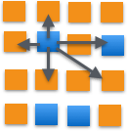
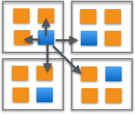
Charm++ Programming Model and RTS
Asynchronous message-driven execution model
Supports over-decomposition
  Dividing computation into more units than hardware processing units
Supports Migratability of work units
Hence, load balancing is possible
Supports a suite of load balancing strategies
Over-decomposition of work into Charm++ objects
Mapping of Charm++ objects to processors
Charm++ RTS view of over-decomposition

Slide 5
Need for Adaptive Load Balancing Selection
HPC application have dynamically varying load imbalance
Applications exhibit varying characteristics
  Varying over input sizes
  Varying over phases within an application run
  Varying core counts
Load Imbalance characteristics also vary as a result
Need for choosing the optimal load balancing strategy
Previous work
  Metabalancer chooses the best load balancing period
Lassen’s Propagating Wave Front
Reference: Lassen from LLNL

Slide 6
Differences in Load Balancing Strategies
Different applications require different load balancing strategies
  Communication intensive applications require comm-aware load balancers such as graph partitioning-based LBs
  Computation-based load imbalance may require
    From-scratch load balancers
    Refinement-based
Applications may require different strategies at different stages of the run

Slide 7
Load balancing Strategies in Charm++
Available load balancing strategies
Centralized:
  GreedyLB : From-scratch re-mapping of objects to PEs
  RefineLB : Re-mapping of objects, taking into account current mapping of objects
  HierarchicalLB : HybridLB performs GreedyLB at sub-trees and RefineLB at higher-levels
Distributed:
  DistributedLB : A distributed strategy for load statistics propagation for mapping of chares from overloaded to underloaded processors
Communication-aware:
  MetisLB : Objects are mapped based on partitioning of communication graph
  ScotchLB : Communication graph partitioning, also taking into account load imbalance
  ScotchRefineLB : Similar to ScotchLB but takes existing mapping of chares into account

Slide 8
Performance of Load-balancing strategies
Different strategies perform differently with different applications, different datasets, varying core counts etc.
Figure shows performance of Lassen on varying number of cores
HybridLB shows better speedup for smaller number of cores
DistributedLB performs better for large core counts
Even for the same application with weak-scaling, we observe variations in performance
Performance of Lassen with different LBs

Slide 9
Meta-Balancer: For Automated Strategy Selection
Capture Features
How do we select a strategy from the set of strategies?
Train a Random Forest Machine learning model offline with training data
At application runtime, capture application characteristics
Adaptive run-time system component
  Identifies when to balance load and which strategy to use
  Invokes LB and continues to monitor application load imbalance characteristics
Perform multiple runs
Feed test data to Trained Model
Train Random Forest Model
Generate Load-balancing strategy decision
Invoke Load-balancer

Slide 10
Meta-Balancer – Statistics collection
Objects deposit load information at the iteration boundary
Aggregation of object load statistics at PEs
  AtSync application calls are used to collect statistics on each PE
  There is no waiting on barrier unlike regular load balancing at AtSync
  Hence they are very low overhead AtSync calls
Tree based reductions to collect statistics
  Double array with about 30 features are aggregated by reduction

Slide 11
Random Forest Machine Learning technique
Random forest ML technique to predict the best load balancing strategy - classification task
We use 100 trees for good prediction accuracy
Nodes in the tree represent features with associated threshold values
Leaf Nodes are load-balancing strategy classes with assigned probabilities
Tunable model parameters for accuracy
  Tree depth
  Types of classifier etc.

Slide 12
Random Forest Machine Learning technique
Why not use a decision tree?
  Issues in coming up with the right threshold per internal node
  They can result in overfitting
We use a decision tree to:
  Provide a general idea of different scenarios applicable to different LB strategies
  Decide on Features that can be used to train a model
Random Forest Model
  Uses several trees to determine the LB with highest probability
  Trees are constructed by considering random sets of features

Slide 13
Decision Tree – How strategies vary with differing load imbalance characteristics
Test data
No
High load imbalance
Yes
No LB
High
comm load/compute load
Yes
No
No
Topology sensitive
Yes
High rate of change of imbalance
Yes
No
High rate of change of imbalance
Migration cost low
Large core counts
High
None
Yes
Low
Yes
No
No
CommRefineLB
ScotchLB
MetisLB
TopoAware
(Refine)LB
GreedyLB
RefineLB
DsitributedLB

Slide 14
Statistics Collected
PE stats
  Number of PEs
  PE load imbalance
  PE utilization (min, max, avg)
Obj stats
  Num objs
  Per PE Obj load (min, max, avg)
Migration overhead
Communication stats
  Total messages, Total bytes, External messages fraction, External bytes fraction, Avg hops, Avg hop bytes, Avg comm neighbors
Machine stats
  Latency, Bandwidth
  Comm cost by Compute cost
Overhead over Benefit of Centralized strategy

Slide 15
Features generated from Statistics
PE stats
  PE load imbalance = PE max load / PE avg load
  Relative rate of change of load (max load, avg load)
Communication cost by Compute cost
  Communication cost based on latency, bandwidth
  Computation cost is the sum of time taken to execute work
Overhead by Benefit of Centralized strategy
  Overhead of centralized GreedyLB strategy is O(num_objs * log (p))
  Benefit of the centralized strategy is based on the assumption that it achieves perfect balance

Slide 16
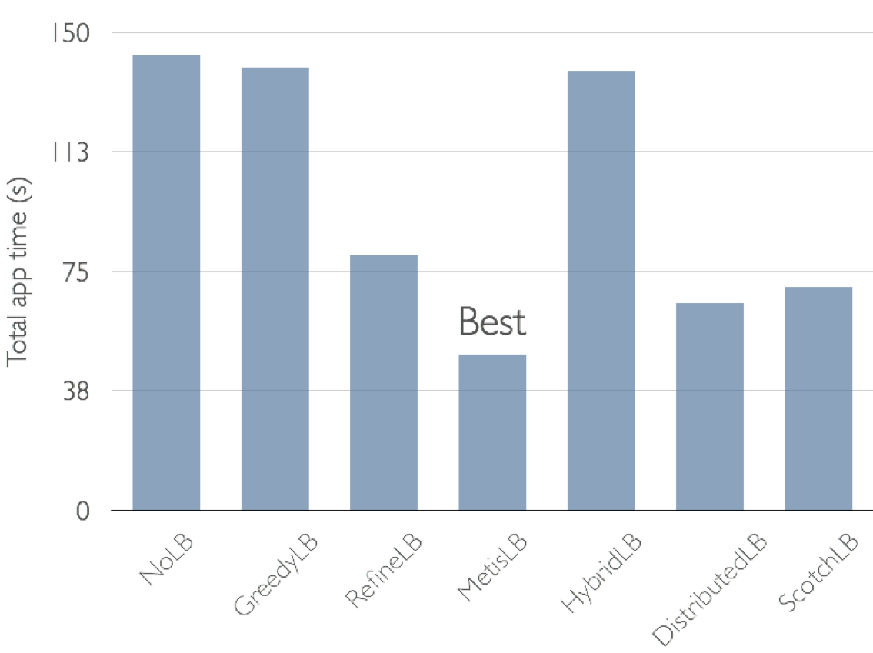
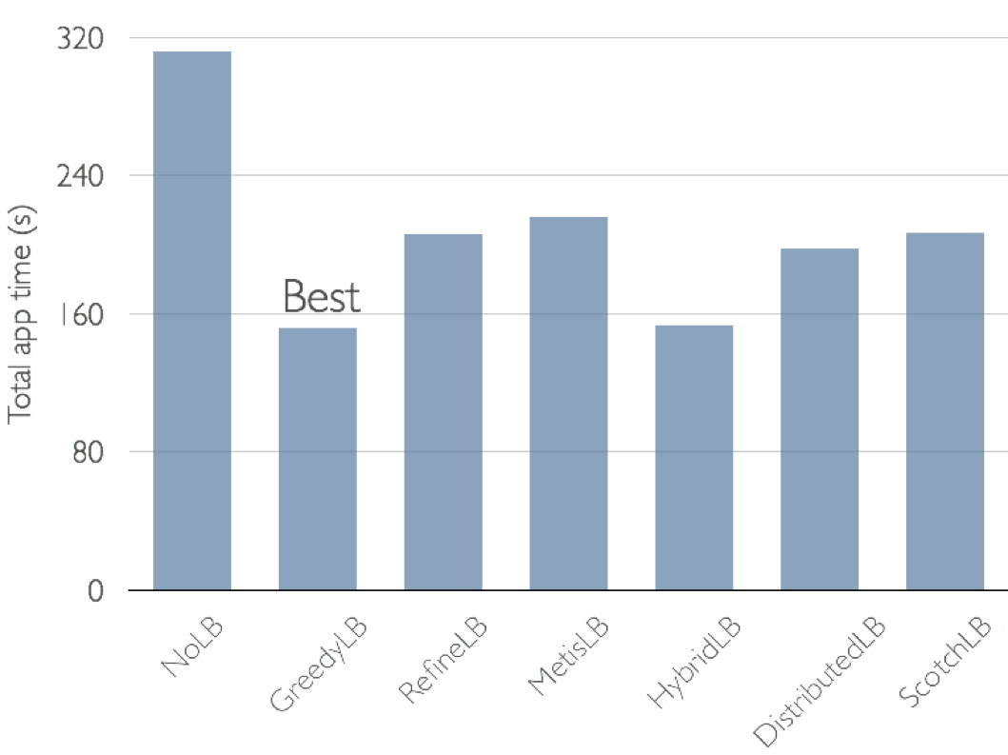
Training Set
Synthetic benchmark lb_test to study different behavior
  varying communication pattern
  computation load
  migration cost
  message sizes
These parameters allow us to introduce application characteristics
  Load imbalance
  Dynamic load imbalance
  Compute vs Communication-intensive
Communication-intensive synthetic run
Computation-intensive synthetic run

Slide 17
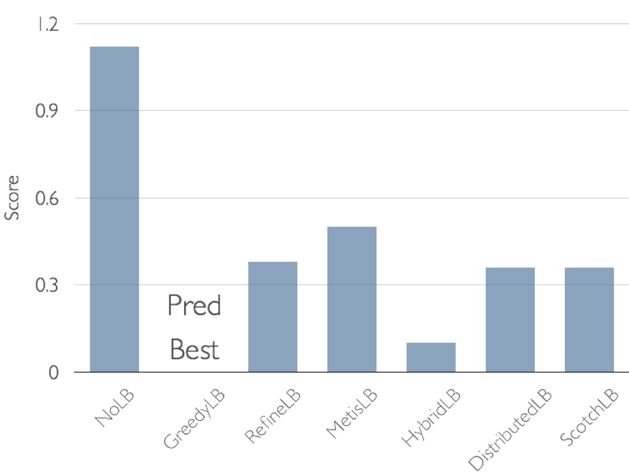
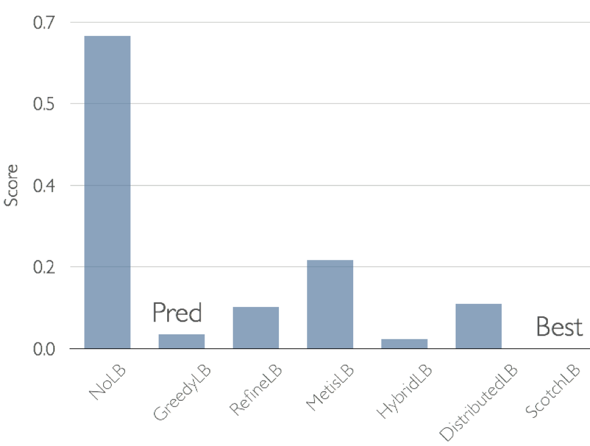


Predictions on Test Data
75 configurations were used in training set and 25 in test set
Variations in parameters allowed to simulate different application characteristics
  Eg: Communication-intensive, Compute-intensive
score = T_{predicted_lb} / T_{best_lb}-1
Larger the score, worse the performance
Prediction Scores

Slide 18
Histogram of Features
Histogram of features used for sample test data
100 trees are traversed by the classifier to find the load balancer with maximum probability
We output how often a feature is used to make a decision on the path
Some key features were:
  PE_load_Imb
  Avg_utilization
  Overhead_vs_benefit
  Comm_vs_Compute
Histogram of features used by Random Forest for synthetic test data

Slide 19
Using Trained Model for applications
Trained Random Forest Model from synthetic runs was used with
  Lassen
  PRK Particle-In-Cell Simulation
  NPB BT-MZ
  PDES
  LeanMD
Some of the mini-application results are presented here

Slide 20
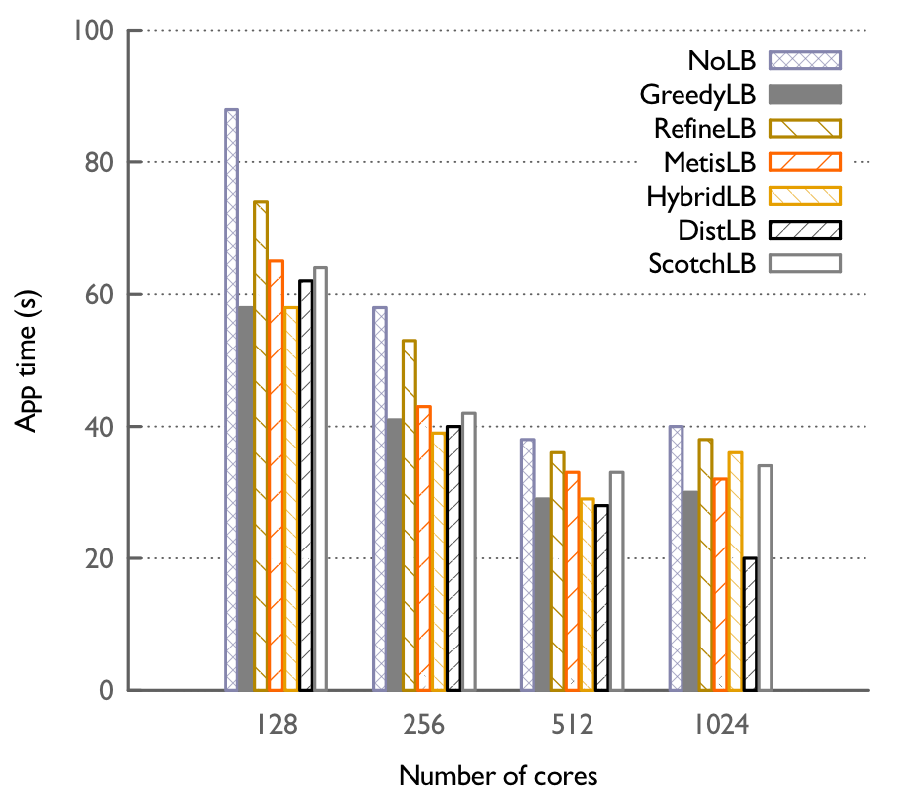
Lassen – Wave propagation application
Used to study detonation shock dynamics
Suffers from varying load imbalance
Meta-Balancer is able to choose a good load balancer
  In most cases, atleast the 2nd best load balancer
Meta-Balancer predicts LB (DistLB -1024 cores) that improves performance by 2X for worst LB
Application times for all LBs
Lassen Prediction for LB strategies
Notes:
Worst was – Refine for 1024

Slide 21
Prediction for Particle-In-Cell Simulation
Charm++ implementation of PRK PIC
Used for simulation of plasma particles
Load imbalance results from imbalanced distribution of particles and particle motion
Meta-Balancer is able to predict GreedyLB that improves performance by more than 2X for worst LB
PRK PIC Prediction for LB strategies

Slide 22
Prediction for NPB BT-MZ
Use of Random Forest Algorithm for prediction of Load balancer
Example: NPB BT-MZ, an AMPI benchmark
Uneven zone size – load imbalance
Communication intensive
Input classes used: C and D
For core 128, 256 cores, prediction is the second best
NPB BT-MZ Prediction for LB strategies

Slide 23
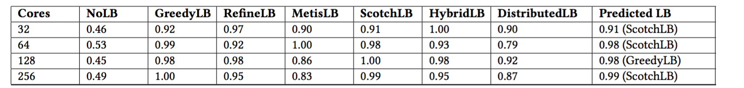
Prediction for NPB BT-MZ
Load-Balancing Score for NPB BT-MZ
Score of prediction with respect to performance speedup is shown
For core 128, 256 cores, prediction is the second best
Smaller cores show might have variability due to short run time
Notes:
ScotchLB could show up as dominating for larger dataset

Slide 24
Tree Path description for BT-MZ
Result Analysis:
  What features work?
Figure shows BT-MZ’s LB prediction
LB_Gain (overhead_vs_benefit) is > 0.09
  Hence centralized strategy is acceptable
NUM_PEs is low
  Hence Greedy is acceptable (instead of Hybrid)
Migration overhead is low
  Hence Greedy is acceptable than Refine
Rate of imbalance is low
  Hence greedy is acceptable, since it can be called infrequently with low overhead
Random Forest’s tree for BT-MZ’s LB prediction

Slide 25
Summary: Meta-Balancer for Strategy Selection
Random Forest algorithm for training and to predict suitable load balancing strategy with high accuracy
Adaptive run-time component to make the load balancing strategy selection decision
Several applications benefit from strategy selection
Our Result Analysis looks at why a Load-balancing strategy was predicted with high probability

Slide 26
Thank You

