Slide 1
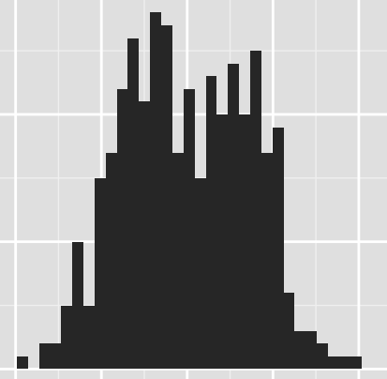
Histogram sort with Sampling (HSS)
Vipul Harsh, Laxmikant Kale

Slide 2
Parallel sorting in the age of Exascale
Charm N-body GrAvity solver
Massive Cosmological N-body simulations
Parallel sorting in every iteration

Slide 3
Parallel sorting in the age of Exascale
Charm N-body GrAvity solver
Massive Cosmological N-body simulations
Parallel sorting in every iteration
Cosmology code based on Chombo
Global sorting every step for load balance/locality
CHARM

Slide 4
Parallel sorting: Goals
Load balance across processors
Optimal data movement
Generality: robustness to input distributions, duplicates
Scalability and performance

Slide 5
Parallel sorting: A basic template
p processors, N/p keys in each processor
Determine (p-1) splitter keys to partition keys into p buckets
Send all keys to appropriate destination bucket processor
Eg. Sample sort, Histogram sort

Slide 6
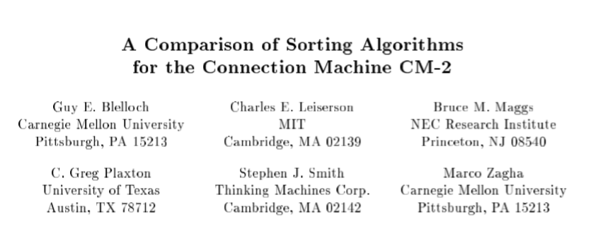
Existing algorithms: Parallel Sample sort
Samples s keys from each processor
Picks (p-1) splitters from p x s samples
[SPAA’ 91]
Problem: Too many samples required for good load balance

Slide 7
Existing algorithms: Parallel Sample sort
Samples s keys from each processor
Picks (p-1) splitters from p x s samples
[SPAA’ 91]
Problem: Too many samples required for good load balance
64 bit keys, p = 100,000 & 5% max load imbalance, sample size ≈ 8 GB

Slide 8
Existing algorithms: Histogram sort
Pick s x p candidate keys
Compute rank of each candidate key (histogram)
Select splitters from the candidates
[ICPP’ 93]

Slide 9
Existing algorithms: Histogram sort
Pick s x p candidate keys
Compute rank of each candidate key (histogram)
Select splitters from the candidates
[ICPP’ 93]
OR
Refine the candidates and repeat

Slide 10
Existing algorithms: Histogram sort
Pick s x p candidate keys
Compute rank of each candidate key (histogram)
Select splitters from the candidates
[ICPP’ 93]
OR
Refine the candidates and repeat
Works quite well for large p
But can take more iterations if input skewed

Slide 11
Histogram sort with sampling (HSS)
An adaptation of Histogram sort
Sample before each histogramming round
Sample intelligently
Use results from previous rounds
Discard wasteful samples at source

Slide 12
Histogram sort with sampling (HSS)
An adaptation of Histogram sort
Sample before each histogramming round
Sample intelligently
Use results from previous rounds
Discard wasteful samples at source
HSS has sound theoretical guarantees

Slide 13
Histogram sort with sampling (HSS)
An adaptation of Histogram sort
Sample before each histogramming round
Sample intelligently
Use results from previous rounds
Discard wasteful samples at source
HSS has sound theoretical guarantees
Independent of input distribution

Slide 14
Histogram sort with sampling (HSS)
An adaptation of Histogram sort
Sample before each histogramming round
Sample intelligently
Use results from previous rounds
Discard wasteful samples at source
HSS has sound theoretical guarantees
Independent of input distribution
Justifies why Histogram sort does well

Slide 15
HSS: Intelligent Sampling
Find (p-1) splitter keys to partition input into p ranges

Slide 16
HSS: Intelligent Sampling
Find (p-1) splitter keys to partition input into p ranges
Ideal Splitters

Slide 17
HSS: Intelligent Sampling
Find (p-1) splitter keys to partition input into p ranges
Ideal Splitters
After first round

Slide 18
HSS: Intelligent Sampling
Find (p-1) splitter keys to partition input into p ranges
Ideal Splitters
After first round
Next round of sampling only in shaded intervals

Slide 19
HSS: Intelligent Sampling
Find (p-1) splitter keys to partition input into p ranges
Ideal Splitters
After first round
Next round of sampling only in shaded intervals
Samples outside the shaded intervals are wasteful

Slide 20
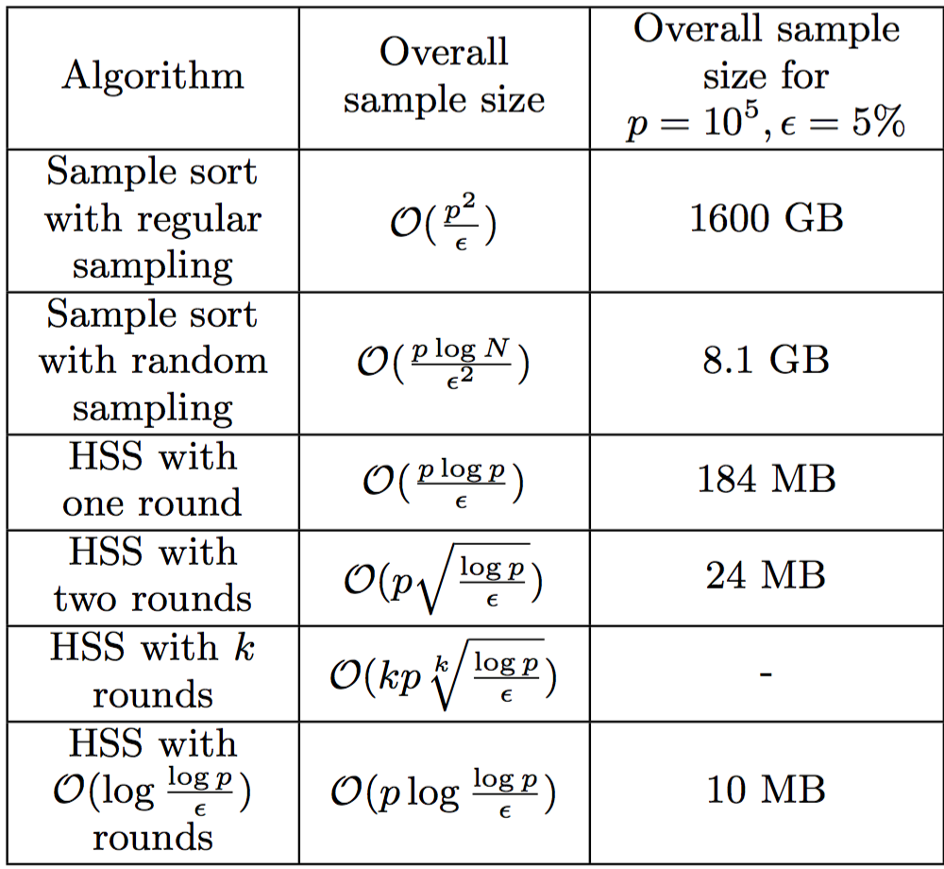
HSS: Sample size

Slide 21
HSS: Sample size

Slide 22
HSS: Sample size

Slide 23
HSS: Sample size

Slide 24
HSS: Sample size

Slide 25
HSS: Sample size

Slide 26
HSS: Sample size

Slide 27
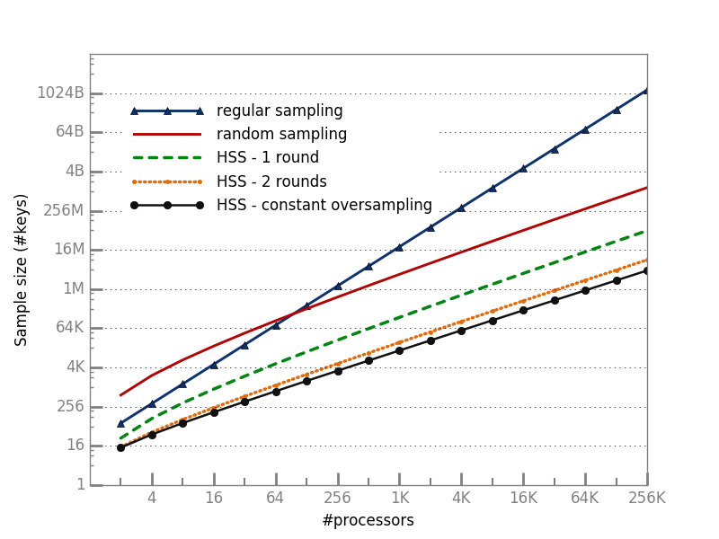
HSS: Sample size
350 x
64 bit keys, 5% load imbalance

Slide 28
Number of histogram rounds
p (x 1000) | sample size/round (x p) | Number of rounds | Number of rounds (Theoretical)
4 | 5 | 4 | 8
8 | 5 | 4 | 8
16 | 5 | 4 | 8
32 | 5 | 4 | 8
Number of rounds hardly increases with p ➔ log (log p) complexity

Slide 29
Optimizing for shared memory
Modern machines are highly multicore
BG/Q: 64 hardware threads/node
Stampede KNL(2.0): 272 hardware threads/node
How to take advantage of within-node parallelism?

Slide 30
Final All-to-all data exchange
In the final step, each processor sends a data message to every other processor
O($p^{2})$ fine grained messages in the network

Slide 31
Final All-to-all data exchange
In the final step, each processor sends a data message to every other processor
O($p^{2})$ fine grained messages in the network
What if all messages having the same source, destination node are combined into one?
Messages in the network: O($n^{2})$
Two orders of magnitude less!

Slide 32
What about splitting?…
We really need splitting across nodes rather than individual processors
(n-1) splitters needed instead of (p-1)
An order of magnitude less
Reduces sample size even more
Add a final within node sorting step to the algorithm

Slide 33
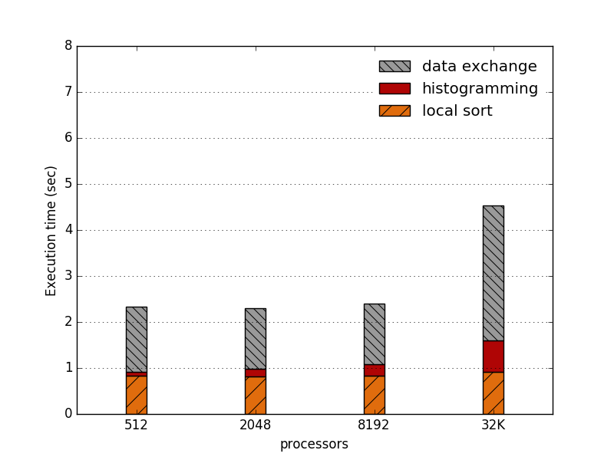
Execution time breakdown
Very little time is spent on histogramming!
Weak Scaling experiments on BG/Q Mira with 1 million 8 byte keys and 4 byte payload per key on each processor, with 4 ranks/node

Slide 34
Conclusion
HSS combines sampling and histogramming to accomplish fast splitter determination
HSS provides sound theoretical guarantees
Most of the running time spent in local sorting & data exchange (unavoidable)

Slide 35
Future work
Integration in HPC applications (e.g. ChaNGa)

Slide 36
Future work
Integration in HPC applications (e.g. ChaNGa)
Acknowledgements
Edgar Solomnik
Omkar Thakoor
ALCF

Slide 37
Thank You!

Slide 38
Thank You!

Slide 39
Backup slides

Slide 40
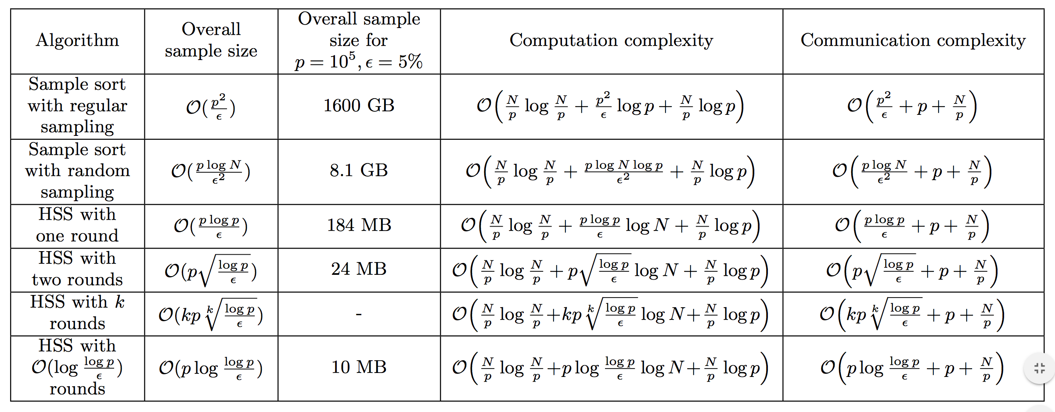
HSS: Computation/Communication complexity

