Slide 1
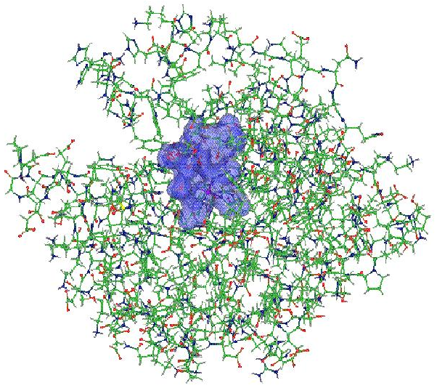
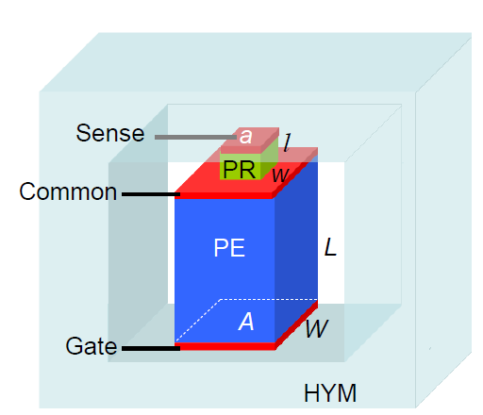
OpenAtom Project: Ground and Excited Electronic State Simulations for large systems on massively parallel platforms
PIs: G.J. Martyna (IBM), S. Ismail-Beigi (Yale) and L.V. Kale (UIUC)

Slide 2
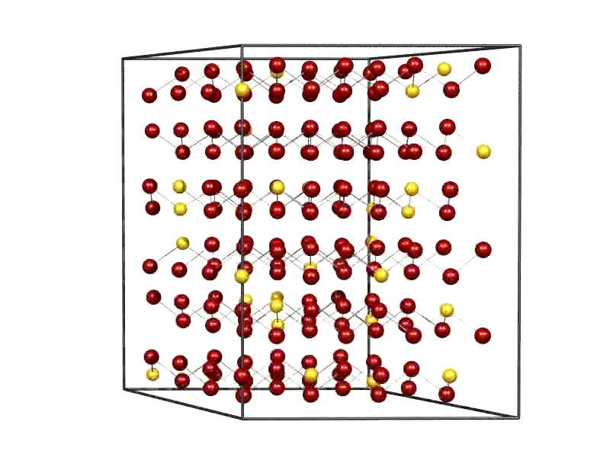
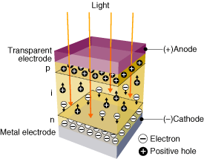
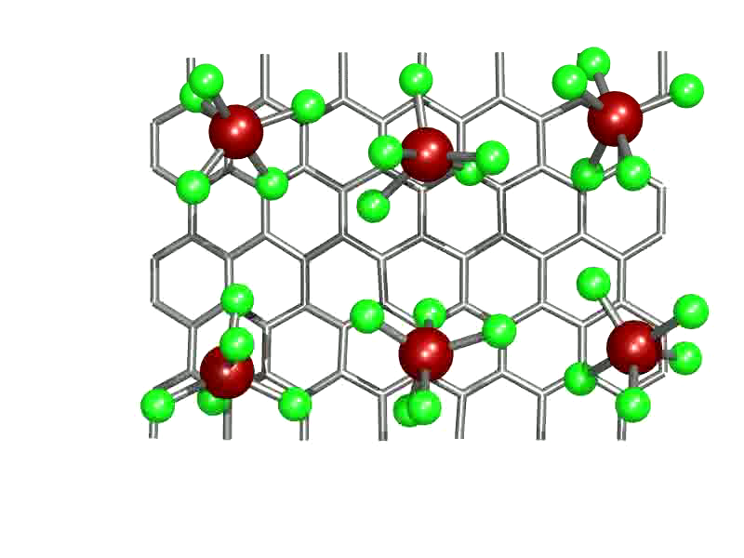
Goal : The accurate treatment of complex heterogeneous
systems to gain physical insight via novel
electronic structure computations

Slide 3
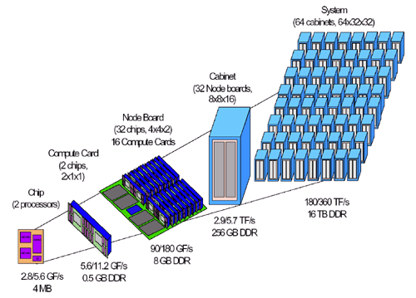
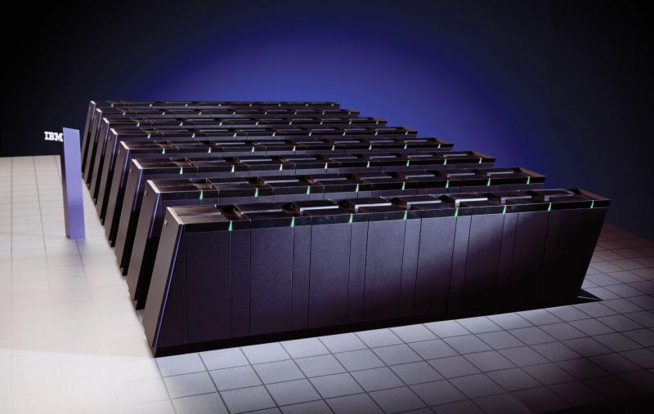
Supercomputers and novel methods for new
Science and Technology
Collaboration between Martyna, Ismail-Beigi and Kale groups to enable
novel e-structure capabilities on massively parallel platforms

Slide 4
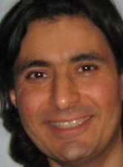


What is OpenAtom
Sohrab Ismail-Beigi
Applied Physics
& Materials
Yale
Sanjay Kale
Computer Science
UIUC
Glenn Martyna
Physical Chemistry
& Materials
IBM
NSF SI2-SSI: Scalable, Extensible, and
Open Framework for Ground and
Excited State Properties of Complex Systems
OpenAtom software package : DFT MD now , GW next
Plane waves and pseudopoentials
charm++ parallel infrastructure

Slide 5


Density Functional Theory (DFT)
Energy functional E[n] of electron density n(r)
Minimizing over n(r) gives exact
Ground-state energy E₀
Ground-state density n(r)
Minimum
condition
equivalent to Kohn-Sham equations
LDA/GGA for E_{xc} : good geometries and total energies
Bad band gaps and excitations
Hohenberg & Kohn, Phys. Rev. (1964); Kohn and Sham, Phys. Rev. (1965).

Slide 6
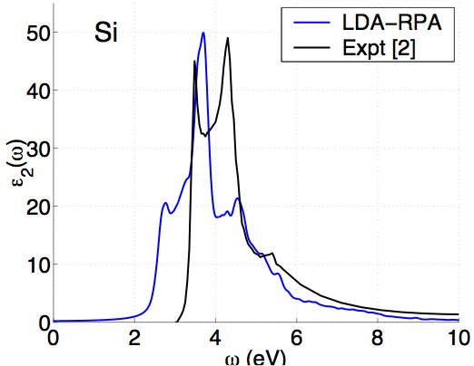
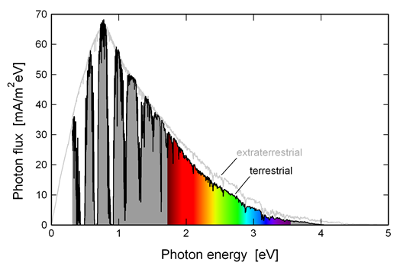
DFT: problems with excitations
Energy gaps (eV)
Material | LDA | Expt. [1]
Diamond | 3.9 | 5.48
Si | 0.5 | 1.17
LiCl | 6.0 | 9.4
[1] Landolt-Bornstien, vol. III; Baldini & Bosacchi, Phys. Stat. Solidi (1970).
Solar spectrum

Slide 7
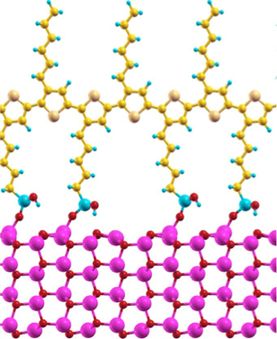
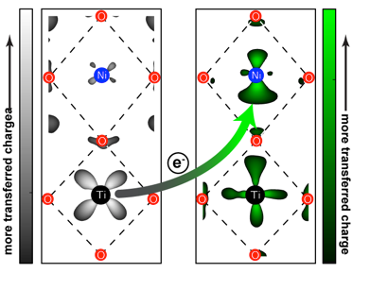
DFT: problems with energy alignment
Interfacial systems:
Electrons can transfer across
Depends on energy level alignment across interface
DFT has errors in band energies
Is any of it real?
e⁻

Slide 8
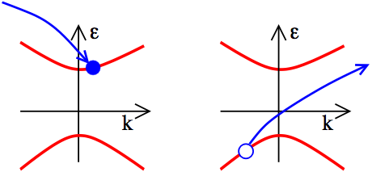
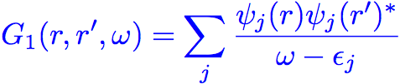

One particle Green’s function
(r’,0)
(r,t)
Dyson Equation:
DFT:

Slide 9
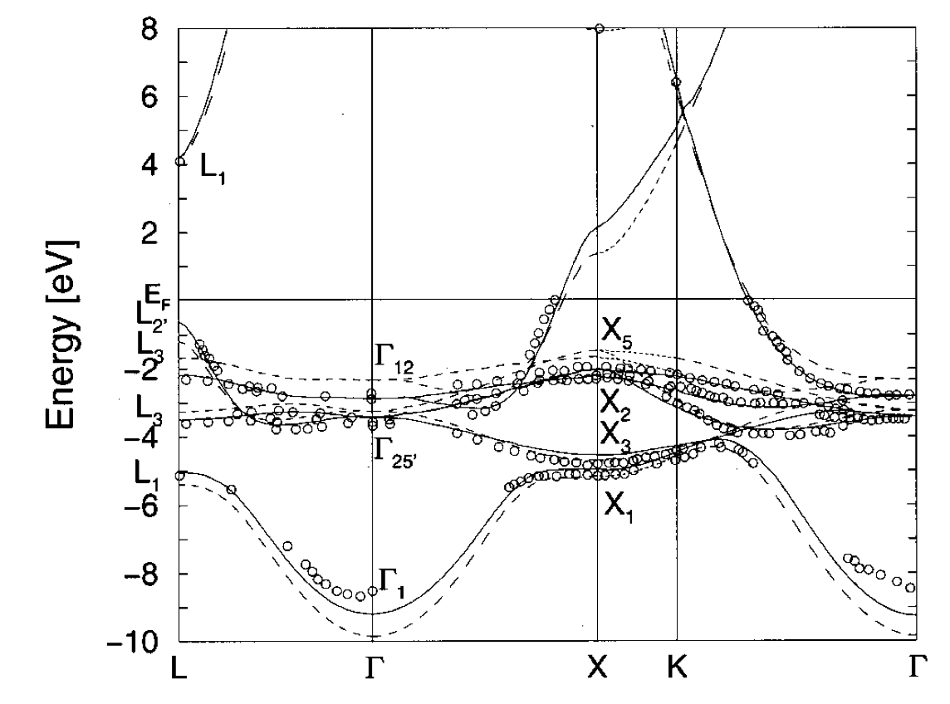
Green’s functions successes
Quasiparticle gaps (eV)
Material | LDA | GW | Expt.
Diamond | 3.9 | 5.6* | 5.48
Si | 0.5 | 1.3* | 1.17
LiCl | 6.0 | 9.1* | 9.4
SrTiO₃ | 2.0 | 3.4-3.8 | 3.25
* Hybertsen & Louie, Phys. Rev. B (1986)
Band structure of Cu
Strokov et al., PRL/PRB (1998/2001)

Slide 10
What is a big system for GW?
P3HT polymer
Band alignment for
this potential
photovoltaic system?
100s of atoms/unit cell
Not possible routinely
(with current software)
Zinc oxide nanowire

Slide 11
GW is expensive
Scaling with number of atoms N
DFT : N³
GW : N⁴ (gives better bands)
BSE : N⁶ (gives optical excitations)
But in practice the GW is the killer
e.g. a nanoscale system with 50-75 atoms (GaN)
DFT : 1 cpu x hours
GW : 91 cpu x hours
BSE : 2 cpu x hours
∴ Focus on GW

Slide 12
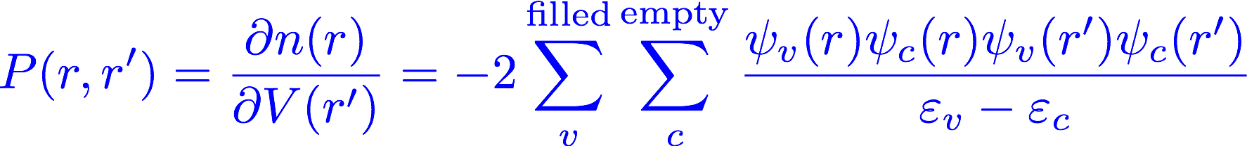
What is so expensive in GW?
One key element : response of electrons to perturbation
P(r,r’) = Response of electron density n(r) at position r
to change of potential V(r’) at position r’
Notes:
The factor fi=1 if a state if filled with electron and 0 if empty in the ground state. The sum over j this in theory goes to infinity

Slide 13
What is so expensive in GW?
One key element : response of electrons to perturbation
Standard perturbation theory expression
Problems:
Must generate “all” empty states (sum over c )
Lots of FFTs to get functions 𝜓_{i}(r) functions
Enormous outer produce to form P
Dense r grid : P huge in memory
Notes:
The factor fi=1 if a state if filled with electron and 0 if empty in the ground state. The sum over j this in theory goes to infinity

Slide 14
Steps for typical G₀W₀ calculation
Stage 1 : Run DFT calc. on structure → output : ε_{i} and 𝜓_{i}(r)
Stage 2.1 : compute Polarizability matrix
Stage 2.2 : double FFT rows and columns → P(G,G’)
Stage 3 : compute and invert dielectric screening function
Stage 4 : “plasmon-pole” method → dynamic screening
Stage 5 : put together ε_{i} , 𝜓_{i}(r) and → self-energy Σ(ω)

Slide 15
Steps for typical G₀W₀ calculation
Stage 1 : Run DFT calc. on structure → output : ε_{i} and 𝜓_{i}(r)
Stage 2.1 : compute Polarizability matrix
Stage 2.2 : double FFT rows and columns → P(G,G’)
Stage 3 : compute and invert dielectric screening function
Stage 4 : “plasmon-pole” method → dynamic screening
Stage 5 : put together ε_{i} , 𝜓_{i}(r) and → self-energy Σ(ω)
Most expensive

Slide 16



G versus R space P calculation
G-space:
R-space:
-
-
Big multiply: N_{v} N_{c} N_{r}² = O(N⁴)
Directly compute P in G space
Many FFTs : N_{v} N_{c}
Big multiply: N_{v} N_{c} N_{G}² = O(N⁴)
FFT N_{r} rows
N_{v} : # occupied states
N_{c} : # unoccupied states
N_{G} : # of g vectors
FFT N_{r} columns
N_{r}: # r grid
N_{r} ≈ 4Nc
N_{v}N_{c} FFTs needed
Big O(N⁴) matrix multiply
N_{v}+N_{c} + 8N_{c} FFTs needed
Big O(N⁴) matrix multiply

Slide 17
Eric Mikida

Slide 18
Parallel Implementation
Completed up to self-energy computation
Memory is a primary constraint
Formation of P is the most costly step
Basic Computation
f_{lm} = ψ_{l} × ψ_{m} for all l, m
P += f_{lm} f^{T}_{lm} for all f

Slide 19
GW-BSE Memory Concerns
1 MB per state
10,000 total states per k-point
10 k-points
100 GB to store all states
1 TB to store P
90,000,000 f vectors (90 TB total)

Slide 20
Parallel Decomposition
Ψ Vectors
1D Chare Array
L occupied
M unoccupied
…
R
P Matrix
2D Tiles
2D Chare Array
R
R

Slide 21
Parallel Decomposition

Slide 22
Parallel Decomposition
Duplicate occupied states on each node
Psi Cache
Psi Cache

Slide 23
Parallel Decomposition
Duplicate occupied states on each node
Broadcast an unoccupied state to compute f vectors
F Cache
F Cache
Psi Cache
Psi Cache

Slide 24
Parallel Decomposition
Duplicate occupied states on each node
Broadcast an unoccupied state to compute f vectors
Locally update each matrix tile
F Cache
F Cache
Psi Cache
Psi Cache

Slide 25
Parallel Decomposition
Duplicate occupied states on each node
Broadcast an unoccupied state to compute f vectors
Locally update each matrix tile
Repeat step 2 for next unoccupied state
F Cache
F Cache
Psi Cache
Psi Cache

Slide 26

P Formation Scaling
54 atom bulk Si
~0.1MB per state
108 occupied
1000 unoccupied
1 k point
32 processors per node on Vesta (IBM BG/Q @ ANL)
Note: used Berkeley GW v1.1
(8 months old compared to v1.2)

Slide 27
P Formation Scaling
108 atom bulk Si
~0.2MB per state
216 occupied
1832 unoccupied
1 k point
32 processors per node on Vesta (IBM BG/Q @ ANL)
Note: used Berkeley GW v1.1
(8 months old compared to v1.2)

Slide 28
FFT P to GSpace
Convert P to 1D decomposition
FFT each row (locally with fftw)
Transpose (requires message throttling)
FFT each row again
Transpose and convert back to 2D

Slide 29
Epsilon Inverse
Iterative inverse of ε (ε = P multiplied and cutoff)
Utilizes existing OpenAtom matrix multiply library
Epsilon size is reduced by up to 10x from P
Basic Computation
Initial: X = ε*ε^{T}
Step 1: M1 = 2I - A * X
Step 2: X1 = X * M1
Converge on (X = X1)
CLA Matrix Algorithm - 2D
Notes:
2D decomposition
Uses sections for multicast

Slide 30
Self-Energy Calculation
Operation on pairs of f_{nl} where n is from an input set of state indices
Bare Exchange and Screened Exchange
Basic Computation
f_{nl} A f^{T}_{n’l} for all n,l
Screened: A = ε
Bare: A = v(g)

Slide 31
Parallel Decomposition
Cache portions of f vectors during P calculation
Multiply all pairs of f_{nl}
Sum reduction for final result
Very Little Communication
F Cache
Psi Cache

Slide 32
Future Optimizations
Pipeline unoccupied states in P formation
Smarter node-level cache storage layout
Dynamic creation/deletion of matrices
GPGPUs for BLAS operations
Overlap phases where possible

Slide 33
Sohrab Ismail-Beigi

Slide 34
Parallel performance: P calculation
54 atom bulk Si
108 occupied
1000 unoccupied
1 k point
32 processors per node
Supercomputer : Vesta (ANL) : BlueGene/Q
Note: used Berkeley GW v1.1
(8 months old compared to v1.2)

Slide 35
Parallel performance: P calculation
108 atom bulk Si
216 occupied
1832 unoccupied
1 k point
16 processors per node
(42x22x22)
(111x55x55)
Supercomputer : Mira (ANL) : BQ BlueGene/Q
Note: used Berkeley GW v1.1
(8 months old compared to v1.2)

Slide 36
Parallel performance: P calculation
108 atom bulk Si
216 occupied
1832 unoccupied
1 k point
32 processors per node
Supercomputer : Vesta (ANL) : BQ BlueGene/Q
Note: used Berkeley GW v1.1
(8 months old compared to v1.2)

Slide 37
Where we are with OpenAtom GW
Phase |  | Serial | Parallel
1 | Compute P in RSpace | Complete | Complete
2 | FFT P to GSpace | Complete | Complete
3 | Invert epsilon | Complete | Complete
4 | Plasmon pole | Complete | In Progress
5 | COHSEX self-energy | Complete | In Progress
6 | Dynamic self-energy | In Progress | Future
7 | Coulomb Truncation | Future | Future
Aim to release COHSEX version early summer 2017

Slide 38
Minjung Kim

Slide 39
Static polarizability calculations
$$N^{4}$$
$$N^{3}$$
?
Giustino, Cohen, and Louie, PRB 81 (2010)
Wilson, Gygi, and Galli, PRB 78 (2008)
Liu, Kaltak, Klimes, and Kresse, PRB 94 (2016)

Slide 40
Cubic scaling algorithm – 1. Interpolation
$$P\left(r,r^{′}\right)=−2\sum_{v,c}{\frac{ψ_{v}(r)ψ_{c}^{∗}(r)ψ_{c}(r′)ψ_{v}^{∗}(r′)}{ε_{c}−ε_{v}}}$$
$$N_{r}^{2}N_{c}N_{v} \sim N^{4}$$
$$A\left(r,r^{′};z\right)=\sum_{c}{\frac{ψ_{c}^{∗}(r)ψ_{c}(r′)}{ε_{c}−z}}$$
$$N_{r}^{2}N_{c}N_{z}$$
1. Save values over some z grid
2. Interpolate
$$P\left(r,r^{′}\right)=−2\sum_{v}{ψ_{v}\left(r\right)ψ_{v}^{∗}\left(r^{′}\right)A(r,r^{′};ε_{v})}$$
$$N_{r}^{2}{N_{v}N}_{int}$$
N_{z}: number of points to be evaluated
N_{int}: number of points for interpolation
If N_{z} << N_{v} it scales N³
N_{int} = 2 (linear interpolation) works well

Slide 41
Cubic scaling algorithm – 2. Laplace method
1. Laplace Identity:
$$\frac{1}{ε_{c}−ε_{v}}=\int_{0}^{∞}{e^{−\left(ε_{c}−ε_{v}\right)x}dx}$$
$$≈\sum_{k}{ω_{k}}e^{−\left(ε_{c}−ε_{v}− 1\right)x_{k}}$$
$$\int_{0}^{∞}{{f(x)e}^{−x}}dx≈\sum_{k}^{N_{GL}}{ω_{k}}f\left(x_{k}\right)$$
2. Gauss-Laguerre quadrature:
w_{k}: weight
x_{k}: node
N_{GL}: # quadrature nodes
$$P\left(r,r^{′}\right)=−2\sum_{c}{\sum_{v}{\frac{1}{ε_{c}−ε_{v}}ψ_{v}(r)ψ_{c}^{∗}(r)ψ_{c}(r′)ψ_{v}^{∗}(r′) }}$$
$$P\left(r,r^{′}\right)=−2\sum_{k}{ω_{k}e^{−\left(μ_{c}−μ_{v}−1\right) x_{k}}}\sum_{c}{ψ_{c}^{∗}(r)ψ_{c}(r′)e^{−\left(ε_{c}−μ_{c}\right) x_{k}}\sum_{v}{ψ_{v}(r)ψ_{v}^{∗}(r′)e^{−\left(μ_{v}−ε_{v}\right) x_{k}}}}$$
separable!
Number of computation:
$N_{r}^{2}N_{GL}{(N}_{c}+N_{v}$)
$$\sim N^{3}$$
$N_{GL}$does not depend on system size

Slide 42
Cubic scaling algorithm – 2. Laplace method
3. Windowing:
  Observation: N_{GL} depends on $\frac{E_{bw}}{E_{gap}}$
E_{bw}: band width (E_{c,max}-E_{v,min})
E_{gap}: band gap
$N_{r}^{2}N_{GL}{(N}_{c}+N_{v}$)
$$P\left(r,r^{′}\right)=\sum_{l}^{N_{wv}}{\sum_{m}^{N_{wc}}{P_{lm}(r,r^{′})}}$$
N_{wv}: # windows for E_{v}
N_{wc}: # of windows for E_{c}
  Example: 2 by 2 windows
$$P=$$
$$P_{11}$$
$$+ P_{21}$$
$$+ P_{12}$$
$$+ P_{22}$$
{E_{v}}₁
{E_{v}}₂
{E_{c}}₁
{E_{c}}₂
E
E_{v,min}
E_{v,max}
E_{c,min}
E_{c,max}
Windowing can save computational costs
Useful for materials with small band gap

Slide 43
Estimate the computational costs
N_{GL} depends on $\frac{E_{bw}}{E_{gap}}$
E_{bw}: band width (E_{c,max}-E_{v,min})
E_{gap}: band gap
Cost = $N_{r}^{2}N_{GL}{(N}_{c}+N_{v}$)
$$N_{GL}∝\sqrt{\frac{E_{bw}}{E_{g}}}$$
computation cost can be estimated by E_{bw} and E_{g}
1.
$$C∝\sum_{l}^{N_{vw}}{\sum_{m}^{N_{cw}}{\sqrt{\frac{E_{bw}^{lm}}{E_{g}^{lm}}}\left(\frac{E_{vl}^{max}−E_{vl}^{min}}{E_{v}^{max}−E_{v}^{min}}N_{v}−\frac{E_{cm}^{max}−E_{cm}^{min}}{E_{c}^{max}−E_{c}^{min}}N_{c}\right)}}$$
2.
$${(N}_{c}+N_{v})/N∝(E_{bw}−E_{g})$$

Slide 44
Estimate the computational costs
{E_{v}}₁
{E_{v}}₂
{E_{c}}₁
{E_{c}}₂
Example: 2x2 window
E
E_{v,min}
E_{v}*
E_{v,max}
E_{c,min}
E_{c}*
E_{c,max}
E_{bw} = 2 Hartree
E_{g} = 0.02 Hartree
$$E_{v,ratio}=\frac{E_{v}^{∗}−E_{v,min}}{E_{v,max}−E_{v}^{∗}}$$
$$E_{c,ratio}=\frac{E_{c}^{∗}−E_{c,min}}{E_{c,max}−E_{c}^{∗}}$$
Real computational costs
Estimated computational costs

Slide 45
Windowing
How many windows for occupied and unoccupied states?
E_{vmax}-E_{vmin}= 0.44 Ha
E_{cmax}-E_{cmin}= 1.44 Ha
E_{bw} = 2 Ha
E_{g} = 0.02 Ha
Optimized number of windows:
Nvw =1
Ncw = 4

Slide 46
Results
Si crystal with 16 atoms
Number of bands: 433
Number of windows: 1 for N_{v} & 4 for N_{c}
Maximum error of band gap
Laplace + windowing: 0.02eV
Interpolation: 0.23eV
$$ε_{∞}$$
Laplace method with windows wins!!

Slide 47
Results
Scaling data
Si crystal with 2, 4, 8, and 16 atoms
$$N^{4} : \frac{Operation Time}{N_{v}N_{c}N_{r}^{2}}$$
$$L+W: \frac{Operation Time}{\sum_{l}^{N_{wv}}{\sum_{m}^{N_{wc}}{N_{GL}\left(N_{v}+N_{c}\right)N_{r}^{2}}}}$$

Slide 48
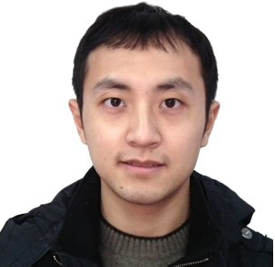
Glenn Martyna and Qi Li

Slide 49
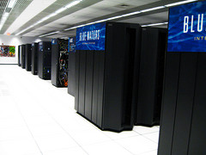
Projector Augmented Wave based
Kohn-Sham Density Functional Theory
in OpenAtom with N² log N scaling
OpenAtom team,
Qi Li and Glenn Martyna

Slide 50
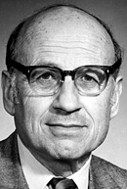
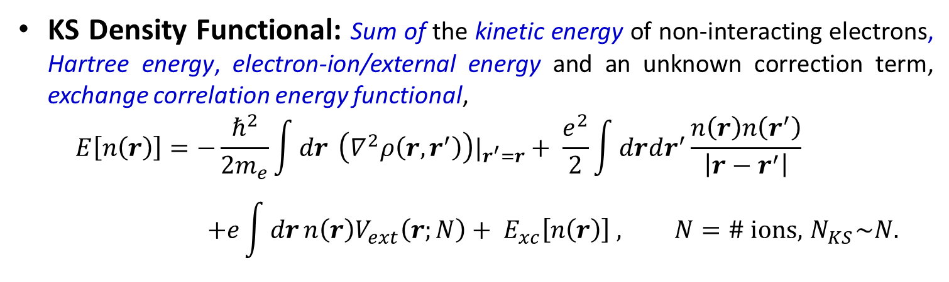
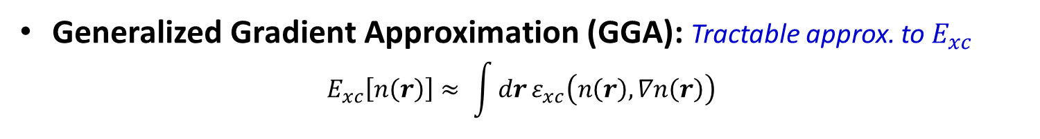
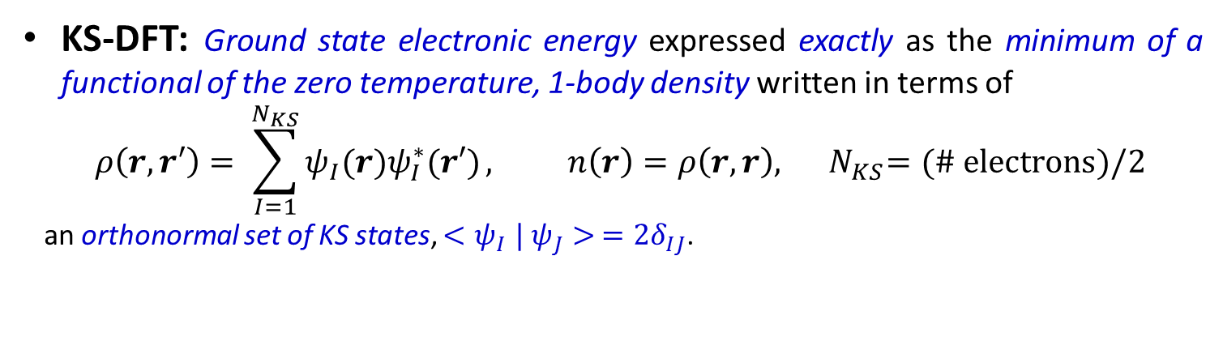
Kohn-Sham Density Functional Theory (KS-DFT):
A workhorse of computational science.
KS-DFT: Ground state electronic energy expressed exactly as the minimum of a functional of the zero temperature, 1-body density written in terms of
$$ρ\left(r,r′\right)= \sum_{I=1}^{N_{KS}}{ψ_{I}(r)ψ_{I}^{∗}(r′)}, n\left(r\right)=ρ\left(r,r\right),{ N}_{KS}=(\# electrons)/2$$
an orthonormal set of KS states, ${<ψ}_{I}|$ $ψ_{J}> ={2δ}_{IJ}$.
Walter Kohn,
Nobel Chemistry
1998
KS Density Functional: Sum of the kinetic energy of non-interacting electrons, Hartree energy, electron-ion/external energy and an unknown correction term, exchange correlation energy functional,
$$E\left[n\left(r\right)\right]=−\frac{ℏ^{2}}{2m_{e}}\int{dr} \left(∇^{2}ρ\left(r,r^{′}\right)\right)|_{r^{′}=r}+ \frac{e^{2}}{2}\int{drdr^{′}}\frac{n\left(r\right)n\left(r^{′}\right)}{\left|r−r^{′}\right|} \\ +e\int{dr}n\left(r\right)V_{ext}\left(r;N\right)+ E_{xc}\left[n\left(r\right)\right] , N=\# ions, { N}_{KS}\sim N.$$
Generalized Gradient Approximation (GGA): Tractable approx. to $E_{xc}$
$$E_{xc}\left[n\left(r\right)\right]≈ \int{dr}ε_{xc}\left(n\left(r\right),∇n\left(r\right)\right)$$

Slide 51
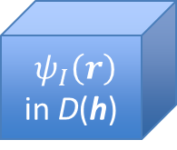
KS-DFT in OpenAtom
OpenAtom: Plane-wave (PW) based KS-DFT within the GGA – expand
KS states in the delocalized PW basis.
$ψ_{I}\left(r\right)$ in D(h)
PW-KS-DFT in OpenAtom - Advantages:
  N² log N or better scaling of interactions & derivatives -
  Euler Exponential Spline (EES) Interpolation.
  Only orthogonalization is ~N³ .
  High parallelism under charm++.
  k-points, path integrals, LSDA &
  tempering implemented.
PW-KS-DFT in OpenAtom - Disadvantages:
  Large basis set required - millions and millions (c.f. Carl Sagan).
  Large memory required – need large machines.
  Heavy atoms computationally intensive.

Slide 52
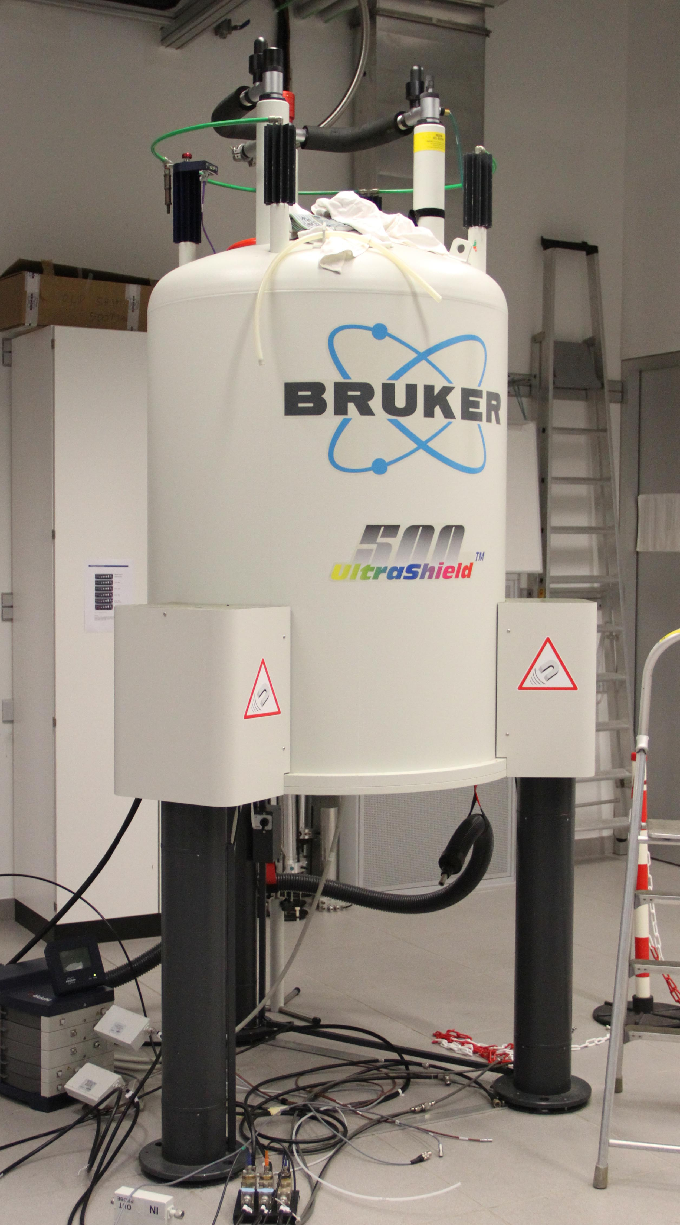
Projector Augmented Wave Method (PAW)
Projector-Augmented Wave (PAW) : accurate treatment of
heavy atoms in KS-DFT with low computational cost.
PAW-KS-DFT Advantages
  KS states split into localized and delocalized/smooth parts –
  small basis possible even for heavy atoms.
  NMR and some other linear response methods require the core –
  PAW makes it easy.
  Small memory requirement.
PAW-KS-DFT Disadvantages
  Implemented with inefficient N³ methods for interactions.
  Parallel performance of standard implementations poor.
Goal: Implement N² log N EES-based PAW with high parallel efficiency
in OpenAtom.

Slide 53
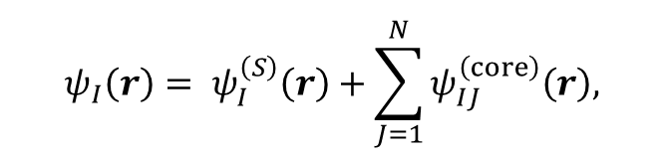
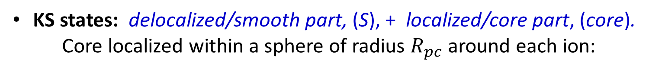
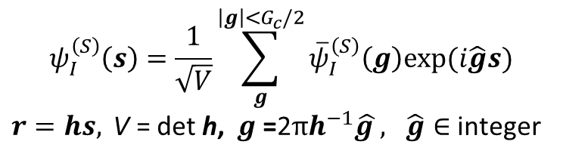

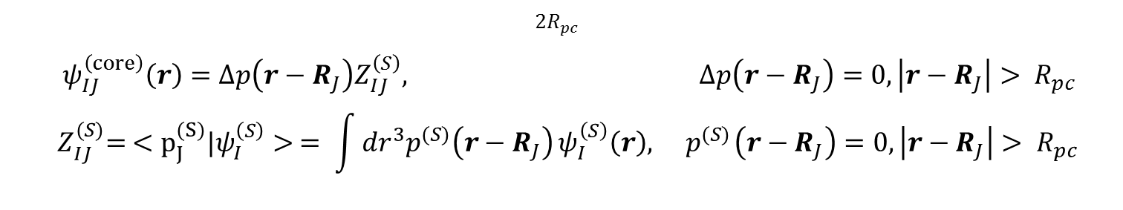


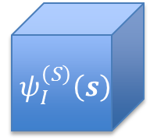
PAW Basics: KS states
KS states: delocalized/smooth part, (S), + localized/core part, (core).
Core localized within a sphere of radius $R_{pc}$ around each ion:
$$ψ_{I}\left(r\right)= ψ_{I}^{\left(S\right)}\left(r\right)+\sum_{J=1}^{N}{ψ_{IJ}^{\left(core\right)}\left(r\right),}$$
$$ψ_{IJ}^{\left(core\right)}\left(r\right)=0, |r−R_{J}|> R_{pc}$$
Smooth: fills all spaces & varies, expanded in plane-waves:
$$ψ_{I}^{\left(S\right)}\left(s\right)=\frac{1}{\sqrt{V}}\sum_{g}^{\left|g\right|<G_{c}/2}{{\overline{ψ}}_{I}^{\left(S\right)}\left(g\right)exp⁡(i\hat{g}s)}$$
$r=hs, \text{V}\text{ = }\text{det} \text{h}\text{, } g\text{ =}\text{2}πh^{−1}\hat{g }, \hat{g}∈$ integer
$${ ψ}_{I}^{\left(S\right)}\left(s\right)$$
$${ \overline{ ψ}}_{I}^{\left(S\right)}\left(g\right)$$
Core: localized, written in terms of fixed core projectors, ${\left\{Δp{,p}^{(S)}\right\}}^{∗}:$
$${2R}_{pc}$$
$ψ_{IJ}^{\left(core\right)}\left(r\right)=Δp\left(r−R_{J}\right)Z_{IJ}^{\left(S\right)}, Δp\left(r−R_{J}\right)=0, \left|r−R_{J}\right|> R_{pc}$
$${ Z}_{IJ}^{(S)}= <p_{J}^{(S)}{|ψ}_{I}^{\left(S\right)}> = \int{{dr}^{3}p^{(S)}\left(r−R_{J}\right)}ψ_{I}^{\left(S\right)}\left(r\right),{ p}^{(S)}\left(r−R_{J}\right)=0, \left|r−R_{J}\right|> R_{pc}$$
$∗1 ion type, 1 channel$ for simplicity

Slide 54







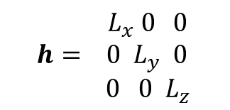
PAW Basics: Example KS state
$${ L}_{x} 0 0$$
$${h= 0 L}_{y} 0$$
${ 0 0 L}_{z}$
Localized ion core states, $ψ_{IJ}^{\left(core\right)}\left(r\right)$embedded
$$ψ_{I,1}^{\left(core\right)}\left(r\right)$$
$$ψ_{I,2}^{\left(core\right)}\left(r\right)$$
$$L_{z}$$
$$ψ_{I}^{\left(S\right)}(r)$$
$$L_{y}$$
$$L_{x}$$
in the smooth part of the state, $ψ_{I}^{\left(S\right)}\left(r\right),$that fills D(h).

Slide 55
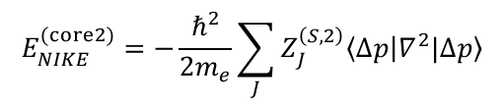
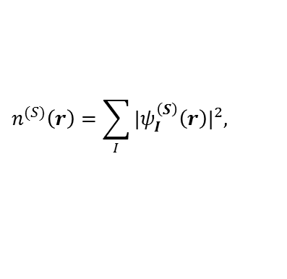



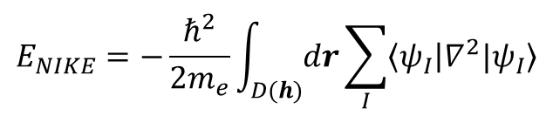
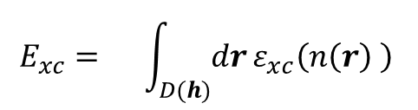
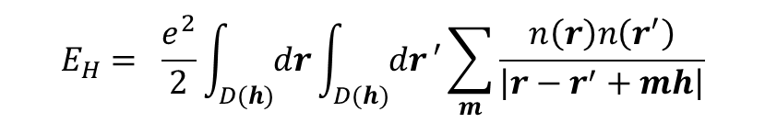
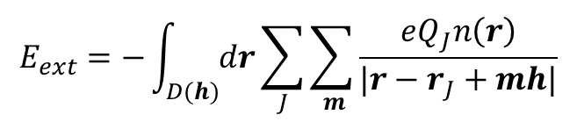

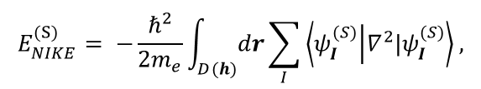
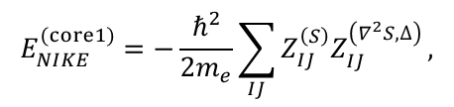
PAW Basics: KS-DFT within LDA under
periodic boundary conditions at Γ
The whole enchilada:
$$E\left[n\left(r\right)\right]=E_{NIKE}+E_{ext}+E_{H}+E_{xc}$$
$$E_{NIKE}=−\frac{ℏ^{2}}{2m_{e}}\int_{D(h)}{dr}\sum_{I}{\left\langle ψ_{I} | ∇^{2}{|ψ}_{I}\right\rangle }$$
$$E_{xc}= \int_{D(h)}{dr}ε_{xc}\left(n\left(r\right) \right)$$
$$E_{H}= \frac{e^{2}}{2}\int_{D(h)}{dr}\int_{D(h)}{dr}′\sum_{m}{\frac{n\left(r\right)n\left(r^{′}\right)}{\left|r−r^{′}+mh\right|}}$$
$$E_{ext}=−\int_{D(h)}{dr}\sum_{J}{\sum_{ m}{\frac{eQ_{J}n\left(r\right)}{|r−r_{J}+mh|}}}$$
Non-interacting electron kinetic energy: Smooth and core terms
$$E_{NIKE}=E_{NIKE}^{(S)}+E_{NIKE}^{(core1)}{+ E}_{NIKE}^{(core2)}$$
$$E_{NIKE}^{(S)}= −\frac{ℏ^{2}}{2m_{e}}\int_{D(h)}{dr}\sum_{I}{\left\langle ψ_{I}^{(S)} | ∇^{2}|ψ_{I}^{(S)}\right\rangle ,}$$
$$E_{NIKE}^{(core1)}=−\frac{ℏ^{2}}{2m_{e}}\sum_{IJ}{Z_{IJ}^{\left(S\right)}Z_{IJ}^{\left(∇^{2}S,∆\right)}},$$
$$E_{NIKE}^{(core2)}=−\frac{ℏ^{2}}{2m_{e}}\sum_{J}{Z_{J}^{\left(S,2\right)}\left\langle ∆p | ∇^{2}|∆p\right\rangle }$$
Exchange Correlation energy: Smooth and core terms
$$E_{xc}=E_{xc}^{(S)}+E_{xc}^{(core)}=\int_{D(h)}{dr}ε_{xc}\left(n^{(S)}\left(r\right) \right)+ \sum_{J}{\int_{D(R_{pc})}{dr}}\left[ε_{xc}\left(n_{J}\left(r\right) \right)−ε_{xc}\left(n_{J}^{(S)}\left(r\right)\right)\right]$$
core
$$n^{(S)}\left(r\right)=\sum_{I}{{{|ψ}_{I}^{\left(S\right)}\left(r\right)|}^{2}, }$$
$n_{J}\left(r\right)=n^{(S)}\left(r−R_{J}\right)+n^{(core1)}\left(r−R_{J}\right)$ + $n^{(core2)}\left(r−R_{J}\right)$, ${ n}_{J}^{(S)}\left(r\right)=n^{(S)}\left(r−R_{J}\right)$
$$∀ r in D(h)$$
$∀ |r−R_{J}$| <${ R}_{pc}$
$∀ |r−R_{J}$| <${ R}_{pc}$

Slide 56



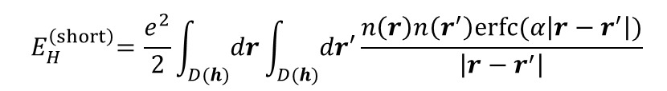
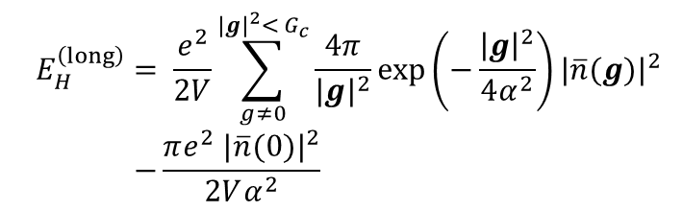
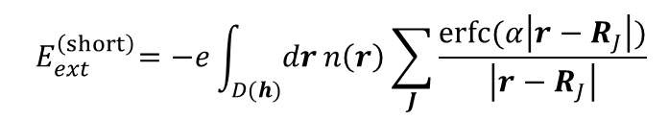
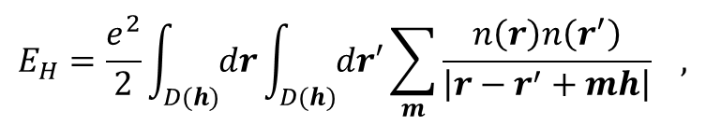
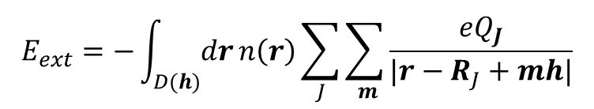
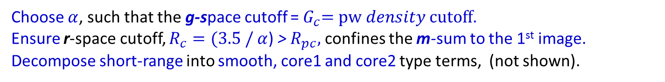
PAW Basics: KS-DFT long/short-range decomposition
Due to the mixed localized and delocalized basis, there is no natural truncation scale
for the long-range interactions of E_{H} and E_{ext} in g-space or r-space alone.
$$E_{H}=\frac{e^{2}}{2}\int_{D(h)}{dr}\int_{D(h)}{dr′}\sum_{m}{\frac{n\left(r\right)n\left(r^{′}\right)}{\left|r−r^{′}+mh\right|}} ,$$
$$E_{ext}=−\int_{D(h)}{dr}n\left(r\right)\sum_{J}{\sum_{ m}{\frac{{eQ}_{J}}{|r−R_{J}+mh|}}}$$
Using Poisson summation and Ewald’s decomposition of 1/r:
$$E_{H} ={ E}_{H}^{\left(short\right)}+{ E}_{H}^{\left(long\right)}$$
$$E_{ext} ={ E}_{H}^{\left(short\right)}+{ E}_{H}^{\left(long\right)}$$
$${ E}_{H}^{\left(short\right)}=\frac{e^{2}}{2}\int_{D(h)}{dr}\int_{D(h)}{dr′}\frac{n\left(r\right)n\left(r^{′}\right)erfc⁡(α\left|r−r^{′}\right|)}{\left|r−r^{′}\right|}$$
$${ E}_{ext}^{\left(short\right)}=−e\int_{D(h)}{dr}n\left(r\right)\sum_{J}{\frac{erfc⁡(α\left|r−R_{J}\right|)}{\left|r−R_{J}\right|}}$$
$${ E}_{H}^{\left(long\right)} = \frac{e^{2}}{2V}\sum_{g≠0}^{{|g|}^{2}<{ G}_{c}}{\frac{4π}{{|g|}^{2}}}exp\left(−\frac{{\left|g\right|}^{2}}{4α^{2}}\right){|\overline{n}(g)|}^{2} \\ −\frac{πe^{2} {|\overline{n}(0)|}^{2}}{2Vα^{2}}$$
$${ E}_{ext}^{\left(long\right)}=−\frac{e}{V}\sum_{g≠0}^{{\left|g\right|}^{2}<{ G}_{c}}{\frac{4π}{{\left|g\right|}^{2}}}exp\left(−\frac{{\left|g\right|}^{2}}{4α^{2}}\right)\overline{n}\left(g\right)\overline{S}\left(g\right) \\ +\frac{πe\overline{n}(0)\overline{S} (0)}{Vα^{2}} \\ \overline{S}\left(g\right)= \sum_{J}{Q_{J}}exp⁡\left(−ig∙R_{J}\right)$$
Choose $α$, such that the g-space cutoff =${ G}_{c}=pw density cutoff$.
Ensure r-space cutoff, $R_{c}=(3.5 /$ $α$) > $R_{pc},$ confines the m-sum to the 1st image.
Decompose short-range into smooth, core1 and core2 type terms, (not shown).

Slide 57
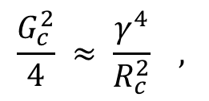


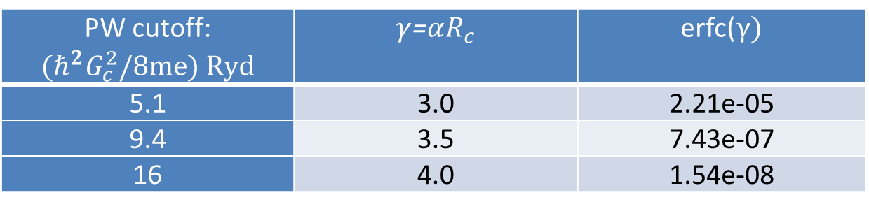
Accuracy of long/short decomposition
To approximately match long/short range accuracy:
$$\frac{G_{c}^{2}}{4} ≈ \frac{γ^{4}}{R_{c}^{2}} ,$$
$$γ=αR_{c}$$
$R_{c}=$ 4 bohr
PW cutoff: $${(ℏ^{2}G}_{c}^{2}/8me) Ryd$$ | $γ$=$αR_{c}$ | erfc($γ)$
5.1 | 3.0 | 2.21e-05
9.4 | 3.5 | 7.43e-07
16 | 4.0 | 1.54e-08
High accuracy can be obtained with both $R_{c}$ and $G_{c}$ small !

Slide 58
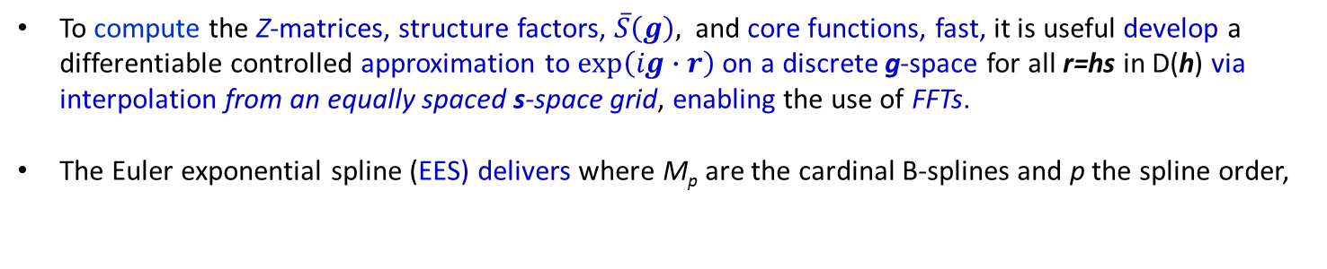
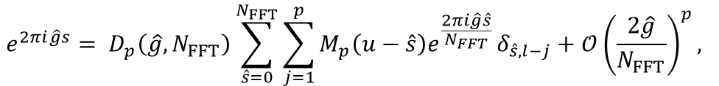



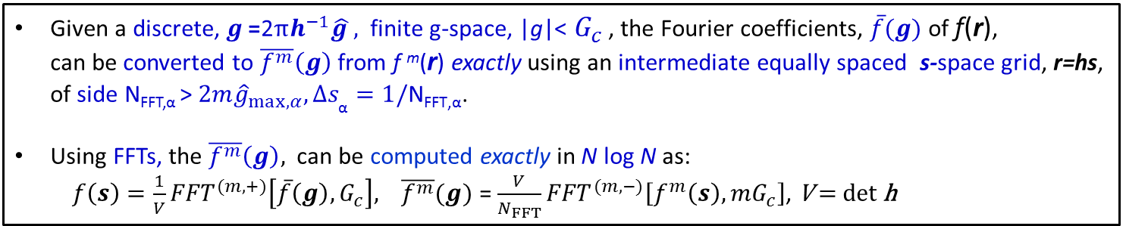
PAW Basics: Multi-Resolution, Grids, EES and N² log N scaling
How do we reduce scaling by one order in N and maintain accuracy?
1. Discrete real-space: Fourier Coefficients and FFTs
Given a discrete, $g\text{ =}\text{2}πh^{−1}\hat{g },$ finite g-space, |g|< $G_{c}$ , the Fourier coefficients, $\overline{f}(g)$ of f(r),
can be converted to $\overline{f^{m}}\left(g\right)$ from f ^{m}(r) exactly using an intermediate equally spaced s-space grid, r=hs, of side N_{FFT,α} > $2m{\hat{g}}_{max,α}, ∆s_{\text{α}}=1/\text{N}\text{FFT}\text{,}\text{α}$.
Using FFTs, the $\overline{f^{m}}\left(g\right),$ can be computed exactly in N log N as:
$f\left(s\right)={\frac{1}{V}FFT}^{(m,+)}\left[\overline{f}\left(g\right),G_{c}\right],$ $\overline{f^{m}}(g)$ = ${\frac{V}{N_{FFT}}FFT}^{(m,−)}\left[f^{m}\left(s\right), mG_{c}\right]$, $\text{V}\text{ = }\text{det} \text{h}$
2. Euler Exponential Spline Interpolation and FFTs
To compute the Z-matrices, structure factors, $\overline{S}\left(g\right),$ and core functions, fast, it is useful develop a differentiable controlled approximation to $exp\left(ig∙r\right)$ on a discrete g-space for all r=hs in D(h) via interpolation from an equally spaced s-space grid, enabling the use of FFTs.
The Euler exponential spline (EES) delivers where M_{p} are the cardinal B-splines and p the spline order,
$$e^{2πi\hat{g}s}= D_{p}\left(\hat{g},N_{FFT}\right)\sum_{\hat{s}=0}^{N_{FFT}}{\sum_{j=1}^{p}{M_{p}\left(u−\hat{s}\right)e^{\frac{2πi\hat{g}\hat{s}}{N_{FFT}} }δ_{\hat{s},l−j}}}+𝒪{\left(\frac{2\hat{g}}{N_{FFT}}\right)}^{p},$$
$M_{p}$ has compact supp.
$$u\text{ = }\text{s} N_{FFT} l=int u$$
$$\text{N}\text{FFT}\text{ > }2{\hat{g}}_{max}≈2.8{\hat{g}}_{max}$$
Using 3 FFT grids, (1) Psi EES, (2) Density, (3) Density EES, and
1 discrete spherical polar grid around each ion, |r|<R_{pc} , all PAW
energy terms & their derivatives can be accurately computed in N² log N .

Slide 59




































PAW Basics: g-space to s-space and back
Psi EES: $N_{g}^{(ψ)}\sim N$
Density:${ N}_{g}^{(ψ)}\sim N$
Density:${ N}_{g}^{(n)}\sim N$
Density EES:${ N}_{g}^{(n)}\sim N$
$${ \overline{ ψ}}_{I}^{\left(S\right)}\left(g\right)$$
$${\overline{n}}^{(S)}\left(g\right)$$
$${\overline{n}}^{(S)}\left(g\right)$$
$${ \overline{ψ}}_{I}^{\left(S\right)}\left(g\right)$$
$$g\text{ =}\text{2}πh^{−1}\hat{g }$$
$$g\text{ =}\text{2}πh^{−1}\hat{g }$$
$$g\text{ =}\text{2}πh^{−1}\hat{g }$$
$$g\text{ =}\text{2}πh^{−1}\hat{g }$$
$${\overline{ψ}}_{I}^{(S,D)}\left(g\right)={\overline{ψ}}_{I}^{\left(S\right)}\left(g\right)D^{(ψ)}(g)$$
${\overline{n}}^{\left(S,D\right)}(g)={\overline{n}}^{\left(S\right)}(g)D^{(n)}$ $(g$)
$${FFT }^{(ψ,+,EES)}\left[{\overline{ψ}}_{I}^{(S)}\left(g\right),\frac{G_{ }}{2}\right]$$
$${FFT }^{(n,−)}\left[{{\overline{n}}^{\left(S\right)}(s),G}_{c} \right]$$
$${FFT }^{(ψ,+,EES)}\left[{\overline{ψ}}_{I}^{(S,D)}\left(g\right),\frac{G_{ }}{2}\right]$$
$$\frac{V}{N_{FFT}^{(n)}}$$
$${FFT }^{(n,+,EES)}\left[{{\overline{n}}^{\left(S,D\right)}(g),G}_{c} \right]$$
$$\sqrt{V}$$
Psi: $N_{FFT}^{(ψ,EES)}\sim N$
Density: $N_{FFT}^{(n)}\sim N$
Density: $N_{FFT}^{(n)}\sim N$
Density EES: $N_{FFT}^{(n, EES)}\sim N$
$$ψ_{I}^{\left(S,D\right)}(s)$$
$$ψ_{I}^{\left(S\right)}(s)$$
${ s}_{α} ≡{\hat{s}}_{α}$/${ N}_{FFT,α}^{(ψ,EES)}$
0 ${≤\hat{s}}_{α}$<${ N}_{FFT,α}^{(ψ,EES)}$
$${{|ψ}_{I}^{\left(S\right)}\left(s\right)|}^{2}$$
$$n^{(S,D)}(s)$$
$$n^{(S)}(s)$$
$$r=hs$$
$$r=hs$$
$$r=hs$$
$$r=hs$$
$$r=hs$$
The $D^{(τ)}\left(g\right)=\prod_{α}{D_{p}}\left({\hat{g}}_{α},N_{FFT,α}^{(τ,EES)}\right)$enables B-spline interpolation

Slide 60









PAW Basics: r-space interpolation
EES provides an accurate, differentiable interpolation between
the different resolutions and length scales of PAW
Psi EES: $N_{FFT}^{(ψ,EES)}\sim N$
Density EES: $N_{FFT}^{(n, EES)}\sim N$
All grid spacings
are independent of
system size.
h defines
D(h) = cuboid
V =det h ~ N
h defines
D(h) = cuboid
V =det h ~ N
$$ψ_{I}^{\left(S,D\right)}(s)$$
$$n^{(S,D)}(s)$$
N-ion cores in D(h): $N_{f}\text{\sim }\text{ 1}$
N-Partition
N-Partition
$${2R}_{pc}$$
$$R_{pc}\text{\sim }\text{1}$$
1
1
1
FFT grid points,
{$N_{B}^{(0,n/ψ)}$, $N_{B}^{(f,n/ψ)}$},
$$\text{s}∈near ion J$$
$$N_{B}^{(α,β)}\sim 1$$
for EES interpolation.
2
Fine
spherical polar
grid ($N_{f}$)
2
2
B-Spline
Interpolation
…
…
…
N
N
N
not to scale

Slide 61

Creating the r-space representation of the e-density
In the following, the multi-length scale PAW method is used to
construct the electron density in N² log N as a demonstration:
$$n\left(r\right)= n^{\left(S\right)}\left(r\right)+\sum_{J}{\left[{n_{J}^{(core 1)}\left(r_{f}\right)+n}_{J}^{(core 2)}\left(r_{f}\right)\right], }{ n}_{J}^{(S)}\left(r_{f}\right)$$
  Create the smooth KS states in real space, ${ ψ}_{I}^{\left(S\right)}\left(s\right)$: N² log N.
  Create the smooth density in real space, $n^{\left(S\right)}\left(s\right)$: N².
  *Create the smooth density in the ion cores, $n_{J}^{(S)}\left(r_{f}\right)$: N log N.
  Create the smooth Z-matrix, $Z_{IJ}^{(S)}$ : N² log N.
  *Create the core-2 densities, $n_{J}^{(core2)}\left(r_{f}\right)$: N².
  *Create the core-1 densities, $n_{J}^{(core1)}\left(r_{f}\right)$: N² log N.
Formulae for all other components of PAW-DFT have been derived
including ionic and pw expansion coefficient derivatives.
* New terms.

Slide 62







1. Creating the smooth part of the KS states,${ ψ}_{I}^{\left(S\right)}\left(s\right)$,
on the density s-space FFT grid, ${s∈N}_{FFT}^{(n)}$
Smooth part
of the KS states
in g-space
Smooth part
of the KS states
on discrete s-space
$${\frac{1}{\sqrt{V}}FFT }^{(n,+)}\left[{\overline{ψ}}_{I}^{\left(S\right)}\left(g\right),\frac{G_{c}}{2}\right]$$
1
1
2
2
$${\overline{ψ}}_{I}^{\left(S\right)}\left(g\right),$$
|g|< $\frac{G_{c}}{2}$,
$ψ_{I}^{\left(S\right)}(s)$,
$\text{s}∈{ N}_{FFT}^{(n)}$,
r$=hs$
3
3
$$g\text{ =}\text{2}πh^{−1}\hat{g },$$
…
…
$\hat{g}∈$ integer
Notation for
discrete s
N_{KS}
N_{KS}
${ s}_{α} ≡{\hat{s}}_{α}$/${ N}_{FFT,α}^{(n)}$
0 ${≤\hat{s}}_{α}$<${ N}_{FFT,α}^{(n)}$
r$=hs$
N_{KS} is the number of KS states

Slide 63




2. Creating the smooth density, $n^{\left(S\right)}\left(s\right)$
on the density s-space FFT grid, $s∈N_{FFT}^{(n)}$
Smooth part
of the KS states
on discrete s-space
Smooth part
of the density
on discrete s-space
1
Point by point sum of mod squares
$${{|ψ}_{I}^{\left(S\right)}\left(s\right)|}^{2} \\ \text{s}{ ∈N}_{FFT}^{(n)},$$
r $=hs$
2
$n^{\left(S\right)}\left(s\right)$,
$$\text{s}{ ∈N}_{FFT}^{(n)},$$
r$=hs$
3
…
N_{KS}
Point by point sum of mod squares:
$$n^{\left(S\right)}\left(s\right)=\sum_{I}{{{|ψ}_{I}^{\left(S\right)}(s)\text{|}}^{2}} ∀ s{ ∈N}_{FFT}^{(n)}$$

Slide 64







3. Creating the smooth density, $n_{J}^{(S)}\left(r_{f}\right)$
around each ion J, on the fine grid, f$∈N_{f}$
EES weighted
smooth density
in g-space
EES weighted
smooth density
on discrete s-space
EES weighted
smooth density
around each J
EES interpolated smooth density
around each J
1
1
B-Spline interpolation
N-Partition
2
2
$${FFT }^{(n,+,EES)}\left[{{\overline{n}}^{\left(S,D\right)}(g),G}_{c} \right]$$
3
3
$${\overline{n}}^{(S,D)}\left(g\right)=$$
$D^{(n)}(g)$ ${\overline{n}}^{\left(S\right)}\left(g\right)$,
$$\left|g\right|<G_{c}$$
$n^{\left(S,D\right)}\left(s\right)$,
$\text{s}{ ∈N}_{FFT}^{\left(n,EES\right)}$,
r$=hs$
…
…
_{N}
_{N}
$${ n}_{J}^{\left(S,D\right)}\left(s\right)\text{,} \\ N_{B}^{(f,n)}\text{:} \text{s}∈near J$$
$n_{J}^{(S)}\left({ r}_{f}\right)$,
$$\text{f} ∈N_{f}$$
N = number of ions, J=1..N, $N≠N_{KS}$
$N_{f}$= number points on spherical-polar grid around each ion.
$N_{f} \text{and} N_{B}^{(f,n)}\text{(}\text{s}∈near J)$independent system size .

Slide 65















4. Creating the $Z_{IJ}^{(S)}$ the matrix elements
EES x ${\tilde{p}}^{\left(S\right)}$
weighted KS states
in g-space
EES x ${\tilde{p}}^{\left(S\right)}$
weighted KS states
in s-space
N–Partition,
N B-Spline Interpolations
per KS state
Smooth
Z-matrix
1
$$N_{B}^{(0,ψ)}$$
$\text{s}∈$ near ion 1
1
1
$$Z_{1J}^{(S)} J=1…N$$
$${FFT }^{(ψ,+,EES)}\left[{\overline{ψ}}_{I}^{(S,D,\tilde{p}) }\left(g\right),\frac{G_{ }}{2}\right]$$
N-Partition,
N B-Spline Interps.
$$N_{B}^{(0,ψ)}$$
$\text{s}∈$ near ion 2
2
2
$$Z_{2J}^{(S)} J=1…N$$
2
$$N_{B}^{(0,ψ)}$$
$\text{s}∈$ near ion 3
3
3
$$Z_{3J}^{(S)} J=1…N$$
3
…
…
…
$$N_{B}^{(0,ψ)}$$
$\text{s}∈$ near ion N
N_{KS}
N_{KS}
$$Z_{N_{KS}J}^{(S)} J=1…N$$
_{N}
$${\overline{ψ}}_{I}^{(S,D,\tilde{p})}\left(g\right)=$$
$D^{(ψ)}(g){\overline{ψ}}_{I}^{\left(S\right)}\left(g\right){\tilde{p}}^{\left(S\right)}(g)$,
$$\left|g\right|<G_{c}/2$$
$$ψ_{I}^{\left(S,D,\tilde{p}\right)}\left(s\right),$$
$$\text{s}∈{ N}_{FFT}^{(ψ,EES)}$$
$$Z_{IJ}^{(S)} J=1…N$$
A small set of points, $\text{s}∈$ near ion J, interpolated to
obtain $Z_{1J}^{(S)}$ for all I,J ($N_{B}^{(0,ψ)}$~1),
$$Z_{IJ}^{(S)}=\sum_{\text{s} ∈ near J}^{N_{B}^{(0,ψ)}}{ψ_{I}^{\left(S,D,\tilde{p}\right)}\left(s\right)M_{J,p}^{(3)} (s)}$$
$\text{s}∈$ near ion J independent of I as are B-splines,${ M}_{J,p}^{(3)}(s)$

Slide 66






















5. Creating the core density component, $n_{J}^{(core2)}\left(r_{f}\right),$
around each ion J, on the fine grid, $f∈N_{f}$
Reduction of $Z_{I1}^{(S)}$
$$∆p^{2}(r_{f})$$
$$Z_{1J}^{(S)} J=1…N$$
$$Z_{1}^{(S,2)}$$
$$n_{1}^{(core2)}\left(r_{f}\right)$$
$$Z_{11}^{(S)}$$
$$Z_{2J}^{(S)} J=1…N$$
$$Z_{21}^{(S)}$$
$$Z_{2}^{(S,2)}$$
$$n_{2}^{(core2)}\left(r_{f}\right)$$
$$Z_{3J}^{(S)} J=1…N$$
$$Z_{3}^{(S,2)}$$
$$n_{3}^{(core2)}\left(r_{f}\right)$$
$$Z_{N_{KS}1}^{(S)}$$
…
…
$$Z_{N_{KS}J}^{(S)} J=1…N$$
$$∆p^{2}(r_{f})$$
$$n_{N}^{(core2)}\left(r_{f}\right)$$
$$Z_{N}^{(S,2)}$$
Reduction of $Z_{IN}^{(S)}$
Each KS state contributes to N unique reductions
$$Z_{J}^{(S,2)}=\sum_{I}{{{|Z}_{IJ}^{(S)}|}^{2}}$$
In this example we have 1 projector
$$n_{J}^{(core2)}\left(r_{f}\right)= Z_{J}^{\left(S,2\right)}∆p^{2}\left(r_{f}\right) ∀ f∈N_{f}$$

Slide 67








6. Creating the core density component, $n_{J}^{(core1)}\left(r_{f}\right),$
around each ion J, on the fine grid, $f∈N_{f}$
EES weighted
KS states
in g-space
EES weighted
KS states
in s-space
EES weighted
KS states
around J
EES interpolated
PAW 1 density
around each J
N reductions of s around J=1
1
1
1
1
$${FFT }^{(ψ,+,EES)}\left[{\overline{ψ}}_{I}^{(S,D)}\left(g\right),\frac{G_{ }}{2}\right]$$
Z₁₁
B-Spline interpolation
Z₂₁
2
2
2
2
Z₃₁
3
3
$$Z_{N_{KS}1}$$
3
3
…
…
…
…
N_{KS}
N_{KS}
_{N}
_{N}
N reductions of s around J=N
$${\overline{ψ}}_{I}^{(S,D)}\left(g\right)=$$
$D^{(ψ)}(g){\overline{ψ}}_{I}^{\left(S\right)}\left(g\right)$,
$$\left|g\right|<G_{c}/2$$
$$ψ_{I}^{\left(S,D\right)}\left(s\right),$$
$$\text{s}∈{ N}_{FFT}^{(ψ,EES)}$$
$ψ_{J}^{\left(S,D,Z\right)}\left(s\right)\text{, }$
$$N_{B}^{(f,ψ)}\text{:} \text{s}∈near J$$
$n_{J}^{\left(core1\right)}\left(r_{f}\right)$,
$$\text{f} ∈N_{f}$$
Each KS state contributes to N unique reductions
$ψ_{J}^{\left(S,D,Z\right)}\left(s\right) \text{= }$ $\sum_{I}{{Z_{IJ}ψ}_{I}^{\left(S,D\right)}\left(s\right) ∀ }\text{s}∈near J:N_{B}^{(f,ψ)}$
${ Z}_{IJ}$ = weight for points $\text{s}∈near J$from KS state, I.

Slide 68



Grand Challenge Application: Perovskite solar cells
CH₃NH₃PbX₃
Pros:
High eff., low cost,
tunable band gap (ABX₃)
Cons:
Instability: water, air,
light, interface … &
toxic compounds.
Perovskite solar cells reach Si eff.
CH₃NH₃
PAW in OpenAtom
MAI-term.
PbI₂-term.
PbI₂-defect.
Understand: mechanism of
instability/degradation.
Search: non-toxic B²⁺ (Fe, Co, Ni,…)
for new high perf. materials.
Design: new interface/encapsulation
for novel devices with long lifetime.
System size: 512 atoms (4x4x2 MAPbI₃ +128 water), 1264 states

Slide 69
Conclusions
PAW-KS-DFT is an important method in computational science
that allows computations beyond PW-KS-DFT – heavy atoms.
Using EES Interpolation, we have derived a multi-length scale
PAW technique that scales as N² log N (all energy terms and all
derivatives) – an important advance
We are currently developing the charm++ implementation to
allow very large systems to be studied efficiently.

Slide 70
Supplementary: More PAW method pictures

Slide 71


Creating the g-space representation of the e-density
$$\overline{n}\left(g\right)= {\overline{n}}^{\left(S\right)}\left(g\right)+{\overline{n}}^{\left(core 1\right)}\left(g\right)+{\overline{n}}^{\left(core 2\right)}\left(g\right)$$
${ \overline{n}}^{\left(S\right)}\left(g\right)$: Sampling theorem from $n^{\left(S\right)}\left(s\right)$
${\overline{n}}^{\left(core 1\right)}\left(g\right)$: Numerical integration over core 1 density + EES
${\overline{n}}^{\left(core 2\right)}\left(g\right)$: Bessel transform (precompute) + EES
  Create the smooth density in g-space,${ \overline{n}}^{\left(S\right)}\left(g\right)$: N log N.
  *Create core-1 density in g-space, ${\overline{n}}^{\left(core 1\right)}\left(g\right)$: N log N
  *Create core-2 density in g-space, ${\overline{n}}^{\left(core 2\right)}\left(g\right)$: N log N
  *new terms

Slide 72









1. Creating the g-space representation of smooth density
Density: $N_{FFT}^{(n)}\sim N$
Density:${ N}_{g}^{(n)}\sim N$
$$\frac{V}{N_{FFT}^{(n)}}$$
$${FFT }^{(n,−)}\left[{{\overline{n}}^{\left(S\right)}(s),G}_{c} \right]$$
$$n^{(S)}(s)$$
$${\overline{n}}^{(S)}\left(g\right)$$
${ s}_{α} ≡{\hat{s}}_{α}$/${ N}_{FFT,α}^{(n)}$
0 ${≤\hat{s}}_{α}$<${ N}_{FFT,α}^{(n)}$
${ \hat{s}}_{α} integer$
$$r=hs$$
Density Fourier coefficients ${\overline{n}}^{(S)}\left(g\right) , \left|g\right|<{ G}_{c}$ are exact,
through intermediate discrete s-space – Theorem 1.
N log N method given $n^{\left(S\right)}\left(s\right).$

Slide 73







2. Creating the g-space core 1 density, ${\overline{n}}^{\left(core,1\right)}(g)$
EES interpolated
core 1 density
around each ion J
EES weighted
core 1 density
around each J
EES weighted
core 1 density
consolidated
EES interpolated
core 1 density
in g-space
1
1
2
2
N-Consolidation
B-Spline +
f-quadrature
$${D^{(n)}(g)FFT }^{(n,−,EES)}\left[n_{}^{\left(core1,EES\right)}\left(s\right)\text{,} Gc \right]$$
3
3
$$n^{(core 1,EES,2)}\left(s\right)\text{,}$$
$$\text{s}∈{ N}_{FFT}^{(n,EES)}$$
$${\overline{n}}^{\left(core,1,EES,2\right)}\left(g\right)\text{,}$$
$$\left|g\right|<G_{c}$$
…
…
N-Consolidation
N-Consolidation
_{N}
$$n^{\left(core.1,EES,2 \right)}\left(s\right)= \sum_{J}{\sum_{s^{′} ∈ near J}{{ n}_{J}^{\left(core1,EES,2\right)}\left(s′\right)δ_{s,s′}}}$$
_{N}
$n_{J}^{\left(core1,EES\right)}\left(r_{f}\right)$,
$$\text{f} ∈N_{f}$$
$${ n}_{J}^{\left(core1,ESS,2\right)}\left(s\right)\text{,} \\ { N}_{B}^{(f,n)}\text{:} \text{s}∈near J$$
g-space representation of core 1 density
$${ \overline{n}}^{\left(core,1,ESS\right)}\left(g\right)= \sum_{J}{\sum_{f}{{w_{f}n}_{J}^{\left(core,1,EES\right)}\left(r_{f}\right)\exp\left(ig∙\left(r_{f}+R_{J}\right)\right) }}$$
Treated
via EES above

Slide 74









3. Creating the g-space core 2 density, ${\overline{n}}^{\left(core 2,EES\right)}(g)$
Structure Factor
$$S_{J}^{\left(Z,2, EES\right)}(s)$$
around each J
EES interpolated
Structure Factor $S_{}^{\left(Z,2,EES\right)}\left(s\right)$
EES interpolated
g-space
core 2 density
$Z_{J}^{(S,2)}$ vector
$$Z_{1}^{(S,2)}$$
1
B-Spline
$$Z_{2}^{(S,2)}$$
2
N-Consolidation
$$D^{(n)}\left(g\right)\tilde{{Δp}^{2}} (g)$$
$${ × FFT }^{(n,−,EES)}\left[S^{\left(Z,2,EES\right)}\left(s\right)\text{,} Gc\right]$$
$$Z_{3}^{(S,2)}$$
3
…
…
$$S^{\left(Z,2,EES\right)}\left(s\right) \text{,}$$
$$\text{s}∈{ N}_{FFT}^{(n,EES)}$$
$${\overline{n}}^{\left(core,2,EES\right)}\left(g\right)\text{,}$$
$$\left|g\right|<G_{c}$$
N-Consolidation
$$Z_{N}^{(S,2)}$$
$${\overline{S}}^{\left(Z,2\right)}\left(g\right)= \sum_{J}{Z_{J}^{\left(S,2\right)}exp(ig∙ R_{J})}$$
Treated via EES to achieve N log N
_{N}
$$S_{J}^{\left(Z,2,EES\right)}\left(s\right)\text{,}$$
$$N_{B}^{(0,n)}\text{:} \text{s}∈near J$$
core 2 density in g-space by EES
$${\overline{n}}^{\left(core,2,EES\right)}\left(g\right)=\tilde{{Δp}^{2}}\left(g\right){\overline{S}}^{\left(Z,2,EES\right)}\left(g\right) ∀ \left|g\right|<G_{c}$$

Slide 75
Creating the Energy
  Kinetic Energy of non-interacting electrons
    Smooth
    Core 1*
    Core 2*
  Local e-ion energy
    Smooth
    Core 1 (short and long)*
    Core 2 (short and long)*
  Exchange-Correlation
    Smooth
    Core*
  Hartree
    Smooth-Smooth : long + short range
    Long range*
    Smooth-Core 1/2 : short range*
    Core 1/Core 2 : short range*
*new terms

Slide 76







  1. Kinetic Energy of non-interacting electrons
$$E_{NIKE}=E_{NIKE}^{(S)}+E_{NIKE}^{(core1)}{+ E}_{NIKE}^{(core2)}$$
$$E_{NIKE}^{(S)}= −\frac{ℏ^{2}}{2m_{e}}\int_{D(h)}{dr}\sum_{I}{\left\langle ψ_{I}^{(S)} | ∇^{2}|ψ_{I}^{(S)}\right\rangle = }\frac{ℏ^{2}}{2m_{e}}\sum_{I}{\sum_{g}^{\left|g\right|<G_{c}/2}{g^{2}{|{\overline{ψ}}_{I}^{(S)}\left(g\right)|}^{2}}}$$
$$E_{NIKE}^{(core1)}=−\frac{ℏ^{2}}{2m_{e}}\sum_{IJ}{Z_{IJ}^{\left(S\right)}Z_{IJ}^{\left(∇^{2}S,∆\right)}}$$
*
$$E_{NIKE}^{(core2)}=−\frac{ℏ^{2}}{2m_{e}}\sum_{J}{Z_{J}^{\left(S,2\right)}\left\langle ∆p | ∇^{2}|∆p\right\rangle ={∆p}^{(KE)}\sum_{J}{Z_{J}^{\left(S,2\right)} }}$$
*
$$= −\frac{ℏ^{2}}{2m_{e}}\int_{D(R_{pc})}{dr∆p(r)}∇^{2}∆p(r)$$
$${∆p}^{(KE)}=constant$$
*new terms
Note, the EES computation of $Z_{J}^{\left(S,2\right)}$ and $Z_{IJ}^{\left(S\right)}$ has already been presented and computing
$${ Z}_{IJ}^{\left(∇^{2}S,∆\right)}= −\frac{ℏ^{2}}{2m_{e}}\int_{D\left(h\right)}{dr} ∆p(r−R_{J})∇^{2}ψ_{I}^{\left(S\right)}(r)$$
by EES just requires utilizing a slightly different input in slide 17,
$${\overline{ψ}}_{I}^{(∇^{2}S,D,∆p)}\left(g\right)=D^{\left(ψ\right)}\left(g\right)g^{2}{\overline{ψ}}_{I}^{\left(S\right)}\left(g\right)\tilde{∆p}(g)$$

Slide 77




Accuracy of long/short decomposition
To approximately match long/short range accuracy:
$$\frac{G_{c}^{2}}{4} ≈ \frac{γ^{4}}{R_{c}^{2}} ,$$
$$γ=αR_{c}$$
$R_{c}=$ 4 bohr
PW cutoff: $${(ℏ^{2}G}_{c}^{2}/8me) Ryd$$ | $γ$=$αR_{c}$ | erfc($γ)$
5.1 | 3.0 | 2.21e-05
9.4 | 3.5 | 7.43e-07
16 | 4.0 | 1.54e-08
$R_{c}=$ 2 bohr
PW cutoff: $${(ℏ^{2}G}_{c}^{2}/8me) Ryd$$ | $γ$=$αR_{c}$ | erfc($γ)$
20.3 | 3.0 | 2.21e-05
37.5 | 3.5 | 7.43e-07
64.0 | 4.0 | 1.54e-08
High accuracy can be obtained with both $R_{c}$ and $G_{c}$ small !

Slide 78

Eric Bohm

Slide 79
OpenAtom Ground State Software Overview
PPL Contributors: Eric Bohm, Nikhil Jain, Prateek Jindal, Eric Mikida, Michael Robson

Slide 80
Software Infrastructure
GIT (Gerrit) based repository:
  http://charm.cs.illinois.edu/gerrit/openatom
  Or https://github.com/ericbohm/OpenAtom/
Test system datasets available in git
  Make test - Basic feature verification
  Make full_test - Extensive use case verification
Jenkins testing
  Release branch in nightly Charm++ testing
  Release branch in Charm++ continuous integration testing

Slide 81


Ground State Feature Status
Feature | Minimization Status | Dynamics Status | Test Integration
CPAIMD Dynamics | NA | Production | Automated
Path Integrals | Production | Production | Automated
K-Points | Production | Needs Verification | Automated
Spin Orbitals | Production | Production | Automated
Tempering | NA | Production | Automated
Born Oppenheimer Dynamics | NA | Production | Automated
Band Generation | Being Evaluated | Being Evaluated | Manual

Slide 82

Control flow in OpenAtom (PW-DFT)

Slide 83
Qbox Comparison
Nikhil Jain

Slide 84


Slide 85


Slide 86


Slide 87
Object Placement
Nikhil Jain

Slide 88
Topology aware mapping

Slide 89
Adapting to different systems
Separate the logical operations and machine-specific operations. Example:
  Logical operation: get an ordered list of nodes
  Machine specific: Hilbert curve traversal, blocked traversal, plane-traversal
Density FFTs: require use of full bisection bandwidth – spread throughout the allocation.
Matrix-matrix multiplies (pair calculators): place near the GSpace planes, but load balance is important.

Slide 90

System utilization without mapping
(barriers introduced for clarity)
States: Many
G -> R FFTs
Density: G -> R -> G
Non-local G-> R -> G
Density to States
States R-> G
Force correction
Ortho-normalizaton

Slide 91

System utilization with mapping

Slide 92
Impact of mapping on Blue Gene/Q: up to 30% improvement

Slide 93
Impact of mapping on Blue Waters: up to 32% improvement

Slide 94
Ubers : Multi-Instance Methods
Eric Bohm, Glenn Martyna

Slide 95
Multi Instance Methods
Retain all existing code with minimal changes
Any feature available for CP minimization or dynamics automatically available for multi-instance use
Add Master Index of objects
  Uber[temper][bead][k-point][spin]
  Objects in any instance can be referenced by any object
  Support simulations with many kinds of multi instance physics
  Instance Controller
  Temper Controller
    Sum energies across Tempers and Beads
    Switch Energies and Temperatures
  Bead Controller
    Intrapolymer force evaluation and integration

Slide 96

Spin Orbitals (LSDA)
Each Spin shares : atom and energy chares
Electron density from down passed to up
  VKS computed for each spin
  Returns to standard flow of control
Independent I/O for state data
Independent placement for instance chares

Slide 97
K-Points
Each k-point shares:
  electron density, atoms, energy chares
Electron density = sum over KP electron states
Wave functions outside the first Brillouin zone forces use of complex (e.g., ZGEMM)
  Instead of the “doublepack” optimization used at the Γ point
Independent I/O for state data
Independent placement for electron state instance chares
ρ

Slide 98
Path Integral Beads
Path Integral Bead replica contains independent instances of all phases of CPAIMD
  May contain k-point and spin ensembles
Intrapolymer force evaluation in PIBeadAtoms
  Interacts with each Bead instance's AtomsCompute
  Supplements CPAIMD nucleic force integration phase
  Computation Parallelized across NumAtoms and NumBeads
Independent I/O for state and coordinate data
Independent placement for instance chares
Bead1
Bead2
Bead4
Bead3
Bead5
Bead6
Bead
Ctrl

Slide 99
Tempers
Contains independent instances of all phases of CPAIMD
Each temper may contain Beads, K-points, and Spin instances
Temper controller manages random neighbor shuffle to exchange temperatures across temper replicas
Independent I/O for state and coordinate data
Independent placement for instance chares
280⁰
290⁰
300⁰
310⁰

Slide 100

Temper Performance

Slide 101

Combined Performance

Slide 102
GPGPU
Please Refer to : Heterogeneous Computing in Charm++
Michael Robson

Slide 103
OpenAtom CPU Performance
Water 256M_70Ry 64 Nodes XK
Notes:
Base: 2.58s

Slide 104
OpenAtom GPU Performance
Water 256M_70Ry 64 Nodes XK
Notes:
CUDA: 2.35s Speedup 1.1x per iter

Slide 105
PAW Parallelization
Eric Bohm, Qi Li, Glenn Martyna

Slide 106
Parallelization of PAW
PAW method variation by Li and Martyna
  Smooth component uses existing DFT code
  Core components
    Implemented via EES FFT
      Reuse prior work
New challenges:
  effective overlap between smooth and core
  Communication and Memory management
    num_coretype * num_channel * num_projector
    core_1 core_2

Slide 107
Parallelization Design
Control flow dependencies introduced by PAW
    PAW elements
      f_grid
      Bsplines
      core zmatrices
    Interactions with existing data structures
      \rho^(s)
        PW rho is now the smooth part of \rho
      \psi^(s)
        PW \psi is now the smooth part of \psi
      Zmatrix
        With PAW projectors, but otherwise same operations of smooth Zmatrix

Slide 108
PAW Design II
F_grids are relatively small
    <500 grid points
  Multicast and reduce to produce results dependent on f_grid
Z-matrices comparatively large
  Decomposed same as in particle plane
Computation of each core_1 and core_2 are mutually independent, also independent by channel
  Can be overlapped
  Expected to require scheduling to constrain memory and bandwidth consumption
Key take away: PAW will greatly expand the portion of the time step spent in non-local and density.

Slide 109
Ground State Future Work
PAW
Section/Partition optimizations for Uber Instances
Band generation (automated testing)
Improved heuristics for default decomposition parameter choices
Fast Hartree-Fock
Charm-FFT
  Integrate use in electron state and non-local
  Offload to GPGPU and Xeon-Phi

Slide 110
Thank you!
NSF: SI2-SSI: Collaborative Research: Scalable, Extensible, and Open Framework for Ground and Excited State Properties of Complex Systems
NCSA: BlueWaters
ANL: Mira
LLNL: Vulcan

Slide 111
Conclusions
Thanks for listening!
… to the update on the OpenAtom GW work
Questions?

Slide 113


Reducing the scaling: quartic to cubic
Both are O(N⁴)
Sum-over-state (i.e., sum over unoccupied “c” band) not to blame:
removal of unocc. states still O(N⁴) but lower prefactor*
Working in R-space can reduce to O(N³) [see also †]
*Umari, Stenuit, Baroni, PRB 81, (2010)
*Giustino, Cohen, Louie, PRB 81, (2010)
* Wilson, Gygi, Galli, PRB 78, (2008); Govoni, Galli, J. Chem. Th. Comp., 11 (2015)
* Gao, Xia, Gao, Zhang, Sci. Rep. 6 (2016)
† Liu, Kaltak, Klimes, and Kresse, PRB 94, (2016)

Slide 114
Steps for typical G₀W₀ calculation
Stage 1 : Run DFT calc. on structure → output : ε_{i} and 𝜓_{i}(r)
Stage 2.1 : compute Polarizability matrix
Stage 2.2 : double FFT rows and columns → P(G,G’)
Stage 3 : compute and invert dielectric screening function
Stage 4 : “plasmon-pole” method → dynamic screening
Stage 5 : put together ε_{i} , 𝜓_{i}(r) and → self-energy Σ(ω)

Slide 115
Inversting epsilon
ε(G,G’) -> ε⁻¹ (G,G’)
Iterative matrix inversion for Hermitian matrix A:
A. Ben-Israel and D. Cohen, SIAM J. Numer. Anal., 3:410-419, 1966
We just “borrow” the pre-existing OpenAtom+charmm
fast parallel matrix multiplication

Slide 116
Steps for typical G₀W₀ calculation
Stage 1 : Run DFT calc. on structure → output : ε_{i} and 𝜓_{i}(r)
Stage 2.1 : compute Polarizability matrix
Stage 2.2 : double FFT rows and columns → P(G,G’)
Stage 3 : compute and invert dielectric screening function
Stage 4 : “plasmon-pole” method → dynamic screening
Stage 5 : put together ε_{i} , 𝜓_{i}(r) and → self-energy Σ(ω)

Slide 117


GW-Static Self-Energy (COHSEX)
For v1 of software: make a simplifying “static” self-energy approximation
An approximation to “real” GW
Easier to code and test correctness
Good quality results with tweaking of approximation
Band Gaps (eV)
System | Experiment | GW (full) | COHSEX | Corrected COHSEX* | DFT-LDA
Diamond | 5.48 | 5.70 | 6.99 | 5.93 | 4.2
Si | 1.17 | 1.29 | 1.70 | 1.18 | 0.49
*Kang & Hybertsen, Phys. Re.v B, 82, (2010)

Slide 118


GW-Static Self-Energy (COHSEX)
Interestingly, direct real space method is not best here
Wave vector (Fourier) space is better computationally
Serial version written and correctness tested

Slide 119





GW: some math details
1. Calculate RPA polarizability P
2. Calculate screened interaction W
3. Calculate self-energy correction ∑ for each state n

Slide 120


GW: matrix elements
How do matrix elements converge with l ?
Simple sum rule
Need ε_{l} ≳ E_{q} to converge
Why?
High energy |l> are ≈ free-e⁻
with ε_{l} ≈ ħ²q_{l}²/2m
So must sample |q_{l}|~|q|
to catch dominant parts
of |vbm>

Slide 121





GW: details 1
Screened interaction W given by convolution
Dielectric function ε(ω) given by polarizability P
RPA polarizability given by

Slide 122


GW: details 2
Solving Dyson’s equation: write as perturbation on DFT
Take matrix elements among DFT states -> diagonalize
Common approximations:
Take |ψ_{j}> ≈ |ψ_{j}^{DFT}> so system already diagonal
Evaluate Σ and dΣ/dє at є_{j}^{DFT} and solve

Slide 123



Density Functional Theory
For a interacting electronic system, can get
  exact ground-state energy E₀
  exact ground-state electron density n(r)
by solving self-consistent effective single-particle problem
Typical: Local Density Approximation (LDA)
Hohenberg & Kohn, Phys. Rev. (1964); Kohn and Sham, Phys. Rev. (1965).

