Slide 1
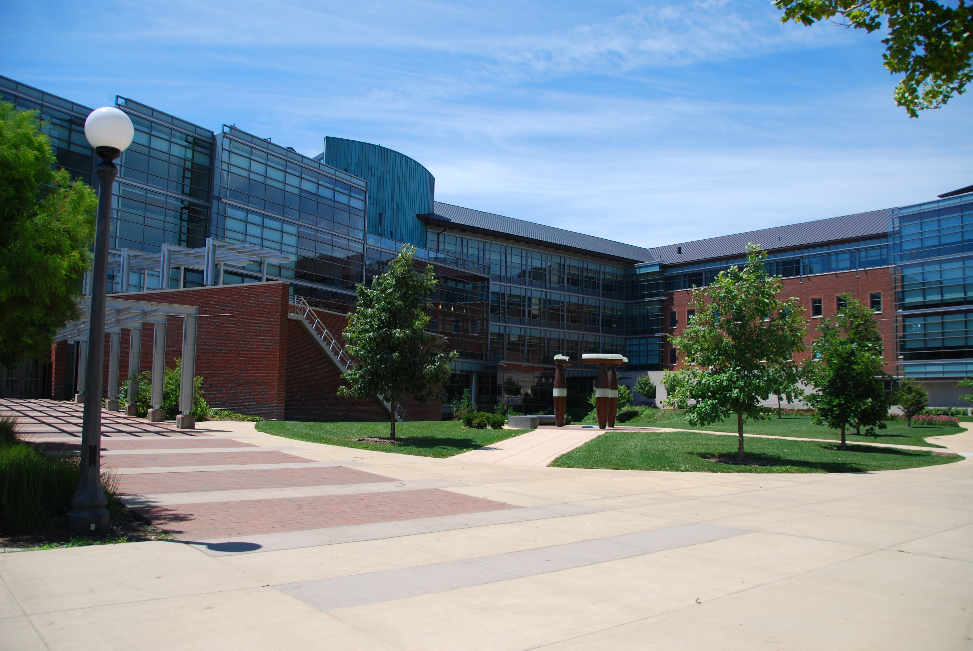
Heterogeneous Computing in Charm++
Michael Robson
Notes:
https://flic.kr/p/2k55rK

Slide 2
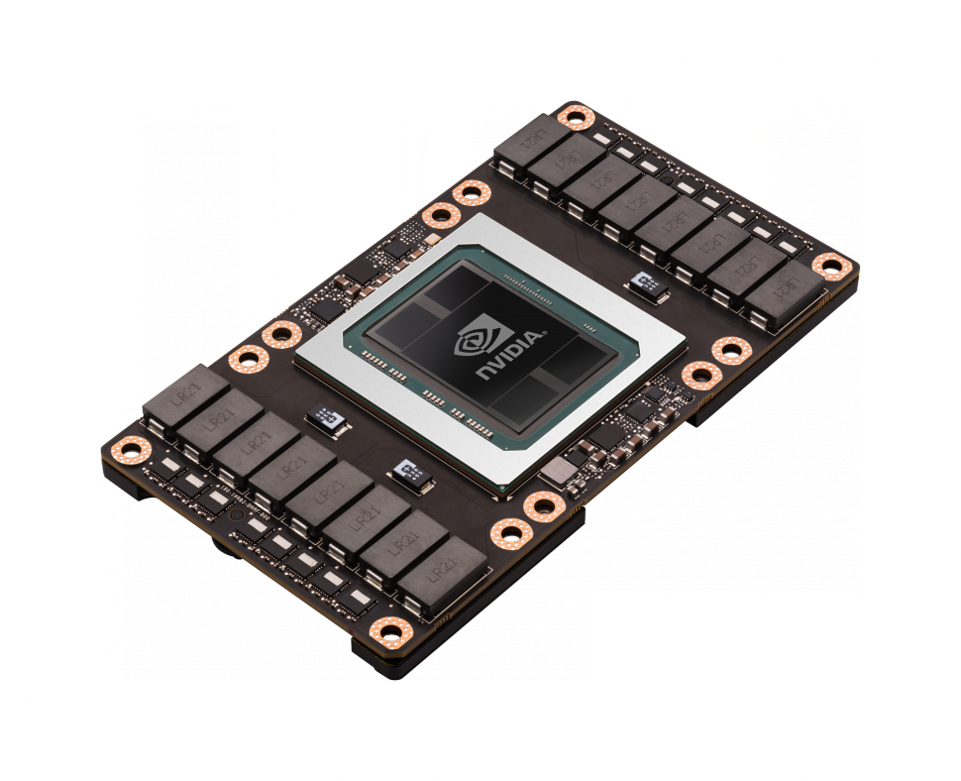
GPU Overview
Programmed with CUDA
1,000s of threads
100s GB/s bandwidth
~16 GB of memory
TeraFLOPS double precision performance
Notes:
http://www.nvidia.com/object/quadro-graphics-with-pascal.html

Slide 3
GPU Manager
Notes:
Work primarily done by Jaemin Choi, new graduate student in PPL

Slide 4
GPU Manager
GPU task Management library
Register kernel for asynchronous invocation
Automates data movement
Overlap kernel execution and data transfer
Pre-allocated pool of pinned memory
Runtime profiling integration (Projections)
Notes:
Allows user to execute CPU code at the same time
Matches well to charms asynchronous model (no polling, synchronization)

Slide 5
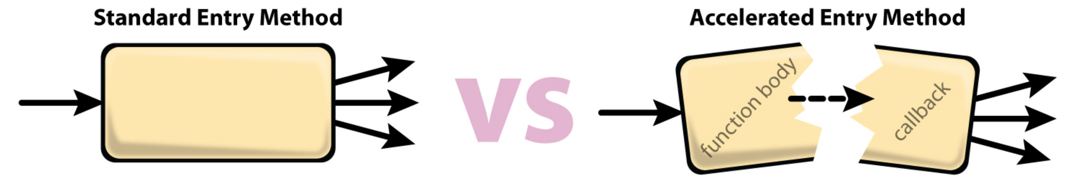
Using GPU Manager
Build charm with cuda
Enqueue work request:
  Describe buffers
  Callback(s)
  Run kernel function

Slide 6
Original Design
Expensive but necessary since having too much pinned memory degrades system performance
* The user can also get pre-pinned memory from mempool.
In this case, there is no need to wait for callback.
User
Charm
To get pinned memory used for asynchronous memcpy
1. Memcpy into pinned memory
2. Insert workRequest
1. Memcpy into host memory
2. Use data
pinnedMallocHost()
Other CPU-side Work
User-defined Callback
...
kernelSelect()
User-defined Callback
When workRequest is complete & data is copied back to host
pinnedMallocHost()
cudaMallocHost()
...
Handles workRequests
Handles workRequests
Only if all streams are free – else put in queue
cudaMallocHost() causes implicit synchronization, halting all operations in the streams
Time
gpuProgressFn()

Slide 7
Handling workRequests
3 streams for data transfer & computation overlap:
  data_in_stream
  kernel_stream
  data_out_stream
Handled via gpuProgressFn(), called periodically by scheduler

Slide 8
Handling workRequests
Could also have started [3] cudaMemcpyAsync
(if no cudaMalloc necessary for [3])
Time
data_in
kernel
data_out
[1] cudaMalloc
[1] cudaMemcpyAsync
Gap
[2] cudaMalloc
[2] cudaMemcpyAsync
[3] cudaMemcpyAsync
Gap
[1] kernel
[2] kernel
gpuProgressFn()
interval
Not good!
Could have started [2] kernel, because of concurrent kernel execution
State
[1] - HEAD | Q | TI | EX
[2] | Q | Q | TI
[3] | Q | Q | Q
* Q: Queued, TI: Transfer-In, EX: Executing, TO: Transfer-Out

Slide 9
New Design
Avoid polling via stream callbacks
  Added new callback locations
  Supported in CUDA 5.0 (K20)
Enable concurrent execution
  Spawns max streams, one per workRequest
  Supported in compute capability 2.x (Tesla)

Slide 10
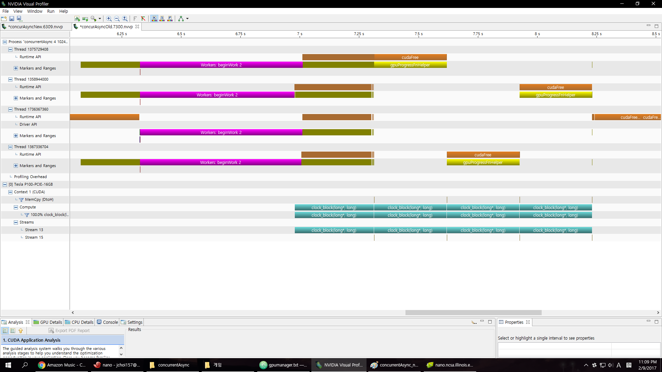
NVTX Concurrent Async Old
Notes:
Nvidia tools extension library

Slide 11
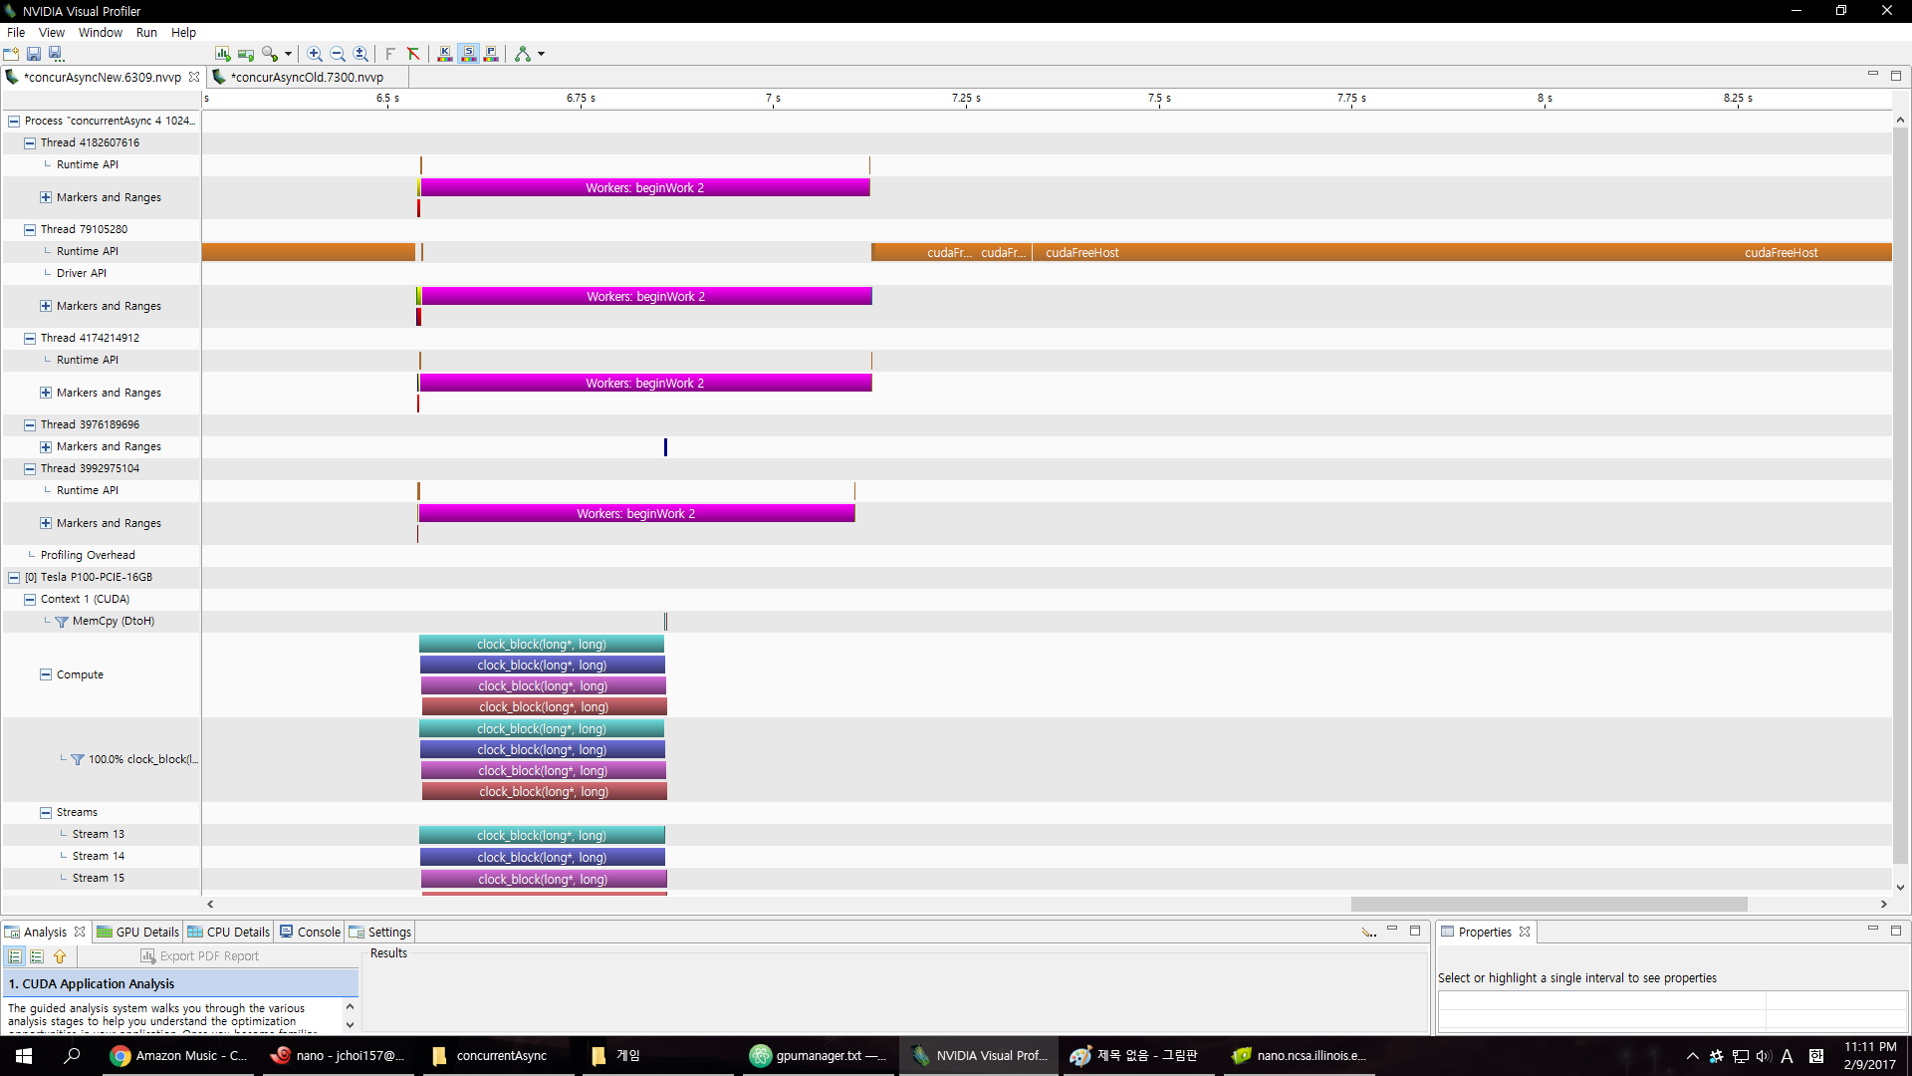
NVTX Concurrent Async New

Slide 12

OpenAtom
Ab-inito molecular dynamics
Offloads forward and backwards path of pair calculator
New GPU target

Slide 13
OpenAtom Performance
Notes:
Water 256 7ry cutoff
64 xk nodes bluewaters
Base: 2.58s

Slide 14
OpenAtom Performance
Notes:
CUDA: 2.35s Speedup 1.1x per iter

Slide 15

OpenAtom
Cosmological N-body simulations
Leverages GPU Manager
Offloads gravity kernels
Active work in optimization

Slide 16
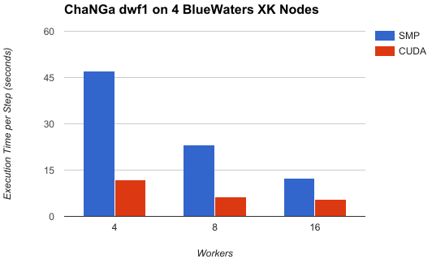
ChaNGa Performance
Notes:
Old design results
SMP: 12.3s
CUDA: 5.6s
Speedup : 2.2x

Slide 17
Accel Framework
Notes:
Research work, presented at ESPM2 workshop at SC16

Slide 18
Motivation
Exploit runtime info. for dynamic execution
Runtime (RTS) can map to various platforms
RTS can proactively move needed data
Don’t leave hardware sitting idle
Notes:
Difficult to estimate performance and split

Slide 19
Accel Framework
Generate code from tagged entry methods
  Host (CPU) and device (CUDA)
  Extend with tuning keywords
  Annotate object data access
Builds on GPU manager
Batch fine grained kernel launches

Slide 20
Example Code
entry [triggered accel] void foo() [
readonly : float matrix [SIZE]
<implobj->matrix>,
writeonly : float matTmp [SIZE]
<implobj->matrixTmp> ] {
// implementation here
} fooPost;

Slide 21
Benchmarks
stencil2d (aka jacobi)
  weighted five point stencil
  CPU friendly
md
  molecular dynamics
  GPU friendly
Stampede
  1 GPU node (K20 + Xeon E5-2680)
  16 cores/processing elements

Slide 22
Stencil 2D
Notes:
Why discontinuities? (batching?)

Slide 23
Molecular Dynamics

Slide 24
Analysis
Using hardware improves performance
Even when it’s not ideal
Code | % Dev. | Host | Device
stencil | 30% | 1.58x | 3.09x
md | 65% | 3.02x | 1.46x

Slide 25
Future work

Slide 26
Future Work
OpenCL and other language support
Stream priorities
Ongoing unified memory experiments
Heterogenous multi-node load balancing
Notes:
Versioning and improved code generation
Improved multi-device support

Slide 27
Questions?
Michael Robson
mprobson@illinois.edu

Slide 28
Backup slides

Slide 29
[accel] Framework Usage
modifiers:
  read-only, write-only, read-write
  shared – one copy per batch
  persist – resident in device memory
parameters:
  triggered – one invocation per chare in array
  splittable (int) – AEM does part of work
  threadsPerBlock (int) – specify block size

Slide 30
Projections Timelines

