Slide 1


Adaptive MPI
Performance & Application Studies
Sam White
PPL, UIUC

Slide 2
Motivation
Variability is becoming a problem for more applications
  Software: multi-scale, multi-physics, mesh refinements, particle movements
  Hardware: turbo-boost, power budgets, heterogeneity
Who should be responsible for addressing it?
  Applications? Runtimes? A new language?
  Will something new work with existing code?
Notes:
2

Slide 3
Motivation
Q: Why MPI on top of Charm++?
A: Application-independent features for MPI codes:
  Most existing HPC codes/libraries are already written in MPI
  Runtime features in familiar programming model:
    Overdecomposition
    Latency tolerance
    Dynamic load balancing
    Online fault tolerance
Notes:
3

Slide 4
Adaptive MPI
MPI implementation on top of Charm++
  MPI ranks are lightweight, migratable user-level threads encapsulated in Charm++ objects
Notes:
4

Slide 5
Overdecomposition
MPI programmers already decompose to MPI ranks:
  One rank per node/socket/core/…
AMPI virtualizes MPI ranks, allowing multiple ranks to execute per core
  Benefits:
    Cache usage
    Communication/computation overlap
    Dynamic load balancing of ranks

Slide 6
Thread Safety
AMPI virtualizes ranks as threads
  Is this safe?
int rank, size;
int main(int argc, char *argv[]) {
MPI_Init(&argc, &argv);
MPI_Comm_size(MPI_COMM_WORLD, &size);
MPI_Comm_rank(MPI_COMM_WORLD, &rank);
if (rank==0) MPI_Send(…);
else MPI_Recv(…);
MPI_Finalize();
}

Slide 7
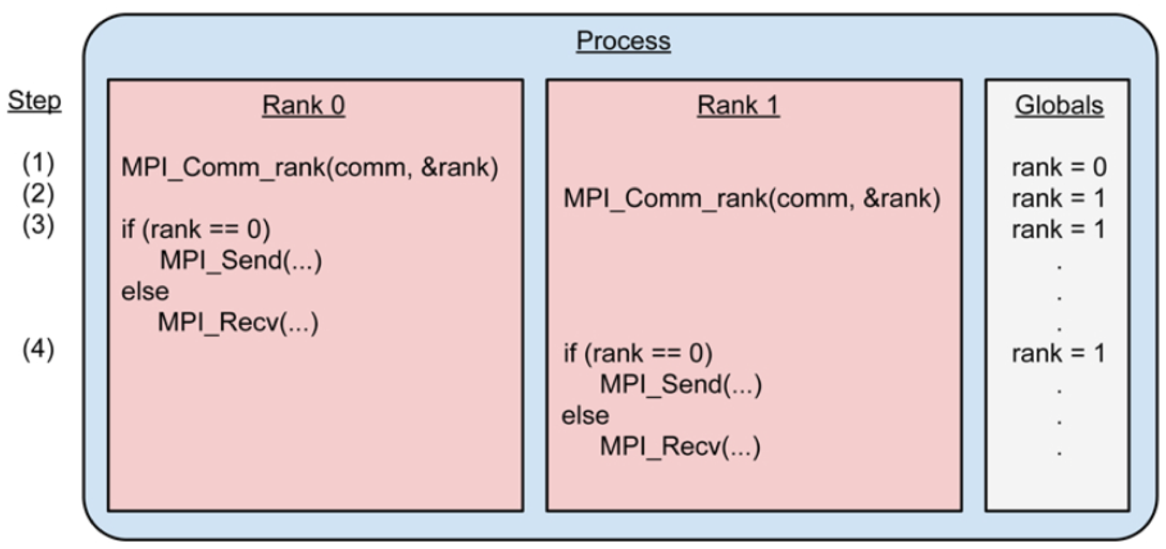
Thread Safety
AMPI virtualizes ranks as threads
  Is this safe? No, globals are defined per process

Slide 8
Thread Safety
AMPI programs are MPI programs without mutable global/static variables
  Refactor unsafe code to pass variables on the stack
  Swap ELF Global Offset Table entries during ULT context switch
    ampicc -swapglobals
  Swap Thread Local Storage (TLS) pointer during ULT context switch
    ampicc -tlsglobals
    Tag unsafe variables with C/C++ ‘thread_local’ or OpenMP’s ‘threadprivate’ attribute, or …
    In progress: compiler can tag all unsafe variables, i.e. ‘icc –fmpc-privatize’

Slide 9
Message-driven Execution
MPI_Send()

Slide 10
Migratability
AMPI ranks are migratable at runtime across address spaces
  User-level thread stack & heap
Isomalloc memory allocator
  No application-specific code needed
  Link with ‘-memory isomalloc’

Slide 11
Migratability
AMPI ranks (threads) are bound to chare array elements
  AMPI can transparently use Charm++ features
‘int AMPI_Migrate(MPI_Info)’ used for:
  Measurement-based dynamic load balancing
  Checkpoint to file
  In-memory double checkpoint
  Job shrink/expand

Slide 12
Applications
LLNL proxy apps & libraries
Harm3D: black hole simulations
PlasComCM: Plasma-coupled combustion simulations

Slide 13
LLNL Applications
Work with Abhinav Bhatele & Nikhil Jain
Goals:
  Assess completeness of AMPI implementation using full-scale applications
  Benchmark baseline performance of AMPI compared to other MPI implementations
  Show benefits of AMPI’s high-level features

Slide 14
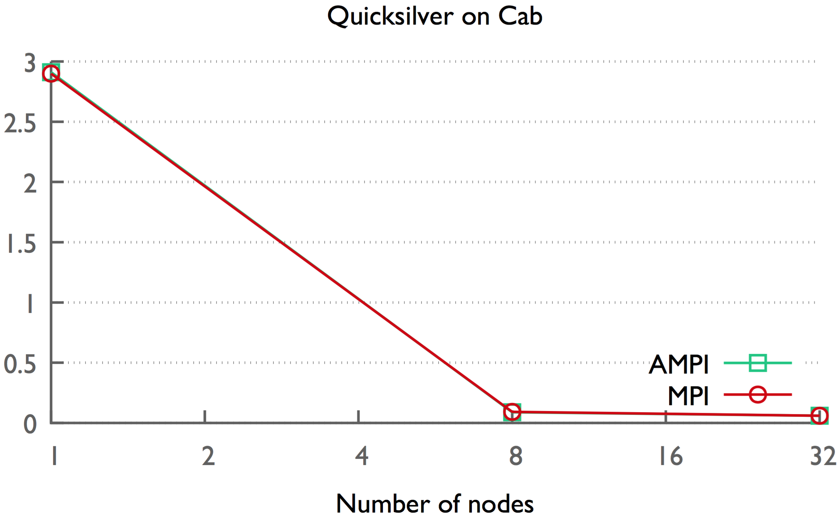
LLNL Applications
Quicksilver proxy app
  Monte Carlo Transport
  Dynamic neutron transport problem

Slide 15
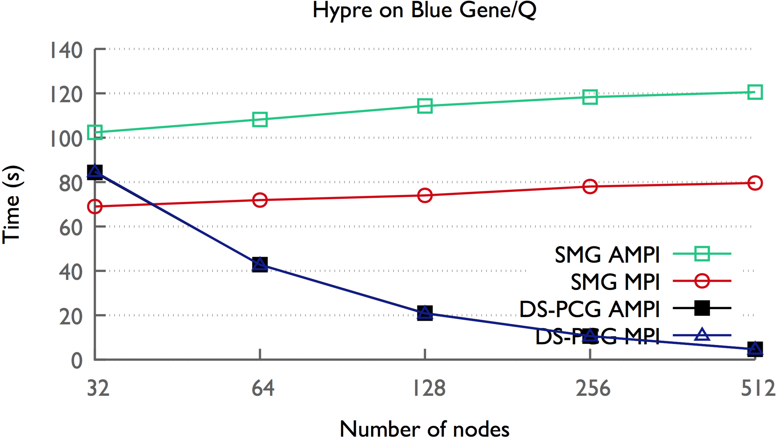
LLNL Applications
Hypre benchmarks
  Performance varied across machines, solvers
    SMG uses many small messages, latency sensative

Slide 16
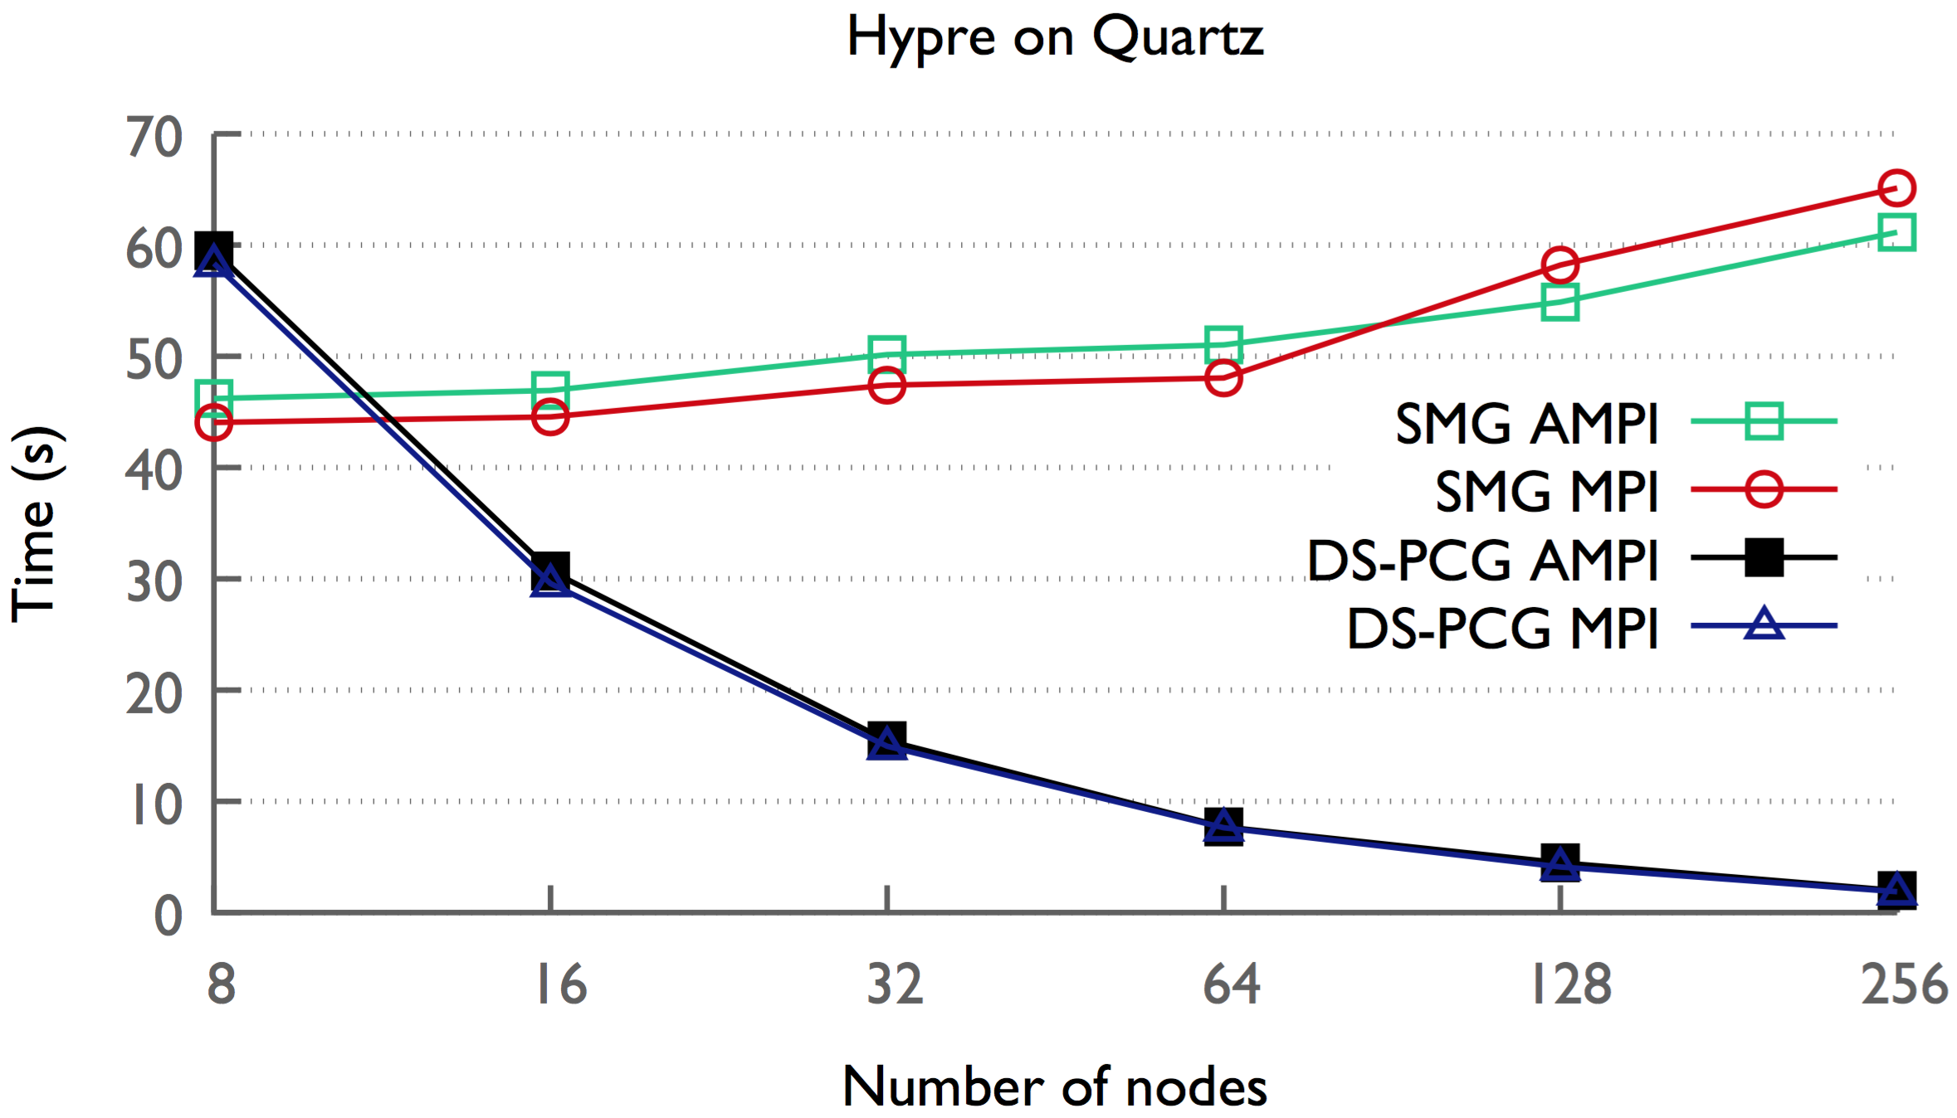
LLNL Applications
Hypre benchmarks
  Performance varied across machines, solvers
    SMG uses many small messages, latency sensative

Slide 17
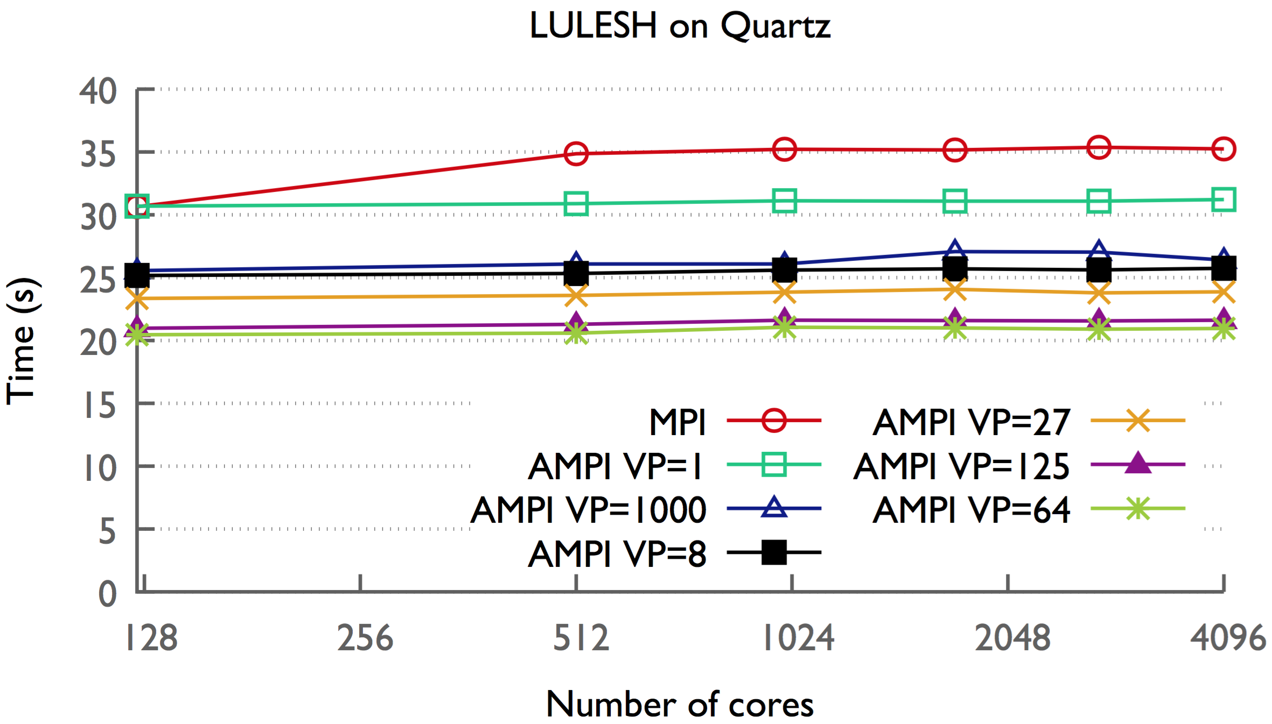
LLNL Applications
LULESH 2.0
  Shock hydrodynamics on a 3D unstructured mesh

Slide 18
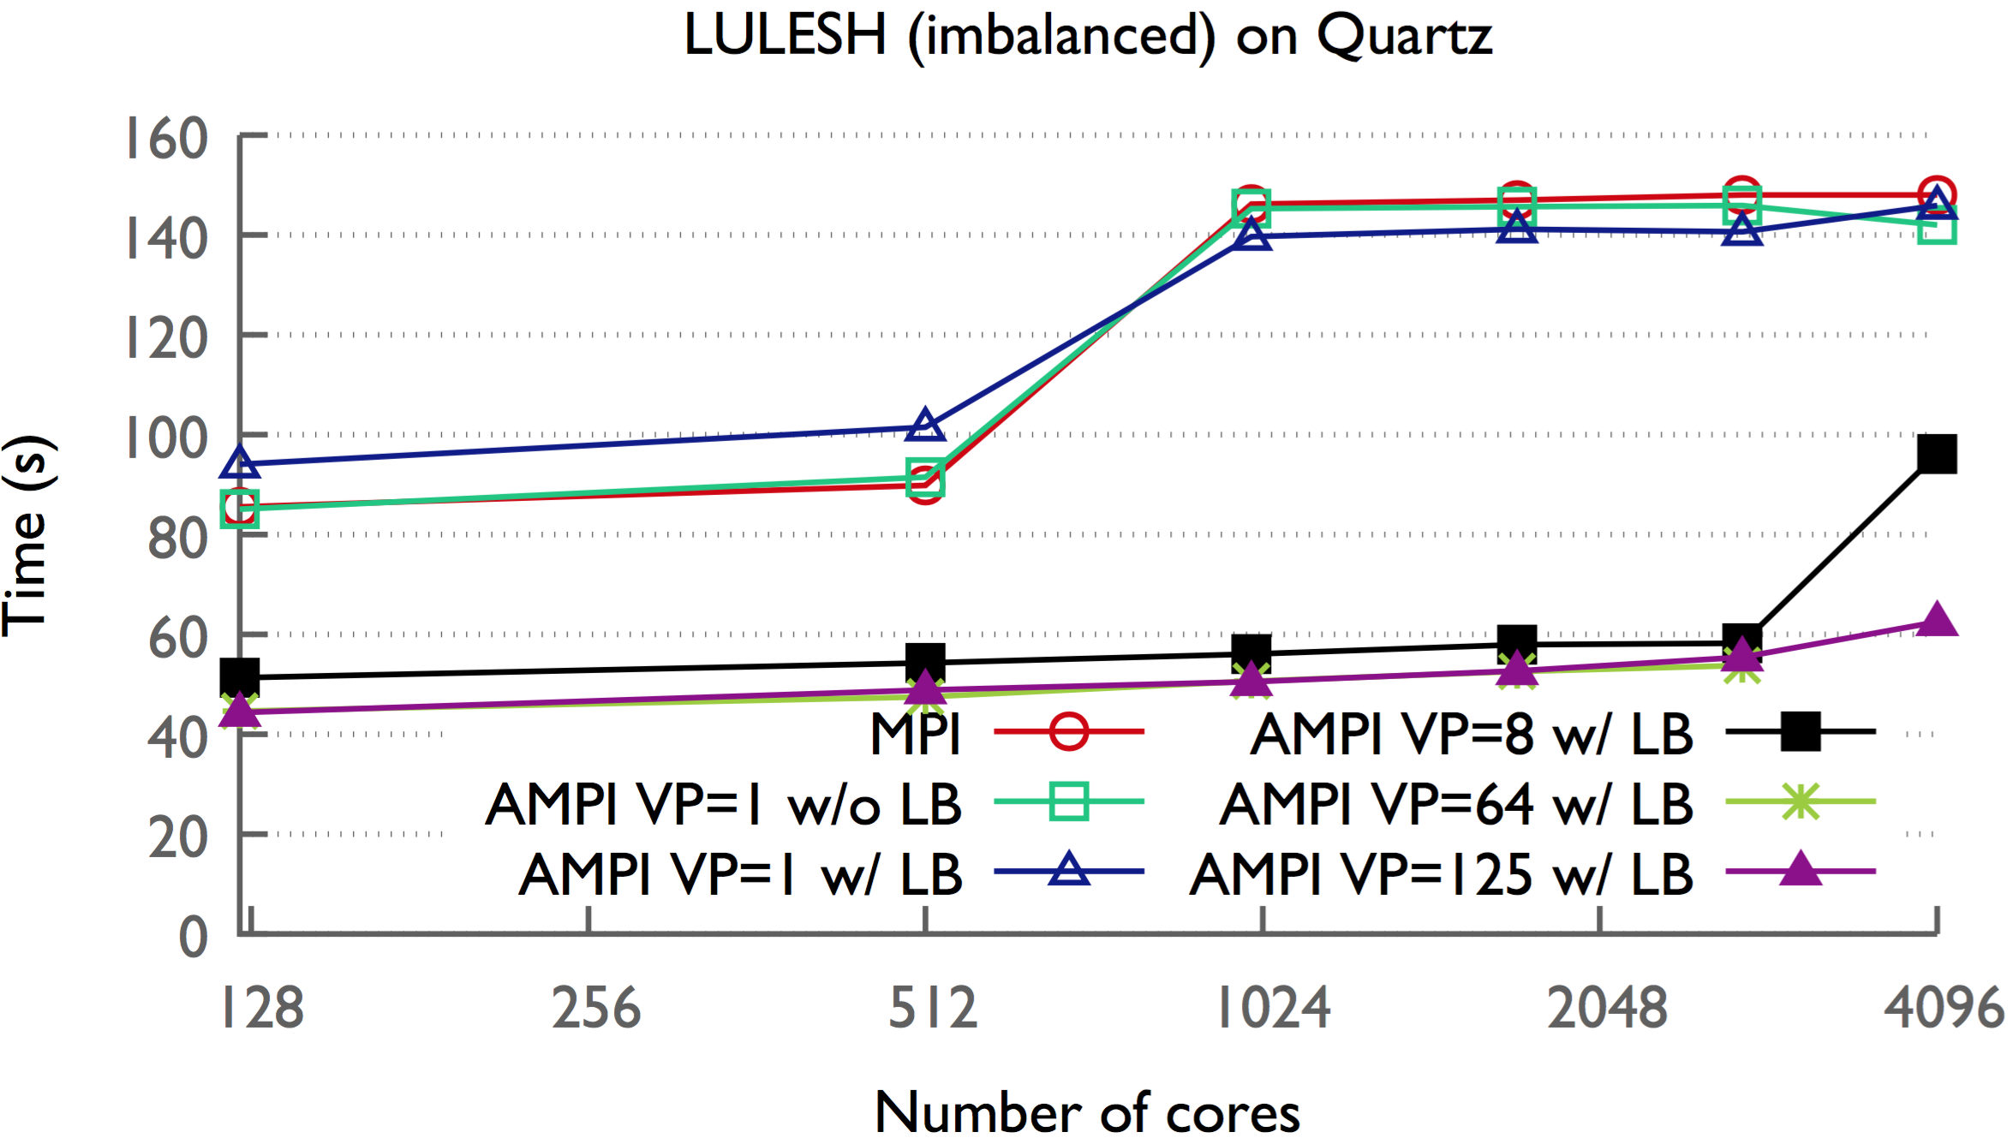
LLNL Applications
LULESH 2.0
  With multi-region load imbalance

Slide 19
Harm3D
Collaboration with Scott Noble, Professor of Astrophysics at the University of Tulsa
  PAID project on Blue Waters, NCSA
Harm3D is used to simulate & visualize the anatomy of black hole accretions
  Ideal-Magnetohydrodynamics (MHD) on curved spacetimes
  Existing/tested code written in C and MPI
  Parallelized via domain decomposition

Slide 20
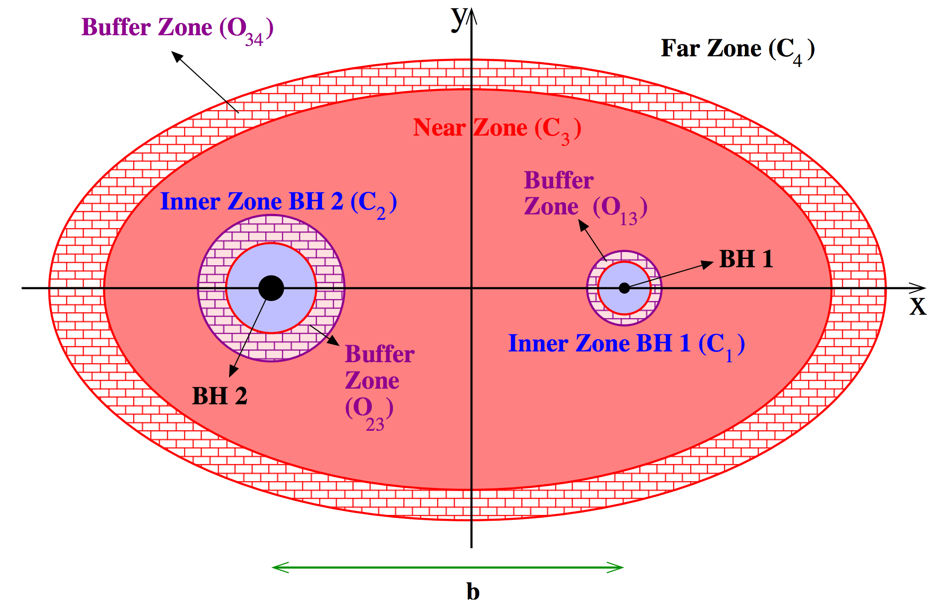
Harm3D
Load imbalanced case: two black holes (zones) move through the grid
  3x more computational work in buffer zone than in near zone

Slide 21
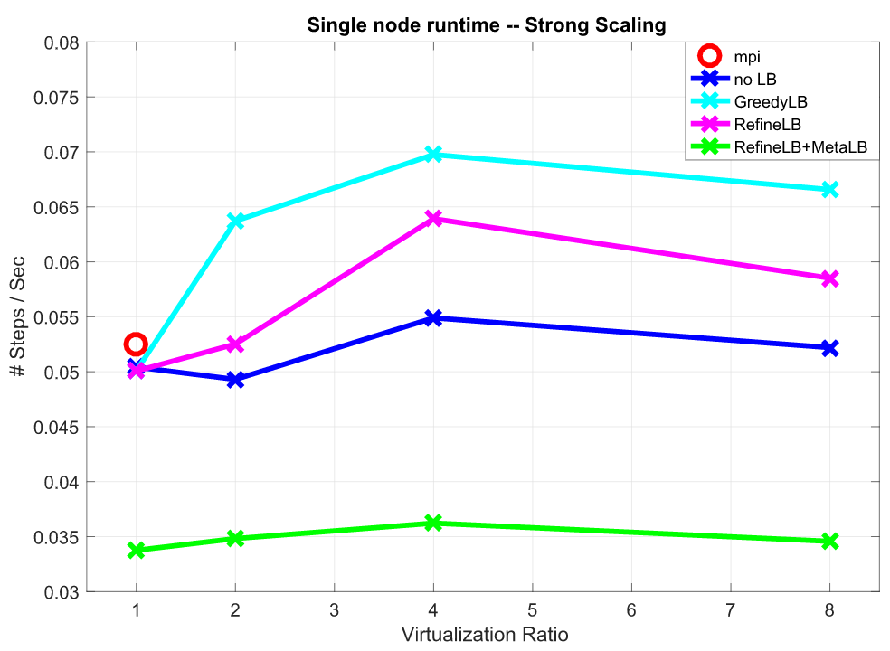
Harm3D
Recent/initial load balancing results:

Slide 22
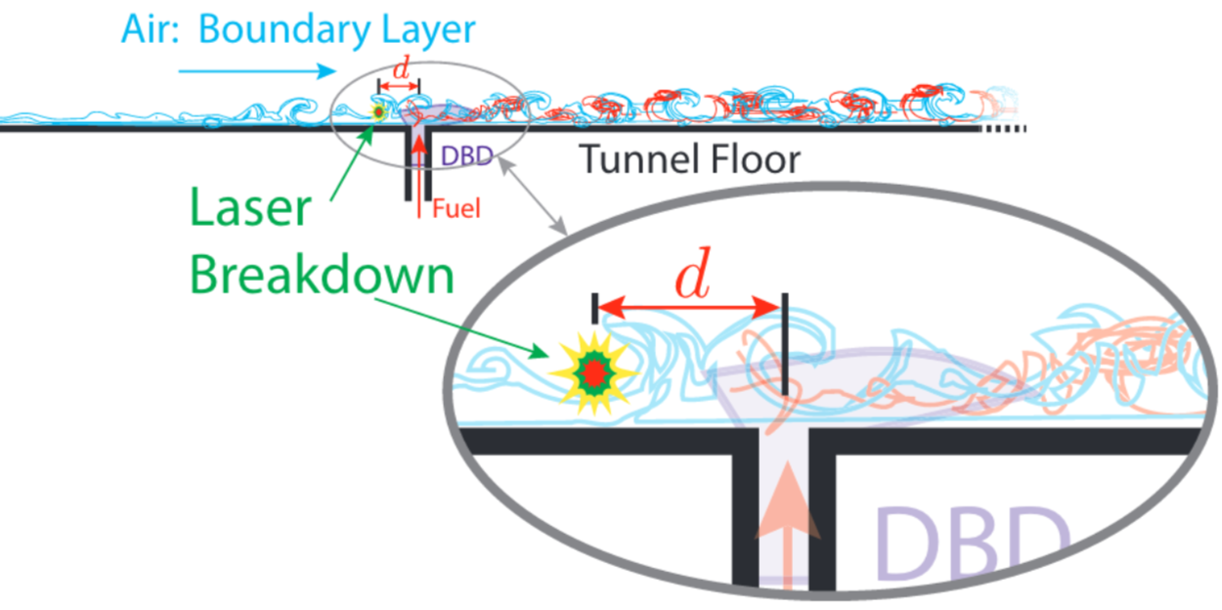
PlasComCM
XPACC: PSAAPII Center for Exascale Simulation of Plasma-Coupled Combustion

Slide 23
PlasComCM
The “Golden Copy” approach:
  Maintain a single clean copy of the source code
    Fortran90 + MPI (no new language)
  Computational scientists add new simulation capabilities to the golden copy
  Computer scientists develop tools to transform the code in non-invasive ways
    Source-to-source transformations
    Code generation & autotuning
    JIT compiler
    Adaptive runtime system

Slide 24
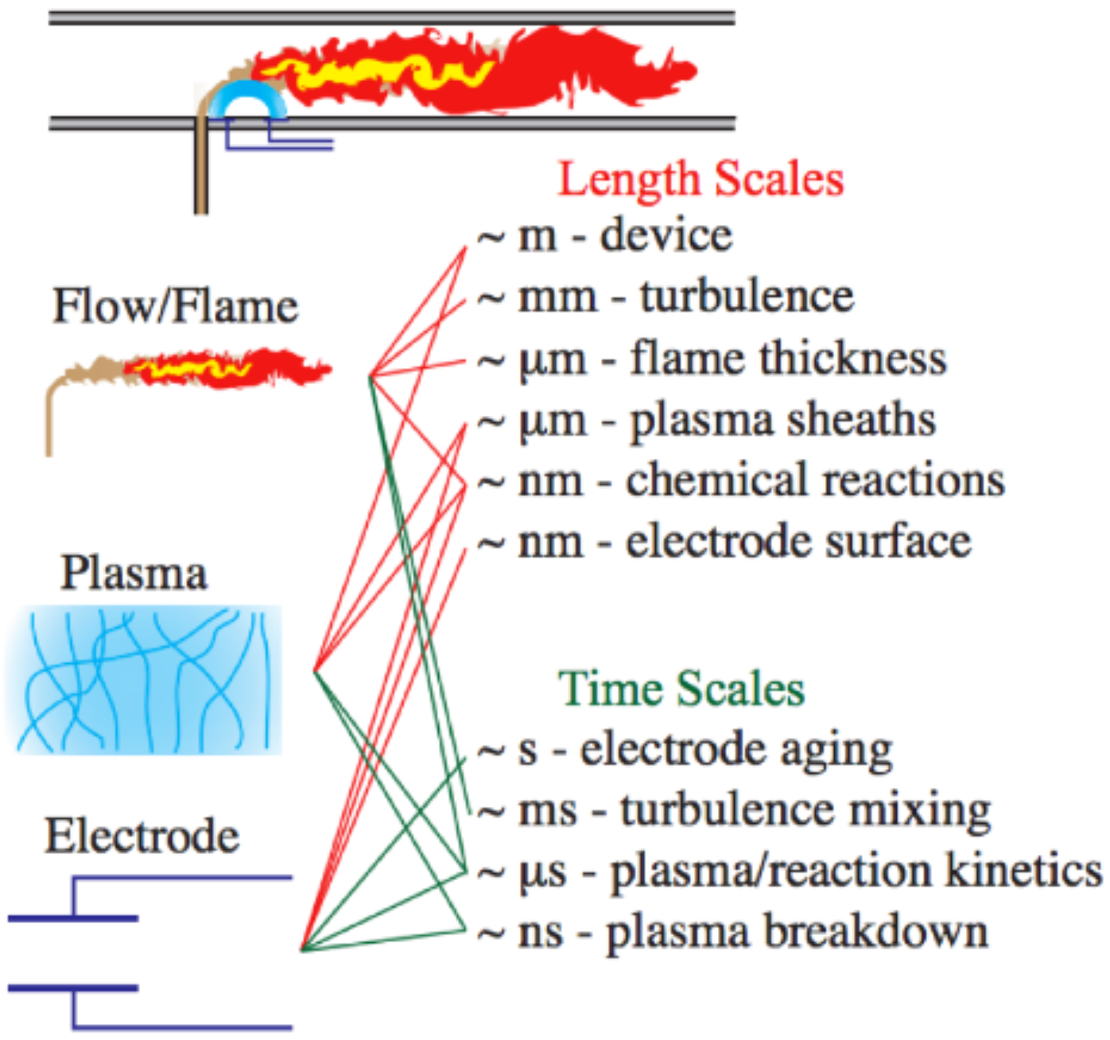
PlasComCM
Multiple timescales involved in a single simulation (right)
  Leap is a python tool that auto-generates multi-rate time integration code
    Integrate only as needed, naturally creating load imbalance
    Some ranks perform twice the RHS calculations of others

Slide 25
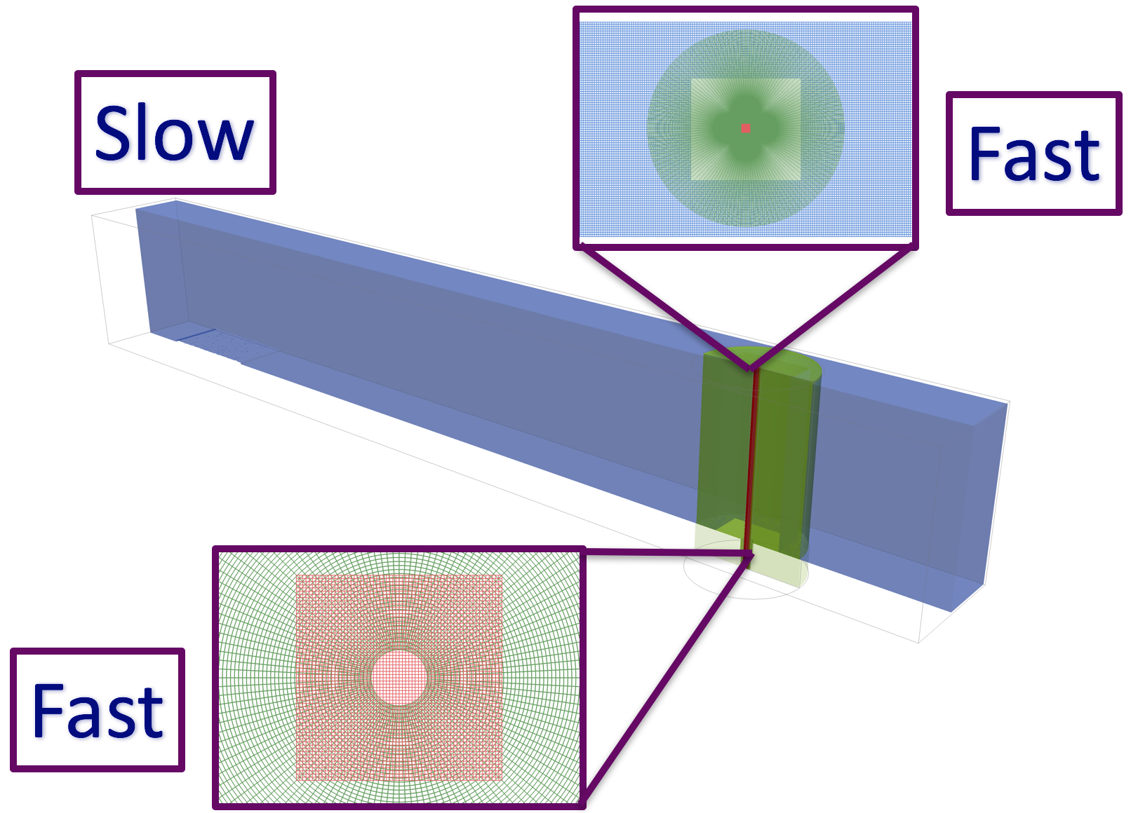
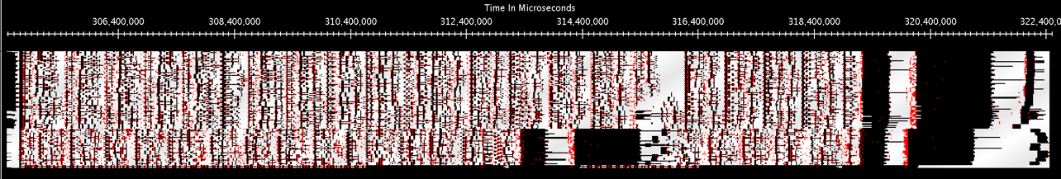
PlasComCM
The problem is decomposed into 3 overset grids
  2 ”fast”, 1 ”slow”
  Ranks only own points on one grid
  Below: load imbalance

Slide 26
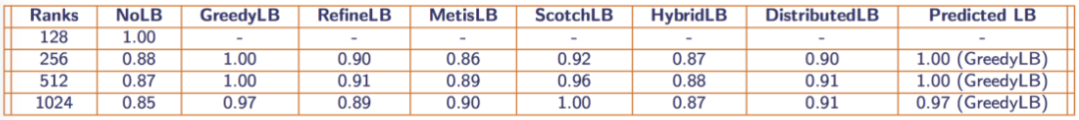
PlasComCM
Metabalancer
  Idea: let the runtime system decide when and how to balance the load
    Use machine learning over LB database to select strategy
    See Kavitha’s talk later today for details
  Consequence: domain scientists don’t need to know details of load balancing
PlasComCM on 128 cores of Quartz (LLNL)

Slide 27
Recent Work
Conformance:
  AMPI supports the MPI-2.2 standard
  MPI-3.1 nonblocking & nbor collectives
  User-defined, non-commutative reductions ops
  Improved derived datatype support
Performance:
  More efficient (all)reduce & (all)gather(v)
  More communication overlap in MPI_{Wait,Test}{any,some,all} routines
  Point-to-point messaging, via Charm++’s new zero-copy RDMA send API

Slide 28
Summary
Adaptive MPI provides Charm++’s high-level features to MPI applications
  Virtualization
  Communication/computation overlap
  Configurable static mapping
  Measurement-based dynamic load balancing
  Automatic fault recovery
See the AMPI manual for more info.

Slide 29
Thank you

Slide 30
OpenMP Integration
Charm++ version of LLVM OpenMP works with AMPI
  (A)MPI+OpenMP configurations on P cores/node:
  AMPI+OpenMP can do >P:P without oversubscription of physical resources
Notation | Ranks/Node | Threads/Rank | MPI(+OpenMP) | AMPI(+OpenMP)
P:1 | P | 1 | ✔ | ✔
1:P | 1 | P | ✔ | ✔
P:P | P | P |  | ✔
Notes:
30

