Slide 1
Welcome to the 2018 Charm++ Workshop!
Laxmikant (Sanjay) Kale
http://charm.cs.illinois.edu
Parallel Programming Laboratory
Department of Computer Science
University of Illinois at Urbana Champaign

Slide 2
What is Charm++?
Charm++ is a generalized approach to writing parallel programs
An alternative to the likes of MPI, UPC, GA etc.
But not to sequential languages such as C, C++, Fortran
Represents:
The style of writing parallel programs
The adaptive runtime system
And the entire ecosystem that surrounds it
Three design principles:
Overdecomposition, Migratability, Asynchrony

Slide 3
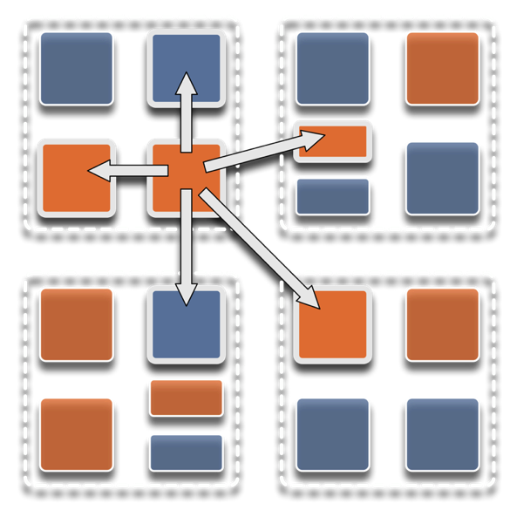
Overdecomposition
Decompose the work units & data units into many more pieces than execution units
Cores/Nodes/..
Not so hard: we do decomposition anyway

Slide 4
Migratability
Allow these work and data units to be migratable at runtime
i.e. the programmer or runtime, can move them
Consequences for the application developer
Communication must now be addressed to logical units with global names, not to physical processors
But this is a good thing
Consequences for RTS
Must keep track of where each unit is
Naming and location management

Slide 5
Asynchrony: Message-Driven Execution
With over decomposition and Migratibility:
You have multiple units on each processor
They address each other via logical names
Need for scheduling:
What sequence should the work units execute in?
One answer: let the programmer sequence them
Seen in current codes, e.g. some AMR frameworks
Message-driven execution:
Let the work-unit that happens to have data (“message”) available for it execute next
Let the RTS select among ready work units
Programmer should not specify what executes next, but can influence it via priorities

Slide 6
Realization of this model in Charm++
Overdecomposed entities: chares
Chares are C++ objects
With methods designated as “entry” methods
Which can be invoked asynchronously by remote chares
Chares are organized into indexed collections
Each collection may have its own indexing scheme
1D, ..7D
Sparse
Bitvector or string as an index
Chares communicate via asynchronous method invocations
A[i].foo(….); A is the name of a collection, i is the index of the particular chare.

Slide 7
Message-driven Execution
A[23].foo(…)
Processor 0
Processor 1
Scheduler
Scheduler
Message Queue
Message Queue
Notes:
Certain member functions of certain classes are globally visible
Invocation of a member function may lead to communication

Slide 8
Processor 0
Processor 1
Scheduler
Scheduler
Message Queue
Message Queue
Processor 2
Processor 3
Scheduler
Scheduler
Message Queue
Message Queue

Slide 9
Processor 0
Processor 1
Scheduler
Scheduler
Message Queue
Message Queue
Processor 2
Processor 3
Scheduler
Scheduler
Message Queue
Message Queue

Slide 10
Processor 0
Processor 1
Scheduler
Scheduler
Message Queue
Message Queue
Processor 2
Processor 3
Scheduler
Scheduler
Message Queue
Message Queue

Slide 11
Empowering the RTS
Adaptive
Runtime System
Introspection
Adaptivity
Asynchrony
Overdecomposition
Migratability
The Adaptive RTS can:
Dynamically balance loads
Optimize communication:
Spread over time, async collectives
Automatic latency tolerance
Prefetch data with almost perfect predictability

Slide 12
Relevance to Exascale
Intelligent, introspective, Adaptive Runtime Systems, developed for handling application’s dynamic variability, already have features that can deal with challenges posed by exascale hardware

Slide 13
Relevant capabilities for Exascale
Load balancing
Data-driven execution in support of task-based models
Resilience
Multiple approaches: in-memory checkpoint, leveraging NVM, message-logging for low MTBF
All leveraging object-based overdecomposition
Power/Thermal optimizations
Shrink/Expand sets of processors allocated during execution
Adaptivity-aware resource management for whole-machine optimizations

Slide 14
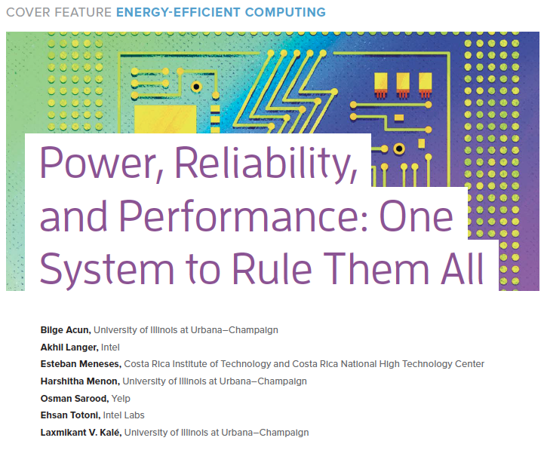
IEEE Computer highlights Charm++ energy efficient runtime

Slide 15
Interaction Between the Runtime System and the Resource Manager
Allows dynamic interaction between the system resource manager or scheduler and the job runtime system
Meets system-level constraints such as power caps and hardware configurations
Achieves the objectives of both datacenter users and system administrators

Slide 16
Charm++ interoperates with MPI
So, you can write one module in Charm++, while keeping the rest in MPI
Charm++ Control

Slide 17
Integration of Loop Parallelism
Used for transient load balancing within a node
Mechanisms:
Interoperation with extant OpenMP, OMPSS etc.
Charm++’s old CkLoop construct
New integration with OpenMP via LLVM
RTS splits a loop into Charm++ messages
Pushed into each local work stealing queue
where idle threads within the same node can steal tasks

Slide 18
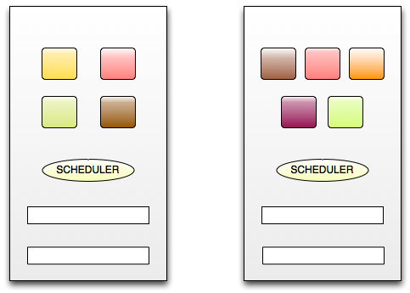
Core0
Core1
Message Queue
Message Queue
Task Queue
Task Queue
Integrated RTS (Using Charm++ construct or OpenMP pragmas)
for ( i = 0; i < n ; i++) { … }
2018 CHARM++ WORKSHOP

Slide 19
Challenges of the Coming Era
Some at Extreme Scale, and some common to both

Slide 20
Hardware Variability: Observed Performance Variation at Scale
Up to 16% Performance Variation on Edison, Cab, Stampede!
Only 1% Variation on Blue Waters!
16K cores running local DGEMM kernel of Intel-MKL
*Acun, Bilge, Phil Miller, and Laxmikant V. Kale. "Variation Among Processors Under Turbo Boost in HPC Systems." Proceedings of the 2016 International Conference on Supercomputing. ACM, 2016.
Notes:
Performance variation is bad because:
Performance testing: performance is not repeatable – hard to detect if a small optimization in a large application is effective at all.
Performance of applications: Most current applications and programming models are not designed for a variable environment, therefore if there is synchronization, there will be a high overhead. One slow processor in the critical path can slow down whole application
The benchmark is Intel’s MKL DGEMM benchmark running contiguously in a loop:
Whole data fits in the last level cache – this eliminates the cache performance related variations
No communication in the benchmark – only local computation
All cores in the processor are active and running the computation independently

Slide 21
Fat Nodes
GPGPUs require consolidation/aggregation to make “reasonably-sized”, chunky kernels.
For NAMD:
Aggregate multiple (actually, all) force calculation objects into a single one
Which means: wait for all communication and then start computation
Now, we are latency-dependent again!
What is worse:
The bandwidth increase has not kept pace with CPU speeds

Slide 22
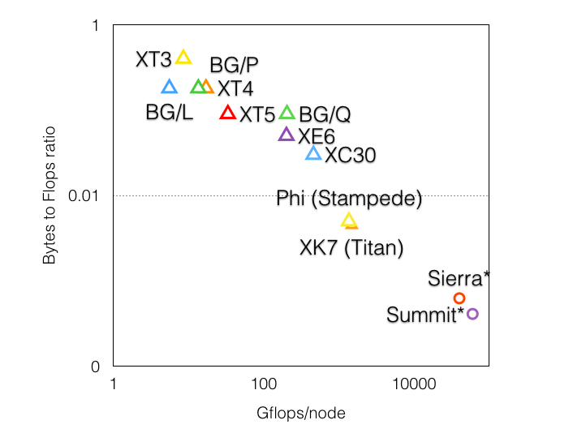
Injection Bandwidth vs CPU speeds

Slide 23
Fat Nodes
First law of holes:
If you find yourself in a hole, stop digging!
1 TF
40 TF
We are digging ourselves deeper into a node

Slide 24
Impact on communication
Current use of communication network:
Compute-communicate cycles in typical MPI apps
The network is used for a fraction of time
and is on the critical path
Current communication networks are over-engineered for by necessity
P1
P2
BSP based application

Slide 25
Impact on communication
With overdecomposition:
Communication is spread over an iteration
Adaptive overlap of communication and computation
P1
P2
Overdecomposition enables overlap

Slide 26
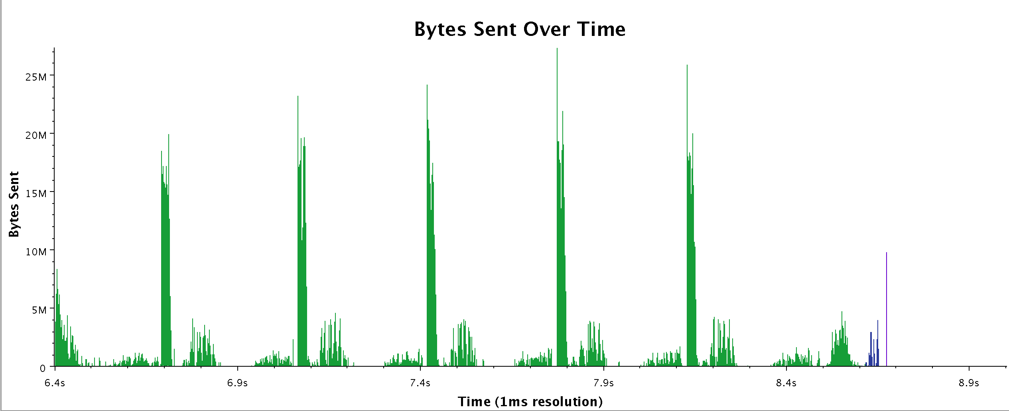
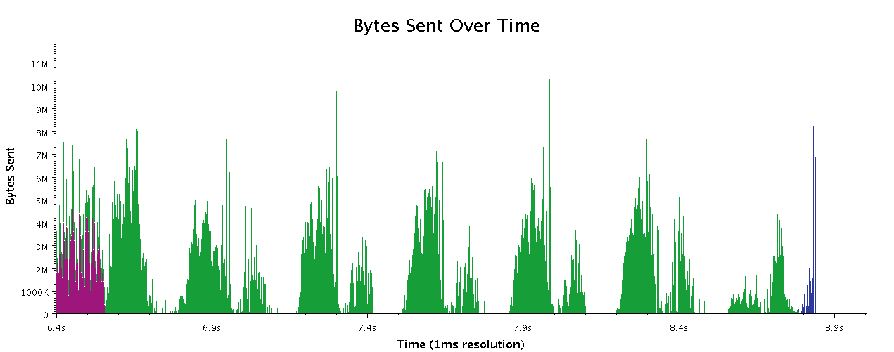
Recent data from Chombo
Work by Phil Miller
Chombo with reductions
Chombo on Charm (experimental)

Slide 27
Some Highlights from the last year

Slide 28
Adaptive MPI
AMPI is our implementation of the MPI standard on Charm++
Brings the benefits of Adaptive RTS to MPI applications
Made significant progress
Communication Performance
More in Sam White’s talk
Helped by Charmworks via DoE SBIR grant
We expect it to take its place among other established MPI implementations

Slide 29
Charm++ robustness and usability
Charmworks: supporting and improving Charm++
Engineering tasks were moved to Charmworks to the extent possible allowing PPL to focus on research
New use cases via its clients
All improvements merged into the University version
One sided communication
Use of it with existing API
New API Change for Charm++
Avoids both sender side and receiver side copying when possible
Nitin Bhat of Charmworks
Command line simplification for pemap, ppn, commmap,..
You can optionally specify just numnodes, and processes you want on each node, and the let system figure out the rest

Slide 30
CharmPy
Parallel programming in Python
With the Charm++ programming model and RTS
Juan Galvez started as a personal-interest project
Triggered by a talk by a fomer PPLer Ehsan Totoni (HPAT, Intel)
Helped by other students, including Karthik Senthil
Already a full fledged implementation

Slide 31
Connected Components
Scalable, distributed implementation of union-find data structure
Karthik Senthil, Nihar Sheth, Prof. Edgar Solomonik
Running in distributed mode and scaling
Further optimizations planned for the next month
Expect a release soon

Slide 32
ParaTreet framework
NSF funded seed grant
Collaboration with 8 faculty from 5 institutions
Quinn, Balazinska (UW), Lawlor (U Alaska), Kulkarni (Purdue), Kale, Hart (UIUC), Richardson & Losert (U. MD)
Framework for parallel algorithms over distributed tree-structured data
Decompositions, multiple tree types, generic traversals, algorithms, I/O, ..

Slide 33
Parallel Discrete Event Simulations
Charades: Charm++ based PDES framework
Optimistic concurrency model
Excellent performance results, with
Novel Global Virtual Time Algorithms
Load balancing for PDES
Production strength implementation

Slide 34
Modern C++ in the Runtime, Finally!
6.9 onwards (inclusive), C++11 will be assumed
Earlier, backward compatibility with Argonne Blue Gene prevented this
C++11 will be required from 6.9 on
Also, several collaborators are working on features based on modern C++
Eliminating interface files, for example
Two relevant talks: Nils Deppe (Cornell), Jozsef Bakosi (LANL)

Slide 35
And many more talks
Keynotes:
Ron Brightwell (now)
D. K. Panda (tomorrow morning)
Panel:
Architectural convergence for Big Data and CSE applications:
Marriage of convenience or conviction

Slide 36
Backup slides

Slide 37
Little’s Law, concurrency and latency
Using concurrency to tolerate latency
If you have enough things to do (that are ready tasks), you can tolerate latency
Need enough bandwidth of course,
Note: we are talking about concurrency, not parallelism
I.e. the same computational resource has many ready tasks
So, (maybe with the help of RTSs such as Charm++), we can translate latency problems into bandwidth problems
Which is good

Slide 38
Example: MD across clusters
Molecular Dynamics across geographically separate clusters
Part of work in a PhD thesis by Greg Koenig in my group years ago
We were able to use a cluster at Argonne and one at UIUC
Ran classical MD with execution time-per-step of 5 ms
With latencies across clusters of a few ms!

Slide 39
Time Profile of ApoA1 on Power7 PERCS
92,000 atom system, on 500+ nodes (16k cores)
2ms total
A snapshot of optimization in progress.. Not the final result
Overlapped steps, as a result of asynchrony

Slide 40
Timeline of ApoA1 on Power7 PERCS
230us

Slide 41
Lesson from NAMD example
Opportunistic automatic overlap of communication and computation, enabled by by fine-grained chunks of work, most triggered by remote data

Slide 42
Proposition 1
For a class of applications, we may need thinner nodes
You get a larger number of nodes, which means a larger sets of wires for communication
Communication link is also resource just like a floating point unit is

Slide 43
Alternatives
Reduce communication
Different algorithms?
Compression? But tends to elongate critical path.
Use different algorithms
Less stress on bisection bandwidth
“Phase transitions”
Switch parallelization strategies and maybe even algorithms above a threshold number of processors

