Slide 1
Integrated Runtime of Charm++ and OpenMP
Parallel Programming Laboratory, CS @ Illinois
Ph.D Student
Seonmyeong Bak

Slide 2
Tables of contents
Introduction
  Motivation
  Load imbalance/performance analysis of periodic LB and overdecomposition
Implementation
  Integrated runtime of OpenMP and Charm++/AMPI using user-level threads
Evaluation
  Scaling results on KNL with applications (Lassen, Kripke, ChaNGa)

Slide 3
Motivation
Load imbalance becomes more critical issue
  The number of cores increasing rapidly
  Parallel applications have variable size of problems, which cannot be evenly distributed among nodes and cores

Slide 4
Ways to resolve load imbalance within a node
Coarse-grained periodic load balancing
  Load information on all processes is collected and make decision to migrate objects
  Periodic load balancing incurs overhead so cannot be called frequently
Using hybrid programming model such as MPI +X
  Help load imbalance with fine-grained task-level parallelism and low cost
  Each process has separate thread pool -> limited load balancing

Slide 5

Analysis of periodic load balancing / overdecomposition
Application: Lassen, proxy application
  Wave propagation, highly load imbalanced
Machine: NERSC Cori(Haswell, 16-core x 2 sockets on each node)
  2 hardware threads per core are used -> 64 threads on a single node
Measure the load imbalance of Lassen and and performance
  Metric
    Bigger Value means processing elements and nodes have more load imbalance

Slide 6
Analysis of periodic load balancing / overdecomposition
4 different Load Balancing strategies
  GreedyLB
    Move the load on the heaviest loaded PE to the least loaded PE
  GreedyRefineLB
    Similar to GreedyLB but minimize migration of objects
  RefineLB
    Compute the average load of PEs and migrate chares to make each PE reach the average
  Hybrid LB
    Hierarchical Load balancing -> RefineLB for the 1st level of the hierarchy of Pes and GreedyRefineLB for the 2nd level
  NoLB (Baseline, periodic load balancing is not called)

Slide 7
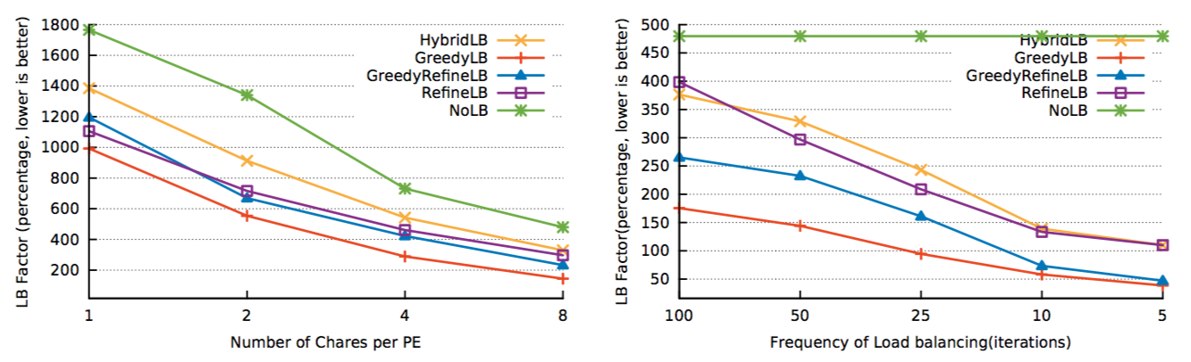
Fixed LB freq = 25
Fixed decomposition ratio = 2
More number of chares per PE -> Load imbalance reduced
More frequent LB -> Load imbalance reduce
The reduced load imbalance leads to performance gain? NO!

Slide 8
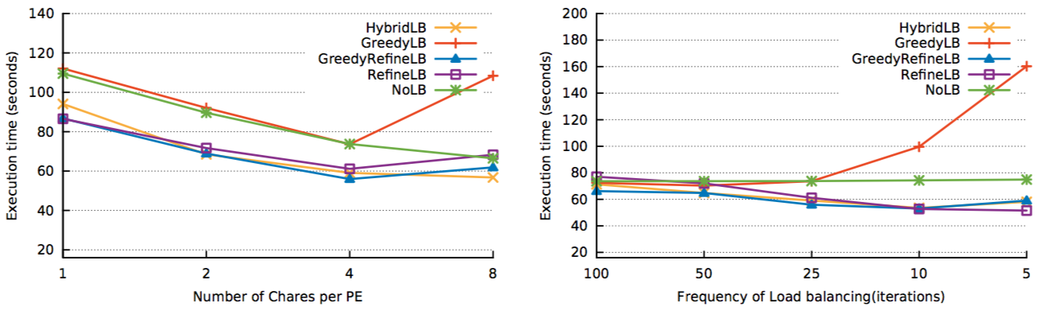
Fixed LB freq = 25
Fixed decomposition ratio = 2
More number of chares per PE -> Performance get worse with more than 8 chares / PE
  More number of chares -> surface to volume ratio increases, scheduling overhead, lack of locality
More frequent LB -> Performance doesn’t get better from 10 iterations
  Load balancing overhead, migrating cost

Slide 9
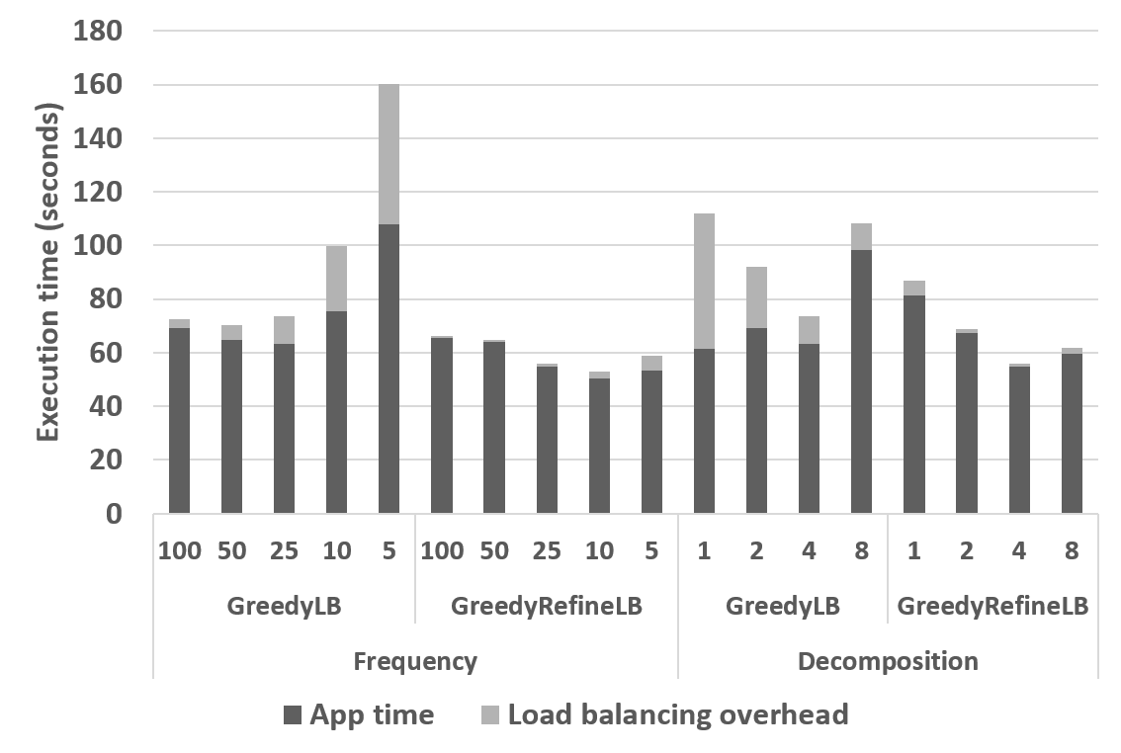
Detailed timing result of Lassen
More frequent LB
  LB Overhead increased
Higher decomposition ratio
  Application time increased
    Lack of locality
    Scheduling overhead
    Surface to volume ratio increased
Periodic LB have limitation in performance gain

Slide 10
Implementation
Create implicit tasks (OpenMP threads) using user-level threads on each chare
  These ULTs can be migratable within a node
  Idle PE steals ULTs from busy PEs, which improve load imbalance within a node in marginal cost
  Use heuristics to minimize the unnecessary creation of ULTs
    Use an atomic counter to keep record of how many PEs are idle within a node
    Keep history vector on each PE to monitor how many tasks created on the PE has been stolen

Slide 11
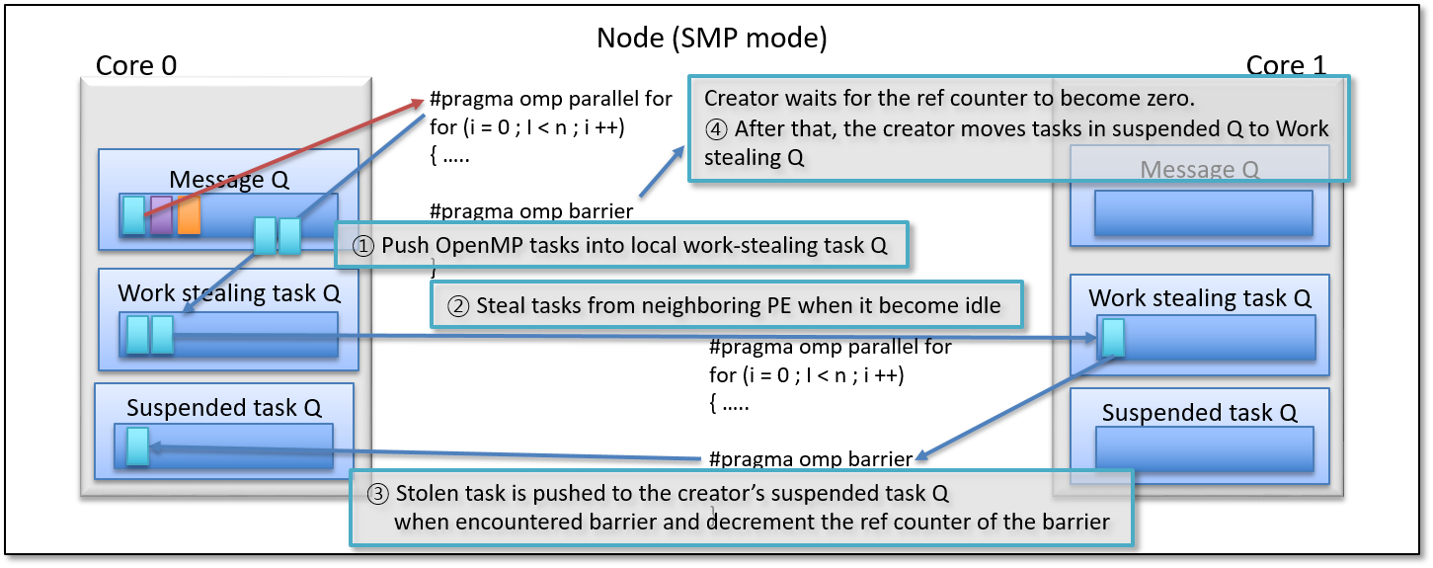
Implementation – Integrated OpenMP on Charm++

Slide 12
Implementation
All the barriers are implemented using atomic reference counters
  Suspend/Resume cannot work for this integrated scheme -> chares creating implicit tasks cannot be suspended
Minimize unnecessary internal barriers in LLVM OpenMP runtime
  more overlapping internally
Works with ICC, Clang, and GNU on Charm++ x86/IBM Power targets

Slide 13
Evaluation
Applications
  Lassen: Wave propagation mini app by LLNL, written in Charm++, highly load imbalanced
  Kripke: LLNL proxy app for parallel deterministic transport codes, written in MPI+OpenMP
  ChaNGa: N-body cosmology simulation, written in Charm++
Machines
  NERSC Cori (Haswell, 2 x 16 cores on each node), ANL Theta(KNL, 64 cores)
    2 hardware threads per node on both machines
    Cori used only for Lassen, Theta used for all the applications
Compiler: icc 17.0

Slide 14
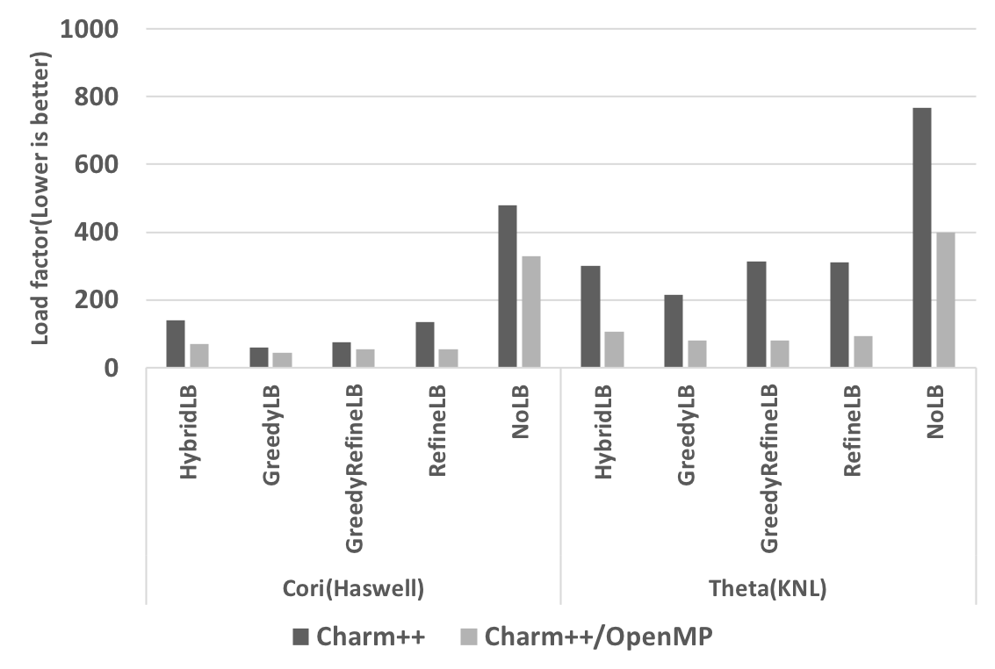
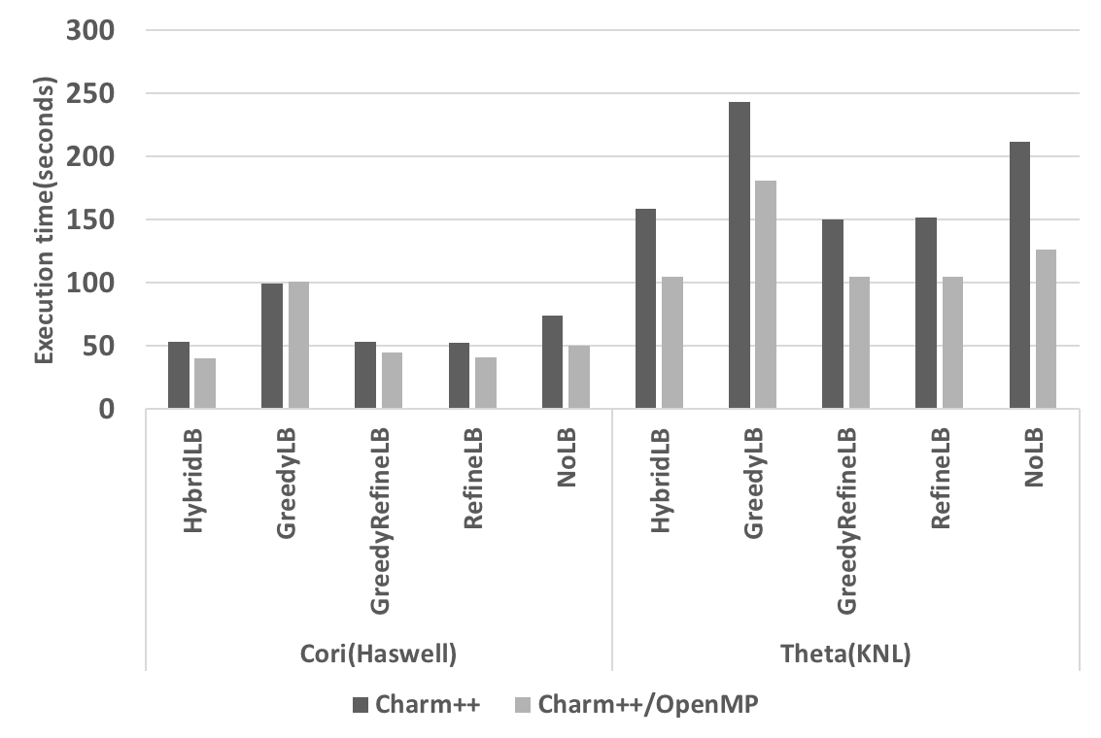
LB factor & Performance on a single node – Lassen
On both Haswell and KNL, the LB factor and performance is improved
  Improved load imbalance results in performance gain-> marginal overhead

Slide 15
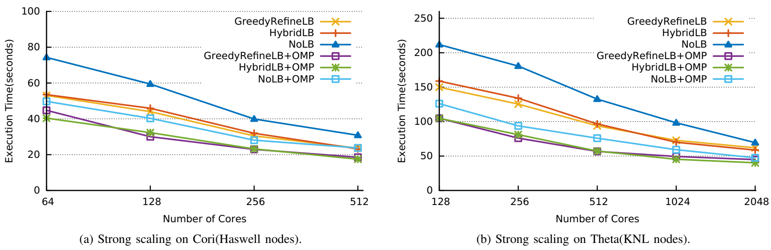
Scaling results – Lassen
  Strong scaling
  32.5% on Cori(Haswell, 512 cores run), 45.9% on Theta (KNL, 2K cores run)

Slide 16
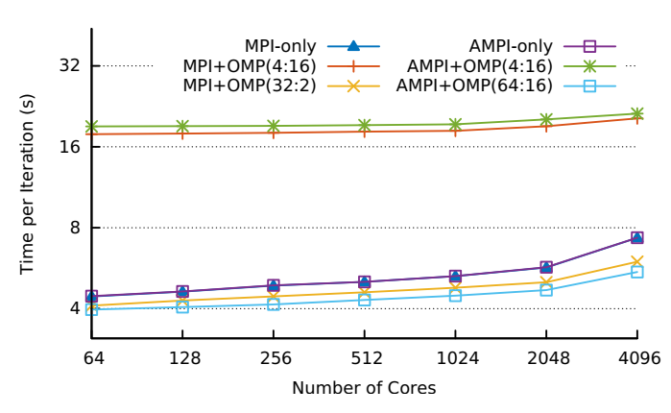
Scaling result – Kripke
Weak scaling
Run Kripke with standard MPI+OpenMP,
AMPI + OpenMP
  AMPI + OpenMP can use all the threads within a node for all MPI ranks and OpenMP threads
    Better performance
    11% improved over the best MPI config

Slide 17
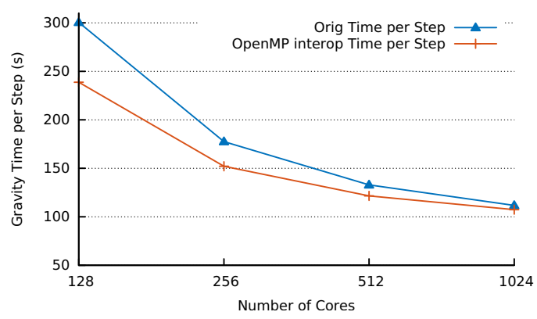
Scaling result – ChaNGa
Input set: Dwf1.2048
  This input has strong scaling limit
  Best LB applied for both experiments
  25.7% on single node,
  16.7% on two nodes, 9.4% on 4 nodes
  4% on 8 nodes

Slide 18
Publications & Future work
Integrated OpenMP has been open to public since 6.8
  The initial version published and presented in ESPM2 `17
    Seonmyeong Bak, Harshitha Menon, Sam White, Matthias Diener, and Laxmikant Kale.
    Integrating OpenMP into the Charm++ Programming Model. In ESPM2’17: Third International Workshop on Extreme Scale Programming Models and Middleware, November 12–17, 2017, Denver, CO, USA
The version of integrated OpenMP for this work will be available in 6.9
  All the results in this presentation are based on a paper accepted to CCGrid `18
    Seonmyeong Bak, Harshitha Menon, Sam White, Matthias Diener, and Laxmikant Kale.
    Multi-level Load Balancing with an Integrated Runtime Approach. In CCGrid `18: Eighteenth IEEE/ACM International Symposium on Cluster, Cloud and Grid Computing, May 1-4, 2018, Washington DC, USA (to appear)
Standalone User-level thread based OpenMP is in progress for accelerating existing OpenMP applications/libraries
  Similar to BOLT in Argonne National Lab with different scheduling strategies and limitations

Slide 19
Summary
Periodic LB and overdecomposition have limitation in performance due to incurred overhead
  Scheduling overhead, LB overhead, lack of locality and surface to volume ratio increased
Integrated OpenMP enables creation of implicit tasks which handling load imbalance within a node in marginal cost
Evaluated the benefit of the integrated runtime with three applications
on Xeon and KNL machines

