Slide 1
Using OpenMP offloading in Charm++
Matthias Diener
Charm++ Workshop 2018

Slide 2
OpenMP on accelerators
Heterogeneous architectures (CPU + Accelerator) are becoming common
Main question: how do we use accelerators?
Traditionally: Cuda, OpenCL, …
OpenMP is an interesting option
Supports offloading to accelerators since version 4.0
No code duplication
Use standard languages
Target different types of accelerators

Slide 3
General overview – ZAXPY in OpenMP
CPU
double x[N], y[N], z[N], a; //calculate z[i]=a*x[i]+y[i]
#pragma omp parallel for
for (int i=0; i<N; i++)
z[i] = a*x[i] + y[i];

Slide 4
General overview – ZAXPY in OpenMP
GPU
Compiler: Generate code for GPU
double x[N], y[N], z[N], a; //calculate z=a*x+y
#pragma omp target
{
#pragma omp for
for (int i=0; i<N; i++)
z[i] = a*x[i] + y[i];
}
Runtime: Run code on device if possible, copy data from/to GPU
Code is unmodified except for the pragma
Data is implicitly copied
All calculation done on device

Slide 5
Compiler support
Compiler | OpenMP offload version | Device types | Device types
Gcc | 4.5 | Nvidia GPU, Xeon Phi | Nvidia GPU, Xeon Phi
Clang | 4.5 | Nvidia GPU, AMD GPU | Nvidia GPU, AMD GPU
Flang | n/a
icc | 4.5 |  | Xeon Phi
Cray cc | 4.0 |  | Nvidia GPU
IBM xl | 4.5 |  | Nvidia GPU
PGI | n/a
Limitations:
Static linking only
Recent linker
No C++ exceptions
Not all operations offloadable (e.g., I/O, network, …)

Slide 6
Performance results – K40
, gcc 7.3

Slide 7
Performance results – V100
, xl 13.1.7 beta2

Slide 8
Using OpenMP offloading in Charm++/AMPI

Slide 9
Using OpenMP offloading in Charm++
Current Charm++ includes LLVM-based OpenMP, but currently without offloading
Build Charm++ as usual
Build with offloading enabled compiler
Do not specify “omp” option
No need to add –fopenmp (or similar) options
Application
Can use OpenMP pragmas directly
Need to take care of data consistency for migration
Compile with charmc/ampicc with compiler’s OpenMP/offloading option
charmc -fopenmp file.cpp
charmc -qsmp -qoffload file.cpp

Slide 10
Example – Jacobi3D
Modified Jacobi3D application to use OpenMP
Run on Ray machine (Power8 + P100), XL 13.1.7 b2
Two input sets: small (100*100*100), large (1000*100*100)

Slide 11
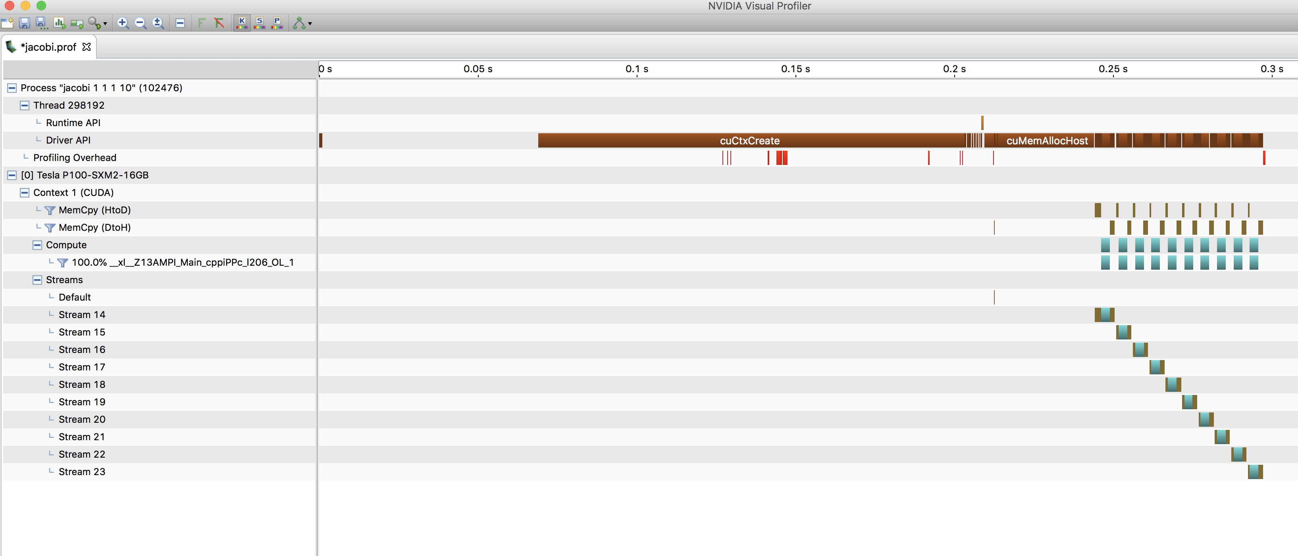
Nvidia Visual Profiler

Slide 12
Conclusions and next steps
OpenMP provides a simple way to use accelerators
Reasonable performance on GPUs compared to Cuda
Main challenge: comprehensive compiler support
Can be used easily in Charm++/AMPI
Next steps
Extend integrated LLVM-OpenMP to support offloading
Interface with GPU Manager

Slide 13
Questions?

