Slide 1
Migratable Objects and Task-Based Parallel Programming with Charm++

Slide 2
Challenges in Parallel Programming
Applications are getting more sophisticated
  Adaptive refinement
  Multi-scale, multi-module, multi-physics
  E.g. load imbalance emerges as a huge problem for some apps
Exacerbated by strong scaling needs from apps
  Strong scaling: run an application with same input data on more processors, and get better speedups
  Weak scaling: larger datasets on more processors in the same time
Hardware variability
  Static/dynamic
  Heterogeneity: processor types, process variation, etc.
  Power/Temperature/Energy
  Component failure

Slide 3
Our View
To deal with these challenges, we must seek:
  Not full automation
  Not full burden on app-developers
  But: a good division of labor between the system and app developers
    Programmer: what to do in parallel, System: where,when
Develop language driven by needs of real applications
  Avoid “platonic” pursuit of “beautiful” ideas
  Co-developed with NAMD, ChaNGa, OpenAtom,..
Pragmatic focus
  Ground-up development, portability,
  accessibility for a broad user base

Slide 4
What is Charm++?
Charm++ is a generalized approach to writing parallel programs
  An alternative to the likes of MPI, UPC, GA etc.
  But not to sequential languages such as C, C++, and Fortran
Represents:
  The style of writing parallel programs
  The runtime system
  And the entire ecosystem that surrounds it
Three design principles:
  Overdecomposition, Migratability, Asynchrony

Slide 5
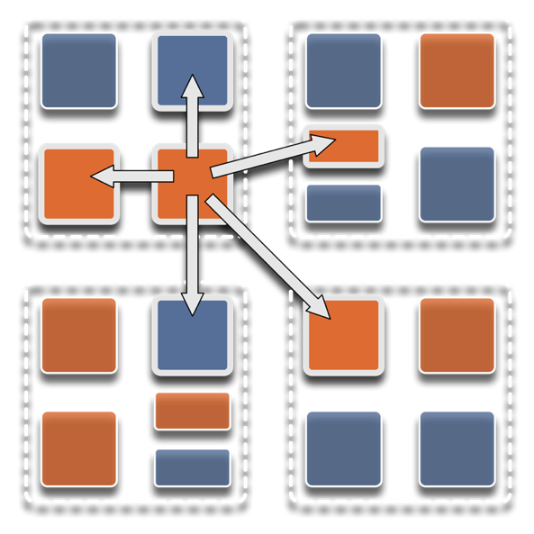
Overdecomposition
Decompose the work units & data units into many more pieces than execution units
  Cores/Nodes/…
Not so hard: we do decomposition anyway

Slide 6
Migratability
Allow these work and data units to be migratable at runtime
  i.e. the programmer or runtime can move them
Consequences for the application developer
  Communication must now be addressed to logical units with global names, not to physical processors
  But this is a good thing
Consequences for RTS
  Must keep track of where each unit is
  Naming and location management

Slide 7
Asynchrony: Message-Driven Execution
With over-decomposition and migratability:
  You have multiple units on each processor
  They address each other via logical names
Need for scheduling:
  What sequence should the work units execute in?
  One answer: let the programmer sequence them
    Seen in current codes, e.g. some AMR frameworks
  Message-driven execution:
    Let the work-unit that happens to have data (“message”) available for it execute next
    Let the RTS select among ready work units
    Programmer should not specify what executes next, but can influence it via priorities

Slide 8
Realization of This Model in Charm++
Overdecomposed entities: chares
  Chares are C++ objects
  With methods designated as “entry” methods
    Which can be invoked asynchronously by remote chares
  Chares are organized into indexed collections
    Each collection may have its own indexing scheme
      1D, ..., 6D
      Sparse
      Bitvector or string as an index
  Chares communicate via asynchronous method invocations
    A[i].foo(…);
      A is the name of a collection, i is the index of the particular chare.

Slide 9
Global Object Space
Processor 0
Processor 1
Scheduler
Scheduler
Message Queue
Message Queue
Processor 2
Processor 3
Scheduler
Scheduler
Message Queue
Message Queue

Slide 10
Message-driven Execution
A[23].foo(…)
Processor 0
Processor 1
Scheduler
Scheduler
Message Queue
Message Queue
Notes:
Certain member functions of certain classes are globally visible
Invocation of a member function may lead to communication

Slide 11
Processor 0
Processor 1
Scheduler
Scheduler
Message Queue
Message Queue
Processor 2
Processor 3
Scheduler
Scheduler
Message Queue
Message Queue

Slide 12
Processor 0
Processor 1
Scheduler
Scheduler
Message Queue
Message Queue
Processor 2
Processor 3
Scheduler
Scheduler
Message Queue
Message Queue

Slide 13
Processor 0
Processor 1
Scheduler
Scheduler
Message Queue
Message Queue
Processor 2
Processor 3
Scheduler
Scheduler
Message Queue
Message Queue

Slide 14
Empowering the RTS
Adaptive
Runtime System
Introspection
Adaptivity
Asynchrony
Overdecomposition
Migratability
The Adaptive RTS can:
  Dynamically balance loads
  Optimize communication:
    Spread over time, async collectives
  Automatic latency tolerance
  Prefetch data with almost perfect predictability

Slide 15
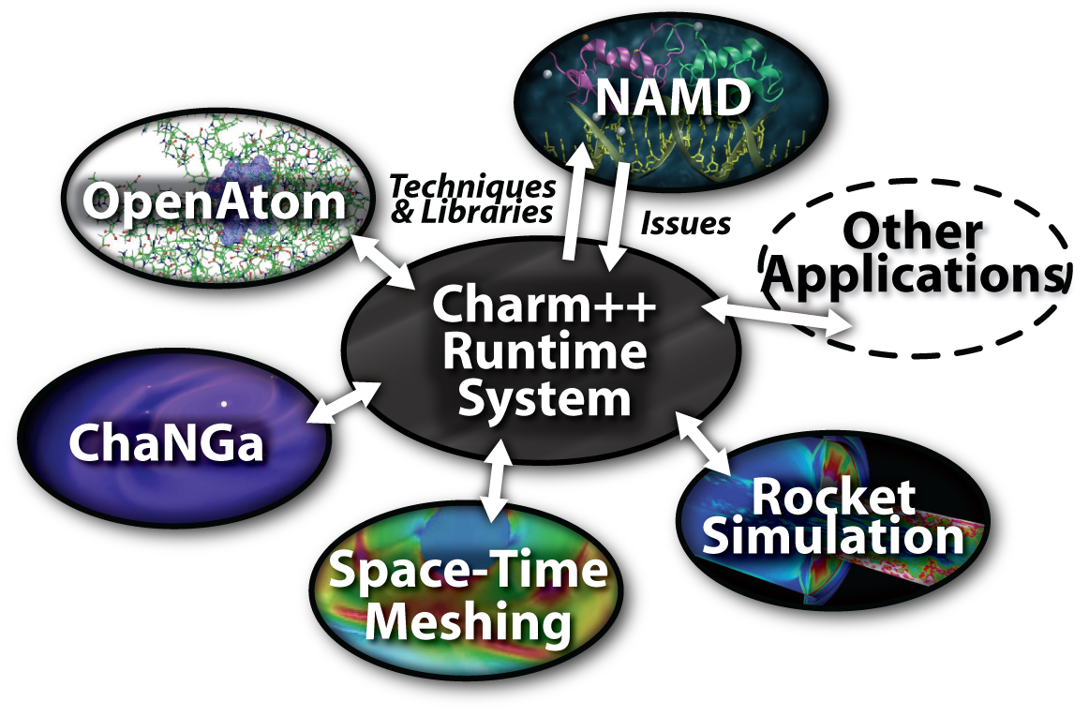
Charm++ and CSE Applications
Well-known Biophysics Molecular Simulation App
Gordon Bell Award, 2002
Nano-Materials
Synergy
Enabling CS technology of parallel objects and intelligent runtime systems has led to several CSE collaborative applications
Computational Astronomy

Slide 16
Summary: What is Charm++?
Charm++ is a way of parallel programming
It is based on:
  Objects
  Overdecomposition
  Asynchrony
    Asynchronous method invocations
  Migratability
  Adaptive runtime system
It has been co-developed synergistically with multiple CSE applications

Slide 17
Grainsize
Charm++ philosophy:
  Let the programmer decompose their work and data into coarse-grained entities
It is important to understand what I mean by coarse-grained entities
  You don’t write sequential programs that some system will auto-decompose
  You don’t write programs when there is one object for each float
  You consciously choose a grainsize, but choose it independently of the number of processors
    Or parameterize it, so you can tune later

Slide 18
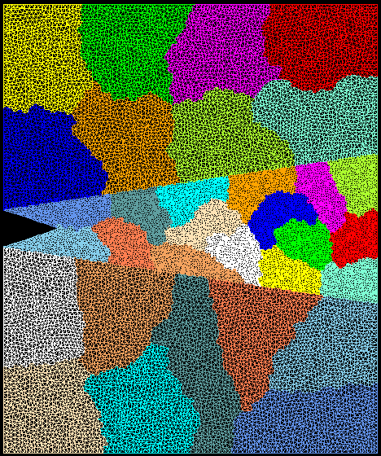
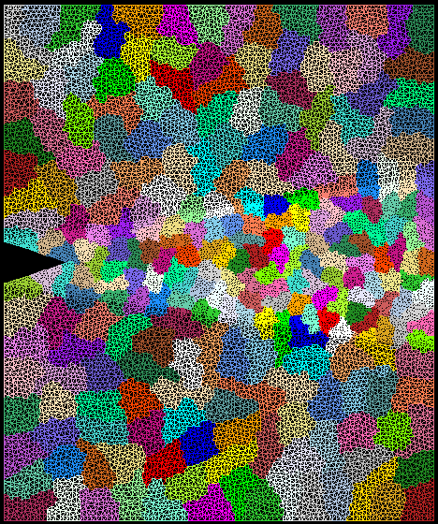
Crack Propagation
This is 2D, circa 2002...
but shows overdecomposition for unstructured meshes
Decomposition into 16 chunks (left) and 128 chunks, 8 for each PE (right). The middle area contains cohesive elements. Both decompositions obtained using Metis. Pictures: S. Breitenfeld, and P. Geubelle

Slide 19
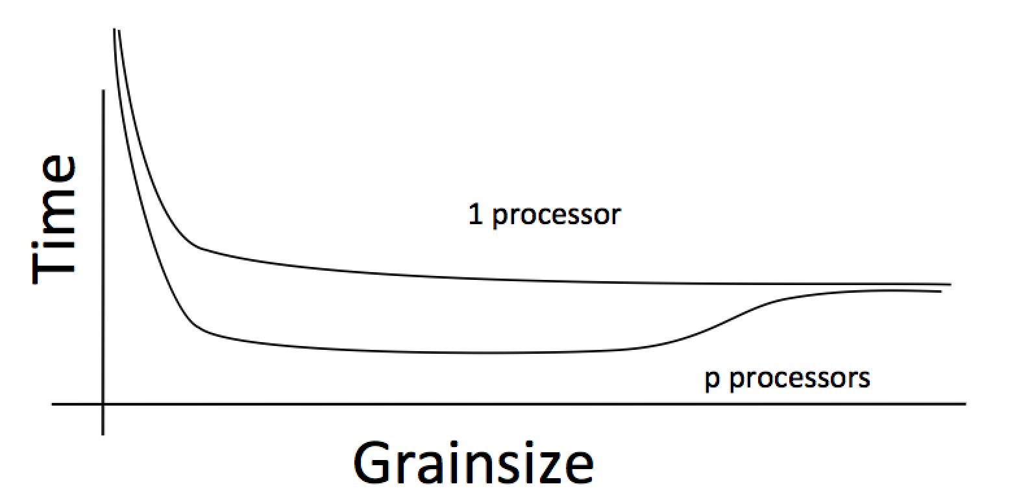
Working definition of grainsize:
amount of computation per remote interaction
Choose grainsize to be just large enough to amortize the overhead

Slide 20
Grainsize in a common setting
2 MB/chare,
256 objects per core
number of points per chare

Slide 21
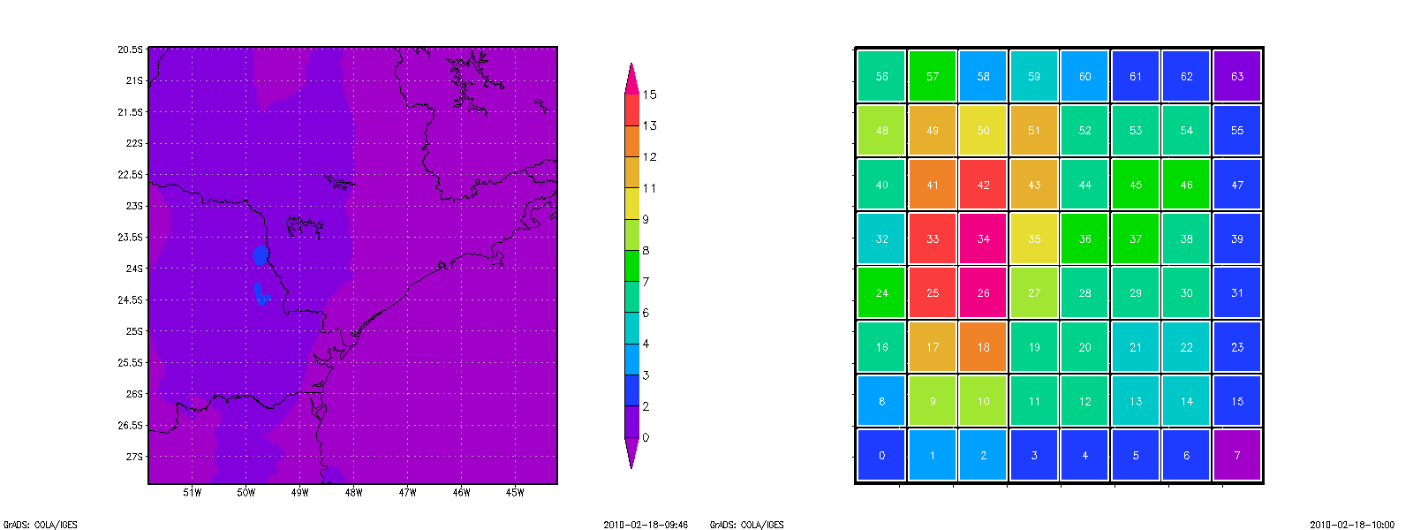
Grainsize: Weather Forecasting in BRAMS
BRAMS: Brazillian weather code (based on RAMS)
AMPI version (Eduardo Rodrigues, with Mendes, J. Panetta, ..)
Instead of using 64 work units on 64 cores, used 1024 on 64

Slide 22
Baseline: 64 Objects

Slide 23
Overdecomposition: 1024 Objects
Benefits from communication/computation overlap

Slide 24
With Load Balancing: 1024 objects
No overdecomp (64 threads) | 46 sec
+ Overdecomposition (1024 threads) | 33 sec
+ Load balancing (1024 threads) | 27 sec

Slide 25
Rules of Thumb for Grainsize
Make it as small as possible, as long as it amortizes the overhead
More specifically, ensure:
  Average grainsize is greater than kv (for some k, say 10v)
    v: overhead per message
  No single grain should be allowed to be too large
    Must be smaller than T/p, where p: number of processors, T: sequential execution time
    Can generalize by saying must be smaller than kmv (say 100v)
Important corollary:
  You can be at close to optimal grainsize without having to think about p, the number of processors

Slide 26
Charm++ Benefits
Overdecomposition
Scalable tools
Automatic overlap of communication and computation
Message-driven execution
Perfect prefetch
Compositionality
Emulation for performance prediction
Migratability
Fault tolerance
Dynamic load balancing (topology-aware, scalable)
Introspective and adaptive runtime system
Temperature/power/energy optimizations

Slide 27
Locality and Prefetch
Objects connote and promote locality
Message-driven execution
  A strong principle of prediction for data and code use
  Much stronger than principle of locality
    Can use to scale memory wall:
    Prefetching of needed data:
      Into scratchpad memories, for example
Processor 1
Scheduler
Message Queue
Notes:
Replace figure with a new drawing

Slide 28
Impact on Communication
Current use of communication network:
  Compute-communicate cycles in typical MPI apps
  The network is used for a fraction of time
    And is on the critical path
Current communication networks are over-engineered by necessity
P1
P2
BSP based application

Slide 29
Impact on Communication
With overdecomposition:
  Communication is spread over an iteration
  Adaptive overlap of communication and computation
P1
P2
Overdecomposition enables overlap

Slide 30
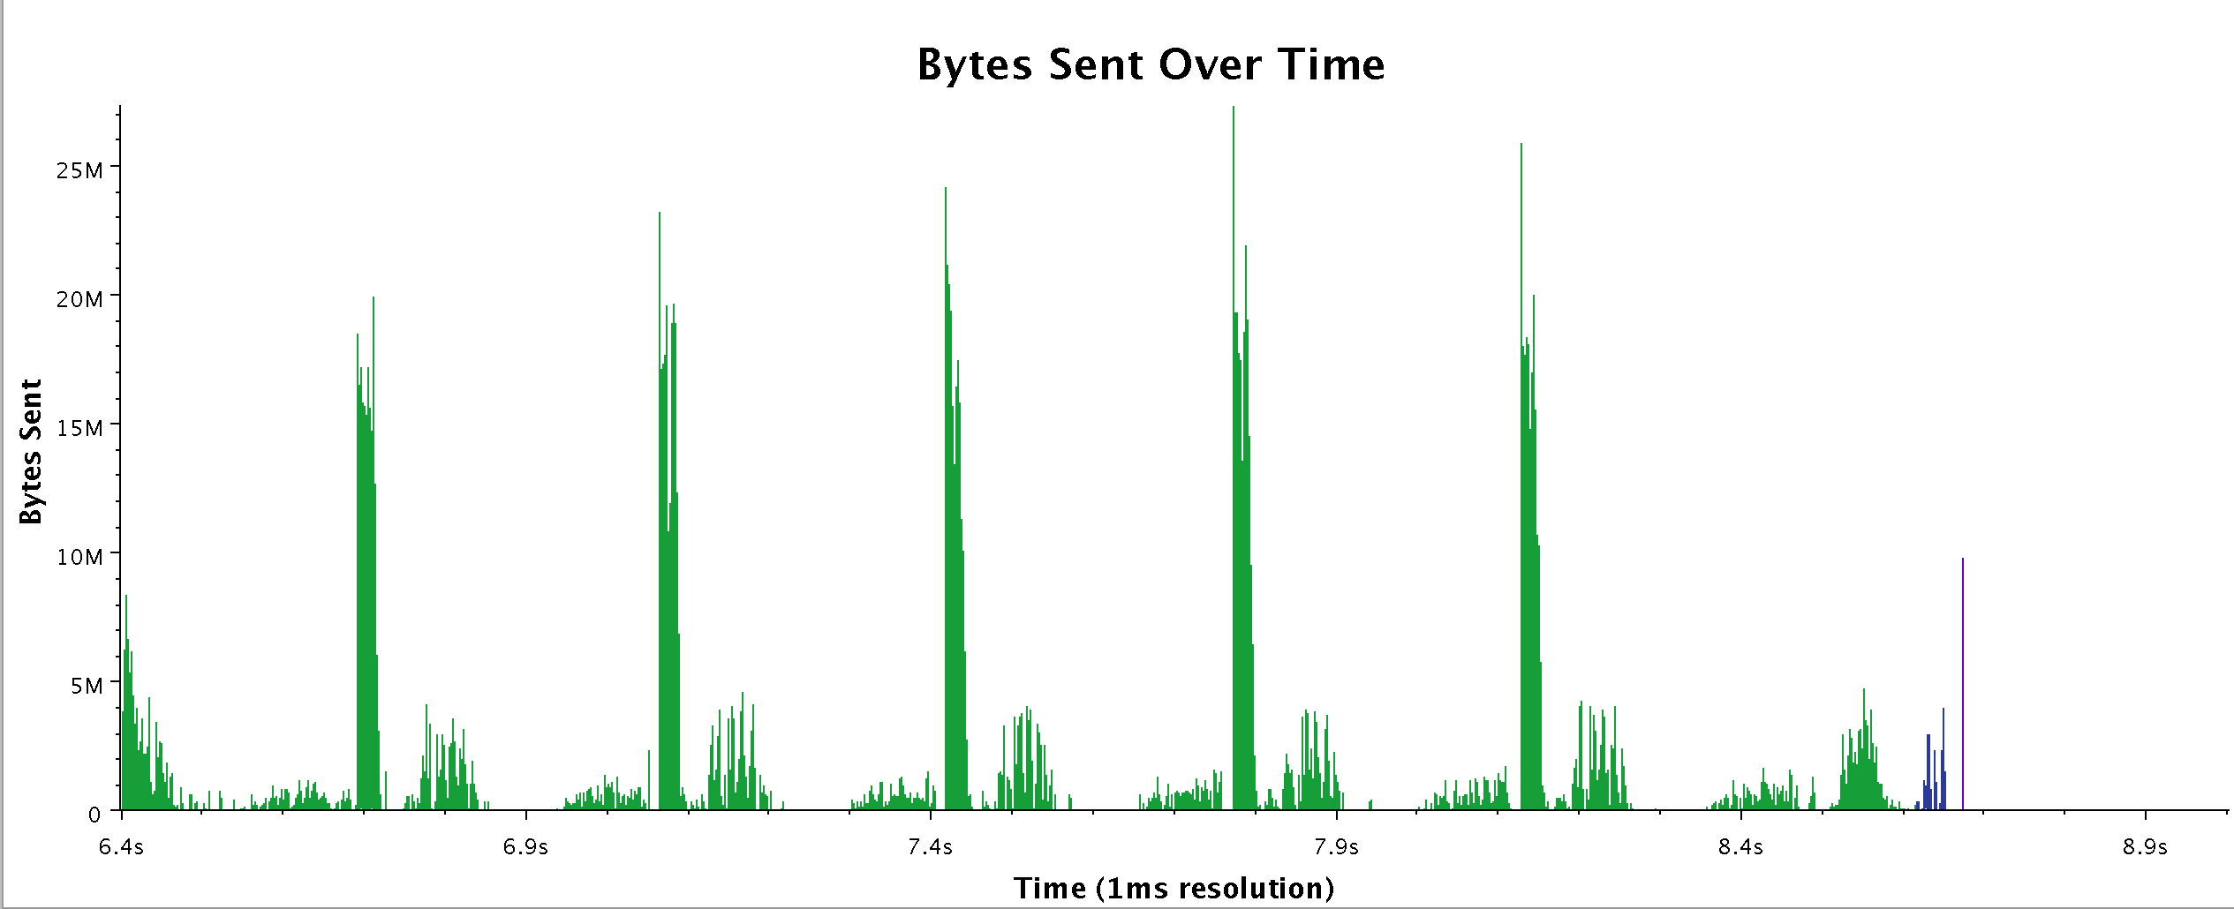
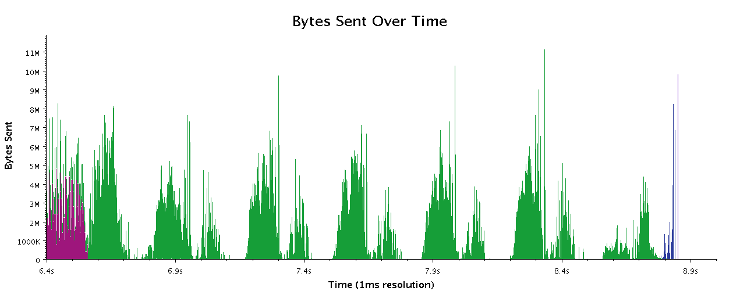
Communication Data from Chombo
Work by Phil Miller
Chombo with reductions
Chombo on Charm (experimental)

Slide 31
Decomposition Challenges
Current method is to decompose to processors
  This has many problems
  Deciding which processor does what work in detail is difficult at large scale
Decomposition should be independent of number of processors – enabled by object based decomposition
Let runtime system (RTS) assign objects to available resources adaptively

Slide 32
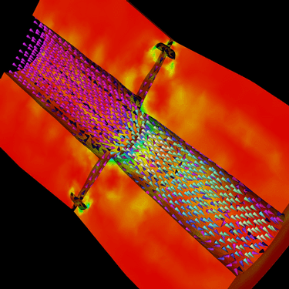
Decomposition Independent of numCores
Rocket simulation example under traditional MPI
With migratable-objects:
  Benefit: load balance, communication optimizations, modularity
Solid
Solid
. . .
Solid
Fluid
Fluid
Fluid
1 2 P
Solid₁
Solid₂
Solid₃
. . .
Solid_{n}
Fluid₁
Fluid₂
. . .
Fluid_{m}
Notes:
32
In traditional MPI paradigm. The number of partitions of both modules is typically equal to the number of processor P
And although the i’th elements of fluid module and solid module are not connected geometrically in the simulation, they are glued together on the I’th processor.
Under Charm++/AMPI framework, the two modules each get their own set of parallel objects. And the size of the arrays are not restricted or related.
The benefit of this is performance optimizations and better modularity.
Problem: due to the asynchronous method invocation, the flow of control is buried deep into the object code

Slide 33
Compositionality
It is important to support parallel composition
  For multi-module, multi-physics, multi-paradigm applications…
What I mean by parallel composition
  B || C where B, C are independently developed modules
  B is parallel module by itself, and so is C
  Programmers who wrote B were unaware of C
  No dependency between B and C
This is not supported well by MPI
  Developers support it by breaking abstraction boundaries
    E.g., wildcard recvs in module A to process messages for module B
  Nor by OpenMP implementations

Slide 34
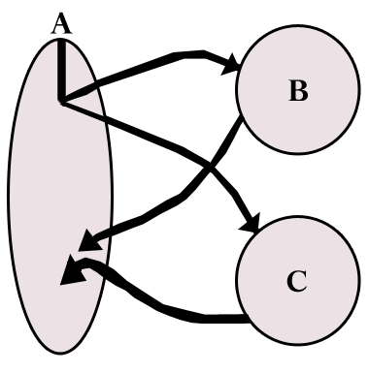
Without message-driven execution (and virtualization), you get either:
Space-division
B
C
Time
Notes:
Replace “scanned” diagram on the left with a better one, in all the slides that use this.

Slide 35
OR: Sequentialization
B
C
Time

Slide 36
Parallel Composition: A1; (B || C ); A2
  Recall: different modules, written in different languages/paradigms, can overlap in time and on processors, without programmer having to worry about this explicitly

Slide 37
Hello World Example
hello.ci file
hello.cpp file
mainmodule hello {
mainchare Main {
entry Main(CkArgMsg ∗m);
};
};
#include <stdio.h>
#include “hello.decl.h”
class Main : public CBase_Main {
public: Main(CkArgMsg∗ m) {
ckout << “Hello World!” << endl;
CkExit();
};
};
#include “hello.def.h”
Notes:
Structure of charm program
Include decl and def files, generated code
Inherit from generated chare class

Slide 38
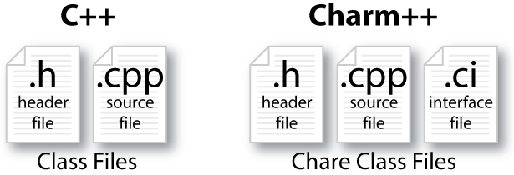
Charm++ File Structure
C++ objects (including Charm++ objects)
  Defined in regular .h and .C files
Chare objects, entry methods (asynchronous methods)
  Defined in .ci file
  Implemented in the .C file
Hello World Example
Compiling
  charmc hello.ci
  charmc -c hello.C
  charmc -o hello hello.o
Running
  ./charmrun +p7 ./hello
  The +p7 tells the system to use seven cores

Slide 39
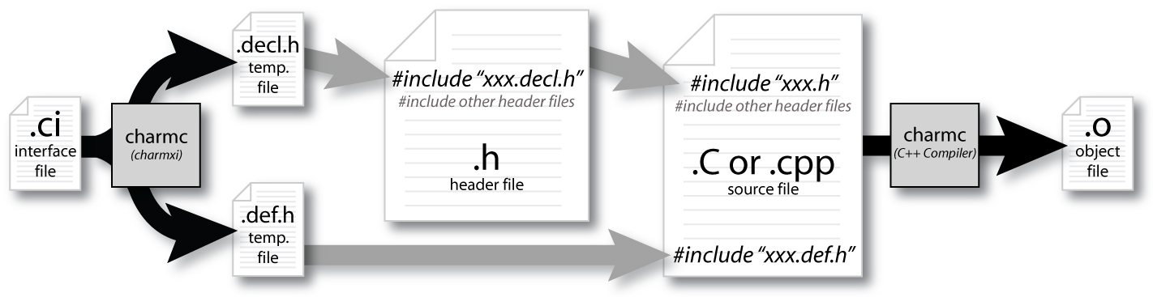
Compiling a Charm++ Program

Slide 40
Charm Interface: Modules
Charm++ programs are organized as a collection of modules
Each module has one or more chares
The module that contains the mainchare is declared as the mainmodule
Each module, when compiled, generates two files: MyModule.decl.h and MyModule.def.h
.ci file
[main]module MyModule {
//... chare definitions ...
};

Slide 41
Charm Interface: Chares
Chares are parallel objects that are managed by the RTS
Each chare has a set of entry methods, which are asynchronous methods that may be invoked remotely
The following code, when compiled, generates a C++ class CBase_MyChare that encapsulates the RTS object
This generated class is extended and implemented in the .cpp file
.ci file
.cpp file
[main]chare MyChare {
//... entry method definitions ...
};
class MyChare : public CBase_MyChare {
//... entry method implementations ...
};

Slide 42
Charm Interface: Entry Methods
Entry methods are C++ methods that can be remotely and asynchronously invoked by another chare
.ci file
.cpp file
entry MyChare(); /∗ constructor entry method ∗/
entry void foo();
entry void bar(int param);
MyChare::MyChare() { /∗... constructor code ...∗/ }
MyChare::foo() { /∗... code to execute ...∗/ }
MyChare::bar(int param) { /∗... code to execute ...∗/ }

Slide 43
Charm Interface: mainchare
Execution begins with the mainchare’s constructor
The mainchare’s constructor takes a pointer to system-defined class CkArgMsg
CkArgMsg contains argv and argc
The mainchare will typically creates some additional chares

Slide 44
Creating a Chare
A chare declared as chare MyChare {...}; can be instantiated by the following call:
To communicate with this class in the future, a proxy to it must be retained
CProxy_MyChare::ckNew(…constructor arguments…);
CProxy_MyChare proxy = CProxy_MyChare::ckNew(arg1);

Slide 45
Chare Proxies
A chare’s own proxy can be obtained through a special variable thisProxy
Chare proxies can also be passed so chares can learn about others
In this snippet, MyChare learns about a chare instance main, and then invokes a method on it:
.ci file
.cpp file
entry void foobar(CProxy_Main main);
MyChare::foobar(CProxy_Main main) {
main.foo();
}

Slide 46
Hello World with Chares
hello.ci
hello.cpp
mainmodule hello {
mainchare Main {
entry Main(CkArgMsg ∗m);
};
chare Singleton {
entry Singleton();
};
};
#include <stdio.h>
#include “hello.decl.h”
class Main : public CBase_Main {
public: Main(CkArgMsg∗ m) {
CProxy_Singleton::ckNew();
};
};
class Singleton : public CBase_Singleton {
public: Singleton() {
ckout << “Hello World!” << endl;
CkExit();
};
};
#include “hello.def.h”
Notes:
CkExit global termination

Slide 47
Charm Termination
There is a special system call CkExit() that terminates the parallel execution on all processors (but it is called on one processor) and performs the requisite cleanup
The traditional exit() is insufficient because it only terminates one process, not the entire parallel job (and will cause a hang)
CkExit() should be called when you can safely terminate the application (you may want to synchronize before calling this)
SC'17

Slide 48
Chare Creation Example: .ci file
mainmodule MyModule {
mainchare Main {
entry Main(CkArgMsg ∗m);
};
chare Simple {
entry Simple(int x, double y);
};
};

Slide 49
Chare Creation Example: .cpp file
#include “MyModule.decl.h”
class Main : public CBase_Main {
public: Main(CkArgMsg∗ m) {
ckout << “Hello World!” << endl;
CProxy_Simple::ckNew(12, 3.1415);
} };
class Simple : public CBase_Simple {
public: Simple(int x, double y) {
ckout << “Radius:” << x << “, Area:” << y*x*x << endl;
CkExit();
} };
#include “MyModule.def.h”

Slide 50
Asynchronous Methods
Entry methods are invoked by performing a C++ method call on a chare’s proxy
The foo and bar methods will then be executed with the arguments, wherever the created chare, MyChare, happens to live
The policy is one-at-a-time scheduling (that is, one entry method on one chare executes on a processor at a time)
CProxy_MyChare proxy =
CProxy_MyChare::ckNew(…constructor arguments…);
proxy.foo();
proxy.bar(5);

Slide 51
Asynchronous Methods
Method invocation is not ordered (between chares, entry methods on one chare, etc.)!
For example, if a chare executes this code:
These prints may occur in any order
CProxy_MyChare proxy = CProxy_MyChare::ckNew();
proxy.foo(); proxy.bar(5);
MyChare::foo() {
ckout << “foo executes” << endl;
}
MyChare::bar(int param) {
ckout << “bar executes with ” << param << endl;
}

Slide 52
Asynchronous Methods
For example, if a chare invokes the same entry method twice
These may be delivered in any order
Output
proxy.bar(7);
proxy.bar(5);
MyChare::bar(int param) {
ckout << “bar executes with ” << param << endl;
}
bar executes with 5
bar executes with 7
bar executes with 7
bar executes with 5
or

Slide 53
Asynchronous Example: .ci file
mainmodule MyModule {
mainchare Main {
entry Main(CkArgMsg ∗m);
};
chare Simple {
entry Simple(double y);
entry void findArea(int radius, bool done);
};
};

Slide 54
Does this program execute correctly?
struct Main : public CBase_Main {
Main(CkArgMsg∗ m) {
CProxy_Simple sim = CProxy_Simple::ckNew(3.1415);
for (int i = 1; i < 10; i++) sim.findArea(i, false);
sim.findArea(10, true); } };
struct Simple : public CBase_Simple {
double y;
Simple(double pi) { y = pi; }
void findArea(int r, bool done) {
ckout << “radius: ” << r << “Area:” << y∗r∗r << endl;
if (done) CkExit(); } };

Slide 55
No! Methods are Asynchronous
If a chare invokes several entry methods
These may be delivered in any order
Output:
radius: 254.34
radius: 200.96
radius: 28.26
radius: 3.14
radius: 12.56
radius: 153.86
radius: 50.24
radius: 78.50
radius: 314.00
radius: 28.26
radius: 78.50
radius: 3.14
radius: 113.04
radius: 314.00
sim.findArea(1, false);
...
sim.findArea(10, true);
or
Simple::findArea(int r, bool done){
ckout << “radius: ” << r <<
“Area:” << y∗r∗r << endl;
if (done) CkExit(); } };
if (count++ = 10) CkExit(); } };
Notes:
Change bool to count

Slide 56
Readonly Variables
The only global variables officially allowed in a Charm++ program are readonly variables
  readonlys can be modified only in the constructor of the main chare
    And from any functions called from them (not entry methods)
  After the constructor finishes, before any other chares execute any methods, the readonly variables are available on all processors
Declare a readonly in .ci file and also in the .cpp file
  In .ci: readonly int grainSize;
  In .cpp, just a normal declaration

Slide 57
Data Types and Entry Methods
You can pass basic C++ types to entry methods (int, char, bool)
C++ STL data structures can be passed by including pup_stl.h
Arrays of basic data types can also be passed like this:
.ci file:
.cpp file
entry void foobar(int length, int data[length]);
MyChare::foobar(int length, int∗ data) {
// ... foobar code ...
}

Slide 58
Hands-On Exercise 0. Fibonacci
charm.cs.illinois.edu/tutorial_ecp18/
  LCF Users: login and clone exercises
  AWS Users: claim instance and login
    Login: ssh –Y tutorial@<MY_IP_ABOVE>
    Password: vXStB3yB
Exercise: ecp18/ex0 (compile and run)
  Detailed instructions in README

Slide 59
Guidelines for Hands-On Exercises
The AWS image contains the following:
  charm
    Charm++ source code, version 6.8.2
  charm_tutorial_exercises
  projections
    For Exercises 3-1 & 3-2
  ccs_tools
    For Exercise 3-3

Slide 60
Guidelines for Hands-On Exercises
Building Charm++ and AMPI on your machine
  Clone the source code and build:
    Linux: ./build LIBS netlrts-linux-x86_64
    Mac: ./build LIBS netlrts-darwin-x86_64
    Windows: Utilize putty to log in to an AWS instance
  Add –j<numtasks> at the end to parallelize build (a la make)
  Export CHARM_DIR as the path to the Charm++ folder

Slide 61
Chare Arrays
Indexed collections of chares
  Every item in the collection has a unique index and proxy
  Can be indexed like an array or by an arbitrary object
  Can be sparse or dense
  Elements may be dynamically inserted and deleted
For many scientific applications, collections of chares are a convenient abstraction
Instead of creating networks of chares that learn about each other (by sending proxies to each other), each element in a chare array knows about all the others

Slide 62
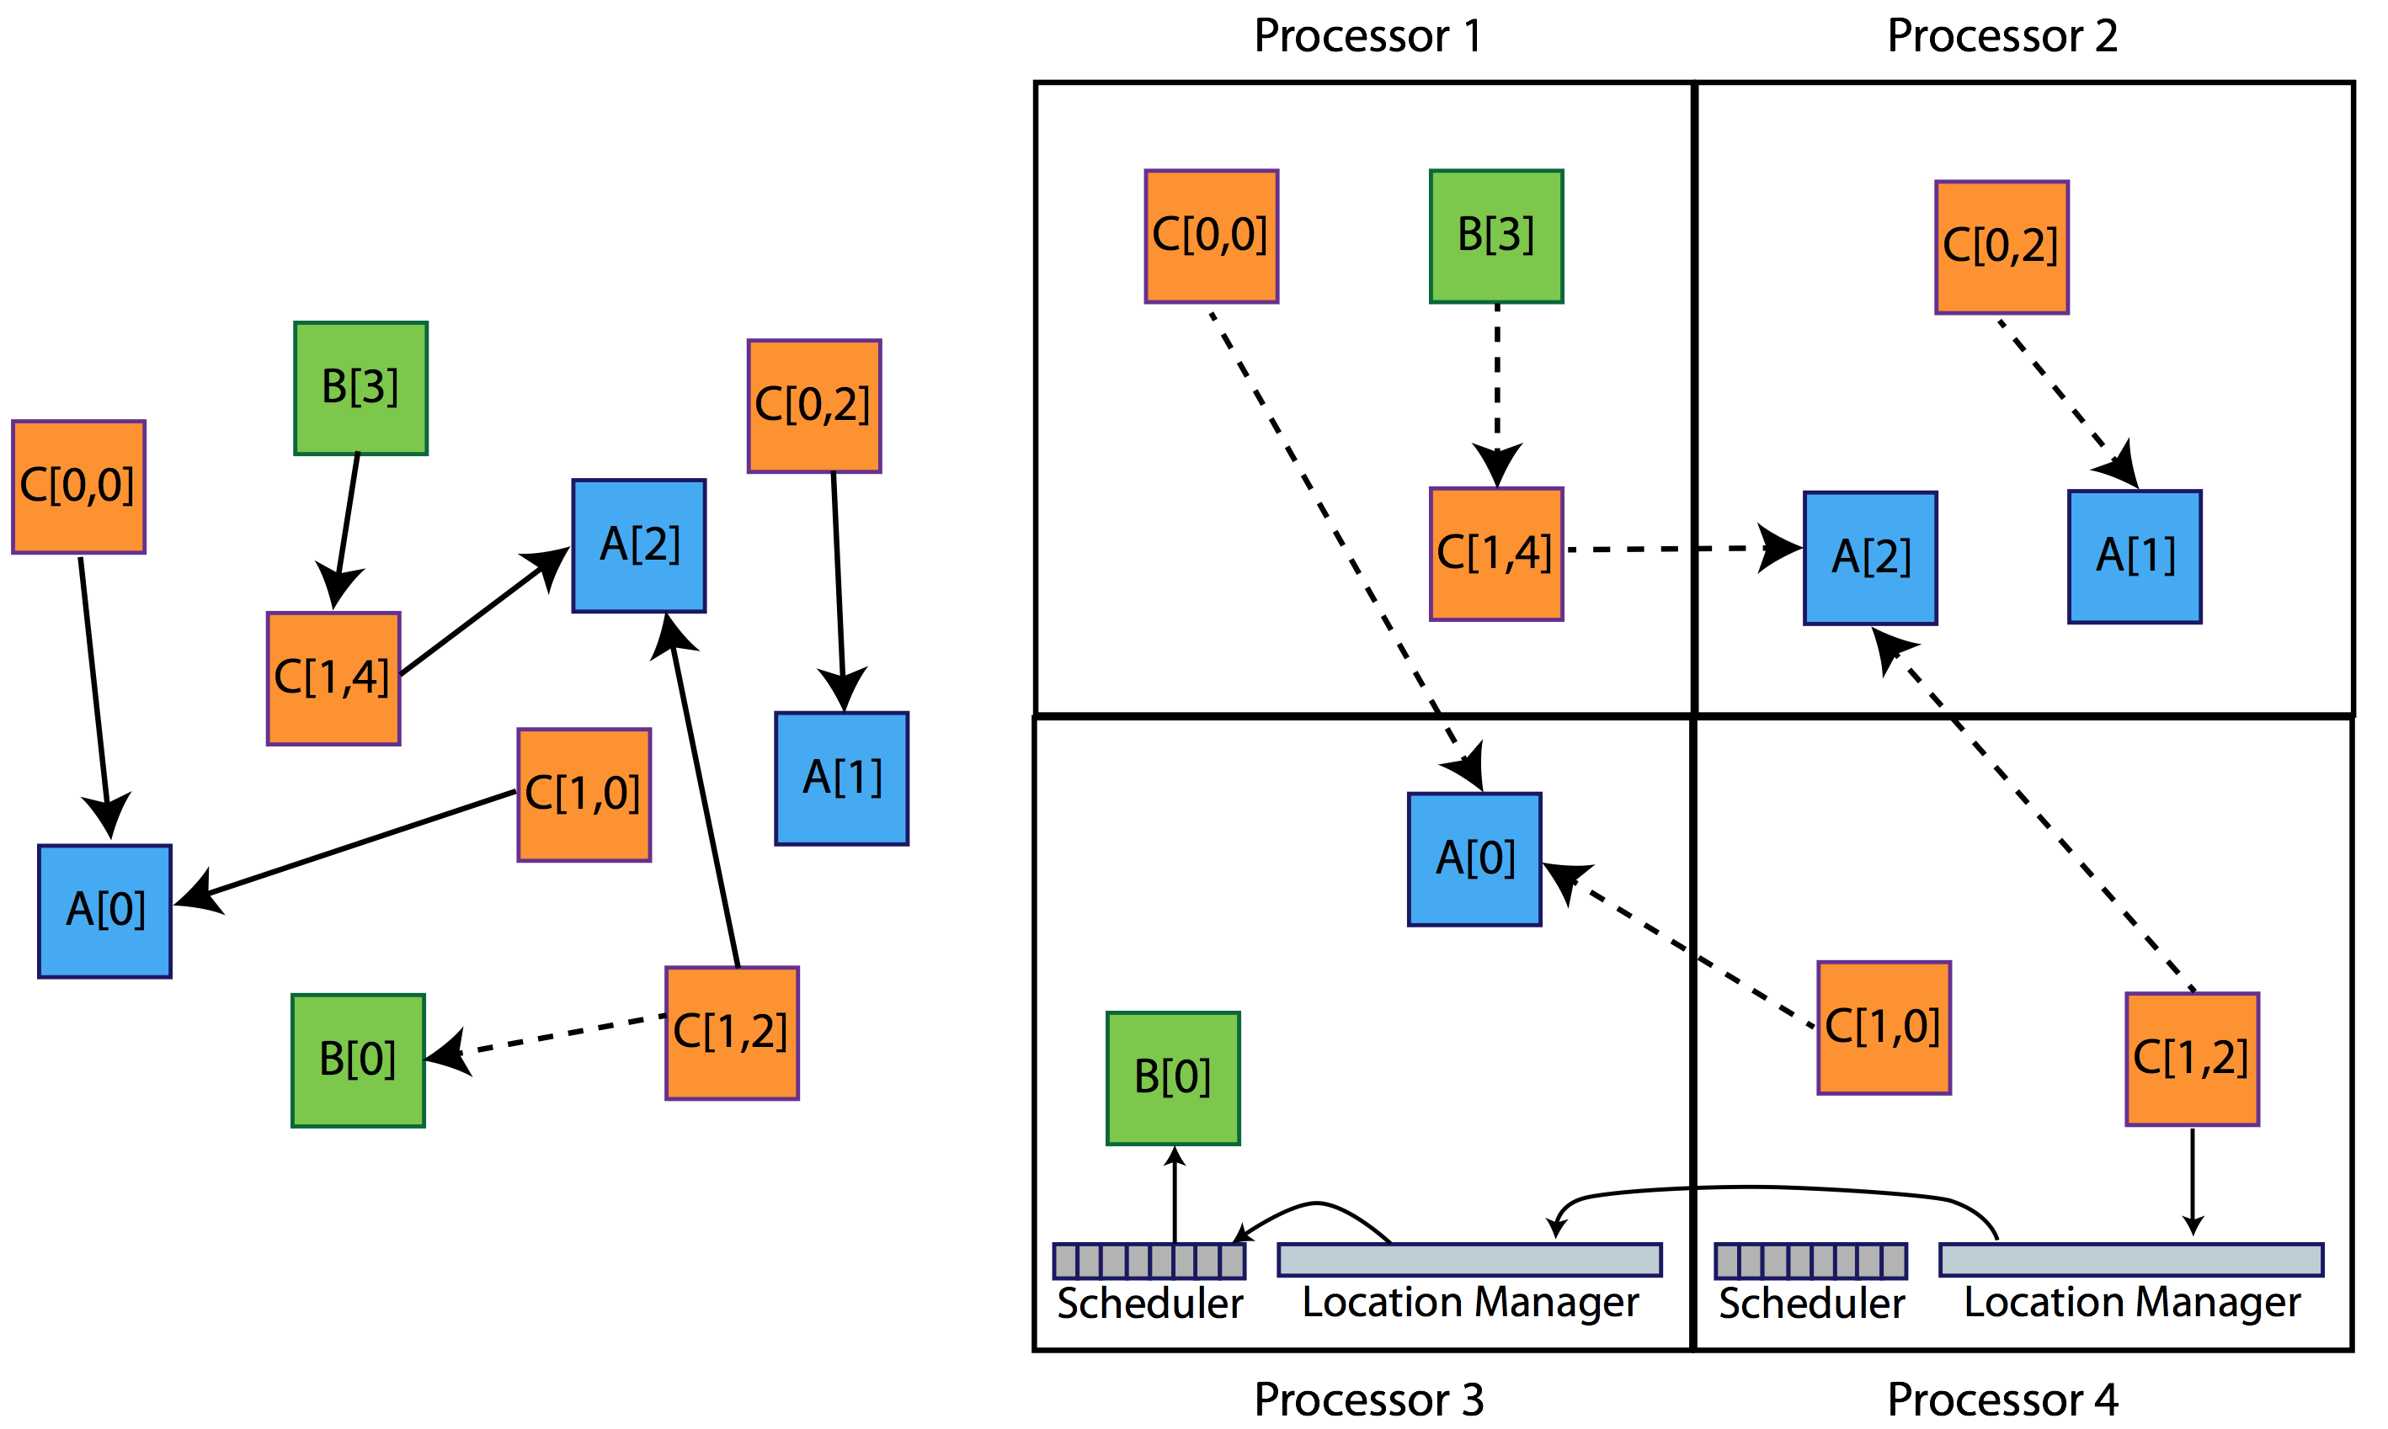
Collections of Objects

Slide 63
Managing Object Placement
System knows how to “find” objects efficiently:
(collection, index) → processor
Applications can specify a custom mapping or use simple runtime-provided options (e.g. blocked, round-robin)
Distribution can be static or dynamic!
Key abstraction: application logic doesn’t change, even though performance might

Slide 64
Managing Object Placement
Application logic development decoupled from any notion of processors or object mapping
Separation in time: make it work, then make it fast
Division of labor: domain specialist writes object code, CS specialist writes mapping
Portability: different mappings for different systems, scales, or configurations

Slide 65
Adaptive MPI Tutorial

Slide 66
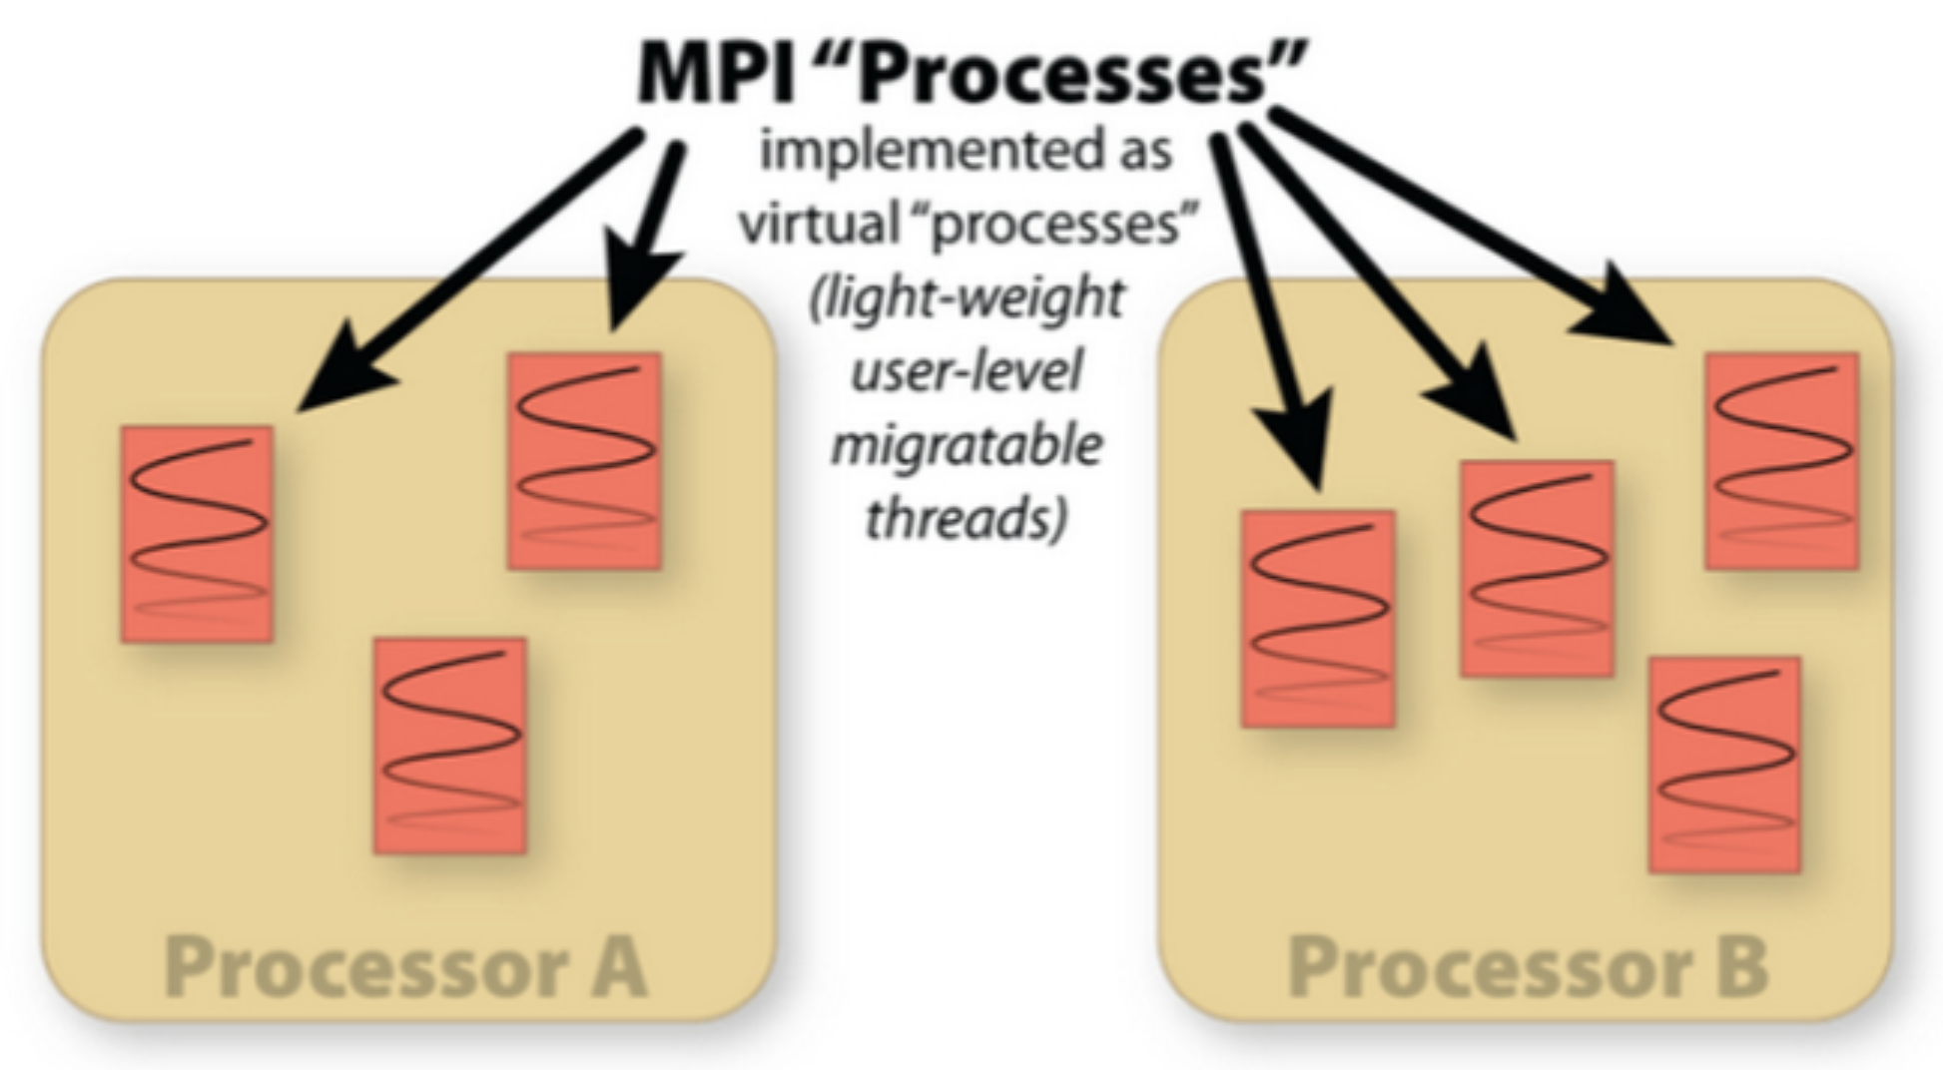
What is Adaptive MPI?
AMPI is an MPI implementation on top of Charm++’s runtime system
  Enables Charm++’s dynamic features for pre-existing MPI codes

Slide 67
Process Virtualization
AMPI virtualizes MPI “ranks”, implementing them as migratable user-level threads rather than OS processes
  Benefits:
    Communication/computation overlap
    Cache benefits to smaller working sets
    Dynamic load balancing
    Lower latency messaging within a process
  Disadvantages:
    Global/static variables are shared by all threads in an OS process scope
      AMPI provides support for automating this at compile/run-time
      Ongoing work to fully automate

Slide 68
Dynamic Load Balancing
AMPI ranks are migratable across address spaces at runtime
  Add a call to AMPI_Migrate(MPI_Info) where info is the following:
    MPI_Info_set(info, “ampi_load_balance”, “sync”);
Isomalloc memory allocator
  User-level thread stack + heap
  Reserves globally unique slices of virtual memory on each process for all ranks
  No need for Pack/UnPack routines
  Works on all 64-bit platforms except BGQ & Windows

Slide 69
Fault Tolerance
AMPI ranks can be migrated to persistent storage or in remote memories for fault tolerance
  Storage can be Disk, SSD, NVRAM, etc.
  Online fault detection and recovery
Just pass a different MPI_Info to AMPI_Migrate()
  MPI_Info_set(info1, “ampi_checkpoint”, “in_memory”);
  MPI_Info_set(info2, “ampi_checkpoint”, “to_file=dir_name”);

Slide 70
Compiling & Running AMPI Programs
To compile an AMPI program:
  charm/bin/ampicc –o pgm pgm.o
  For migratability, link with: -memory isomalloc
  For LB strategies, link with: –module CommonLBs
To run an AMPI job, specify the # of virtual processes (+vp)
  ./charmrun +p 1024 ./pgm
  ./charmrun +p 1024 ./pgm +vp 16384
  ./charmrun +p 1024 ./pgm +vp 16384 +balancer RefineLB

Slide 71
AMPI Tutorial
Steps:
  Build and run the LULESH mini-app on AMPI
  Experiment with varying degrees of virtualization (#ranks/core)
  Add calls to create MPI_Info for LB and to AMPI_Migrate()
  Experiment with dynamic load balancing (frequency, strategy)
  Use Projections to visualize and analyze performance
Get started:
  AMPI is distributed with Charm++, and is already built in the pre-installed versions we have provided
  Exercise in ecp18/ex1; see README for more instructions

Slide 72
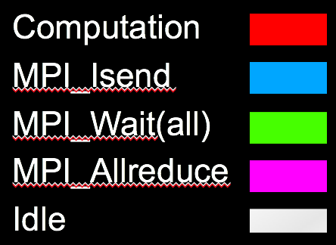
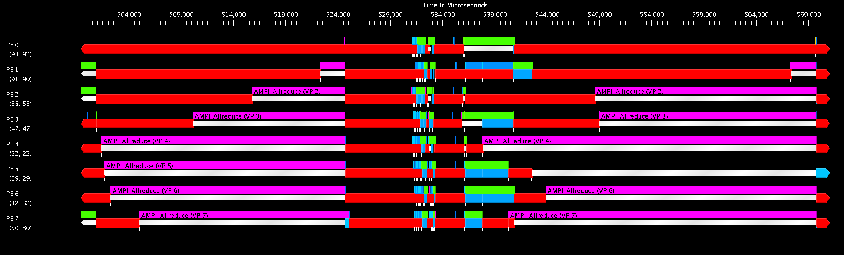
Without Virtualization & LB
Load imbalance appears during pt2pt messaging and in MPI_Allreduce each timestep

Slide 73
Without Virtualization & LB
Communication/computation cycles mean the network is underutilized most of the time

Slide 74
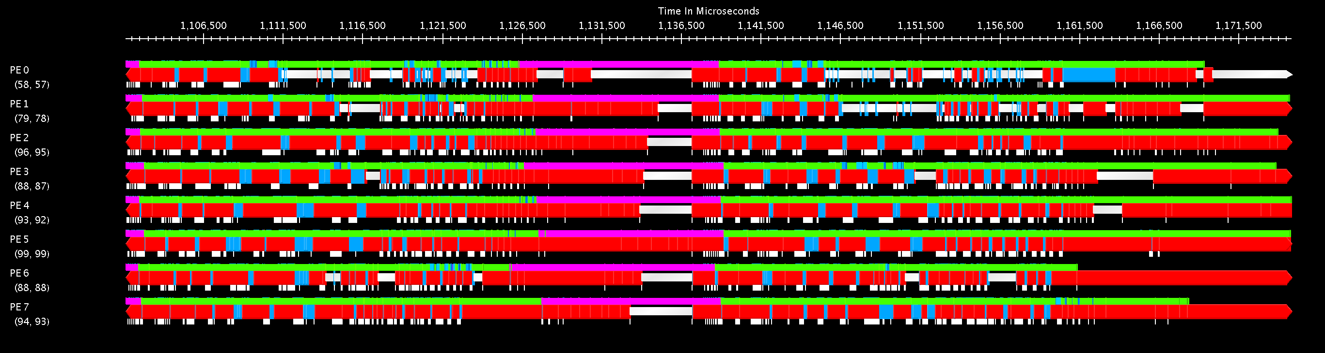
With 8x Virtualization & LB
Most of the idle time due to pt2pt messaging and MPI_Allreduce is now hidden by computation

Slide 75
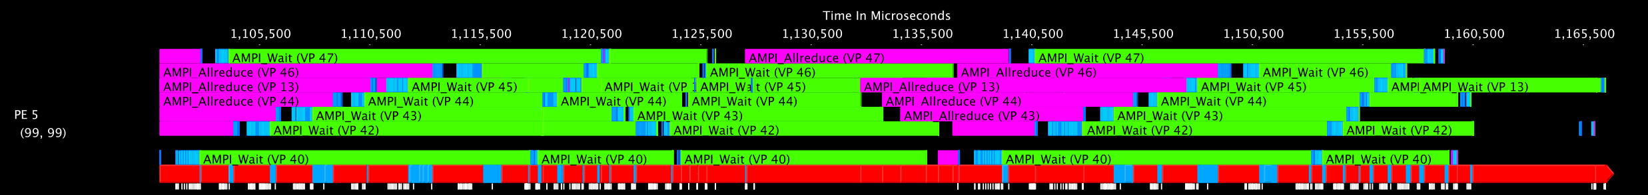
With 8x Virtualization & LB
The communication of each virtual rank is overlapped with the computation of others scheduled on the same core
  Projections allows viewing all virtual ranks on a PE, not only what is currently scheduled on one
    In Projections Timeline, select: View -> Show Nested Bracketed User Events

Slide 76
With 8x Virtualization & LB
Communication is spread over the whole timestep
  Peak network bandwidth used is reduced by 3x

Slide 77
Summary
AMPI provides the dynamic RTS support of Charm++ with the familiar API of MPI
  Communication optimizations
  Dynamic load balancing
  Automatic fault tolerance
  Checkpoint/restart
  OpenMP runtime integration
See the AMPI Manual for more info.

Slide 78
Chare Arrays
Indexed collections of chares
  Every item in the collection has a unique index and proxy
  Can be indexed like an array or by an arbitrary object
  Can be sparse or dense
  Elements may be dynamically inserted and deleted
For many scientific applications, collections of chares are a convenient abstraction
Instead of creating networks of chares that learn about each other (by sending proxies to each other), each element in a chare array knows about all the others

Slide 79
Chare Array Location
By default, chare arrays are distributed across the available processors
Chare array elements can be migrated by the user or the runtime (load balancing)

Slide 80
Declaring a Chare Array
.ci file:
.cpp file:
array [1d] foo {
entry foo(); // constructor
// … entry methods …
}
array [2d] bar {
entry bar(); // constructor
// … entry methods …
}
struct foo : public CBase_foo {
foo() { }
foo(CkMigrateMessage∗) { }
// … entry methods …
};
struct bar : public CBase_bar {
bar() { }
bar(CkMigrateMessage∗) { }
// … entry methods …
};

Slide 81
Constructing a Chare Array
Constructed much like a regular chare
The size of each dimension is passed to the constructor at the end
The proxy doesn’t have to be retained:
The proxy represents the entire array, and may be indexed to obtain a proxy to an individual element in the array
void someMethod() {
CProxy_foo myFoo = CProxy_foo::ckNew(<params>, 10); // 1d, size 10
CProxy_bar myBar = CProxy_bar::ckNew(<params>, 5, 5); // 2d, size 5x5
}
CProxy_foo::ckNew(10);
myFoo[4].invokeEntry(…);
myBar(2,4).method3(…);

Slide 82
thisIndex
1d: thisIndex returns the index of the current chare array element
2d: thisIndex.x and thisIndex.y return the indices of the current chare array element
.ci file:
.cpp file:
array [1d] foo {
entry foo();
}
struct foo : public CBase_foo {
foo() {
CkPrintf(“array index = %d”, thisIndex);
}
};

Slide 83
Chare Array: Hello Example
mainmodule arr {
mainchare Main {
entry Main(CkArgMsg∗);
}
array [1D] hello {
entry hello(int);
entry void printHello();
}
}

Slide 84
Chare Array: Hello Example
#include “arr.decl.h”
struct Main : CBase_Main {
Main(CkArgMsg∗ msg) {
int arraySize = atoi(msg->argv[1]);
CProxy_hello p = CProxy_hello::ckNew(arraySize, arraySize);
p[0].printHello();
}
};
struct hello : CBase_hello {
int arraySize;
hello(int n) : arraySize(n) { }
void printHello() {
CkPrintf(“PE[%d]: hello from p[%d]\n”, CkMyPe(), thisIndex);
if (thisIndex == arraySize – 1) CkExit();
else thisProxy[thisIndex + 1].printHello();
}
};
#include “arr.def.h”

Slide 85
Managing Object Placement
System knows how to “find” objects efficiently:
(collection, index) → processor
Applications can specify a custom mapping or use simple runtime-provided options (e.g. blocked, round-robin)
Distribution can be static or dynamic!
Key abstraction: application logic doesn’t change, even though performance might

Slide 86
Managing Object Placement
Application logic development decoupled from any notion of processors or object mapping
Separation in time: make it work, then make it fast
Division of labor: domain specialist writes object code, CS specialist writes mapping
Portability: different mappings for different systems, scales, or configurations

Slide 87
Collections of Objects

Slide 88
Broadcast
A message to each object in a collection
The chare array proxy object is used to perform a broadcast
It looks like a function call to the proxy object
From the main chare:
From a chare array element that is a member of the same array:
From any chare that has a proxy p to the chare array
CProxy_Hello helloArray = CProxy_Hello::ckNew(helloArraySize);
helloArray.foo();
thisProxy.foo();
p.foo();

Slide 89
Reduction
Combines a set of values: sum, max, concat, …
Usually reduces the set of values to a single value
Combination of values requires an operator
The operator must be commutative and associative
Each object calls contribute in a reduction

Slide 90
Reduction: Example
mainmodule reduction {
mainchare Main {
entry Main(CkArgMsg∗ msg);
entry [reductiontarget] void done(int value);
};
array [1D] Elem {
entry Elem(CProxy_Main mProxy);
};
}
Entry Method Attribute

Slide 91
Reduction: Example
#include “reduction.decl.h”
const int numElements = 49;
class Main : public CBase_Main {
public:
Main(CkArgMsg∗ msg) { CProxy_Elem::ckNew(thisProxy, numElements); }
void done(int value) { CkPrintf(“value: %d\n”, value); CkExit(); }
};
class Elem : public CBase_Elem {
public:
Elem(CProxy_Main mProxy) {
int val = thisIndex;
CkCallback cb(CkReductionTarget(Main, done), mProxy);
contribute(sizeof(int), &val, CkReduction::sum_int, cb);
}
};
#include “reduction.def.h”
Output
value: 1176
Program finished.

Slide 92
Exercise 2. Particles: Reductions
Files under charm_tutorial_exercises/ecp18/ex2
Goal: Perform reductions on a chare array
  Particles move around randomly in the grid
  Each chare in the array is responsible for a cell of the grid
  Complete the skeleton code
  Detailed instructions provided in README
  Refer to Section 4.6 ‘Reductions on Chare Arrays’ in http://charm.cs.illinois.edu/manuals/html/charm++/4.html

Slide 93
Dynamic Load Balancing
Object-based decomposition (i.e. virtualized decomposition) helps
  Allows RTS to remap them to balance load
  But how does the RTS decide where to map objects?
  Just move objects away from overloaded processors to underloaded processors
  How is load determined?

Slide 94
Measurement Based Load Balancing
Principle of Persistence
  Object communication patterns and computational loads tend to persist over time
  In spite of dynamic behavior
    Abrupt but infrequent changes
    Slow and small changes
  Recent past is a good predictor of near future
Runtime instrumentation
  Measures communication volume and computation time
Measurement-based load balancers
  Measure load information for chares
  Periodically use the instrumented database to make new decisions and migrate objects
  Many alternative strategies can use the database
Notes:
User can specify load info instead

Slide 95
Using the Load Balancer
Link a LB module
  -module <strategy>
  RefineLB, NeighborLB, GreedyCommLB, others
  EveryLB will include all load balancing strategies
Compile time option (specify default balancer)
  -balancer RefineLB
Runtime option (override default)
  +balancer RefineLB

Slide 96
Instrumentation
By default, instrumentation is enabled
  Automatically collects load information
Sometimes, you want LB decisions to be based only on a portion of your program
  To disable by default, provide runtime argument +LBOff
  To toggle instrumentation in code, use LBTurnInstrumentOn() and LBTurnInstrumentOff()

Slide 97
Code to Use Load Balancing
Write PUP method to serialize the state of a chare
Set usesAtSync = true; in chare constructor
Insert AtSync() call at a natural barrier
  Call from every chare in all collections
  Does not block
Implement ResumeFromSync() to resume execution
  A typical ResumeFromSync() contributes to a reduction
Notes:
PUP later

Slide 98
Example: Stencil
// Synchronize at every iteration: Main starts next iteration
void Main::endIter() { stencilProxy.sendBoundaries(); }
// Assume a 1D Stencil chare array with near neighbor communication
void Stencil::sendBoundaries() {
thisProxy(wrap(x-1)).updateGhost(RIGHT, left_ghost);
thisProxy(wrap(x+1)).updateGhost(LEFT, right_ghost);
}
void Stencil::updateGhost(int dir, double ghost) {
updateBoundary(dir, ghost);
if (++remoteCount == 2) {
remoteCount = 0;
doWork(); } }

Slide 99
Example: Stencil cont.
void Stencil::doWork() {
underThreshold = (computeKernel() < DELTA);
if (++i % 10 == 0) { AtSync(); } // Allow load balancing every 10 iterations
else { contribute(CkCallback(CkReductionTarget(Main, endIter), mainProxy)); }
}
void Stencil::ResumeFromSync() {
contribute(CkCallback(CkReductionTarget(Main, endIter), mainProxy));
}

Slide 100
Serialization in Charm++
To do load balancing, we move chares to different PEs
How do we do this for arbitrary objects?
Charm++ has a framework for serializing data called PUP

Slide 101
PUP
What is PUP?
Pack and Unpack
With PUP, chares become serializable and can be transported to memory, disk, or another processor
Used in dynamic load balancing framework for object movement

Slide 102
Hello World with Chares
class MyChare :
public Cbase_MyChare {
int a;
float b;
char c;
double localArray[LOCAL_SIZE];
};
void pup(PUP::er &p) {
p | a;
p | b;
p | c;
p(localArray, LOCAL_SIZE);
}

Slide 103
Writing an Advanced PUP Routine
class MyChare : public Cbase_MyChare {
int heapArraySize;
float* heapArray;
MyClass* pointer;
};
void pup(PUP::er &p) {
p | headArraySize;
if (p.isUnpacking()) {
heapArray = new float[heapArraySize]; }
p(heapArray, heapArraySize);
bool isNull = !pointer;
p | isNull;
if (!isNull) {
if (p.isUnpacking()) {
pointer = new MyClass(); }
p | *pointer; }}

Slide 104
PUP: Applicability
PUP works on:
A simple type, e.g. char, short, int, long, float, or double
Any object with a PUP method defined
STL containers (#include pup_stl.h)
Some others, see Section 6 of Charm++ manual for details
Notes:
PUP bytes in manual

Slide 105
PUP Uses
Moving objects for load balancing
Marshalling user defined data types
  When using a type you define as a parameter for an entry method
  Type has to be serialized to go over network, uses PUP for this
  Can add PUP to any class, doesn’t have to be a chare
Serializing for storage

Slide 106
Split Execution: Checkpoint Restart
Can use to stop execution and resume later
  The job runs for 5 hours, then will continue in new allocation another day!
We can use PUP for this!
Instead of migrating to another PE, just “migrate” to disk

Slide 107
How to Enable Split Execution
Call to checkpoint the application is made in the main chare at a synchronization point
log_path is file system path for checkpoint
Callback cb called when checkpoint (or restart) is done
  For restart, user needs to provide argument +restart and path of checkpoint file at runtime
CkCallback cb (CkIndex_Hello:SayHi(), helloProxy);
CkStartCheckpoint(“log_path”, cb);
shell> ./charmrun hello +p4 +restart log_path
Notes:
P can be different number

Slide 108
Fault Tolerance
Checkpointing can also be used for fault tolerance
Makes programs robust against software or hardware faults
  Becoming more common as process size becomes smaller and chips become more dense
Can use disk checkpoints for this, but they’re slow
Charm++ can also PUP to memory

Slide 109
Double In-Memory Checkpointing with Automatic Restart
Can checkpoint data in a buddy processor’s memory, in addition to local checkpoint
System auto detects when node crashes using heartbeat mechanism
Failed process restarted on a working core, retrieves checkpoint from buddy
Every other processor uses local checkpoint

Slide 110
Using Double In-Memory Checkpointing with Automatic Restart
Build Charm++ with syncft option on a net-based machine layer
At synchronization point, call from main chare:
Callback cb called when checkpoint or restart is complete
To test, invoke CkDieNow() to mimic failure
CkStartMemCheckpoint(CkCallback& cb);

Slide 111
Exercise 3-1. Particles: Load Imbalance
Files under ecp18/ex3-1
Goal: Observe load imbalance with projections
  Chares on the first and last cores get no particles
  In usage profile view of projections, significant difference in usage among cores
  Detailed instructions provided in README
Also see load_imbalance.png for a screenshot of projections

Slide 112
Exercise 3-2. Particles: Load Balancing
Files under ecp18/ex3-2
Goal: Perform load balancing and observe its effects with projections
  Complete the skeleton code
  Detailed instructions provided in README
  Refer to Section 7.3 ‘Load Balancing Chare Arrays’ in http://charm.cs.illinois.edu/manuals/html/charm++/7.html
Also see solution/load_balance.png for a screenshot of projections

Slide 113
Exercise 3-3. Particles: liveViz
Files under ecp18/ex3-3
Goal: Visualization of particles using liveViz
  Detailed instructions provided in README
Also see liveViz.png for a screenshot of liveViz

Slide 114
Chares Are Reactive
The way we described Charm++ so far, a chare is a reactive entity:
  If it gets this method invocation, it does this action,
  If it gets that method invocation then it does that action
  But what does it do?
  In typical programs, chares have a life-cycle
How to express the life-cycle of a chare in code?
  Only when it exists
    i.e. some chares may be truly reactive, and the programmer does not know the life cycle
  But when it exists, its form is:
    Computations depend on remote method invocations, and completion of other local computations
    A DAG (Directed Acyclic Graph)!

Slide 115
Fibonacci Example
mainmodule fib {
mainchare Main {
entry Main(CkArgMsg∗ m);
};
chare Fib {
entry Fib(int n, bool isRoot, CProxy_Fib parent);
entry void respond(int value);
};
};

Slide 116
Fibonacci Example
class Main : public CBase_Main {
public:
Main(CkArgMsg∗ m) {
CProxy_Fib::ckNew(atoi(m−>argv[1]), true, CProxy_Fib());
}
};
class Fib : public CBase_Fib {
public:
CProxy_Fib parent; bool isRoot; int result, count;
Fib(int n, bool isRoot_, CProxy_Fib parent_)
: parent(parent_), isRoot(isRoot_), result(0), count(2) {
if (n < THRESHOLD) { respond(seqFib(n)); }
else { CProxy_Fib::ckNew(n − 1, false, thisProxy);
CProxy_Fib::ckNew(n − 2, false, thisProxy);
}
}
};

Slide 117
Fibonacci Example
void respond(int val) {
result += val;
if (−−count == 0 || n < THRESHOLD) {
if (isRoot) {
CkPrintf(“Fibonacci number is: %d\n”, result);
CkExit();
}
else {
parent.respond(result);
delete this;
}
}
}
};

Slide 118
Consider the Fibonacci Chare
The Fibonacci chare gets created
If it is not a leaf,
  It fires two chares
  When both children return results (by calling respond):
    It can compute my result and send it up, or print it
  But in our example, this logic is hidden in the flags and counters
    This is simple for this simple example, but …
  Lets look at how this would look with a little notational support

Slide 119
Structured Dagger
The when construct
The when construct
  Declare the actions to perform when a message is received
  In sequence, it acts like a blocking receive
entry void someMethod() {
when entryMethod1(parameters) { /∗ block2 ∗/ }
when entryMethod2(parameters) { /∗ block3 ∗/ }
};

Slide 120
Structured Dagger
The serial construct
The serial construct
  A sequential block of C++ code in the .ci file
  The keyword serial means that the code block will be executed without interruption/preemption, like an entry method
  Syntax: serial <optionalString> { /* C++ code */ }
  The <optionalString> is used for identifying the serial for performance analysis
  Serial blocks can access all members of the class they belong to
Examples (.ci file):
entry void method1(parameters) {
serial {
thisProxy.invokeMethod(10);
callSomeFunction();
}
};
entry void method2(parameters) {
serial “setValue” {
value = 10;
}
};

Slide 121
Structured Dagger
The implicit sequence construct
entry void someMethod() {
serial { /∗ block1 ∗/ }
when entryMethod1(parameters) serial { /∗ block2 ∗/ }
when entryMethod2(parameters) serial { /∗ block3 ∗/ }
};
Sequence:
  Sequentially execute /* block1 */
  Wait for entryMethod1 to arrive, if it has not, return control back to the Charm++ scheduler, otherwise, execute /* block2 */
  Wait for entryMethod2 to arrive, if it has not, return control back to the Charm++ scheduler, otherwise, execute /* block3 */

Slide 122
Structured Dagger
The when construct: waiting for multiple invocations
Execute SDAG_CODE when method1 and method2 arrive
Which is semantically the same as this:
when method1(int param1, int param2),
method2(bool param3)
SDAG_CODE
when myMethod1(int param1, int param2) {
when myMethod2(bool param3) { }
SDAG_CODE
}

Slide 123
Structured Dagger
Boilerplate
Structured Dagger can be used in any entry method (except for a constructor)
  Can be used in a mainchare, chare, or array
For any class that has Structured Dagger in it you must insert in the class definition in the .cpp file:
  The Structured Dagger macro: [ClassName]_SDAG_CODE

Slide 124
Structured Dagger
Boilerplate
The .ci file:
The .cpp file:
[mainchare,chare,array] MyFoo {
…
entry void method(parameters) {
// … structured dagger code here …
};
…
}
class MyFoo : public CBase_MyFoo {
MyFoo_SDAG_Code /* insert SDAG macro */
public:
MyFoo() { }
};

Slide 125
Fibonacci with Structured Dagger
mainmodule fib {
mainchare Main {
entry Main(CkArgMsg∗ m);
};
chare Fib {
entry Fib(int n, bool isRoot, CProxy_Fib parent);
entry void calc(int n) {
if (n < THRESHOLD) serial { respond(seqFib(n)); }
else {
serial {
CProxy_Fib::ckNew(n − 1, false, thisProxy);
CProxy_Fib::ckNew(n − 2, false, thisProxy);
}
when response(int val), response(int val2)
serial { respond(val + val2); }
}
};
entry void response(int);
};
};

Slide 126
Fibonacci with Structured Dagger
#include “fib.decl.h”
#define THRESHOLD 10
class Main : public CBase_Main {
public: Main(CkArgMsg∗ m) {
CProxy_Fib::ckNew(atoi(m−>argv[1]), true, CProxy_Fib()); } };
class Fib : public CBase_Fib {
public:
Fib_SDAG_CODE
CProxy_Fib parent; bool isRoot;
Fib(int n, bool isRoot_, CProxy_Fib parent_):parent(parent_), isRoot(isRoot_){
calc(n); }
int seqFib(int n) { return (n < 2) ? n : seqFib(n − 1) + seqFib(n − 2); }
void respond(int val) {
if (!isRoot) {
parent.response(val);
delete this;
} else {
CkPrintf(”Fibonacci number is: %d\n”, val);
CkExit(); } } };
#include “fib.def.h”
Notes:
Just say.. The rest of the code remains the same.. (Unless we want to show the Fib_SDAG_CODE macro)

Slide 127
Structured Dagger
The when construct : reference number matching
The when clause can wait on a certain reference number
If a reference number is specified for a when , the first parameter for the when must be the reference number
Semantics: the when will “block” until a message arrives with that reference number
when method1[100](int ref, bool param1)
/∗ sdag block ∗/
serial {
proxy.method1(200, false); /∗ will not be delivered to the when ∗/
proxy.method1(100, true); /∗ will be delivered to the when ∗/
}

Slide 128
Structured Dagger
The if-then-else construct
The if-then-else construct:
  Same as the typical C if-then-else semantics and syntax
if (thisIndex.x == 10) {
when method1[block](int ref, bool someVal) /∗ code block1 ∗/
} else {
when method2(int payload) serial {
//... some C++ code
}
}

Slide 129
Structured Dagger
The for construct
The for construct:
Defines a sequenced for loop (like a sequential C for loop)
Once the body for the i’th iteration completes, the i + 1 iteration is started
iter must be defined in the class as a member
for (iter = 0; iter < maxIter; ++iter) {
when recvLeft[iter](int num, int len, double data[len])
serial { computeKernel(LEFT, data); }
when recvRight[iter](int num, int len, double data[len])
serial { computeKernel(RIGHT, data); }
}
class Foo : public CBase_Foo {
public: int iter;
};

Slide 130
Structured Dagger
The while construct
The while construct:
Defines a sequenced while loop (like a sequential C while loop)
while (i < numNeighbors) {
when recvData(int len, double data[len]) {
serial {
/∗ do something ∗/
}
when method1() /∗ block1 ∗/
when method2() /∗ block2 ∗/
}
serial { i++; }
}

Slide 131
Structured Dagger
The overlap construct
The overlap construct:
  By default, Structured Dagger defines a sequence that is followed sequentially
  overlap allows multiple independent clauses to execute in any order
  Any constructs in the body of an overlap can happen in any order
  An overlap finishes in sequence when all the statements in it are executed
  Syntax: overlap { /* sdag constructs */ }
What are the possible execution sequences?
serial { /∗ block1 ∗/ }
overlap {
serial { /∗ block2 ∗/ }
when entryMethod1[100](int ref_num, bool param1) /∗ block3 ∗/
when entryMethod2(char myChar) /∗ block4 ∗/
}
serial { /∗ block5 ∗/ }

Slide 132
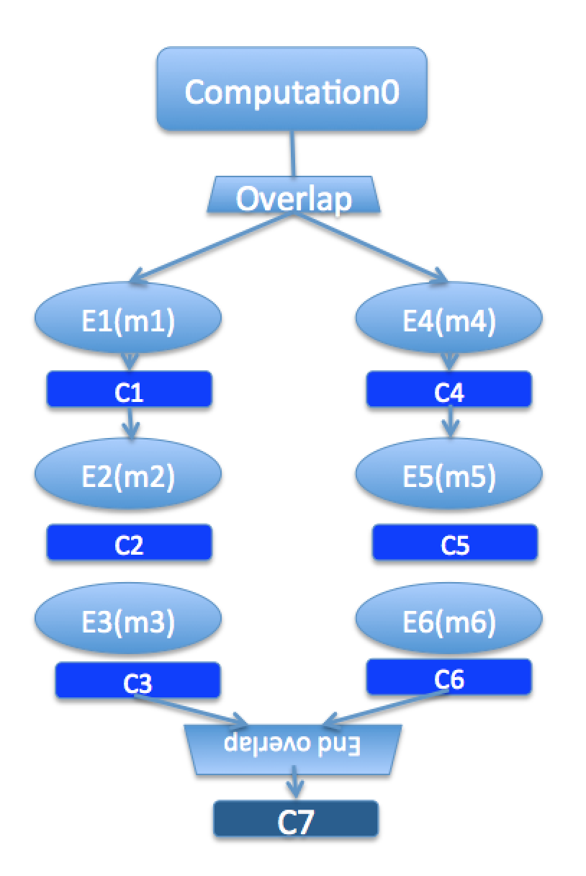
Illustration of a Long “Overlap”
Overlap can be used to get back some of the asynchrony within a chare
  But it is constrained
  Makes for more disciplined programming
    Fewer race conditions

Slide 133
Parallel Prefix with SDAG: .ci file I
mainmodule prefix {
mainchare Main {
entry Main(CkArgMsg∗ msg);
entry [reductiontarget] void checkIn();
};
array [1D] Prefix {
entry Prefix(int n, CProxy_Main m);
entry void passValue(int step, unsigned int incomingValue);
}

Slide 134
Parallel Prefix with SDAG: .ci file II
entry void startPrefixCalculation() {
for(stage = 0; (1 << stage) < numElements; stage++) {
serial “send_value” {
targetIndex = thisIndex + (1 << stage);
if (targetIndex < numElements)
thisProxy[targetIndex].passValue(stage, value);
}
if (thisIndex >= (1 << stage))
when passValue[stage](int incoming_stage, unsigned int incoming_value)
serial { value += incoming_value; }
}
serial “done” {
contribute(CkCallback(CkReductionTarget(Main, checkIn), mainProxy));
}
};
};
};

Slide 135
Stencil Codes
Iterative applications where array elements are updated according to some fixed pattern
Used in computational simulations, solving partial differential equations, Jacobi kernel, Gauss-Seidel method, image processing applications etc.
Can be 2D or 3D

Slide 136
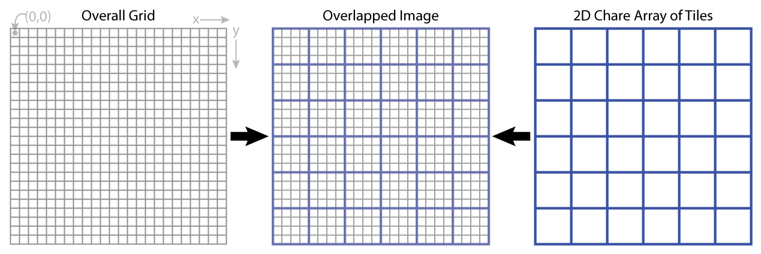
5-point Stencil

Slide 137
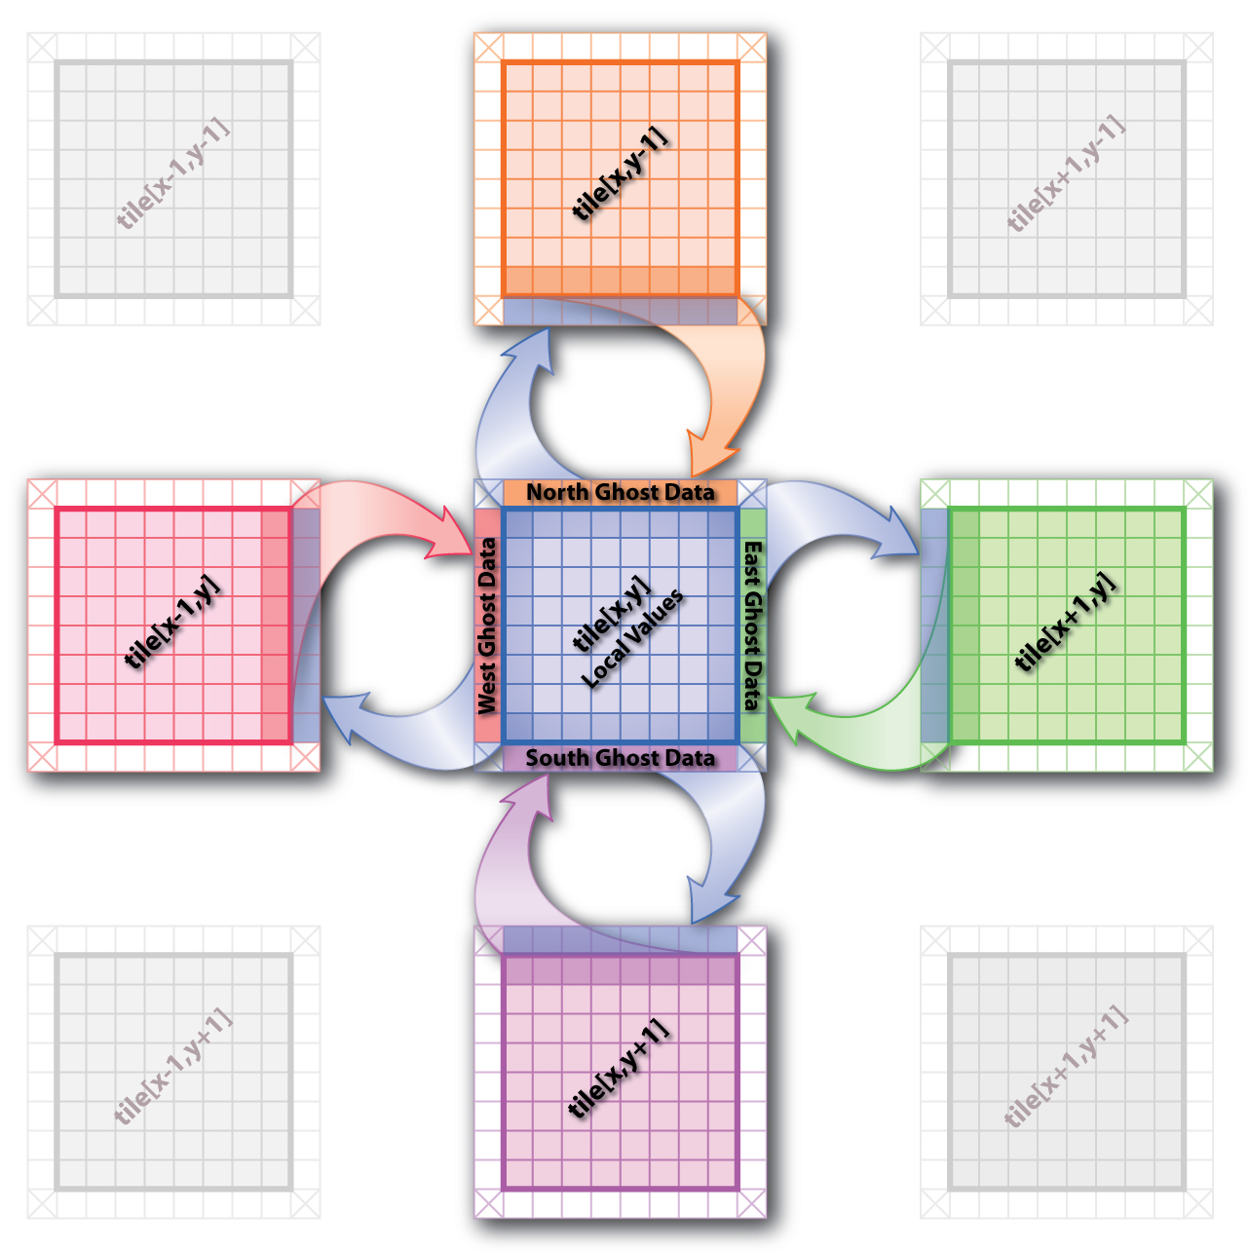
5-point Stencil

Slide 138
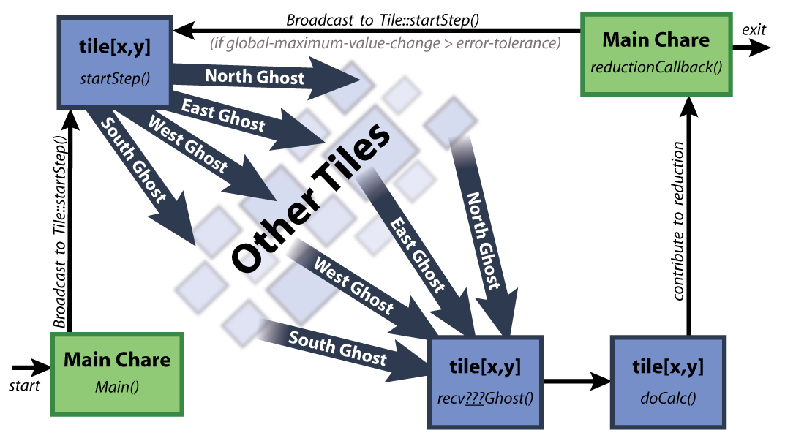
5-point Stencil

Slide 139
Jacobi: .ci file
mainmodule jacobi2d {
mainchare Main {
entry Main(CkArgMsg ∗m);
entry void done(int iterations);
};
array [2D] Jacobi {
entry Jacobi(CProxy_Main);
entry void updateGhosts(int ref, int dir, int w, double gh[w]);
entry [reductiontarget] void checkConverged(bool result);
entry void run() {
// ... main loop (next slide) ...
};
};
};

Slide 140
Jacobi: .ci file
while (!converged) {
serial {
copyToBoundaries();
int x = thisIndex.x, y = thisIndex.y;
int bdX = blockDimX, bdY = blockDimY;
thisProxy(wrapX(x-1),y).updateGhosts(iter, RIGHT, bdY, rightGhost);
thisProxy(wrapX(x+1),y).updateGhosts(iter, LEFT, bdY, leftGhost);
thisProxy(x,wrapY(y-1)).updateGhosts(iter, TOP, bdX, topGhost);
thisProxy(x,wrapY(y+1)).updateGhosts(iter, BOTTOM, bdX, bottomGhost);
freeBoundaries();
}
for (remoteCount = 0; remoteCount < 4; remoteCount++)
when updateGhosts[iter](int ref, int dir, int w, double buf[w]) serial {
updateBoundary(dir, w, buf);
}
serial {
double error = computeKernel();
int conv = error < DELTA;
CkCallback cb(CkReductionTarget(Jacobi, checkConverged), thisProxy);
contribute(sizeof(int), &conv, CkReduction::logical_and, cb);
}
when checkConverged(bool result)
if (result) serial { mainProxy.done(iter); converged = true; }
serial { ++iter; }
};
};
MPI analogue
4 send calls
Sequential
C++ code
4 recv calls
Asynchronous
Reduction

Slide 141
Jacobi: .ci file (with asynchronous reductions)
entry void run() {
while (!converged) {
serial {
copyToBoundaries();
int x = thisIndex.x, y = thisIndex.y;
int bdX = blockDimX, bdY = blockDimY;
thisProxy(wrapX(x−1),y).updateGhosts(iter, RIGHT, bdY, rightGhost);
thisProxy(wrapX(x+1),y).updateGhosts(iter, LEFT, bdY, leftGhost);
thisProxy(x,wrapY(y−1)).updateGhosts(iter, TOP, bdX, topGhost);
thisProxy(x,wrapY(y+1)).updateGhosts(iter, BOTTOM, bdX, bottomGhost);
freeBoundaries();
}
for (remoteCount = 0; remoteCount < 4; remoteCount++)
when updateGhosts[iter](int ref, int dir, int w, double buf[w]) serial {
updateBoundary(dir, w, buf);
}
serial {
double error = computeKernel();
int conv = error < DELTA;
if (iter % 5 == 1)
contribute(sizeof(int), &conv, CkReduction::logical_and, CkCallback(CkReductionTarget(Jacobi,
checkConverged), thisProxy));
}
if (++iter % 5 == 0)
when checkConverged(bool result)
if (result) serial { mainProxy.done(iter); converged = true; }
}
};
To add Load Balancing
if (iter % 20 == 0) { serial { AtSync(); }
when resumeFromSync() {} }

Slide 142
Jacobi: .ci file (with load balancing)
entry void run() {
while (!converged) {
serial {
copyToBoundaries();
int x = thisIndex.x, y = thisIndex.y;
int bdX = blockDimX, bdY = blockDimY;
thisProxy(wrapX(x−1),y).updateGhosts(iter, RIGHT, bdY, rightGhost);
thisProxy(wrapX(x+1),y).updateGhosts(iter, LEFT, bdY, leftGhost);
thisProxy(x,wrapY(y−1)).updateGhosts(iter, TOP, bdX, topGhost);
thisProxy(x,wrapY(y+1)).updateGhosts(iter, BOTTOM, bdX, bottomGhost);
freeBoundaries();
}
for (remoteCount = 0; remoteCount < 4; remoteCount++)
when updateGhosts[iter](int ref, int dir, int w, double buf[w]) serial {
updateBoundary(dir, w, buf);
}
serial {
double error = computeKernel();
int conv = error < DELTA;
if (iter % 5 == 1)
contribute(sizeof(int), &conv, CkReduction::logical_and, CkCallback(CkReductionTarget(Jacobi,
checkConverged), thisProxy));
}
if (++iter % 5 == 0)
when checkConverged(bool result)
if (result) serial { mainProxy.done(iter); converged = true; }
if (iter % 20 == 0) { serial { AtSync(); }
when resumeFromSync() {} }
}
};

Slide 143
Advanced Concepts
Threaded entry methods, Futures, …
Priorities
Entry method tags
Quiescence detection
LiveViz: visualization from a parallel program
CharmDebug: a powerful debugging tool
Projections: Performance Analysis and Visualization, really nice, and a workhorse tool for Charm++ developers
Messages (instead of marshalled parameters)
Processor-aware constructs:
  Groups: like a non-migratable chare array with one element on each “core”
  Nodegroups: one element on each process

Slide 144
More Information
http://charm.cs.illinois/edu
  Papers, downloads, manuals, tools
Mailing list: charm@lists.cs.illinois.edu
  https://lists.cs.illinois.edu/lists/info/charm
http://charmplusplus.org
  Tutorial material, mini apps, ...
  A series of programming exercises designed to teach basic concepts in Charm++
    http://charmplusplus.org/exercises/
http://charmplusplus.com
  Charmworks Inc., supporting Charm++

Slide 145
Charm++ Applications as case studies
Only brief overview today

Slide 146
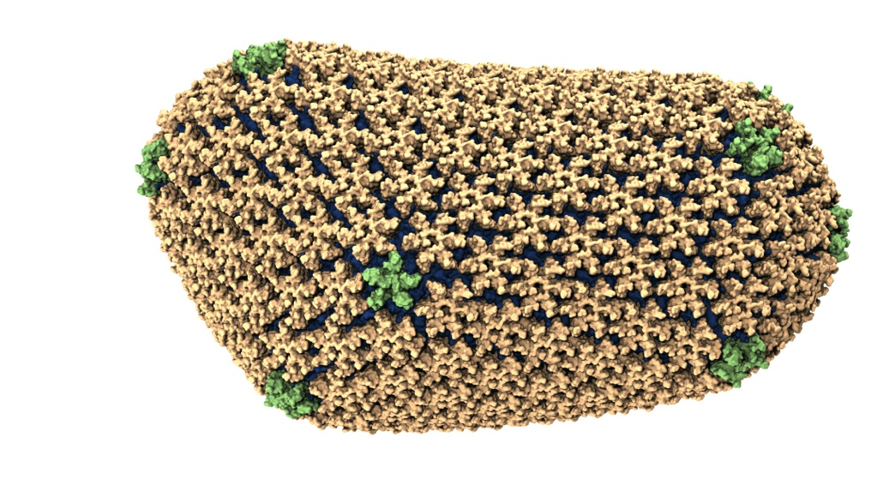
NAMD: Biomolecular Simulations
Collaboration with K. Schulten
With over 50,000 registered users
Scaled to most top US supercomputers
In production use on supercomputers and clusters and desktops
Gordon Bell award in 2002
Recent success: Determination of the structure of HIV capsid by researchers including Prof Schulten

Slide 147
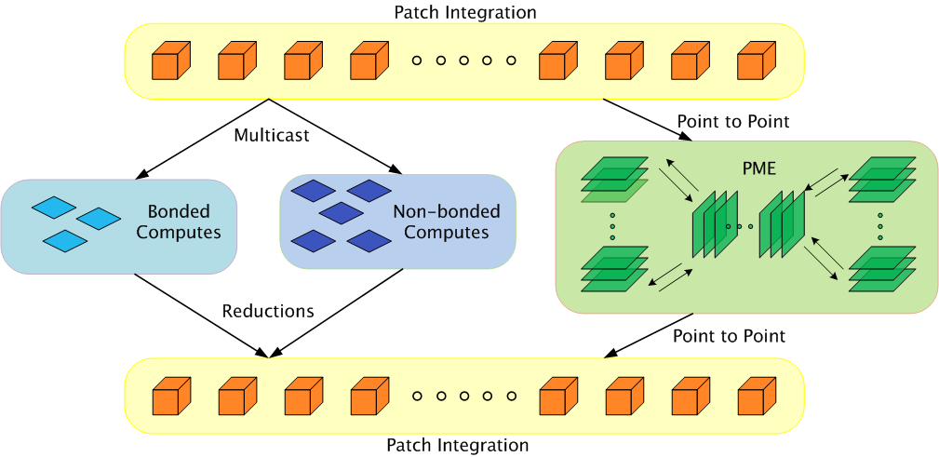
Parallelization using Charm++

Slide 148
Grainsize example: NAMD
High performing examples (objects are the work-data units in Charm++):
On Blue Waters, 100M atom simulation
  128K cores (4K nodes): 5,510,202 objects
Edison, Apoa1 (92K atoms)
  4K cores: 33,124 objects
Hopper, STMV (1M atoms)
  15,360 cores: 430,612 objects

Slide 149
NAMD strong scaling on Titan Cray XK7, Blue Waters Cray XE6, and Mira IBM Blue Gene/Q for 21M and 224M atom benchmarks

Slide 150
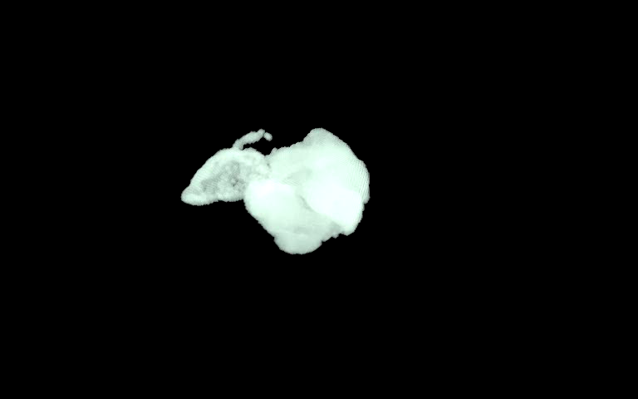
ChaNGa: Parallel Gravity
Evolution of Universe and Galaxy Formation
Collaborative project (NSF)
  with Tom Quinn, Univ. of Washington
Gravity, gas dynamics
Barnes-Hut tree codes
  Oct tree is natural decomp
  Geometry has better aspect ratios, so you “open” up fewer nodes
  But is not used because it leads to bad load balance
  Assumption: one-to-one map between sub-trees and PEs
  Binary trees are considered better load balanced
  With Charm++: Use Oct-Tree, and let Charm++ map subtrees to processors

Slide 151
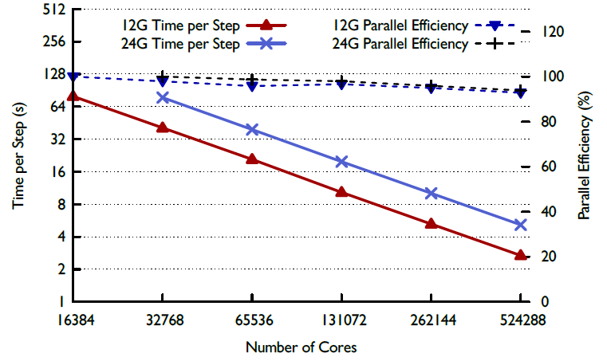
ChaNGa : a recent result

Slide 152
Episimdemics
Simulation of spread of contagion
  Code by Madhav Marathe, Keith Bisset, .. Vtech
  Original was in MPI
Converted to Charm++
  Benefits: asynchronous reductions improved performance considerably

Slide 155
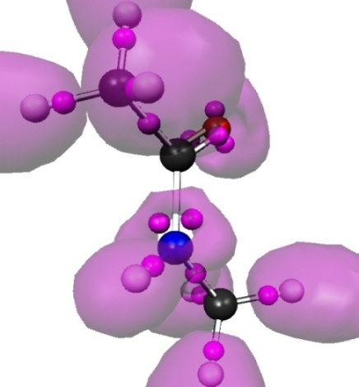
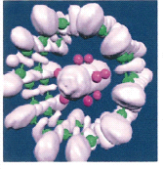
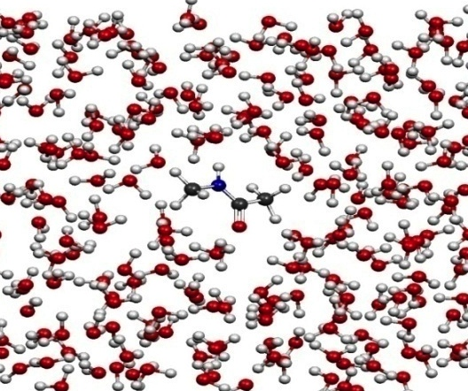
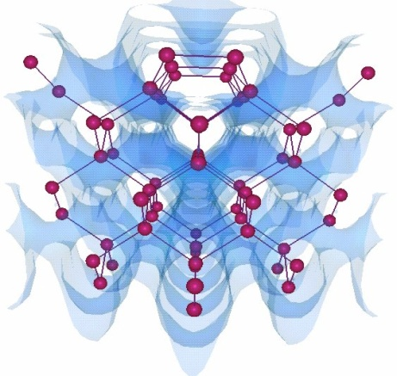
OpenAtom
Car-Parinello Molecular Dynamics
NSF ITR 2001-2007, IBM, DOE,NSF
Molecular Clusters :
Nanowires:
Recent NSF SSI-SI2 grant
With
G. Martyna (IBM)
Sohrab Ismail-Beigi
Semiconductor Surfaces:
3D-Solids/Liquids:
Using Charm++ virtualization, we can efficiently scale small (32 molecule) systems to thousands of processors

Slide 156
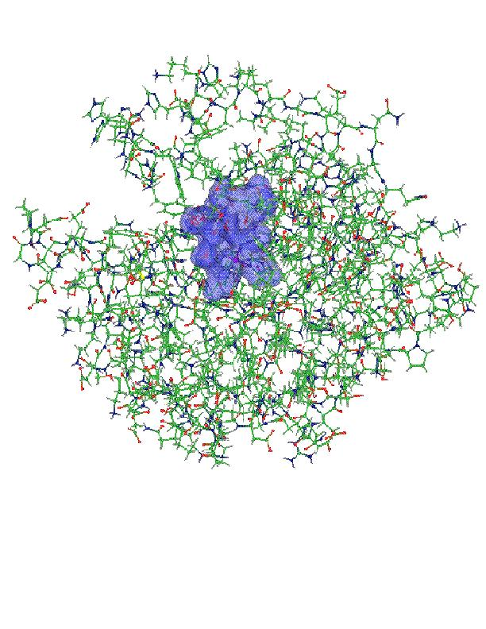
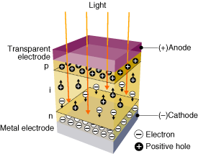
OpenAtom: On the fly ab initio molecular dynamics on the ground state surface with instantaneous GW-BSE level spectra
PIs: G.J. Martyna, IBM; S. Ismail-Beigi, Yale; L. Kale, UIUC;
Team: Q. Li, IBM, M. Kim, Yale; S. Mandal, Yale;
E. Bohm, UIUC; N. Jain, UIUC; M. Robson, UIUC;
E. Mikida, UIUC; P. Jindal, UIUC; T. Wicky, UIUC.
Light in
1

Slide 157
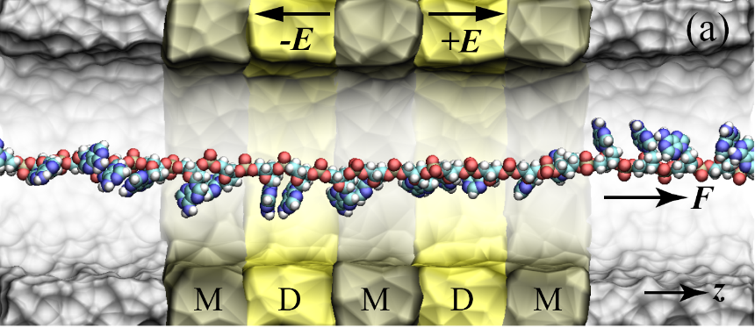

Goal : The accurate treatment of complex heterogeneous
systems to gain physical insight.
Light in
7

Slide 158
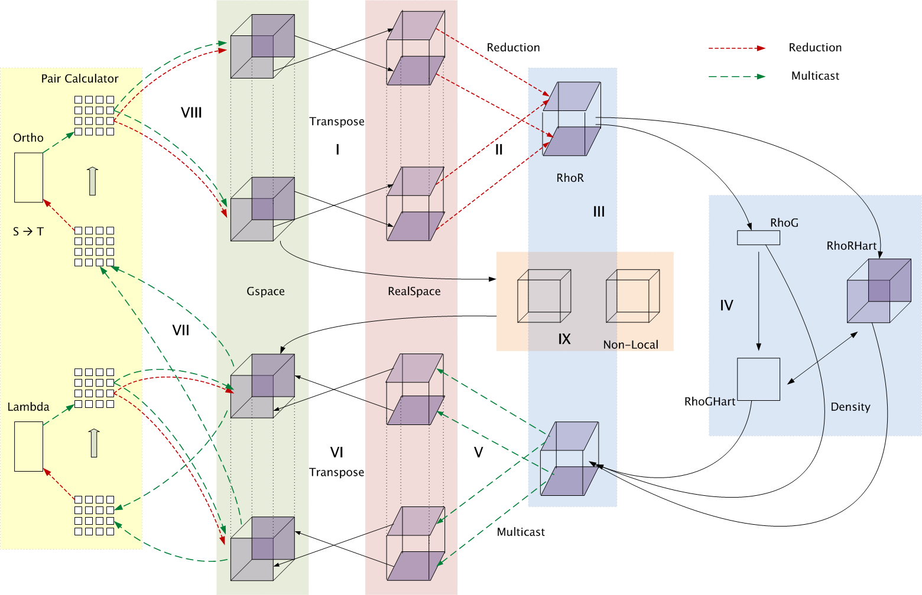
Decomposition and Computation Flow

Slide 159
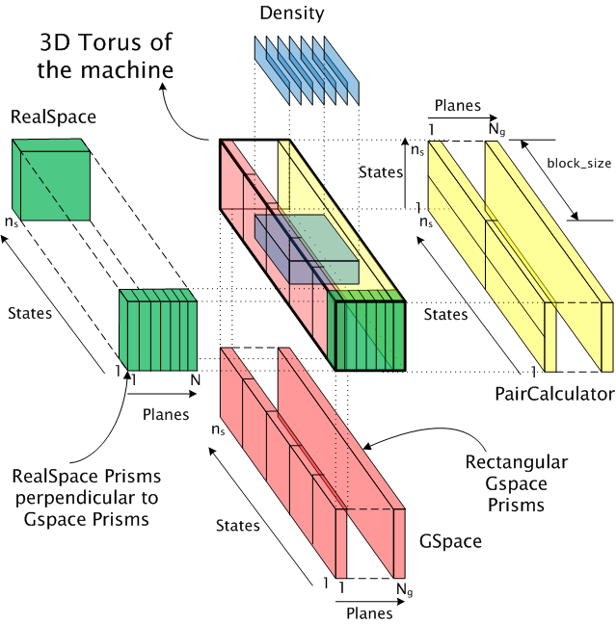
Topology Aware Mapping of Objects

Slide 160
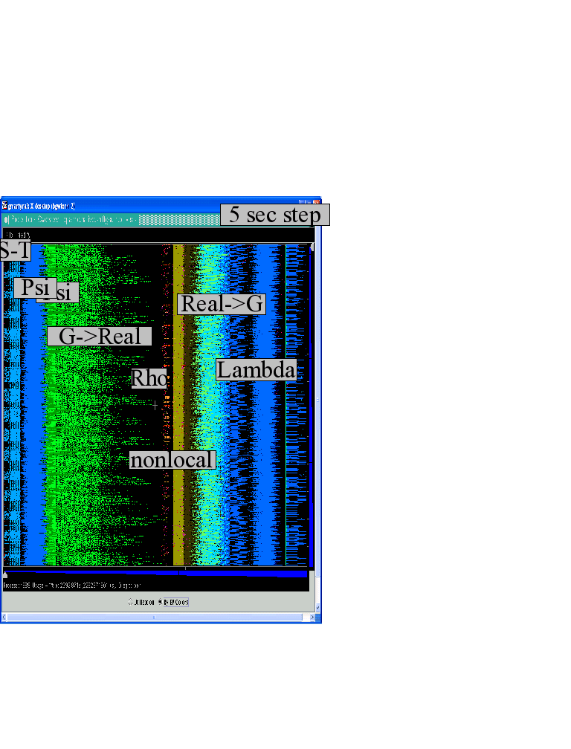
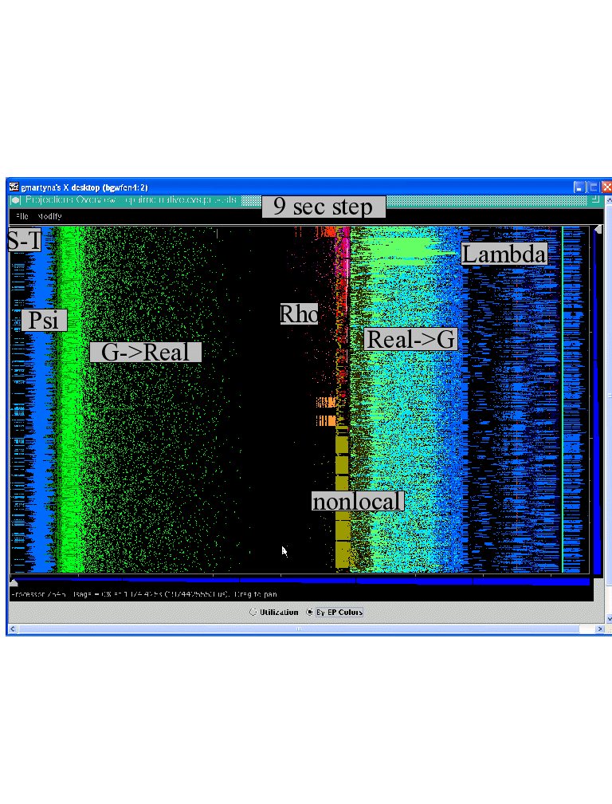

Improvements by topological aware mapping of computation to processors
Punchline: Overdecomposition into Migratable Objects created the degree of freedom needed for flexible mapping
The simulation of the left panel, maps computational work to processors taking the network connectivity into account while the right panel simulation does not. The “black’’ or idle time processors spent waiting for computational work to arrive on processors is significantly reduced at left. (256waters, 70R, on BG/L 4096 cores)

Slide 161
OpenAtom Performance Sampler
Ongoing work on:
K-points

Slide 162
Impact of mapping on Blue Waters: up to 32% improvement

Slide 163
MiniApps
Available at: http://charmplusplus.org/miniApps/
Mini-App | Features | Machine | Max cores
AMR | Overdecomposition, Custom array index, Message priorities, Load Balancing, Checkpoint restart | BG/Q | 131,072
LeanMD | Overdecomposition, Load Balancing, Checkpoint restart, Power awareness | BG/P BG/Q | 131,072 32,768
Barnes-Hut (n-body) | Overdecomposition, Message priorities, Load Balancing | Blue Waters | 16,384
LULESH 2.02 | AMPI, Over-decomposition, Load Balancing | Hopper | 8,000
PDES | Overdecomposition, Message priorities, TRAM | Stampede | 4,096

Slide 164
More MiniApps
Mini-App | Features | Machine | Max cores
1D FFT | Interoperable with MPI | BG/P BG/Q | 65,536 16,384
Random Access | TRAM | BG/P BG/Q | 131,072 16,384
Dense LU | SDAG | XT5 | 8,192
Sparse Triangular Solver | SDAG | BG/P | 512
GTC | SDAG | BG/Q | 1,024
SPH |  | Blue Waters | -

Slide 165
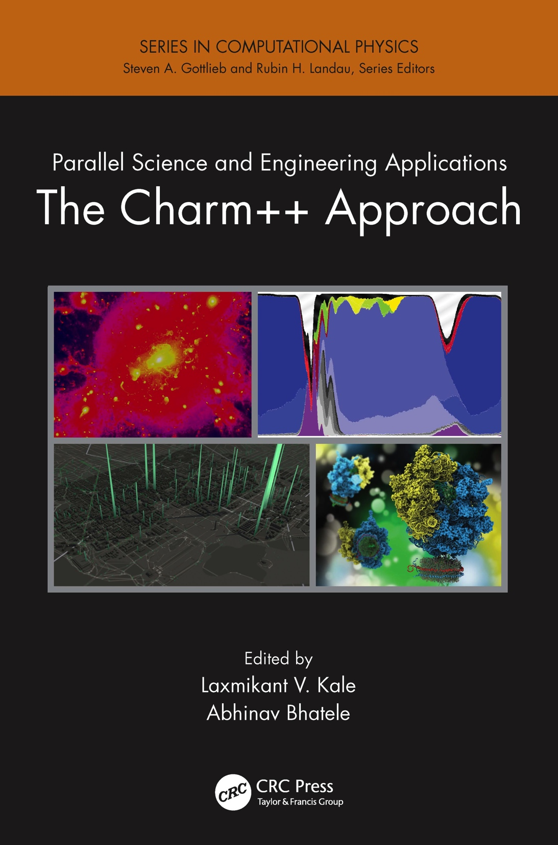
A recently published book
surveys seven major applications developed using Charm++
More info on Charm++:
http://charm.cs.illinois.edu
Including the miniApps

Slide 166
Where are Exascale Issues?
I didn’t bring up exascale at all so far..
  Overdecomposition, migratability, asynchrony were needed on yesterday’s machines too
  And the app community has been using them
  But:
    On *some* of the applications, and maybe without a common general-purpose RTS
The same concepts help at exascale
  Not just help, they are necessary, and adequate
  As long as the RTS capabilities are improved
We have to apply overdecomposition to all (most) apps

Slide 167
Relevance to Exascale
Intelligent, introspective, Adaptive Runtime Systems, developed for handling application’s dynamic variability, already have features that can deal with challenges posed by exascale hardware

Slide 168
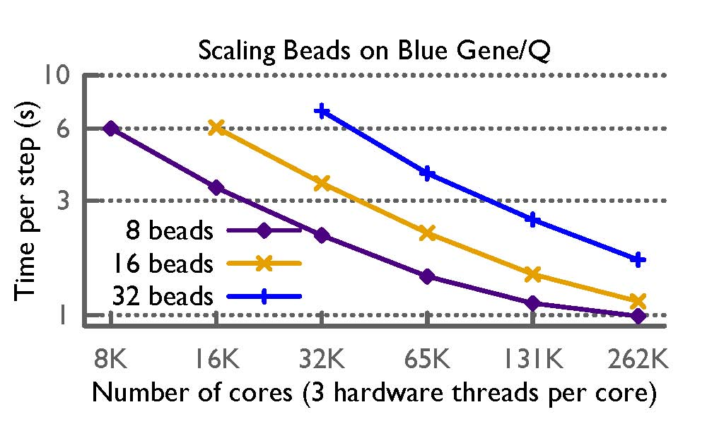
Path Integral Performance

Slide 169
Fault Tolerance in Charm++/AMPI
Four approaches available:
  Disk-based checkpoint/restart
  In-memory double checkpoint w auto. restart
  Proactive object migration
  Message-logging: scalable fault tolerance
Common Features:
  Easy checkpoint: migrate-to-disk
  Based on dynamic runtime capabilities
  Use of object-migration
  Can be used in concert with load-balancing schemes
Notes:
169

Slide 170
Power
Power consumption is continuous
Normal Checkpoint-Resart method
Progress
Progress is slowed down with failures
Time

Slide 171
Power consumption is lower during recovery
Message logging + Object-based virtualization
Progress is faster with failures

Slide 172
Saving Cooling Energy
Easy: increase A/C setting
  But: some cores may get too hot
So, reduce frequency if temperature is high (DVFS)
  Independently for each chip
But, this creates a load imbalance!
No problem, we can handle that:
  Migrate objects away from the slowed-down processors
  Balance load using an existing strategy
  Strategies take speed of processors into account
Implemented in experimental version
  SC 2011 paper, IEEE TC paper
Several new power/energy-related strategies
  PASA ‘12: Exploiting differential sensitivities of code segments to frequency change

Slide 173
PARM:Power Aware Resource Manager
Charm++ RTS facilitates malleable jobs
PARM can improve throughput under a fixed power budget using:
  overprovisioning (adding more nodes than conventional data center)
  RAPL (capping power consumption of nodes)
  Job malleability and moldability

Slide 174
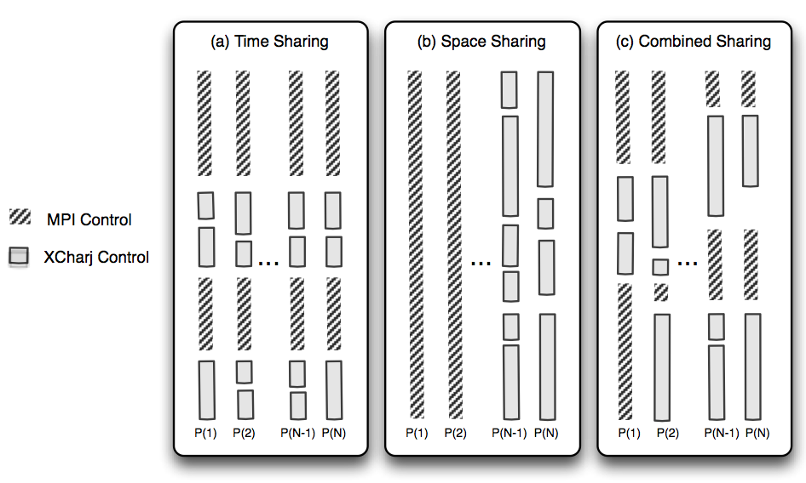
Charm++ interoperates with MPI
Charm++ Control

Slide 175
Summary
Charm++ embodies an adaptive, introspective runtime system
Many applications have been developed using it
  NAMD, ChaNGa, Episimdemics, OpenAtom, …
  Many miniApps, and third-party apps
Adaptivity developed for apps is useful for addressing exascale challenges
  Resilience, power/temperature optimizations, ..
More Info: http://charm.cs.illinois.edu/ (including the miniApps)
Overdecomposition
Asynchrony
Migratability

