Slide 1
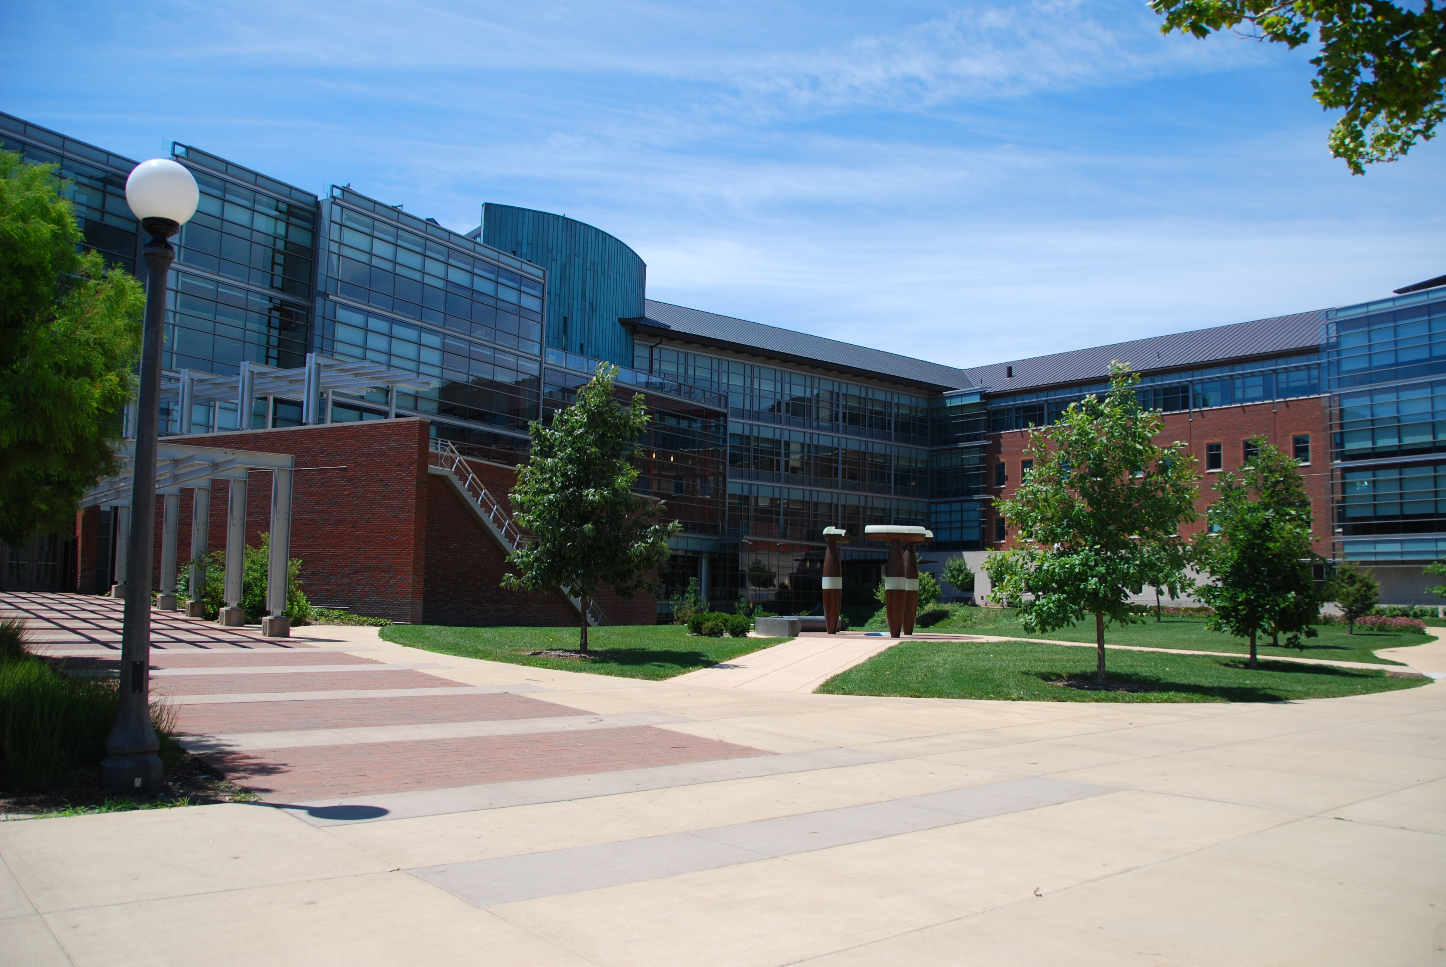

Charm++ and the Future of GPUs
Michael Robson
University of Illinois Urbana-Champaign

Slide 2
Outline
Interfaces
Applications
Future

Slide 3
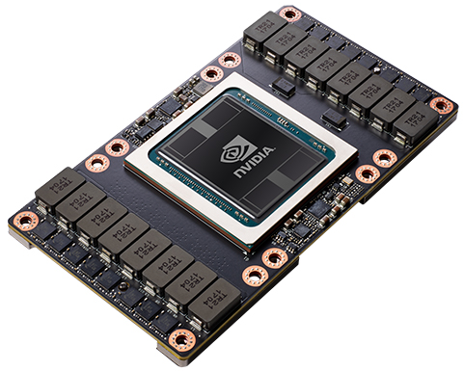
GPU Overview
Programmed with CUDA
1,000s of threads
100s GB/s bandwidth
~16 GB of memory
TeraFLOPS double precision performance

Slide 4
Interfaces

Slide 5
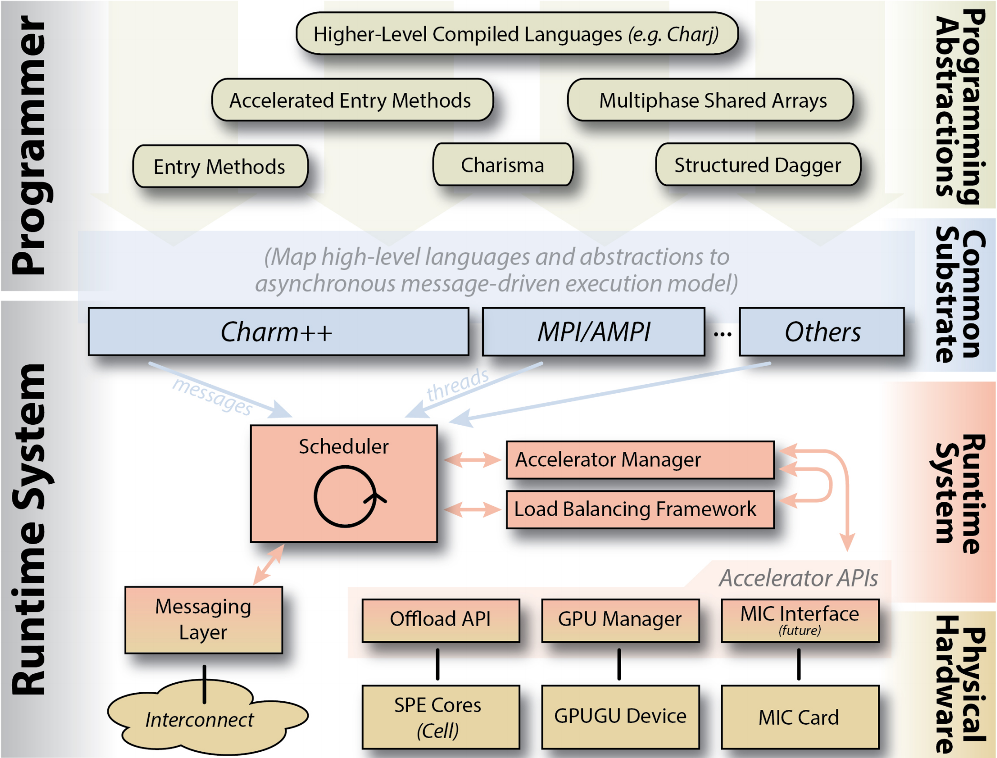
Charm++ GPU Frameworks
Notes:
Charm++ GPU Frameworks
GPU-enabled Applications
Future Work
(Brief) Accelerator Overview

Slide 6
HAPI – Hybrid API
Drop in replacement for CUDA
Enables tools (projections, load balance, etc)
Adds useful extensions
Automatic stream management
Optional pinned memory pool
Charm Callbacks
User still responsible for kernels, memory, etc
“Don’t get in the way”

Slide 7
GPU Manager – Legacy API
Asynchronous task offload and management library
Fill struct describing both data dependency and work
Runtime responsible for launching kernels
Runtime responsible for moving data
Automatically overlaps data movement and execution
Utilizes callbacks for notifications at various phases
“Set it and forget it”

Slide 8
Recent GPU API Updates
Improved callbacks – event pooling
Alternate polling methods
Broader stream support
Better QD integration
AMPI Interoperation
Optional mempool
Multi-GPU support
General cleanup – e.g. smartbuild prompt, examples, etc

Slide 9
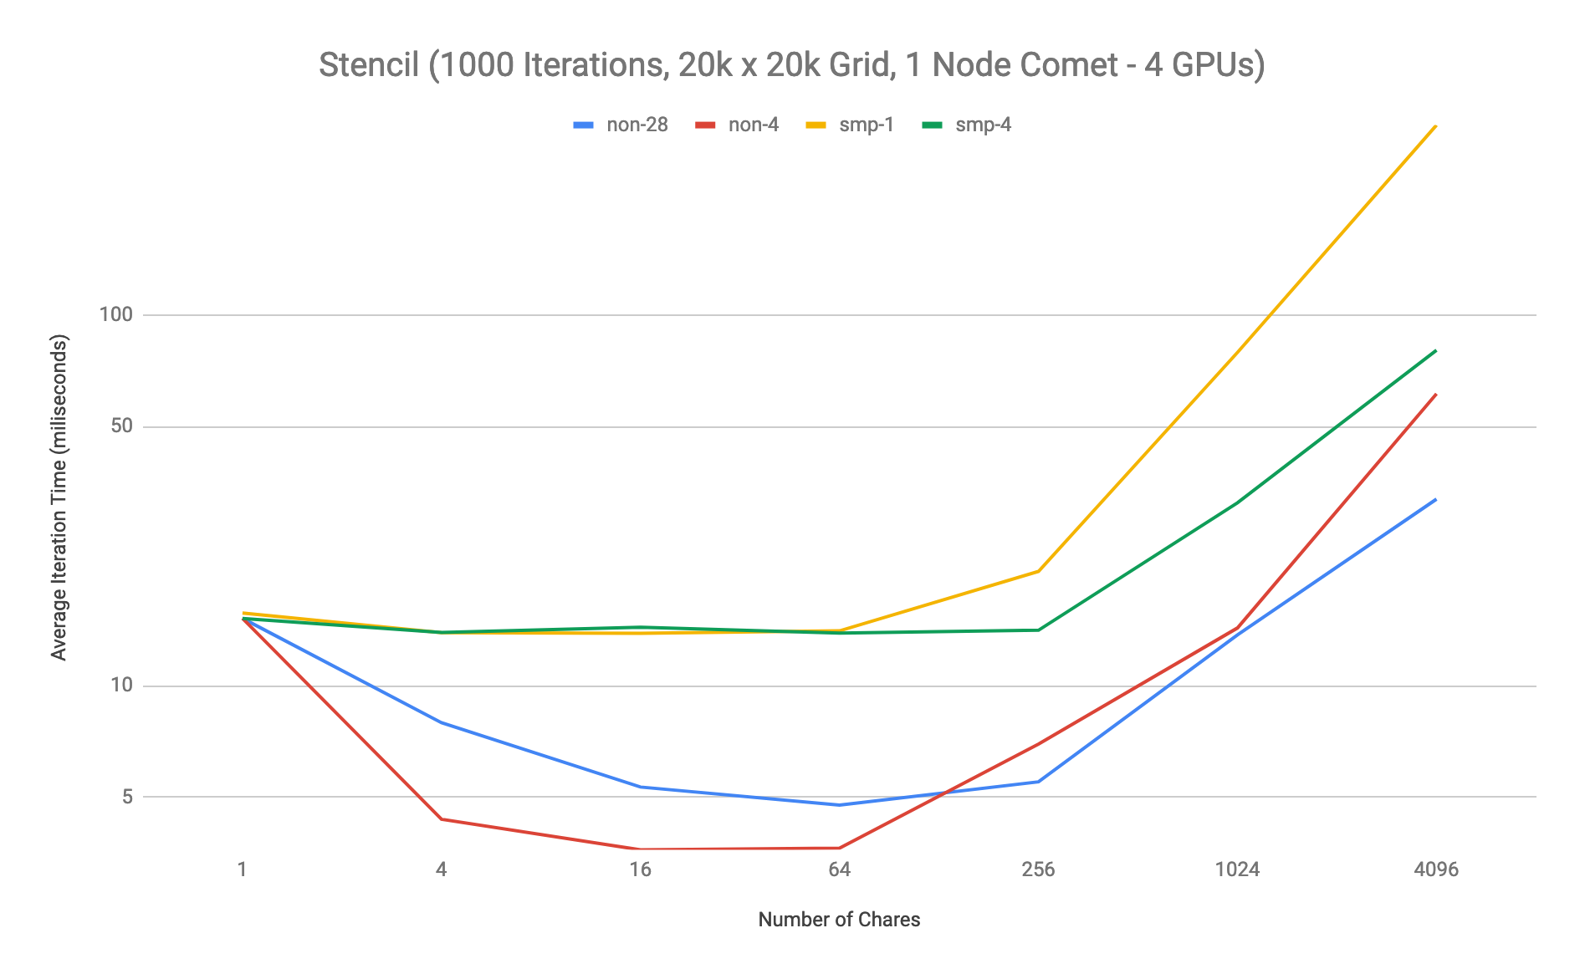
Multi-GPU Performance
Notes:
tab: nodesFix

Slide 10
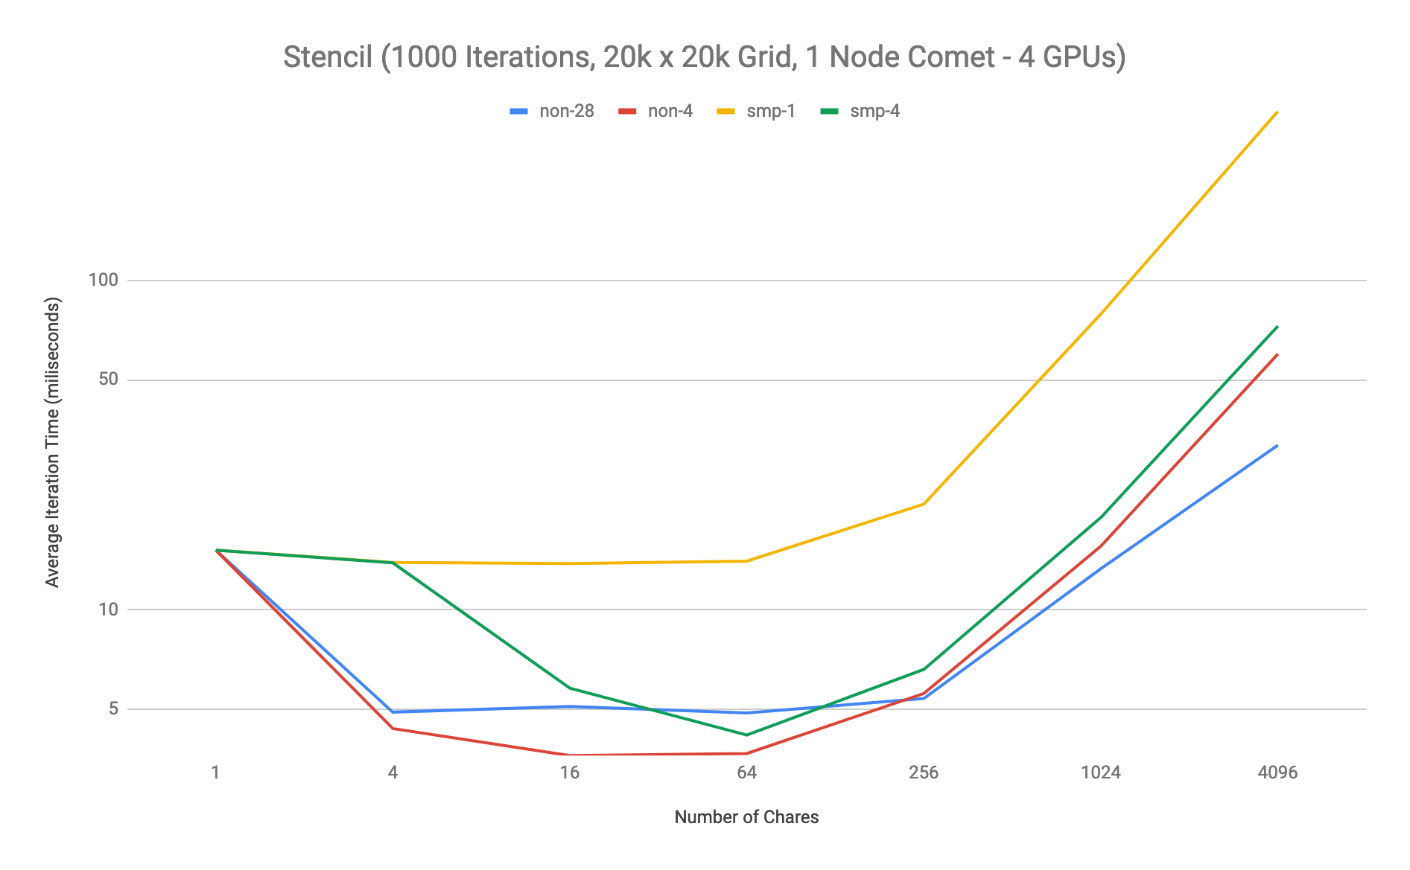
Multi-GPU Performance
Notes:
tab: nodesFixUp

Slide 11
Applications

Slide 12
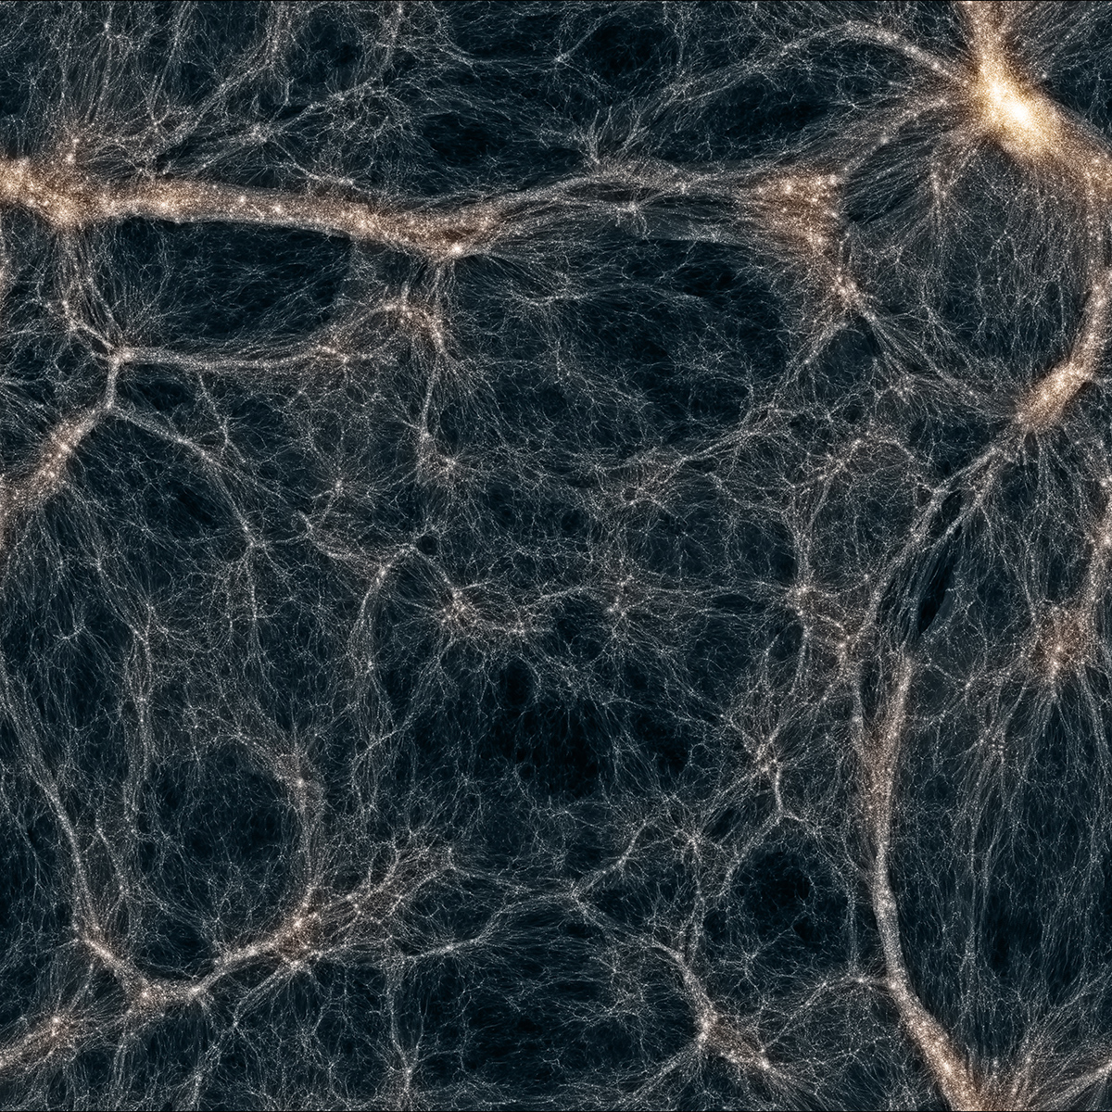
ChaNGa: Charm N-Body Gravity
Notes:
Cosmological N-body simulations
Leverages GPUs
Offloads gravity kernels
Active work in optimization
https://www.nas.nasa.gov/SC14/demos/demo27.html#prettyPhoto

Slide 13
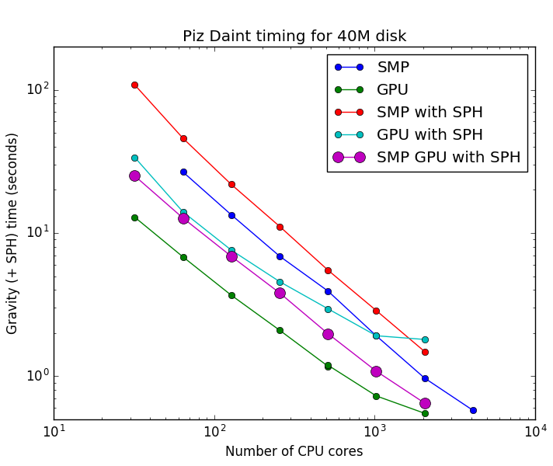
Notes:
Idea of performance

Slide 14
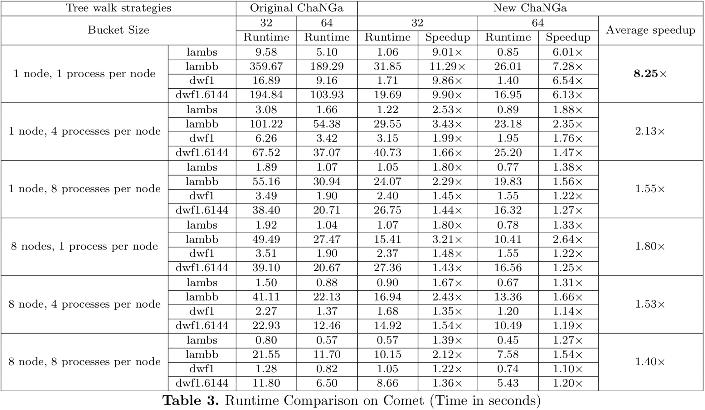
Efficient GPU Tree Walks in ChaNGa
Notes:
Questions?

Slide 15
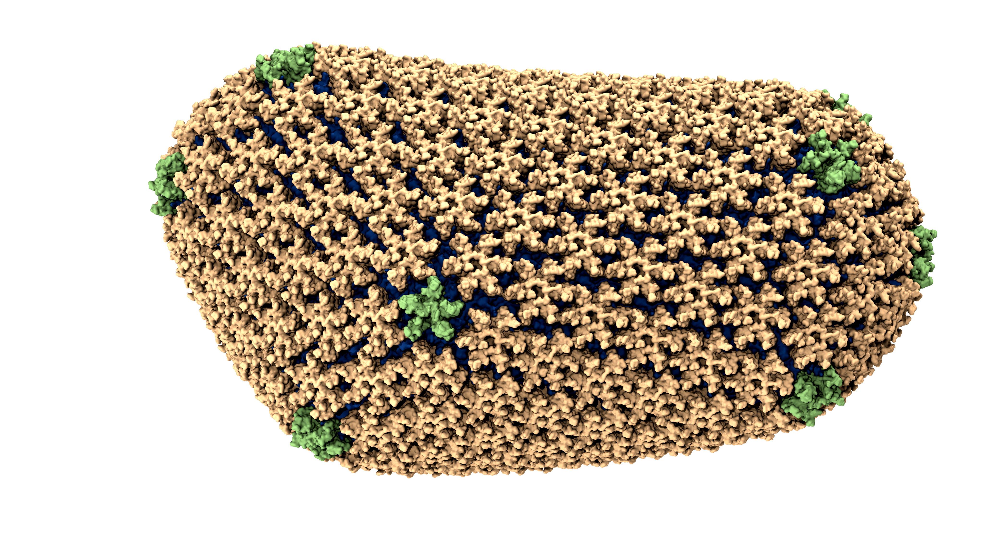
NAMD: Molecular Dynamics
Notes:
NAMD 2.12 (Dec 2016) provides order-of-magnitude performance increase for 5.7M-atom implicit solvent HIV capsid simulation on GPU-accelerated XK nodes.

Slide 16
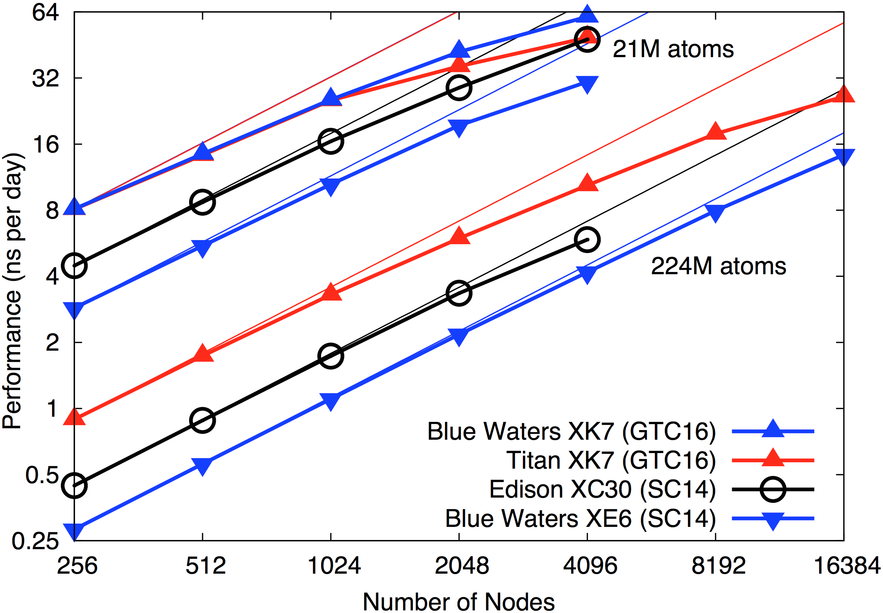
NAMD Runs Large Simulations Well
(2fs timestep)
Notes:
2fs timestep

Slide 17
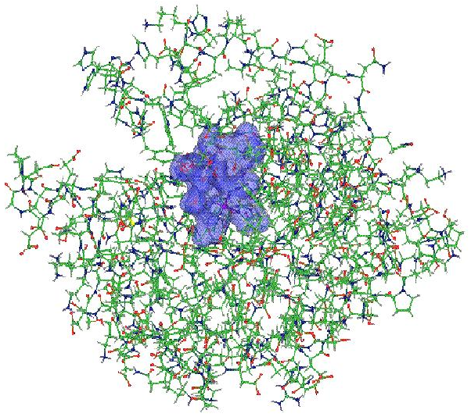
OpenAtom

Slide 18
Results for 256 Water Molecules
1 iterations, 1 PE, 64 XK Nodes of Blue Waters
Baseline
164 ms
205 ms
163 ms
216 ms
CUBLAS
47 ms
113 ms
90 ms
142 ms
 | Forward | Speedup
Baseline | 327 ms
CUBLAS | 137 ms | 2.39x
Backward | Speedup
421 ms
255 ms | 1.65x
Per Iter | Speedup
2.582796 s
2.346571 s | 1.10x
Notes:
2 Logical Node Example

Slide 19
Xiaoyang Results - Placeholder

Slide 20
Future

Slide 21
Accel
Motivation
Exploit runtime information for dynamic execution
Runtime (RTS) can map to various platforms
RTS can proactively move needed data
Don’t leave hardware sitting idle
Framework
Generate code from tagged entry methods
Host (CPU) and device (CUDA)
Extend with tuning keywords
Annotate object data access
Batch fine grained kernel launches
Notes:
Difficult to estimate performance and split

Slide 22
Accel Analysis
Code | % Dev. | Host | Device
stencil | 30% | 1.58x | 3.09x
md | 65% | 3.02x | 1.46x
Using hardware improves performance
Even when it’s not ideal

Slide 23
Runtime Interoperation
Charm + X Model
Similar approach to HAPI/CUDA
Targets: Raja, Kokkos, StarPU, OpenMP (target directive)
Examples and docs in repo for Kokkos, others coming
Other targets?

Slide 24
Proposed Multi-GPU Interface
Previously round robin PEs to GPUs
Currently map PEs in node/process to shared GPU
Non-SMP often outperforms SMP
Oversubscribing processes to GPUs, CUDA MPS
Coarse grained control, use SMP; one process per GPU
But this ties to comm thread, etc
Proposed design:
++gpupernode 4
++gpumap 0:1
hwloc:
++gpuauto

Slide 25
GPU Messages
Send GPU resident data
Based on zero copy API
Invoke correct CUDA API call
based on size, stride, sender, destination, etc
IPC, GPUDirect, UM, ZC, etc
Notification via callback
Future: Potentially callable inside CUDA kernels
Feedback?

Slide 26
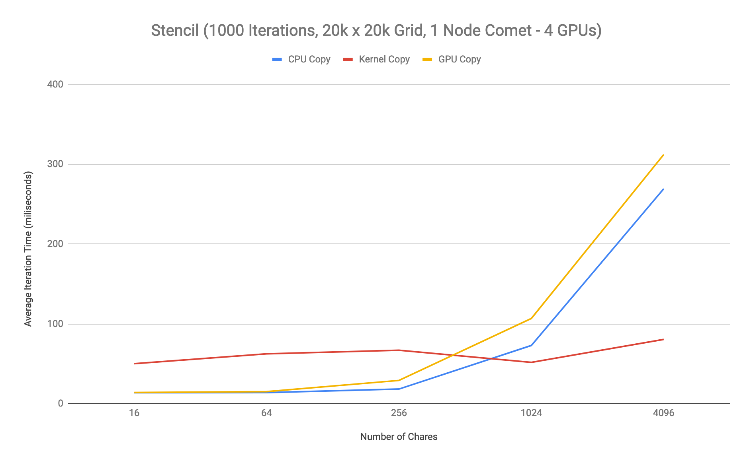
Notes:
tab: smp(d+g+c+m+gm)

Slide 27
Collaborators
PPL: Ronak Buch, Jaemin Choi, Xiaoyang Wang, Eric Bohm, Sanjay Kale
UIUC: Jim Phillips
UWash: Tom Quinn
UWisc: Tim Haines
Purdue: Jianqiao Liu, Milind Kulkarni
Yale: Sohrab Ismail-Beigi
IBM: Glenn Martyna And many more!
Notes:
ORNL: Antti-Pekka Hynninen
LLNL: Abhinav Bhatele
NVIDIA: Nikhil Jain
UIUC: Atul Jain, Rahul Barhman, Phil Miller

Slide 28
Outline
Interfaces
HAPI
GPU Manager
Applications
NAMD
ChaNGa
OpenAtom
Future
Accel
Runtime Interoperation
Multi-GPU
GPU Messages
Michael Robson
mprobson@illinois.edu

Slide 29
Backup Slides

Slide 30
Outline
(Charm) GPU Intro
Charm GPU Interfaces
HAPI
GPU Manager
Charm GPU Applications
ChaNGa
NAMD
OpenAtom
Charm GPU Future
Runtime Interoperation
Accel
Proposed Multi-GPU Interface Design
GPU Messages

Slide 31
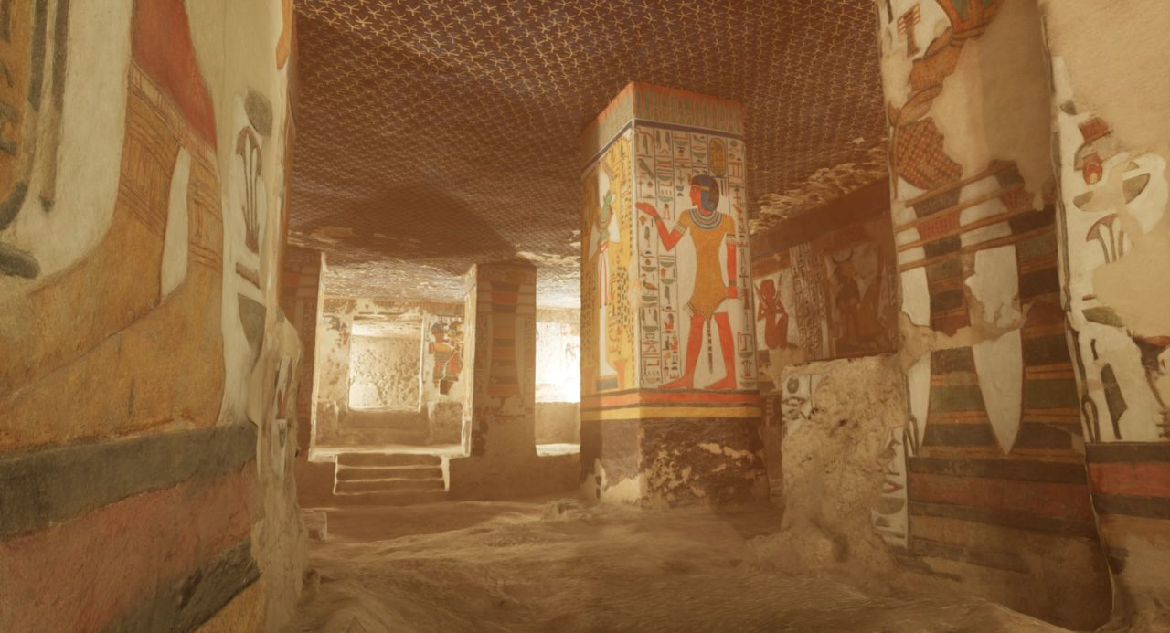

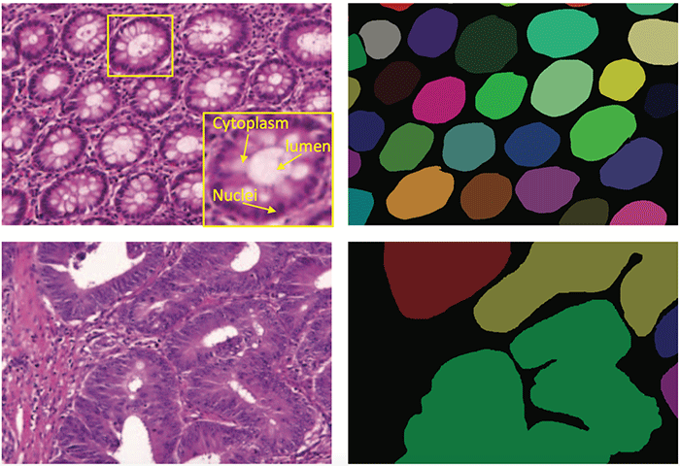
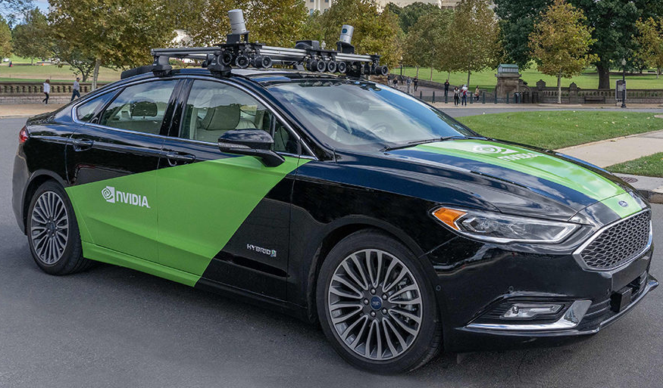
GPU – Graphics Processing Unit
Notes:
Activity!
blogs.nvidia.com/blog/2015/12/23/deep-learning-cancer/
commons.wikimedia.org/w/index.php?curid=15411063
blogs.nvidia.com/wp-content/uploads/2018/10/auto-sr-launch-blog-header-1280x720-1280x720.jpg
blogs.nvidia.com/wp-content/uploads/2018/10/2HighresScreenshot00011-1280x693.jpg

Slide 32
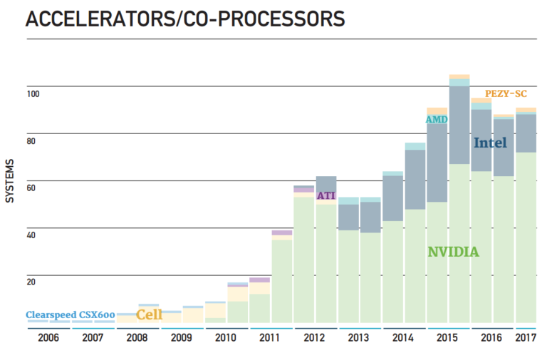
Notes:
PEZY-SC JP
https://www.hpcwire.com/2017/06/19/49th-top500-list-announced-isc/

Slide 33
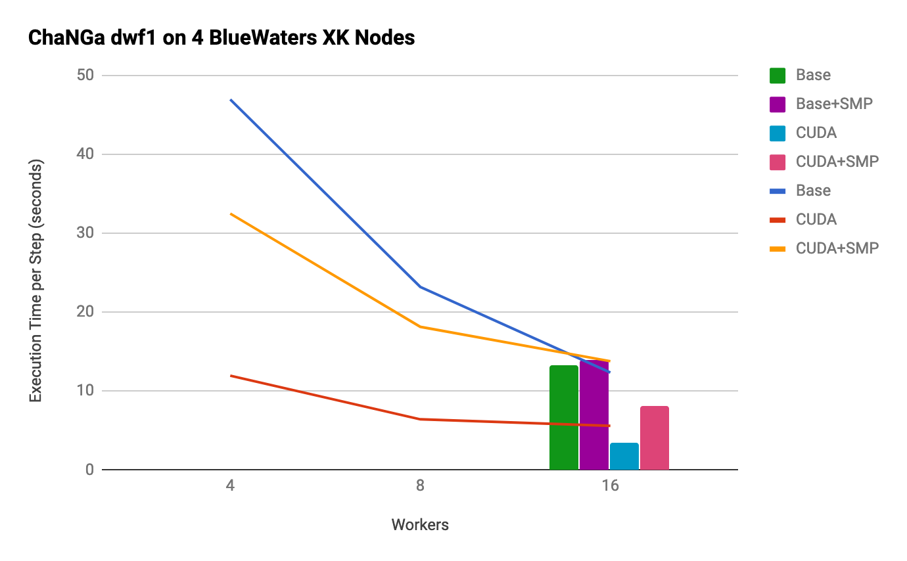
Post-6.9 numbers (remade graph?)

Slide 34
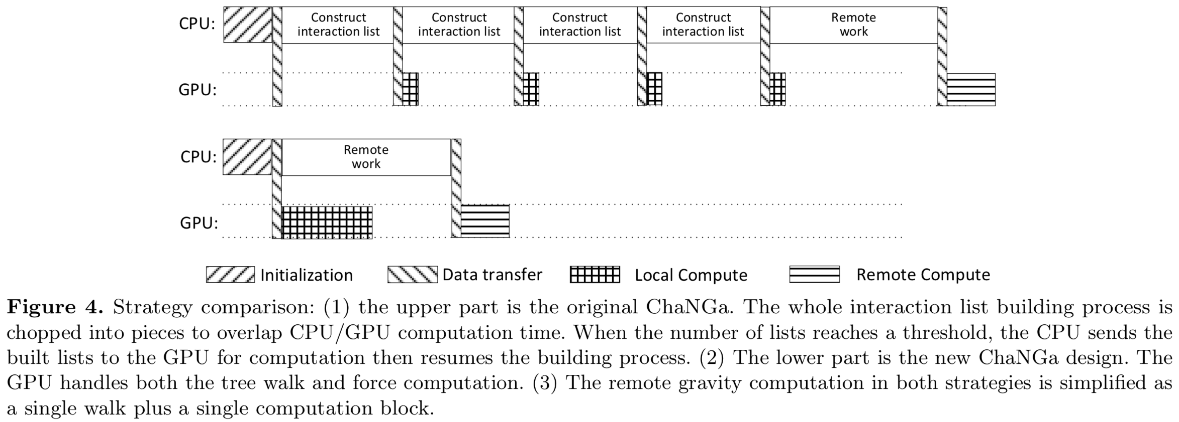
Notes:
List build overlap threshold
Single walk on GPU

Slide 35
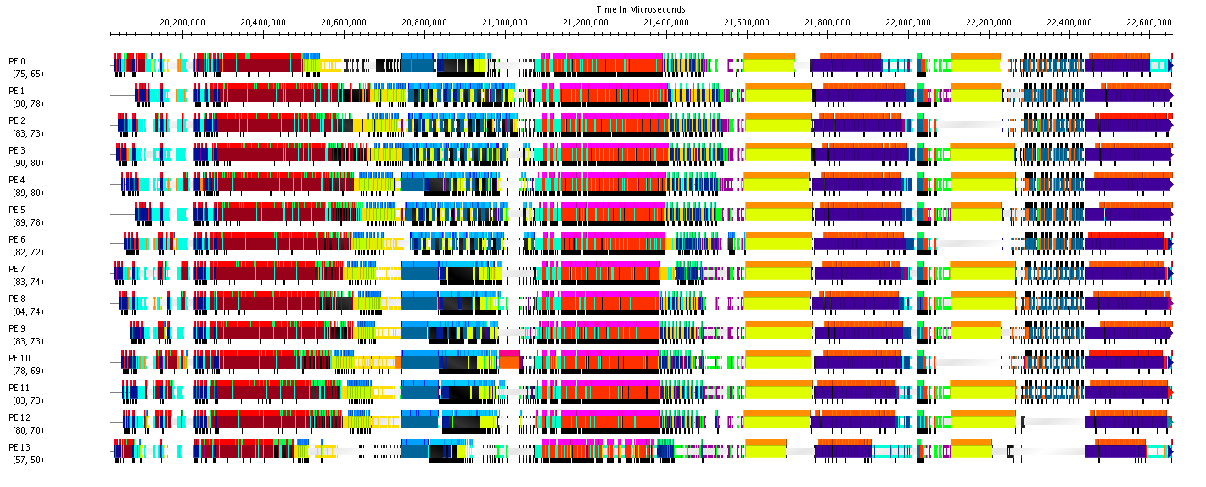
Opportunities for GPUs
PC
PC
ORTHO
Notes:
Orthonormalization (Ortho) - Inverse Square Root of Matrix; work from last time
Pair Calculator (PC) - Matrix Matrix Multiplication; current work
- Offloads forward and backwards path of pair calculator
Both make good GPU targets
Future/current work: FFTs

Slide 36
Results for 256 Water Molecules
1 iteration, 16 PEs, 64 XK Nodes of Blue Waters
Notes:
Time in microseconds
Water 256 7ry cutoff
Baseline -> CUDA
Backward and forwards
GPU manager callbacks/suspend resume
Ongoing work

Slide 37
Results for 256 Water Molecules
2 iterations, 1 PE, 64 XK Nodes of Blue Waters
Baseline
161 ms
161 ms
161 ms
167 ms
CUBLAS
67 ms
78 ms
86 ms
93 ms
 | GEMM | Speedup
Baseline | 650 ms
CUBLAS | 324 ms | 2x
Per Iter | Speedup
2.58526 s
2.46871 s | 1.047x
Notes:
2 Logical Node Example
First cut baseline CUBLAS implementation
- Use CUDA Streams
Directly allocate memory
Offload only forward multiply
Synchronize on data move

Slide 38
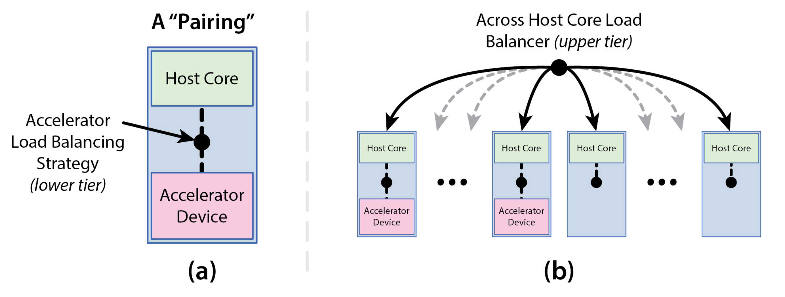
Heterogeneous Load Balancing
Automatically overlap useful work between CPU and GPU
Based on various parameters:
Idle time, latency, load
Notes:
Extend this to Xeon Phi

Slide 39
Accel Motivation
Exploit runtime information for dynamic execution
Runtime (RTS) can map to various platforms
RTS can proactively move needed data
Don’t leave hardware sitting idle
Notes:
Difficult to estimate performance and split

Slide 40
Accel Framework
Generate code from tagged entry methods
Host (CPU) and device (CUDA)
Extend with tuning keywords
Annotate object data access
Batch fine grained kernel launches

Slide 41
Accel Example Code
entry [triggered accel] void foo() [
readonly : float matrix [SIZE]
<implobj->matrix>,
writeonly : float matTmp [SIZE]
<implobj->matrixTmp> ] {
// implementation here
} fooPost;

Slide 42
Benchmarks
stencil2d (aka jacobi)
weighted five point stencil
CPU friendly
md
molecular dynamics
GPU friendly
Stampede
1 GPU node (K20 + Xeon E5-2680)
16 cores/processing elements

Slide 43
Stencil 2D
Notes:
Why discontinuities? (batching?)

Slide 44
Molecular Dynamics

Slide 45
Some Production Applications
Application | Domain | Previous parallelization | Scale
NAMD | Classical MD | PVM | 500k
ChaNGa | N-body gravity & SPH | MPI | 500k
EpiSimdemics | Agent-based epidemiology | MPI | 500k
OpenAtom | Electronic Structure | MPI | 128k
Spectre | Relativistic MHD |  | 100k
FreeON/SpAMM | Quantum Chemistry | OpenMP | 50k
Enzo-P/Cello | Astrophysics/Cosmology | MPI | 32k
ROSS | PDES | MPI | 16k
SDG | Elastodynamic fracture |  | 10k
ADHydro | Systems Hydrology |  | 1000
Disney ClothSim | Textile & rigid body dynamics | TBB | 768
Particle Tracking | Velocimetry reconstruction |  | 512
JetAlloc | Stochastic MIP optimization |  | 480

