Slide 1




OpenAtom:
First Principles GW method for electronic excitation
Minjung Kim, Subhasish Mandal, and Sohrab Ismail-Beigi
Yale University
Kavitha Chandrasekar, Eric Mikida, Eric Bohm, Raghavendra Kanakagiri,
Nikhil Jain, Qi Li, and Laxmikant Kale
University of Illinois at Urbana-Champaign
Glenn Martyna
Pimpernel Science, Software and Information Technology

Slide 2
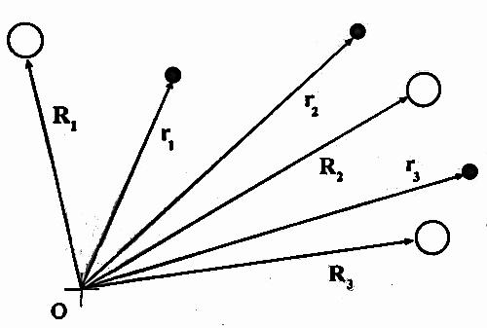

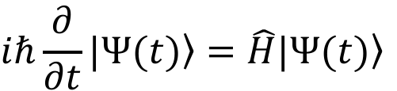
Electronic structure calculations
Schrodinger equation
$$iℏ\frac{∂}{∂t}|\left.Ψ(t)\right\rangle =\hat{H}|\left.Ψ(t)\right\rangle$$
Many R_{i} & r_{j}
Density functional theory
Solve for wavefunctions $ψ_{j}(r)$ and energies $ε_{j}$
LDA/GGA for E_{xc} : good geometries and total energies
Bad band gaps and excitations

Slide 3

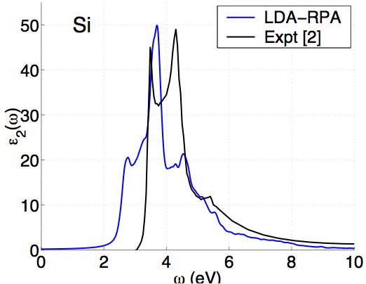
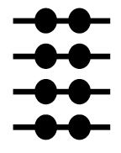
DFT - problems with excitations
ground state
Energy gaps (eV)
Optical absorption
Material | DFT | Expt.
Diamond | 3.9 | 5.48
Si | 0.5 | 1.17
LiCl | 6.0 | 9.4
SrTiO₃ | 2.0 | 3.25
DFT
Expt
DFT

Slide 4
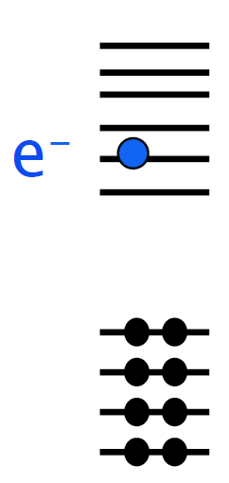
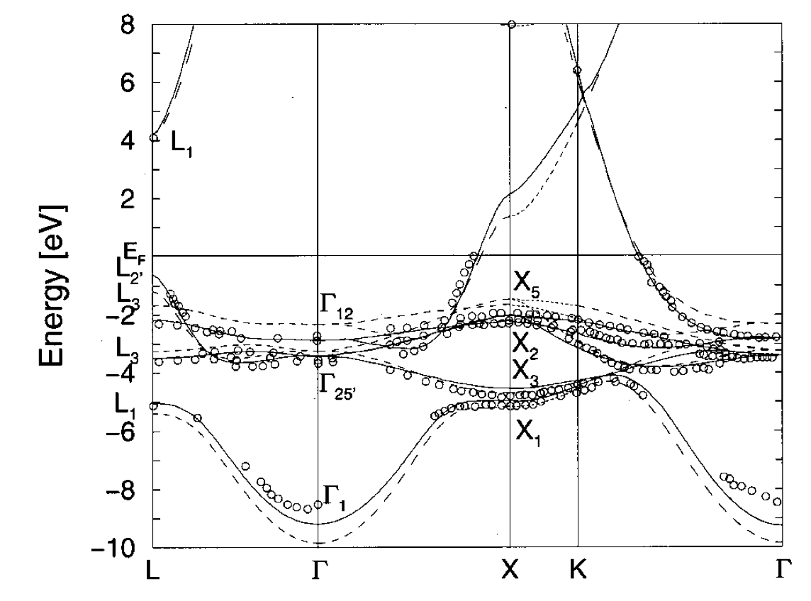
GW method
excited state
Band structure of Cu
Energy gaps (eV)
Material | DFT | GW | Expt.
Diamond | 3.9 | 5.6* | 5.48
Si | 0.5 | 1.3* | 1.17
LiCl | 6.0 | 9.1* | 9.4
SrTiO₃ | 2.0 | 3.4-3.8 | 3.25
DFT
O(N³)
GW
O(N⁴)
* Hybertsen & Louie, Phys. Rev. B (1986)
Strokov et al., PRL/PRB (1998/2001)

Slide 5
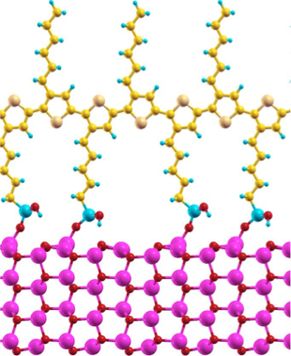
What is a big system for GW?
P3HT polymer
Band alignment for this potential
photovoltaic system?
100s of atoms/unit cell
Not possible routinely (with current software)
Zinc oxide nanowire

Slide 6
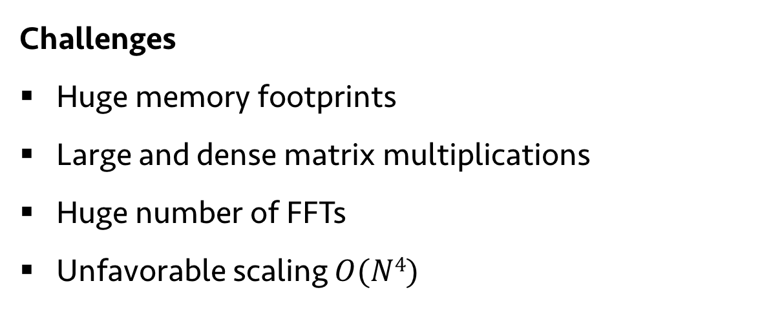
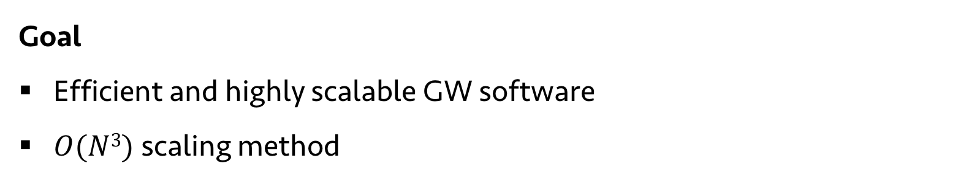
OpenAtom-GW code development
Challenges
Huge memory footprints
Large and dense matrix multiplications
Huge number of FFTs
Unfavorable scaling $O(N4)$
Goal
Efficient and highly scalable GW software
$O(N3)$ scaling method

Slide 7
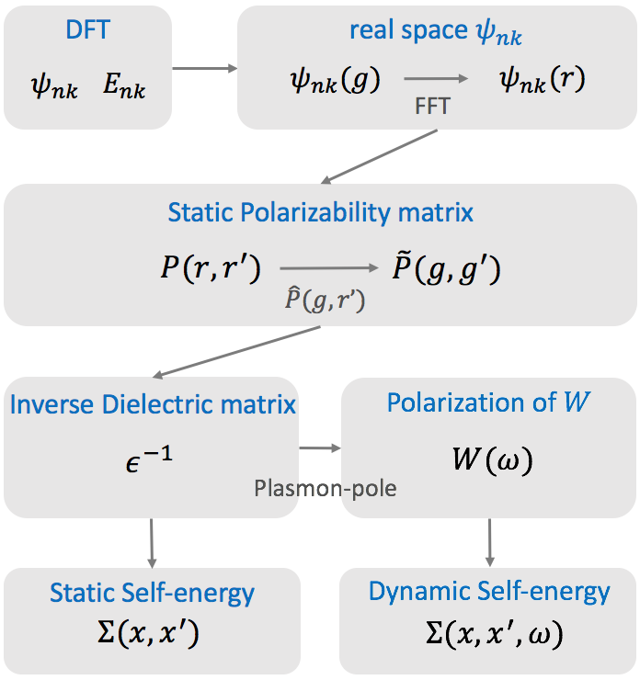
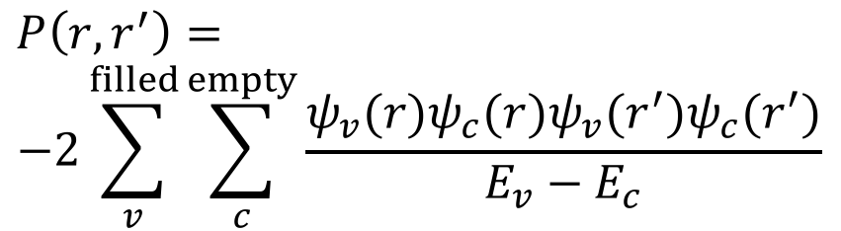
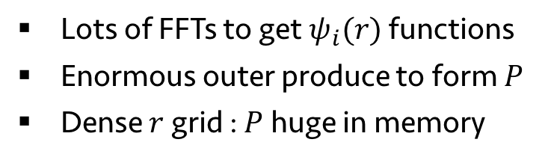
What is expensive in GW?
$$P\left(r,r^{′}\right)=$$
$$−2\sum_{v}^{filled}{\sum_{c}^{empty}{\frac{ψ_{v}(r)ψ_{c}(r)ψ_{v}(r^{′})ψ_{c}(r^{′})}{E_{v}−E_{c}}}}$$
Most expensive
Lots of FFTs to get $ψ_{i}(r)$ functions
Enormous outer produce to form $P$
Dense $r$ grid : $P$ huge in memory
Real-space representation of P matrix :
Reduces number of FFTs performed

Slide 8
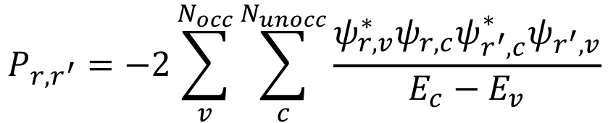
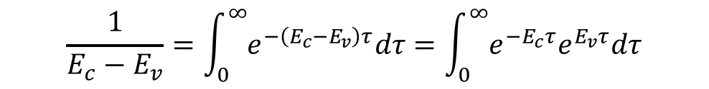
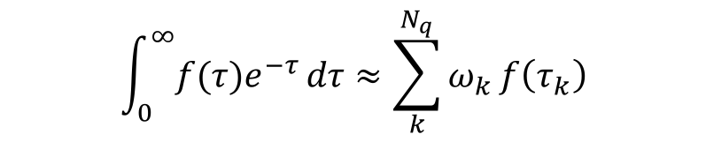
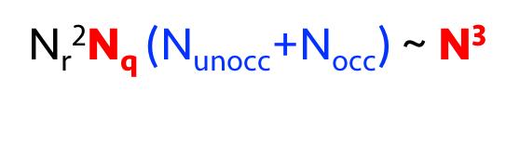
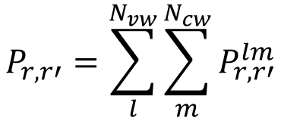
O(N³) algorithm for P
$$P_{r,r^{′}}=−2\sum_{v}^{N_{occ}}{\sum_{c}^{N_{unocc}}{\frac{ψ_{r,v}^{∗}ψ_{r,c}ψ_{r^{′},c}^{∗}ψ_{r^{′},v}}{E_{c}−E_{v}}}}$$
N_{r}²N_{unocc}N_{occ} ~ N⁴
$$\frac{1}{E_{c}−E_{v}}=\int_{0}^{∞}{e^{−\left(E_{c}−E_{v}\right)τ}dτ}=\int_{0}^{∞}{e^{−E_{c}τ}e^{E_{v}τ}dτ}$$
(1) Laplace transform:
$$\int_{0}^{∞}{{f(τ)e}^{−τ}}dτ≈\sum_{k}^{N_{q}}{ω_{k}}f\left(τ_{k}\right)$$
(2) Gauss-Laguerre quadrature:
N_{r}²N_{q} (N_{unocc}+N_{occ}) ~ N³
$$P_{r,r′}=\sum_{l}^{N_{vw}}{\sum_{m}^{N_{cw}}{P_{r,r′}^{lm}}}$$
(3) Energy windows:
$$N^{4}$$
$$N^{3}$$

Slide 9
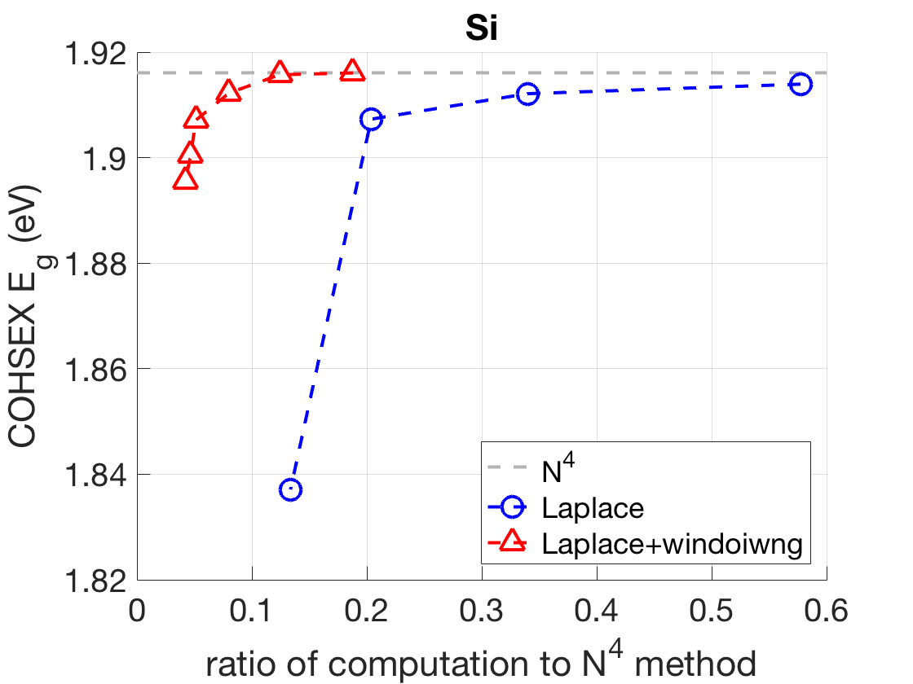
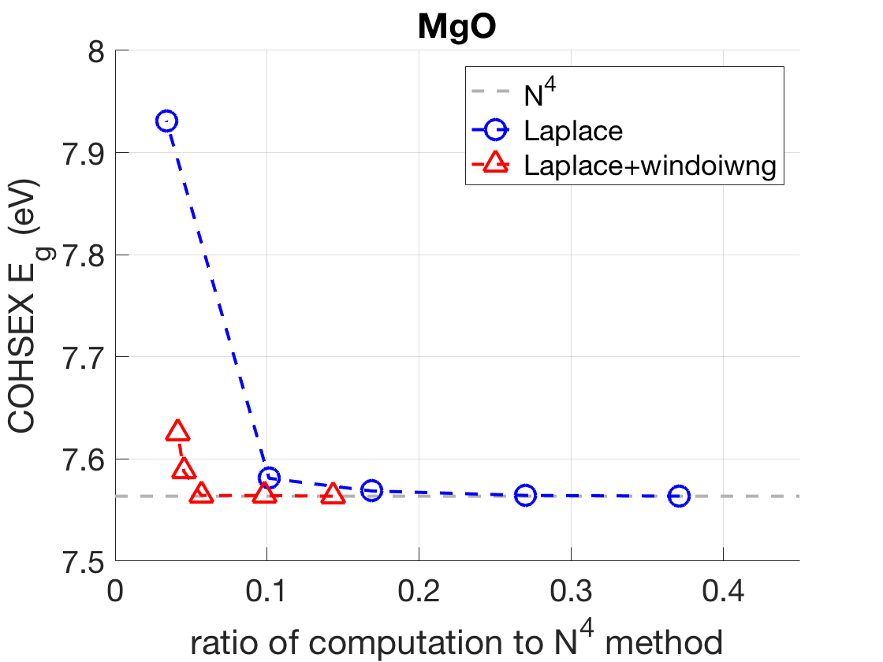
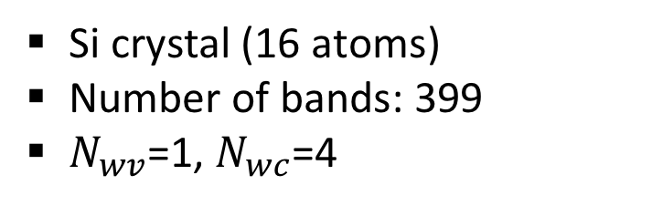
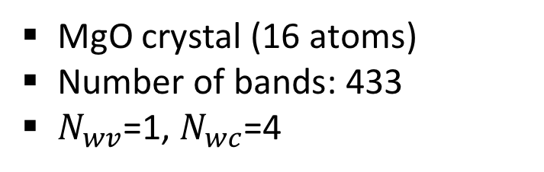
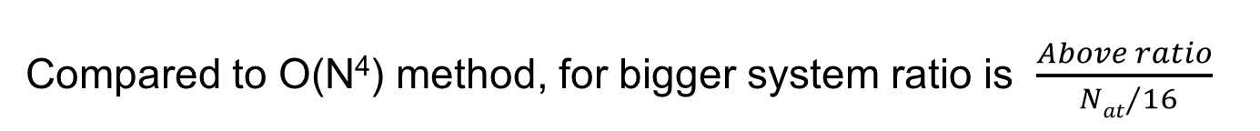
Results: Energy gap
Si crystal (16 atoms)
Number of bands: 399
$N_{wv}$=1, $N_{wc}$=4
MgO crystal (16 atoms)
Number of bands: 433
$N_{wv}$=1, $N_{wc}$=4
Compared to O(N⁴) method, for bigger system ratio is $\frac{Above ratio}{ {Nat}/{16}}$

Slide 10
Steps for typical GW calculations
Most expensive
Real-space P
O(N³) method
Also expensive - O(N⁴)

Slide 11
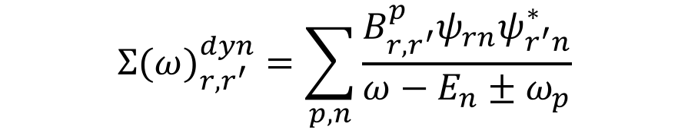
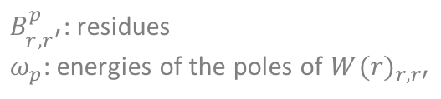
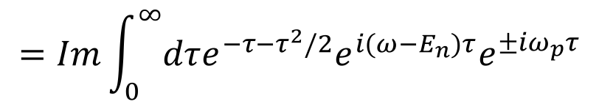
O(N³) method for self-energy
$${Σ(ω)}_{r,r^{′}}^{dyn}=\sum_{p,n}{\frac{B_{r,r^{′}}^{p}ψ_{rn}ψ_{r^{′}n}^{∗}}{ω−E_{n}±ω_{p}}}$$
$B_{r,r^{′}}^{p}$: residues
$ω_{p}$: energies of the poles of ${W(r)}_{r,r′}$
The denominator ($ω−ε_{n}±ω_{p}$) can change sign: Gauss-Laguerre quadrature not applicable
New quadrature is needed and was developed: Hermite-Gauss-Laguerre quadrature
$$\frac{1}{ω−E_{n}±ω_{p}}=Im\int_{0}^{∞}{dτe^{−τ−τ^{2}/2}e^{i(ω−E_{n}±ω_{p})τ}}$$
$$=Im\int_{0}^{∞}{dτe^{−τ−τ^{2}/2}e^{i(ω−E_{n})τ}e^{±{iω}_{p}τ}}$$
$$N^{4}$$
$$N^{3}$$

Slide 12
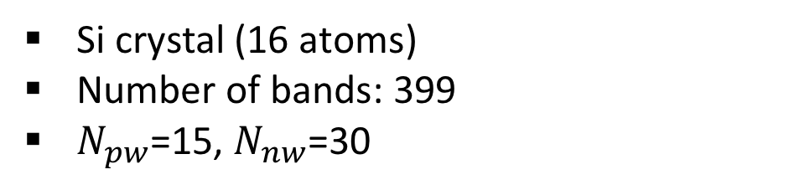
Results: Energy gap
Si crystal (16 atoms)
Number of bands: 399
$N_{pw}$=15, $N_{nw}$=30

Slide 13
OpenAtom GW
Parallel Scaling
OpenAtom Team

Slide 14
GW-BSE Parallelization
Phase |  | Serial | Parallel
1 | Compute P in RSpace | Complete | Complete
2 | FFT P to GSpace | Complete | Complete
3 | Invert epsilon | Complete | Complete
4 | Plasmon pole | Complete | Future Work
5 | COHSEX Self-energy | Complete | Complete
6 | Dynamic Self-energy | Complete | Future Work
OpenAtom GW 1.0 has been released and is available at https://charm.cs.illinois.edu/gerrit/openatom.git

Slide 15
GW Phase-I
P Matrix Computation (N⁴ method)
Ψ Vectors
1D Chare Array
L occupied
M unoccupied
…
R
P Matrix
2D Tiles
2D Chare Array
R
R

Slide 16
Parallel Decomposition
Duplicate occupied states on each node
ψ
ψ
ψ
Psi Cache
Psi Cache

Slide 17
Parallel Decomposition
Duplicate occupied states on each node
Broadcast an unoccupied state to compute f vectors
ψ
ψ
ψ
ψ
F Cache
F Cache
Psi Cache
Psi Cache

Slide 18
Parallel Decomposition – Scaling Improvements
Duplicate occupied states on each node
Broadcast an unoccupied state to compute f vectors
Locally update each matrix tile
P
P
P
P
P
P
P
P
P
F Cache
F Cache
Psi Cache
Psi Cache

Slide 19
Computation of F-Vectors
PMatrix is formed from outer product of f-vectors
Compute only portions of F-vectors on each node corresponding to the PMatrix tiles on the node
F-vector computation
Reduced Computation
Reduced memory usage
P Matrix
2D Tiles
2D Chare Array
R
R

Slide 20
Scaling Results on Bluewaters

Slide 21
Scaling Results on Mira

Slide 22
Parallel Decomposition – Sigma Computation
Cache portions of f vectors during P calculation
Multiply all pairs of f_{nl}
Sum reduction for final result
Very Little Communication
F Cache
Psi Cache

Slide 23
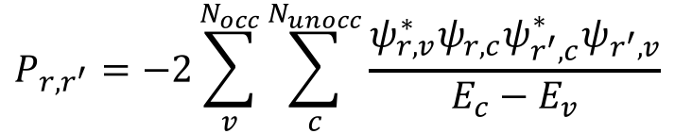
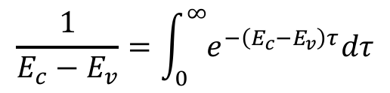


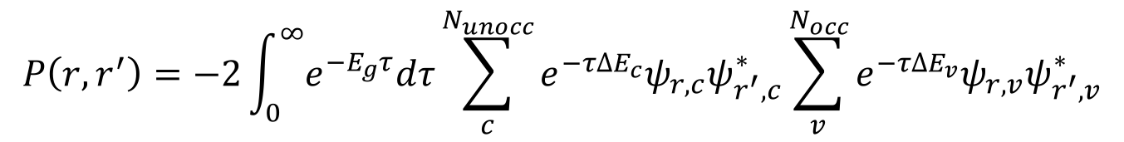

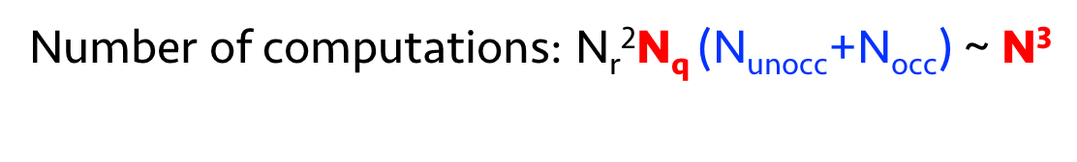
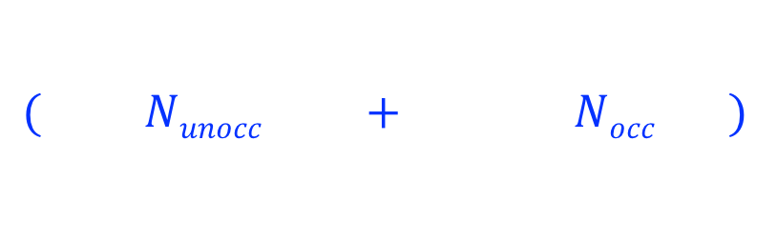
O(N³) algorithm
$$P_{r,r^{′}}=−2\sum_{v}^{N_{occ}}{\sum_{c}^{N_{unocc}}{\frac{ψ_{r,v}^{∗}ψ_{r,c}ψ_{r^{′},c}^{∗}ψ_{r^{′},v}}{E_{c}−E_{v}}}}$$
N_{r}²N_{unocc}N_{occ} ~ N⁴
$$\frac{1}{E_{c}−E_{v}}=\int_{0}^{∞}{e^{−\left(E_{c}−E_{v}\right)τ}dτ}$$
(1) Laplace transform:
$$P\left(r,r^{′}\right)=−2\int_{0}^{∞}{e^{−E_{g}τ}dτ}\sum_{c}^{N_{unocc}}{e^{−τ∆E_{c}}ψ_{r,c}ψ_{r^{′},c}^{∗}}\sum_{v}^{N_{occ}}{e^{−τ∆E_{v}}ψ_{r,v}ψ_{r^{′},v}^{∗}}$$
$$E_{g}≡E_{c,min}−E_{v,max}$$
$$∆E_{c}≡E_{c}−E_{c,min}$$
$$∆E_{v}≡E_{v,max}−E_{v}$$
$($ $Nunocc$ $+$ $Nocc$ $)$
$$\int_{0}^{∞}{{f(τ)e}^{−τ}}dτ≈\sum_{k}^{N_{q}}{ω_{k}}f\left(τ_{k}\right)$$
(2) Gauss-Laguerre quadrature:
Number of computations: N_{r}²N_{q} (N_{unocc}+N_{occ}) ~ N³

Slide 24
GW Phase-I
Pmatrix Computation (N^3 method)

Slide 25
Parallel Decomposition – N³ method
Duplicate occupied states and partition unoccupied on each node
Compute rho, rho-bar and PMatrix tiles
Communicate cached unoccupied states to neighbors and continue step 2.
P
P
P
P
P
P
P
P
P
P
P
P
P
P
F Cache
F Cache
F Cache
Psi Cache
Psi Cache
Psi Cache

Slide 26



Parallel Decomposition – N³ method
Duplicate occupied states on each node
Duplicate portion of unoccupied states on each node
Locally compute rho, rho-bar and Pmatrix tiles
P
P
P
P
P
P
P
P
P
P
P
P
P
P
F Cache
F Cache
F Cache
Psi Cache
Psi Cache
Psi Cache

Slide 27
Future Plans
Implement N³ dynamic sigma and analyze performance
Questions?

Slide 28
Back up slides

Slide 29
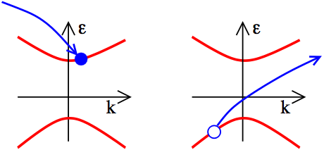
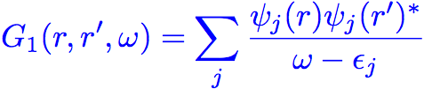

One particle Green’s function
(r’,0)
(r,t)
Dyson Equation:
DFT:

Slide 30
P matrix: real-space approach
Standard G-space approach
R-space approach
FFT
FFT
Directly compute P in G space
Number of FFTs : N_{occ} N_{unocc}
Number of FFTs : 2N_{r} ~ 8N_{unocc}
 | G-space | R-space
#FFT | N_{occ}N_{unocc} | 8N_{unocc}
N_{occ}=500 N_{unocc}=1,500 | 750,000 | 12,000
N_{occ} : # occupied states
N_{unocc} : # unoccupied states
N_{G} : # of G grids
N_{r} : # of R grids

Slide 31
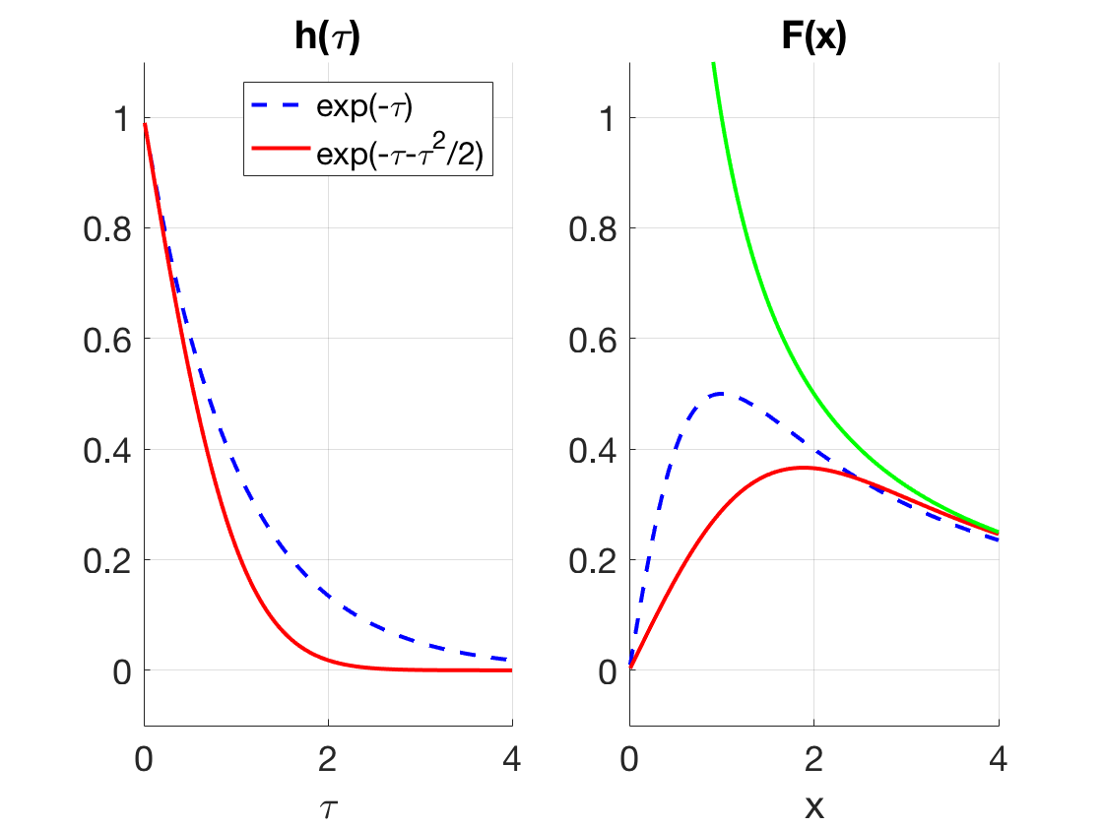
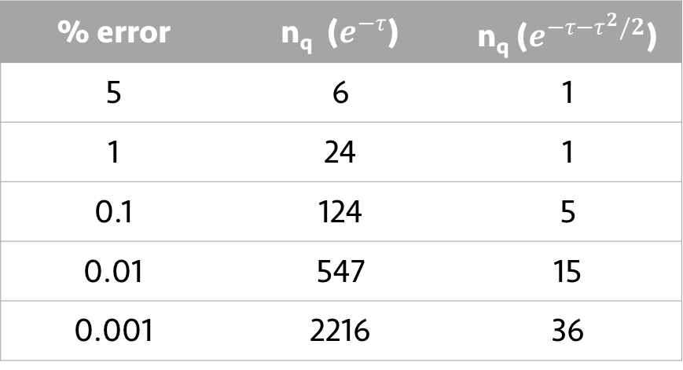


New quadrature for self-energy
$h\left(τ\right)=e^{−τ}$ $→ F(x)=\int_{0}^{∞}{dτe^{−τ}\sin{(τx)}}$
(Lorentzian)
$h\left(τ\right)=e^{−τ−τ^{2}/2}$ $→ F(x)=\int_{0}^{∞}{dτe^{−τ−τ^{2}/2}\sin{(τx)}}$
$$\frac{1}{x}$$
Size of quadrature grid at $x=1$
% error | n_{q} ($e^{−τ}$) | n_{q} ($e^{−τ−τ^{2}/2}$)
5 | 6 | 1
1 | 24 | 1
0.1 | 124 | 5
0.01 | 547 | 15
0.001 | 2216 | 36

