Slide 1


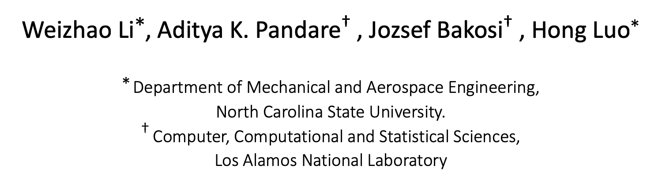
Adaptive Discontinuous Galerkin Method for Compressible Flow Using Charm++
Weizhao Li∗, Aditya K. Pandare† , Jozsef Bakosi† , Hong Luo∗
∗ Department of Mechanical and Aerospace Engineering,
North Carolina State University.
† Computer, Computational and Statistical Sciences,
Los Alamos National Laboratory

Slide 2
Outline
Motivation
Quinoa
Governing Equations
Numerical Method
  Discontinuous Galerkin Discretization
  Adaptive Scheme
    Error Indicator based p-refinement
    Propagation of refinement
Numerical Experiments
Summary

Slide 3

Motivation
Discontinuous Galerkin method is suitable for solving hyperbolic system
  However, the cost for high order DG is expensive
Adaptive DG method could reduce the cost
Different order of polynomial of numerical solution leads to unbalanced load
  Need to use dynamic load balancing technique
$$⟹Charm++$$

Slide 4

Quinoa
Computational tools for fluid dynamics
Written in modern C++
Production-style, rigorously tested
Asynchronous, distributed-memory parallel programming
Fully unstructured tetrahedral mesh support
Dynamic load balancing and automatic object migration using Charm++
Open source: https://github.com/quinoacomputing/quinoa

Slide 5
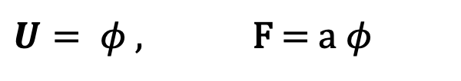
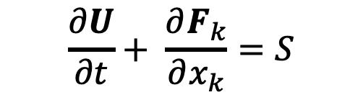
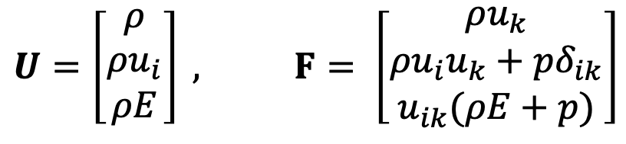
Governing Equations
Transport phenomena represented by system of (non-linear) PDEs
Scalar equation
Euler equations
$$\frac{∂U}{∂t}+ \frac{∂F_{k}}{∂x_{k}}=S$$
$U= φ$ , F = a$φ$
$$U=\left[\begin{aligned}ρ \\ ρu_{i} \\ ρE\end{aligned}\right] , F= \left[\begin{aligned}ρu_{k} \\ ρu_{i}u_{k}+pδ_{ik} \\ u_{ik}(ρE+p)\end{aligned}\right]$$

Slide 6
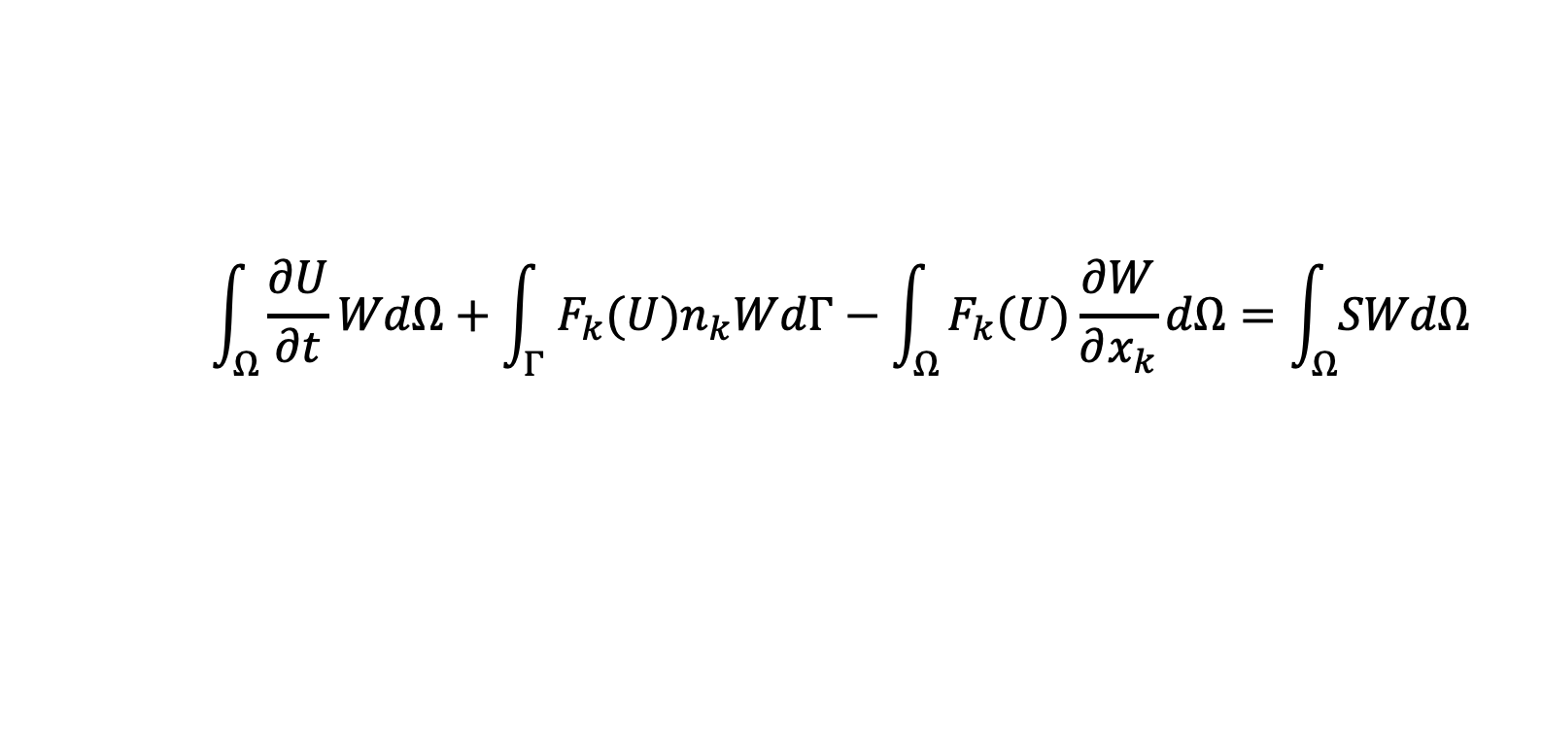
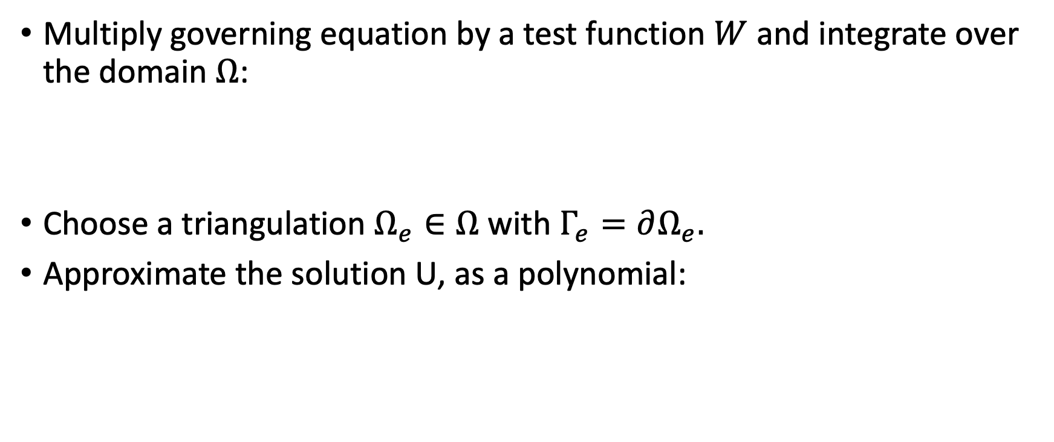
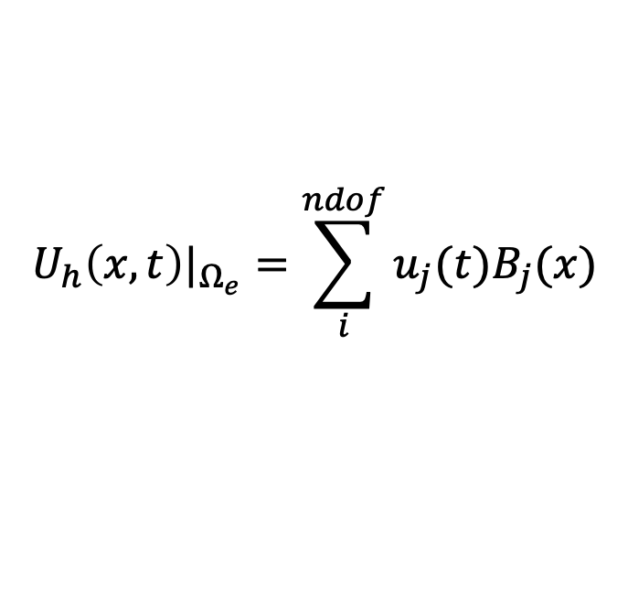
Discontinuous Galerkin Discretization
Multiply governing equation by a test function $W$ and integrate over the domain $Ω$:
Choose a triangulation $Ω_{e}∈Ω$ with $Γ_{e}=∂Ω_{e}.$
Approximate the solution U, as a polynomial:
$$\int_{Ω}^{ }{\frac{∂U}{∂t}WdΩ}+\int_{Γ}^{ }{F_{k}{(U)n}_{k}WdΓ−\int_{Ω}^{ }{F_{k}(U)\frac{∂W}{∂x_{k}}dΩ}=\int_{Ω}^{ }{SWdΩ}}$$
$$U_{h}\left(x,t\right)|_{Ω_{e}}=\sum_{i}^{ndof}{u_{j}(t)B_{j}(x)}$$

Slide 7
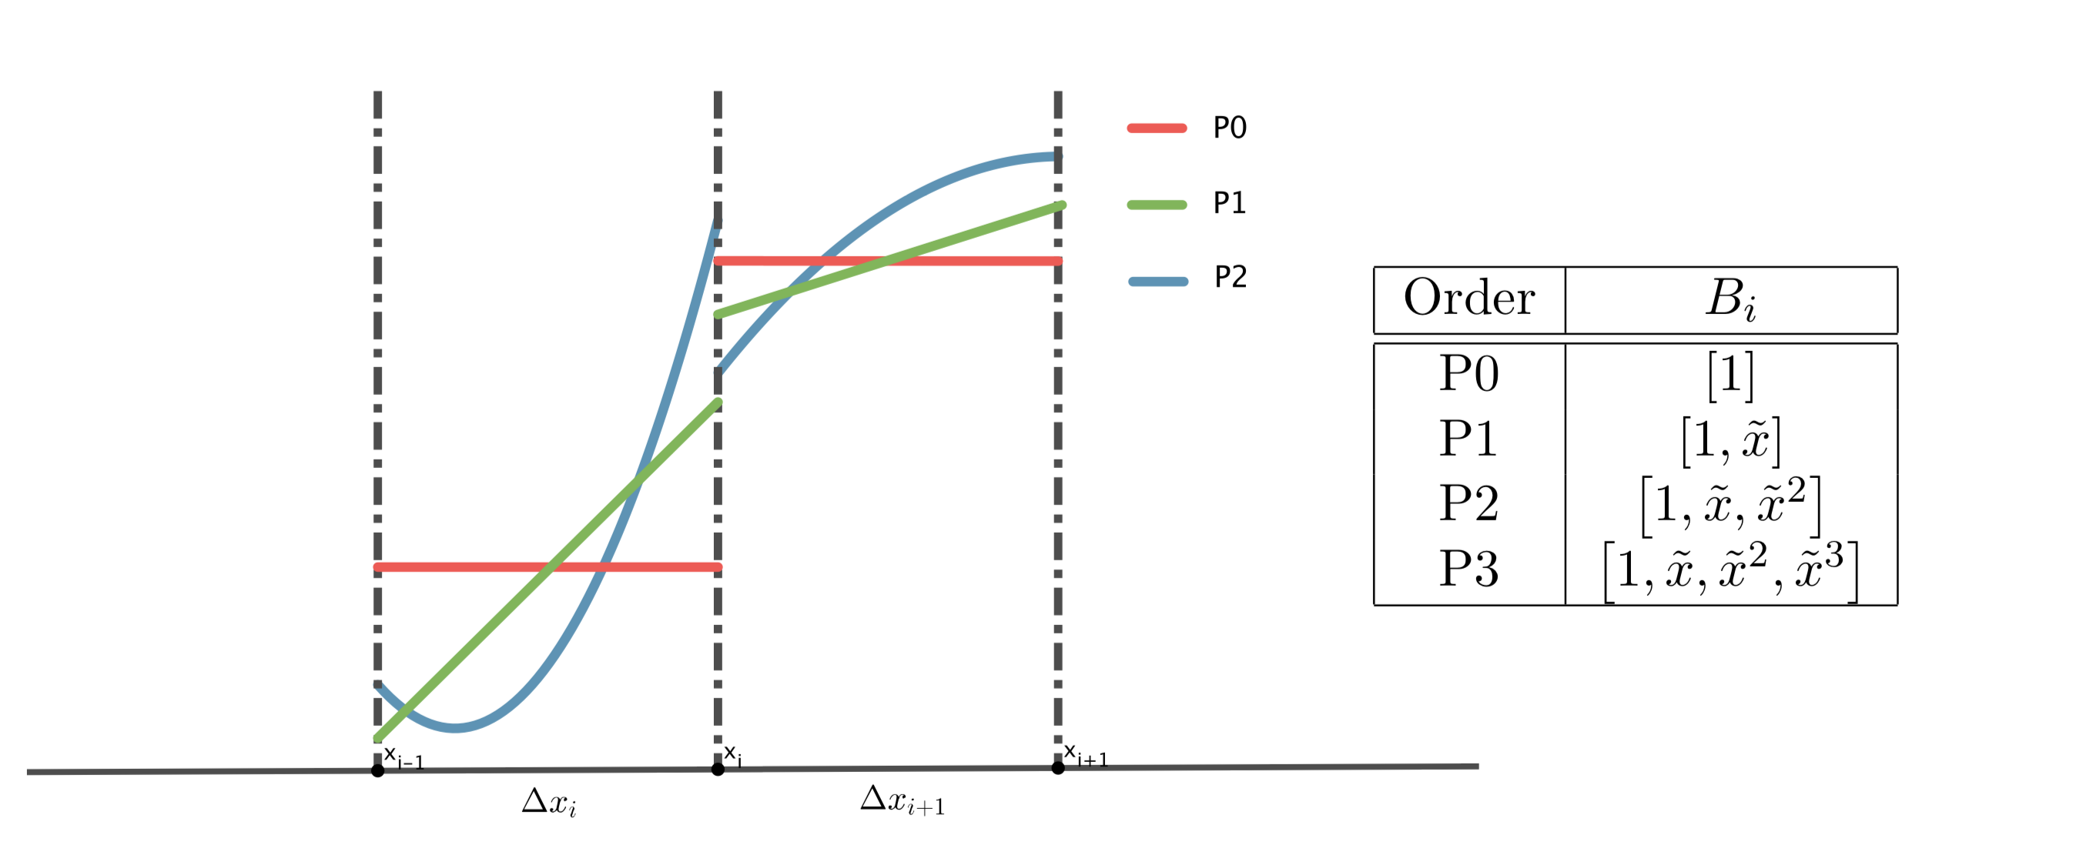
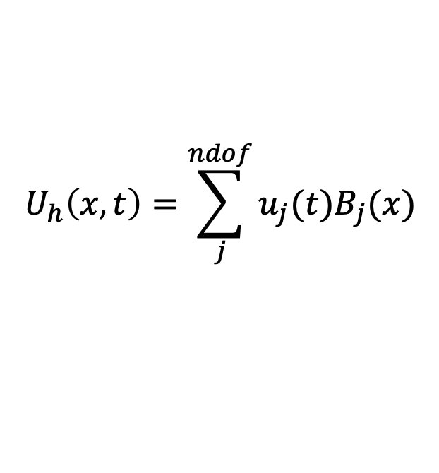
Discontinuous Galerkin Solutions
$$U_{h}\left(x,t\right)=\sum_{j}^{ndof}{u_{j}(t)B_{j}(x)}$$
Finite element solutions:

Slide 8
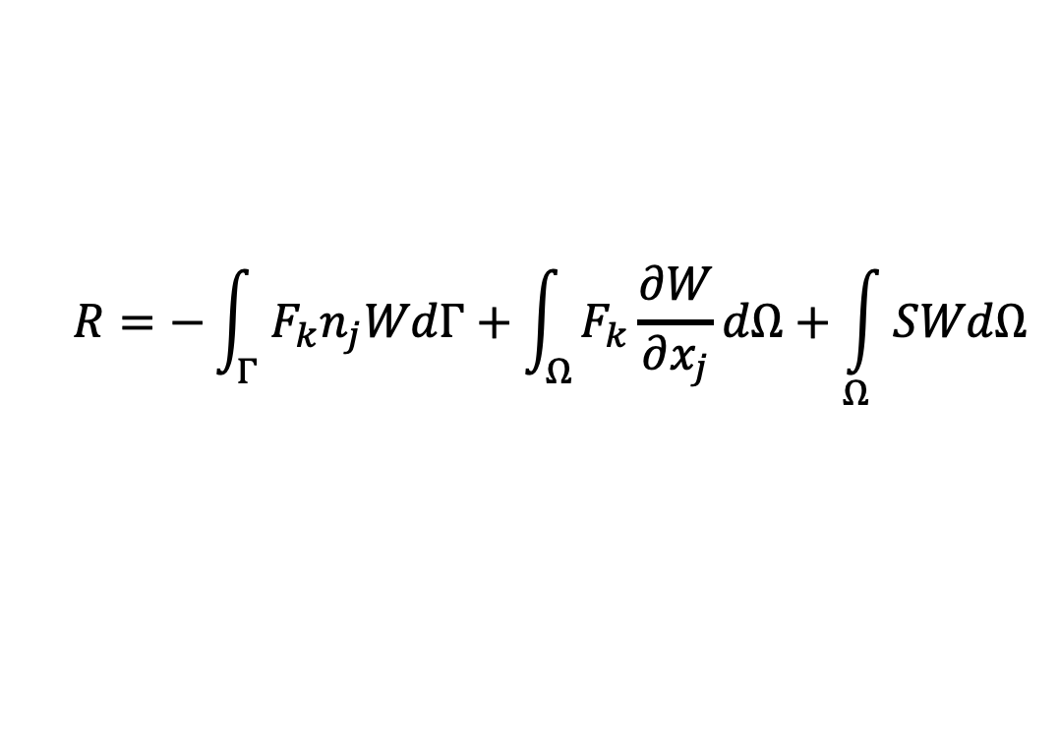
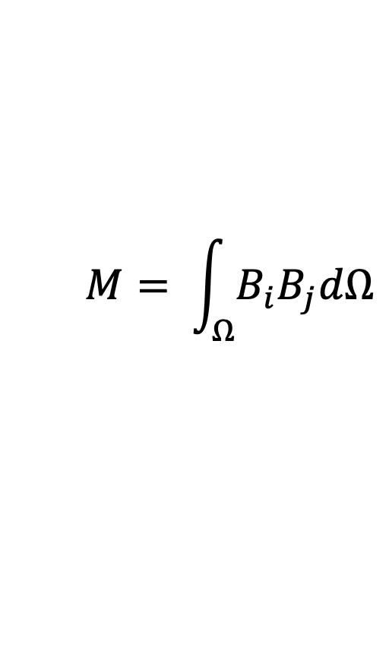
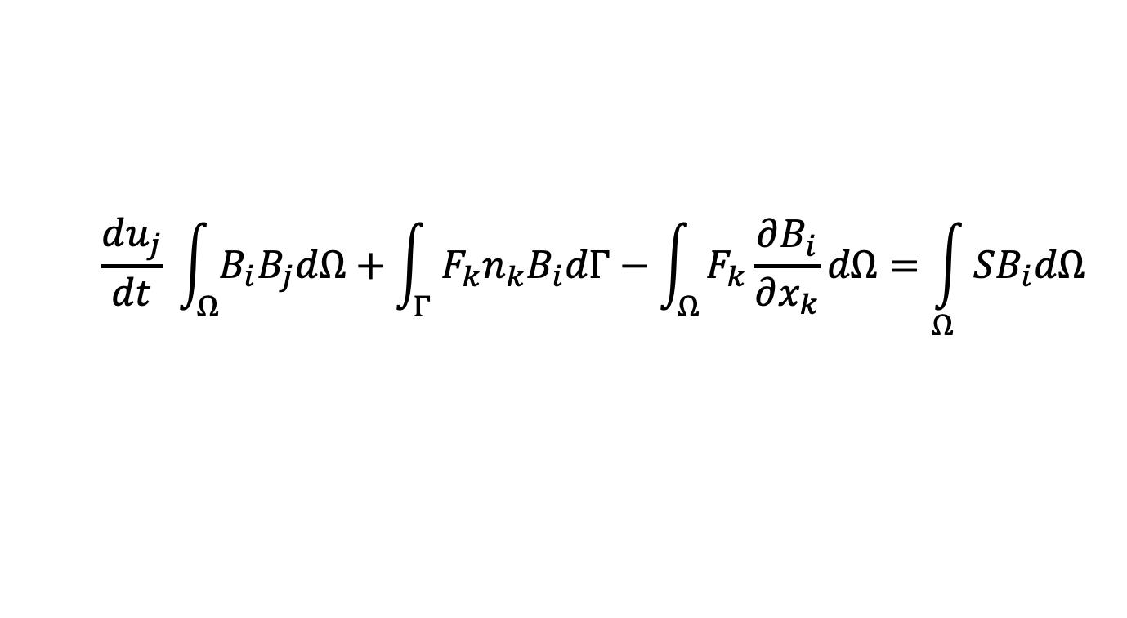
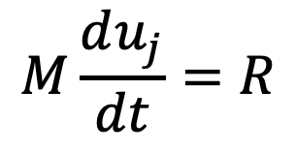
ODE system
The above weak formulation could be written per element using the numerical solution approximation:
which leads to a system of ODEs:
$$\frac{du_{j}}{dt} \int_{Ω}^{ }{B_{i}B_{j}dΩ}+\int_{Γ}^{ }{F_{k}n_{k}B_{i}dΓ−\int_{Ω}^{ }{F_{k}\frac{∂B_{i}}{∂x_{k}}dΩ}=\int_{Ω}^{ }{SB_{i}dΩ}}$$
$$M\frac{du_{j}}{dt}=R$$
$$M= \int_{Ω}^{ }{B_{i}B_{j}dΩ}$$
$$R=−\int_{Γ}^{ }{F_{k}n_{j}WdΓ+\int_{Ω}^{ }{F_{k}\frac{∂W}{∂x_{j}}dΩ}+\int_{Ω}^{ }{SWdΩ}}$$

Slide 9
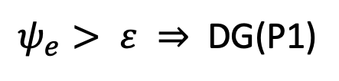
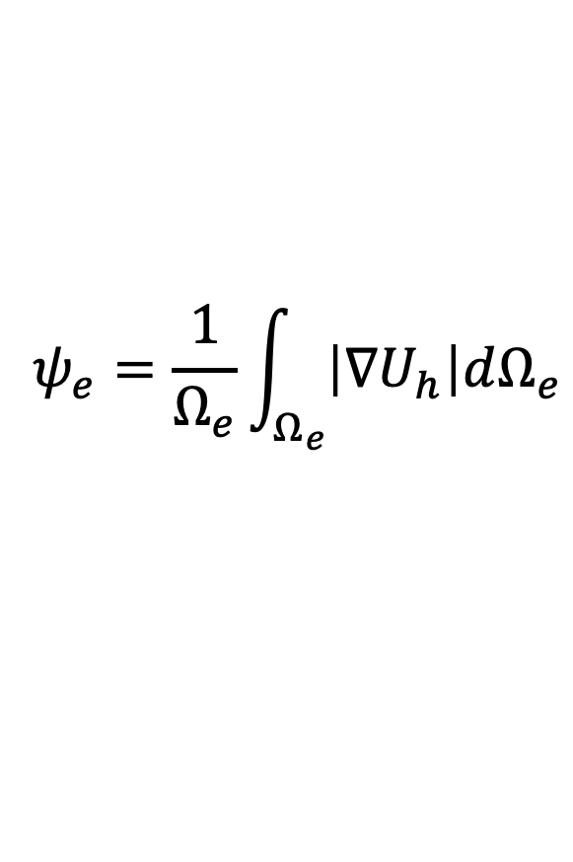
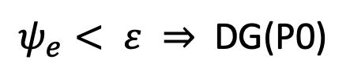
Adaptive Scheme
I. Error Indicator based p-refinement
Use a posteriori local error indicator to determine where the order of element solution should be refined or coarsened
In the present P0/P1 adaptive work, we choose the gradient of the solution as our error indicator.
$$ψ_{e}=\frac{1}{Ω_{e}}\int_{Ω_{e}}^{ }{\left|∇U_{h}\right|dΩ_{e}}$$
$ψ_{e}> ε ⇒$ DG(P1)
$ψ_{e}< ε ⇒$ DG(P0)

Slide 10
Adaptive Scheme
II. Propagation of refinement
For elements which have been promoted to P1 based on error indicator, the immediately neighboring elements will also be promoted to high order DG
DG(P0)
DG(P1)
DG(P1)
DG(P1)
DG(P0)
DG(P0)
DG(P1)
DG(P1)

Slide 11
Adaptive Scheme
Communication
PE #1
PE #2
element i
element j
element i
element j

Slide 12
Adaptive Scheme
Description of the adaptive process
Solve
Check exit condition
Output
Propagation of Refinement
Error Indicator Estimation

Slide 13


Adaptive Scheme
Sources of unbalanced load
PE #1
PE #2
$$u=\left[\begin{aligned}u_{0} \\ u_{1} \\ u_{2}\end{aligned}\right]$$
DG (P1)
DG(P0)
$$u =u_{0}$$

Slide 14

Adaptive Scheme
Sources of unbalanced load
PE #1
PE #2
DG(P1)
DG(P0)
$$⟹Dynamic Load Balancing$$

Slide 15
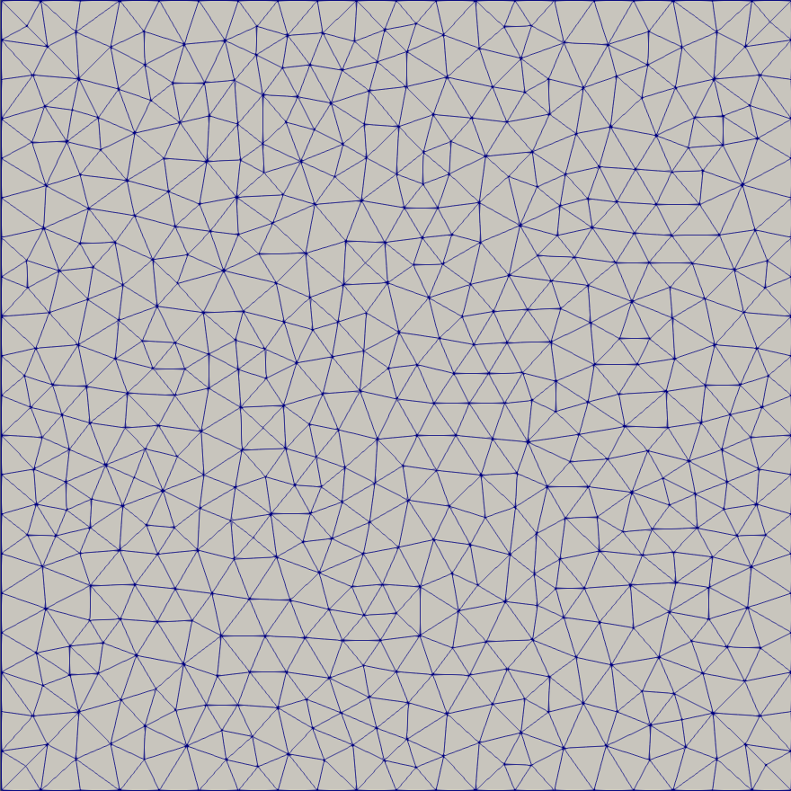
Numerical Experiments
Gaussian Hump
2D linear advection equation
Analytical solution which allows for a grid convergence study
3D tetrahedron mesh

Slide 16
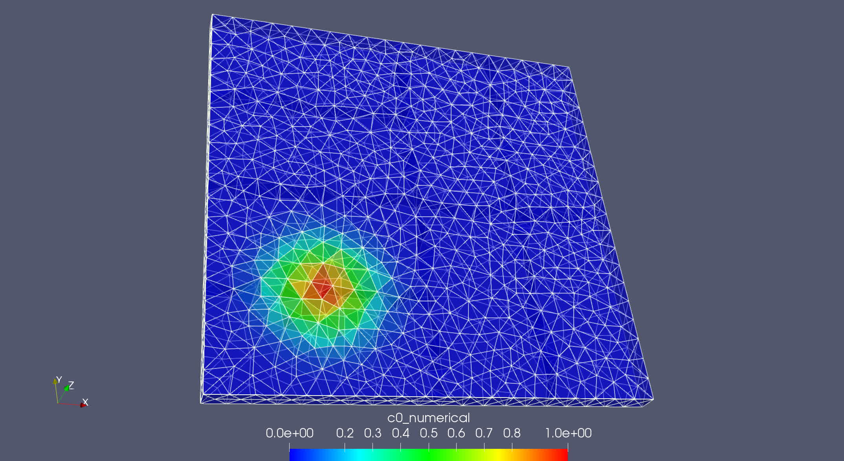
Gaussian Hump

Slide 17
Gaussian Hump
Number of tetrahedron: 233k
Number of processor: 8
Load Balancer: GreedyRefineLB
Configuration | Elapsed Time(m:s)
8 partitions, DG(P1), No LB | 4:54
8 partitions, Adaptive DG, No LB | 4:05
39 partitions, Adaptive DG, With LB | 2:26
8 partitions, DG(P0), No LB | 1:30

Slide 18
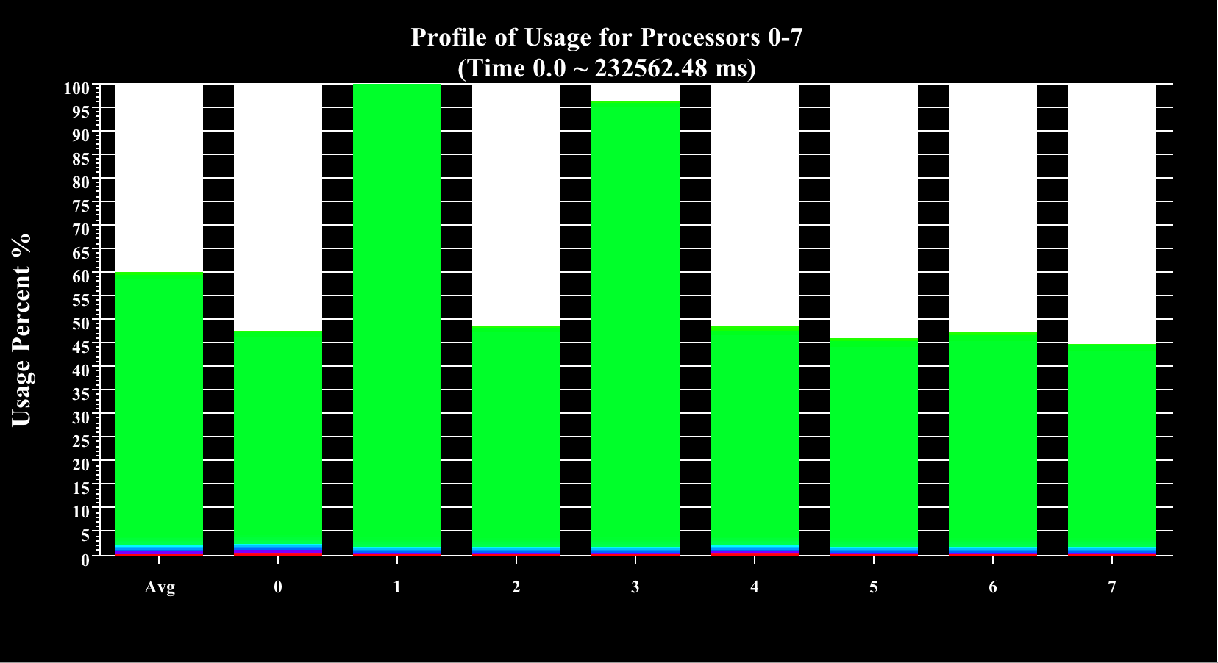
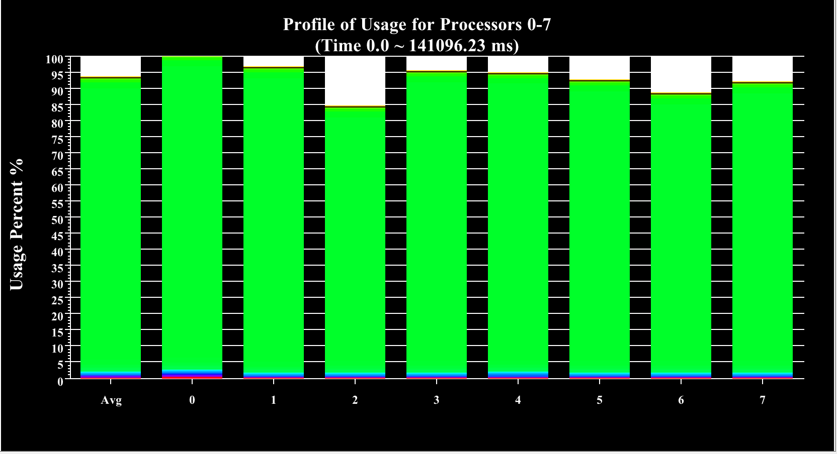
Gaussian Hump
Time Usage Chart
(8 cores, 8 partitions, Adaptive DG, No LB)
(8 cores, 39 partitions, Adaptive DG, With LB)

Slide 19
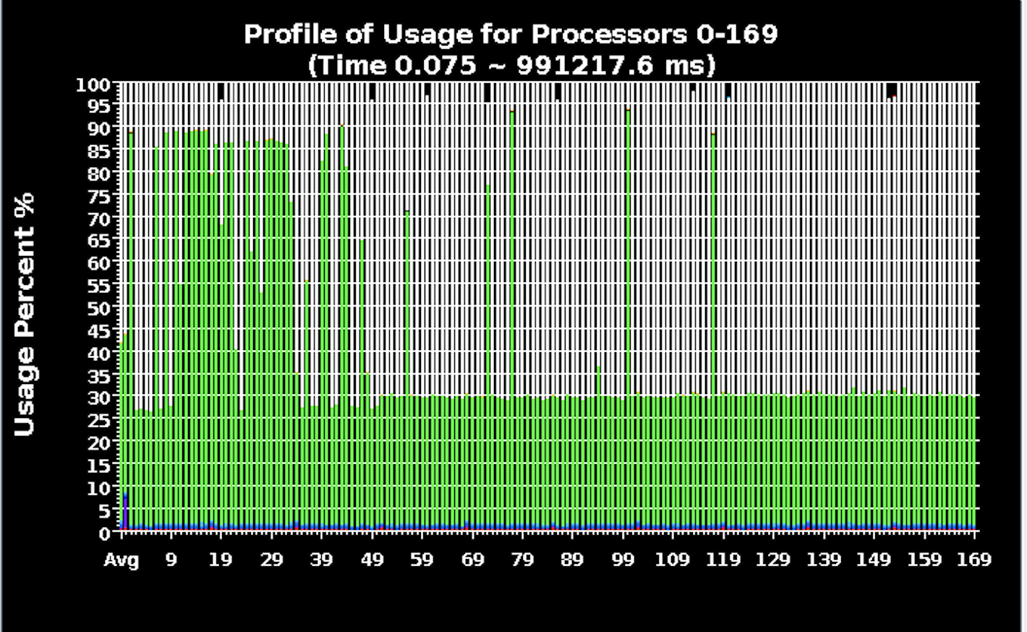
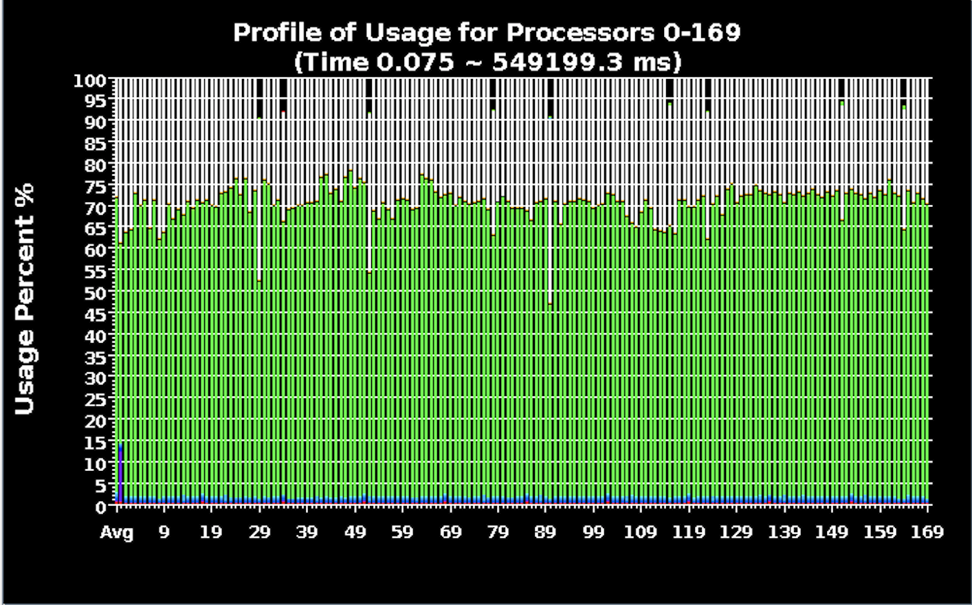
Gaussian Hump
Time Usage Chart
(170 cores, Adaptive DG, No LB)
(170 cores, Adaptive DG, With LB)

Slide 20
Numerical Experiments
Sedov Blast
Euler equations
Verification problem for hydrodynamics
Testing adaptive scheme for extreme shock waves

Slide 21
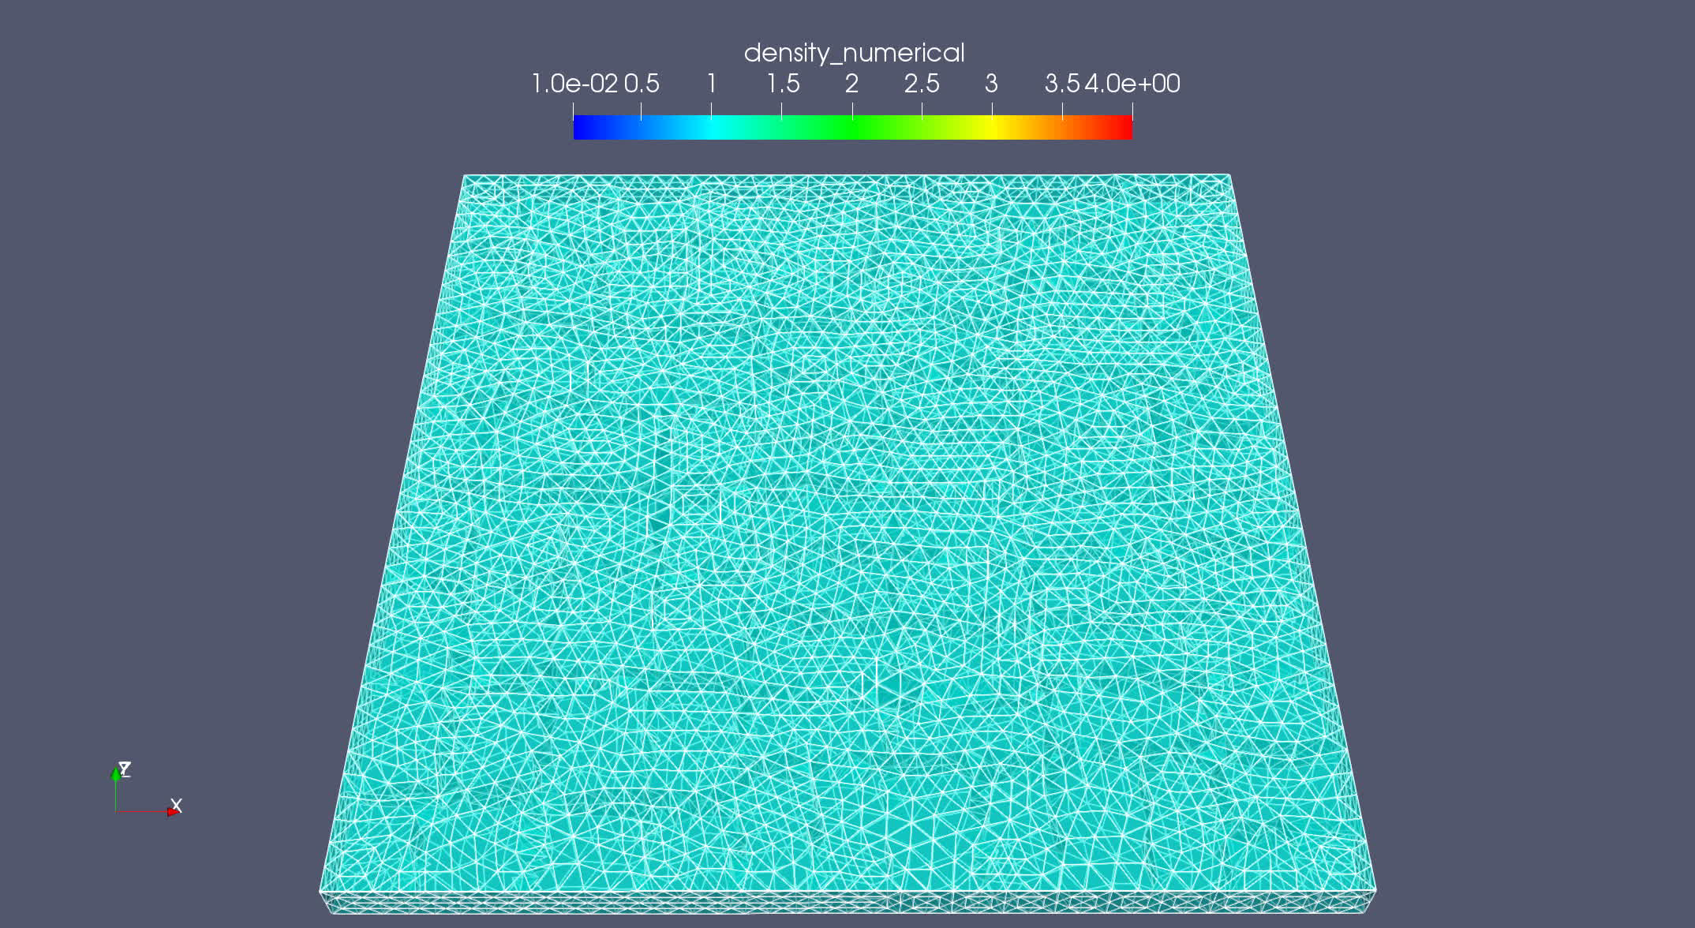
Sedov Blast

Slide 22
Summary
DG P0, P1 and P2 implemented into our code base and been verified the robustness and accuracy of our numerical scheme
An adaptive DG P0/P1 scheme has been developed.
The adaptive scheme combined with load balancing techniques significantly increase the computation efficiency
Future Works
Achieve DG P0/P1/P2 adaptive scheme
Test with more error indicator options
Run more demanding testcases on HPC system

Slide 23
Thank you!

