Slide 1
Dynamically Turning Cores Off for Performance And Energy in Charm++
Kavitha Chandrasekar

Slide 2
Objective
Enable turning PEs/cores off at runtime to improve performance/energy usage
Some HPC applications have high memory bandwidth requirements
Running an application with all cores on a node is not necessarily the best performing configuration
Add support for turning off cores in Charm++ at run time

Slide 3
Turning Off Cores (PEs) in Charm++ at run time
Invoke LB – Migrate chares away from inactive cores to active cores on each node
Call conditional wait on idle PEs (pthreads) so converse scheduler on idle PEs are not using cores
Reductions
  Rank 0 handles reduction contribution for idle PEs on each node
Message Delivery
  Location Manager for idle PEs is not available
  Currently store Location Manager information on all PEs
    To implement: node-level location manager

Slide 4
Automating Turning Off PEs
In order to turn cores off at runtime we use the steps below:
  Uses AtSync calls to call LB and store profiling information
  At each of the profiling steps, the runtime decrements core count by one starting at max core count
  The runtime records a) Execution time and b) Energy Usage corresponding to the configuration
At the end of profiling phase, the runtime sets the number of cores on all nodes uniformly to the best performing/lowest energy core count

Slide 5
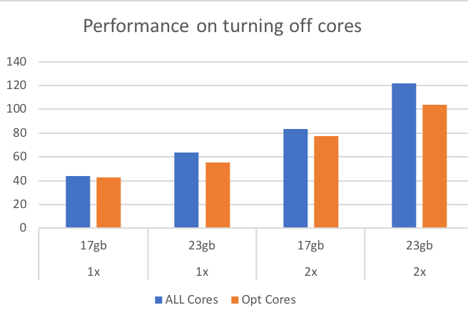
Performance goal
12 core Intel Haswell machine with 32GB DRAM
Stencil3D with upto 23GB memory allocation
High memory bandwidth requirement
Finds configuration with lowest execution time
6-8 cores perform better than all cores

Slide 6

Energy tradeoffs/benefits
6 core Sandy Bridge, 16GB DRAM
Stencil3D with upto 5GB dataset
Finds configuration with the lowest energy consumption
Might be useful to consider cases where performance is within a certain threshold

Slide 7
Future Work
Use feature to turn off PEs mapped to SMT cores automatically to improve performance
  eg: KNL support upto 4-way SMT
Improve implementation
  Disable pup for arrays during intra-node migrations
  Enable Location Manager support at node level

