Slide 1


Recent Developments in Dynamic Load Balancing in Charm++
Ronak Buch, Kavitha Chandrasekar, Juan Galvez
rabuch2@illinois.edu
Parallel Programming Laboratory, University of Illinois at Urbana-Champaign

Slide 2
LB Framework Revamp

Slide 3
LB Framework Revamp
Supports two independent load balancing modes:
AtSync (from now on the default)
Removed timer dependency
Periodic (only if +LBPeriod is used)
Migratable chares must support anytime migration. This is generally true automatically with charm4py
(manual mode -using CkStartLB- removed)
Remove many unused/deprecated load balancing strategies
Keeping Greedy, GreedyRefine, Refine, Random, …, DistributedLB, Dummy, Rotate
Software redesign of internal infrastructure to improve readability and code maintenance
New hierarchical load balancing framework (called TreeLB) replaces the old centralized (CentralLB) and hierarchical (HybridLB)

Slide 4
TreeLB
Many performance optimizations (load balancing times substantially reduced)
Simpler to write load balancing strategies
Current built-in trees:
PE_Root (equivalent to old CentralLB)
PE_Process_Root
PE_Process_ProcessGroup_Root
Other custom hierarchies can be implemented (advanced)
For the built-in trees, users can configure:
Strategies used at each level
Frequency at which lb occurs at each level (e.g. balance frequently within-process, and less frequently between processes or hosts)

Slide 5
Configuring TreeLB
Configuration file (JSON format) passed at application start
TreeLB can also be (re)configured at runtime, constructing a JSON object with provided API
Basic format is:
{
"tree" : tree_name,
"levelA" : {
# options for level A
"step_freq" : N, # lb at this level every N steps
"strategies" : [strategyA, strategyB, ...],
"strategyA" : {
# options for strategy A at level A
}
},
"levelB" : {
# options for level B
"strategies" : [strategyB, strategyC, ...]
"strategyC" : {
# options for strategy C at level B
}
}
}

Slide 6
TreeLB configuration example
{
"tree": "PE_Process_ProcessGroup_Root",
"Root": {
"pe": 0, # tree root runs on PE 0
"step_freq": 9
},
"ProcessGroup": {
"num_groups": 4, # divide processes into 4 groups
"step_freq": 3,
"strategies": ["GreedyRefine", "RefineA",
"Random"],
"repeat_strategies": true,
"GreedyRefine": {
"tolerance": 1.05
}
},
"Process": {
"strategies": ["GreedyRefine"],
"GreedyRefine": {
"tolerance": 1.01,
}
}
}
Can use multiple strategies at each level. Current options:
Loop through strategies
Go through sequence, and then repeat last one

Slide 7
TreeLB runtime configuration
Charm++:
Charm4py:
json config;
config["tree"] = "PE_Root";
config["Root"]["strategies"] = {"GreedyRefine"};
config["Root"]["GreedyRefine"]["tolerance"] = 1.03;
lbmanager->configureTreeLB(config); // *Need to do on every PE*
config = {} # empty Python dictionary
config['tree'] = 'PE_Root'
config['Root']['GreedyRefine'] = { 'tolerance' : 1.03 }
config['Root']['strategies'] = ['GreedyRefine']
charm.thisProxy.configureTreeLB(config, ret=True).get() # thread blocks

Slide 8
Writing LB Strategies for TreeLB
template <typename O, typename P, typename S>
class Greedy : public Strategy<O,P,S>
{
public:
void solve(vector<O> &objs, vector<P> &procs, S &solution, bool objsSorted)
{
if (!objsSorted) sort(objs.begin(), objs.end(), CmpLoadGreater<O>());
priority_queue<P, vector<P>, CmpLoadGreater<P>> procHeap(CmpLoadGreater<P>(), procs);
for (const auto &o : objs) {
P p = procHeap.top();
procHeap.pop();
solution.assign(o, p); // update solution (assumes solution updates processor load)
procHeap.push(p);
}
}
};

Slide 9
Vector Load Balancing

Slide 10
Vector Load Balancing
New LB framework supports storing and utilizing vectors of loads
<CPU time, GPU time>
<Phase 1 time, Phase 2 time, …, Phase n time>
<Runtime measured time, application specified parameter>
HAPI to automatically measure GPU load, runtime calls to designate phase boundaries, etc.
New strategies needed to make use of this information

Slide 11
Vector Load Strategies
GreedyMaxLB – Naïve strategy, reimplements GreedyLB using max of vector as load, 1 maxheap of objects, 1 minheap of PEs
MultiGreedyLB – Greedily assigns object with most load to PE with least load in object’s heaviest dimension, 1 maxheap of objects, n minheaps of processors
GreedyNormLB – Greedily assigns objects to PEs while minimizing norm of PE load vectors, 1 maxheap of objects, no processor heap (uses exhaustive search with heuristics)

Slide 12
Vector LB Results
 | Speedup vs NullLB | Speedup vs GreedyLB
NullLB | 1.00 | -
GreedyLB | 1.12 | 1.00
GreedyMaxLB | 1.44 | 1.28
MultiGreedyLB | 1.51 | 1.35
GreedyNormLB | 1.57 | 1.40
Simulated run of 2 phase application with 20000 objects on 2048 PEs

Slide 13
Vector Load Balancing Future Work
Dynamically learn parameters useful for performance tuning
Currently, strategies always try to minimize maximum overall load on PE, instead, allow user to specify optimization targets
e.g. constrain memory usage on PE to not exceed threshold

Slide 14
Within Node Task Stealing

Slide 15
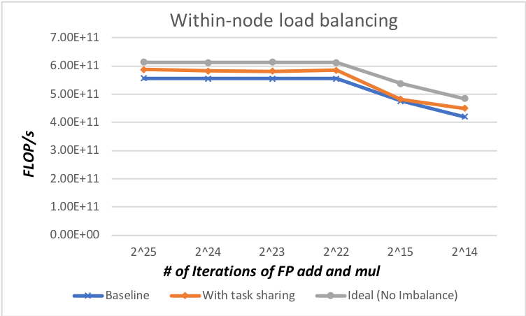
Task Bench Benchmark
Task Bench benchmark assesses efficiency of runtime systems for compute bound, memory bound and load imbalanced applications
We use their benchmark to assess efficiency of within node load imbalance
Between LB steps there might be transient load imbalance
We tag entry methods that can be executed by any PE within a node
Runtime adds the tasks to node level queue to handle imbalance via node level task sharing

Slide 16
Task Bench Benchmark – Imbalance Details
Imbalance
>= 0 and <= 2.0
Each object generates load between 0 to 2.0 of the specified number of iterations
Experiments on 32 cores with imbalance in PEs of up to 10% over average load (2 objects per PE)
Other runtimes like OpenMP have finer granularity of tasks and hence can perform close to 100% efficiency
Our performance is within 10% of full efficiency
Link: https://github.com/StanfordLegion/task-bench

Slide 17
Distributed Graph Refinement

Slide 18
Load Balancing - DiffusionLB Strategy
Strategy performs diffusion of loads with neighbor nodes
For each diffusion iteration (pseudo-loadbalancing)
Neighbor nodes exchange load values
Overloaded neighbors send underloaded neighbors load transfer value
At the end of N iterations exchange of load is finalized so nodes can reach threshold*avg_load
Perform actual load balancing by migrating objects to neighbor nodes
Communication-aware
Perform intra-node load balancing of objects (Greedy strategy)

Slide 19
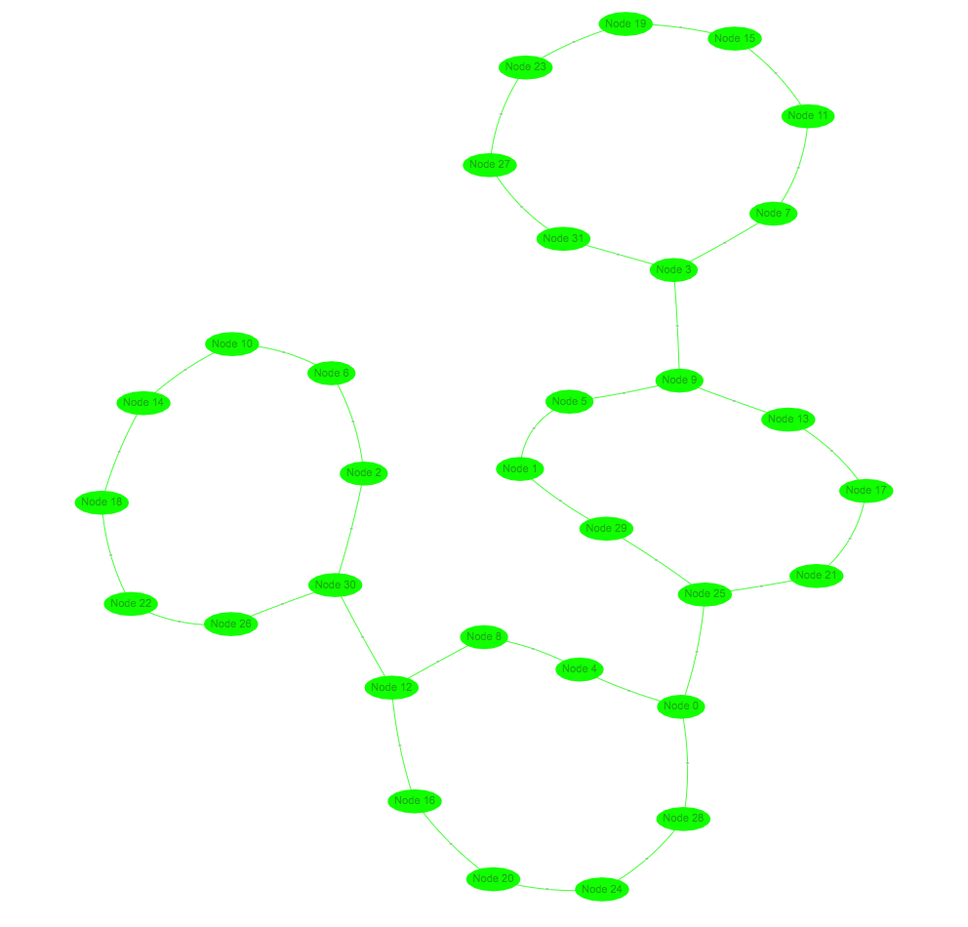
Neighbor Topology
Based on comm. graph of application
Find K highest communicating neighbors for each node
Make neighbors symmetric, each node has at most 2K neighbors
Neighbors are communicating logical nodes (to be mapped to neighboring physical nodes)
Can result in disconnected graph
Find connected components
Add edges between connected components
Eg: Block-mapping Stencil3D on 32 nodes

Slide 20
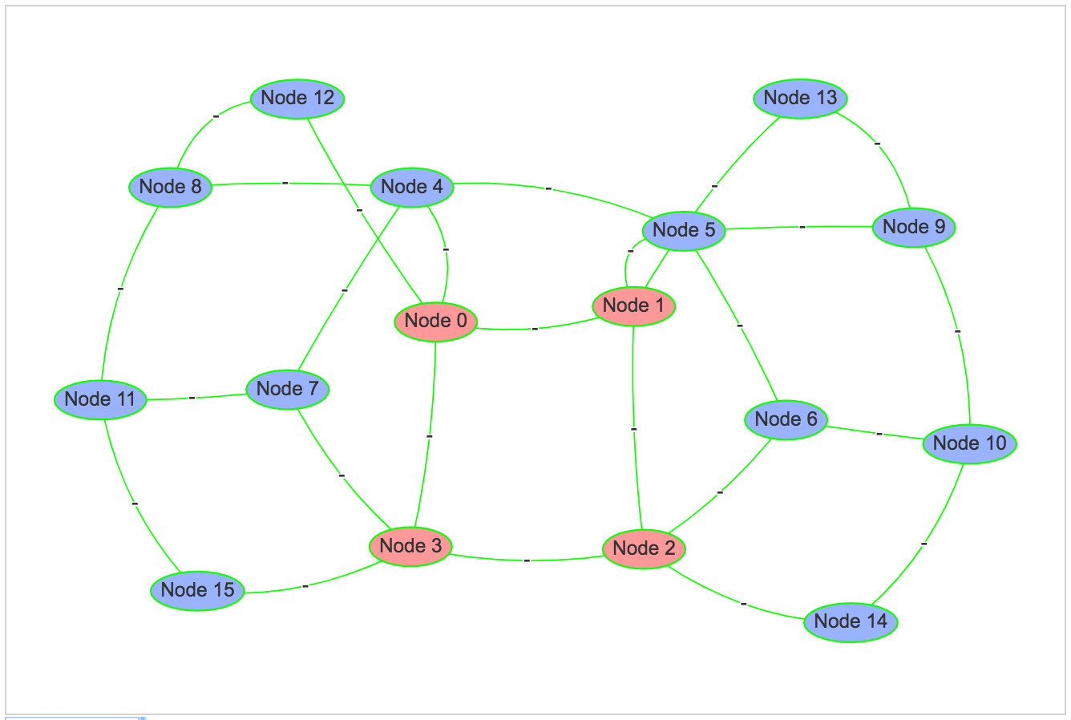
DiffusionLB – Stencil3D on 16 nodes
Overloaded
Underloaded
Average

Slide 21
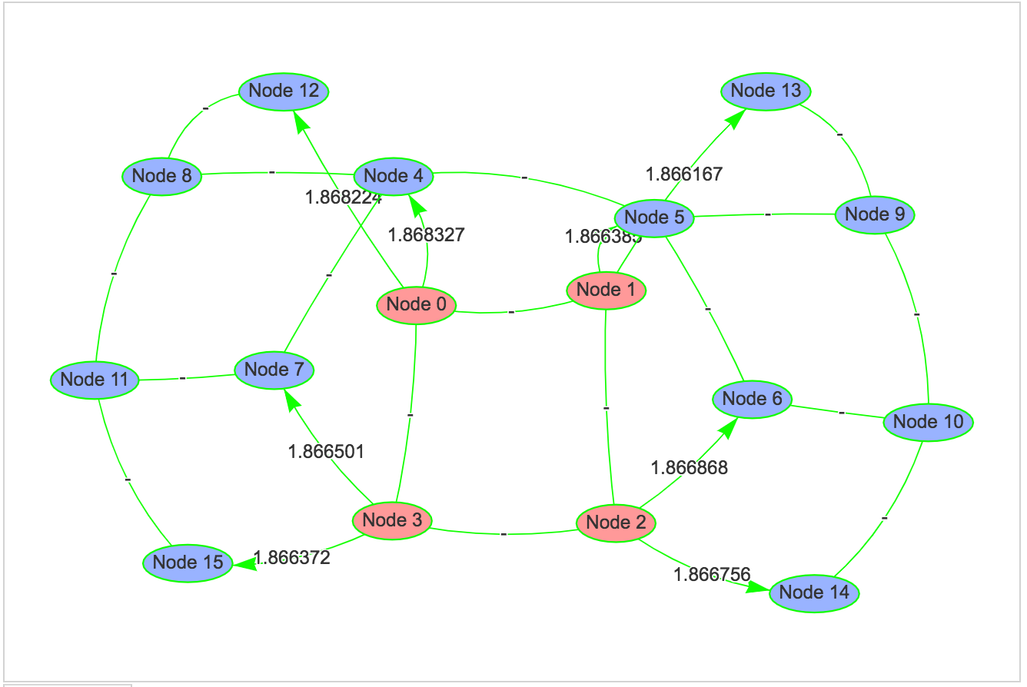
Overloaded
Underloaded
Average

Slide 22
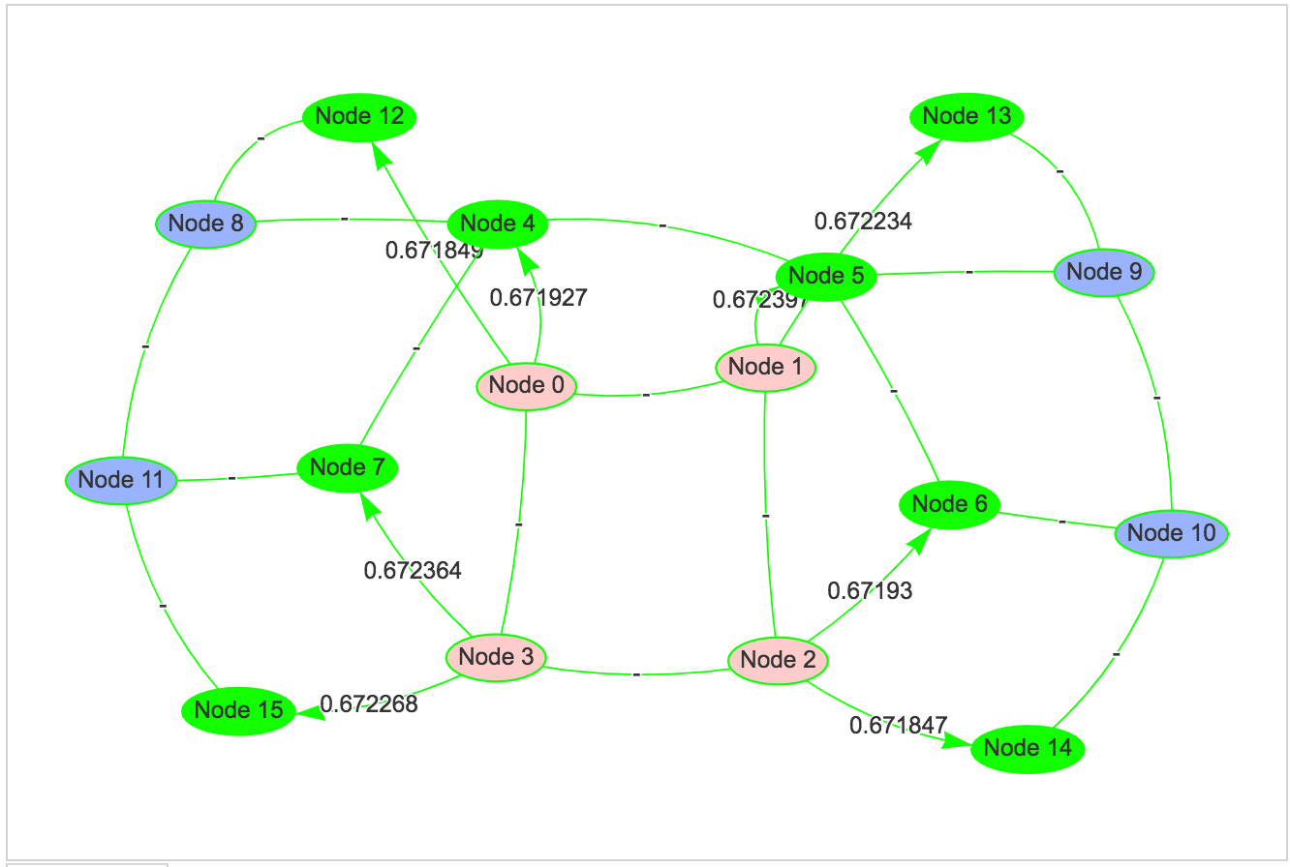
Overloaded
Underloaded
Average

Slide 23
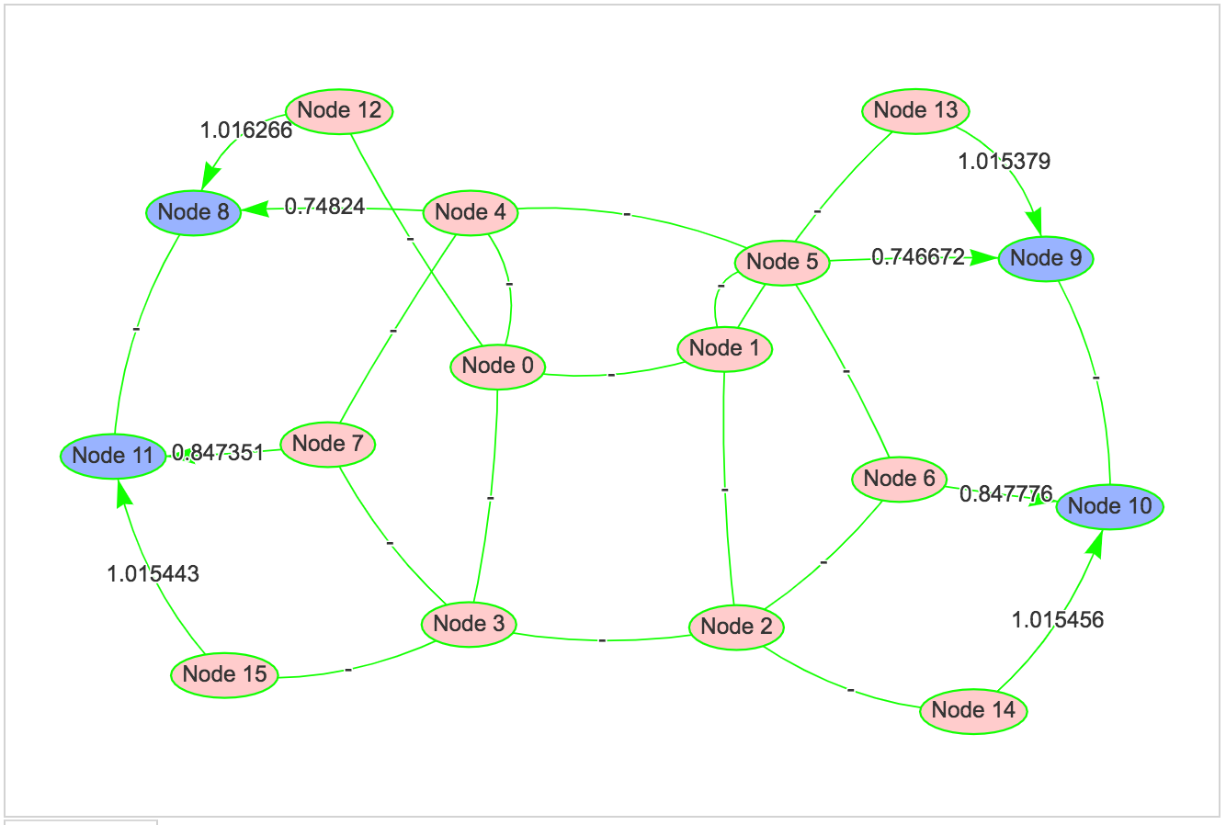
Overloaded
Underloaded
Average

Slide 24
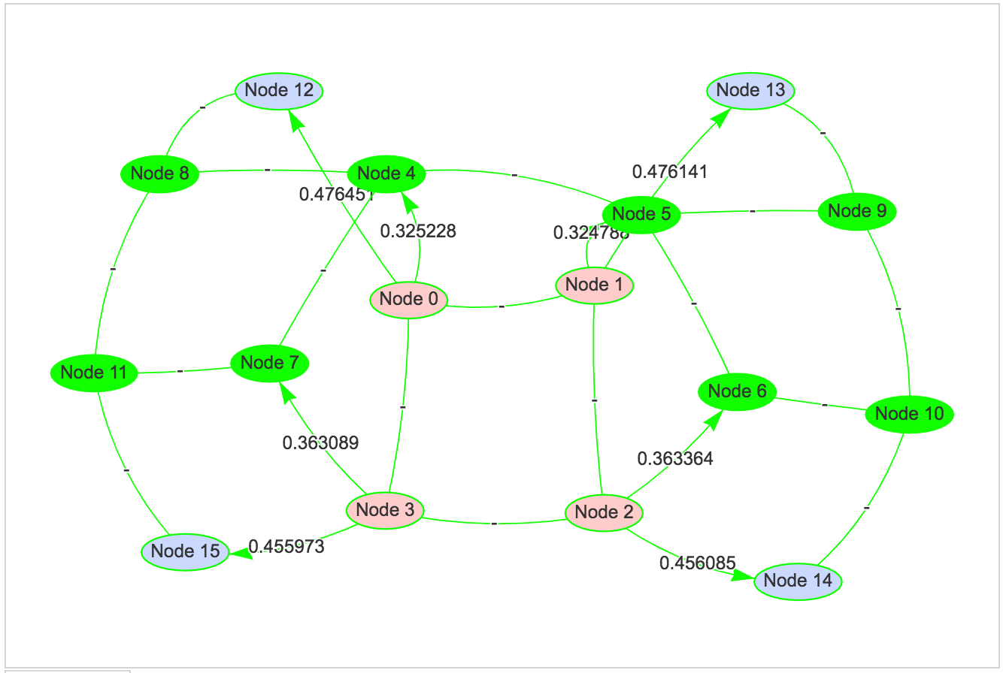
Overloaded
Underloaded
Average

Slide 25
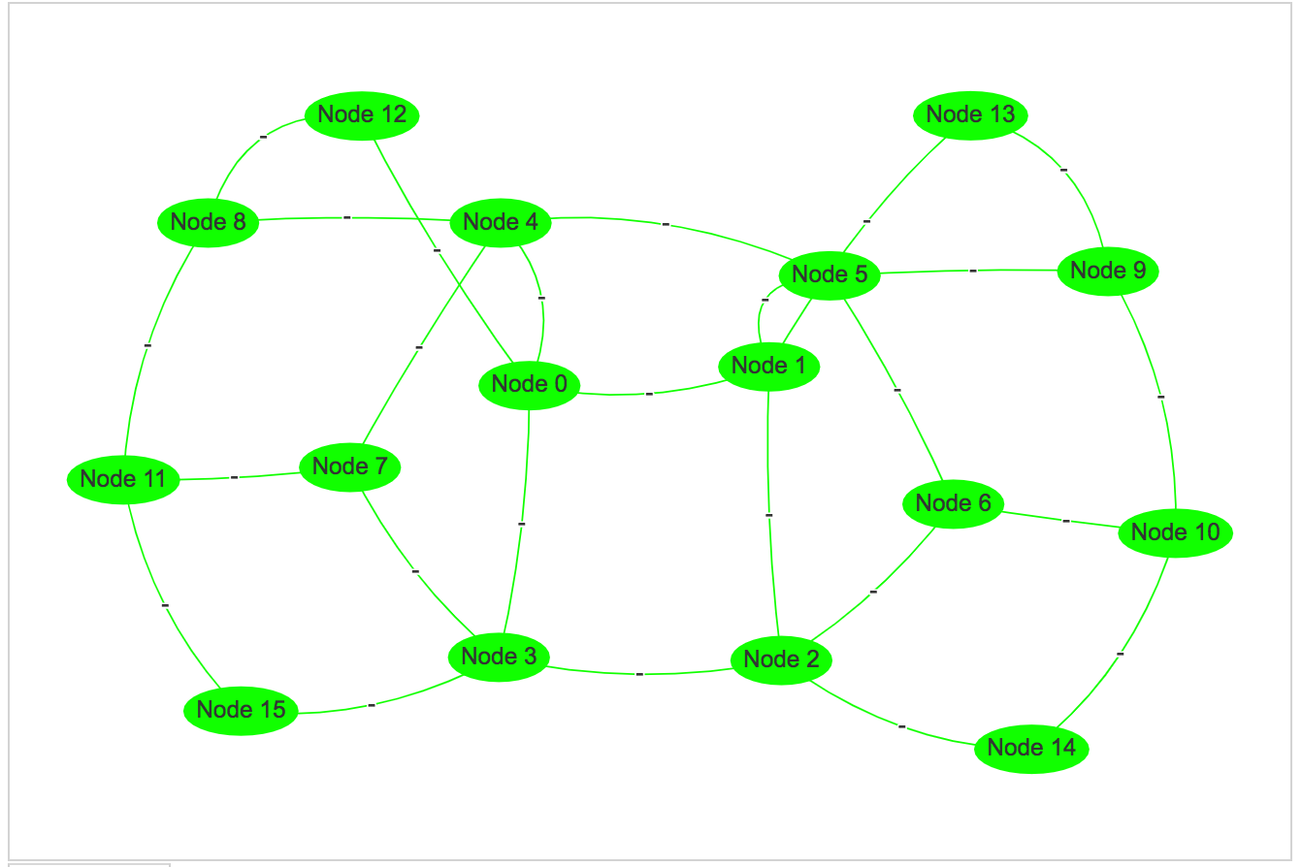
Overloaded
Underloaded
Average

Slide 26
DiffusionLB Strategy – Communication-aware
On each node, maintain a matrix of communication bytes for each object with each neighbor node
For final load value to be sent to each neighbor
Form a heap of objects sorted based on communication
Selected object has maximum external communication
And maximum external communication with destination node
Pick objects till required load value for neighbor is satisfied
 | Nbor0 | Nbor 1 | … | Nbor 2K | Internal Comm
Obj-0
Obj-1
Obj-2
…
Obj n

Slide 27
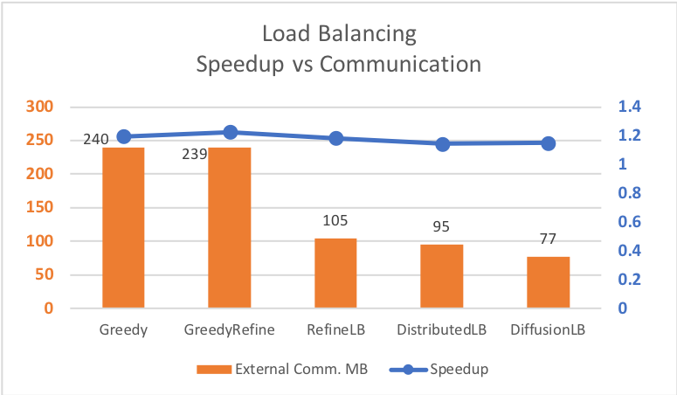
DiffusionLB Strategy – Experimental runs
Stencil3D
7x8x16 chares on 8 nodes x 7 ppn
On vesta
Load imbalance
thisIndex.x <=1 || thisIndex.x >=5
Speedup similar to Distributed
Within 5% of Greedy/GreedyRefine

Slide 28
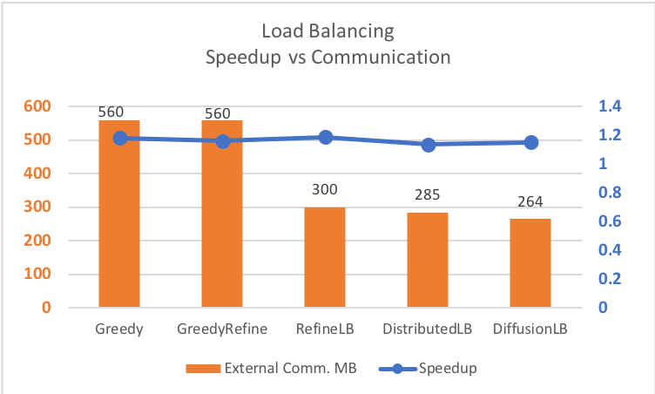
DiffusionLB Strategy – Experimental runs
Larger block size per chare
Stencil3D
7x8x16 chares on 8 nodes x 7 ppn
Load imbalance
thisIndex.x <=1 || thisIndex.x >=5
Speedup similar to Distributed
Within 5% of Greedy/GreedyRefine

Slide 29
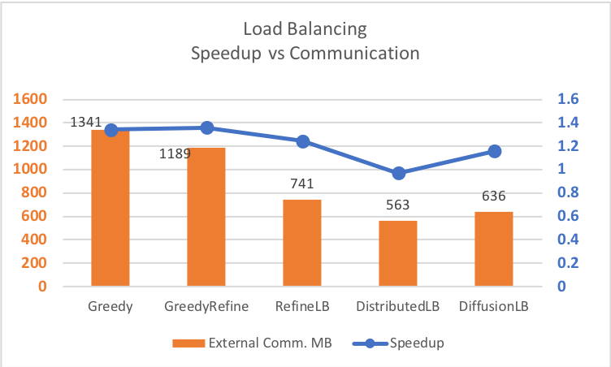
DiffusionLB Strategy – Experimental runs
32 nodes on vesta
Strategy time
Includes finding neighbor topology
Finding connected components
Work in progress
Number of migrations
Fewer than Greedy/GreedyRefine
600 vs 2900 or 1600
Load balance – poorer than Greedy
Lowest external communication bytes
Next steps:
Map neighbors to physical nodes

Slide 30
Questions?
rabuch2@illinois.edu

