Slide 1
Improving Throughput of Fine-grained Messages with Aggregation
Venkatasubrahmanian Narayanan
Parallel Programming Laboratory
University of Illinois Urbana-Champaign

Slide 2
Agenda
Motivation
TRAM’s interface
What’s new in Charm++ 6.10
Future work

Slide 3
What’s the problem?
Point-to-point messages are general-purpose
Need to be independent of each other
Unnecessary per-message cost

Slide 4
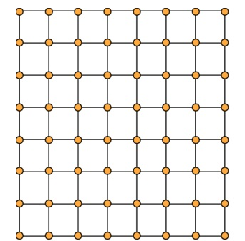
Unoptimized

Slide 5
The existing solution
Topological Routing and Aggregation Module(TRAM)
Combine messages headed “in the same direction”
Easy drop-in solution

Slide 6

What’s the difference?
The default approach:
🚴 🚴 🚴 🚴 🚴 🚴 🚴 🚴 🚴 🚴 🚴 🚴 🚴 🚴 🚴 🚴 🚴
vs
TRAM:

Slide 7
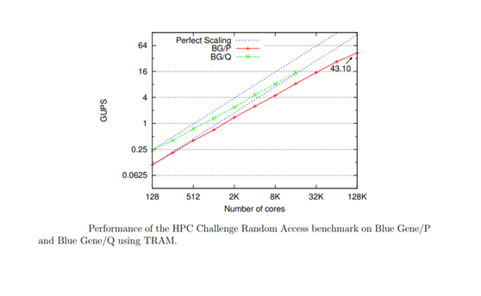
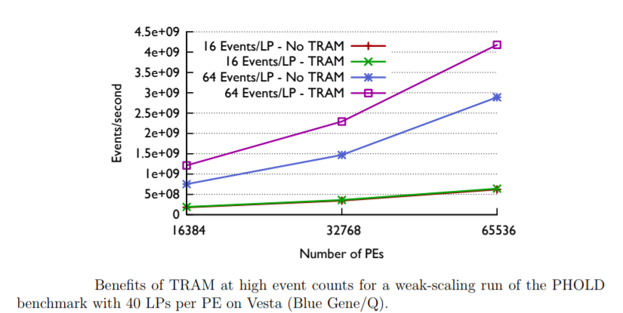
Benchmarks(old)

Slide 8

Example
Drop-in replacement *

Slide 9
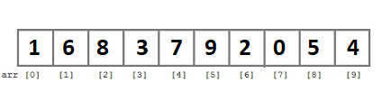
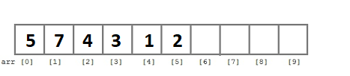

Aggregation policy illustrated
Flush when buffer fills up
Flush on timeout

Slide 10
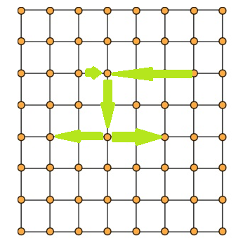
Routing
Virtual grid topology

Slide 11
Feature limitations(prior to release)
Support only for 1D chare arrays and groups
Messages must be fixed size

Slide 12
New feature updates
Charm++ 6.10 adds support for multidimensional chare arrays
Future release:
  Variable sized messages
  Tunable parameters

Slide 13

Future aggregation policy
Flush on reaching threshold
Flush on timeout (same as earlier)
Send messages larger than cutoff directly

Slide 14
Use cases?
Generalized stencil computation
Graph algorithms
Any communication-heavy application

Slide 15
Future work
Improve current implementation
Support for more computational topologies

Slide 16
Questions?

